Slide 1
The Bryant Bannister Tree-Ring Building

Slide 2
Scope:
$8M Construction Cost
30-35,000 GSF

Slide 3
Goals:
Consolidate the LTTR facilities
Provide Long-Term solution to Archives
Vacate the West Stadium/Sunnyside
Provide for exhibit/public outreach

Slide 4
Program:
Faculty Offices
Departmental Office
Multipurpose Room
Exhibit/Display/Lobby
Dendro/Research Labs
Shared/Wet Labs
Processing/Prep/Lab Support

Slide 5
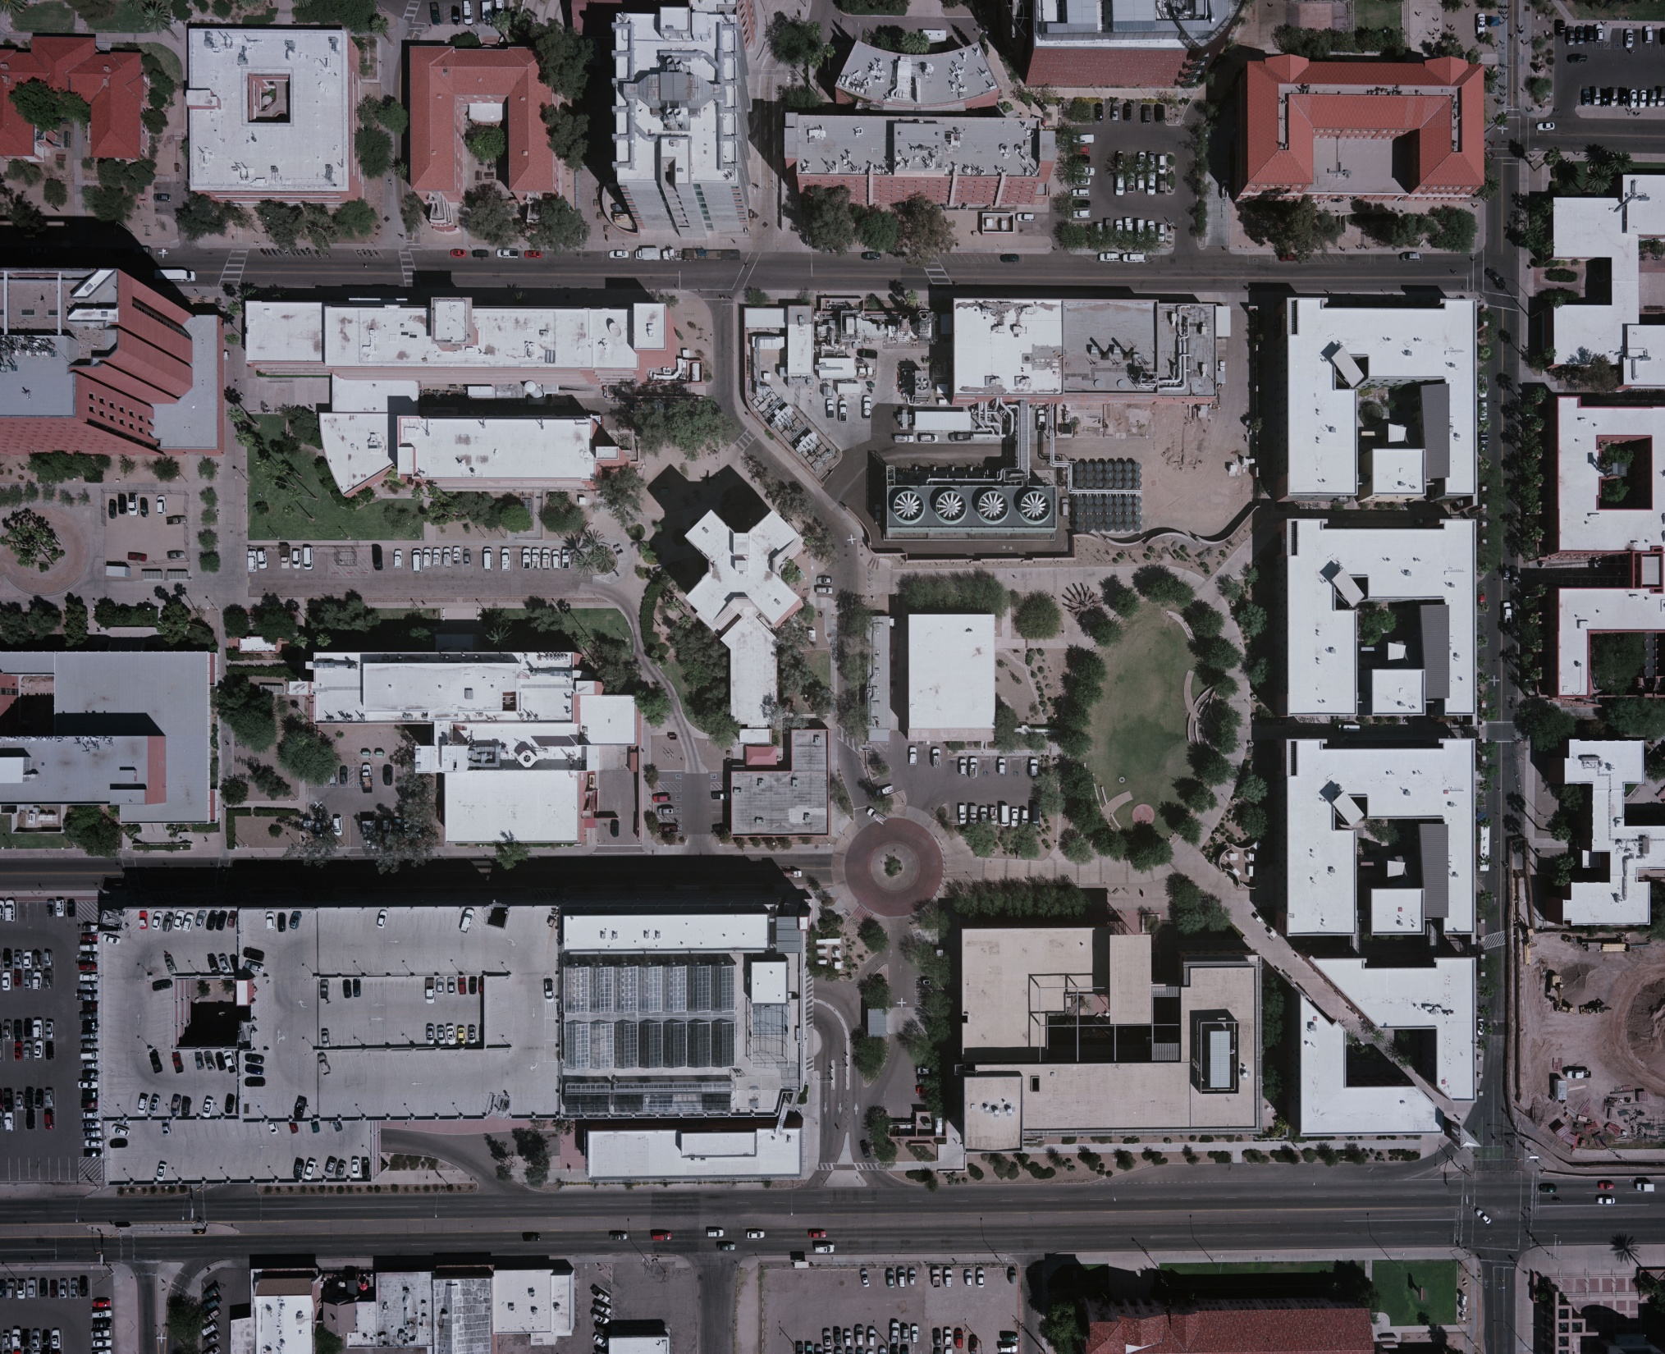
site

Slide 6
site

Slide 7
vehicular access

Slide 8
pedestrian access

Slide 9
key open space

Slide 10
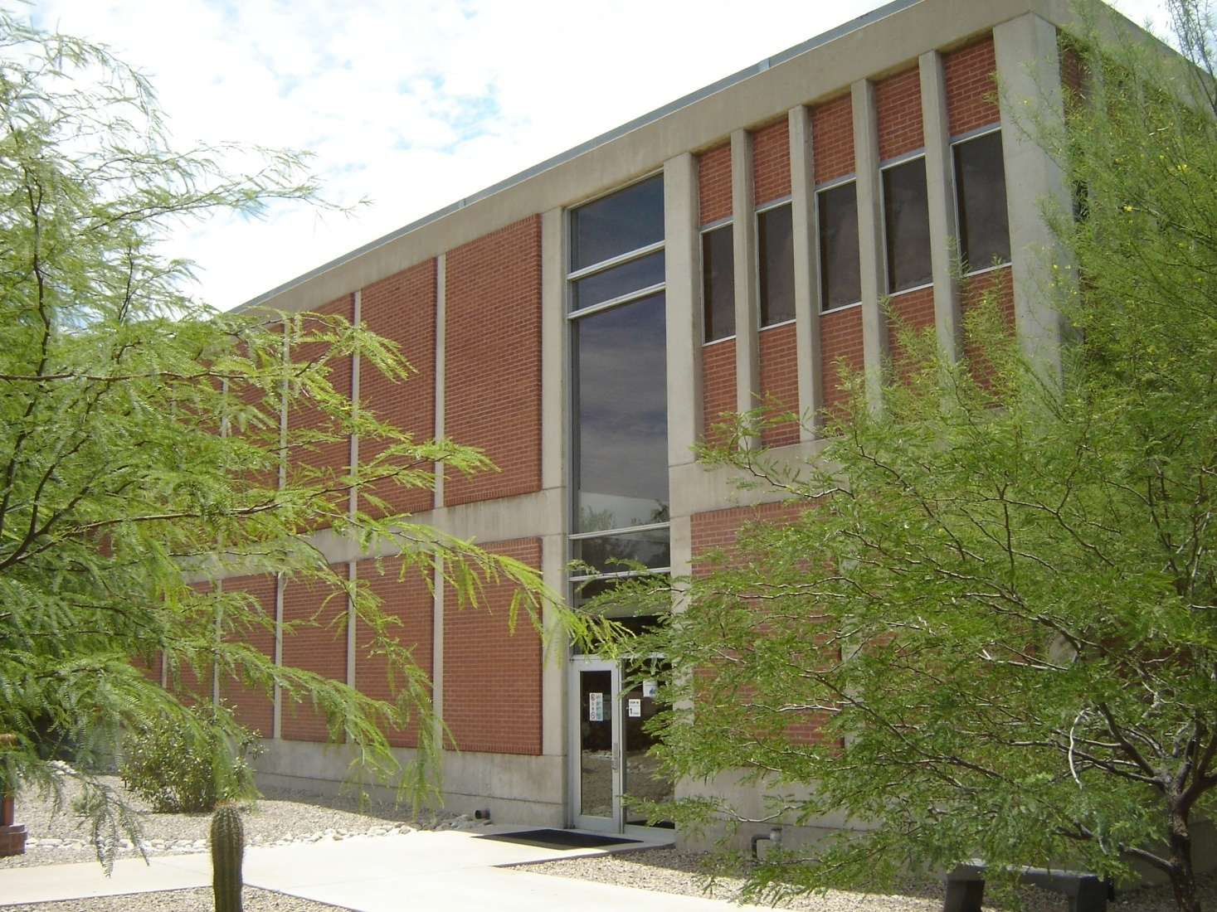

Slide 11
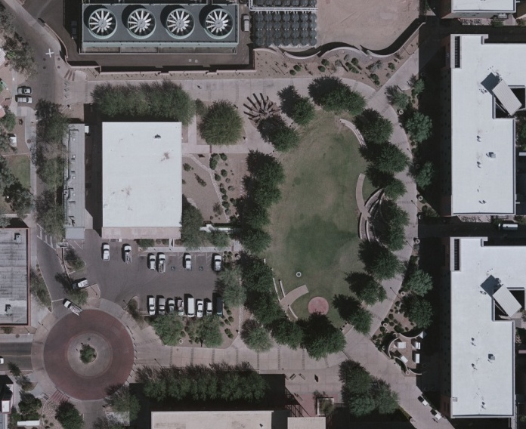
site limits

Slide 12
site utilities

Slide 13
landscape

Slide 14
residual site limits

Slide 15
site options

Slide 16
parking

Slide 17
parking

Slide 18
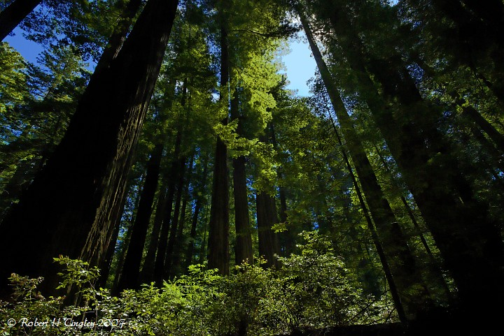

Slide 19
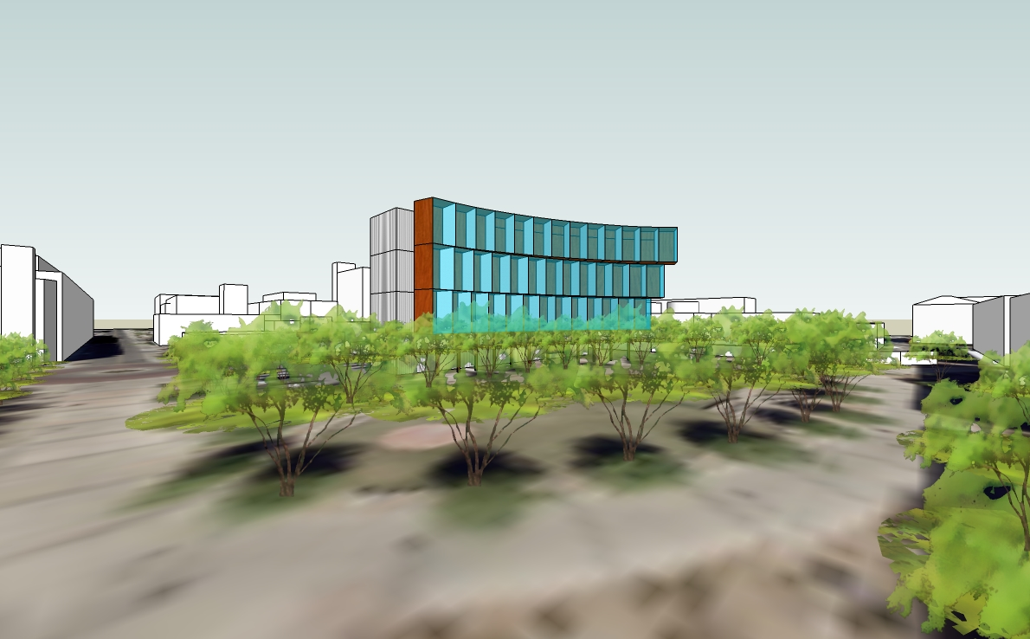

Slide 20
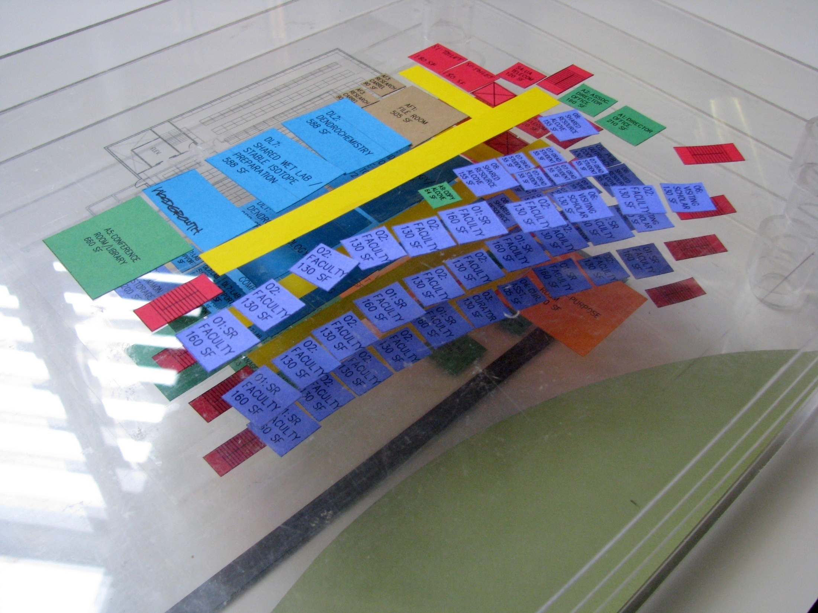

Slide 21
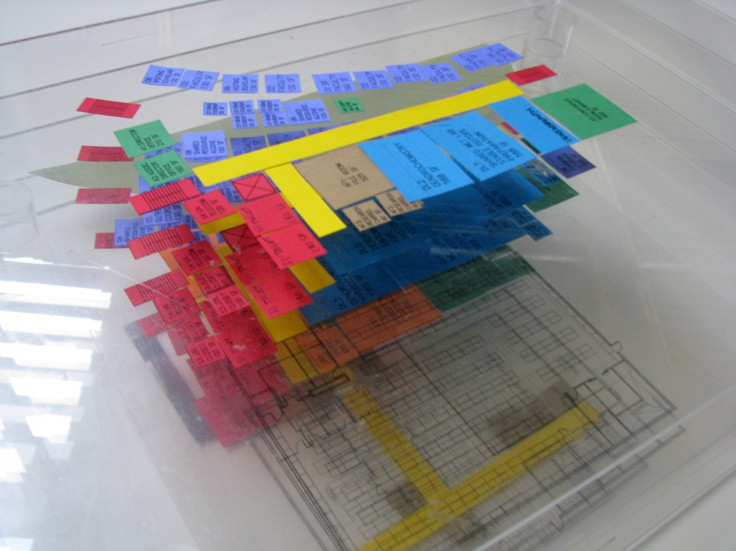

Slide 22
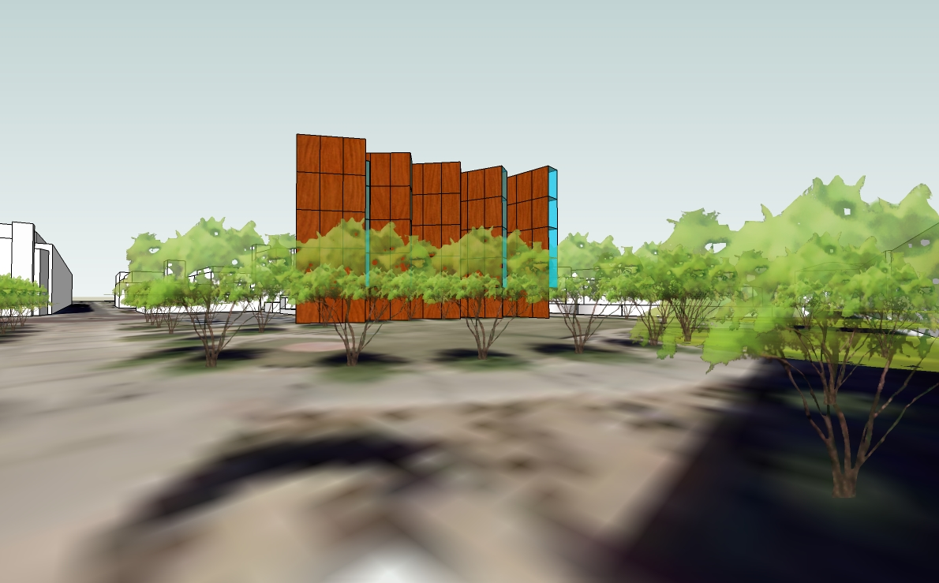

Slide 23
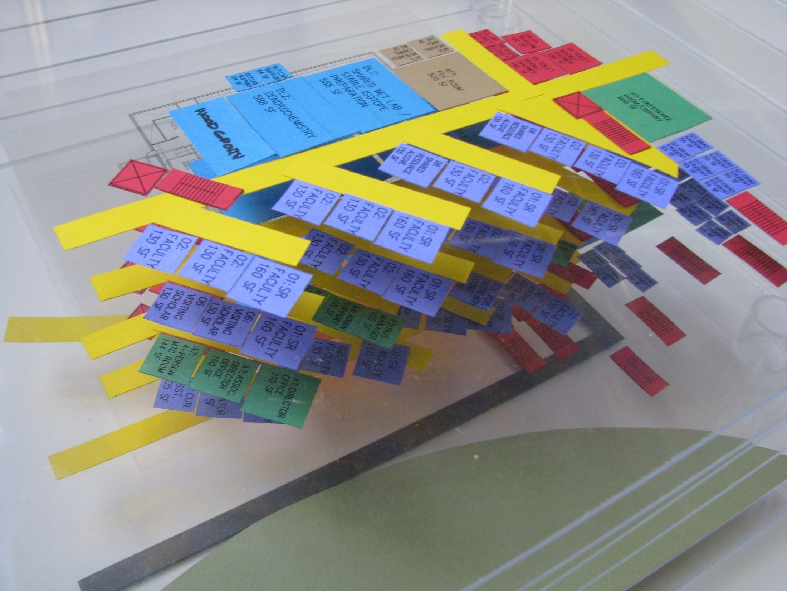

Slide 24
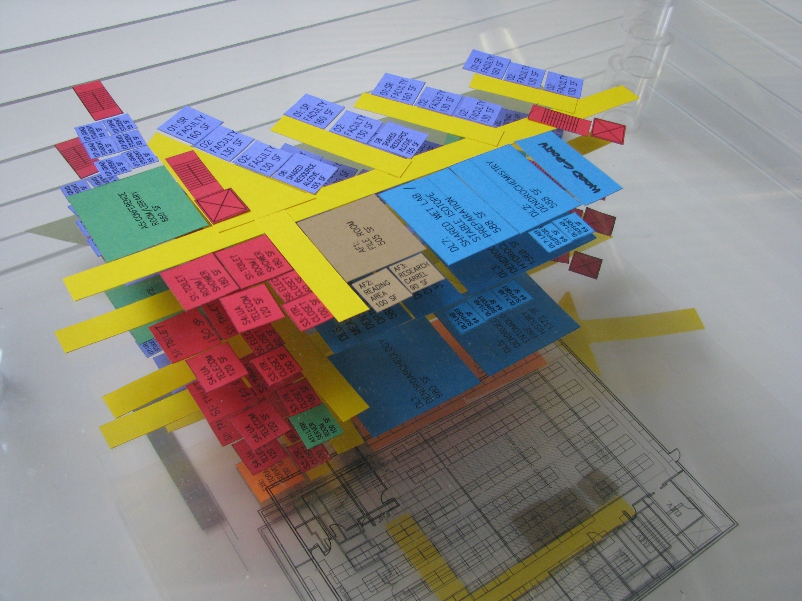

Slide 25
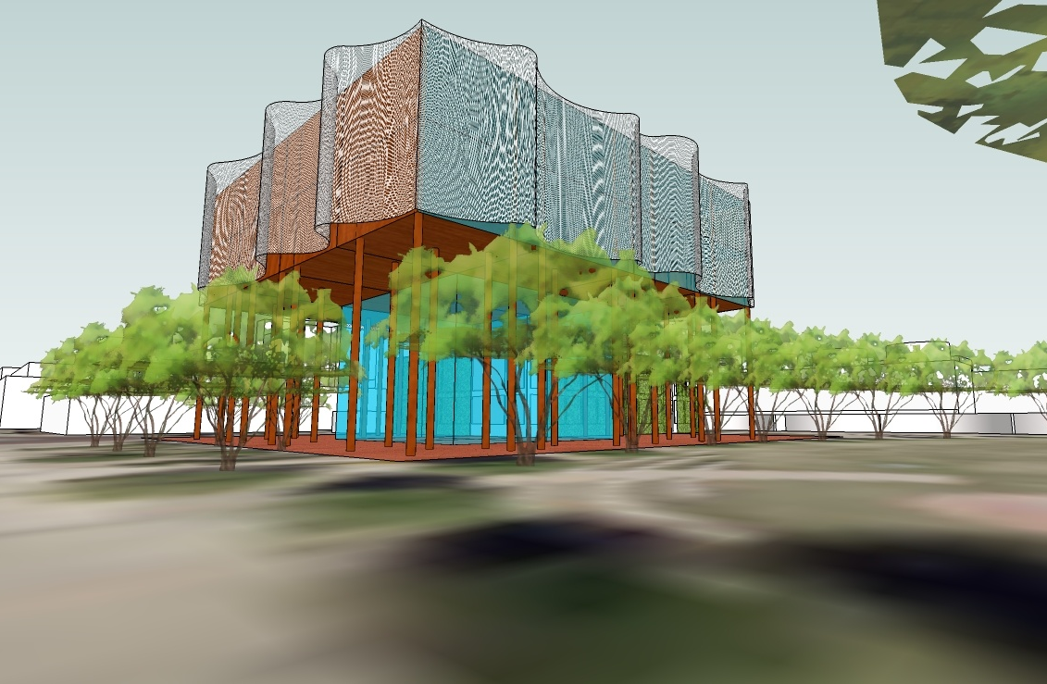

Slide 26
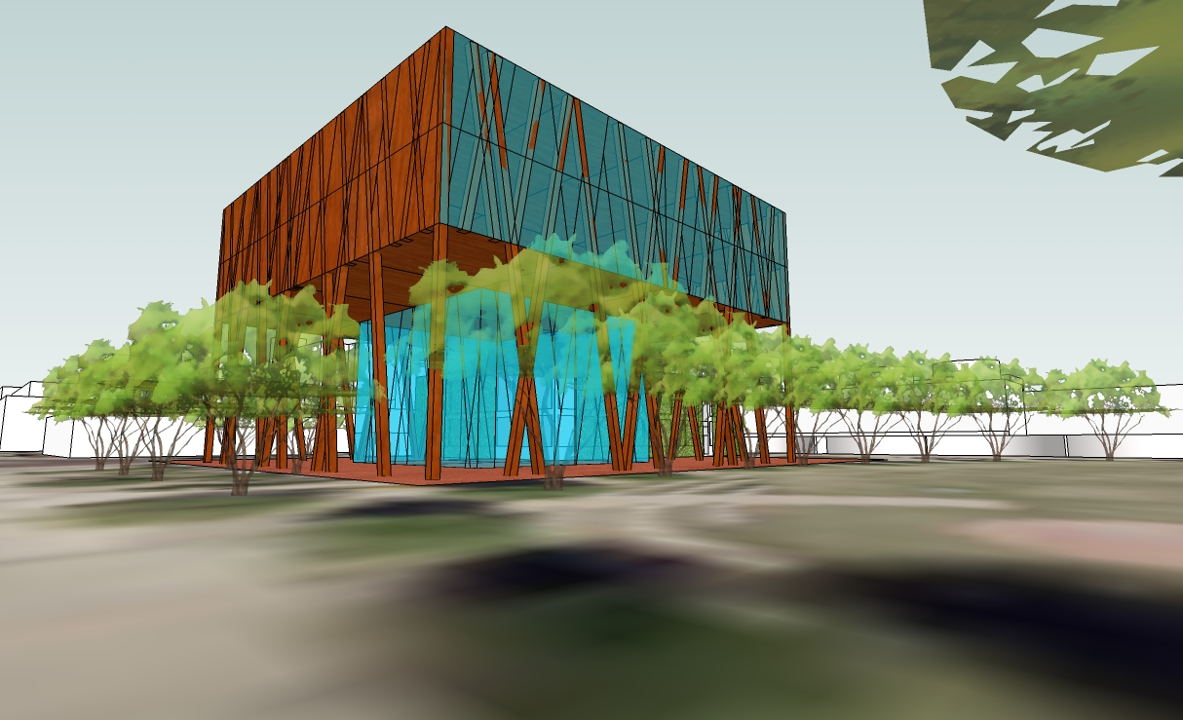

Slide 27
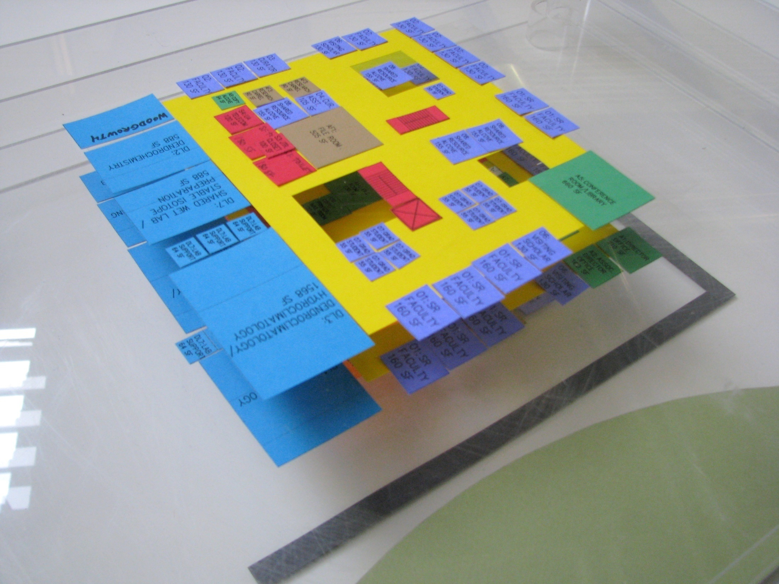

Slide 28
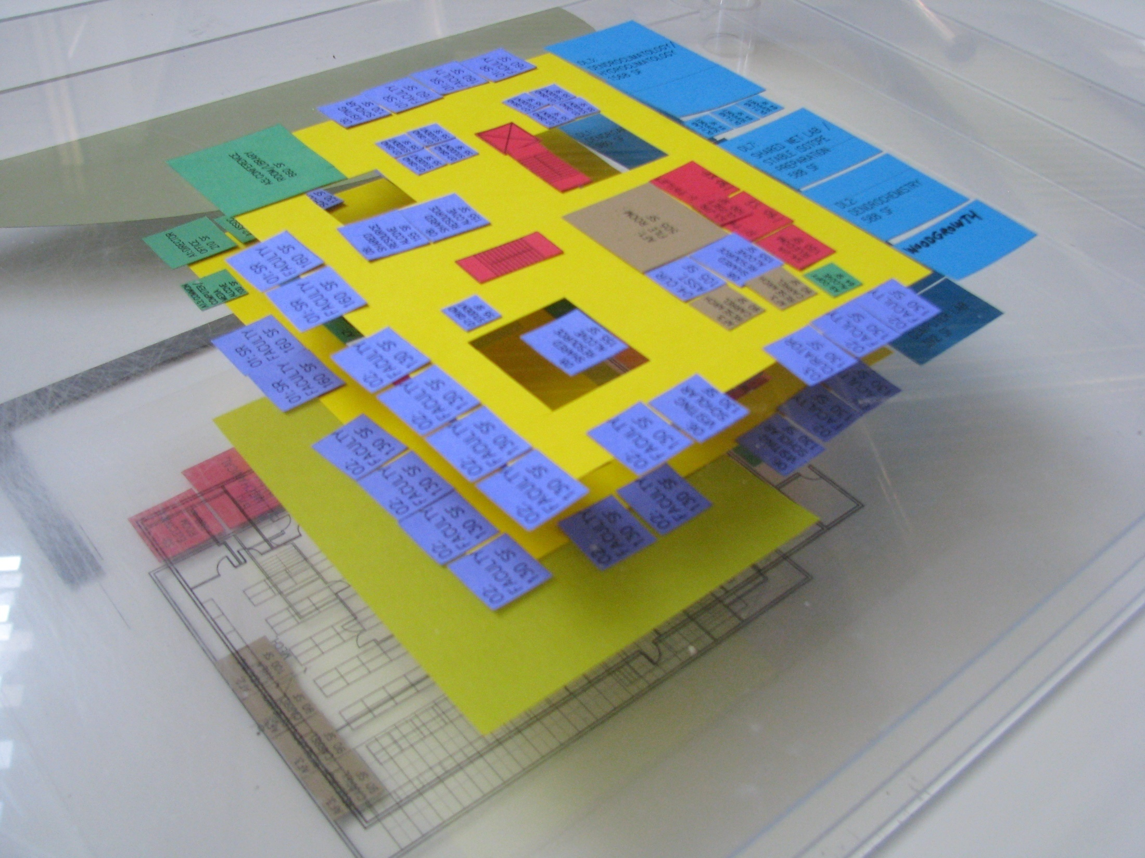

Slide 29
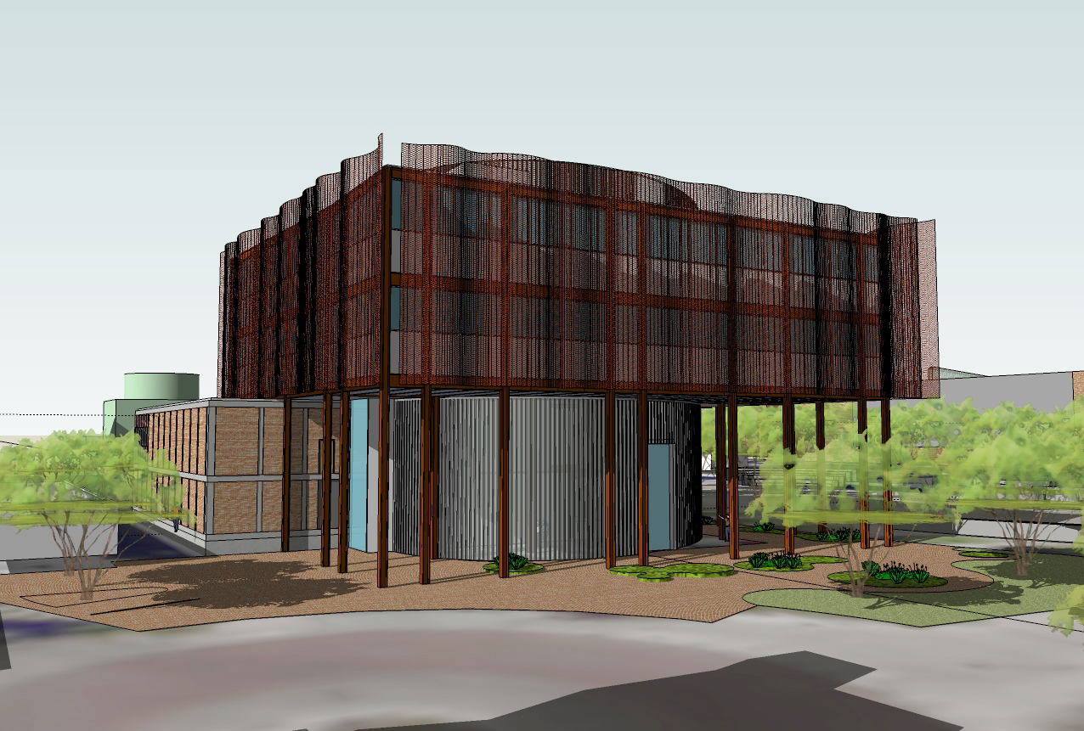
View from Southwest

Slide 31
Second Level

Slide 32
Third Level

Slide 33
Fourth Level

