Slide 1
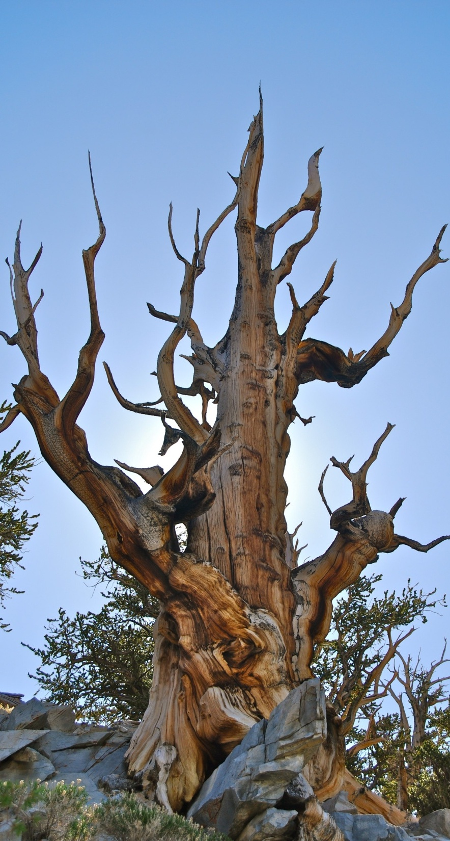

Slide 2
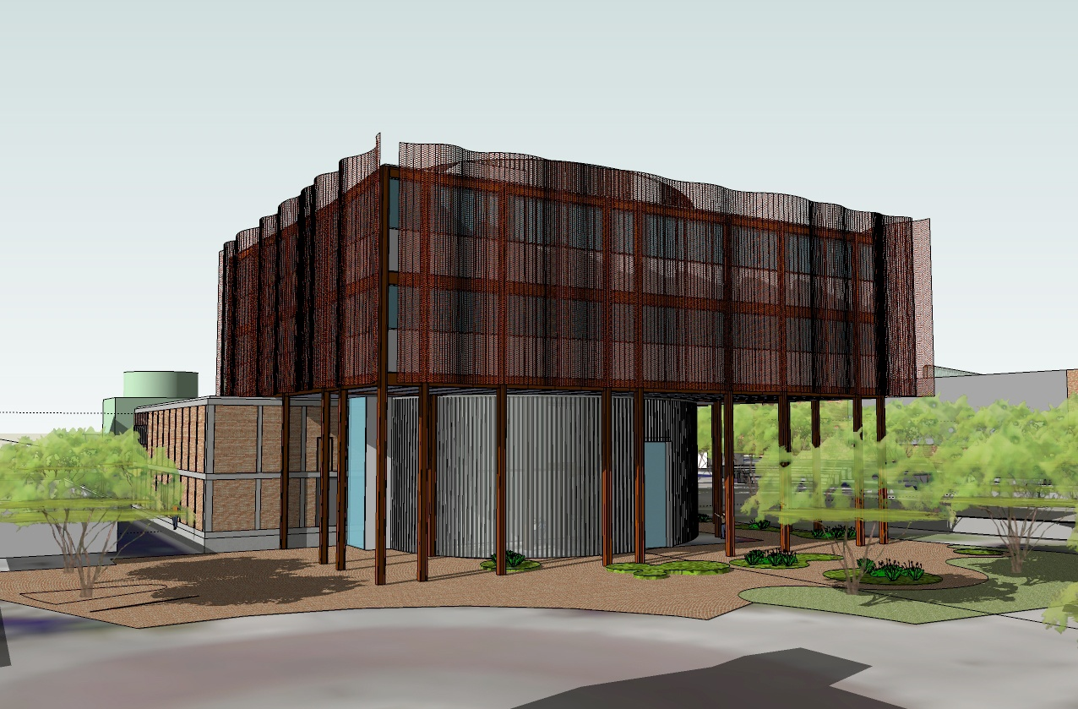
View from Southwest

Slide 3
View from Northeast

Slide 4
First Level

Slide 5
Second Level

Slide 6
Third Level

Slide 7
Fourth Level

Slide 8
Laboratory Plans

Slide 9
Math East Storage – Option A

Slide 10
Math East Storage – Option B

Slide 11
Math East Storage – Option C

Slide 12
Graduate Student Open Office Pods

Slide 13
Graduate Student Open Office Pods

Slide 14
Graduate Student Open Office Pods

