Slide 1
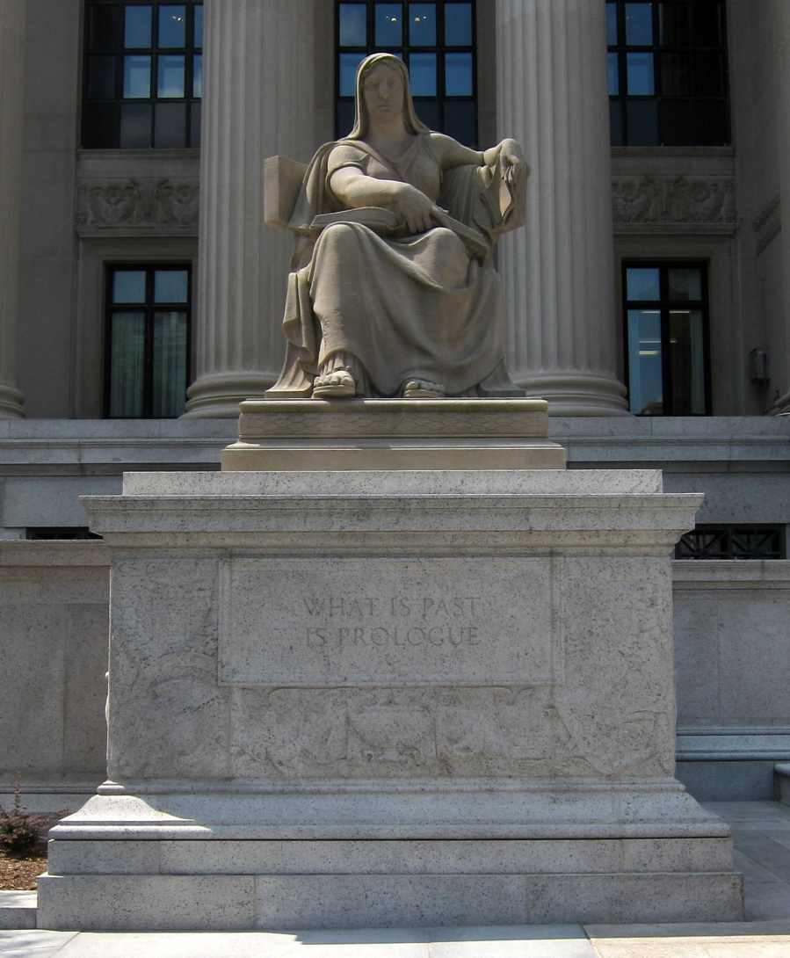
Past is Prologue: Reflections on Using Historical Context for Understanding the Present and Managing the Future
Tom Swetnam
Laboratory of Tree-Ring Research
University of Arizona
"What is past is prologue", inscribed on Future (1935, Robert Aitken) located on the northeast corner of the National Archives Building in Washington, D.C.
“(And by that destiny) to perform an act, Whereof what's past is prologue; what to come, In yours and my discharge" , The Tempest, William Shakespeare

Slide 2

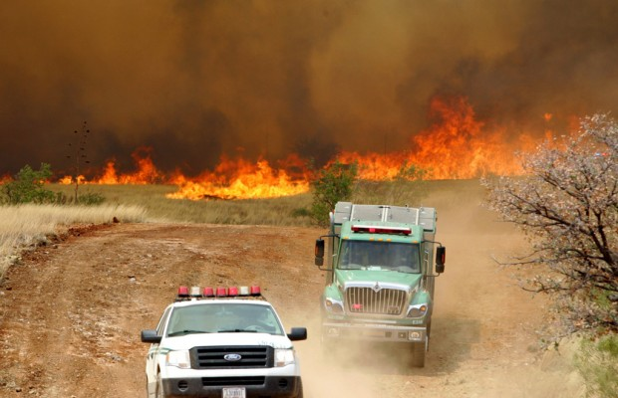
“Using to past to guide present and future decisions is like driving down the road and looking ONLY in the review view mirror.”
Yes, but its also dangerous NOT to use your rearview mirror while driving!
AZ Daily Star

Slide 3
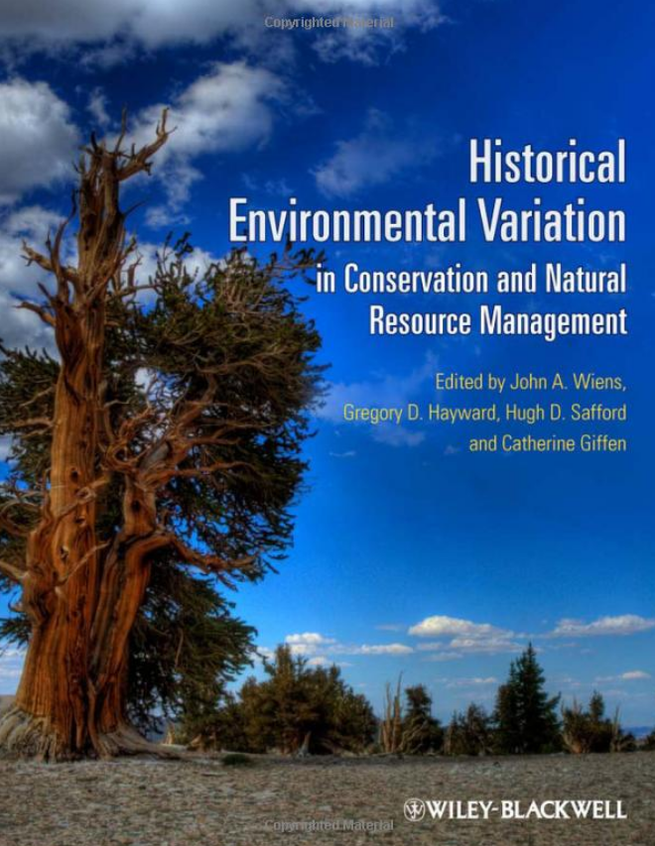

Slide 4
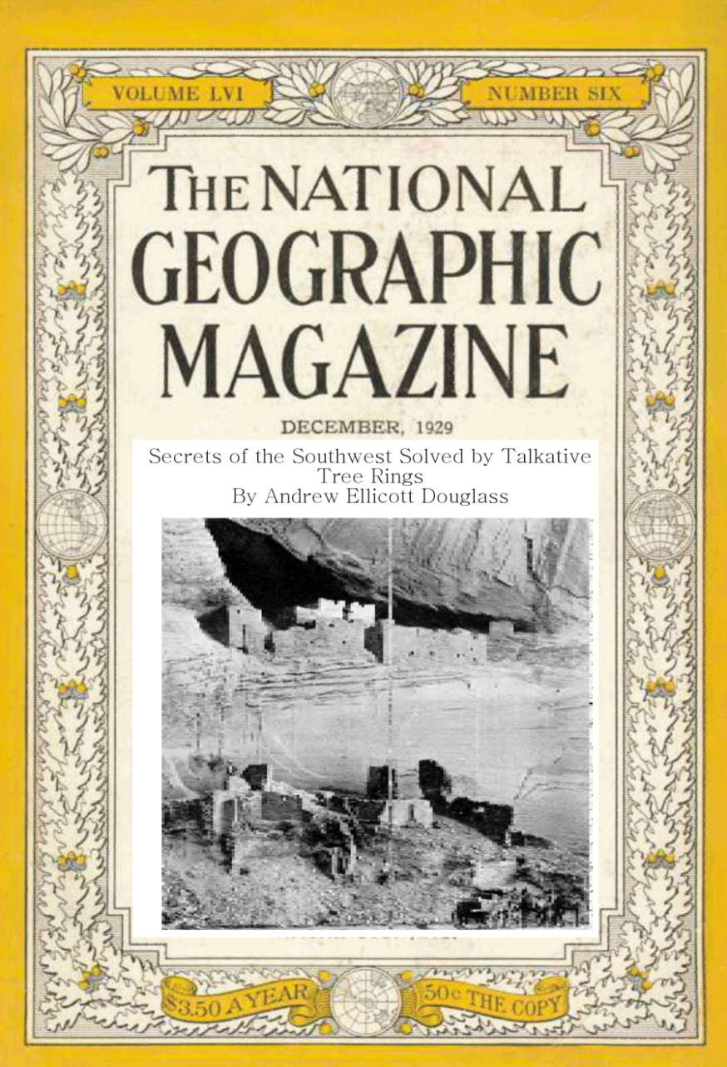
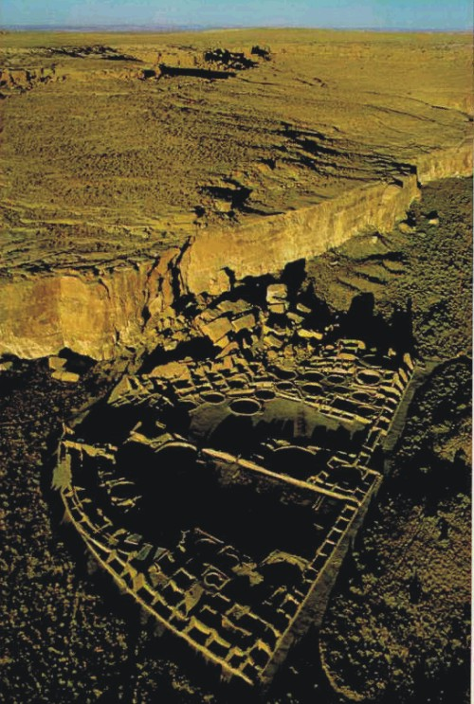
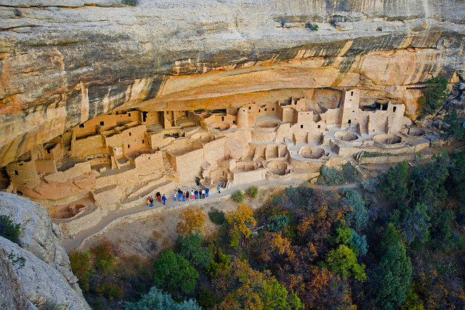
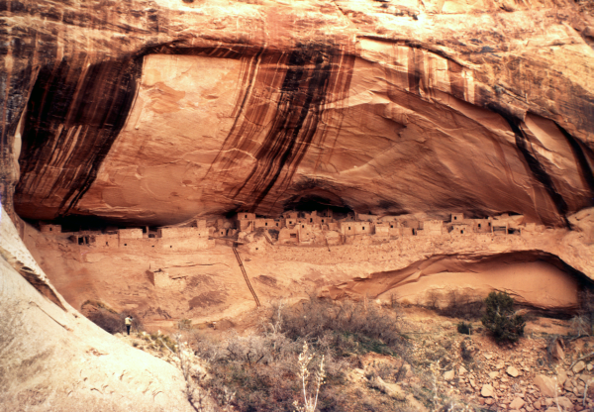
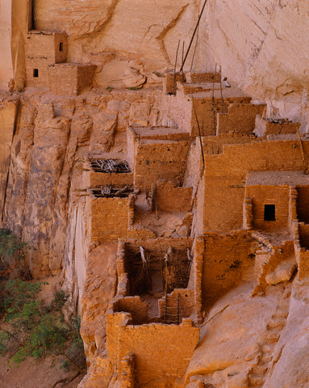
What happened to the Cliff Dwellers? Why did they leave and where did they go?
Cliff Palace, Mesa Verde National Park
Pueblo Bonito, Chaco Culture National Historical Park
Keet Seel, Navajo National Monument
Notes:
In the 19-teens and 20s, when archaeologists were excavating the great ruins of the Southwest, they were intrigued by Douglass’ methods, because they realized he might help them solve a great mystery: When did people build the cliff dwellings and monumental pueblos in the canyons and mesas of the Southwest?
The archaeologists began sending the excavated timbers to Douglass in Tucson. It took almost 20 years, but at least in 1929 Douglass made the breakthrough: He solved the mystery of the Southwest ruins, and discovered these buildings were constructed between about 900 and 1200 AD and all were abandoned by 1300.
This discovery was reported around the world, and it made Douglass, UA and dendrochronology famous.
Now this dating method is used worldwide for dating wood artifacts of all kinds, from Viking ships to Stradivarius violins.

Slide 5
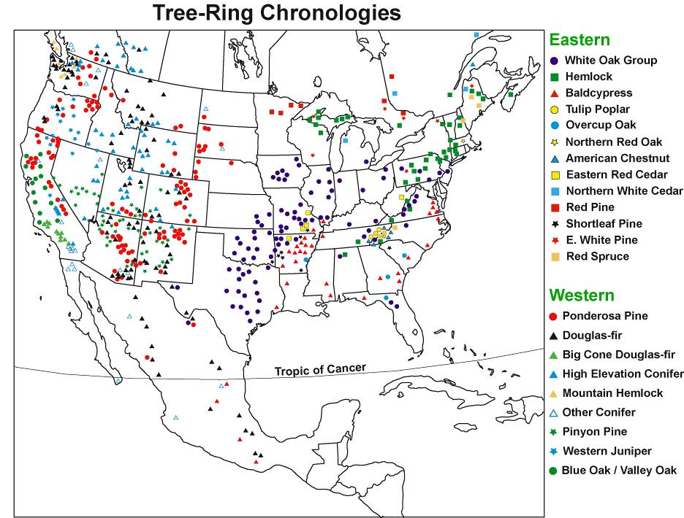
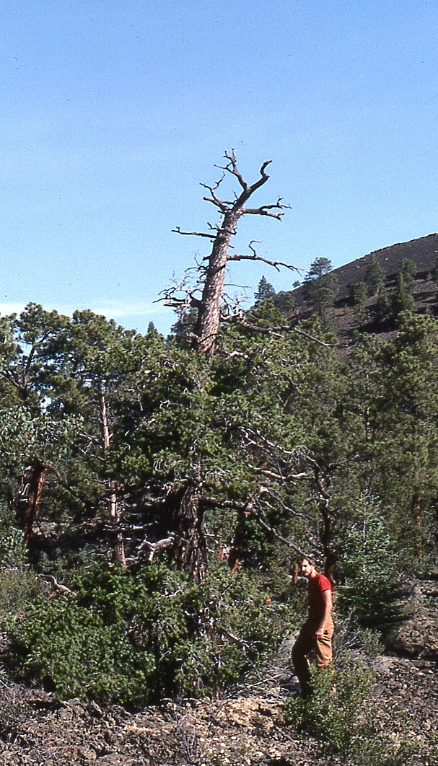
Tree-ring width chronologies have been developed from more than 1,000 sites in North America, and these have been used for extensive, long-term climate history studies.
El Malpais, NM
2,129 year chronology;
1,274 year old living Douglas-fir
Courtesy of David Stahle

Slide 6
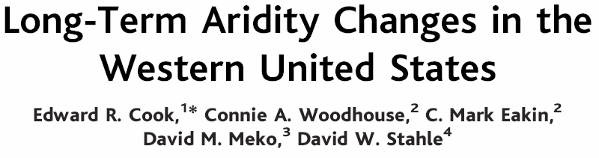

The North American Drought Atlas shows the period from circa 900 to 1300 was generally drier throughout the West, including droughts of magnitude and duration not yet experienced in modern period.
% Drought Area

Slide 7
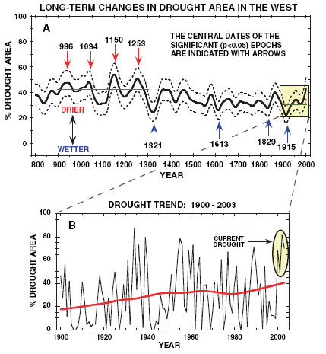
Even if greenhouse gas driven climate change was not a concern, “natural” variability in drought frequency and magnitude in the western is sufficient reason to expect future climate disasters.
Medieval Drought Period!
Cook, E.R., C.A. Woodhouse, C.M. Eakin, D.M. Meko, D.W. Stahle. Science 306:1015-1018. Nov. 5 2004

Slide 8
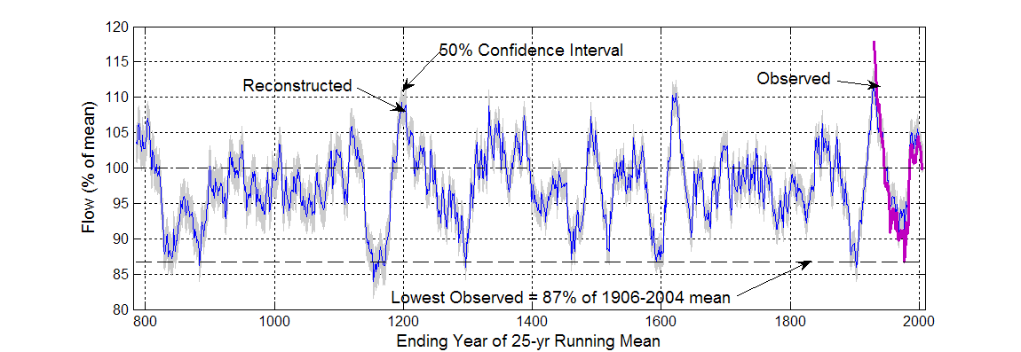


Tree-Ring reconstruction of 1,200 years of Colorado River flow
1130-1157
1950-1957
Meko, Woodhouse and others, 2007
“The general picture of a collision between water demand and supply in the Upper Colorado River Basin in the not-too-distant future is all too apparent.” Stockton and Jacoby 1976

Slide 9
Nature Climate Change, in press

Slide 10

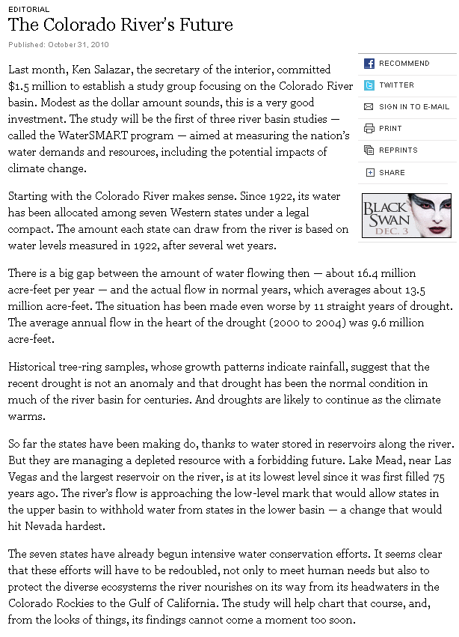
October 31, 2010
Black Swan!
Nassim Nicholas Taleb: unexpected events of large magnitude and consequence and their dominant role in history; “rarity, extreme impact, retrospective (though not prospective) predictability”

Slide 11
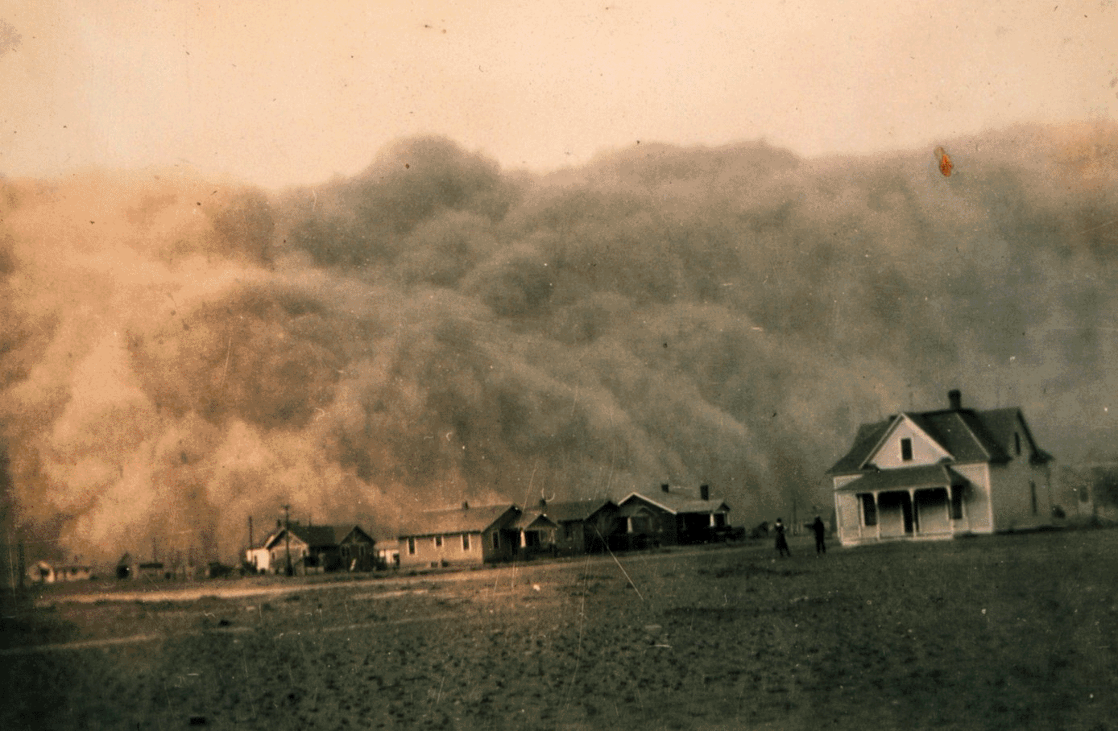
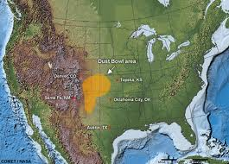

More than 100 million acres of prairie were plowed over, most of it between 1880 & 1920
Dust Bowl
49 dust storms in a 90 day period, 1935

Slide 12
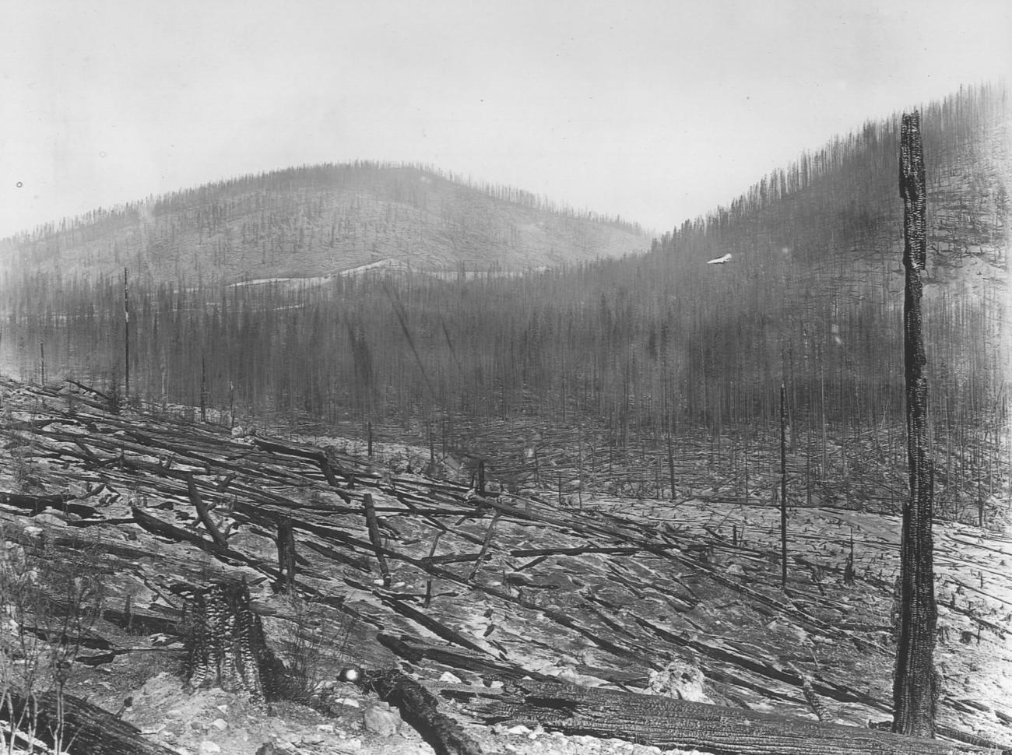
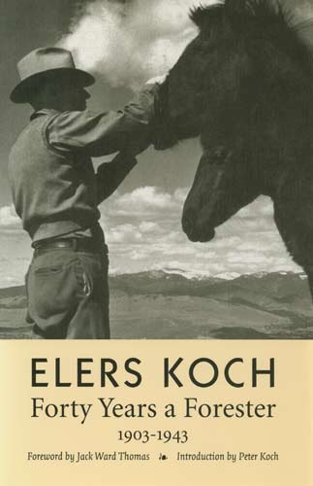

“Has all this effort and expenditure of millions of dollars added anything to human good? Is it possible that it was all a ghastly mistake, like plowing up the good buffalo grass sod of the dry prairies?” Elers Koch, quoted in the “Big Burn” by Tim Egan

Slide 13
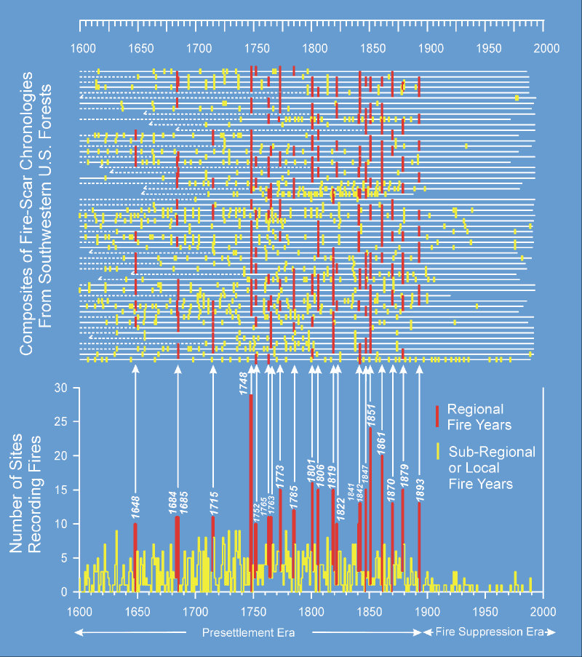
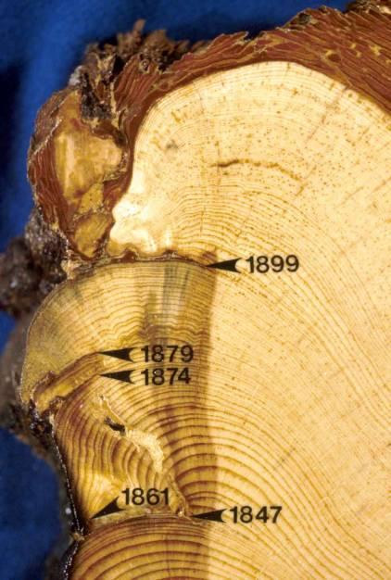
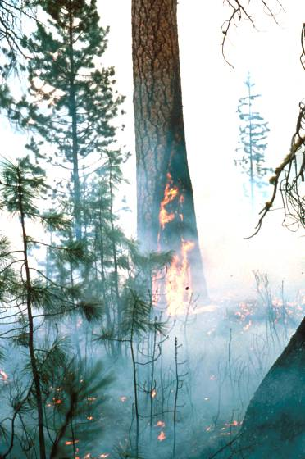
Swetnam, Allen & Betancourt Ecol. Appl. 1999

Slide 14
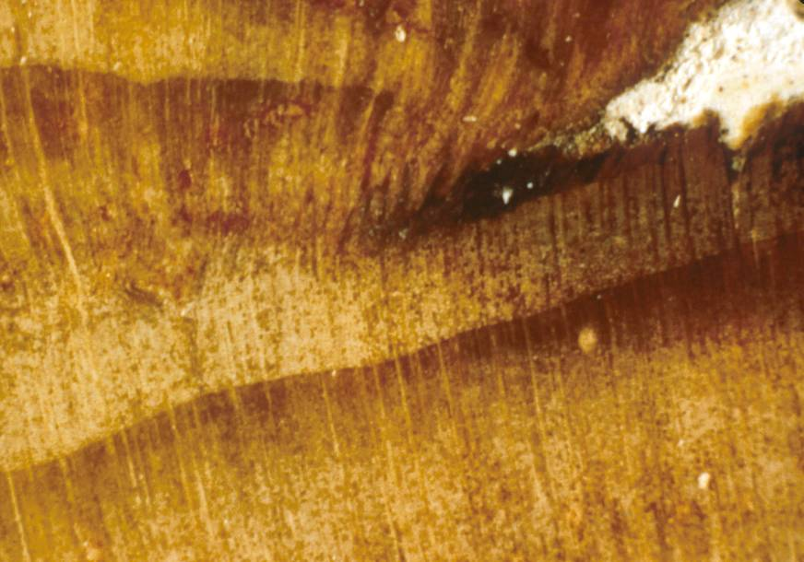
L
LE
ME
EE
D

Slide 15
Synchrony is evident both in timing of fire events, and lack of events in multiple sites.

Slide 16
Regional large and small fire years in the Southwest are strongly linked to wet and dry conditions.

Slide 17
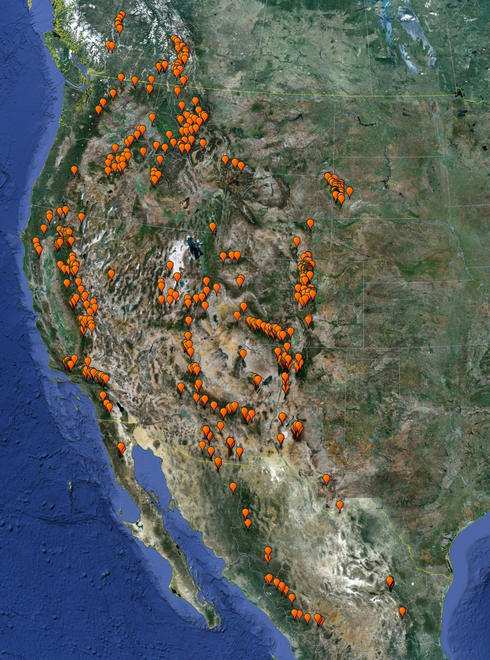
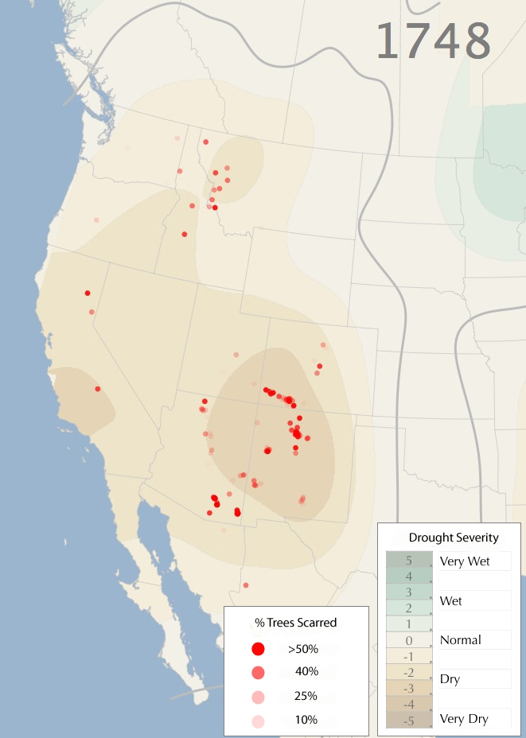

Slide 18
Synchrony fire occurrence over the region is evident both in timing of fire events, and lack of events over the network of sites.
Note consecutive-year fires.
Swetnam, T.W, and P.M. Brown. 2010

Slide 22
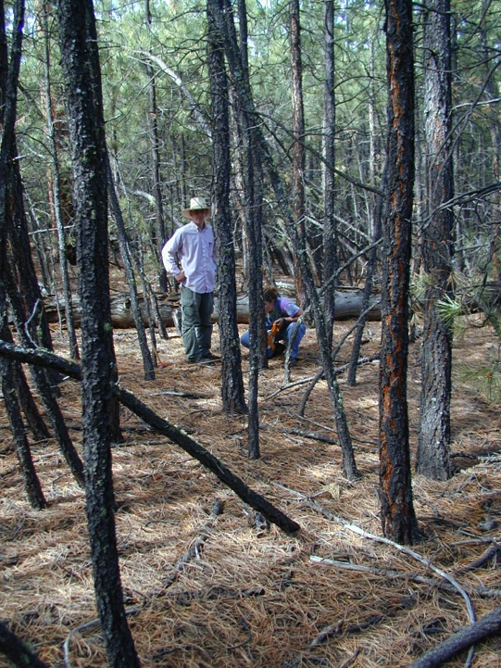

Slide 23
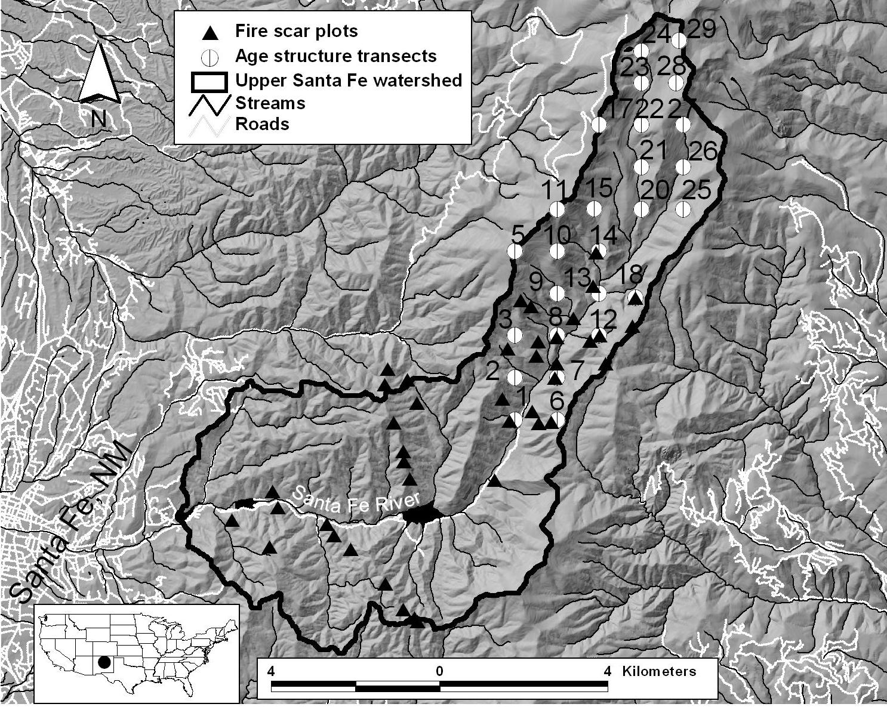
Spruce
Mixed-conifer/ Aspen
PonderosaPine
7016 ha
Elev. 2240m – 3850m

Slide 24
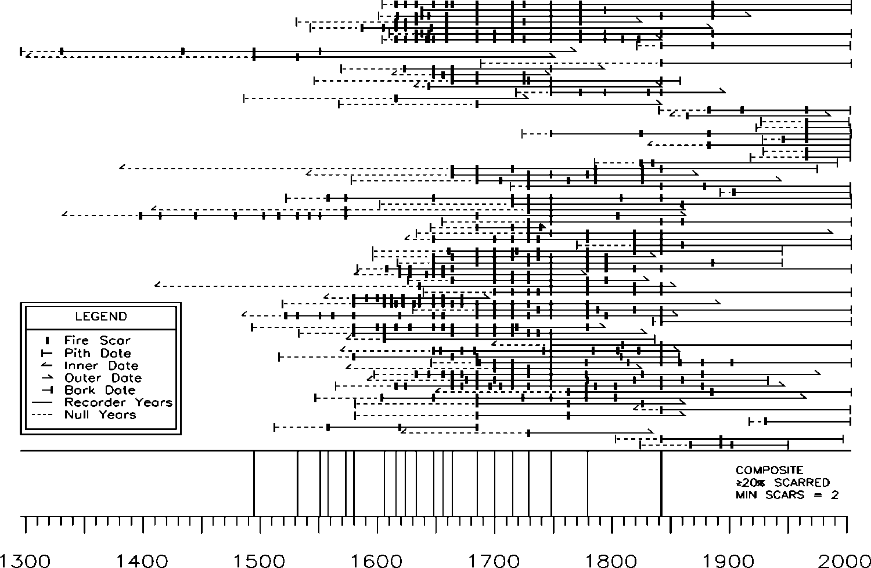
Ponderosa pine fire history (1296-2004)
1685
1842

Slide 25
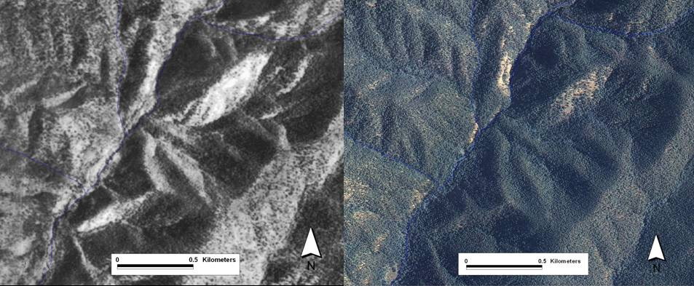
Santa Fe Watershed, source of ~50% of municipal water supplies. Tree-ring fire history studies here show that frequent surface fires burned in the lower and middle watershed for hundreds of years, until about 1850.
1935
2005
Margolis & Balmat 2009, Forest Ecology & Management

Slide 26
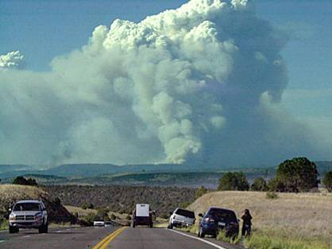
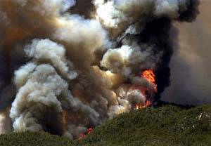
Rodeo-Chedeski Fire June 2002
Aspen Fire, June 2003
Notes:
26

Slide 27
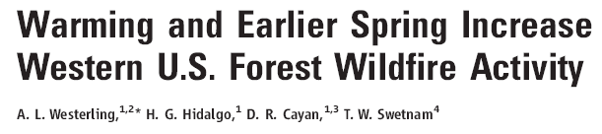
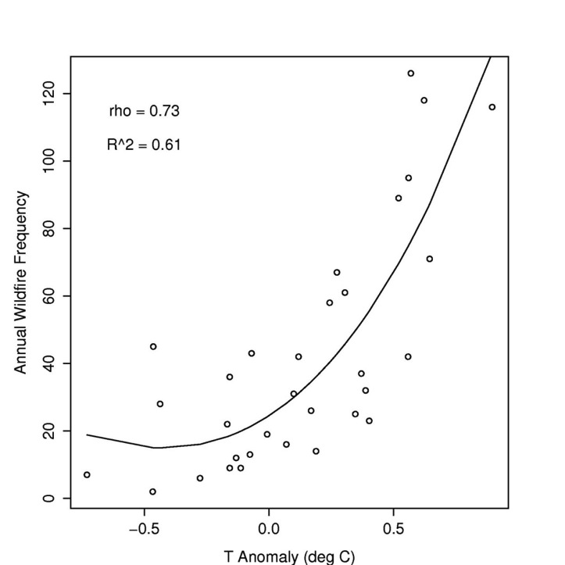
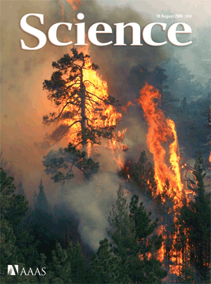
Frequency of
Forest Wildfire (> 200 ha):
Strongly Associated
with spring and summer
Temperature
Non-linearities and Tipping Points?

Slide 28
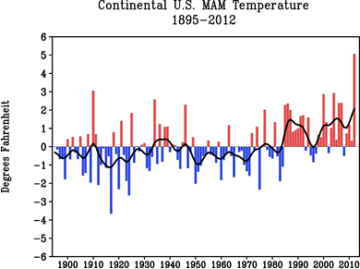
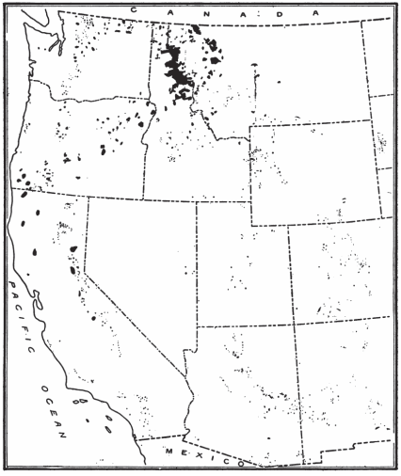
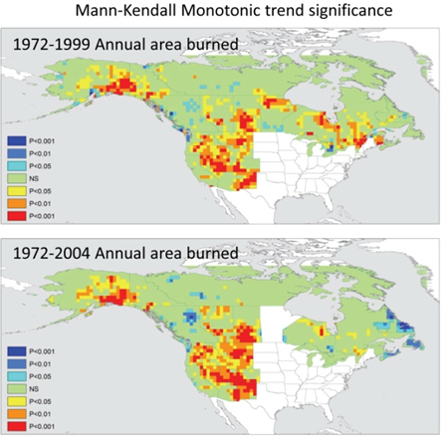
1910 wildfire areas
Diaz & Swetnam, submitted
Plummer 1912
Kitzberger, Falk, Swetnam, Westerling & others in prep.

Slide 29
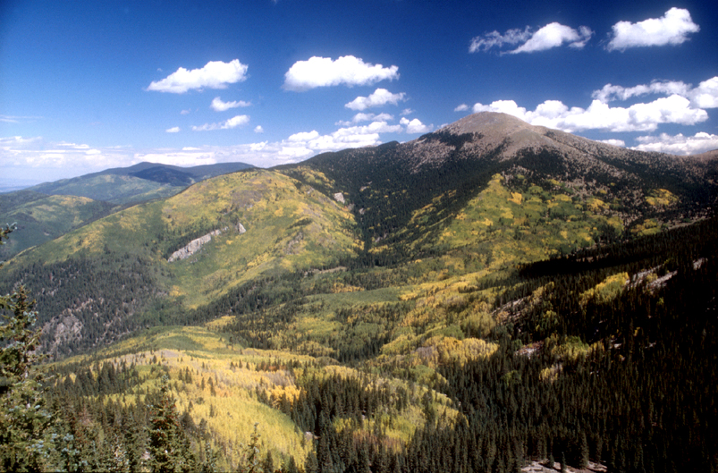
A stand-replacing fire history in upper montane forests of the southern Rocky Mountains. Margolis, Swetnam, Allen, 2007. Canadian Journal of Forest Research 37:2227-2241.

Slide 30
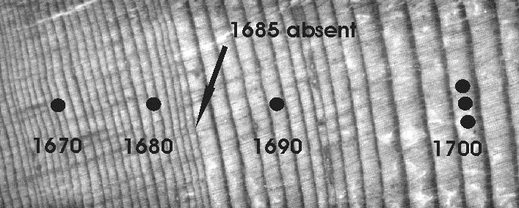
Growth release following crown fire1685 fire in spruce-fir forests
Photo courtesy Ellis Margolis

Slide 31
1685 fire
Recorded by fire scars at 68% of fire scar plots
Largely stand-replacing in the spruce-dominated forest
PDSI = – 6.92!
(Cook et al 2004)

Slide 32
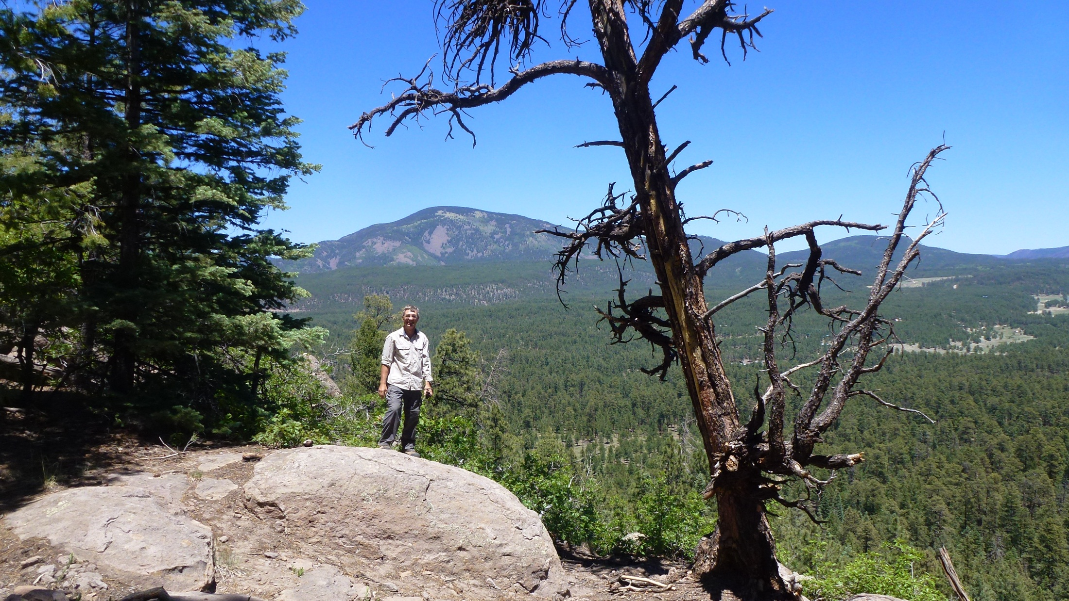

Slide 33
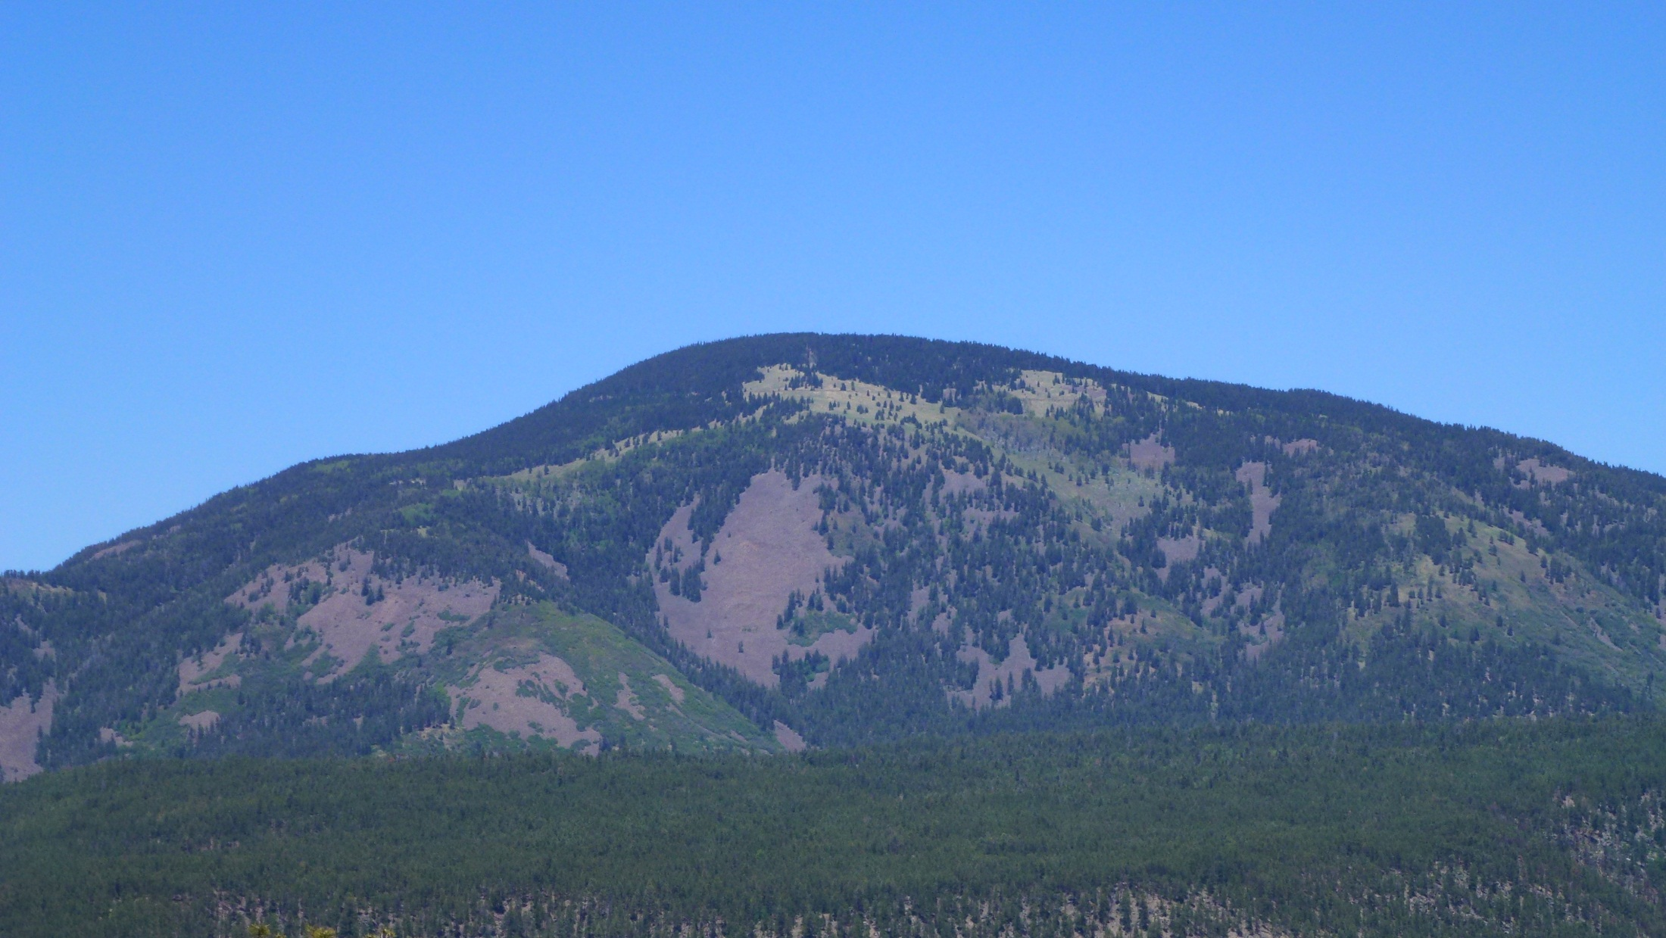

Slide 34
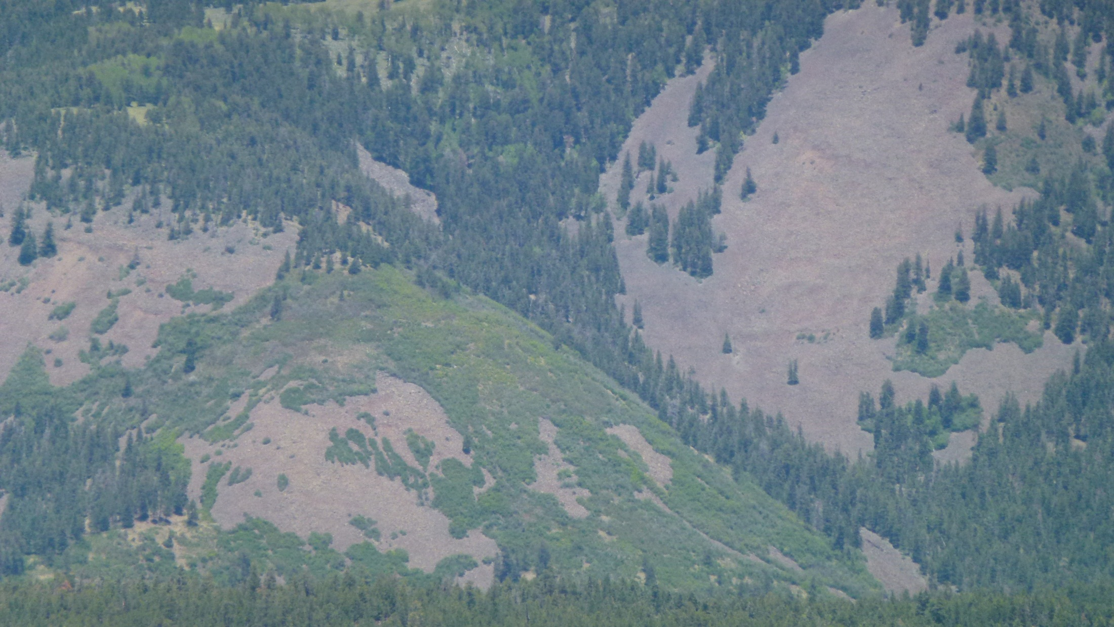

Slide 35
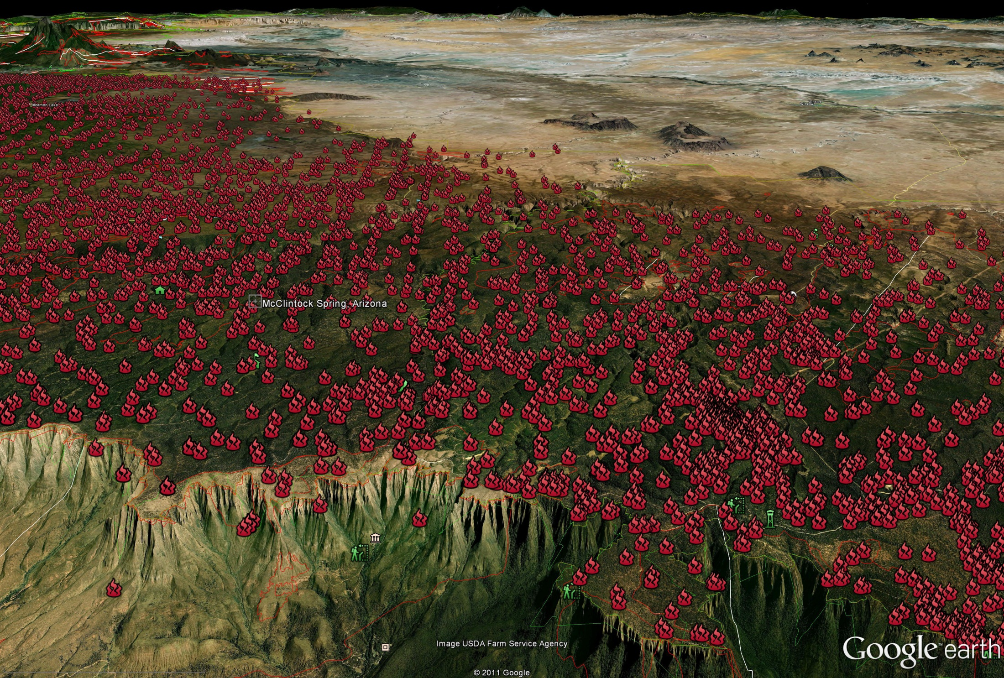

Slide 36
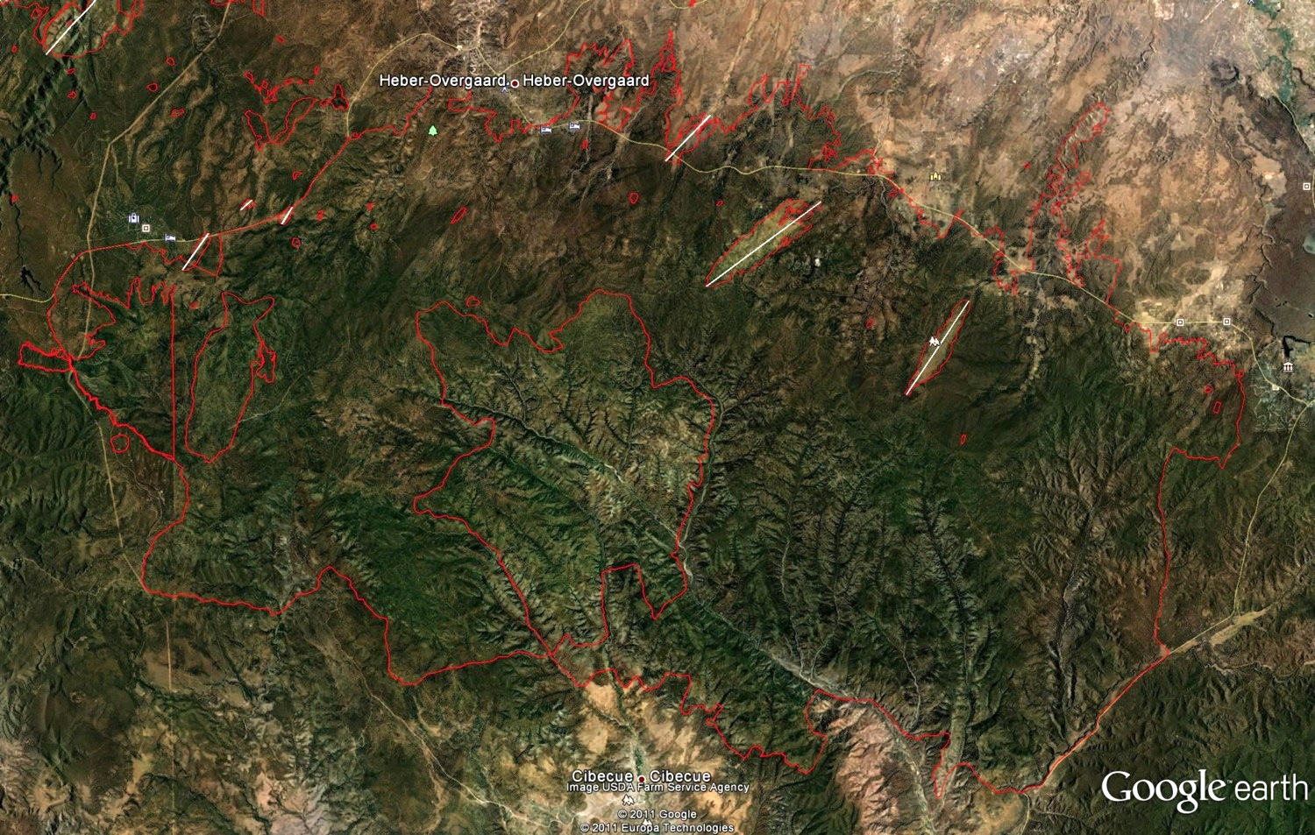
Day Fire 05/29/74
Cottonwood Fire 06/23/96
Rodeo-Chediski Fire 06/18 to 06/29/02
Carrizo Fire Fire 06/24/71

Slide 37
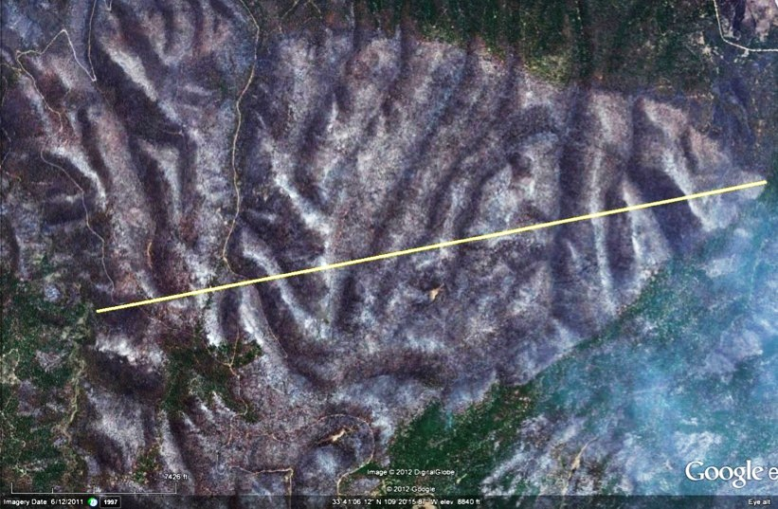
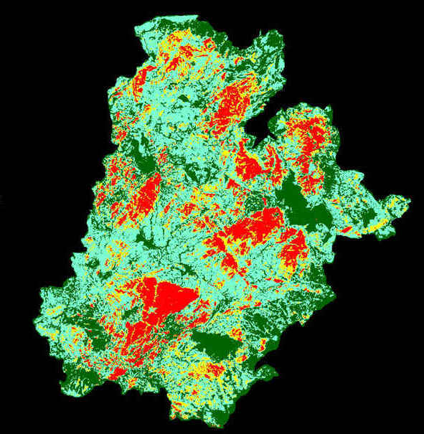
Wallow Fire, May 31-june 28, 2011
540,000 acres
Run on June 2, 3rd day, approx. 30,000 acres, the next day June 3rd burned approx. 60,000 acres.
The high severity canopy hole shown in upper right is at least 10,000 acres.

Slide 38
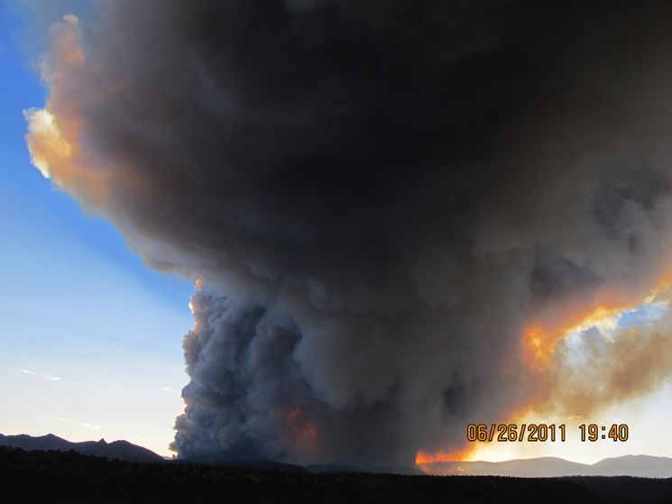
Photo by Craig Allen, late afternoon of Las Conchas Fire “horizontal roll vortex” HRV. The time lapse video by Michael Zeiler shows these orange flashes on multiple occasions, and burning gases at tremendous heights as well.

Slide 39
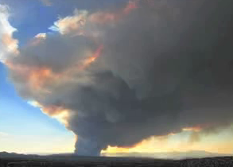
Las Conchas Fire, as viewed from near Santa Fe, afternoon of June 26, 2011. From still images photographed by Michael Zeiler, and assembled into a time lapse film (on YouTube).

Slide 40
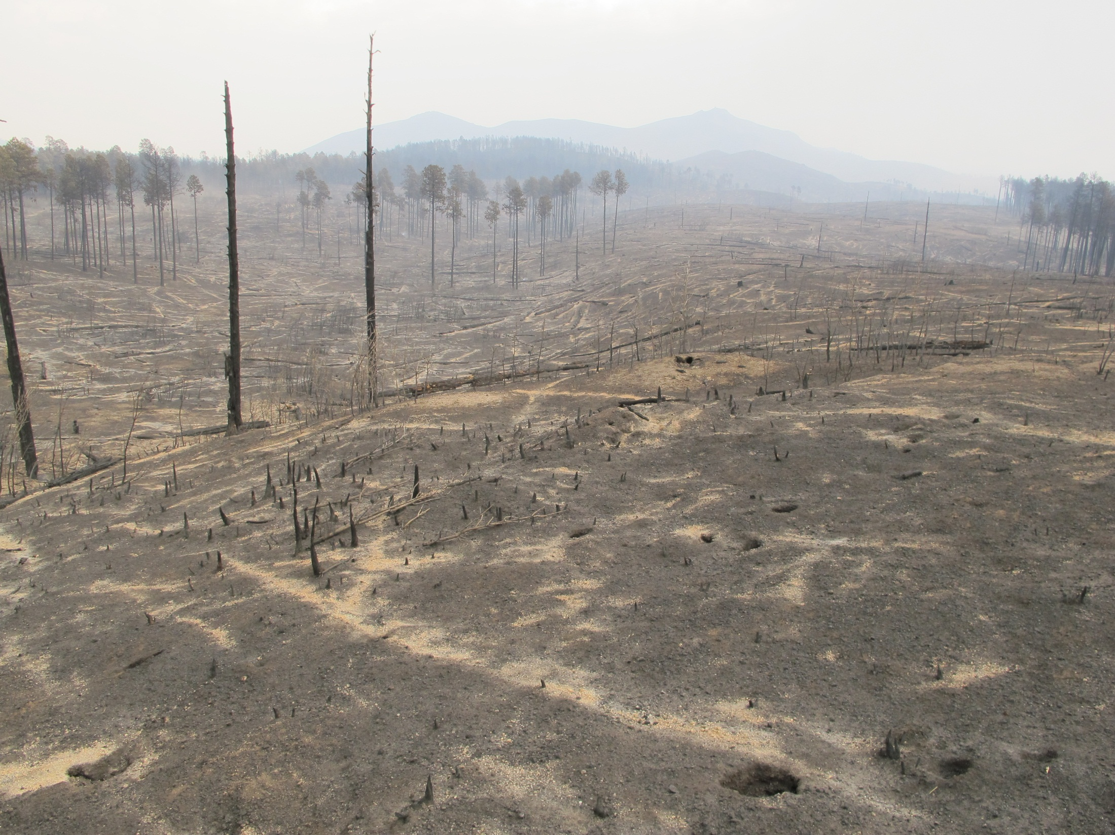
Ghost logs, Dome area
Photo: C.D. Allen

Slide 41
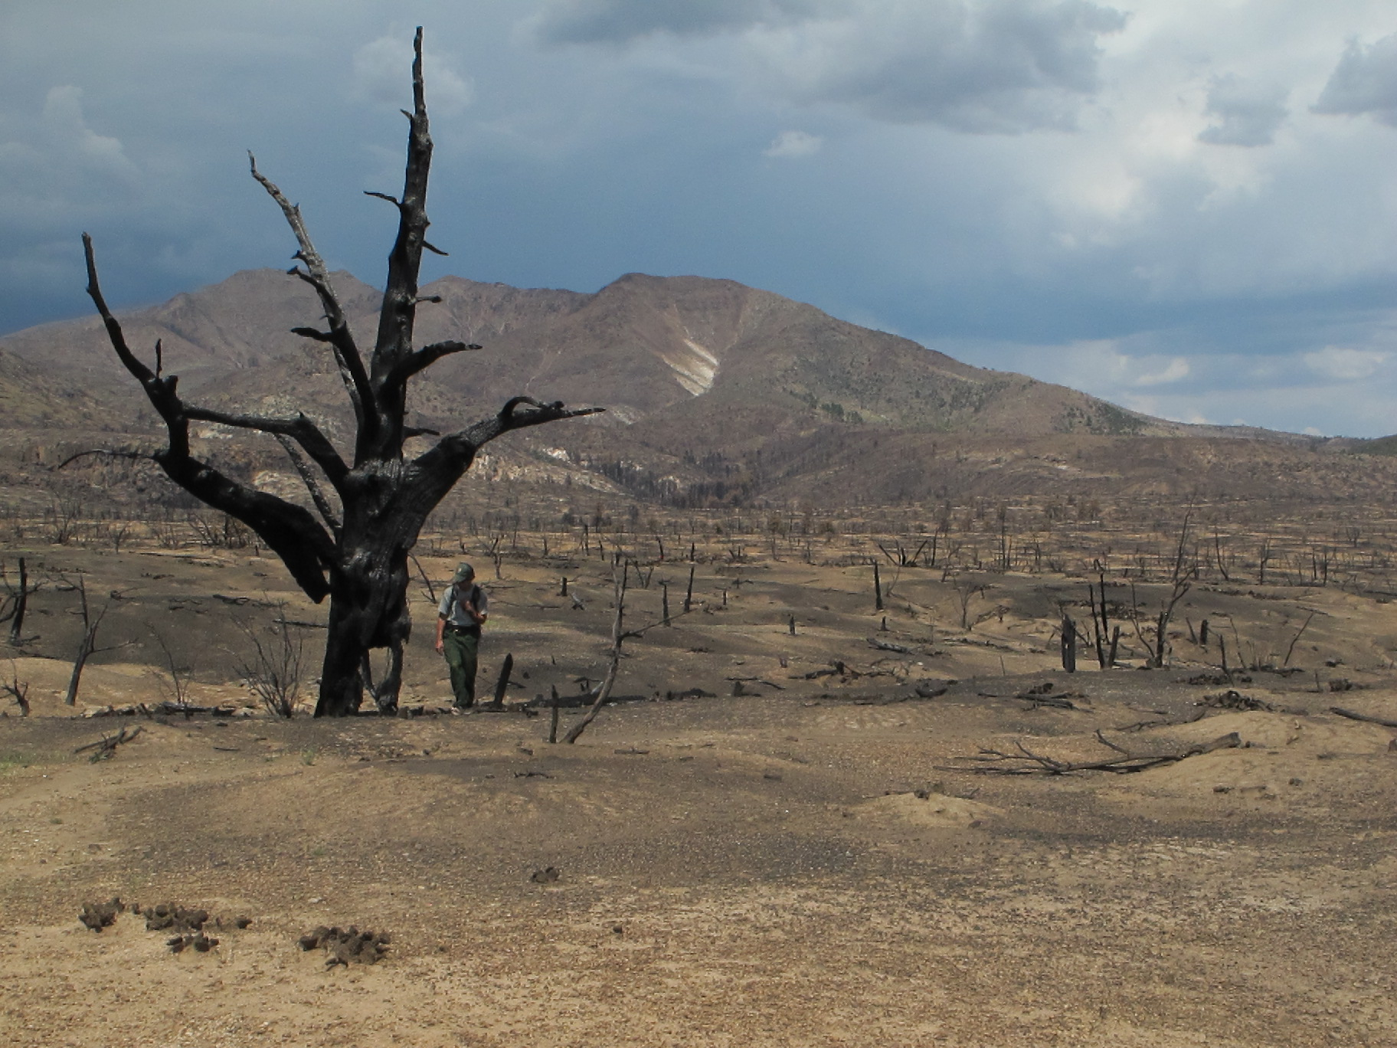

Slide 42
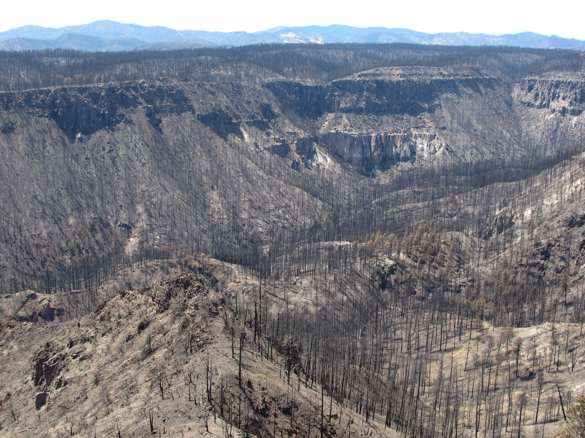
Photo: C.D. Allen

Slide 43

Heat “frozen” pine needles:
Las Conchas Fire, June 2011

Slide 44



Slide 45


??

Slide 46

Photo: C.D. Allen

Slide 47


Slide 48

Cerro Grande Fire killed stand, and Gambel oak regeneration, near Los Alamos
Photos: C.D. Allen

Slide 49


Slide 50

Gambel oak fields near Durango, CO: Is this a forest to shrub, type-converted (or successional?), post-logging/fire landscape?
Photo: C.D. Allen

Slide 51



Pre-Columbian Wildland Urban Interface on the Jemez Plateau
--Jemez, circa 1300-1600: ~28 people/km2 population density
--Modern WUI = minimum population density of 25 people/ km2

Slide 52
More than 8,000 field houses, and dozens of pueblos, ranging in size for 100 to 1,500+ rooms

Slide 53

How did the Jemez people manage to live within ponderosa pine forests during “megadroughts”, and what can we learn from this human-land use system?
Williams et al., Nature Climate Change, in press

Slide 54


Slide 55

Wallow Fire, 2011, near Alpine, AZ

Slide 56

Unintended consequences?
Do we still enough knowledge, time and resources to fix these fire/forest/people problems?

Slide 57


Slide 58


Slide 59



Slide 60
"We all travel the Milky Way together, trees and men.”
John Muir to Gifford Pinchot, while sitting around a campfire on the rim of the Grand Canyon, summer 1896
Time-lapse photo of an ancient bristlecone pine tree and “star rings”, by Robert Kawika Sheer

Slide 61

BARK BEETLES and WILDFIRES from the mid 1980s to 2006 resulted in moderate and high mortality over at least 18% of the area of Southwestern Forests.
Williams, A.P. C. D. Allen, C. I. Millar, T. W. Swetnam, J. Michaelsen, C. J. Still, and S. W. Leavitt. 2010. Forest responses to increasing aridity and warmth in the southwestern United States. Proceedings of the National Academy of Sciences 107(50):21289-21294.

Slide 62
Outline of Talk
Is knowledge and understanding of the past relevant and useful in a dynamic world, and especially with a “no-analog” future?
Update of state of art discussions of HRV: Steve Jackson, Bob Keane, and new Romme et al. book
Examples of using the past: surprises and insights
Jemez, SW, climate and fire, and humans

Slide 63


Slide 64

Jemez Large Pueblo Sites
circa 1300-1550 CE
~7,000 people lived in as many as nine villages within or adjacent to ponderosa pine forests
~7 pueblos with > 1,000 rooms, and 15 other pueblos with >500 rooms
-hundreds of “field houses”
~28 people/km2 population density
~Modern WUI = minimum population density of 25 people/ km2

Slide 65



Slide 66

Superposed epoch analyses shows important lagging patterns in climate-fire relations in tree-ring and modern records.
1600-1900
1905-2004

Slide 67

Regional composite fire scar chronology from 31 sites in the Madrean Archipelago. The vertical tick marks are fire events recorded by 25% or more of sampled trees (in that year) within each site.

Slide 68

A combined dendroclimatic-dendroecology approach
Spearmans’ R
SR vs Observed:
0.49, 1916-1978
0.71, 1916-1962
SR vs FSR
0.61, 1700-1900
(all p levels < 0.05)
Westerling, A. L., and T. W. Swetnam. 2003. Interannual to decadal drought and wildfire in the Western US. EOS Transactions American Geophysical Union 84(49):545-560.

Slide 69

We used a 1,400 year PDSI and precipitation reconstructions from ring widths in the Southwest and a 200-year regional fire scar index from 44 sites to calibrate and validate a regression model, which we then used to retrodict fire history back through the “Little Ice Age” and the “Medieval Warm (Drought) Period”.
Roos and Swetnam, The Holocene, 2012

Slide 70


Owing to past neglect, in the face of the plainest warnings, we have now entered upon a period of danger greater than has befallen Britain since the U-Boat campaign was crushed...
The era of procrastination, of half-measures, of soothing and baffling expedients, of delays, is coming to a close. In its place we are entering a period of consequences...” Winston Churchill, November 1936

