Slide 1
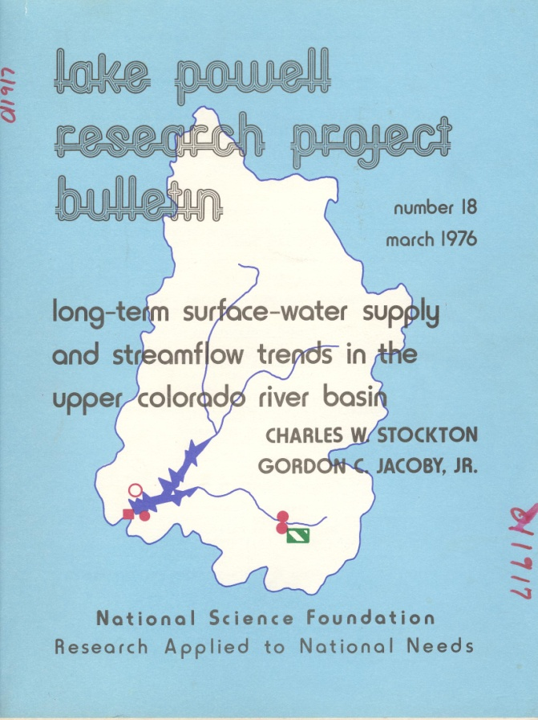
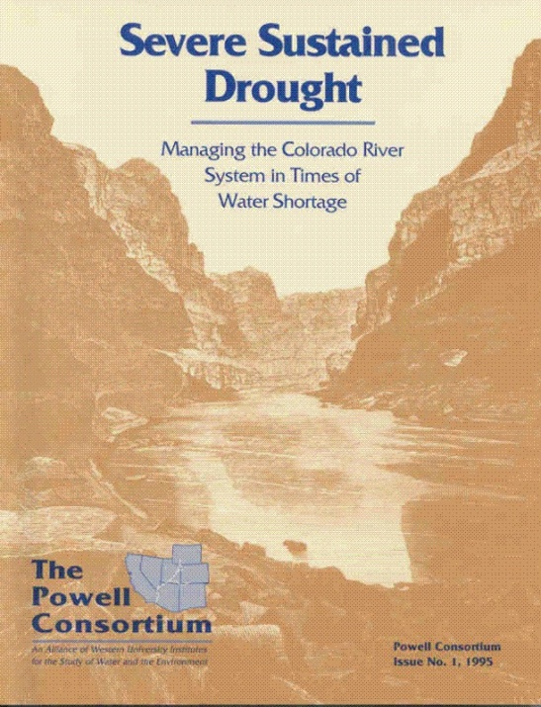
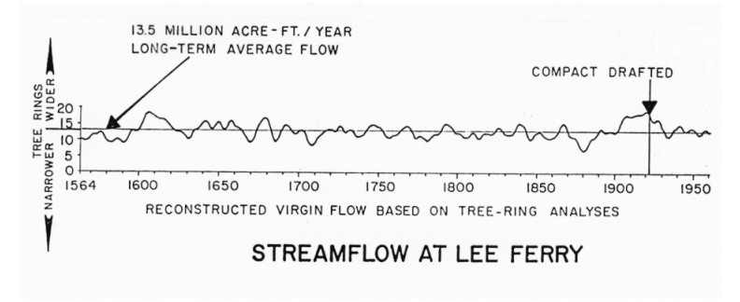
The first Lees Ferry reconstruction was generated by Stockton and Jacoby in 1976.
It pointed out the anomalous wet period in the early 20th century and a prolonged drought in the late 15th century
In 1995, set of studies assessed the impacts of drought using the 15th century drought as a worst case scenario.
Stockton and Jacoby 1976

