Slide 1
DENDROCHRONOLOGY:
When This Ring’s True Tale Is Told
Much More Than Just Counting the Rings

Slide 2
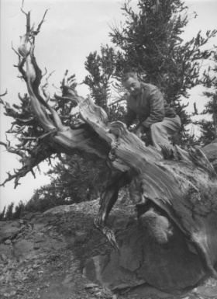
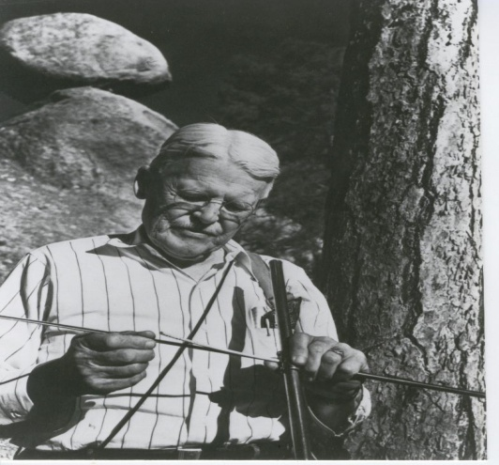
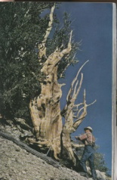
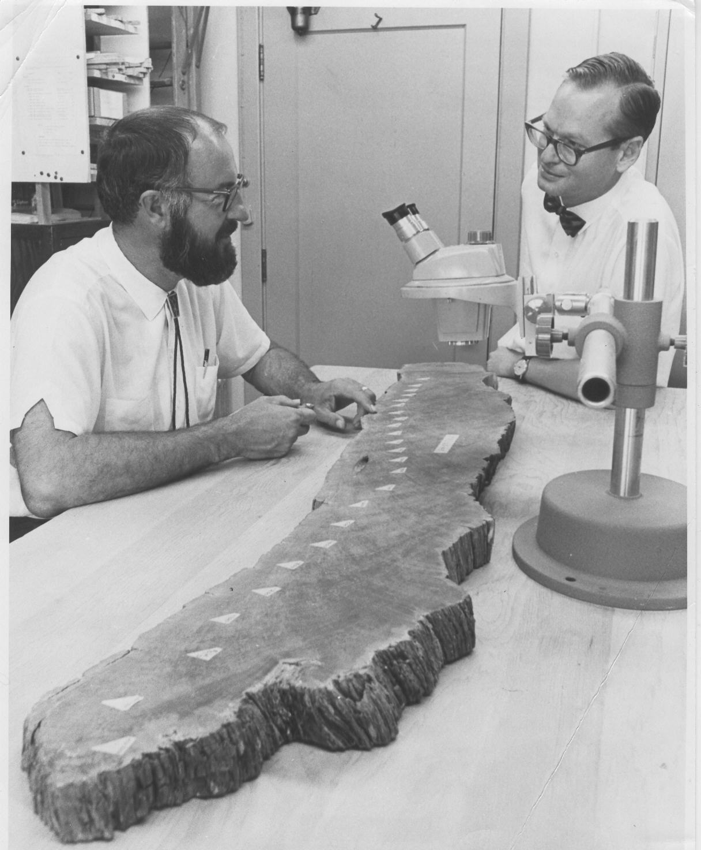
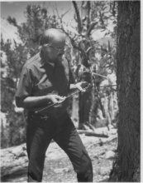
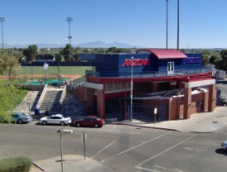
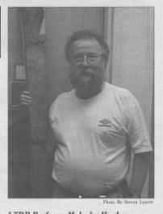
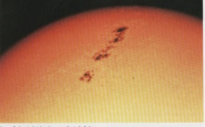
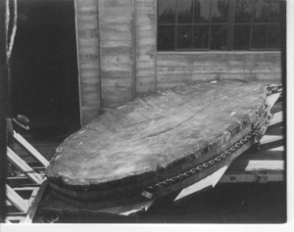
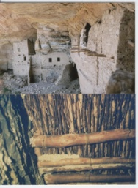
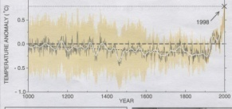
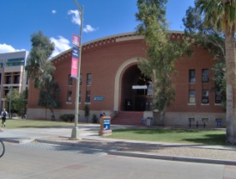
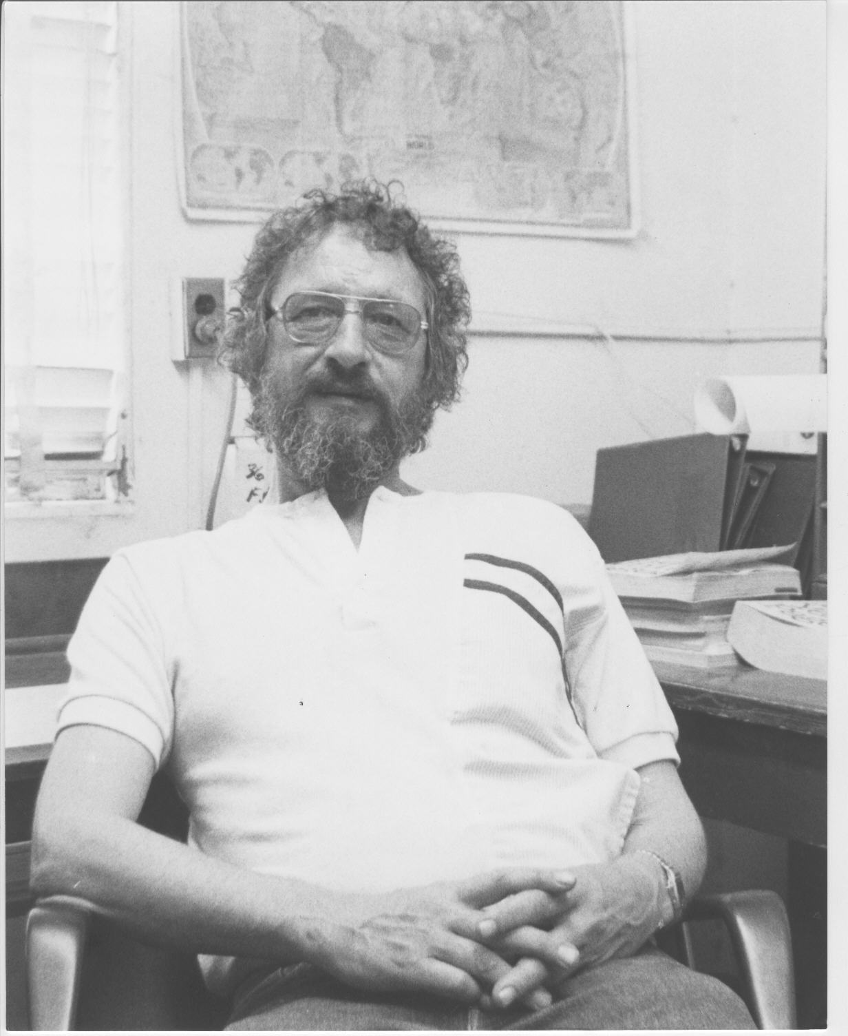
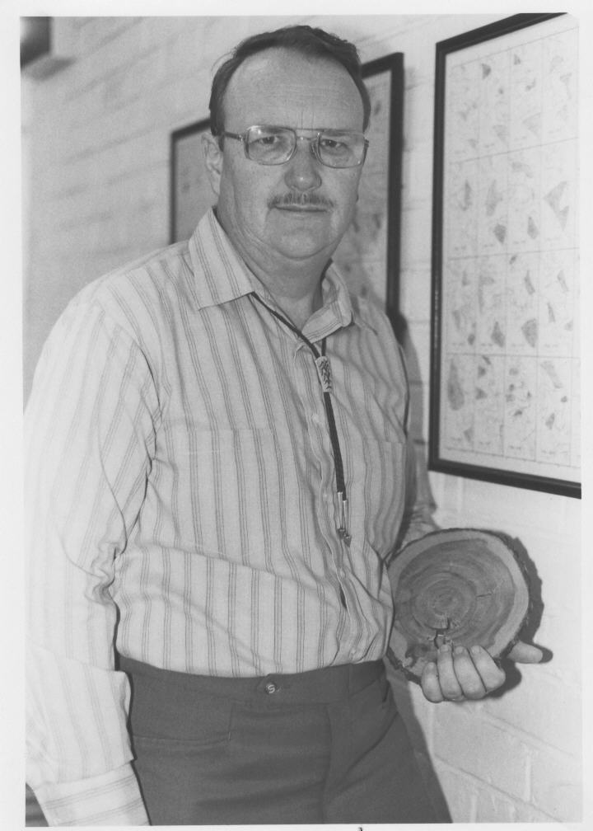
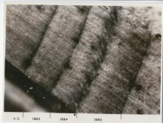
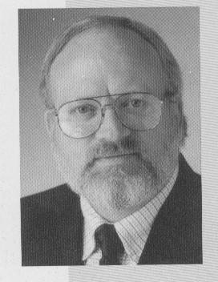
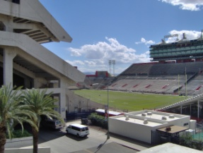
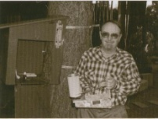
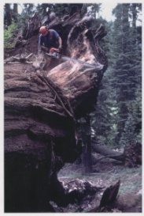
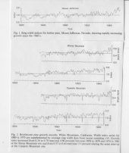
A Bit of History
Edmund Schulman
Wes Ferguson
Andrew E. Douglass Bryant Bannister
Malcolm Hughes
Val LaMarche Tom Swetnam Hal Fritts

Slide 3
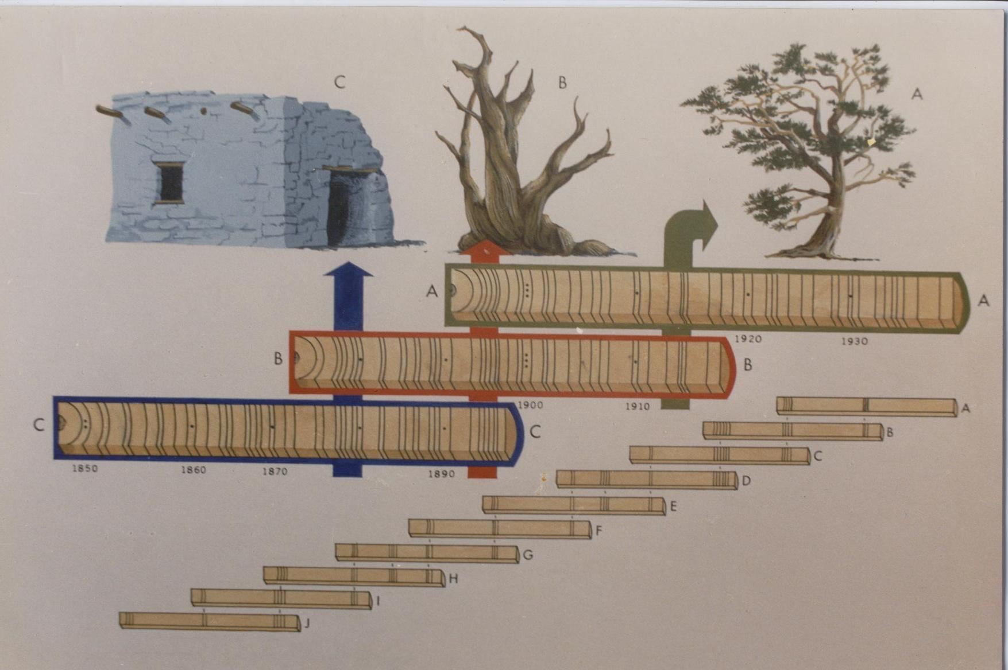
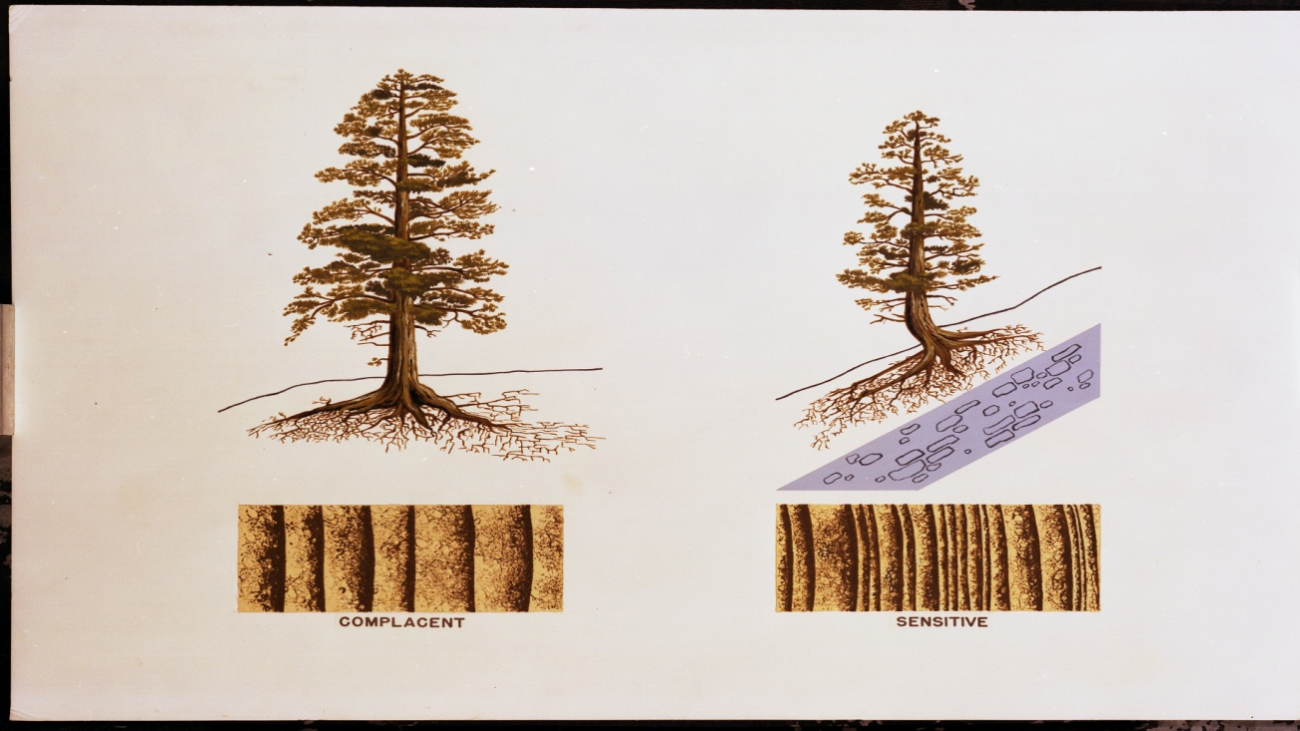
Principle of Crossdating (bridging patterns through time)
Principle of the Limiting Factor (some requirement for growth such as water, temperature, photo period , nutrients is limiting)
Principle of Uniformitarianism
(the present is the key to the past)

Slide 4
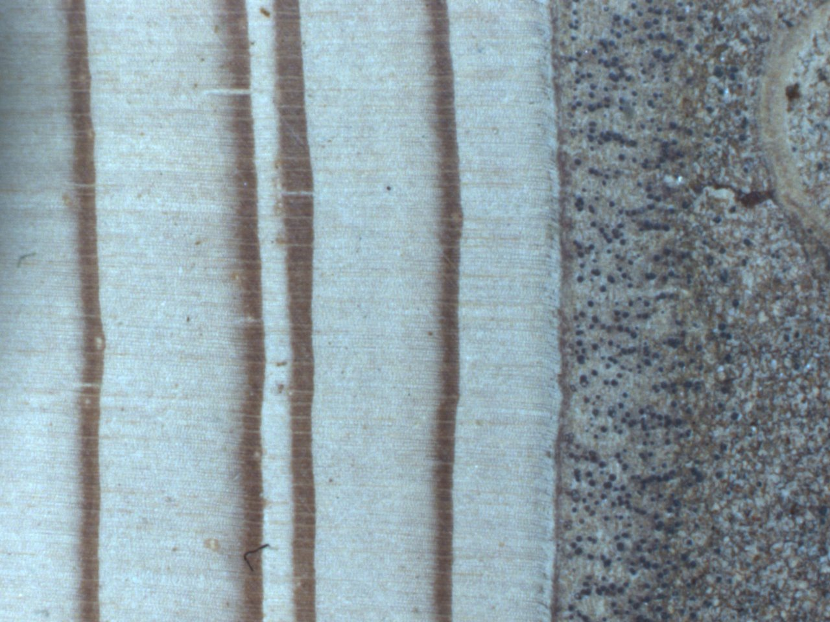
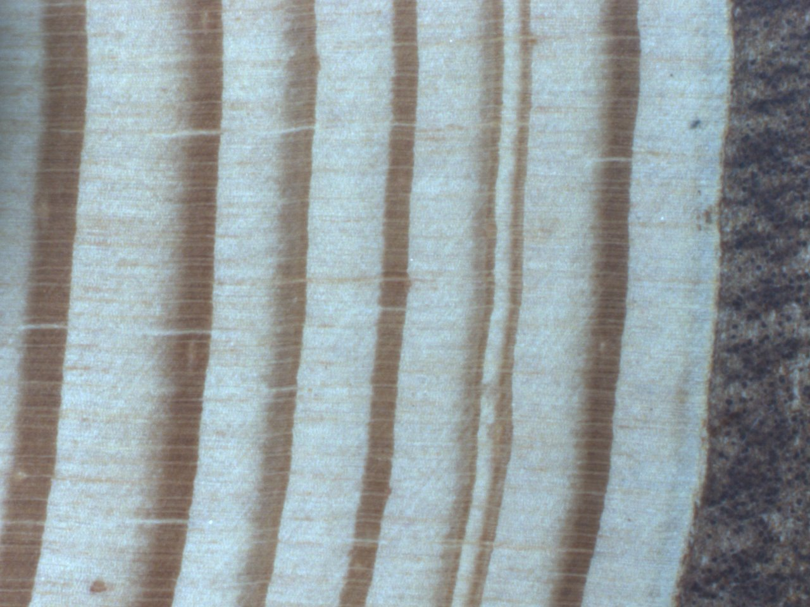
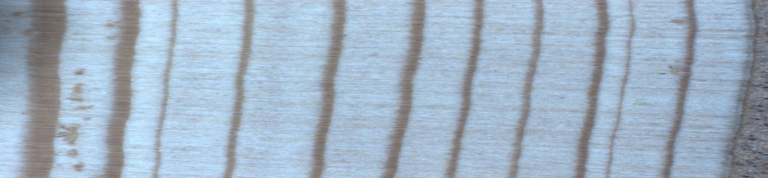
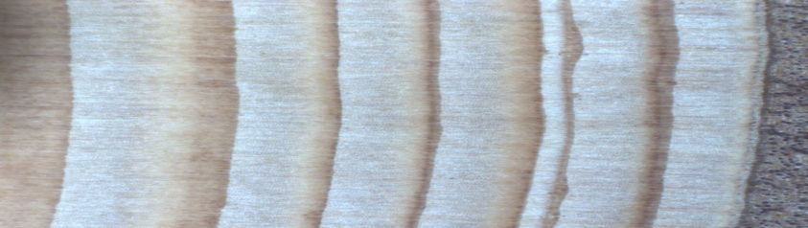
SAMPLE CROSSDATING REQUIREMENTS
An identifiable annual increment of growth i.e. an annual ring:
Variability from increment to increment of growth i.e. rings are not the same :
Circuit uniformity i.e. what is seen on one side should been seen on the other:
Minimum of 50 increments of growth i.e. non-random match, not by chance:

Slide 5
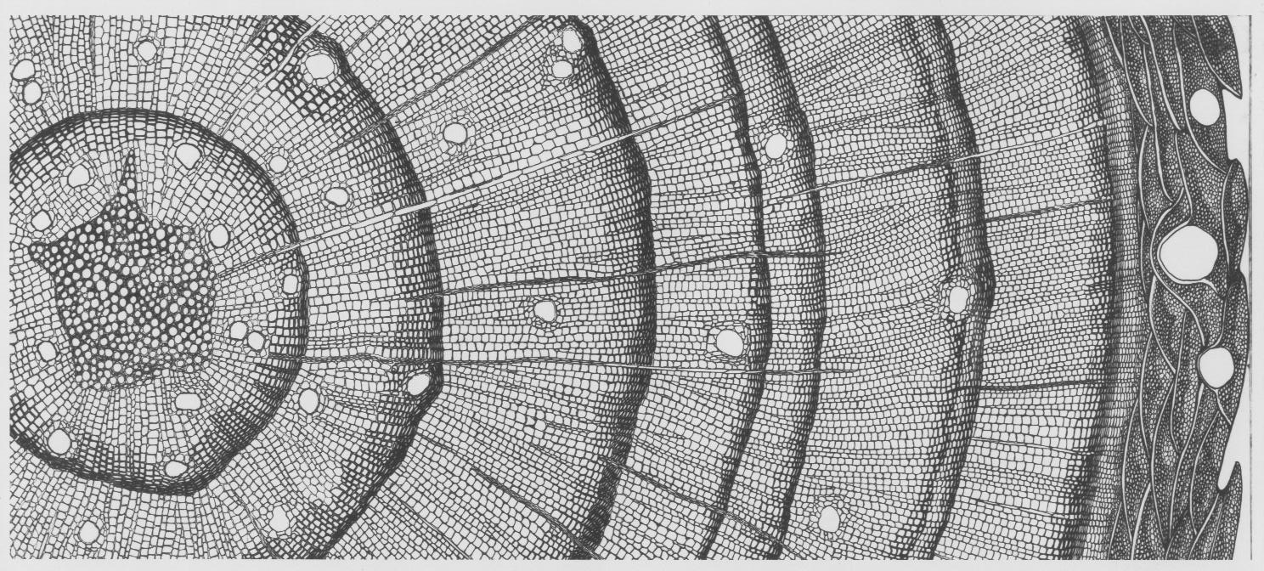
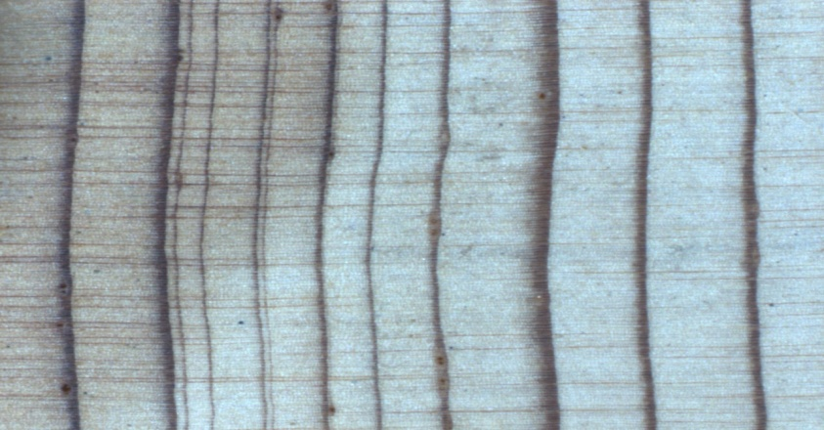
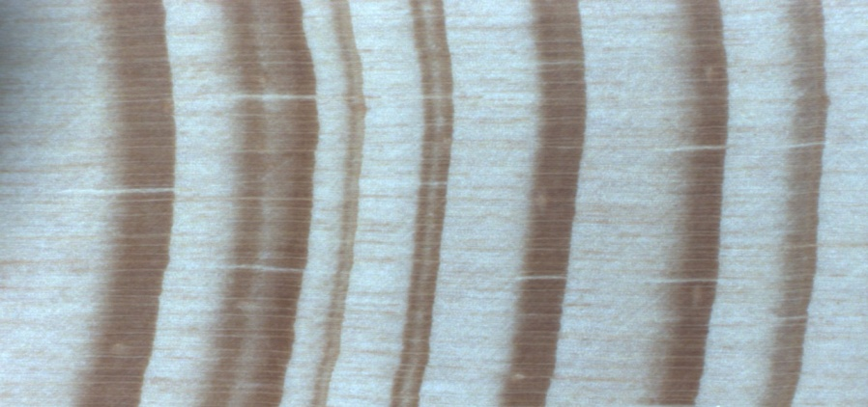
CROSSDATING VERSUS COUNTING ?WHY?
Locally absent rings
False rings(intra-annual bands)

Slide 6
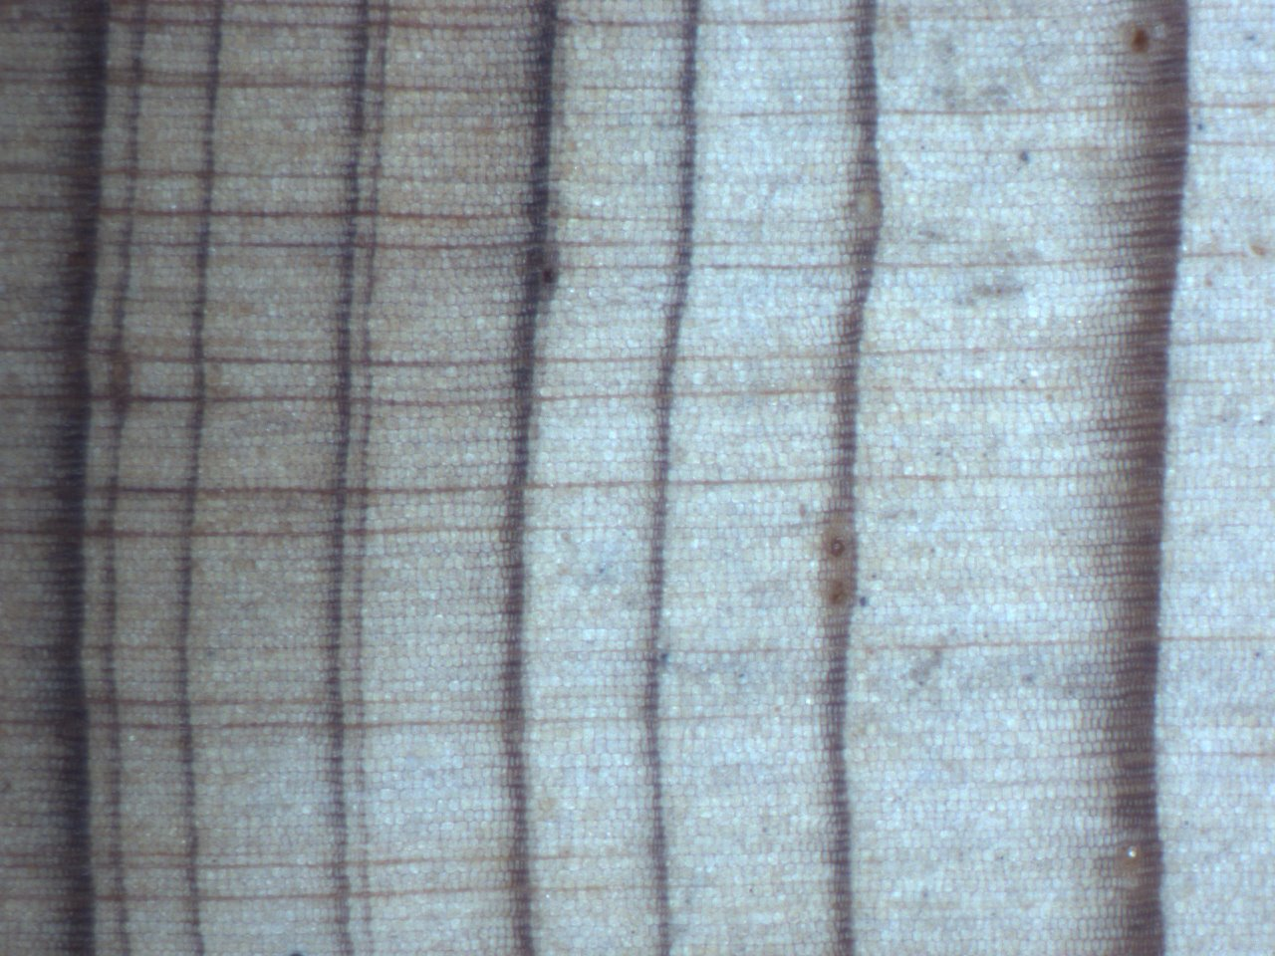
Locally absent or absent (missing rings)
1898
1908

Slide 7

False rings (intra-annual bands)
1994
1987

Slide 8
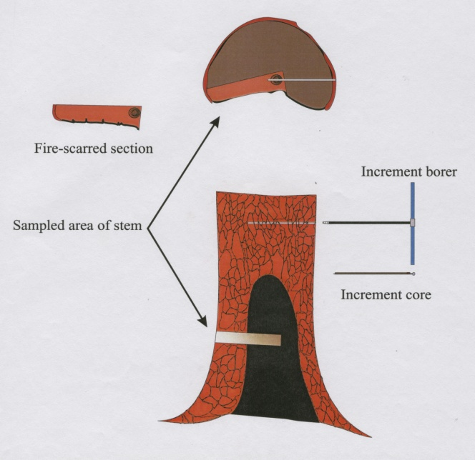
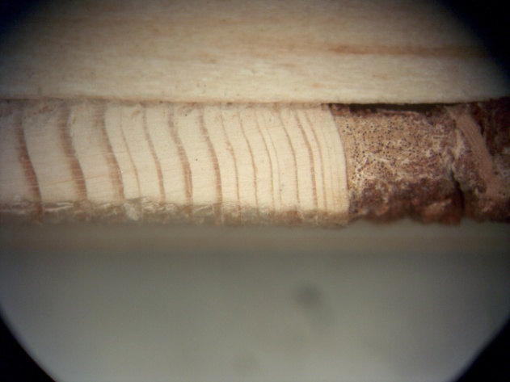
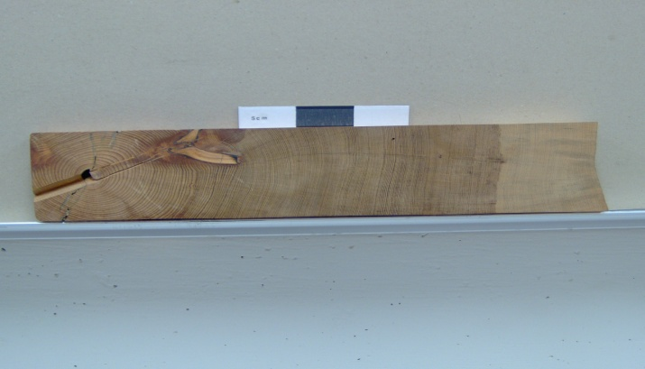
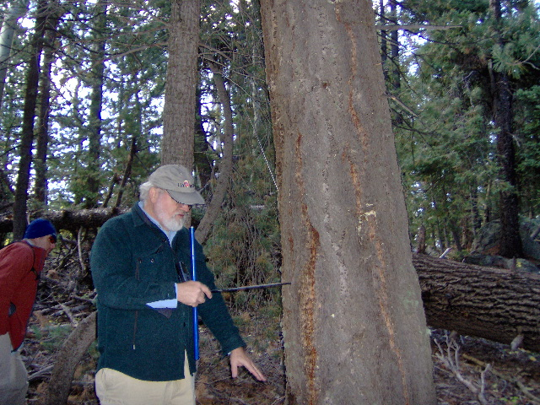
SAMPLING: Full or Partial Cross sections v.s. Increment Cores

Slide 9

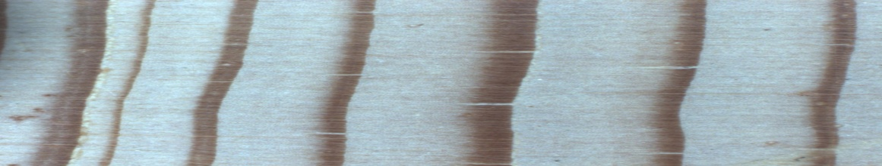
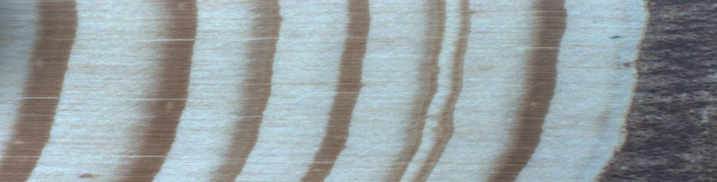

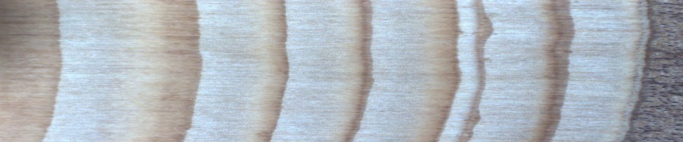
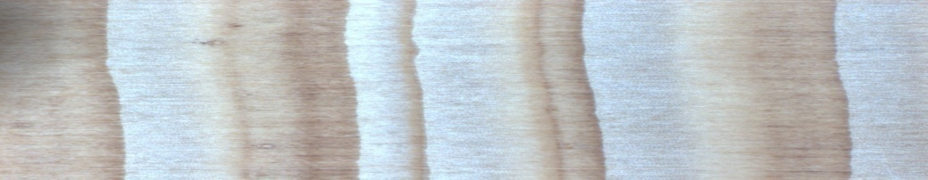
A QUICK CROSSDATING EXERCISE
ZMT08M
ZMT19P
ZMT18U

Slide 10

ZMT76B @ 12X & 50X

Slide 11


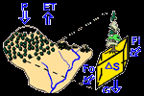
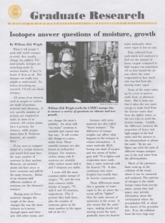
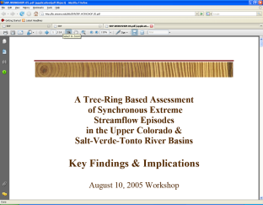
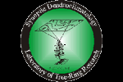
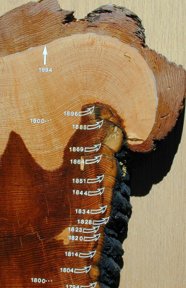
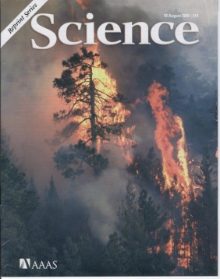
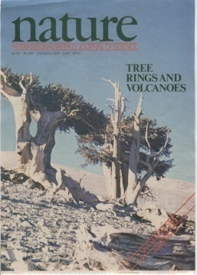
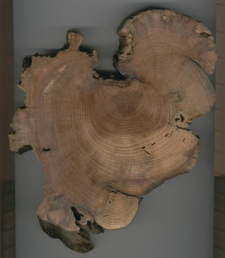
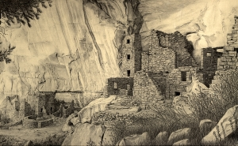
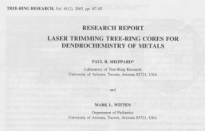
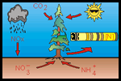
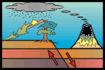


APPLICATIONS dendro +
hydrology isotope chemistry ecology
Climatology
geomorphology archaeology environmental research

Slide 12











CONTEXT FOR
EVENTS & PROCESSES
WITH ABSOLUTE TIME RESOLUTION

Slide 13

*
*
*

Slide 14


AFOGNAK ISLAND, ALASKA
Katmai Volcanic Eruption
6-8 June 1912
Magnitude 9.2 Earthquake Good Friday
27 June1964

Slide 15





Slide 16





Slide 17





Slide 21




