Slide 1
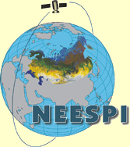
Comparing NDVI and observed stem growth and wood density in forests of northern Eurasia
MK Hughes¹, AG Bunn², AV Kirdyanov⁶, V Shishov⁷, MV Losleben¹, A Oltchev³, E Kuznetsova⁴, E Novenko⁵
1. Laboratory of Tree-Ring Research, University of Arizona, Tucson, AZ, USA.
2. Department of Environmental Sciences, Western Washington University, Bellingham, WA, USA.
3. Severtsov Institute of Ecology and Evolution, Russian Academy of Sciences, Moscow, Russia.
4. Geographical Faculty, Moscow State University, Moscow, Russian Federation.
5. Institute of Geography, Russian Academy of Sciences, Moscow, Russia.
6. Institute of Forest, Russian Academy of Sciences, Krasnoyarsk, Russia.
7. Krasnoyarsk State Institute of Economics and Trade, Krasnoyarsk, Russia.
Supported by:
A contribution to:

Slide 2
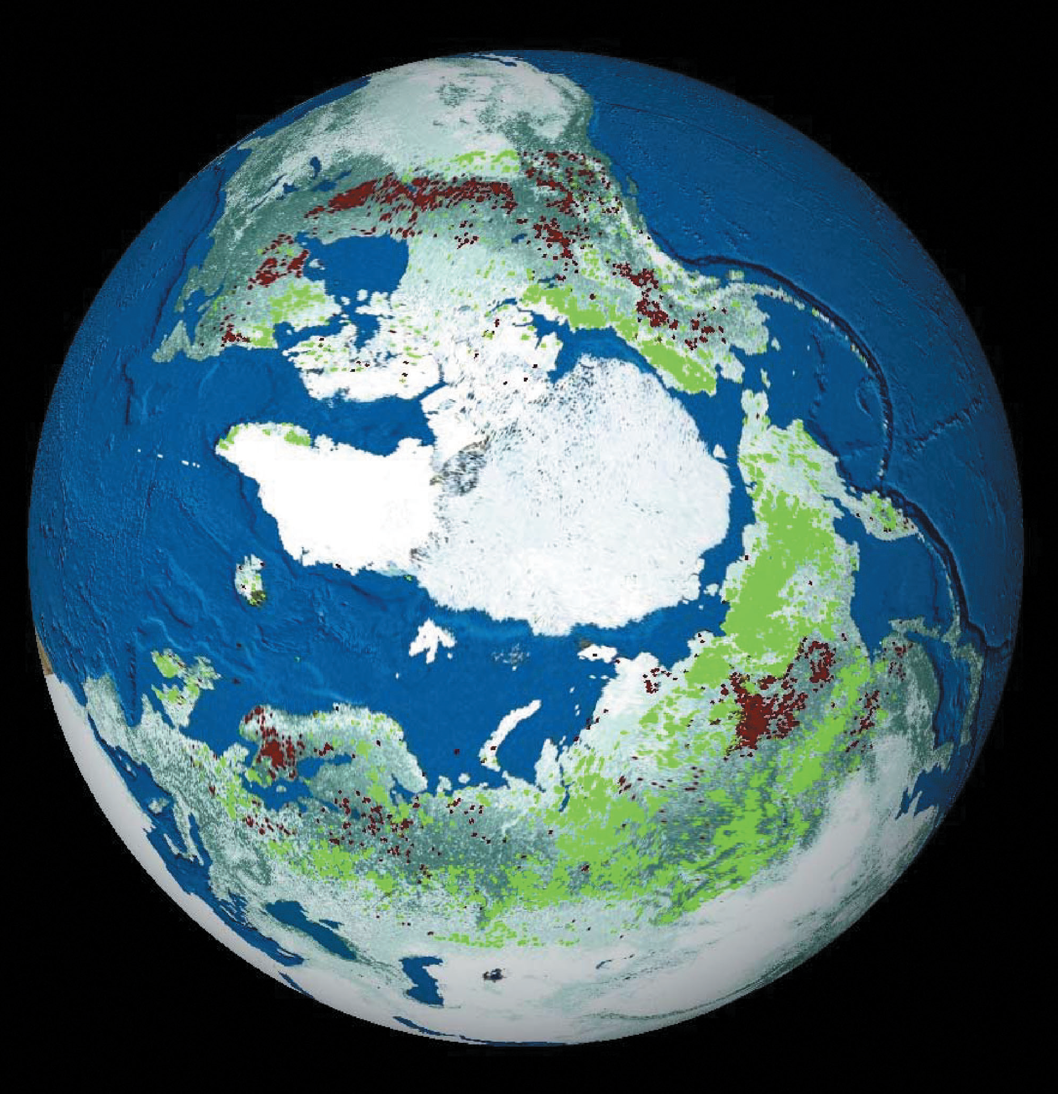
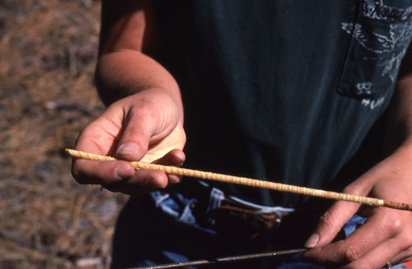
The question
To what extent does NDVI (Normalized Difference Vegetation Index) observed from space co-vary with directly observed stem radial increment and maximum latewood density?
??

Slide 3
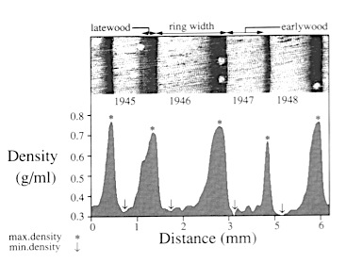
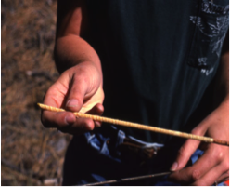
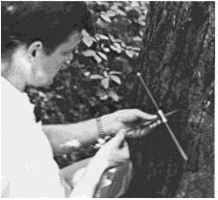
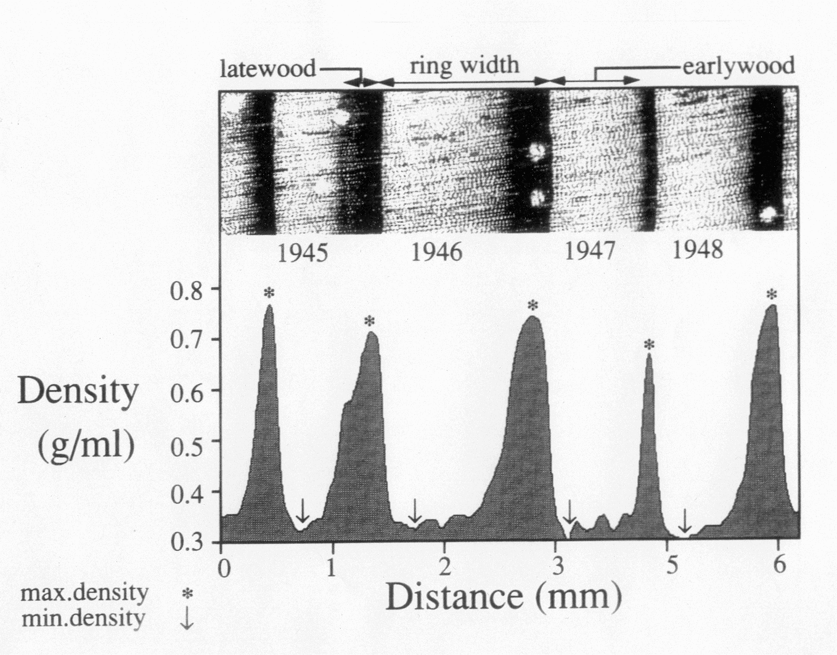
Site SUR, Picea obovata, maximum latewood density,
31 specimens

Slide 4
Picea glauca ring width – no consistent relationship with NDVI,
but for maximum latewood density (MXD)……
“Site-level MXD records reflect early growing season canopy status of large regions” (Beck et al highlights)

Slide 5
376 Site/species combinations, 154 sampled 1998 or later

Slide 6
Maximum monthly correlation with local NDVI
at 19 locations
⬅8km ➔
Tree sampling location
* BAV site
Some locations with ring width and maximum latewood density series ending in 1998 or later.
Larch
Spruce
Pine
Moderate correlations at most locations for both ring width and maximum latewood density, often significant at p<0.05 after taking account of autocorrelation.

Slide 7
We examined correlations between NDVI* and a subset of the 154 local datasets (that end in 1998 or later). First we look at those with both maximum latewood density and ring width data. An example is shown here.
⬅8km ➔
Tree sampling location
Correlation between NDVI (for ~24km box) and Larix gmelinii tree-ring series at the Bolshoi Avam (BAV) site on the Taimyr Peninsula (70.5 degrees North, 93.2 degrees East, 360 meters a.s.l.), 1982-2002.
r
Ring width
Max latewood density
* GIMMs NDVI data computed monthly.

Slide 8
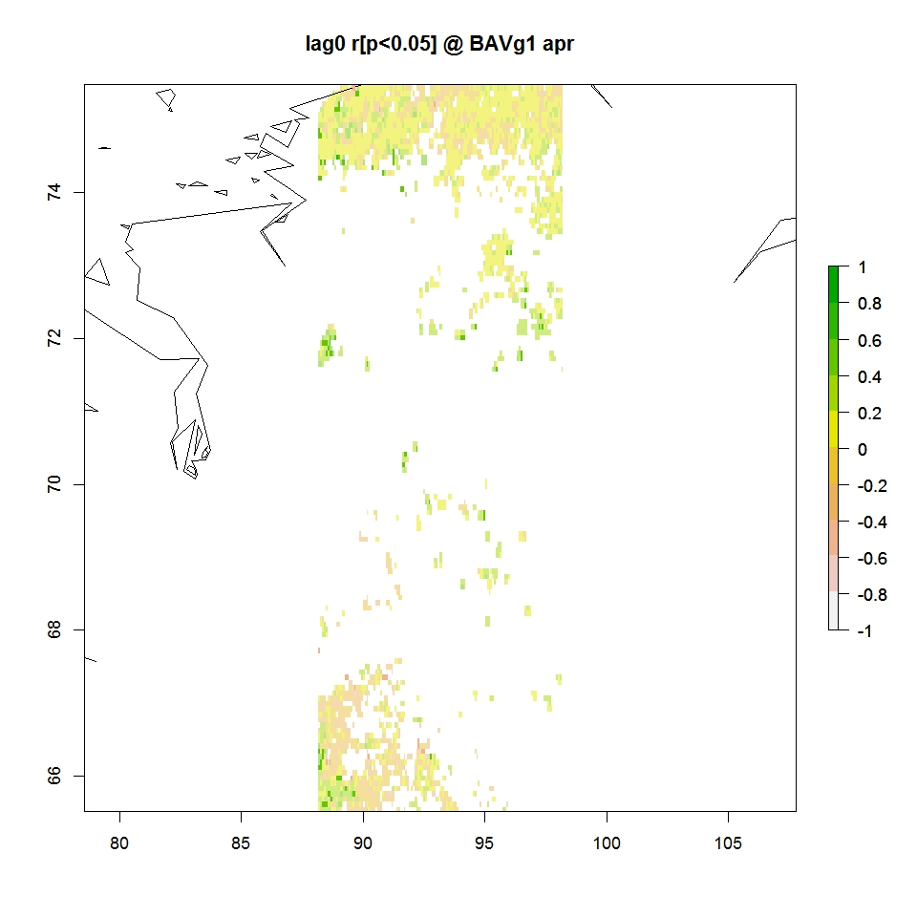
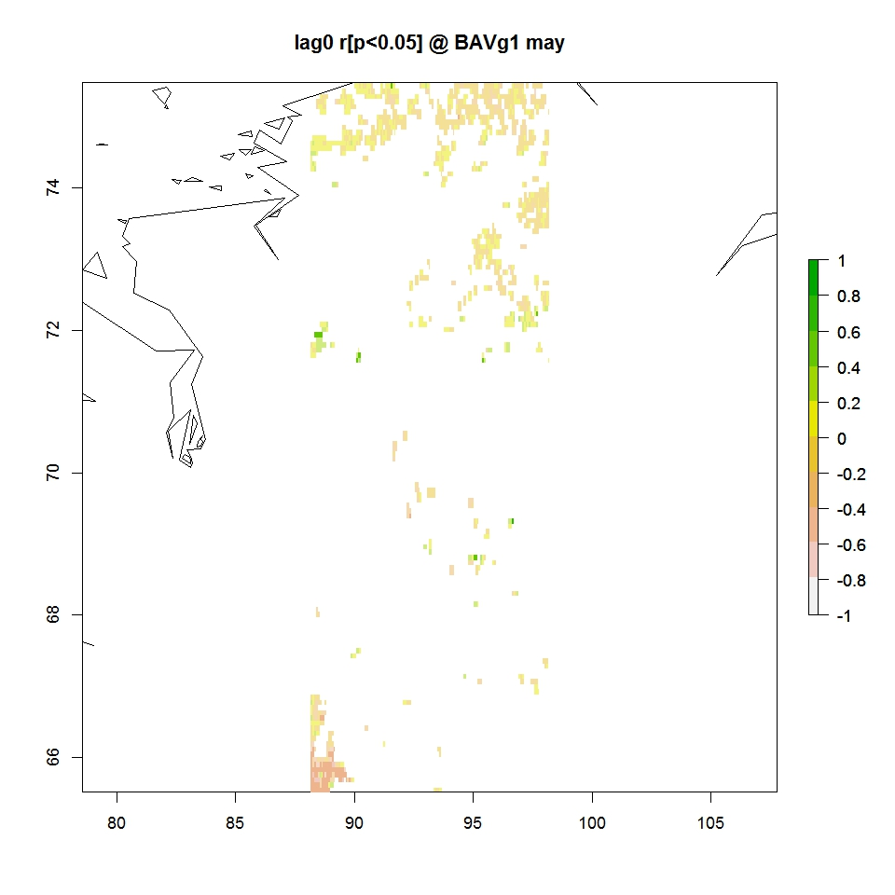
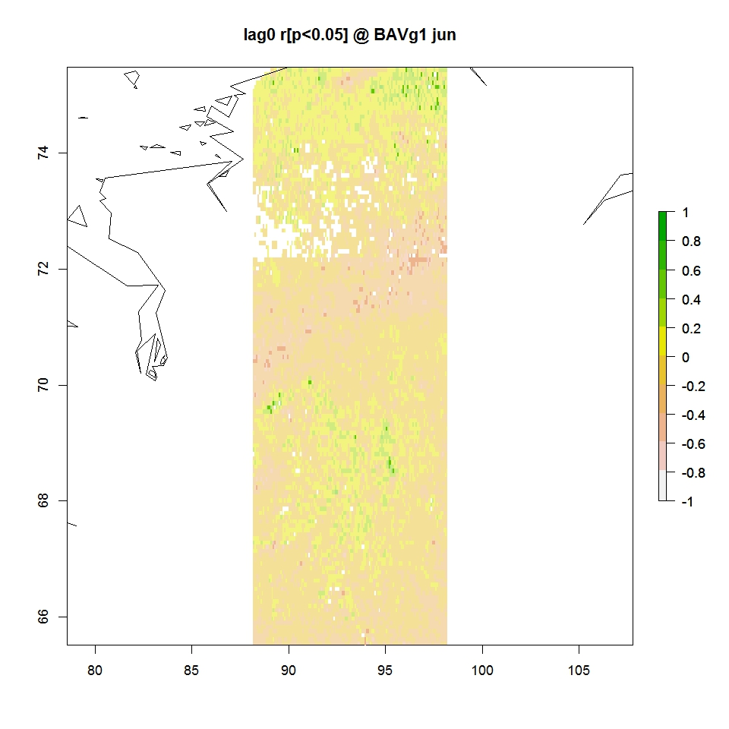
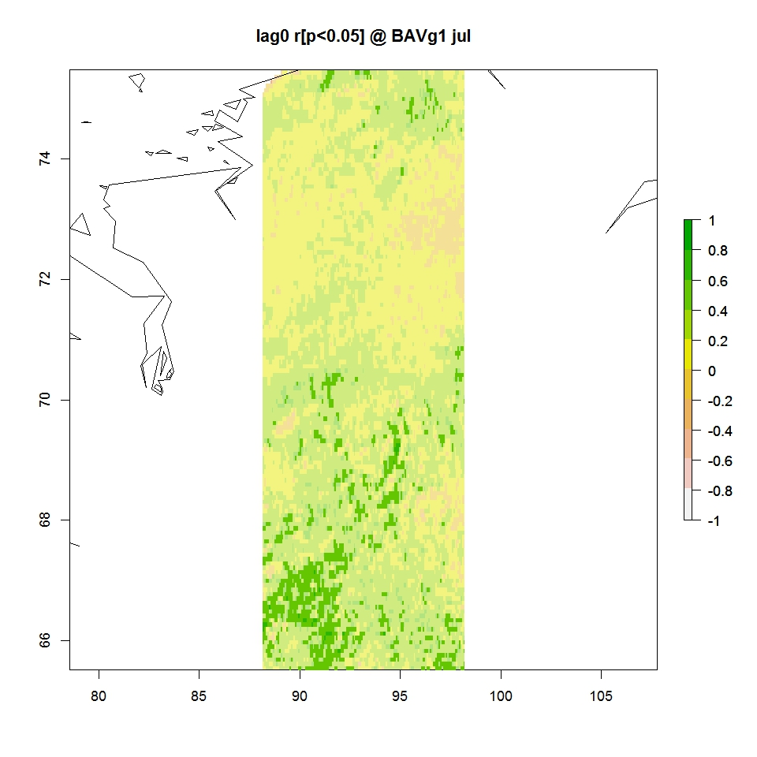
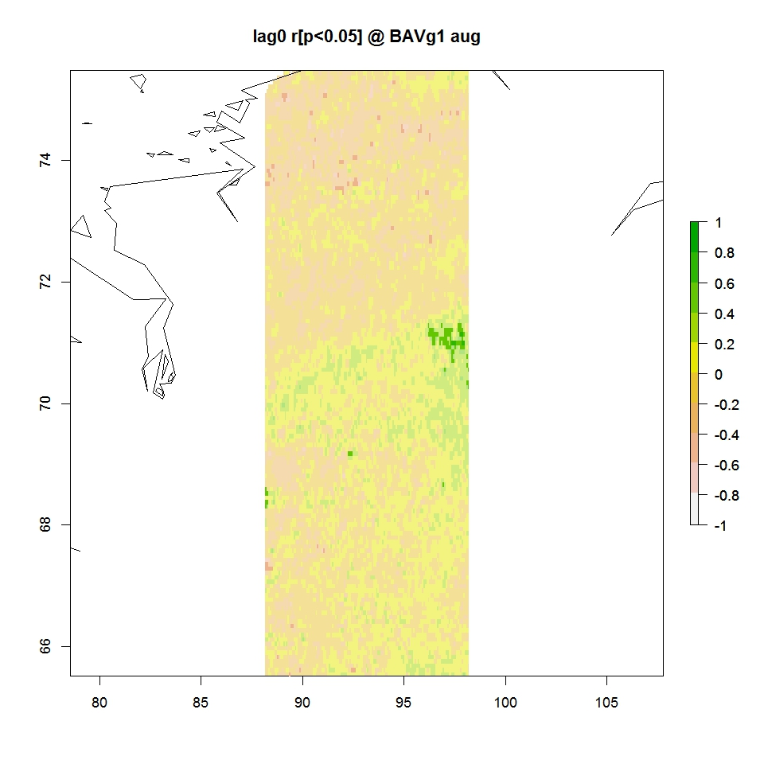
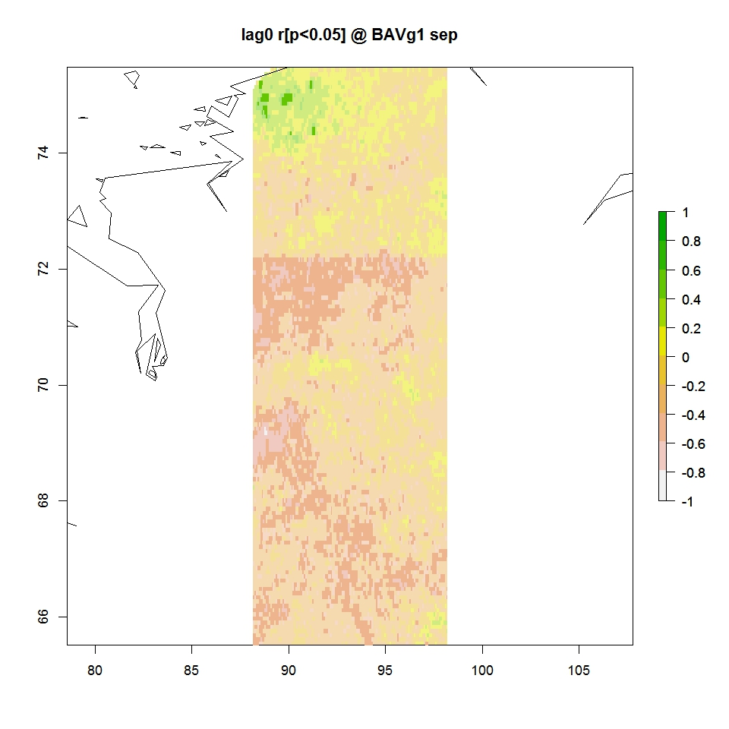
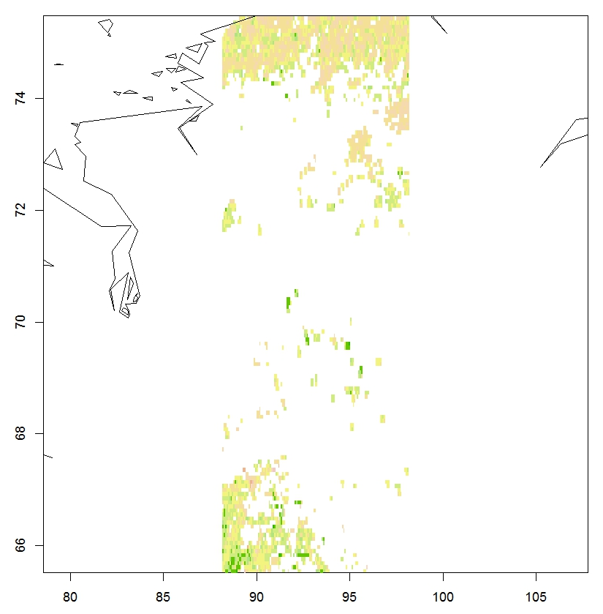
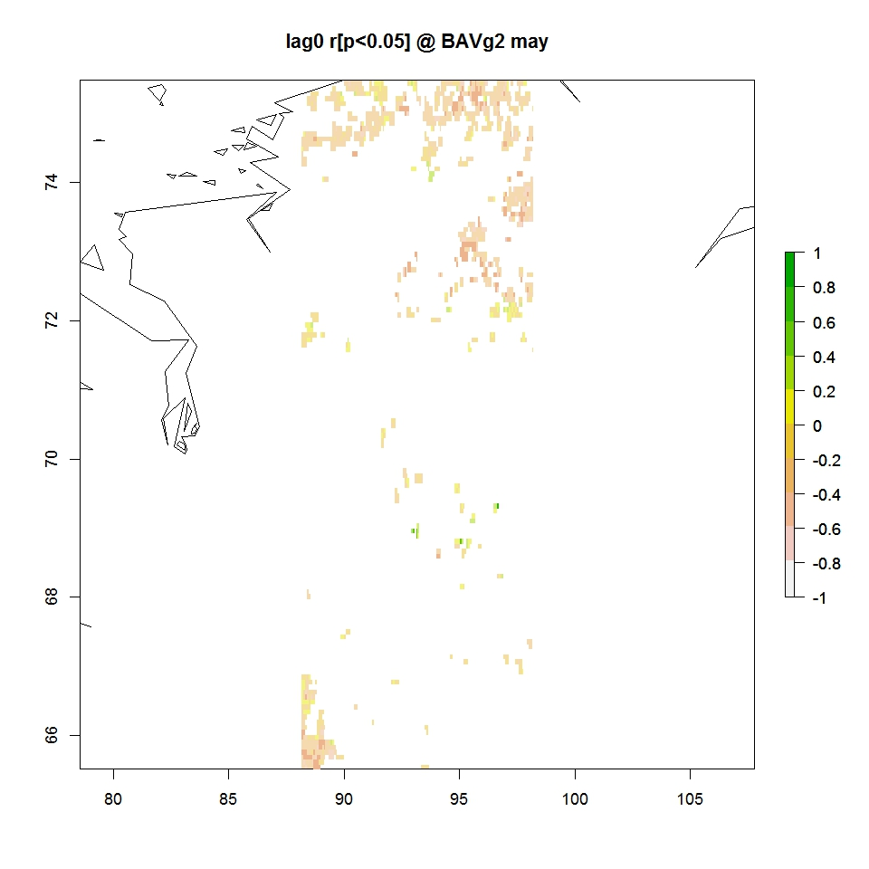
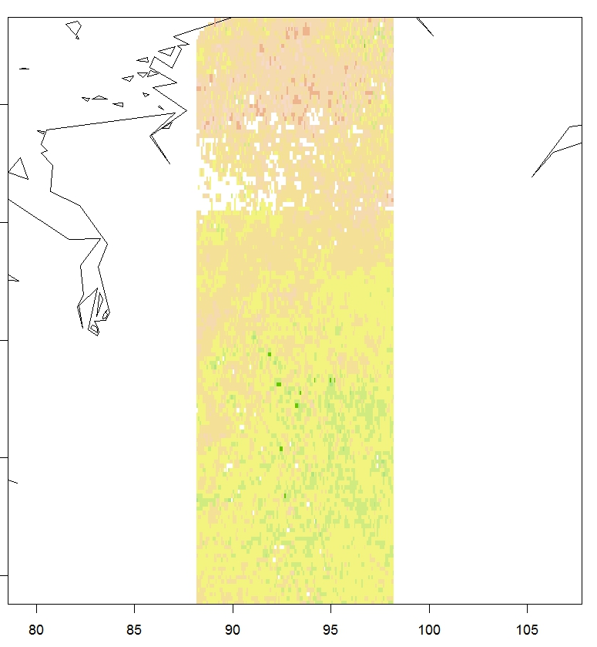
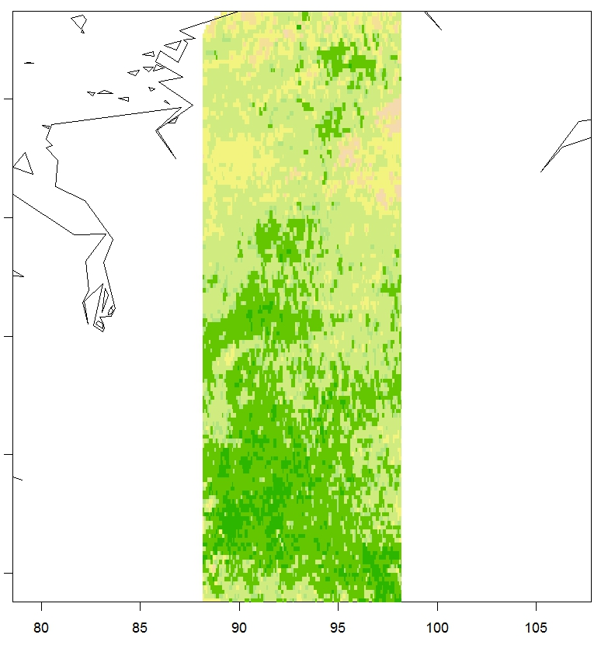
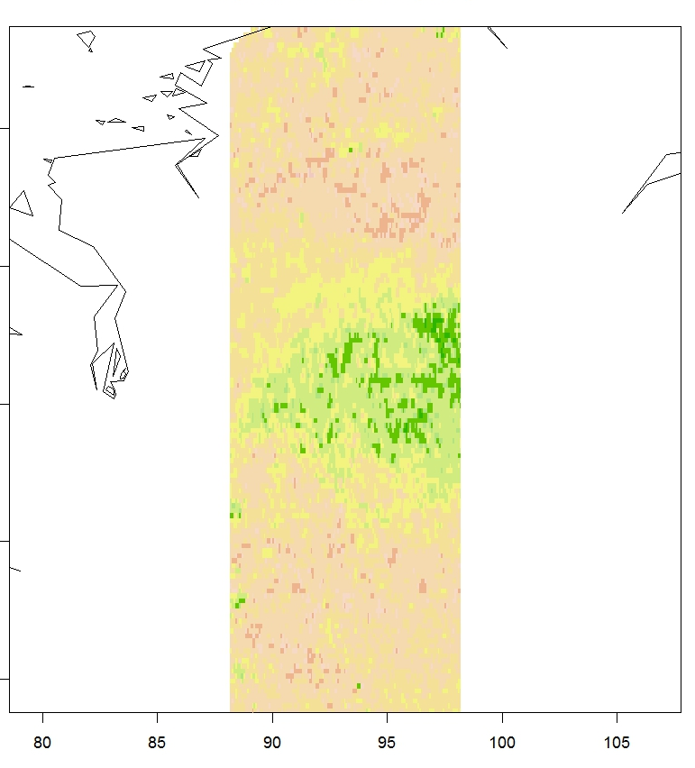
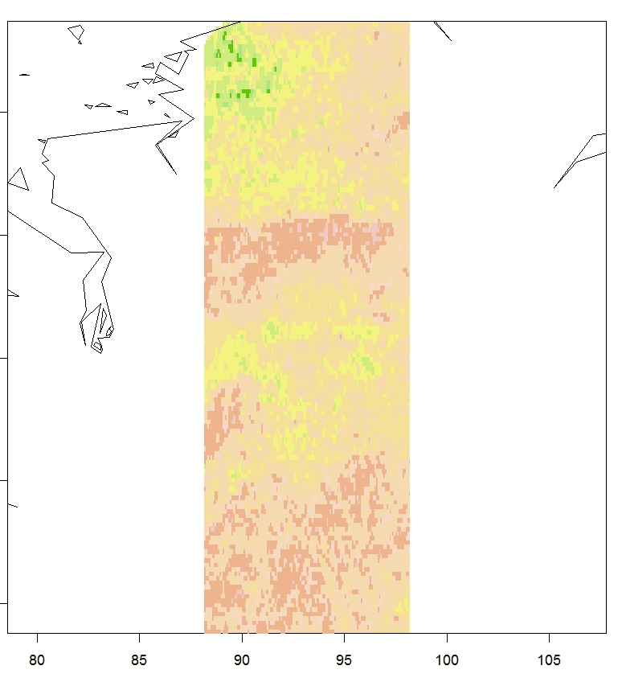
RING WIDTH
MAX LATE-WOOD DENSITY
April May June July August September
correlation
Correlation between NDVI (5 by 5 degree box) and Larix gmelinii tree-ring series at the Bolshoi Avam (BAV) site on the Taimyr Peninsula (70.5 degrees North, 93.2 degrees East, 360 meters a.s.l.), 1982-2002.

Slide 9
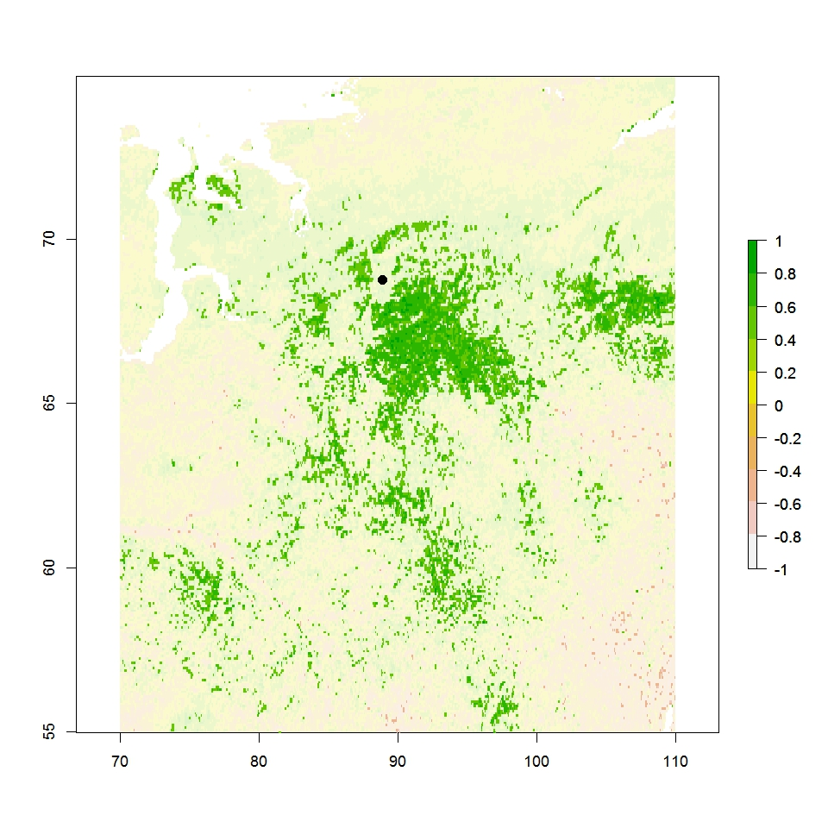
Correlation July NDVI vs 1st PC of tree-ring data from multiple sites, including BAV,
1982- 1998, p<=0.05
.
Centroid of site locations
r
20 degrees latitude by 40 degrees longitude
Ring width
Max latewood density
Site- and regional-level maximum density AND ring width reflect canopy conditions of large regions. Why the difference with Beck et al, North America?
Ring width and maximum latewood density remain strongly intercorrelated in Siberia (maybe a result of small rings), unlike Beck et al examples.
Spruce in Siberia behave as other conifers there, not as in N. America.

Slide 10
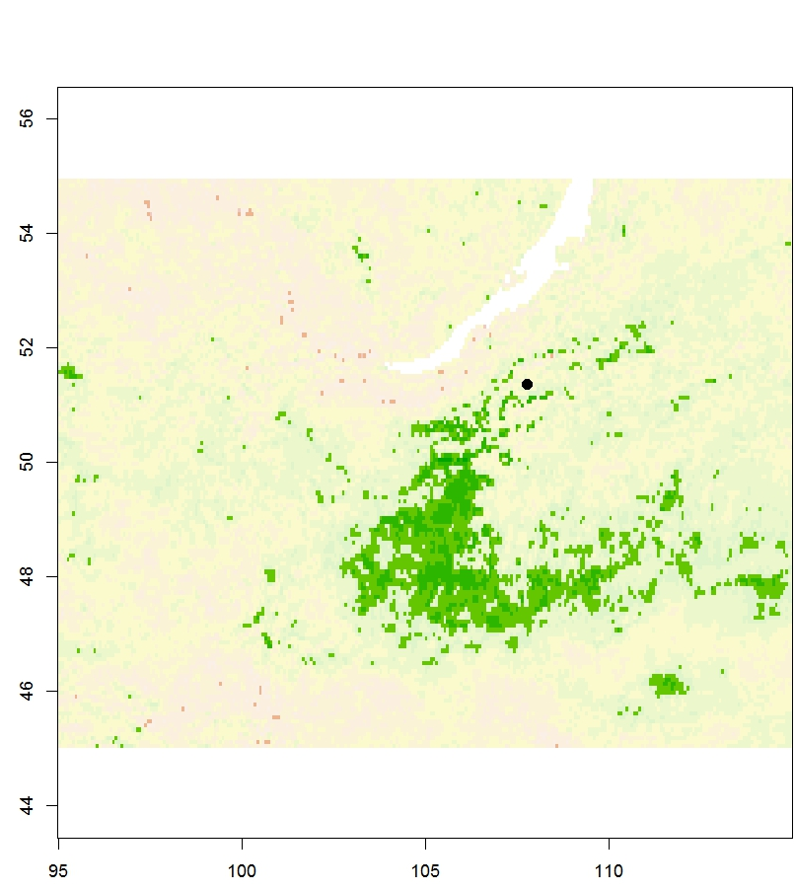
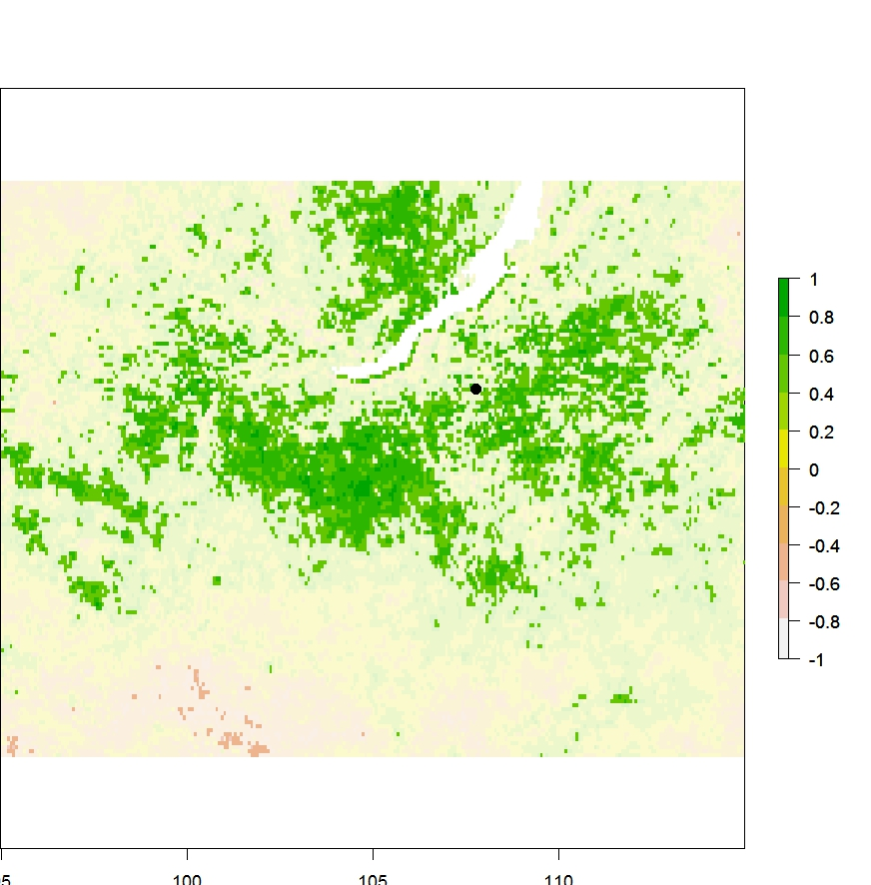
Correlation of NDVI vs 1st PC of tree-ring width data*, 1982- 1998, p<=0.05
.
Centroid of site locations
r
20 degrees latitude by 40 degrees longitude
June ring width
July ring width
*21 site collections of Pinus sylvestris south of Lake Baikal.
Site- and regional-level ring width reflects canopy conditions of a large semi-arid region 20 degrees south of the forest tundra.

Slide 11
The question
To what extent does NDVI (Normalized Difference Vegetation Index) observed from space co-vary with directly observed stem radial increment and maximum latewood density?
This week’s answer
At local level in Siberia, NDVI (usually July) covaries moderately but significantly well with both ring width (stem radial increment) and maximum latewood density.
Regional tree-ring width and density data sets covary significantly and coherently with NDVI over large regions.
The next question
What does this mean?

Slide 12
Correlations in previous studies
Malmström et al 1997
Alaska, one area, many trees 1982-1990, NDVI//TRW
Mixed spruce/birch 0.86
D’Arrigo et al 2000
Siberia (1 site), Alaska (2 sites) 1982-1990, NPP from CASA/FASIR//MXD
Larix gmelinii 0.79; Picea glauca -0.19-0.79
Lopatin et al 2006
Komi Rep., many trees 1982-2001, NDVI//TRW
Pinus sylvestris 0.27-0.57; Picea obovata 0.06-0.59
Berner et al 2011
Siberia (12 sites), Canada (10 sites) 1982-2007/8, NDVI//TRW
Larix gmelinii 0.08-0.57; Picea (abies, glauca/mariana) 0.16-0.75; Pinus banksiana -0.58-0.15; Pinus sylvestris 0.36-0.82
Beck et al 2013
Alaska/Canada (4 locations, very many trees) 1982-2001/4, NDVI//TRW/MXD
Picea glauca TRW – no consistent relationship; MXD – see next slide.

