Slide 1
Malcolm Hughes
6 February 2017
A mystery in the mountains

Slide 2

Great Basin bristlecone pine
the longest-lived tree species in the world (up to 4900 years – see sample on wall opposite elevator, 4th floor)
open stands, resistant to decay, cold, dry location
hence dead wood survives up to 11,000 years
Distribution from ~2800 to ~3600 m.a.s.l.

Slide 3
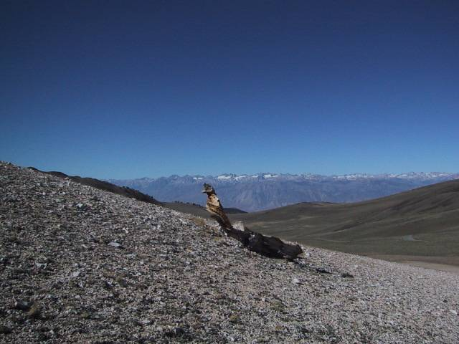
High
Cold
Dry

Slide 4
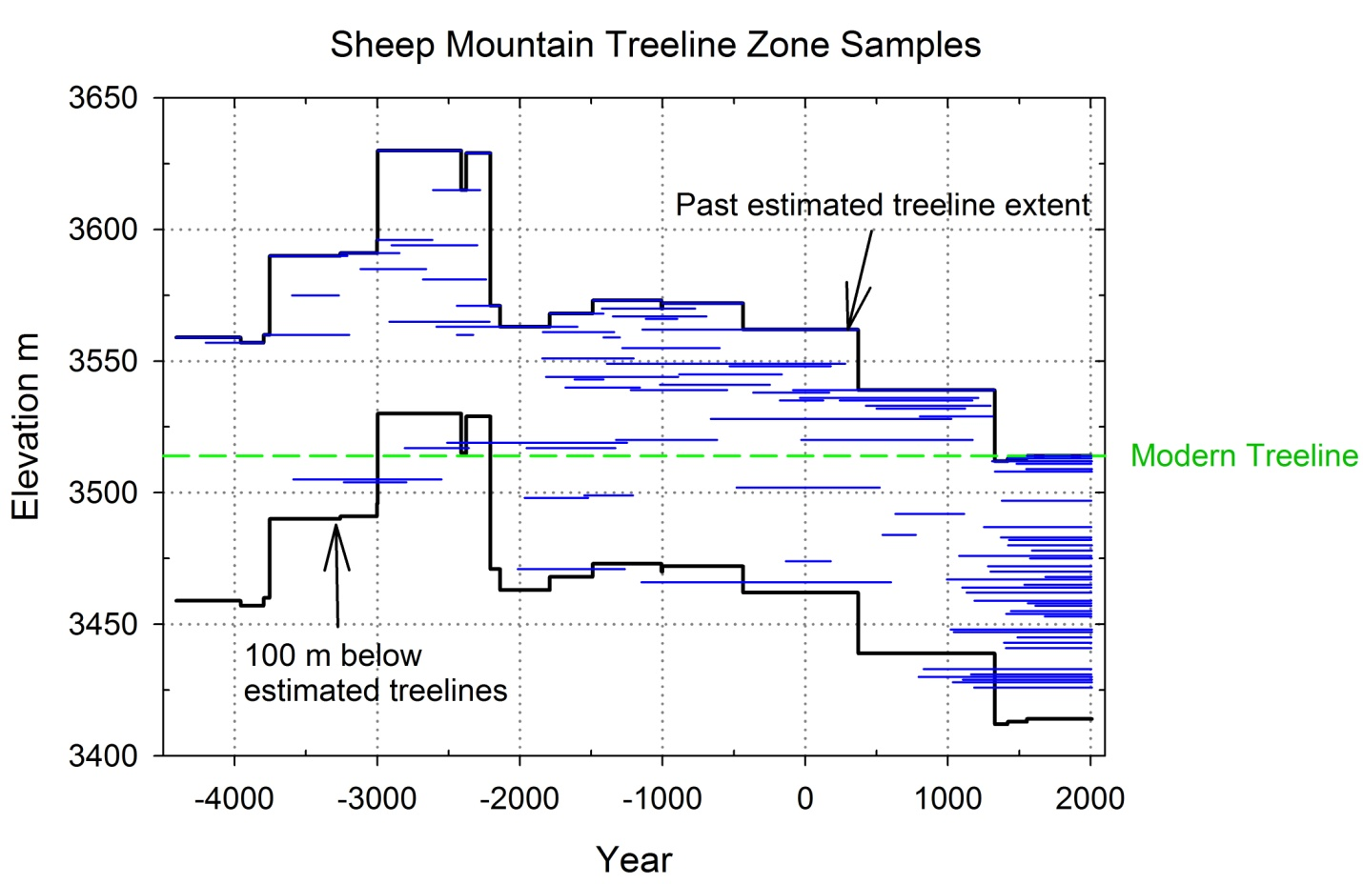
Wood samples from Sheep Mountain, CA - by dates and elevation.

Slide 5
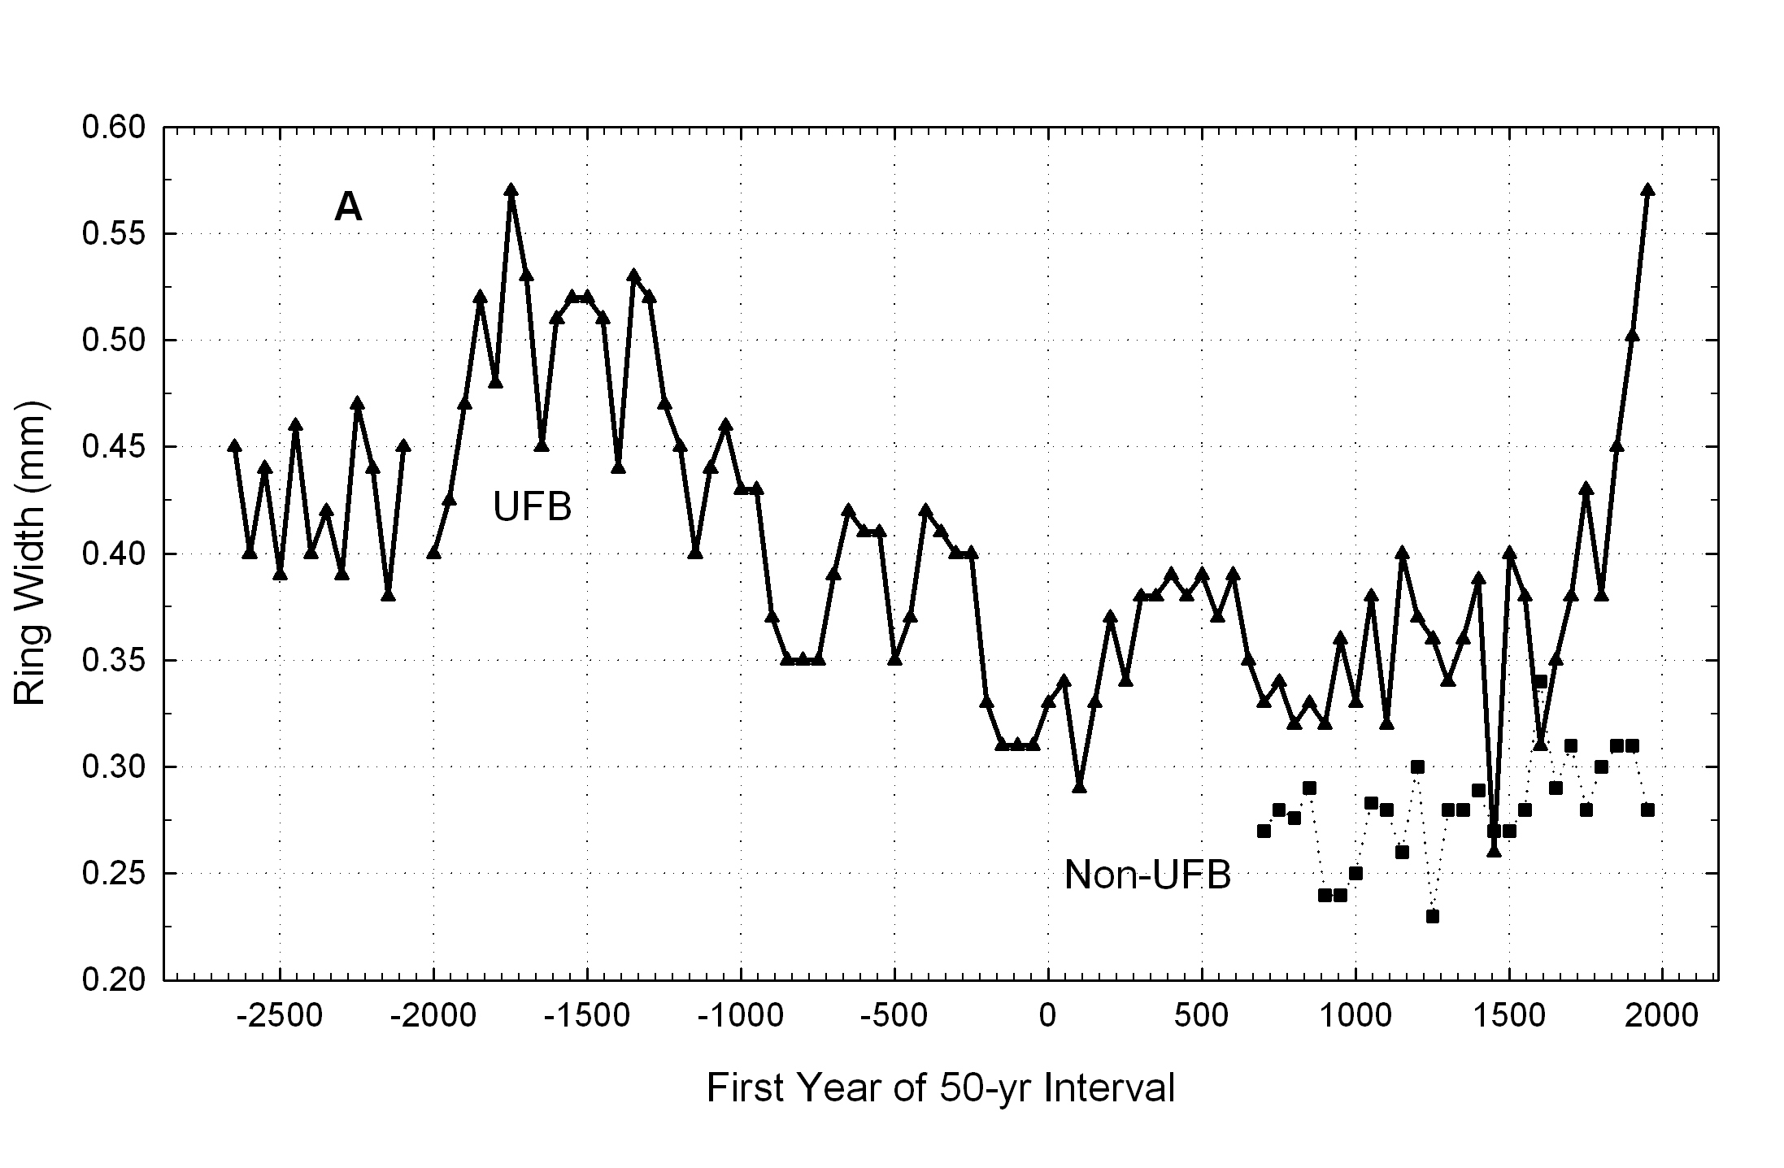
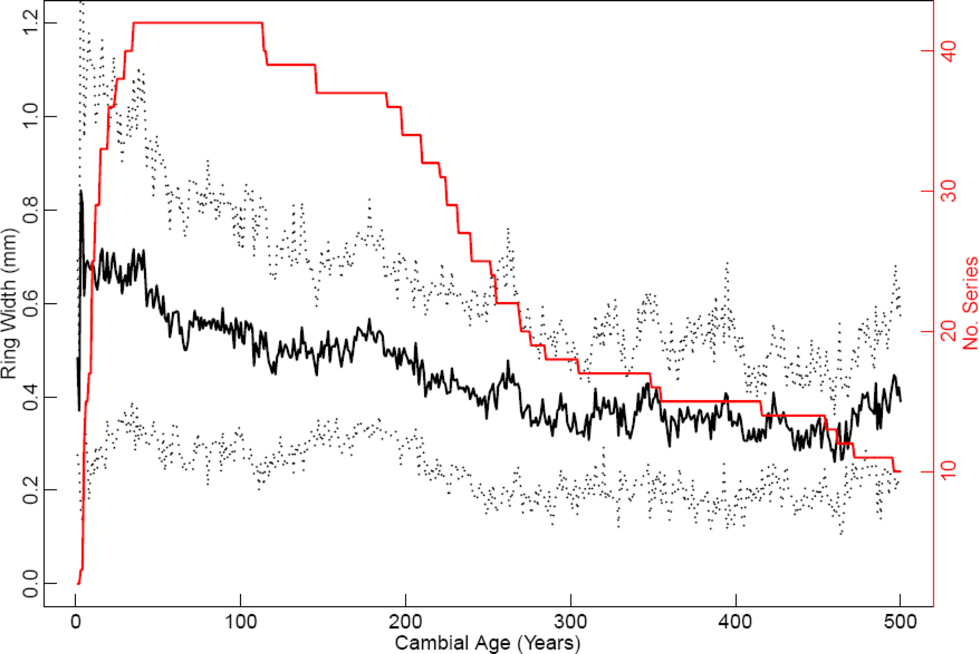
Salzer et al, PNAS, 2009
Median ring width for 50yr blocks
Sheep Mountain, Mt. Washington and Pearl Peak.
A
Ringwidth vs cambial age, black
UFB
Measurements per 50 yr
nnnn
Not so go
nnnnnnnnnn
i
Delete this if possible?
nonnonnonnonnnnnnnnnnn
This is it
BC
AD

Slide 6
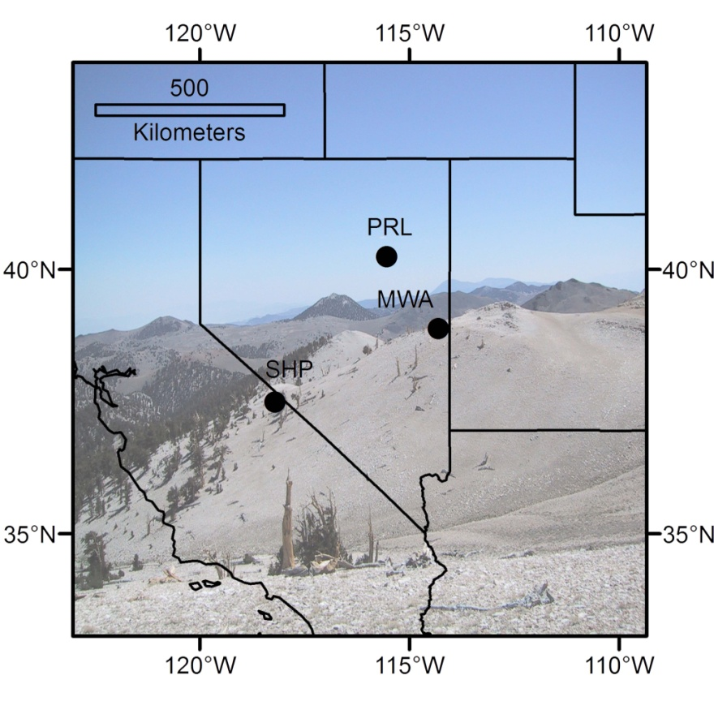
Acceleration associated with proximity to tree-line, NOT absolute elevation,
suggesting temperature influence.

Slide 7
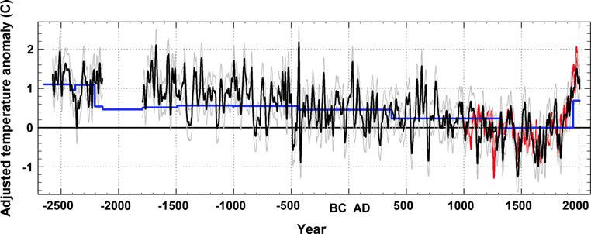
Late Holocene temperatures in the Great Basin, USA
Scaled paleotemperature anomalies from Great Basin, USA: blue is from treeline position, black from ring-widths (GB3rwi) ±1 RMSE (dotted) with trend from treeline position added up to AD 1328, red is ECHO-g climate model. Regional tree-line chronology 2575 BC – AD 2006 SSS>0.85 except for 2140-1795 BC.
Salzer et al, Climate Dynamics, 2013

Slide 8
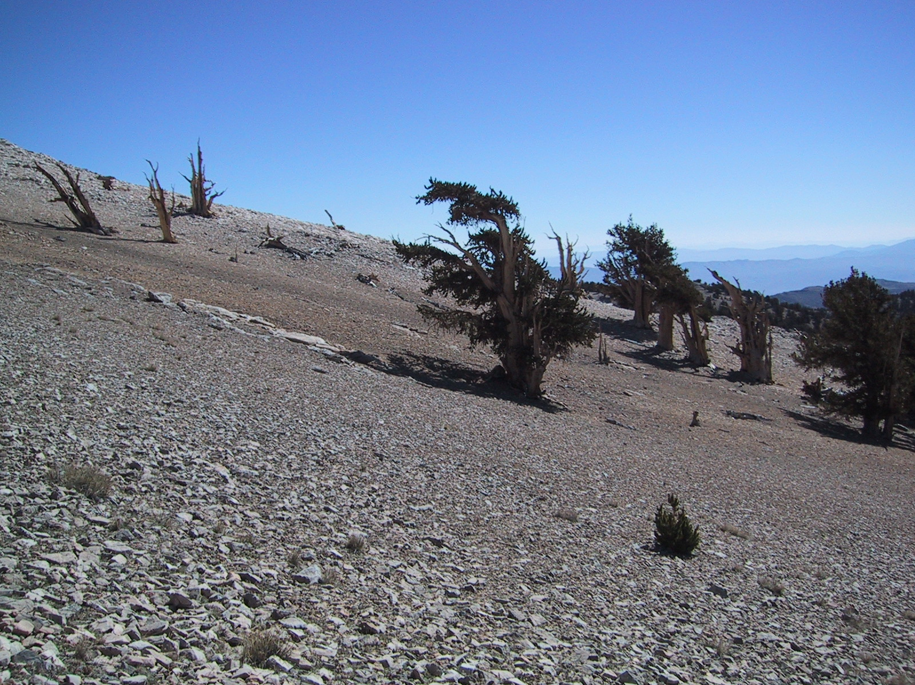
‘Is this really temperature’ OR
‘What caused this growth acceleration’?
650 vertical meters elevational transect

Slide 9
Elevational transect of Pinus longaeva tree ring width series in White Mountains, CA
Not consistent with pCO₂/WUE hypothesis
All on dolomite, within a few kilometers of one another.
All strongly replicated at least back to AD 1400
Salzer et al., PNAS 2009

Slide 10
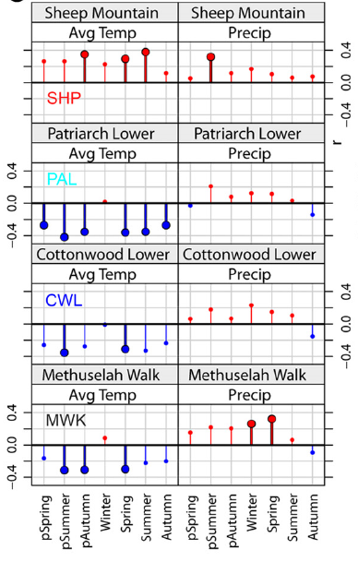
Abrupt change in sign of temperature relationship between 3300 and 3450 m. Not consistent with pCO₂/WUE hypothesis.
Seasonal correlations with PRISM data – interpolated monthly meteorological data, 4km resolution, since 1895.
r
Salzer et al., PNAS 2009

Slide 11
Matt has shown how this has been followed through, especially with greater spatial resolution and quantitative microclimate…..

Slide 12
Next steps - 1:
Will use these data to drive forward models of bristlecone pine tree-ring growth on actual landscapes.
Will test model output against actual TR data.
Will use results to improve use of these trees as climate archives, maybe inverting forward model…
Mechanisms matter, and can be the dendrochronologists’ friends.

Slide 13
Next steps - 2:
Prepare review of bristlecone pine dendrochronology and dendroclimatology (QSR?)
Drafting outline of book using bcp case histories as “antidotes” to “recipe dendroclimatology”.
Mechanisms matter, and can be the dendrochronologists’ friends.

Slide 14
THANKS FOR YOUR ATTENTION!

