Slide 1
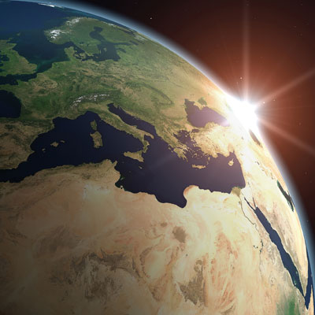
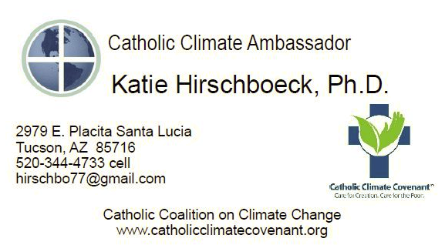
Climate Education and the Faith Community:
Catholic Climate
Ambassadors
ANREP Climate Science Initiative Webinar
1 November 2012 Katie Hirschboeck, PhD
Chair, Global Change Graduate Interdisciplinary Program &
Associate Professor of Climatology
Laboratory of Tree-Ring Research The University of Arizona katie@ltrr.arizona.edu

Slide 2
Outline
What is the Catholic Coalition on Climate Change & What is the Catholic Climate Covenant?
How did this Initiative Emerge from Catholic Teaching & the Church’s Response to Climate Change?
Being an Ambassador & How Faith Communities are Responding
Closing Thoughts: What I’ve Learned

Slide 3
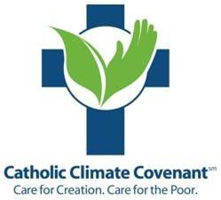
What is the Catholic Coalition on Climate Change ?
A membership organization of 25+ Catholic Partners formed in 2006:
U.S. Conference of Catholic Bishops USCCB Department of Justice, Peace and Human Development Migration and Refugee Services
Catholic Charities USA
Catholic Relief Services
National Catholic Rural Life Conference www.ncrlc.com
National Catholic Education Association
Association of Catholic Colleges and Universities
Catholic Health Association of the United States
Franciscan Action Network www.franciscanaction.org
Leadership Conference of Women Religious (vowed nuns / sisters)
Conference of Major Superiors of Men (vowed priests & brothers)
National Council of Catholic Women and others . . . .
Notes:
Explain the Catholic Coalition

Slide 4
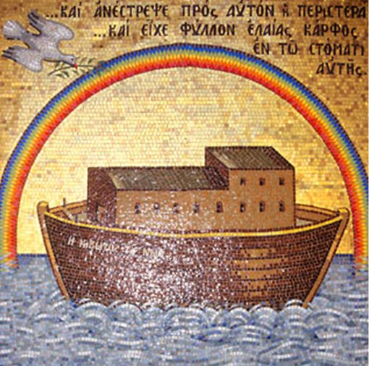
The Coalition is funded with generous assistance from:
The National Religious Partnership for the Environment
established in 1993
www.nrpe.org
The unifying scripture on the NRPE website:
This is the sign of the COVENANT that I make between me and you and every living creature
that is with you, for all future generations.
Genesis 9:12

Slide 5
What is the Catholic Climate Covenant?
“Care for Creation, Care for the Poor”
“After decades of steady progress in reclaiming and advancing the Catholic Church’s efforts to embrace an ethic of environmental stewardship,
the Catholic Coalition on Climate Change launched an unprecedented and historical campaign, the Catholic Climate Covenant . . .
to take RESPONSIBILITY for our contribution to climate change and do what we do best:
to be ADVOCATES for those who will be left out of the public policy debate on climate change.”

Slide 6
How this Initiative Emerged from Catholic Teaching & the Church’s Response to Climate Change
Rooted in . . .
Scripture
Long history of Church teaching, writings, statements, documents
Saints, scholars, popes, bishops St. Francis St. Hildegard of Bingen (newest “Doctor of the Church)
Harmony between Faith and Reason (St. Thomas Aquinas)
Affirmation of the value of Science (scientific advisory groups)

Slide 7
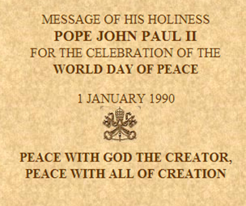
John Paul II’s message is often cited as a key moment in the emergence of the Church’s current faith-based advocacy for environmental responsibility . . . .
Pope John Paul II:
“Today the ecological crisis has assumed such proportions as to be THE RESPONSIBILITY OF EVERYONE”
Slides used in some of my Catholic Ambassador presentations

Slide 8
Followed by the U.S. Conference of Catholic Bishops’ compelling statement on the environment in 1991 . . .
Parish Resource
USCCB 1991

Slide 9
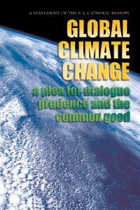
U.S. Conference of Catholic Bishops Statement on Climate Change (USCCB 2001)
Global Climate Change:
A Plea for Dialogue, Prudence and the Common Good
“We enter this debate not to embrace a particular treaty, nor to urge particular technical solutions, but to call for a different kind of national discussion.
Much of the debate on global climate change seems polarized and partisan.”

Slide 10
3 KEY GUIDING PRINCIPLES OF THE 2001 STATEMENT
PRUDENCE A thoughtful, deliberate, and reasoned basis for shaping our conscience and moving us to adopt courses of action to protect the common good
POVERTY The environment is God's gift to everyone, but the impact of climate change falls heaviest on the POOR – for whom we have a sacred obligation and moral responsibility
THE COMMON GOOD The earth's atmosphere encompasses all people, creatures, and habitats and we have a responsibility to be good stewards for the common good, right now . . . and for future generations

Slide 11
A Tone of URGENCY. . .
“Climate change poses the question
‘What does our generation owe to generations yet unborn?’ ”
“Passing along the problem of global climate change to future generations as a result of our delay, indecision, or self-interest would be easy.”
“But we simply cannot leave this problem for the children of tomorrow.”
— U.S Bishops, Global Climate Change: A Plea for Dialogue, Prudence, and the Common Good (2001)

Slide 12
Personal Conversion,
Assessment & Action . . .
“Finally, we wish to emphasize the need for personal conversion and responsibility”
Choices and lifestyles
Reexamine a culture that prizes the consumption of material goods.
Conserve energy, prevent pollution, and live more simply

Slide 13
Beyond the Personal to the Institutional . . .
Global climate change poses a greater threat to the integrity of creation than any other human–caused environmental problem. . . [it] cannot be managed through conventional government regulation: “It will require every person,
every business and
every institution to choose an alternative path . . .”
Care for Creation - A Franciscan Spirituality of the Earth (2008)

Slide 14
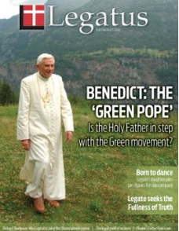
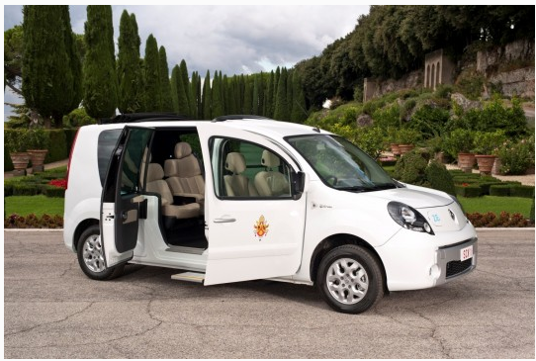
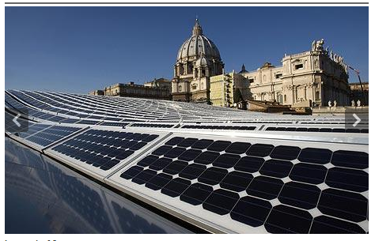
Pope Benedict XVI “The Green Pope”
“Before it is too late, it is necessary to make courageous decisions . . . . A decisive 'yes' is needed in decisions to safeguard creation as well as a strong commitment to reverse tendencies that risk leading to irreversible situations of degradation.” (2007)

Slide 15
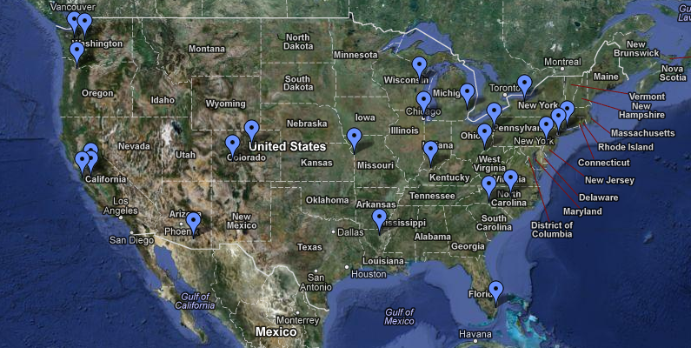
Being an Ambassador How Faith Communities are Responding
Goal of Ambassador Program is to raise the awareness of Catholics about Church teaching on climate change throughout the U.S.
Any Ambassador may be contacted to arrange a speaking engagement.
Locations of the 21 Ambassadors
catholicclimatecovenant.org/about-us/catholic-climate-ambassadors/

Slide 16
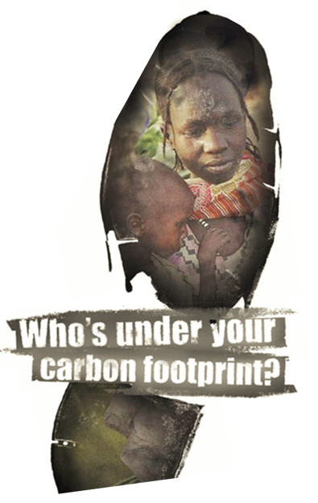
The message:
As faithful Catholics, we have a MORAL obligation to care for both Creation
and
the Poor.

Slide 17
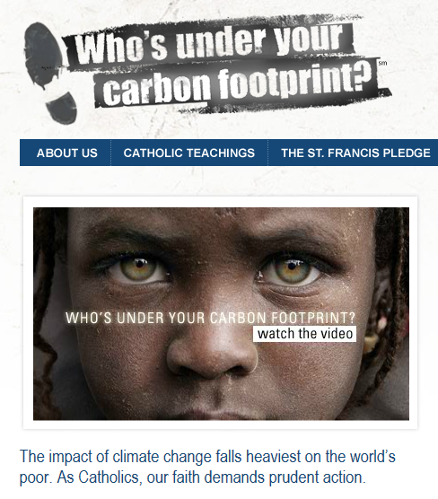
The video:
Can be viewed online at:
http://catholicclimatecovenant.org/

Slide 18
The pledge:
The Ambassadors are charged with promoting the Catholic Climate Covenant: The St. Francis Pledge to Care for Creation and the Poor.
Pray • Learn • Assess • Act • Advocate
PRAY & reflect about our duty to Creation and the poor
LEARN about Catholic teaching and climate change and educate others
ASSESS our contributions to the problem
ACT to change behaviors and choices
ADVOCATE on behalf of those without a voice
“Join Catholics taking action to reduce our carbon footprint and raise our voice
on behalf of Creation
and the poor.”

Slide 19
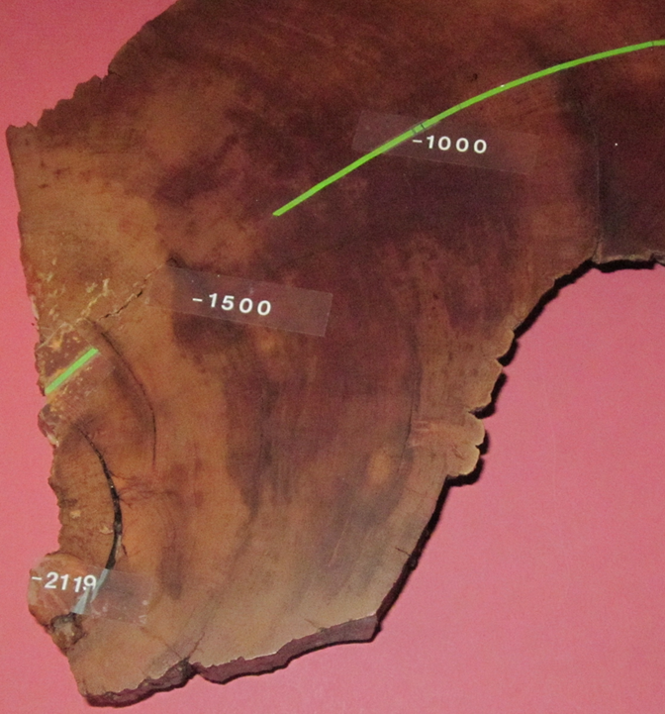
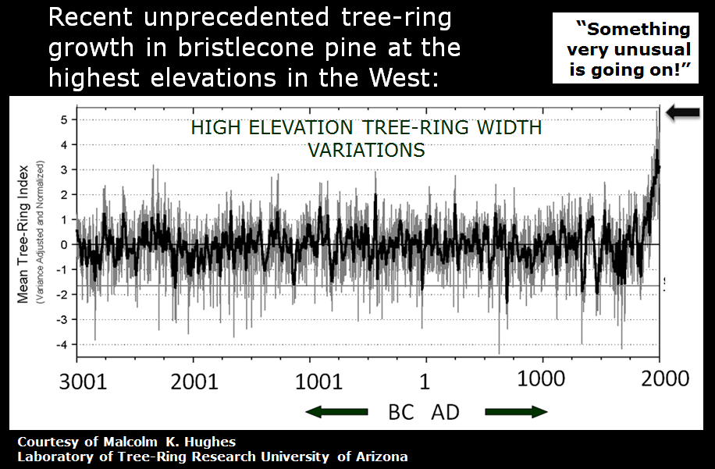
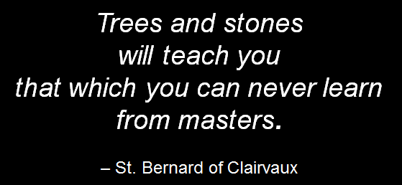
Begin with a story . . . .

Slide 20
Address the science . . . .
Slide used in my Catholic Ambassador presentation

Slide 21
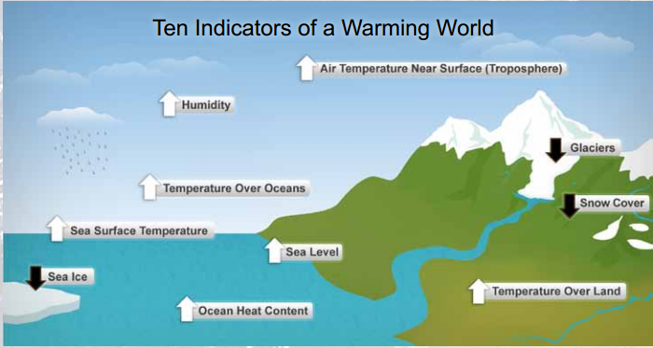
State What The Latest Science Tells Us . . .
State of the Climate Report (NOAA 2009)
Climate Change is real: - change has happened, - change is happening, - change will continue to happen
The Earth is warming
Humans are causing a significant portion of this recent warming
The warming will continue
Globally the net result will be bad for people, plants, and animals – especially those most vulnerable
There are legitimate unresolved questions
There are related -- but distinctly different -- global change processes of great concern: (e.g., biodiversity loss)
INDICATORS & EVIDENCE
Adapted from: SkepticalScience.com “The Big Picture”

Slide 22
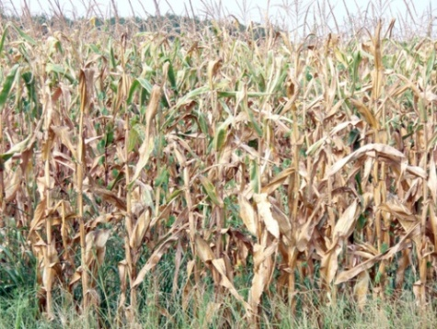
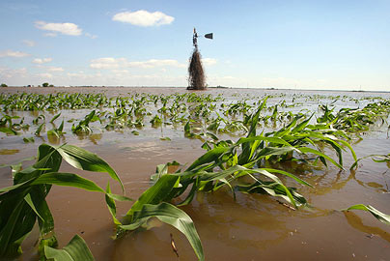
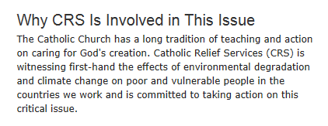
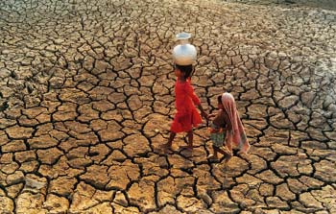
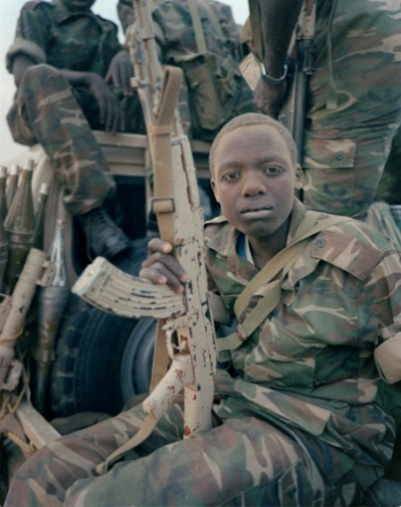
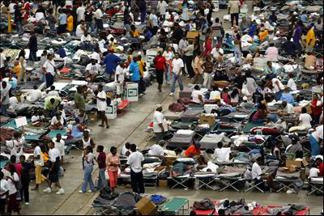
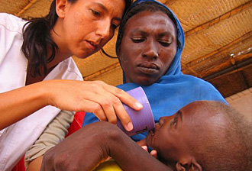
Link to a trusted source of “on the ground” observations . . .
Failed crops
Flooded crops
Environment-related migration
Water
supply
depletion
Conflict over scarce
resources
Vector-borne Disease

Slide 23
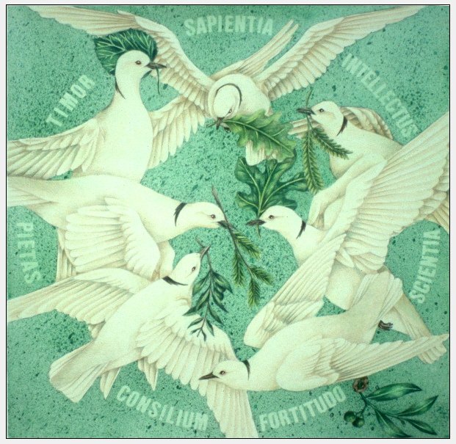
Highlight meaningful faith-based “tools” for grappling with the issue . . .
Wisdom
Understanding
Awe
Piety
Knowledge
GIFTS of the HOLY SPIRIT
Counsel
Fortitude

Slide 24
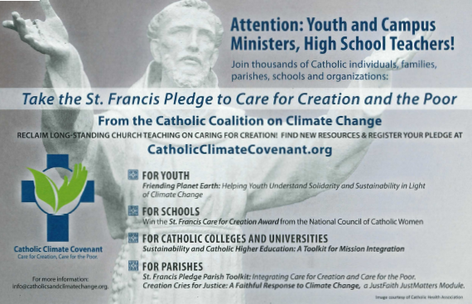
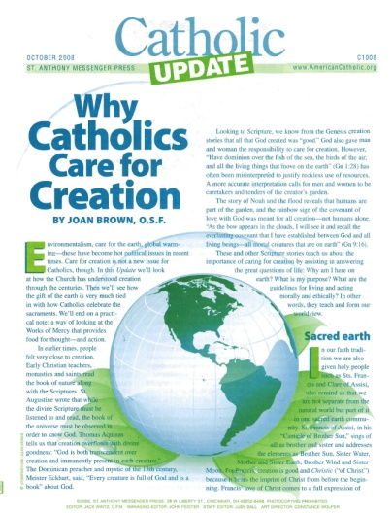
Provide resources for Assessment, Action & Advocacy . . .
CatholicClimateCovenant.org
Join others by taking the St. Francis Pledge and registering your commitment at http://CatholicClimateCovenant.org
Encourage others (family, parish, school, arch/diocese) and promote the St. Francis Pledge - see Planning Guide for Promoting & Taking the St. Francis Pledge at: http://CatholicClimateCovenant.org/resources
Sign up to receive weekly Coalition emails at http://CatholicClimateCovenant.org
Connect on social networks, call or email

Slide 25
How Catholics are responding to this issue:
Survey Item | Agree | Disagree
Climate Change is a serious problem It must be addressed NOW | 55% 58% | 22%
Human activity is contributing significantly to climate change | 60% | 21%
Zogby International Poll (March-April 2009)
1000 U.S. Catholics surveyed
“More than 2/3 believe that even though we don’t know everything about climate change, it is important to act now so the problem does not worsen”
What Catholics Say About Climate Change (2009)
catholicclimatecovenant.org/wp-content/uploads/2009/04/surveryreport1.pdf

Slide 26
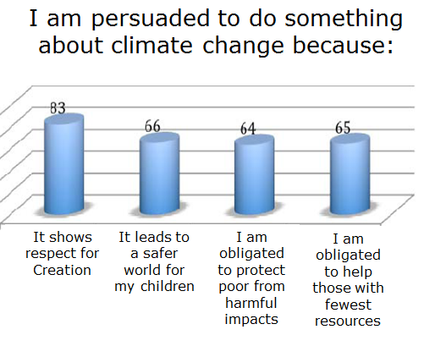
Motivation for Action . . .
What Catholics Say About Climate Change (2009)
catholicclimatecovenant.org/wp-content/uploads/2009/04/surveryreport1.pdf

Slide 27
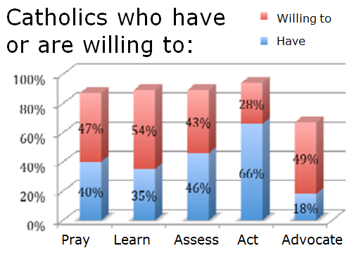
Openness to the goals of the St. Francis Pledge . . .
What Catholics Say About Climate Change (2009)
catholicclimatecovenant.org/wp-content/uploads/2009/04/surveryreport1.pdf

Slide 28
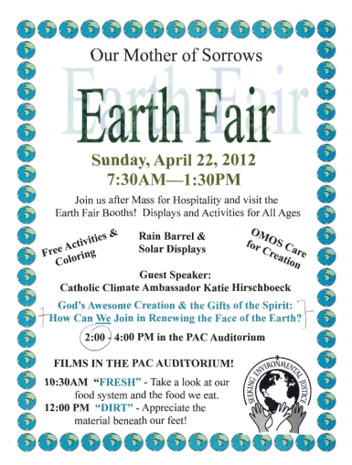
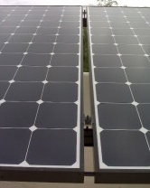
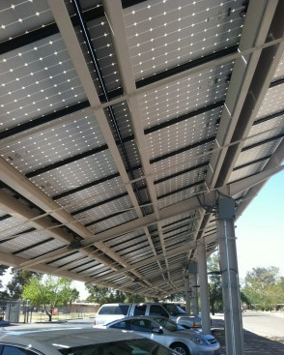
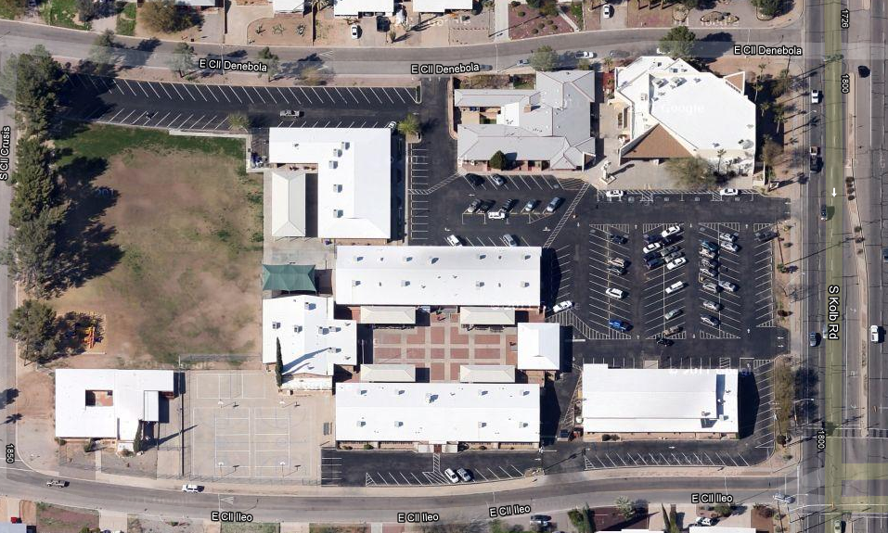
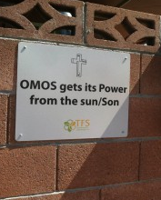
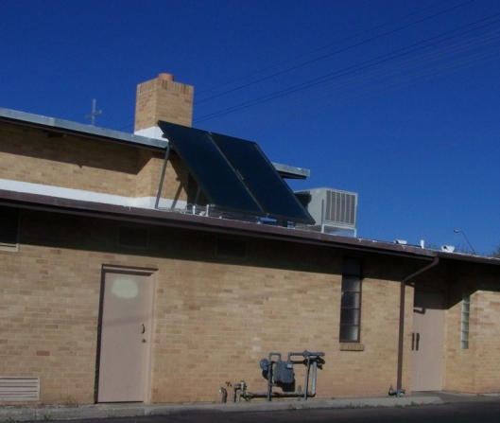
What some faith communities are doing:
CARE FOR CREATION COMMITTEES & ACTIVITIES in parishes, schools, etc.
Our Mother of Sorrows Parish, Tucson AZ
Solar Installation

Slide 29
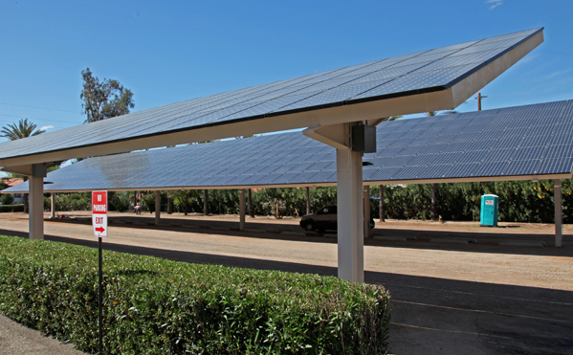
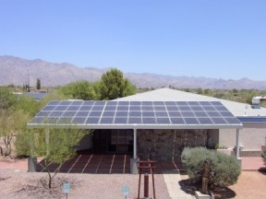
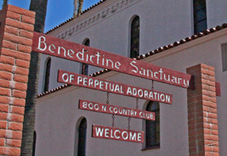
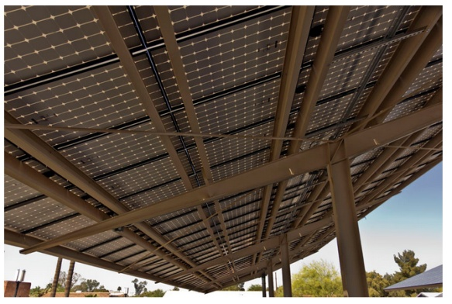
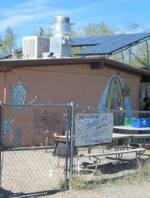
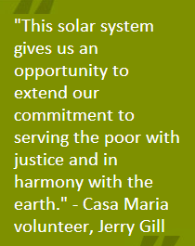
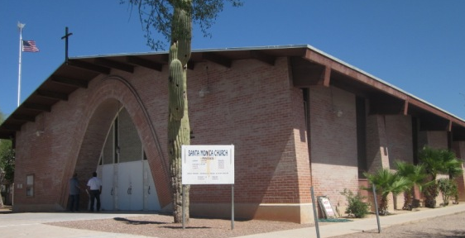
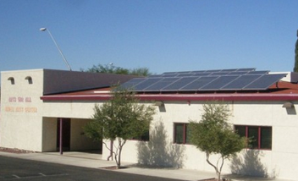

Slide 30
Closing Thoughts:
What I’ve Learned

Slide 31
Climate Change: Issue still not at the forefront of priorities for most faith communities; local leadership is essential; momentum builds slowly
What Works: The ideal – a welcoming pastor, committed staff, teacher, and/or passionate parishioners; committee with diverse backgrounds and talents
Connect Beyond the Science: Don’t overwhelm with the science; rather find a way to link with everyday life, concerns, deeply held values, foundational beliefs, love of Nature, awe for God’s Creation
Freshness: Find a way to spark new insights that are not being raised in other forums (news, media, etc.)
Be positive . . . and HOPE-filled!

Slide 32
What the Faith-Based approach can bring to the CLIMATE CHANGE ISSUE:
Taps Deeply Held Values & Beliefs
Touches the Human Heart
Promotes the Common Good
Recognizes that Sacrifice is Involved
PRAYER CONVERSION ACTION HOPE

Slide 33
QUESTIONS?

Slide 35
For the DISCUSSION, as needed . . .

Slide 36
Training Guidance for Ambassadors Notes from Ambassadors’ Training Weekend
Begin w/ people’s faith, authenticate what we believe, play to Church’s strengths – view thru eyes of faith; accept what scientific community says; advocate prudence
Watch your language: “worldview” instead of cosmology, etc.
Use Creation as the focus, refer to climate change, not global warming
Take questions and objections seriously; no condescension
Stay on message; don’t get sidetracked (energy bills, etc.)
Use stories
Be confident but humble; be principled, but not ideological
Do everything we can to diminish polarization around issue
Strive to take people from FEAR ➔ FAITH ➔ HOPE

Slide 37
Training Guidance for Ambassadors (cont.)
Some critiques and questions are really avoidance of responsibility (e.g., isn’t this issue just about environmentalists trying to “make a buck?”)
Population issue: Some environmental groups claim “People are the problem” and see each new child as a “planet pest;” Catholic position: “The actions of people are the problem” It is our U.S. consumption level that is unsustainable.
Don’t over rely on a didactic / lecturing approach that emphasizes guilt; rather emphasize “our common dilemma” e.g., we didn’t arrive at this nefariously, some decisions in the past were honest choices, only with hindsight do we now understand the severe consequences”
Bend over backwards to enlist everyone on this issue
Stress the positive things out there!

Slide 38
The Catholic Contribution to the Climate Change Discussion
Notes from Ambassadors’ Training Weekend:
The role of the Church in public life is to form consciences
Roman Catholicism has a different way of looking at the world; we (the Catholic Coalition) are not “the Sierra Club at prayer;” we are Catholics doing what Catholics do best : - a very comprehensive approach, i.e., “Both/And” - not “trendy”-- what we bring is old, deep and important, - must connect to reason: Faith and Reason - key principle is emphasis on Human Life & Dignity
Prudence + Poor + Common Good “What could be more common than the climate?”
“Church makes the conservative case for Climate Change”
Church teaching exposes false choice between economics & climate change; every economic decision has moral consequences; it’s economically foolish to ignore climate change & economically wise to conserve at home; want good economics & good morality to converge

Slide 39
The Catholic Contribution to the Climate Change Discussion (cont.)
Church looks at climate change from the bottom up: how it affects the most vulnerable; Catholic Relief Services has a presence everywhere the global poor reside; gives a unique credibility
Catholics understand sacrifice: Sacrifice: “to make holy;” it’s about “making sacred.” We are doing this because we desire to be holy; be transformed; “this issue needs some sacrifice from me; it won’t get better w/o sacrifice ( “a very LONG Lent!”)
People may think the Church’s focus on the Poor is a “sideline issue,” but without a serious plan to help poor countries adapt to climate change, adaptation will not ever be able to happen globally. The issue of the Poor is central to the discussion.
Problem of “Light bulbs vs. Catholic Social Teaching”: pretty soon this issue turns into a discussion about facilities and the CST piece gets lost. “We have to move beyond switching light bulbs to concern over those who don’t have any!” Always connect what we are doing to global solidarity.

