Slide 1
Earth-Sun Relationships

Slide 2
Key Concepts
Insolation: The solar radiation incident on a unit horizontal surface at the top of the atmosphere.
Essentially, the incoming solar radiation that reaches the earth and the atmosphere.
Two factors that determine the amount of solar insolation depending on the season and its progression are intensity and duration.
Intensity of the sun’s ray: this depends on the tilt of the earth’s axis and the point at which the earth is intercepting the sun’s rays.
Duration of daily insolation (the day’s length): This depends on where the circle of the sun’s light is intersecting with the earth’s latitude band.

Slide 3
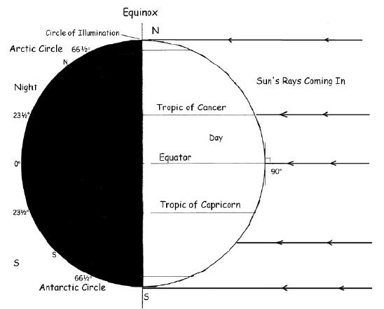

Slide 4
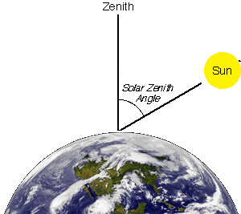
Key Concepts
Zenith is the point directly overhead.
Intensity is greatest at any spot on earth when the sun is closest to the zenith.

Slide 5
Equinox and Solstice
The equinox occurs twice a year and is a day in which the sun crosses the equator and day and night span a fairly equal amount of time, all across the globe.
The solstice occurs twice a year, the summer solstice in the Northern Hemisphere occurs about June 21, when the sun is in the zenith at the tropic of Cancer, and is the longest day of the year. The winter solstice occurs about December 21, when the sun is in the zenith at the tropic of Capricorn, and is the shortest day of the year.

Slide 6
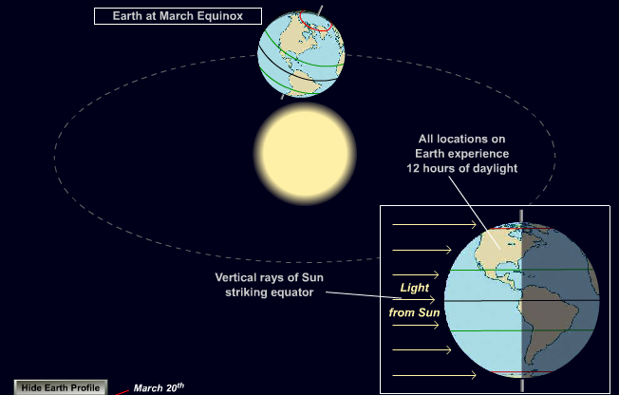
Vernal Equinox

Slide 7
June Solstice
During the June solstice the Northern Hemisphere receives more sunlight than the Southern Hemisphere
This Solstice marks the beginning of summer in the Northern Hemisphere and is the longest day of the year

Slide 8
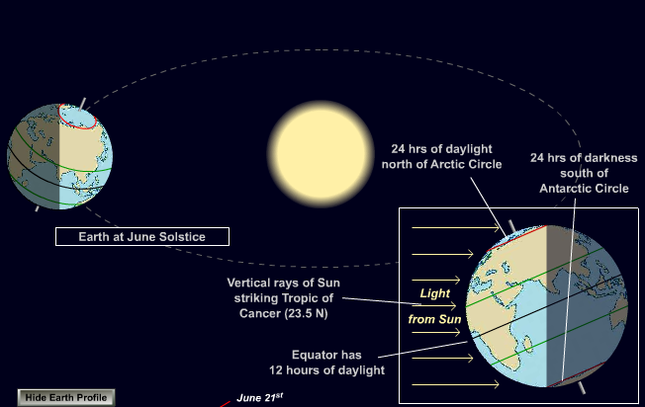

Slide 9
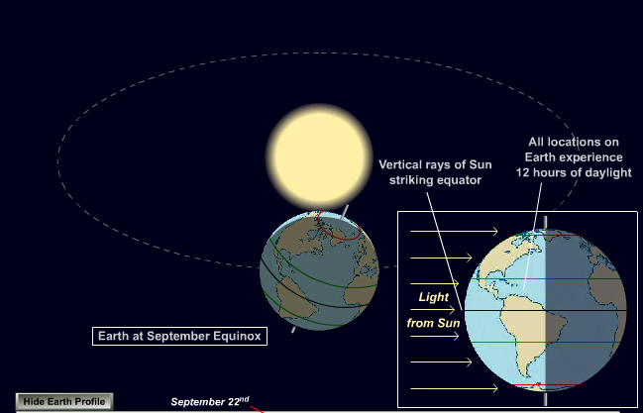
Autumnal Equinox

Slide 10
December Solstice
During the December solstice the Southern Hemisphere receives more sunlight than the Northern Hemisphere
This solstice marks the beginning of the winter in the northern hemisphere and is the shortest day of the year

Slide 11
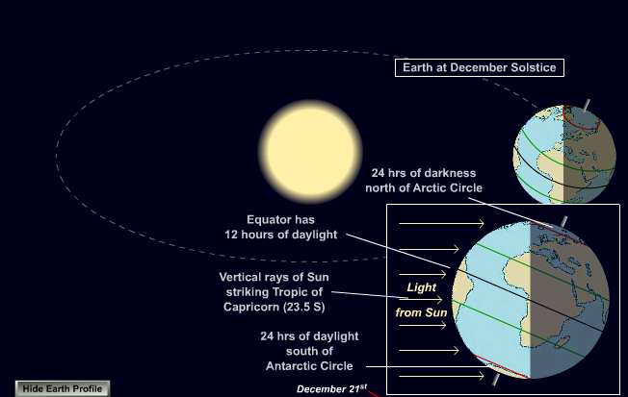

Slide 12
In Action. . .
How Equinox's Work - Beyond Our Earth

Slide 13
Quiz Time!
Q1: What portion of the earth receives 24 hours of darkness during the June Solstice?
A – The Arctic circle
B – The equator
C – The Antarctic circle

Slide 14
Q2: At what time of the year does the vernal equinox occur in the Northern Hemisphere?
A – Spring
B – Summer
C – Fall
D -- Winter

Slide 15
Q3: During the December solstice what in the day is effected?
A – It is the shortest day of the year
B – It is the longest day of the year
C – It is equal day and night

Slide 16
Q4: Where is the Sun’s light hitting the Earth most during Equinox?
A – The tropic of Cancer
B – The tropic of Capricorn
C – The Equator

Slide 17
Critical Thinking. . .
Q5: During the June solstice if the sun’s insolation is greatest in the tropic of cancer, what season is it in Brazil?
Work with your group to write a response and give evidence for your answer.

