Slide 1
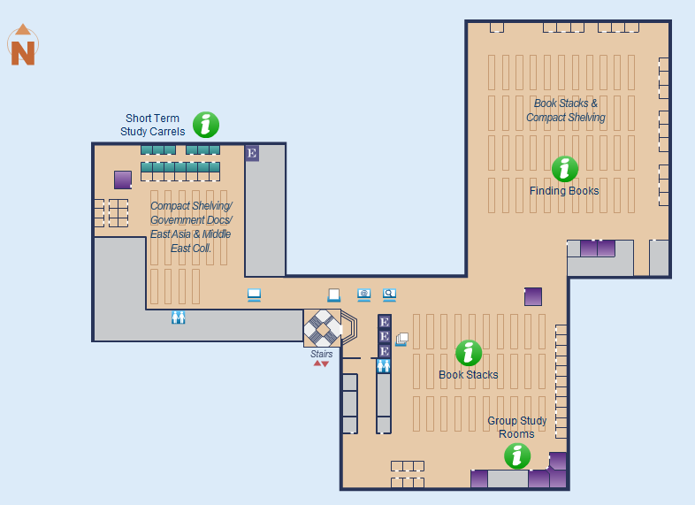
MAIN LIBRARY – 3rd Floor
A-315

