Slide 1
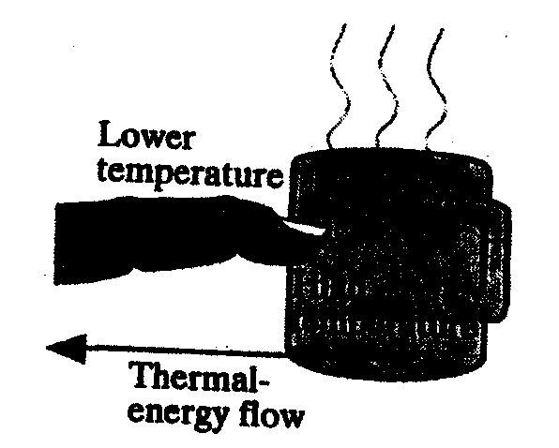
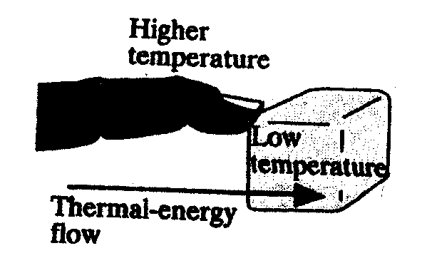
Michael Van Liew Group #18
What is the effect of sealing up one’s home’s cracks and leaks, how and why doing so is energy efficient?
#9 Laws of Thermodynamics
Sealing your House can save
you 30% on your heating and
cooling bill
(U.S. Department of Energy)

