Slide 1
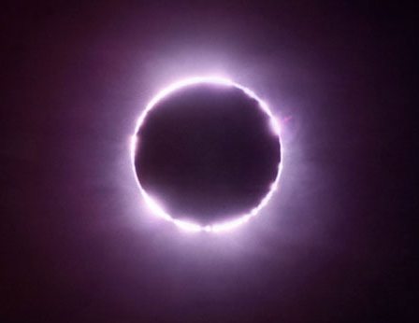
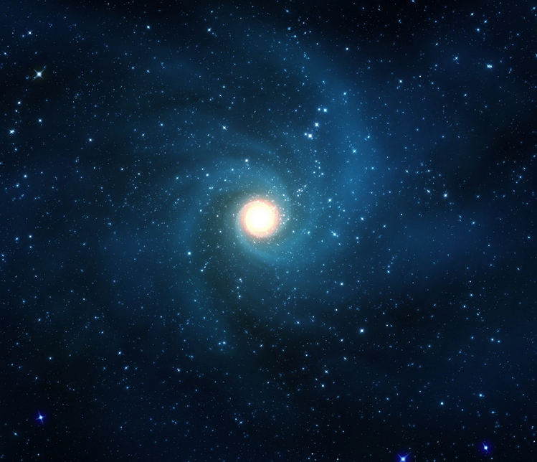
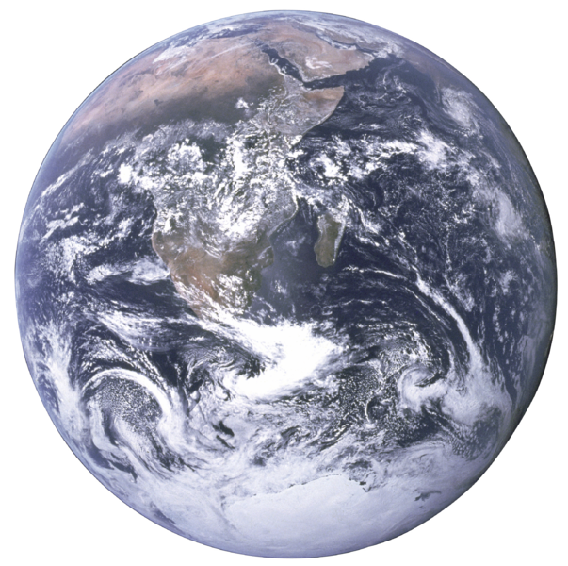
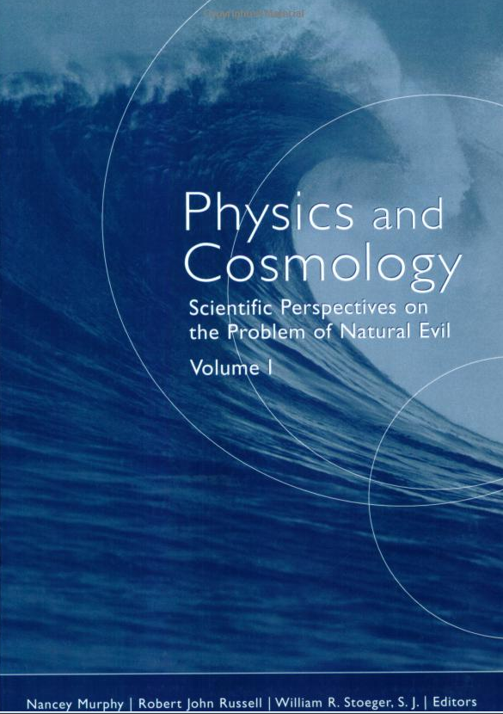
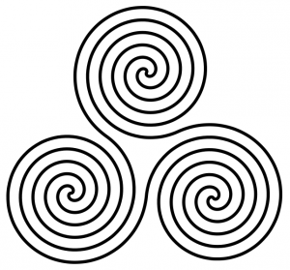
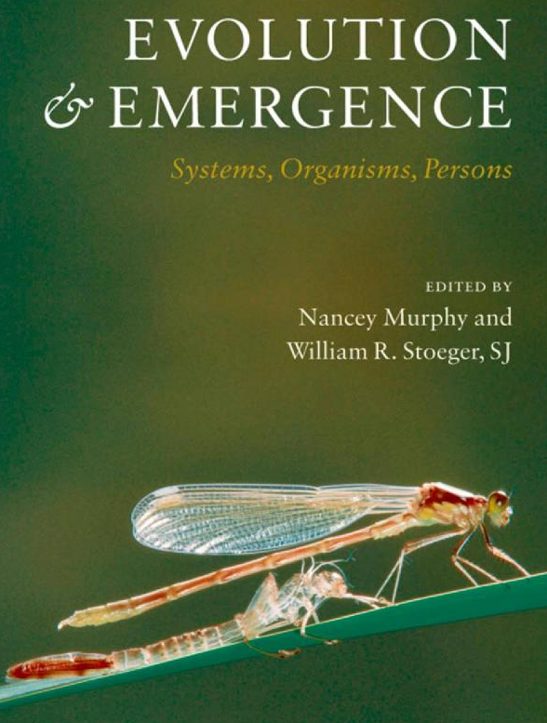
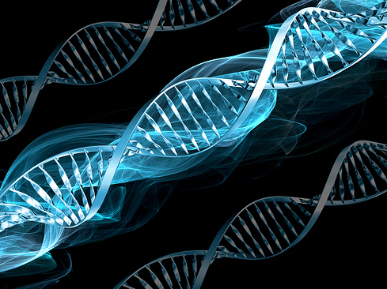
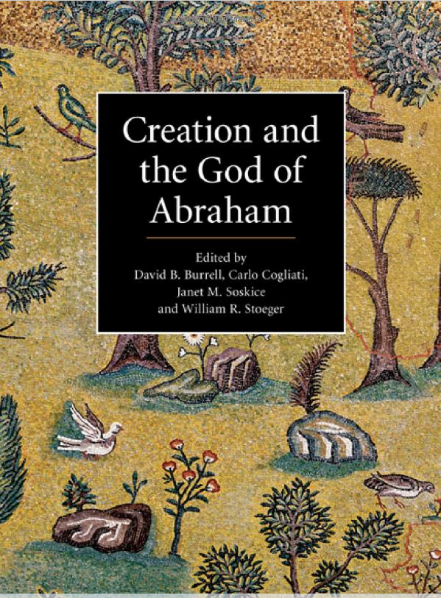
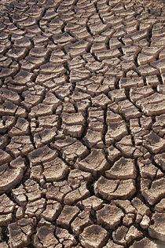
THE
GOD PARTICLE?
Do SCIENCE, FAITH & SPIRITUALITY MIX? THE St ALBERT
THE BIG BANG?
Sessions are held at the St Thomas More Catholic Newman Center on select Thursday evenings from 7:30 – 9:00 pm
Are you curious about how scientists reconcile their science with their faith?
Would you like to deepen your spirituality by probing the wonders of our world through scientific insights?
Science, FAITH & spirituality sessions
GLOBAL WARMING?
COSMOLOGY?
What does the Church say about the pressing science issues of our times?
THE BRAIN?
Do you wonder what your professors believe about God?
MEDICAL ETHICS?
BIOETHICS?
EVOLUTION?
JOIN US FOR thought-provoking PRESENTATIONS & DISCUSSIONS
ALL ARE WELCOME! students  professors  scientists  non-scientists all interested members of the community
CLIMATE CHANGE?
MIRACLES?

