Slide 1
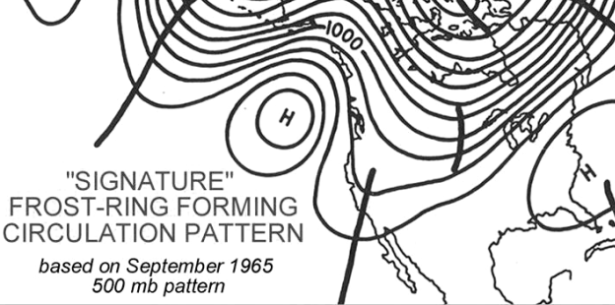
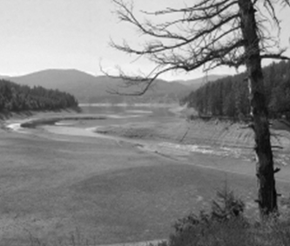
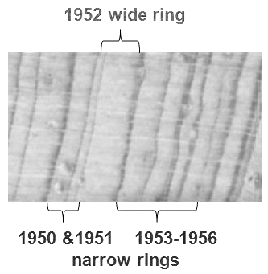
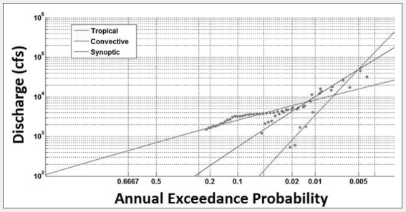
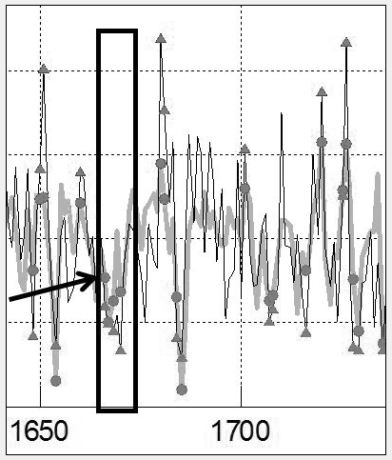
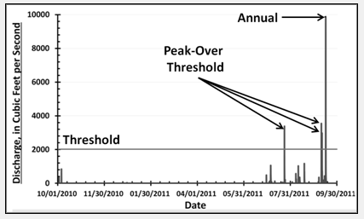
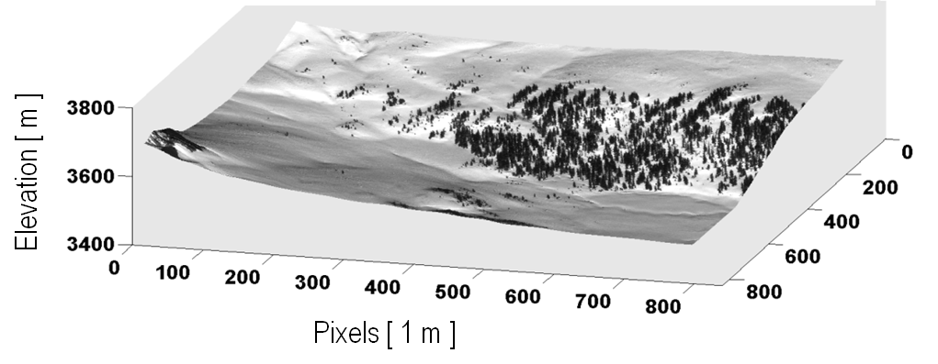
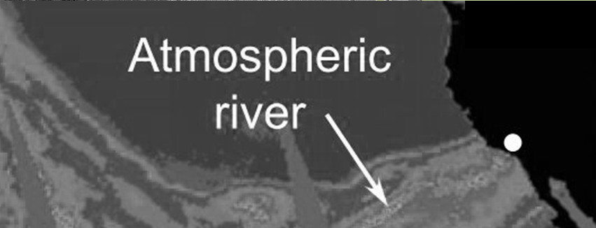
ATMOSPHERIC CIRCULATION EXTREMES
FLOODS
FROST RINGS
EXTREME EVENTS LAB
DROUGHTS
RING WIDTH EXTREMES
ENHANCED MOISTURE FLUX
EXTREME VALUE
STATISTICS
PAST STREAMFLOW
EXTREMES
SNOW COVER

