Slide 1
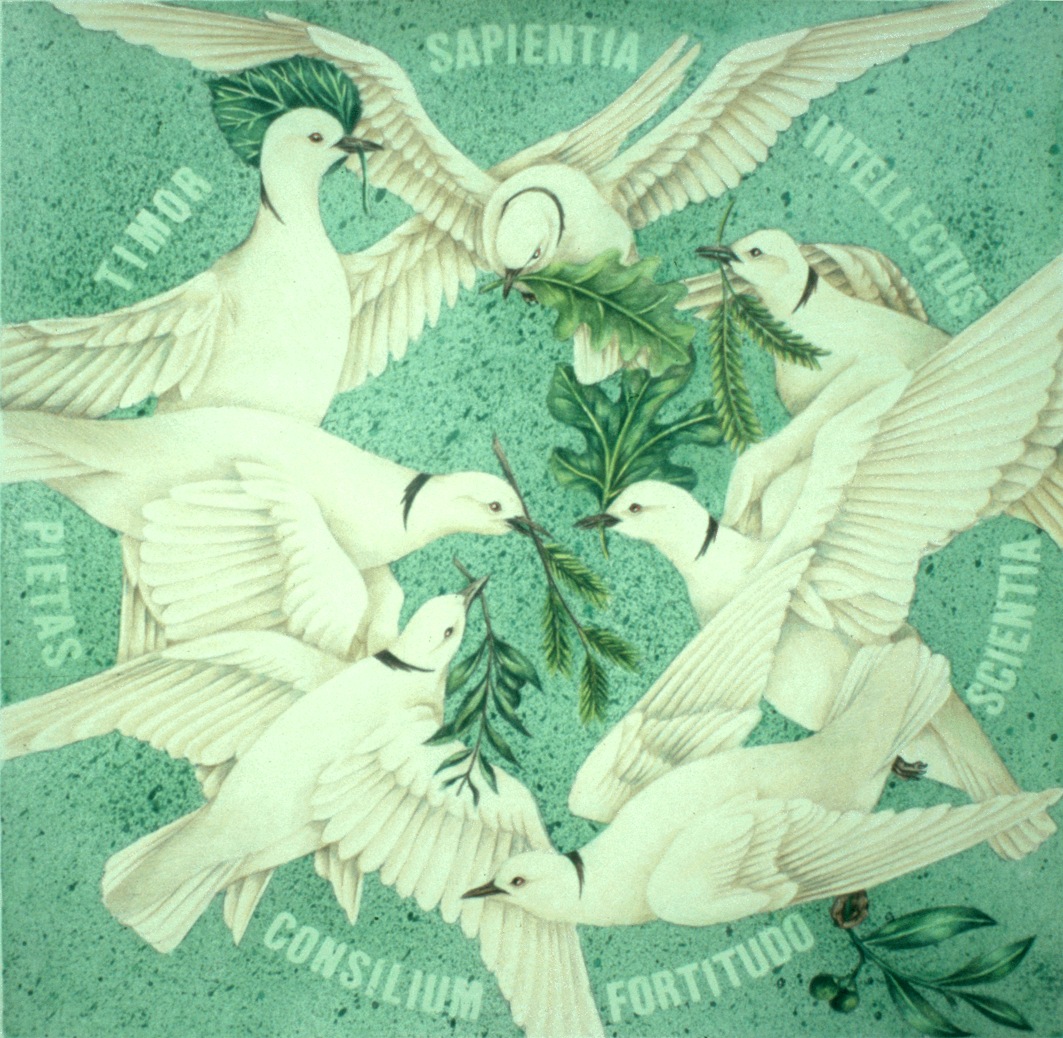

Slide 2
WISDOM

Slide 3
UNDERSTANDING

Slide 4
KNOWLEDGE

Slide 5
FORTITUDE

Slide 6
COUNSEL

Slide 7
PIETY

Slide 8
FEAR OF THE LORD

