Slide 1



HYDROCLIMATE
IN ARIZONA
Past, Present . . . Prospective
What can we learn by
“Thinking Like a Watershed” ?
Katie Hirschboeck, Ph.D.
Laboratory of Tree-Ring Research
White Mountains Land Alliance / Trust
Scenario Planning Workshop
October 25, 2013

Slide 2
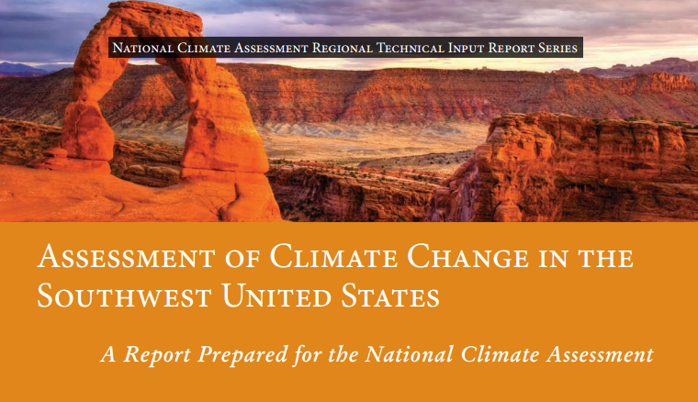
http://www.swcarr.arizona.edu/

Slide 3
Average precipitation will decrease
Precipitation extremes in winter will become more frequent and more intense
Late-season snowpack will continue to decrease
Declines in river flow and soil moisture will continue
Flooding will become more frequent and intense in some seasons and some parts of the Southwest, and less frequent and intense in other seasons and locations.
Droughts in parts of the Southwest will
become hotter, more severe, and more
frequent
FUTURE HYDROCLIMATOLOGY

Slide 4
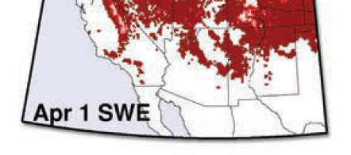
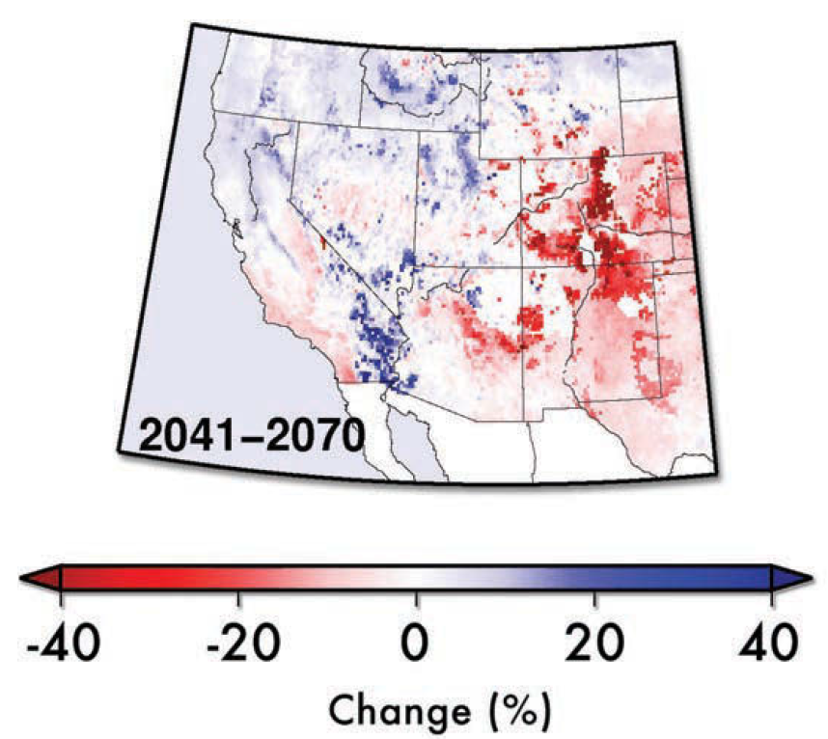
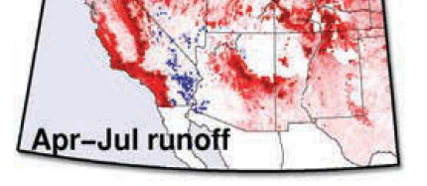
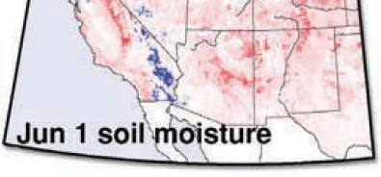
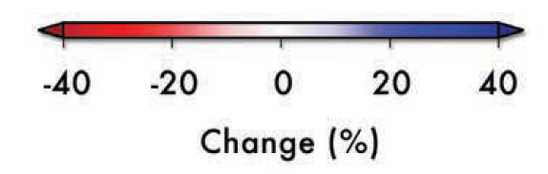
Based on “High Emissions” Scenario
Model-Simulated Changes in
Components of
the Water Cycle
Snow
Water Equivalent
Annual Runoff
% change from 1971–2000

Slide 5
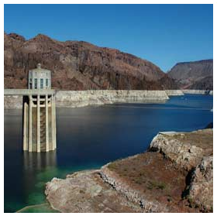
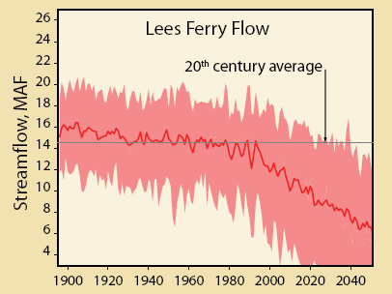
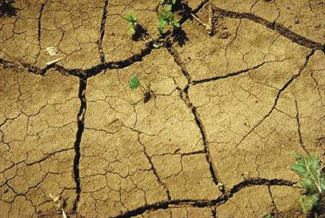
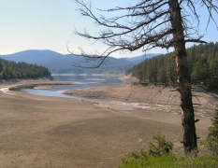
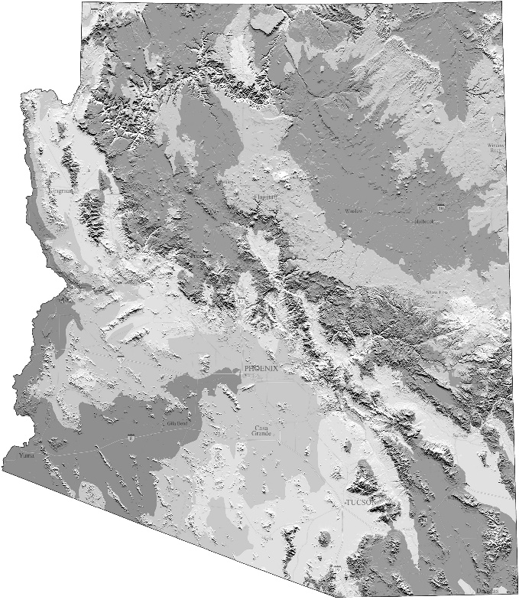

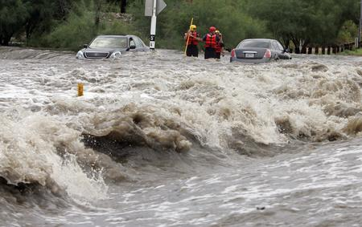

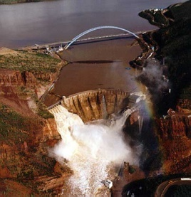
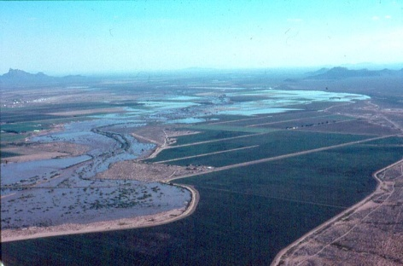
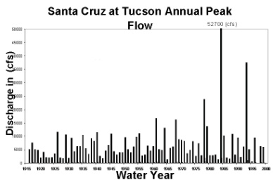
ARIZONA HYDROCLIMATOLOGY . . .
EXTREME
MAKEOVER:
Climate Change Edition
Notes:
EXTREME MAKEOVER: CLIMATE CHANGE EDITION
- We see here images of evidence of climate extremes in the LCRB – drought, reservoir depletion, dire future water supply projections, but also extreme high flows – floods of 1993 & the Coolidge Dam, extreme flash flooding, riparian system being nourished by floodwaters, and curious trends in annual flood time series – and these constitute the research themes I plan to pursue over the next several years.

Slide 6
The CHALLENGE:
DETECTING, UNDERSTANDING, PLANNING FOR, RESPONDING TO, ADAPTING TO
CHANGING EXTREMES
IN AN “ALREADY EXTREME” CLIMATIC REGION
Extremes of both the low and high flows (upper & lower tails of probability distributions) are projected
to increase in future – can this be detected?
Extreme events are rare by definition ➔
it’s a challenge to detect & assess changes in their variability in extreme arid / semi-arid environments
Importance of the paleo-data for assessing extremes in context of long-term record: droughts and floods
Notes:
I’ve been studying extremes of both the upper & lower tails of streamflow probability distribution functions in the LCRB – both droughts and floods – and defining the atmospheric circulation patterns that are associated with these events. As you know, one of the key IPCC projections about future climate is that increased warming will results in a more intense hydrologic cycle – with the precipitation concentrated in the tails: more frequent and extreme precipitation events, and (seemingly paradoxically) more droughts – depending on location. We get a good share of both here in the LCRB.
Extreme events are rare by definition ➔ and this makes it very challenging to study them – the sample sizes are never large enough! But when extremes occur in an arid or semi-arid climatic environment that is by its very nature characterized by a highly variable precipitation regime with long dry periods punctuated by short bursts of rain – this makes the assessment of how unusual or anomalous these events are in the context of the period of record very difficult – AND makes it especially challenging to detect a climate change signal on the basis of the gaged record alone.
– Hence many of us – including Connie and Franco on this panel – are engaged in using paleo-data – specifically tree rings – to reconstruct long records of temperature, precipitation or streamflow. Annual records of several centuries long are produced and these allow us to put the rapid warming of the last decade or so into a long term context and to evaluate how unusual the current drought in the LCRB is. Other kinds of paleo-data such as slack water sediment deposits in bedrock canyons and flood-scarred trees can provide evidence of high flow extremes or paleofloods. Both Connie and I have been collaborating with water managers in the Upper and Lower CRB to find ways for these long records of reconstructed streamflow to be used in their operations. One of my research goals for the next decade is to establish similar partnerships with flood and floodplain managers who are dealing with the upper tails of the streamflow distribution.
- With paleo data one key issue that keeps raising it’s ugly head is that of stationarity or the lack thereof. Can these long records of the past be used to make reliable inferences about current or future low flow or drought probabilities? Last year in Science stationarity was proclaimed dead because according to the authors, we are entering a new era of climatic processes. But as one who studies the paleo-record stationarity has always been dead – or at least not viewed as an appropriate underlying assumption. There is a critical need for more research on finding ways to integrate the richness of the long paleo-record – unparalleled for capturing extreme droughts – into current water management practice and assessments of future water supplies. To do this the stationarity issue must be wrestled with and examined creatively.

Slide 7
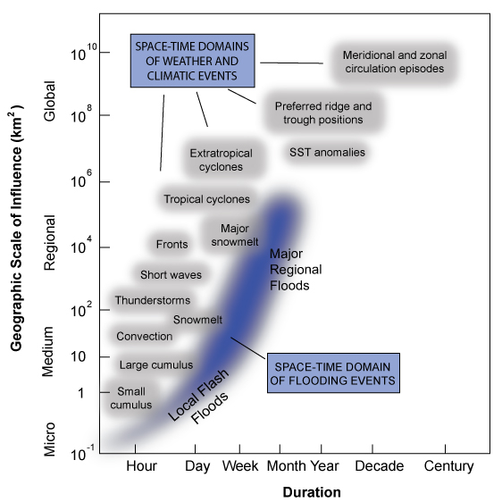
Mechanisms that generate
FLOODS &
DROUGHTS
operate at varying temporal and spatial scales of
WEATHER &
CLIMATE
SPACE-TIME DOMAIN OF DROUGHT EVENTS

Slide 8
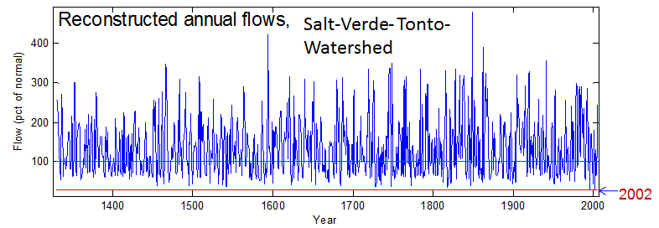
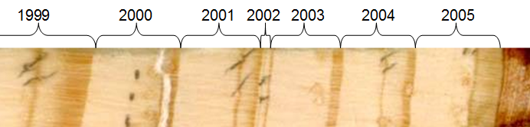
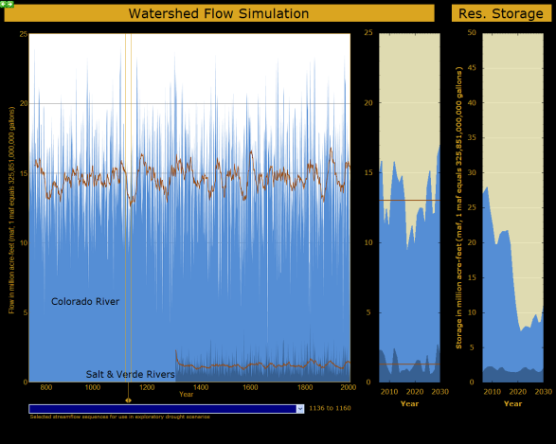
PLANNING
FOR
DROUGHT:
STREAMFLOW RECONSTRUCTION for 1330-2005
Meko & Hirschboeck, 2008 report for Salt River Project
WESTERN
WATER MANAGERS:
have been planning for
future extreme
LOW FLOW conditions using:
-- tree-ring reconstructions
-- simulations
-- scenario-building
-- climate projection modeling
Water supply simulation based on extreme low flow sequences in the paleo-record
Notes:
8
Normal as defined here is 895 kaf
Tally of runs depends on choice of threshold for normal. Medians of observed and reconstructed flows differ for common period 1914-2005: 895 kaf for observed flows and 1059 kaf for reconstructed flows. If use the higher median as threshold for normal, the longest reconstructed run below normal is 9 years. This occurred twice – 1395-2003 and 1442-1450. Even with the relaxed threshold, the reconstructed flows do not contain any runs longer than 4 years in the 1914-2005 period

Slide 9
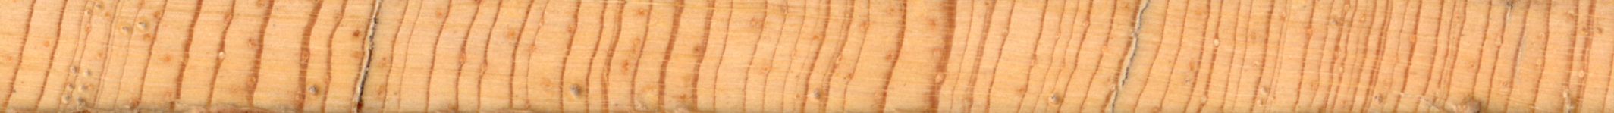

A TREE-RING CORE FROM THE UPPER SALT RIVER WATERSHED showing ring-width variations in the 1900s
1899-1904
dry “signature” pattern
1950’s DROUGHT
1905 -1908 1914 – 1920
two wet episodes
1952 (one wet year)
1899 &1902 = narrow rings
Even in a single tree, the record of
extreme wet and dry streamflow episodes is evident.
1950 &1951 1953 -1956
series of narrow rings
1900 & 1904 = missing rings
Extreme Years of High & Low Streamflow in the Salt-Verde-Tonto River Basin

Slide 10
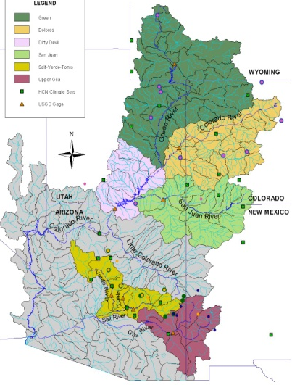
Upper Colorado Basin
Salt – Verde Basin
COMPARISON OF TWO BASINS:
Extreme High & Low Flow Years occuring in BOTH Basins Together
From:
Hirschboeck & Meko study for Salt River Project
wide rings
shift to narrower rings
1660
1661
1662
1663
1664
1665
1666
1667
1668
1669
1671
1672
Tree-Ring core from the Upper Salt River Watershed
1670 = missing ring

Slide 12
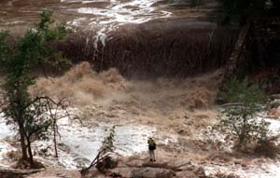
In contrast to drought planning . . .
FLOOD HAZARD MANAGERS:
. . . have been more constrained in developing ways to incorporate climate change planning into their operations due to:
  -- existing flood management policy and practices
  -- the short-term, localized, and weather-based nature of the flooding process itself
  -- lack of a cohesive climate-based explanation for observed variability . . . e.g. are flood trends detectible enough to plan for?

Slide 13
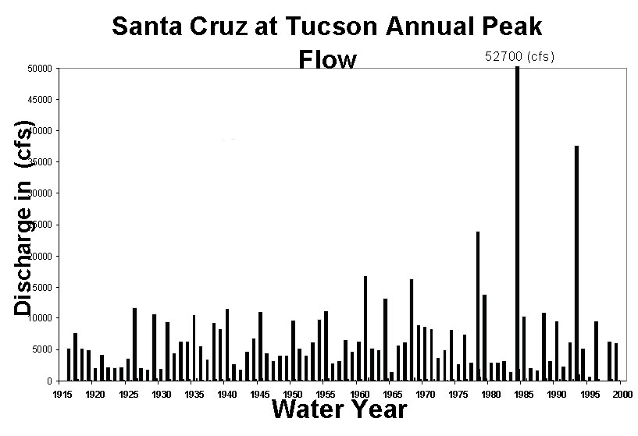
“Assuming climate stationarity, hydrologists have periodically relocated stream gauges so that they could acquire more [spatial] perspective on what was thought to be a fairly constant picture.” Milly et al. 2008
But not anticipating the possibility of climate change / variability can have serious consequences!
Santa Cruz River at Tucson
Annual Flood Peaks
Its long record made this gauging station a candidate for discontinuation in the early 1980s.
The substitution of SPACE for TIME
is not valid when the climate is changing!

Slide 14
Is this evidence of climate change?
Annual Flood Series

Slide 15
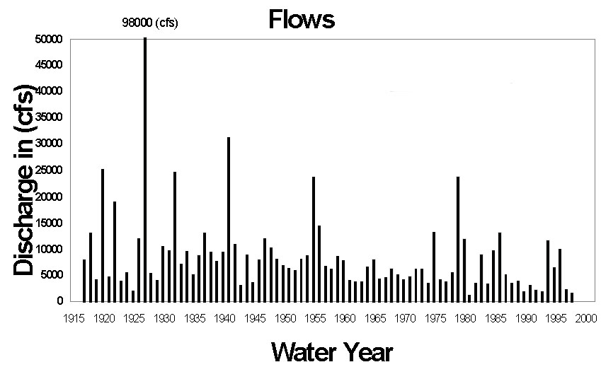
Or this? . . . .
Annual Flood Series

Slide 16
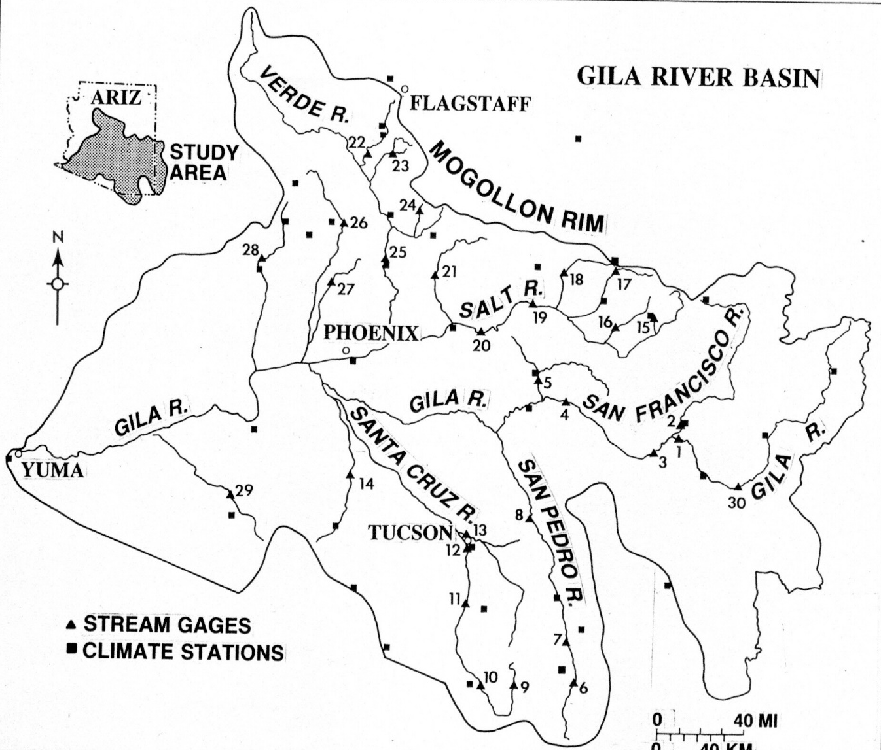

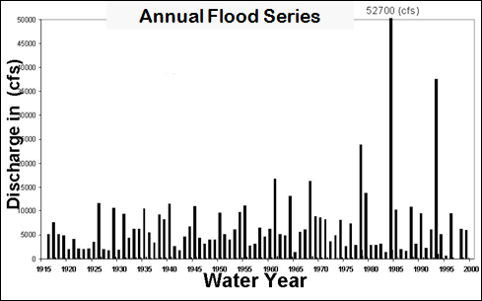
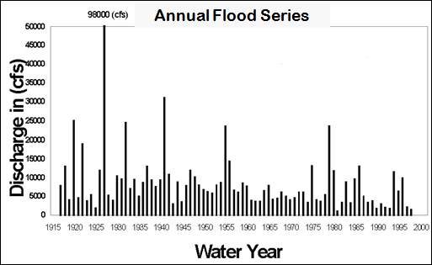
These two flood series are from neighboring
watersheds:

Slide 17
The FLOOD-CLIMATE LINK
can be difficult to sort out !
While increasing trends in extreme precipitation in the United States and else-where have been observed,
(e.g., Groisman et al. 2001, Meehl et al. 2000)
. . . it is unclear whether similar trends have occurred in extreme flooding.
Some studies have not seen any systematic trends in peak streamflow; others have found trends in some watersheds but not others. . .

Slide 18

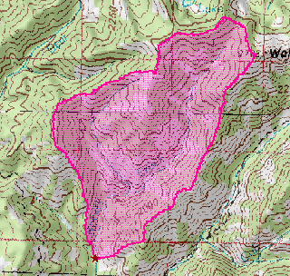
What’s needed . . . .
Information presented in an operationally useful format for planners & managers which describes how changes in the large-scale climatic “drivers” of hydrometeorological extremes will manifest themselves in flooding variability in
SPECIFIC WATERSHEDS ➔

Slide 19
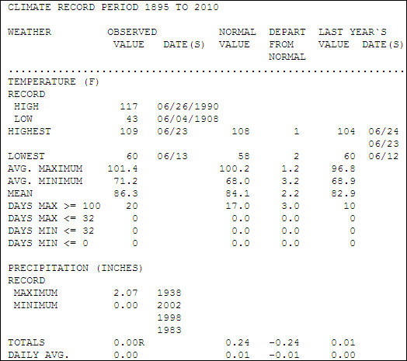
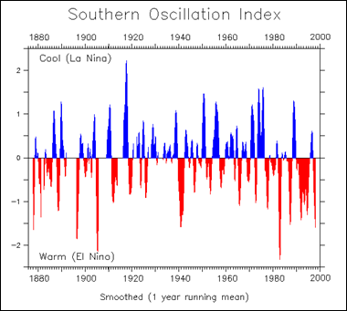
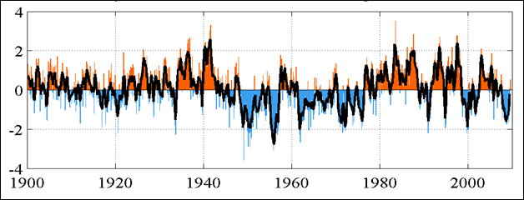
ARE WE THINKING ABOUT CLIMATE IN THE BEST WAY ?
“Climate is what you expect,
weather is what you get.”
Robert A. Heinlein
“Indices”
“Normals”

Slide 20
HOW CAN WE THINK ABOUT CLIMATE DIFFERENTLY ?
#1 Our understanding of climate / climate variability should be expanded beyond statistical definitions to include mechanistic, event-based, weather components.

Slide 21
Mechanisms that generate
FLOODS &
DROUGHTS
operate at varying temporal and spatial scales of
WEATHER &
CLIMATE
SPACE-TIME DOMAIN OF DROUGHT EVENTS

Slide 22

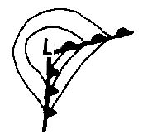

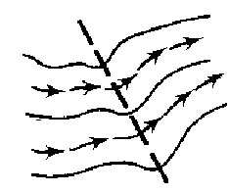


Synoptic Climatology—
as defined by Harman & Winkler (1997):
Macroscale
Synoptic scale
“The study of
climate from the
viewpoint of its
constituent weather
components or events
and the way in which these components are related to atmospheric circulation at all scales.”
Mesoscale
Storm
scale

Slide 23
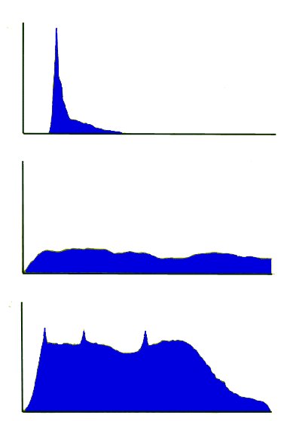
Circulation Pattern
➔ Storm type
➔ Hydrograph
Summer convective event
The type of storm (and its atmospheric drivers) can
both influence
the shape of
the hydrograph and
the magnitude & persistence of a
flood peak
Synoptic-scale event
(typically cool season)
Tropical storm or
other extreme event

Slide 24
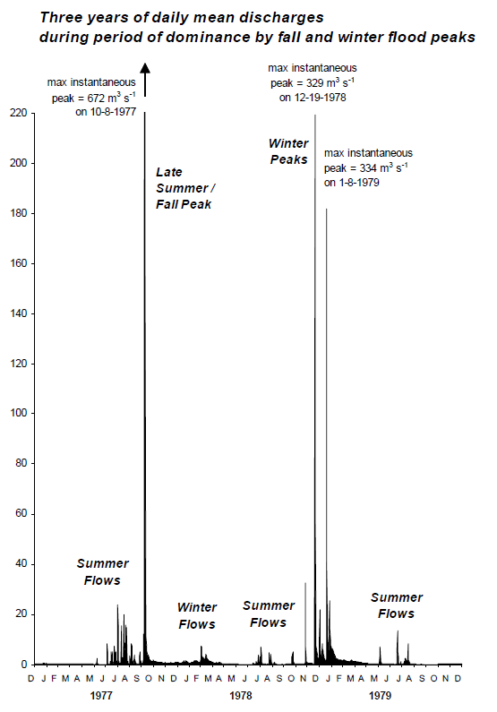
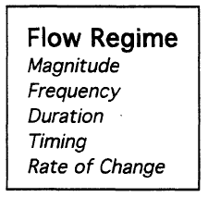
Tropical Storm -related
Winter
synoptic (extreme )
Winter synoptic (moderate)
Summer convective
Notes:
Riparian systems are an essential component of the LCRB ecosystem. Riparian systems experts have been able to define the role of natural streamflow regimes in sustaining the ecological integrity of flowing water systems and have found that the critically important factors are magnitude, frequency and duration of the flows – including extreme high flow events or floods -- as well as the timing of flows and their rate of change. All of these factors are likely to shift with a changing climate – but how? CLICK
I have developed a conceptual framework called “flood hydroclimatology” which links floods to the weather events and atmospheric circulation patterns that produce them. LCRB floods are produced by 3 main types of events: winter synoptic-scale storms that replenish the snowpack, summer convective storms during the monsoon period, and infrequent, though often very extreme, tropical storm-related rainfalls. This figure of varying daily mean discharges in the San Pedro River illustrates the distinctly different flow regimes that occur with each of these flood types.
have had some initial collaborations with riparian ecosystems specialists who have used my flood hydroclimatology framework to deepen their understanding of how and why flow regimes vary seasonally and interannually.
Future climate projections that shift the winter storm track north, or predict a stronger summer monsoon, point to significant changes in the flow regimes that sustain riparian ecosystems. I see flood hydroclimatology as an incredibly useful tool for studying the impact of these climate changes on riparian ecosystems and their flow regimes and hope to partner with plant ecologists and riparian resource managers to develop this such a tool.

Slide 25
MIGHT THIS BE A WAY TO ADDRESS THE NONSTATIONARITY ISSUE?
# 2 This expanded understanding of climate can be linked to flooding both deterministically and probabilistically through a process-sensitive “bottom up” approach in which individual peaks are grouped according to their flood-causing storm types and circulation patterns.

Slide 26
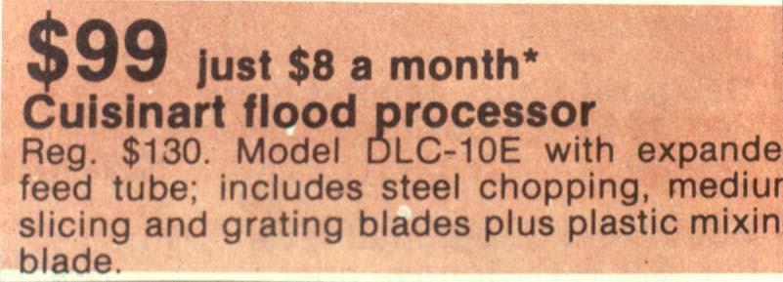
Re-Examining the assumptions underlying conventional
Flood Frequency Analysis
(i.e. the 100-year flood)
Inspired by a newspaper ad . . .

Slide 27

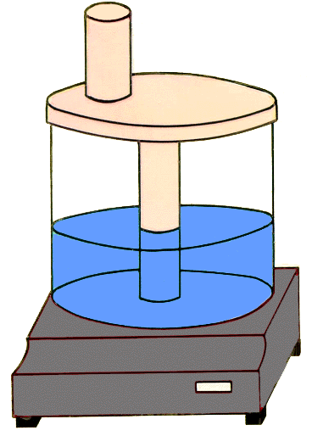
THE FLOOD PROCESSOR
Expanded feed tube
– Combines floods
of different types together
Chopping, slicing
& grating blades
– Chops up climatic cause
information and slices off
extreme outliers
100 Year Flood
Plastic
mixing blade
– Mixes up unique statistical properties of individual floods

Slide 28
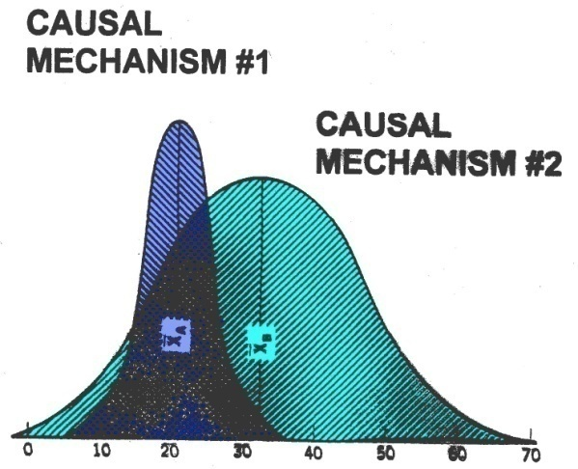
Alternative Conceptual Framework:
Flood
Heterogeneity
“Mixed” frequency distributions
may arise from:
    storm types
    synoptic patterns
    ENSO, etc. teleconnections
    multi-decadal circulation regimes
    pre- and post fire differences, etc. etc. etc.

Slide 29
FLOOD HYDROCLIMATOLOGY
is the analysis of flood events within the context of their history of variation
- in magnitude, frequency, seasonality
- over a relatively long period of time
- analyzed within the spatial framework of changing combinations of meteorological causative mechanisms
Hirschboeck, 1988

Slide 30
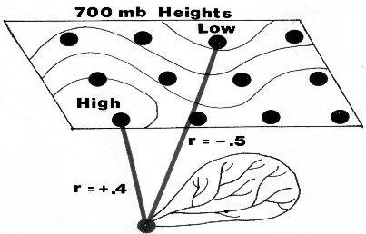
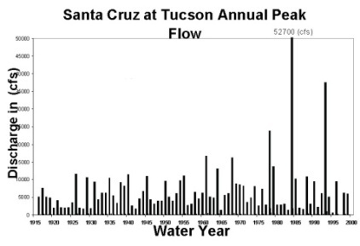
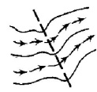
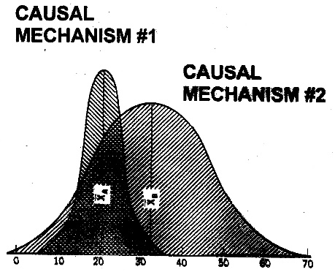
Flood Hydroclimatology Approach
“ Bottom–Up ” Approach
(watershed-to-atmosphere)
Observed Gauge Record
  Meteorological / Mechanistic /
  Circulation-Linked
  Flood Hydroclimatology
  Framework / Link
  to Flood Distribution

Slide 31


EXAMPLES: Flood Hydroclimatology in AZ

Slide 32
What does this time series look like when classified hydroclimatically?
What kinds of storms produced the biggest floods?

Slide 33
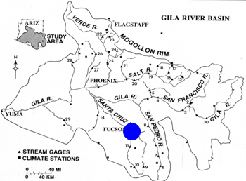
Hydroclimatically classified time series . . .

Slide 34

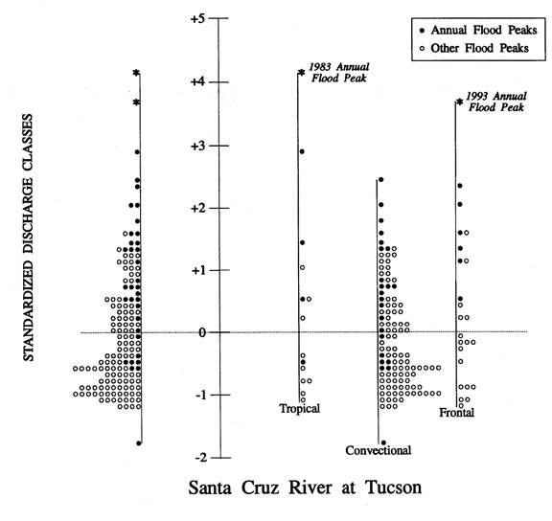

Santa Cruz River at Tucson
Peak flows separated into
3 hydroclimatic subgroups
All Peaks
Tropical storm
Winter Synoptic
Sumer Convective
Hirschboeck et .al. 2000

Slide 35
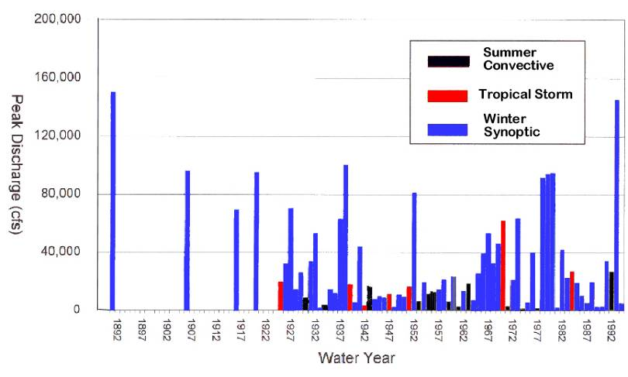
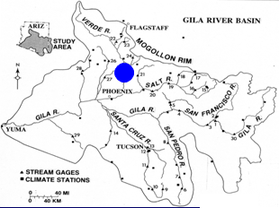
Verde River below Tangle Creek
Historical
Flood

Slide 36

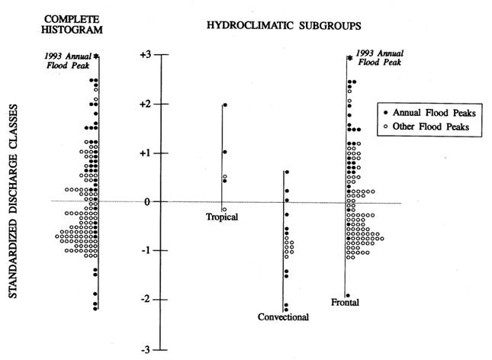

Verde River below Tangle Ck
Peak flows separated into
3 hydroclimatic subgroups
Tropical storm
Winter Synoptic
All Peaks
Sumer Convective
Hirschboeck et .al. 2000

Slide 37
HOW MIGHT CLIMATE CHANGE AFFECT THESE DISTRIBUTIONS?
Planners could envision
individual flood types as alternative,
possible SCENARIOS . . .

Slide 38
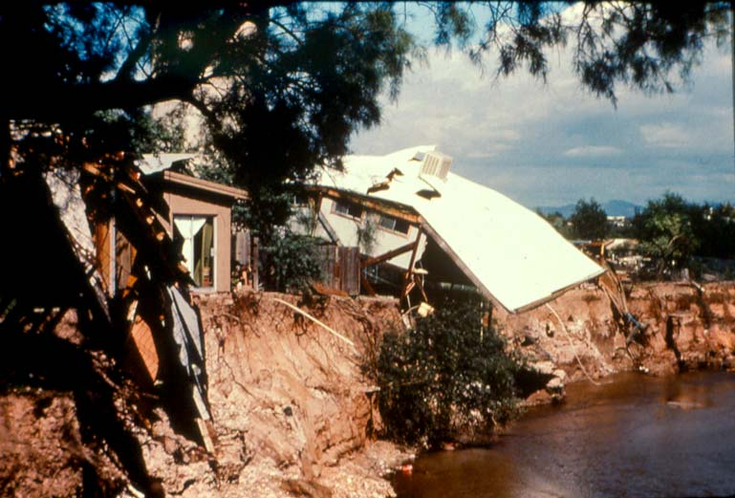
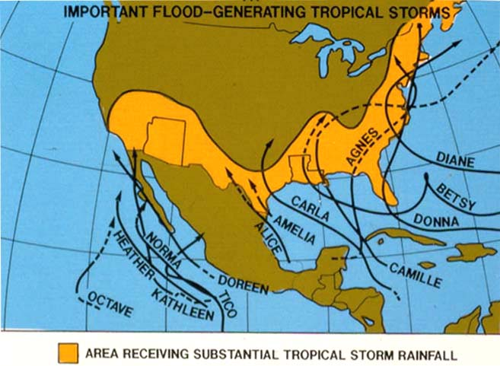




Change in Frequency or Intensity of Tropical Storms?
Some Important Flood-Generating Tropical Storms
Tropical storm Octave Oct 1983
Latitudinal Shifts in
Winter Storm Track?
Roosevelt Dam
Jan 1993
Winter flooding
on Rillito in Tucson
More Intense Summer Monsoon?
Sabino Creek
July 2006

Slide 39



Could also mix in . . . .
POST-FIRE EFFECTS
on the watershed
. . . or other exacerbating factors, such as an “ATMOSPHERIC RIVER” with its huge influx
of moisture
e.g.,“Arkstorm” . . .

Slide 40

http://pubs.usgs.gov/of/2010/1312/

Slide 41
THE BOTTOM-UP
APPROACH . . .

Slide 42

TRADITIONAL DOWNSCALING:
Interpolation of GCM results computed at
large spatial scale fields
to higher resolution,
smaller spatial scale fields,
and eventually
to watershed processes
at the surface.
Hirschboeck 2003 “Respecting the Drainage Divide”
Water Resources Update UCOWR

Slide 43
“Scaling up from local data
is as important as scaling down from globally forced regional models.”
— Pulwarty, 2003

Slide 44

PROPOSED COMPLEMENTARY APPROACH:

Slide 45
RATIONALE FOR
PROCESS-SENSITIVE UPSCALING:
Attention to climatic driving forces & causes:
-- storm type seasonality
-- atmospheric circulation patterns
with respect to:
-- basin size
-- watershed boundary / drainage divide
-- geographic setting (moisture sources, etc.)
. . . can provide a basis for a cross-scale linkage
of GLOBAL climate variability
with LOCAL hydrologic variations
at the individual basin scale . . .

Slide 46
Process-sensitive upscaling . . .
can define relationships that may not be detected via precipitation downscaling
Allows the imprint of a drainage basin’s characteristic mode of interacting with precipitation in a given storm type to be incorporated into the statistics of the flow event’s probability distribution as it is “scaled up” and linked to model output
and /or a larger scale flow-generating circulation pattern

Slide 47
CAN WE GET MORE OUT OF THE RECORDS WE HAVE?
#3 A deeper understanding of flood-climate linkages can be obtained by examining all observed flood peaks at a given gauge (e.g., the peaks-above-base record), not just the annual flood series.

Slide 48

EXAMPLE: Some years have many partial peaks, others few . . .

Slide 49
Climate variability may manifest itself in a shift to more frequent, smaller floods in a given year
. . . which would be missed in the annual series or a selection of the most extreme floods.

Slide 50
ARE THERE UNTAPPED CLIMATE-RELATED EXPLANATIONS FOR WATERSHED RESPONSES?
#4 The dominant flood-producing storm type can vary with drainage basin size, elevation, and orographic influence, resulting in a varied response to climatic variability depending on a watershed’s scale and where it is located in the the drainage network.

Slide 51



Response to weather & climate varies with basin size (e.g. convective events are more important flood producers in small drainage basins)

Slide 52
Final Take-Home Message:

Slide 53

Move beyond the
“Flood Processor” Mentality!

Slide 54
Expand mechanistic understanding of climate
Use a process-sensitive “bottom-up” approach
Take full advantage of different types of data (peaks-above base records)
Target regions of sensitivity to climate
Link all of the above to watershed characteristcs . . . . and . . .

Slide 55


. . . let the watersheds
“speak for themselves”
about how they respond
to climate !

Slide 56
Thank You!
katie@ltrr.Arizona.edu

