Slide 1
A Meditation
on Respecting All Life in God’s Creation
Notes:
End with “Seeing the Hand of God in All Creation” mediation:
via Prezi at: http://prezi.com/w7bxz706vhrj/catholic-climate-ambassador-talk-videos/?auth_key=4fec9d9ce131694381c5b98bbaae51bc23a3db74
or at: http://www.squidinkbooks.com/omosclc/steward-creation-life.htm
[NOTE: still need to update ending with 5 points of St. Francis Pledge]

Slide 2
As Catholics we reverence the Gift of Life in a special way in our call to always RESPECT LIFE

Slide 3
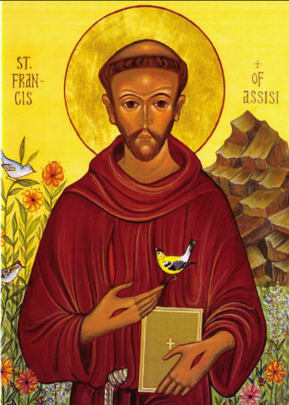
and with ST. FRANCIS of Assisi
we venerate LIFE in every part of God’s Creation —
Plants & Animals, Sun, Sky & Earth. . .
. . . in addition to each & every human being, especially the POOR

Slide 4
How is all of this connected to our Catholic Faith?

Slide 5
Through a CONSISTENT ETHIC OF LIFE
that treasures life
in all its forms . . .

Slide 6
. . . and through
our call to be STEWARDS of the precious GIFT OF CREATION
entrusted to us by GOD . . .

Slide 7
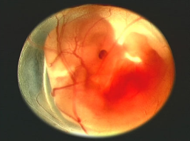
. . . from the tiniest
heartbeat

Slide 8
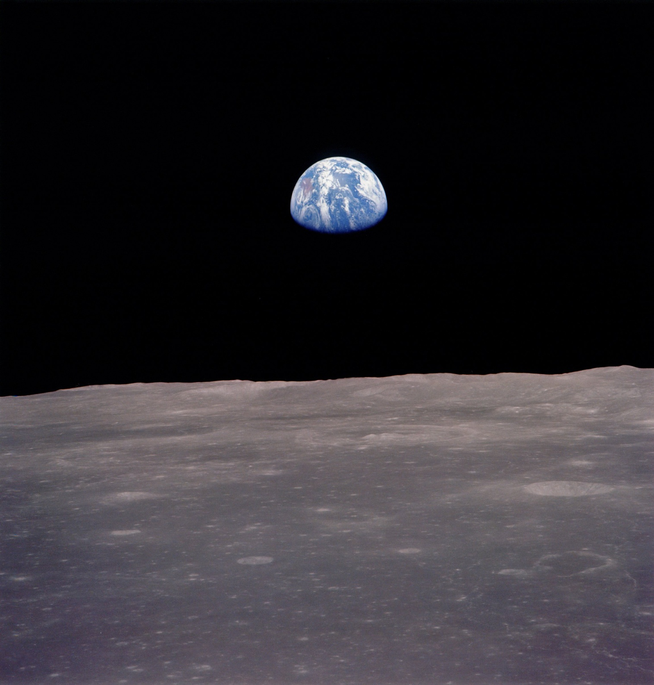
. . . to the wonder of the planet
that sustains us

Slide 9
. . . in the smile of a hungry child in Haiti

Slide 10
. . . and in the
outstretched hand
of our neighbor in need.

Slide 11
OUR COMMON HOME is a gift we share.
To care for it we must see the HAND OF GOD
in all CREATION.

Slide 12
A MEDITATION

Slide 13
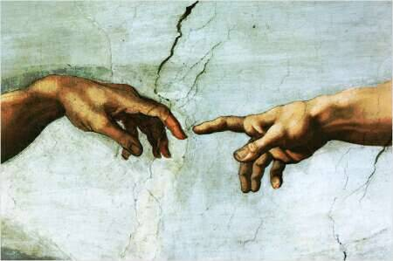
SEEING THE HAND OF GOD
IN ALL CREATION

Slide 14
“God saw all that had been made,
and indeed
it was very good.”
Genesis 1:31

Slide 15
The Genesis story reminds us
that all living
Creatures have
LIFE through
GOD . . .

Slide 16
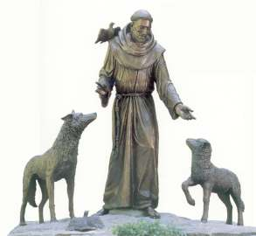
. . . Adam “gave names” to all the animals and we
– like St. Francis –
bless them and interact with them.

Slide 17
We are in RELATIONSHIP
with all living things,
and with
GOD.

Slide 18
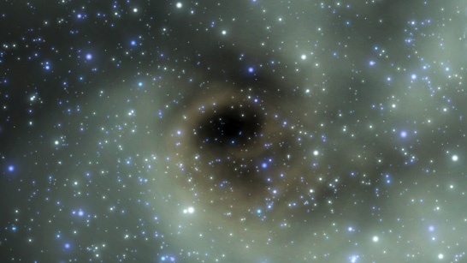
All creatures are created
of the same dust . . .

Slide 19
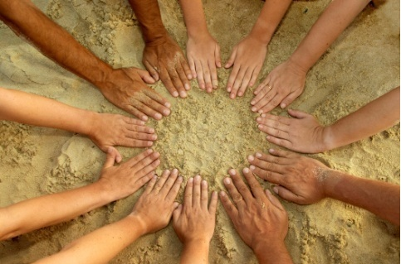
. . . The dust of the ground
our common ground . . .

Slide 20
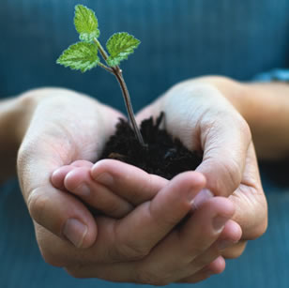
. . . our HOLY GROUND

Slide 21
“ This SHARED HABITAT needs to be nurtured and carefully conserved . . .

Slide 22
. . . if all its INHABITANTS are to live in an integrated and INTER-RELATED manner.”
– International Bishops

Slide 23
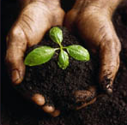
“ The fundamental RELATION between humanity and nature is one of CARING FOR CREATION.”
– U.S. Bishops

Slide 24
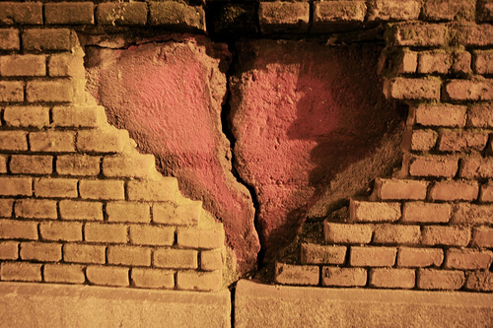
In the Gospel Jesus warns that it is HARDNESS of HEART . . .

Slide 25
that has the potential to break apart
any RELATIONSHIP. . . any COVENANT.

Slide 26
“ The COVENANT between HUMAN BEINGS and the ENVIRONMENT . . .”

Slide 27
“. . . should mirror the creative LOVE of GOD . . .”

Slide 28
“. . . from whom we come and towards whom we are journeying.”
– Pope Benedict XVI

Slide 29
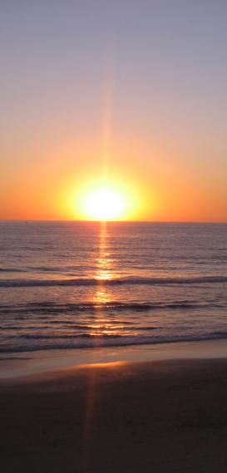
How will we be IMAGES of GOD and care for the
CREATION entrusted to us?

Slide 30
How can we ensure that a rich sense of God’s presence prevails?

Slide 31
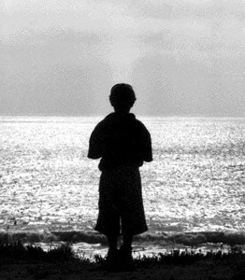
“ The first and primary good
to be preserved is the good of the
individual person. . . .

Slide 32
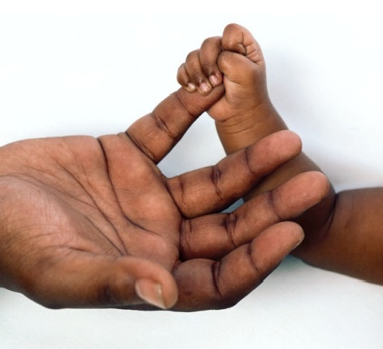
. . . Human life is sacred and the good of the community demands respect
for that life.”
– International Bishops

Slide 33
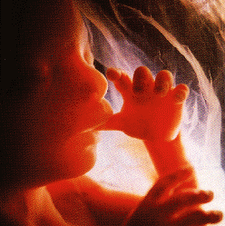
The life in the womb is precious.

Slide 34
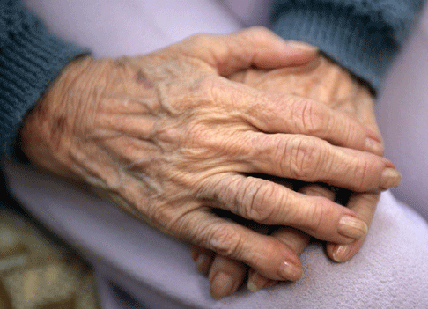
The life of the elderly person is precious.

Slide 35
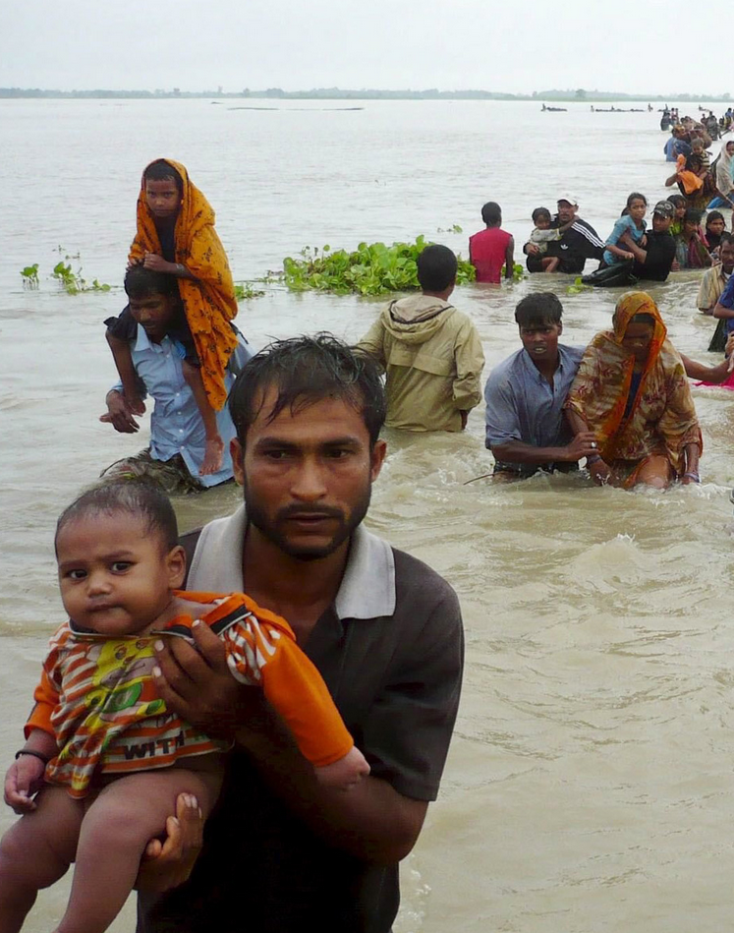
The life of the migrant
is precious.

Slide 36
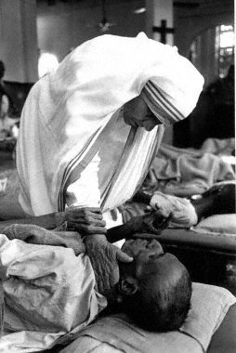
The life of the dying
person is precious.

Slide 37
And the life of the those in poverty
– struggling to live with dignity – is precious.

Slide 38
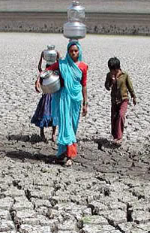
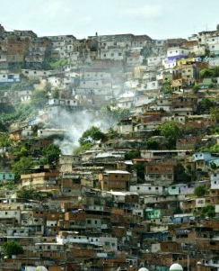
“ The POOR suffer most directly from environmental decline and have the least access to relief from their suffering.”
– U.S. Bishops

Slide 39
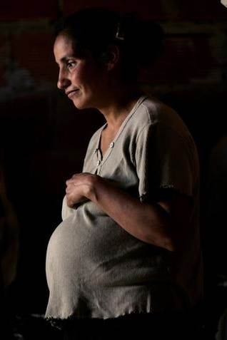
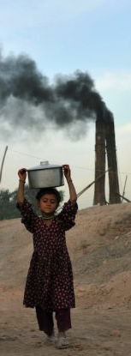
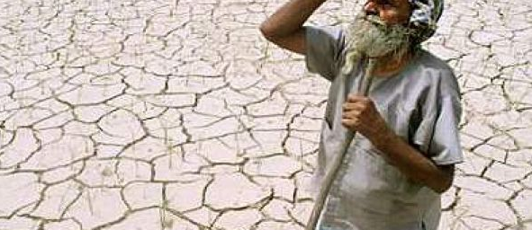
“Environmental degradation can be particularly harmful to the UNBORN, the YOUNG and the ELDERLY.”
– International Bishops

Slide 40
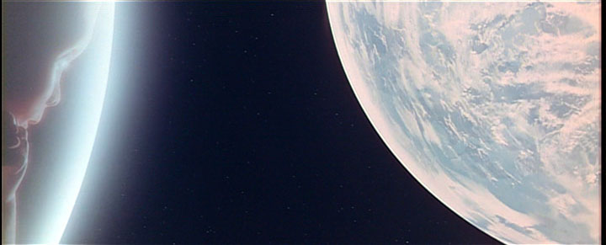
“ No peaceful society can afford to neglect either
RESPECT FOR LIFE or the fact that there is an
INTEGRITY TO CREATION.”
— Pope John Paul II

Slide 41
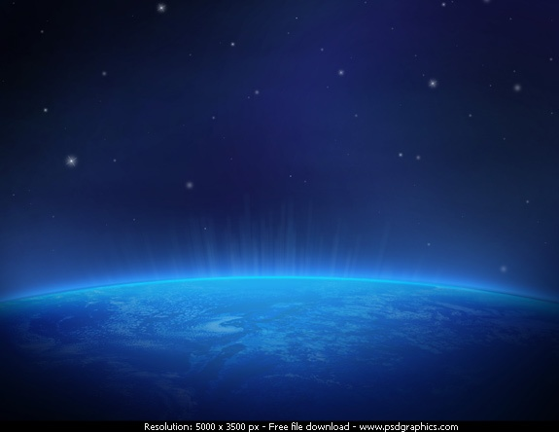
“ Before it is too late, we must make courageous choices with a view to a strong alliance between HUMAN BEINGS and the EARTH.”
— Pope Benedict XVI

Slide 42
OUR COMMON HOME is a gift we share.
To care for it we must see the HAND OF GOD
in all CREATION.

Slide 43
As we gratefully share GOD'S GIFTS,
may we cherish and tend them, in a responsible and accountable manner,
and return them with increase to the LORD.

Slide 44
Amen
Pray
• Learn
• Act
• Advocate •

Slide 45
Los Católicos protegen a la Creación
El Movimiento Católico Mundial por el Clima trabaja dentro de la Iglesia Católica para cuidar mejor nuestra casa común. Nuestro documento fundador es la encíclica del Papa Francisco sobre el cambio climático y la ecología, la Laudato Si’.

Slide 46
Respondiendo al llamado urgente del Papa Francisco en Laudato Si’,
me comprometo a:
• Rezar por y con la creación • Vivir con sencillez • Abogar por el cuidado de nuestra casa común

Slide 47
Quotes from:
Renewing the Earth: An Invitation to Reflection and Action on Environment in Light of Catholic Social Teaching (1991) U.S. Conference of Catholic Bishops Global Climate Change: A Plea for Dialogue, Prudence, and the Common Good (2001) U.S. Conference of Catholic Bishops
The Columbia River Watershed: Caring for Creation and the Common Good ( 2001) An International Pastoral Letter by Catholic Bishops of the Watershed
Stewardship: A Disciple's Response (2003) U.S. Conference of Catholic Bishops
Peace with God the Creator, Peace with All of Creation (1990) Pope John Paul II
Caritas in Veritate (2009) Pope Benedict XVI
Music:
Canción Triste by Jesse Cook
℗ 1998 Narada Productions, Inc.

Slide 48
Meditation by K K Hirschboeck for The Christian Life Commission
of
Our Mother of Sorrows Parish
Tucson, Arizona
www.omosclc.org
In collaboration with the following ministries:
Consistent Ethic of Life Committee
Care for Creation Initiative
Haiti Project Committee

