Slide 1
SECRETS
of the
EXTREME EVENTS
LAB

Slide 2
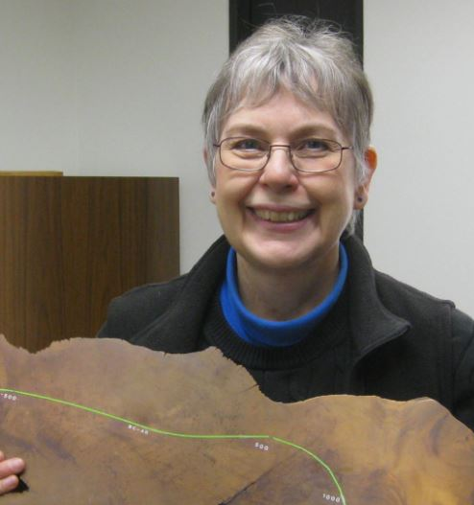
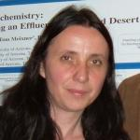
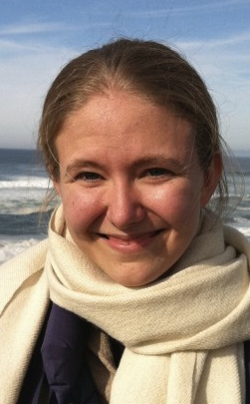
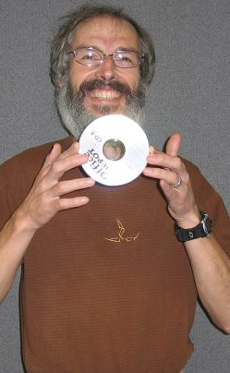
Featuring . . .
Saeahm Kim Hydrology & Water Resources
Katie Hirschboeck LTRR
Diana Zamora Reyes Hydrology & Water Resources
Ela Czyzowska LTRR & Arizona Remote Sensing Center
Martin Munro LTRR
Jen Johnson LTRR
(NSF Macrosystems Project)

Slide 3
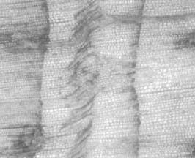
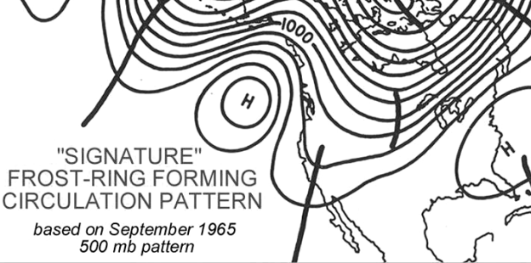
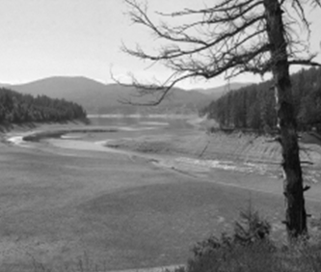
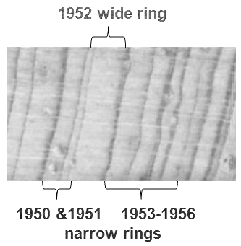
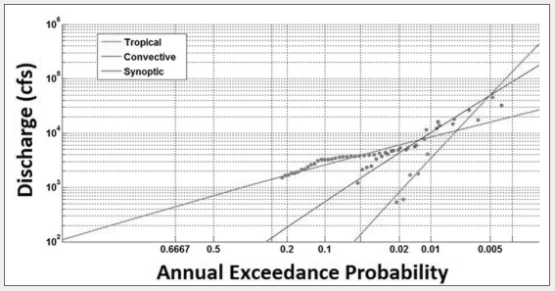
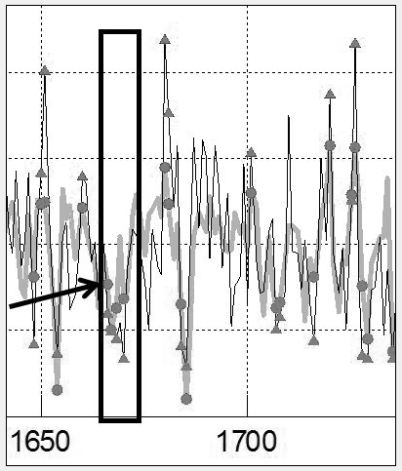
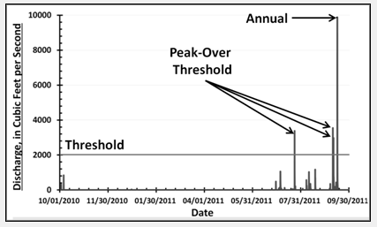
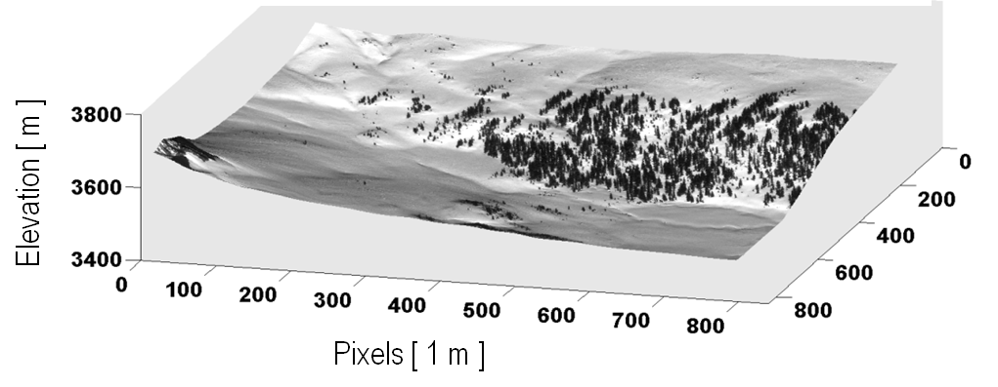
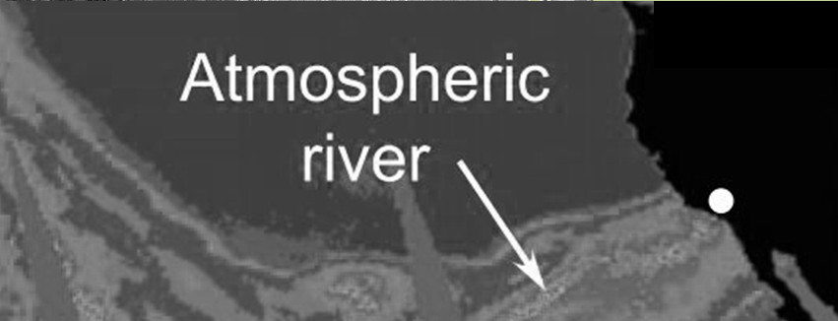
ATMOSPHERIC CIRCULATION EXTREMES
FLOODS
FROST RINGS
EXTREME EVENTS LAB
DROUGHTS
RING WIDTH EXTREMES
ENHANCED MOISTURE FLUX
EXTREME VALUE
STATISTICS
PAST STREAMFLOW
EXTREMES
SNOW COVER

Slide 4
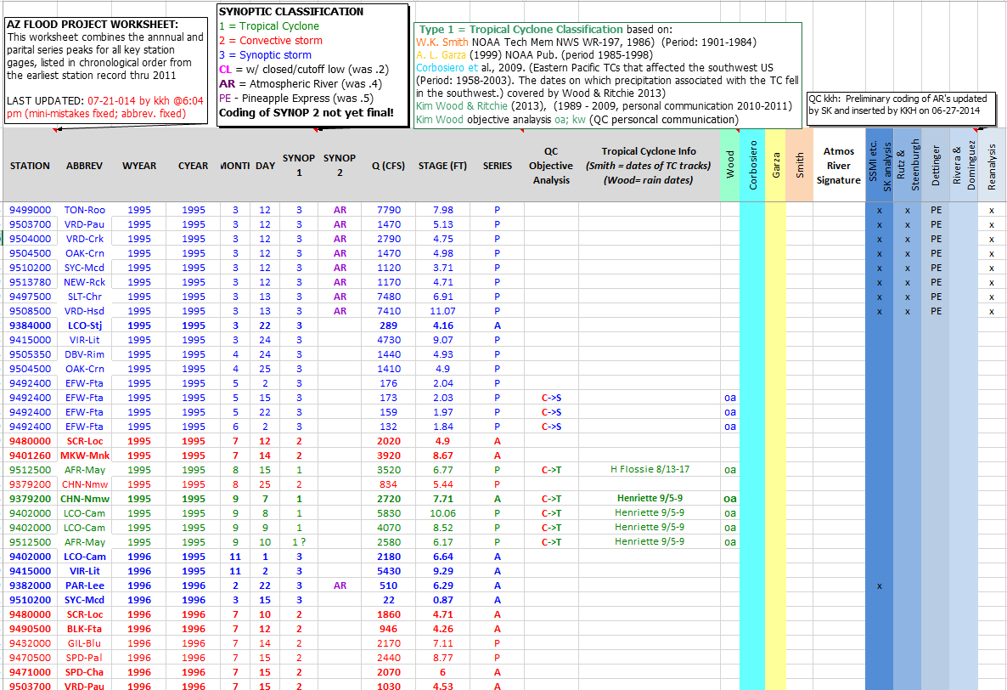
8,500+ “peaks-above-base” floods from 51 USGS gauges in AZ classified according to type of flood-generating process
Currently updated for period 1915-2011

Slide 5
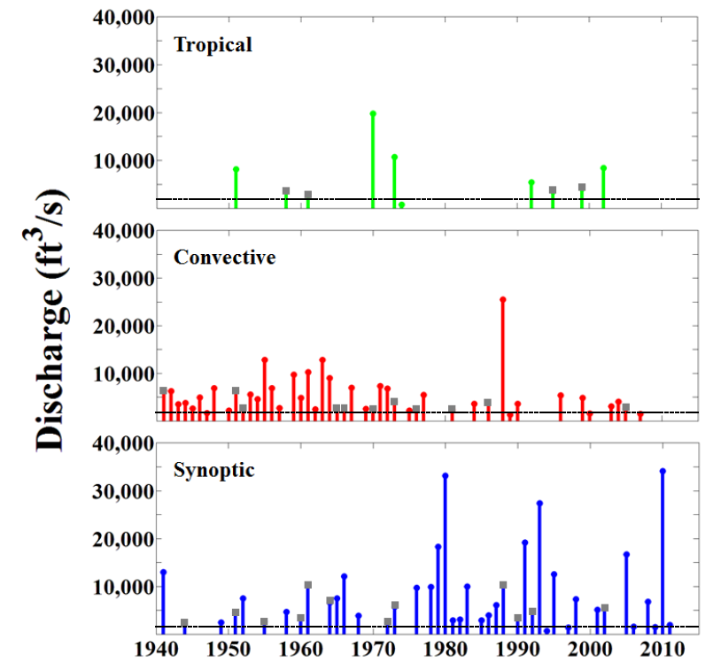
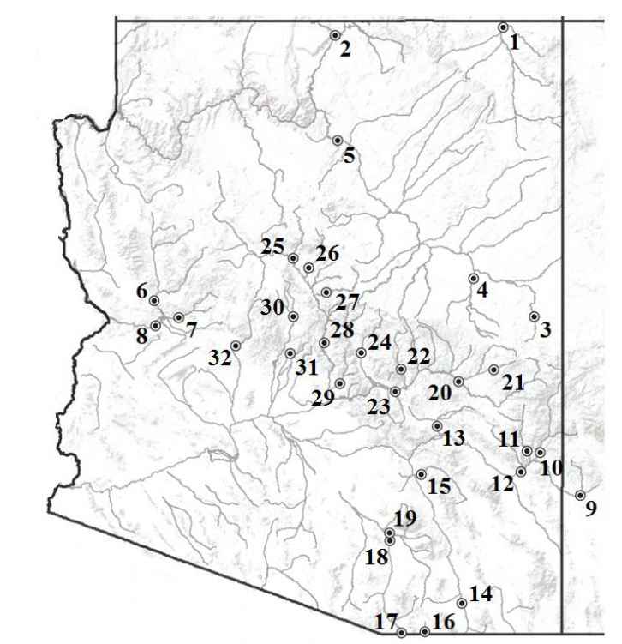
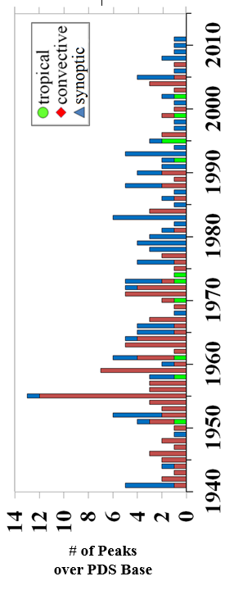
FLOOD TYPE MAGNITUDES
Agua Fria R nr Mayer
Diana Zamora Reyes’s M.S. Thesis ( completed Dec 2014 )
“RELEVANCE OF FLOOD HETEROGENEITY TO FLOOD FREQUENCY IN ARIZONA”
Discharge magnitude of largest flood peak per year
FLOOD TYPE FREQUENCIES
# peaks “above base” per year
MORE details to follow in the next talk!!

Slide 6
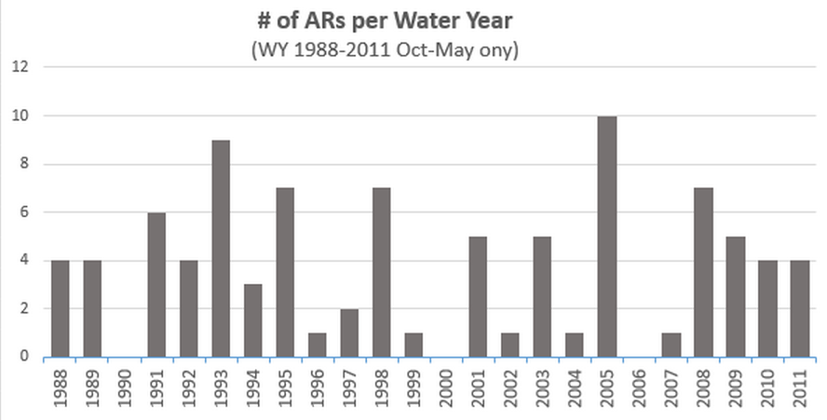
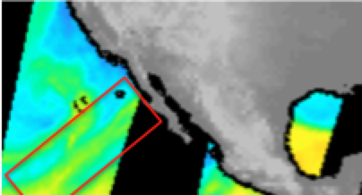
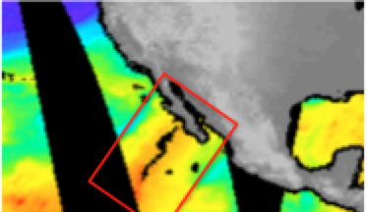
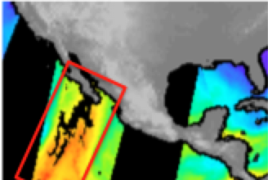
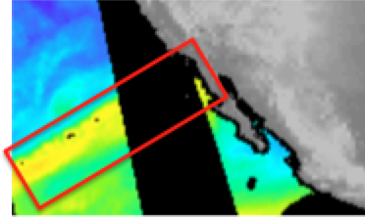
Saeahm Kim’s M.S. Thesis ( in progress )
“AN ASSESSMENT OF ATMOSPHERIC RIVERS AS FLOOD PRODUCERS IN ARIZONA”
1993
2005
1988
Record breaking flood peaks in Jan1993
Feb 2005
April 1988

Slide 7
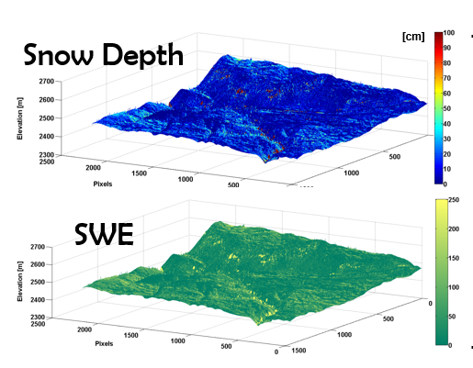
Funded by SALT RIVER PROJECT (expected start Summer 2015)
INVESTIGATORS: Ela Czyzowska, Ph.D. (w / Katie Hirschboeck as managing PI )
GOAL: design, test, and operationalize a state-of-the-art artificial intelligence model for improved estimation of Snow Water Equivalent
Snow Cover
SATELLITE IMAGERY + ARTIFICIAL NEURAL NET FUSION OF HI & LOW RESOLUTION IMAGES TO PROVIDE SNOW COVER MAPS
To manage DROUGHTS
& LOW FLOWS
➔
➔
SWE ESTIMATES
FOR SHORT-TERM & LONG-TERM SRP WATER SUPPLY PLANNING
Deliverables: (1) a user-friendly snow cover model, and (2) a decision support tool attuned to observed patterns of variation in snow cover and depth to estimate SWE at multiple scales.
Notes:
1- Satellite images are an important data source to extract snow information
2-Data fusion between the highest resolution (1 m) and medium (30 m) resolution satellite images
3- Artificial Neural Network is used as a snow estimator that learns from data through a series of training iterations

Slide 8
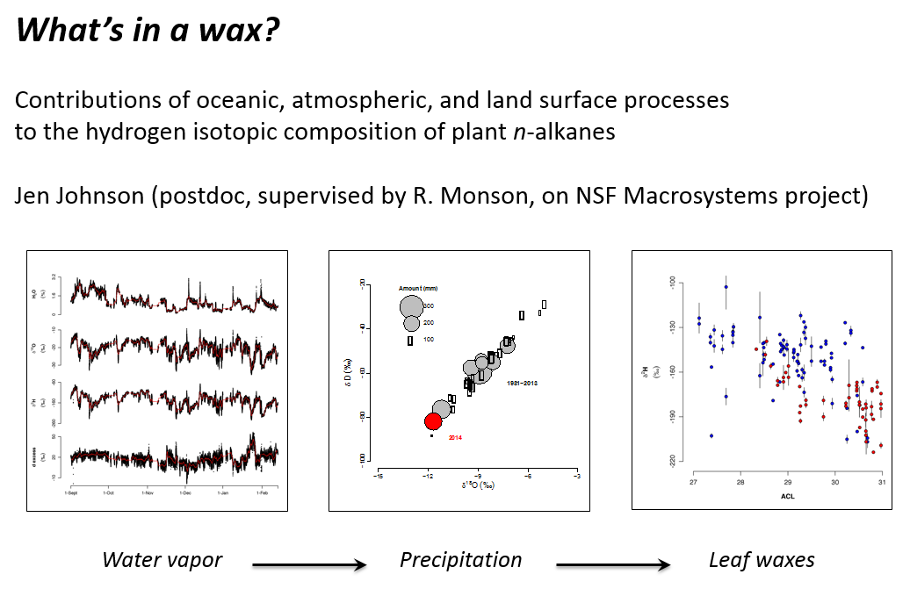
INTRODUCING . . . EXTREMES OF A DIFFERENT KIND . . .
Jen Johnson, Ph.D.

Slide 9
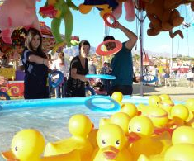
Finally . . . . What secrets does Martin hold?
IS HE SECRETLY TRAINING TO COMPETE IN THE SPRING FLING “RUBBER DUCK EVENT”
THIS YEAR?
Or . . . . .

Slide 10
. . . IS HE REALLY SECRETLY A DRUID?
Inquiring minds want to know!
THANKS, MARTIN, FOR ALL YOU DO TO PROTECT OUR COMPUTERS & INTERNET FROM EXTREME EVENTS!

Slide 11
ATMOSPHERIC CIRCULATION EXTREMES
FLOODS
FROST RINGS
THANK YOU ! from THE EXTREME EVENTS LAB
DROUGHTS
RING WIDTH EXTREMES
ENHANCED MOISTURE FLUX
EXTREME VALUE
STATISTICS
PAST STREAMFLOW
EXTREMES
SNOW COVER

