Slide 1
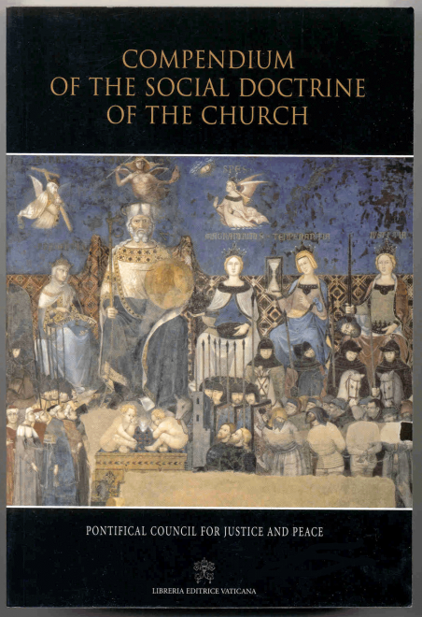
Care for God’s Creation:
Catholic Social Teaching & the Environment
Dominican Lay Associates 21 February 2007
Dr. Katie Hirschboeck Laboratory of Tree-Ring Research

Slide 2
Care for God’s Creation:
Catholic Social Teaching & the Environment
Mini-Overview of Catholic Social Teaching (CST)
Key documents & evolution of the connection between CST and the environment
Closing thoughts on the role of Science
Key source: Silecchia, Lucia A. (2004) Environmental Ethics from the Perspectives of The National Environmental Policy Act (NEPA) and Catholic Social Teaching: Ecological Guidance for the 21st Century: William and Mary Environmental Law and Policy Review 28: 659-798
Notes:
Lucia Silecchia: Associate Prof of Law at Catholic University

Slide 3
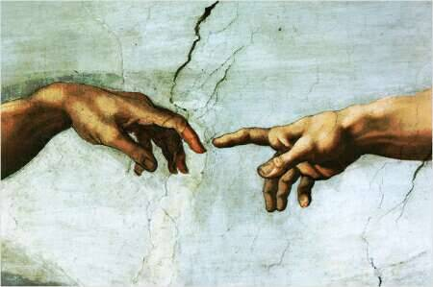
Catholic Social Teaching (CST):
Rooted in Scripture & Judeo-Christian Tradition
BOOK OF GENESIS CREATION STORIES:
Dignity of Human Person – created in image and likeness of God Gn 1:26

Slide 4
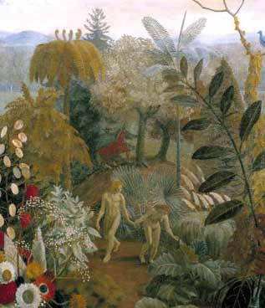
Rooted in Scripture & Judeo-Christian Tradition
BOOK OF GENESIS CREATION STORIES:
- Creation is good Gn 1:31
-"Be fertile and multiply; fill the earth and subdue it. Have dominion over . . . all the living things that move on the earth." Gn 1:28
- Humanity charged to “cultivate and care” for creation Gn 2: 15

Slide 5
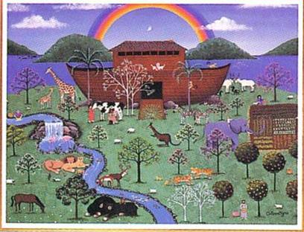
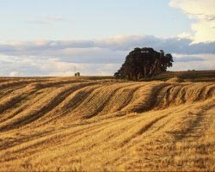
Story of Noah
Relationship between human wrong and resulting harm to the rest of humanity & all creation
God’s Covenant with humanity
I set my bow in the clouds to serve as a sign of the covenant between me and the earth. Gn 9: 13
Sabbatical & Jubilee Years
Let the lands lie fallow, bring good news to the oppressed, set slaves free & proclaim liberty to captives; forgive debts
“a kind of social doctrine in miniature”
Notes:
SABBATICAL: (1) laws address environmental concerns that overuse of the land would make it unusable. (2) some of the laws cover debt concerns. Because of drought and other cyclical crop failures, the poor needed to be allowed to start over and not languish in poverty. (3) land ownership and management concerns affected families in inter-generational settings.
“a kind of social doctrine in miniature”
JUBILLEE: Let the lands lie fallow, bring good news to the oppressed, set slaves free & proclaim liberty to captives; forgive debts http://www.usccb.org/sdwp/jubilee/themes.htm
(1) compulsory restoration of ancestral lands to families that may have lost control of the land, and redemption of land by other family members; (2) the emancipation of all Israelite indentured servants whose term of servitude was unexpired; (3) the emancipation of all Israelite indentured servants who had opted to become long-term “slaves” to their Israelite “masters” even when their original term of servitude had been completed (apparently an additional regulation to insure that servitude of one generation would not become multi-generational); (4) land allocations for Levites.

Slide 6
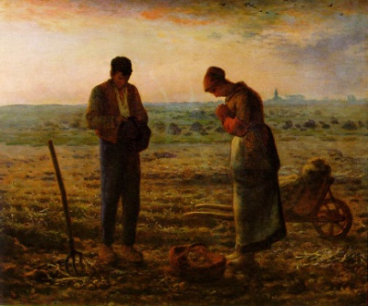
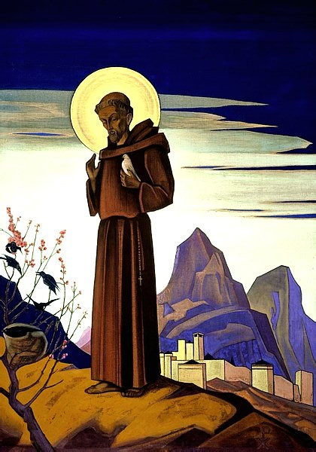
Other spiritual roots:
-- Ancient connections between faith, work and seasonal rhythms of agrarian communities
-- Early Church: “all held in common”
-- Middle Ages:
-- land and work seen as part of God’s creation, subject to religiously inspired ethical standards -- Nature viewed as gift; land belonged to God not humans -- community of property, care & protection of poor in society responsibility of church
-- St. Francis – “Patron Saint of Ecology”
-- care for the natural world -- care for humanity; love for the poor
“Perhaps the most inspiring role for Francis as patron of the environmental movement would be to join ecology with an option for the poor.” [Drew Christiansen, 1991)

Slide 7
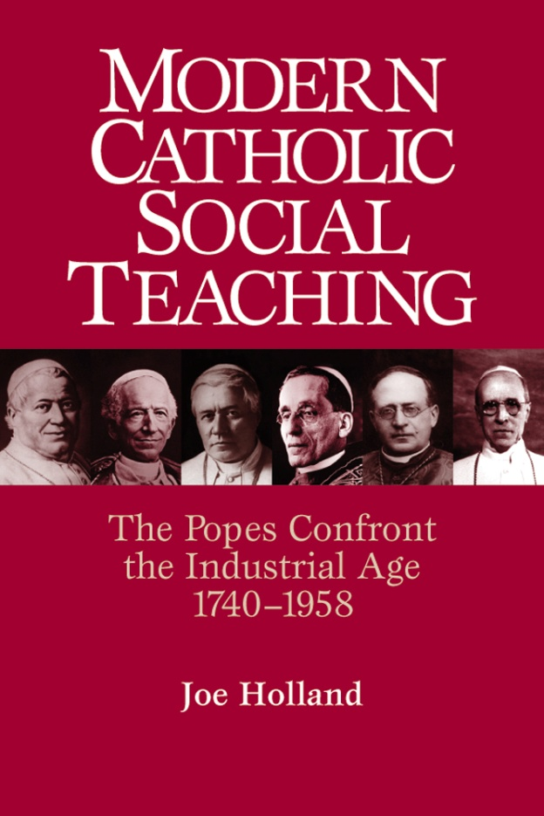
Modern Catholic social teaching has been articulated through a tradition of papal, conciliar, and episcopal documents. . .
The Church's social teaching is a rich treasure of wisdom about building a just society and living lives of holiness amidst the challenges of modern society.

Slide 8
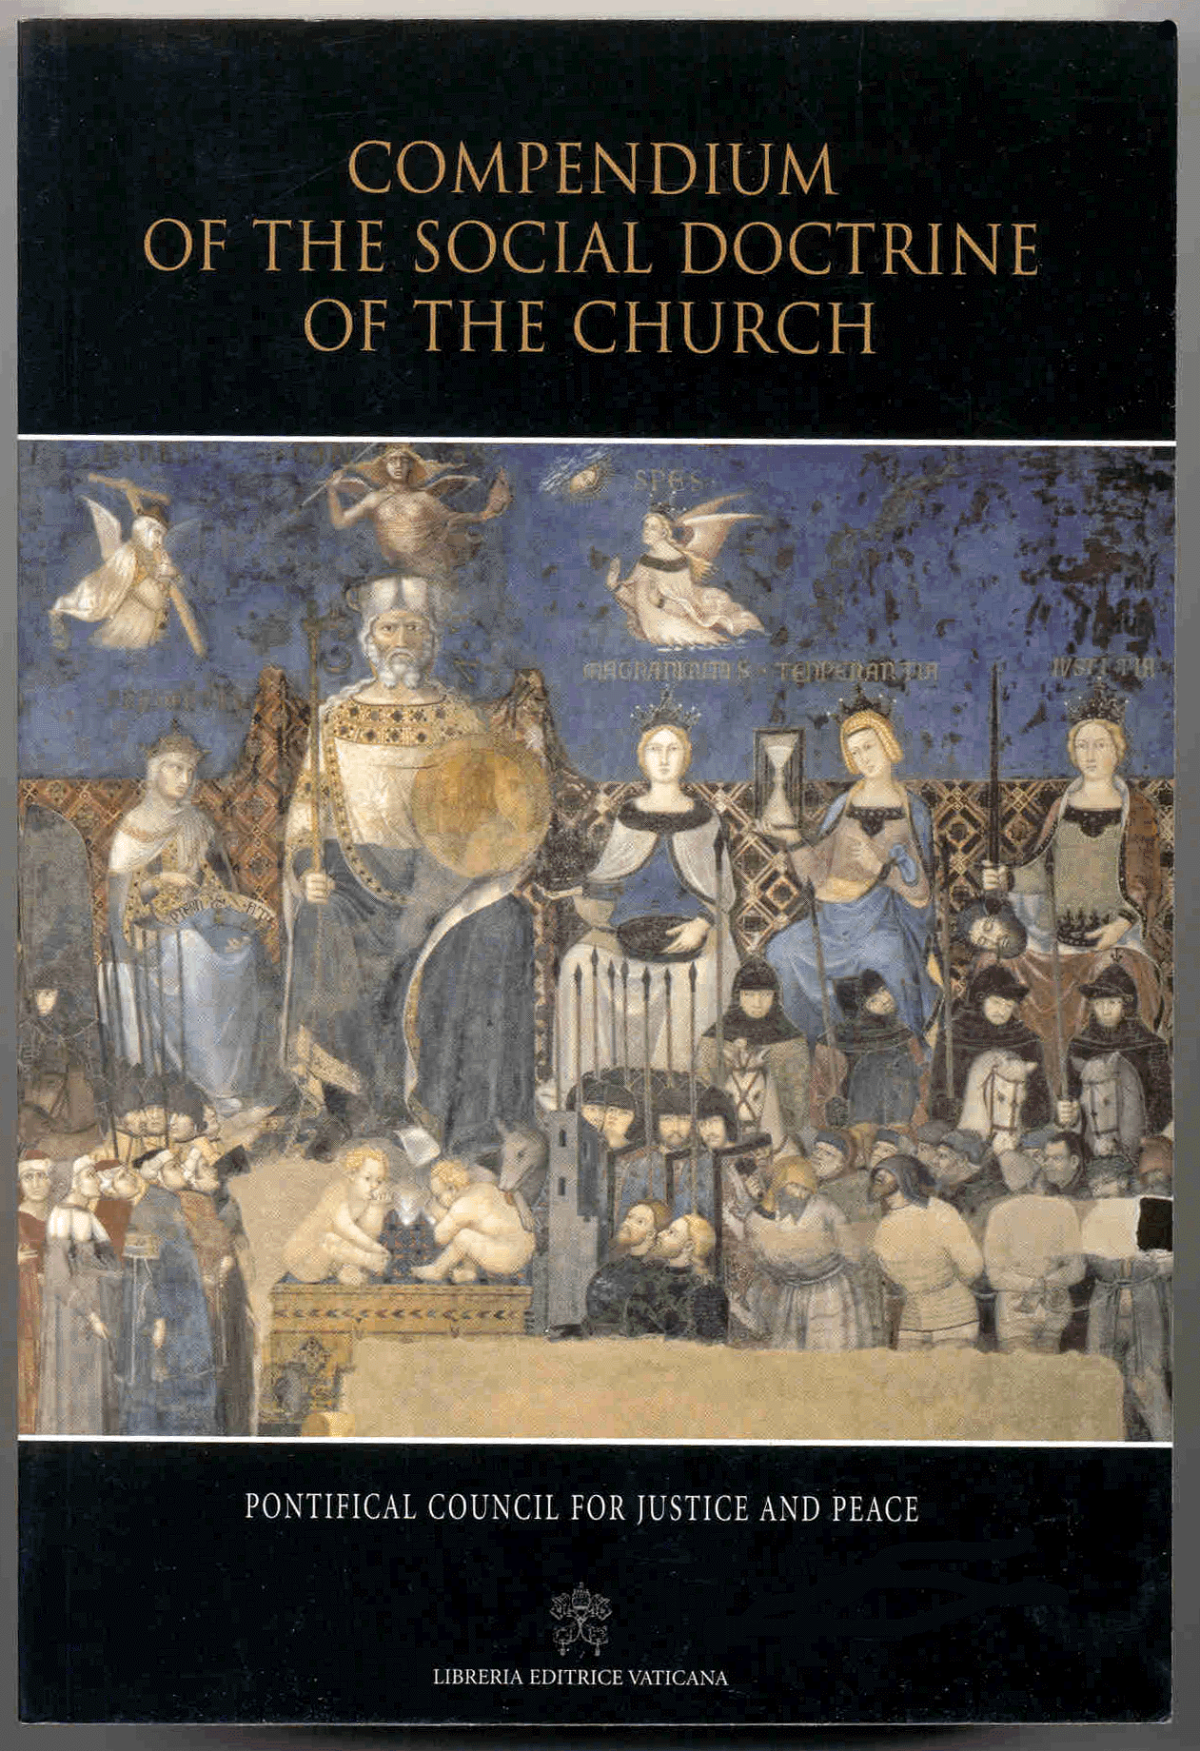
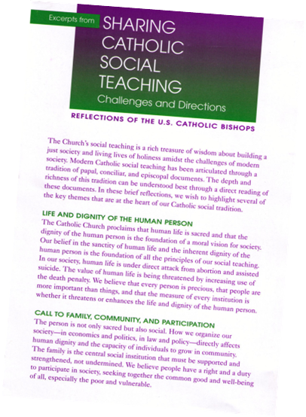
U.S. Conference of Catholic Bishops http://www.usccb.org/sdwp/projects/ socialteaching/excerpt.htm (1999)
Compendium Of The Social Doctrine Of The Church by Pontifical Council For Justice And Peace (2004)

Slide 9
THE SEVEN KEY THEMES OF CATHOLIC SOCIAL TEACHING
1 – Sacredness of Life & Dignity of the Human Person The Catholic Church proclaims that human life is sacred and that the dignity of the human person is the foundation of a moral vision for society.
Our belief in the sanctity of human life and the inherent dignity of the human person is the foundation of all principles of our social teaching.

Slide 10
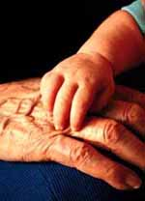
THE SEVEN KEY THEMES OF CATHOLIC SOCIAL TEACHING
2 -- Call to Family, Community, and Participation
The person is not only sacred but also social.
How we organize our society in economics and politics, in law and policy directly affects human dignity and the capacity of individuals to grow in community.
The family is the central social institution We believe people have a right and a duty to participate in society, seeking together the common good and well-being of all, especially the poor and vulnerable.

Slide 11
THE SEVEN KEY THEMES OF CATHOLIC SOCIAL TEACHING
3 – Rights and Responsibilities
The Catholic tradition teaches that human dignity can be protected and a healthy community can be achieved only if human rights are protected and responsibilities are met.
Therefore, every person has a fundamental right to life and a right to those things required for human decency.
Corresponding to these rights are duties and responsibilities to one another, to our families, and to the larger society.

Slide 12
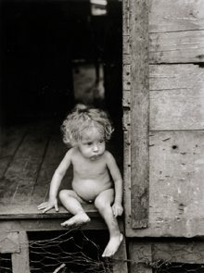
THE SEVEN KEY THEMES OF CATHOLIC SOCIAL TEACHING
4 – Option for the Poor and Vulnerable A basic moral test is how our most vulnerable members are faring.
In a society marred by deepening divisions between rich and poor, our tradition recalls the story of the Last Judgment (Mt 25:31-46) and instructs us to put the needs of the poor and vulnerable first.

Slide 13
THE SEVEN KEY THEMES OF CATHOLIC SOCIAL TEACHING
5 – The Dignity of Work and the Rights of Workers
The economy must serve people, not the other way around.
Work is more than a way to make a living; it is a form of continuing participation in God's creation.
If the dignity of work is to be protected, then the basic rights of workers must be respected the right to productive work, to decent and fair wages, to organize and join unions, to private property, and to economic initiative.

Slide 14
THE SEVEN KEY THEMES OF CATHOLIC SOCIAL TEACHING
6 – Solidarity
We are our brothers' and sisters' keepers, wherever they live.
We are one human family, whatever our national, racial, ethnic, economic, and ideological differences.
Learning to practice the virtue of solidarity means learning that "loving our neighbor" has global dimensions in an interdependent world.

Slide 15
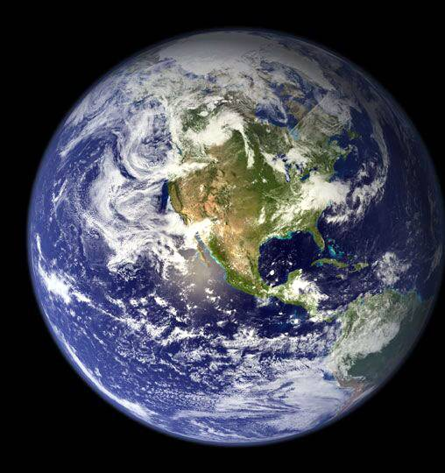
THE SEVEN KEY THEMES OF CATHOLIC SOCIAL TEACHING
7 – Care for God's Creation
We show our respect for the Creator by our stewardship of creation.
Care for the earth is not just an Earth Day slogan, it is a requirement of our faith. We are called to protect people and the planet, living our faith in relationship with all of God's creation.
This environmental challenge has fundamental moral and ethical dimensions that cannot be ignored.

Slide 16
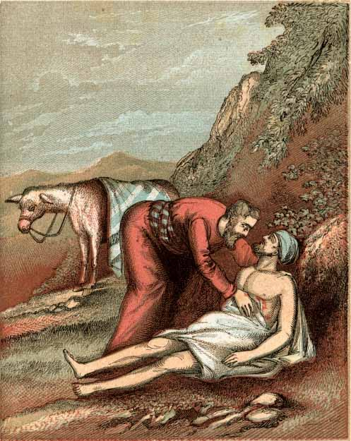
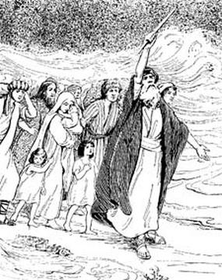
Kindness and truth shall meet, justice and peace shall kiss. Ps 85:11
Works of Charity Social Service | Works of Justice Social Change
Scriptural Reference: Good Samaritan Story The Gospel story does not attempt to survey the causes of highway banditry. The Samaritan provides temporary and immediate relief. | Scriptural Reference: Exodus Story Moses does not ask for food and medicine for the Jewish slave-labor force. He challenges the institutional system. "Let My People Go."
Private, individual acts | Public, collective actions
Responds to immediate need | Responds to long-term need
Provides direct service: food, clothing, shelter | Promotes social change in institutions
Requires repeated actions | Resolves structural injustice
Directed at the effects of injustice: symptoms | Directed at the root causes of social injustice
Examples:
Homeless shelters, food shelves, clothing drives, emergency services | Legislative advocacy, changing corporate policies or practices, congregation-based community organizing.

Slide 17
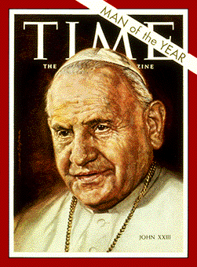
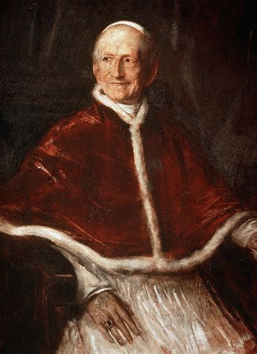
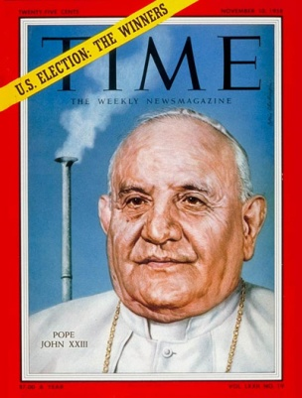
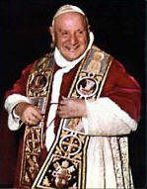
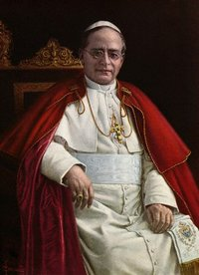
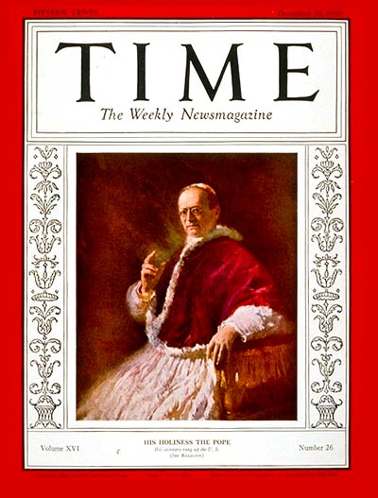
Modern ecological concerns
-- Intergenerational responsibility & its environmental implications
-- Environmental sustainability & population control
Pope John XXIII
Mater et Magistra “Mother and Teacher” On Christianity & Social Progress (1961) Pacem in Terris “Peace on Earth” (1963)
Vatican II
Gaudium et Spes “Joy and Hope” The Church in the Modern World (1965)
Pope Leo XIII
Rerum Novarum “Of New Things” The Condition of Labor (1891)
Human rights & responsibilities, effects of war, addressed to whole world: inclusiveness, science’s ability to address environmental problems
Primacy of humanity over creation private property ➔ common good gifts from God for benefit of all
Reiterates rights & responsibilities attached to private property use importance of common good
Pope Pius XI
Quadragesimo Anno (40th anniversary of Rerum Novarum) On Reconstructing the Social Order (1931)
First to address environment separate from other social concerns; holistic view: humanity is out of harmony with all created things.
Notes:
atomic energy, modern agriculture vs industrial world, space exploration, resources & development

Slide 18
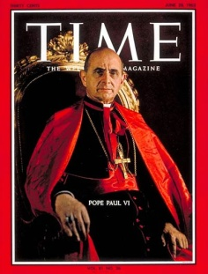
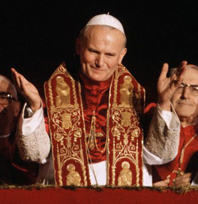
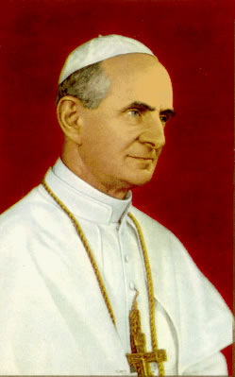
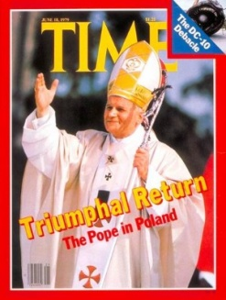
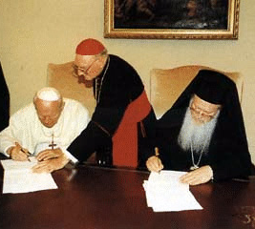
Pope John Paul II
Laborem Exercens “On Human Work” (1981)
Sollicitudo Rei Socialis “On Social Concern” (1987) Peace With The Creator, Peace with All of Creation (1990 )
Centesimus Annus (On the 100th Anniversary of Rerum Novarum) (1991)
Tertio Millenio Adveniente “On the Coming of the Third Millennium” ( 1994)
Evangelium Vitae “The Gospel of Life” (1995) “Declaration on the Environment: We are Still Betraying the Mandate God Has Given Us” (Venice Declaration 2002) with Patriarch Batholomew I of Constantinople
Natural resources are limited
Development & environmental risks, justice & sustainability Global vision of human solidarity: mutual connection, “being is more than “having” Nonrenewable resources & future generations Environmental problem is a moral problem
Human dignity, lack of respect for life in patterns of environmental degradation
Management of earth’s goods – subsidiarity
Human right to a safe environment (poverty, war)
Courage to adopt a new life-style
Broad view of development beyond economic progress, must promote good of every person & the whole person
Pope Paul VI Populorum Progressio “On the Development of Peoples” (1967) Octogesima Adveniens (On the 80th Anniversary of Rerum Novarum) (1971)
Beginning of realization that destruction of nature itself a real possibility; concerns entire human family
- goodness of creation - centrality of human person - at its core, the environmental crisis reflects moral failing

Slide 19
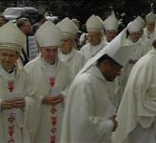
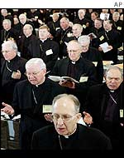
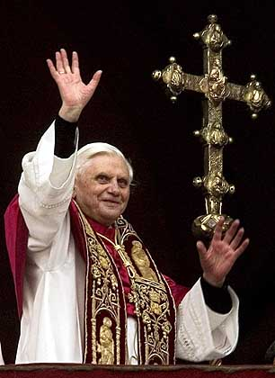
Pope Benedict XVI
Inaugural homily: “The earth’s treasures no longer serve to build God’s garden for all to live in, but they have been made to serve the powers of exploitation and destruction.”
Based on writings as Cardinal:
-- Creation is a vital manifestation of the Creator
-- Liturgical life and natural life are closely linked
-- Technology has power to both aid and harm the environment
-- Humanity must be respected in proposed environmental law
-- War has a destructive impact
U.S. Conference of Catholic Bishops “Brothers and Sisters to Us” (1979) “Statement on Capital Punishment” (1980)
“The Challenge of Peace” (1983) “Economic Justice for All” (1986) Socially Responsible Investment Guidelines (1991) Renewing the Earth (1991) Global Climate Change: A Plea for Dialogue, Prudence, and the Common Good (2001)
Pope Benedict XVI
Deus Caritas Est “God is Love” (2006)

Slide 20
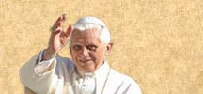
Pope Benedict’s World Day of Peace Message 1 January 2007
“The Human Person, The Heart of Peace”
Humanity, if it truly desires peace, must be increasingly conscious of the links between natural ecology, or respect for nature, and human ecology.
Experience shows that disregard for the environment always harms human coexistence, and vice versa.
It becomes more and more evident that there is an inseparable link between peace with creation and peace among men. Both of these presuppose peace with God.
The poem-prayer of Saint Francis, known as ‘the Canticle of Brother Sun’, is a wonderful and ever timely example of this multifaceted ecology of peace.”

Slide 21
US Conference of Catholic Bishops (USCCB)
Renewing the Earth: An Invitation to Reflection and Action on the Environment in Light of Catholic Social Teaching (1991)
Seven principles upon which environmental policy should be based:
1. Adopting a God-centered & sacramental view of the universe
2. Maintaining respect for human life, which extends to respect for all creation
3. Adopting a worldview affirming the ethical significance of global interdependence & the common good
4. Pursuing ethics of solidarity
5. Respecting the universal purpose of created things
6. Advancing an option for the poor
7. Advocating authentic development that respects human dignity and the limits of material growth

Slide 22
Global Climate Change: A Plea for Dialogue, Prudence, and the Common Good (2001)
Why bishops are entering the debate:
- Much of debate seems polarized & partisan - Science too often used as a weapon - Various interests minimize or exaggerate the challenges we face - Search for the common good & the voices of poor people and poor countries sometimes are neglected - Seek to offer a word of caution and a plea for genuine dialogue
Singles out United States as bearing a weighty responsibility in matter of environmental stewardship
Outlines specific aspects of development linked to ecological policy
Notes:
- bettering education & social conditions for women
- assisting developing nations in dev & financing energy efficient technologies
Involve dev. Nations in decision making
- provide incentives to corporations to reduce GHG emissions & to assist workers affected by these policies

Slide 23
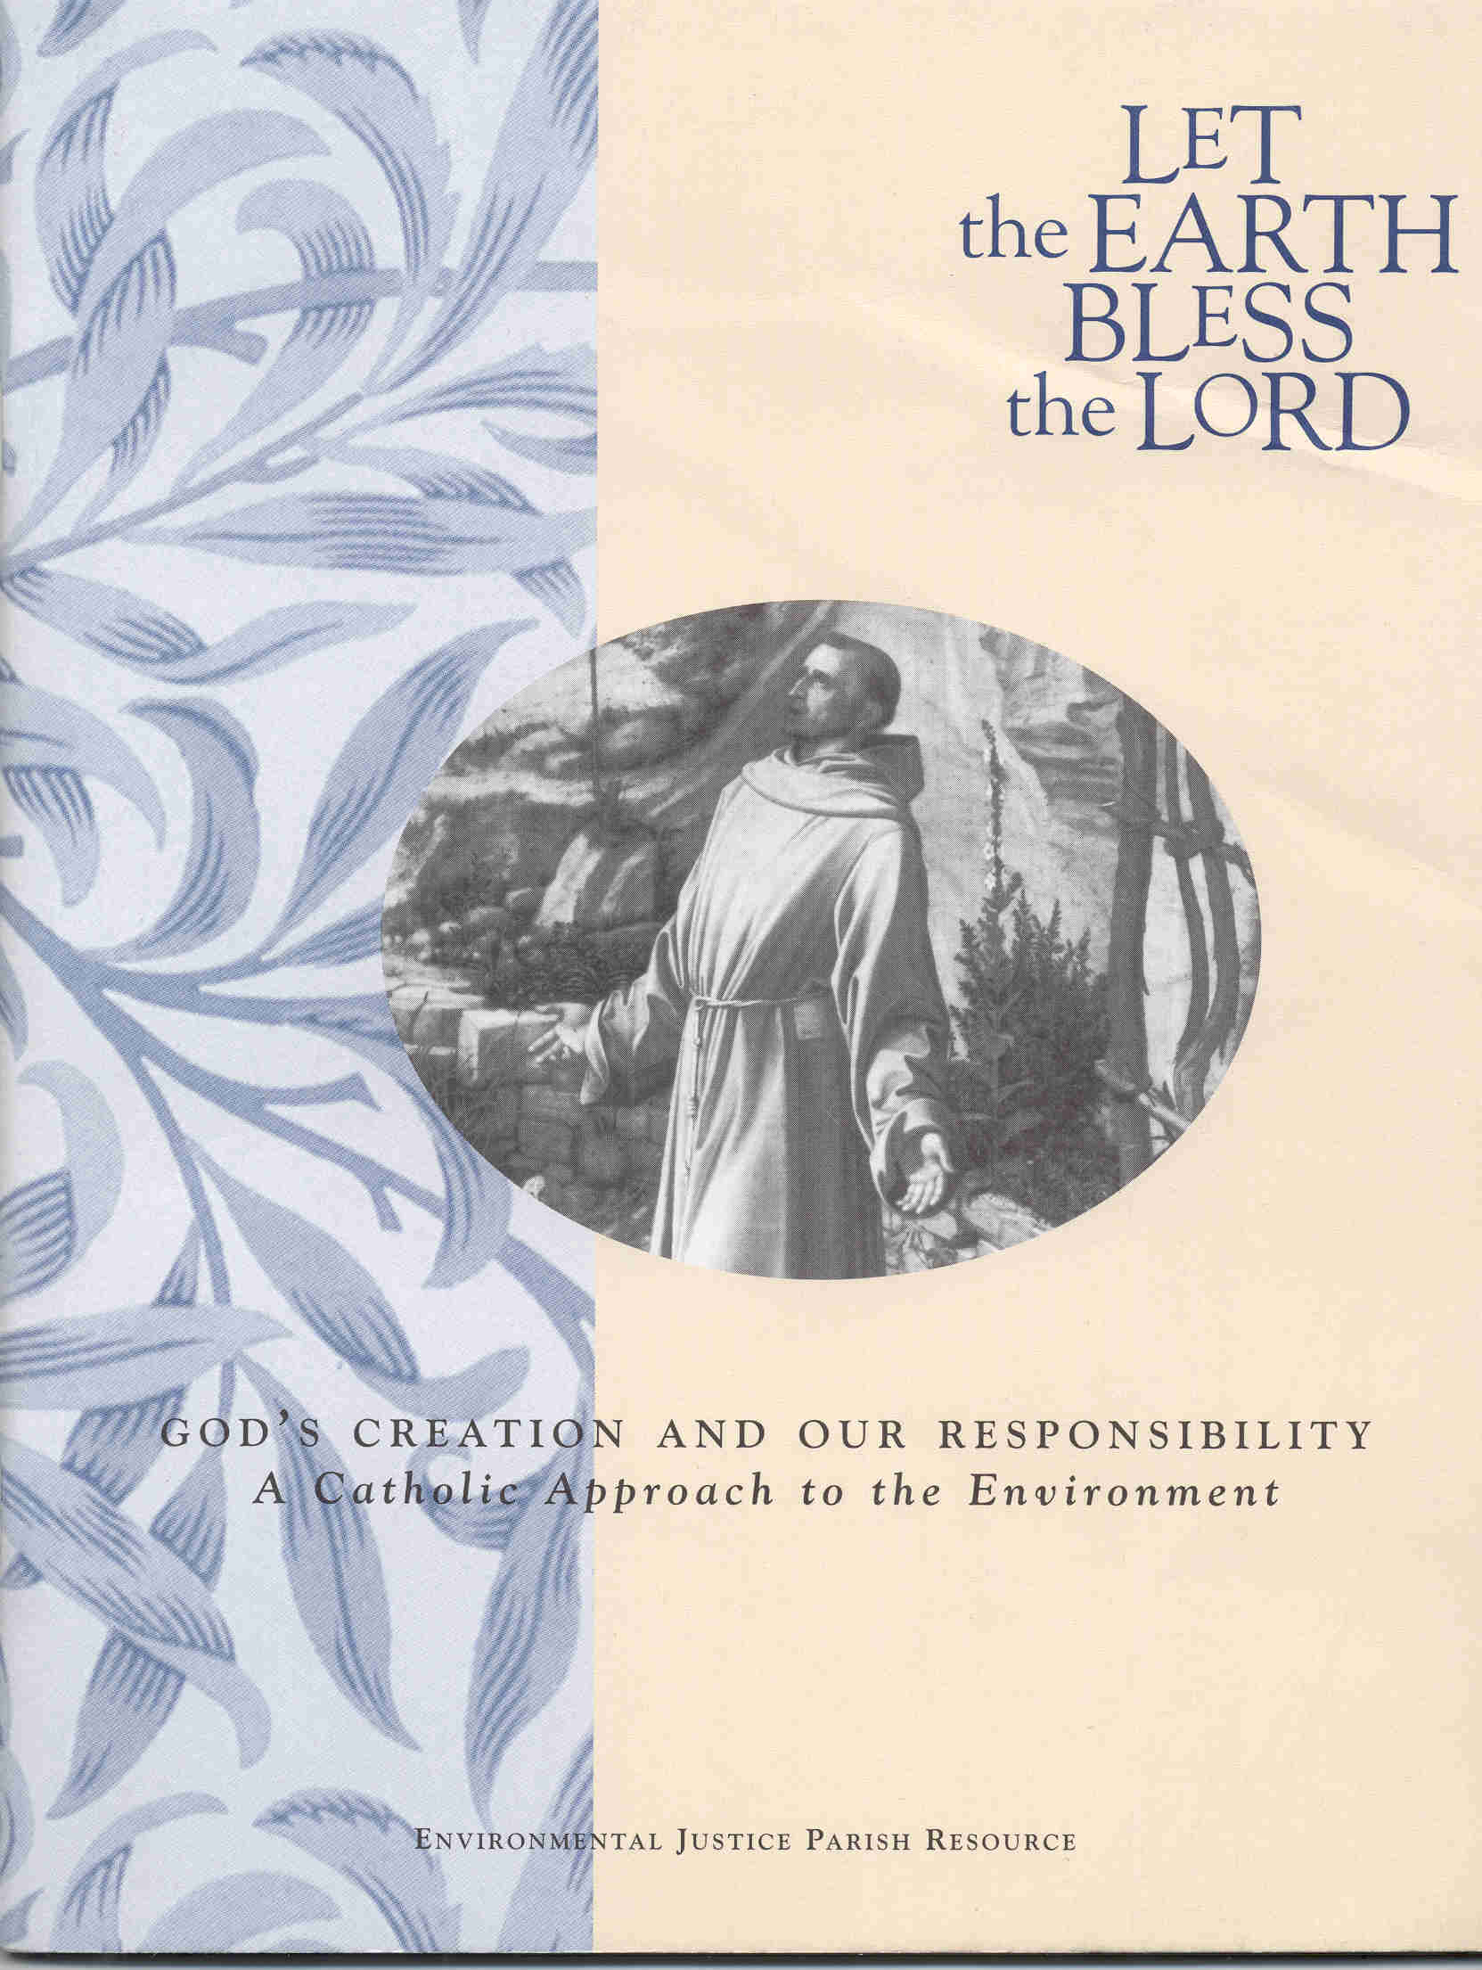
USCCB’s
Environmental Justice Program

Slide 24
EJP’s Policy Framework:
http://www.usccb.org/sdwp/ejp/background/policy.html
(1) environmental justice: defined as the strong link between social justice and environmental protection emphasizing the needs of the poor
(2) sustainable development: with an emphasis on social and economic development that not only protects the sustainability of natural resources but promotes a just distribution of these resources today and for future generations
(3) worker protection: insisting that workers' needs should not be sacrificed at the expense of environmental protection or vice versa
(4) the “commons:” defined as protecting vital global shared resources such as the oceans, land, water and fisheries.

Slide 25
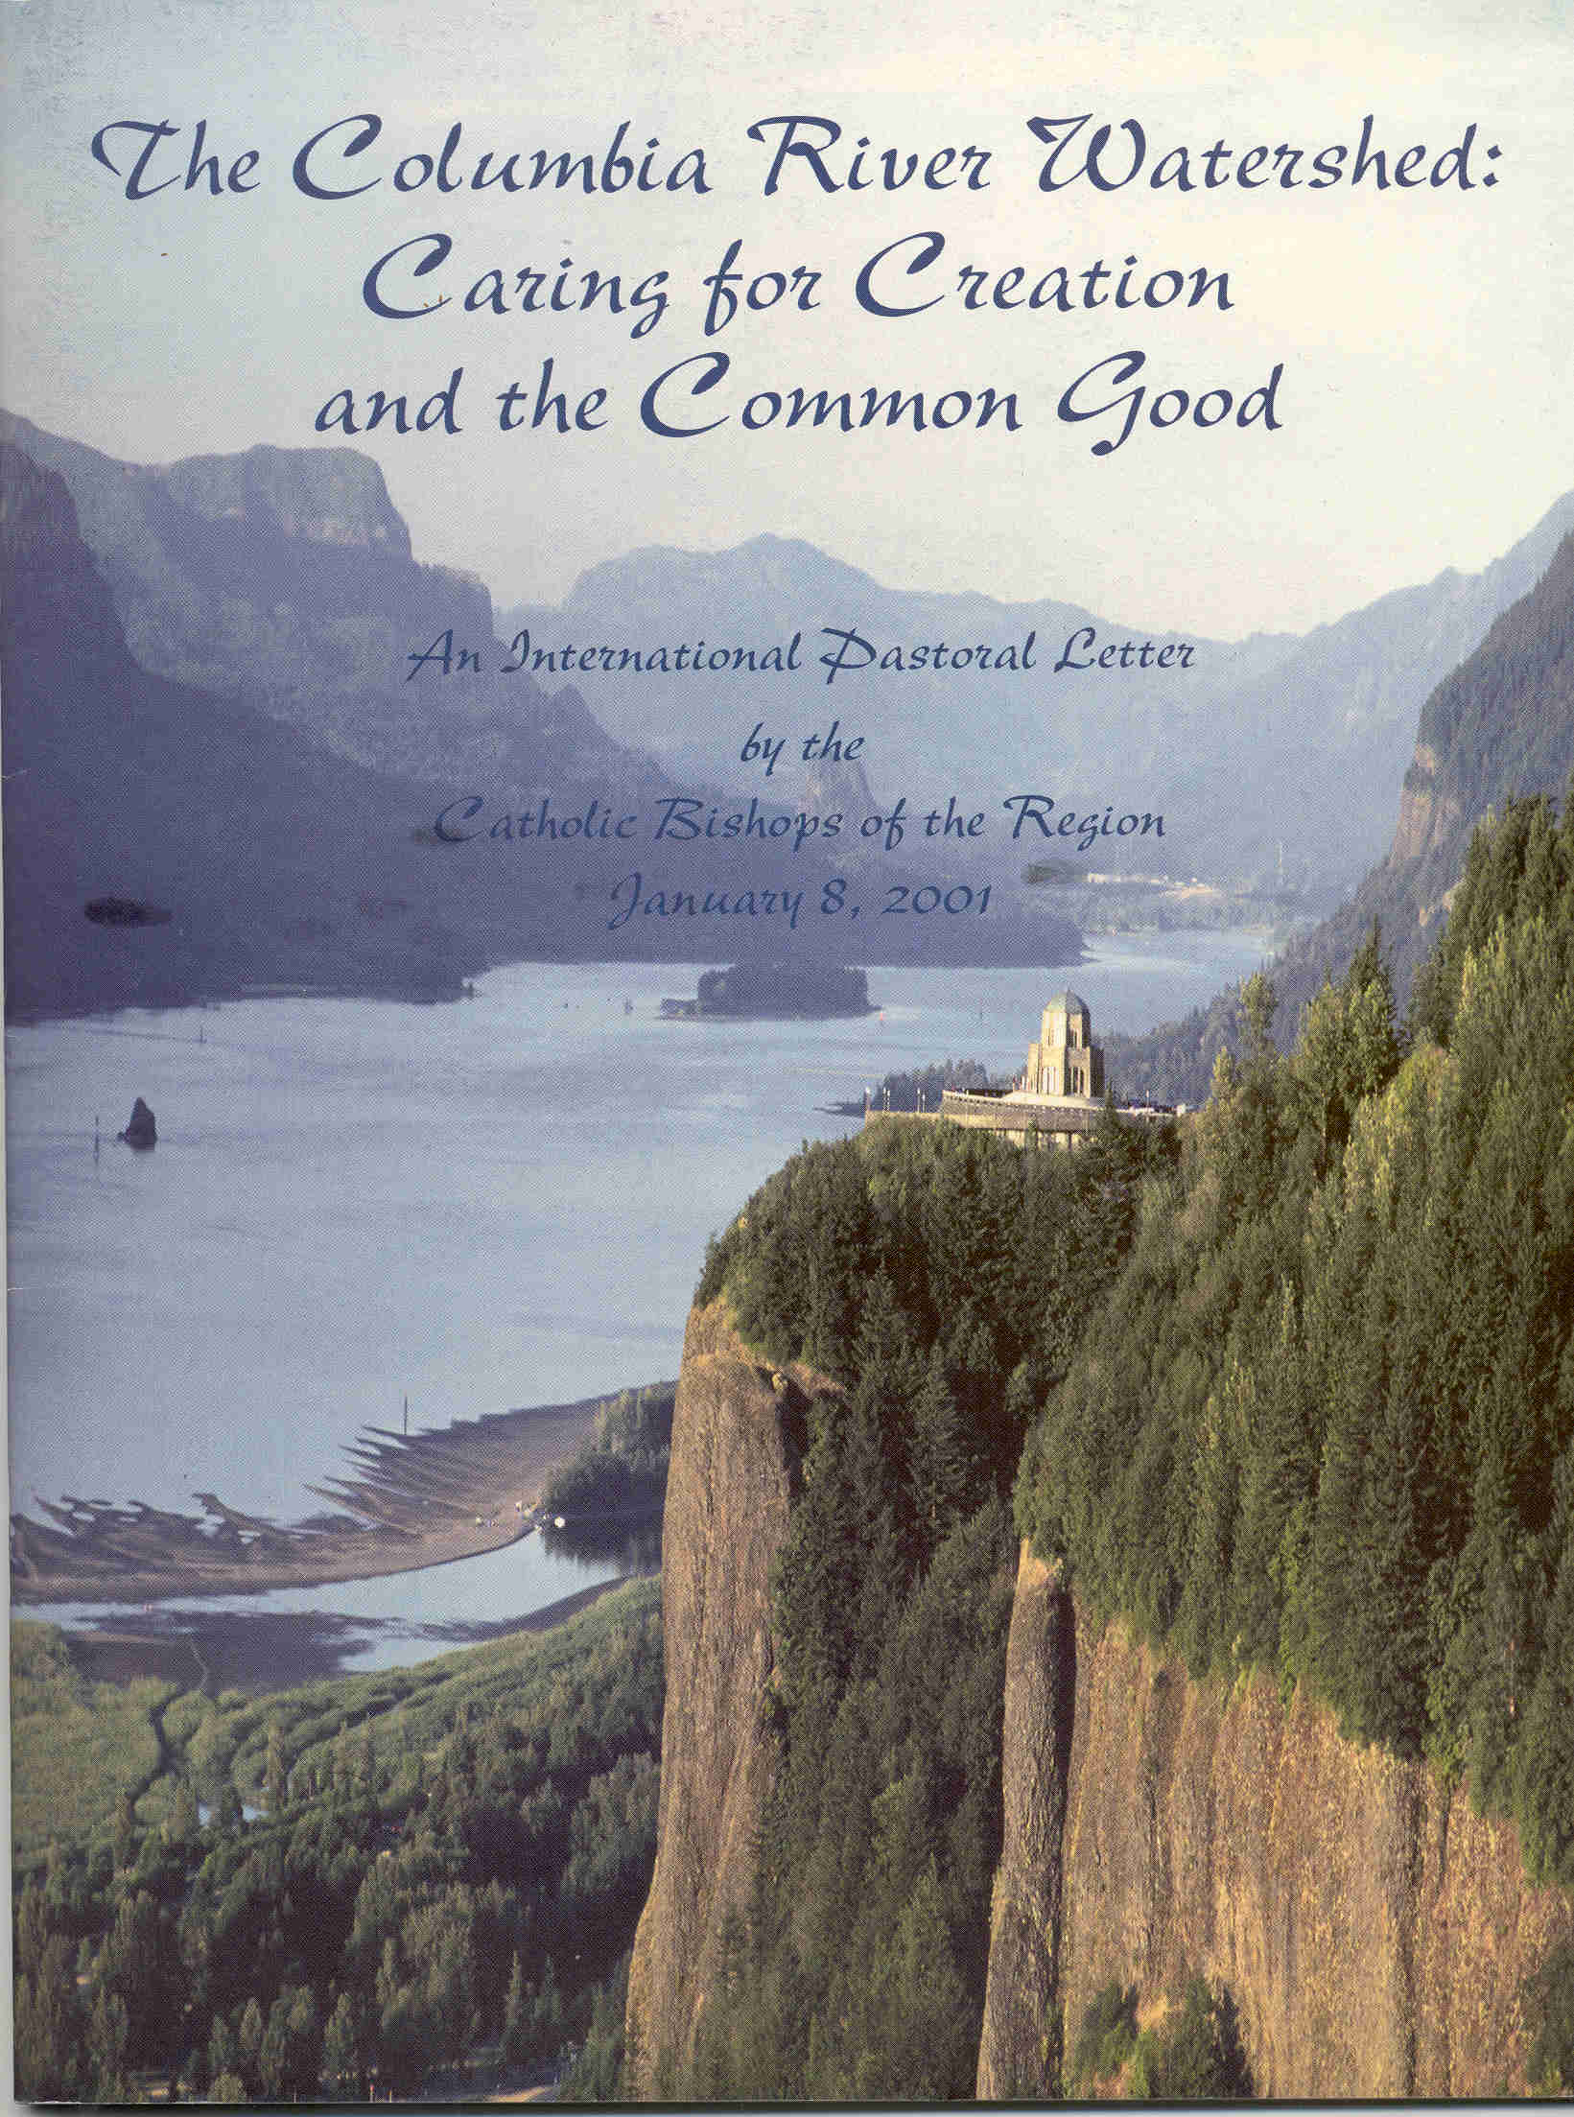
Regional & Local Initiatives . . .
The Columbia River was the focus of an extensive pastoral letter project launched by 12 Catholic bishops of the Northwest and Canada
EJP- sponsored local & regional projects: -- comprehensive vision, address multiple conditions, diverse constituencies
-- address concrete issues linking social & economic justice with environmental protection
-- engage citizen groups, reliable research
-- integrate social teaching / education with direct public policy activity
pastoral letter issued by the NW bishops in February 2001
Notes:
Connecticut: The CenterEdge Project state-wide dialogue focused on the impact of sprawl on low-income communities and on water quality.
Florida: state-wide dialogue on the urgent environmental concerns around water and water quality.
Michigan: Transportation Equity Project, Detroit, Michigan Iowa: This project focused on the environmental, economic and social impacts of large scale hog-farming. California: focused primarily on the important moral consequences of uncontrolled sprawl, unsustainable development, and economic inequality in this enormous metropolitan region.
(a) To build more comprehensive vision, projects will address multiple conditions as experienced by diverse constituencies
(b) To address concrete issues which closely link social and economic justice and environmental protection
(c) To build on broad institutional engagement, coalition with citizen groups, and reliable research
(d) To integrate broad social teaching and education with direct public policy activity

Slide 26
USCCB’s newest EJP initiative: CLIMATE CHANGE JUSTICE AND HEALTH
http://www.usccb.org/sdwp/ejp/climate/index.shtml

Slide 27
SUMMARY
ENVIROMENTAL PRINCIPLES GLEANED FROM CATHOLIC SOCIAL TEACHING (source: Silecchia, 2004)
a) Human life and dignity must remain at the forefront of any consideration of environmental questions
b) Stewardship * is the appropriate model for human care for the environment
c) Obligations to future generations must influence environmental decision-making
* One who cares for property and possessions that belong to others

Slide 28
d) In the spirit of subsidiarity* environmental decision-making must be made at the appropriate level
The right to private property and the mandate to use property for the common good must both be respected in environmental policies
Environmental concerns are also moral concerns which require radical rethinking of consumer culture
* should resolve problems at the lowest possible level, but higher level must step in when needed or appropriate

Slide 29
SOME MOVEMENTS IN CATHOLIC SOCIAL TEACHING BEYOND THE ANTHROPOCENTRIC APPROACH
-- affirmation of sacredness of all creation
-- acknowledgement of interdependence of life in all its forms
-- importance of thinking on behalf of future generations of ALL life forms
-- environmental crisis is a moral crisis
-- critique of market economics and unrestrained use of Earth’s resources
-- ways toward integrating sustainable development as a foundation for Peace

Slide 30
“A summary of Catholic Social Justice teaching suggests the following themes for religious teaching and moral debate:
A God-centered and sacramental view of the universe which grounds human accountability for the fate of the earth.
A consistent respect for human life which extends to respect for all creation.
A world view affirming the ethical significance of global interdependence and the common good.
from: New Mexico Catholic Conference “Partnership for the Future” http://www.ncrlc.com/bishop-statements-webpages/newmexico.html

Slide 31
An ethics of solidarity promoting cooperation and a just structure of sharing in the world community.
An understanding of the universal purpose of created things which requires equitable use of the earth's resources.
An option for the poor which gives passion to the quest for an equitable and sustainable world.
A conception of authentic development offering a direction for progress which respects human dignity and the limits of material growth.

Slide 32
Closing Thoughts on the Role of Science in CST and the Environment
-- parallel development of CST- environment connection and scientific advances
-- as in other areas, popes, bishops, etc. have invited the voice of science
-- CST addresses vital issues beyond purview of science
-- CST deepens and intensifies the need for science’s contributions and vision

Slide 33
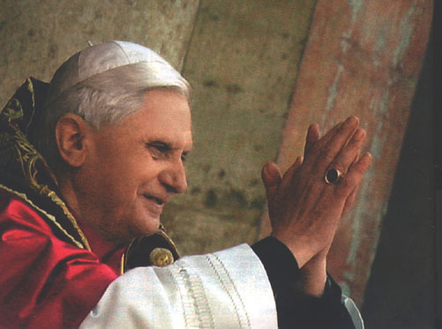
Love—caritas—will always prove necessary, even in the most just society.
This is where Catholic social doctrine has its place: . . . Its aim is simply to help purify reason and to contribute, here and now, to the acknowledgment and attainment of what is just.
Prayer, as a means of drawing ever new strength from Christ, is concretely and urgently needed.
It is time to reaffirm the importance of prayer in the face of the activism and the growing secularism of many Christians engaged in charitable work.

Slide 35
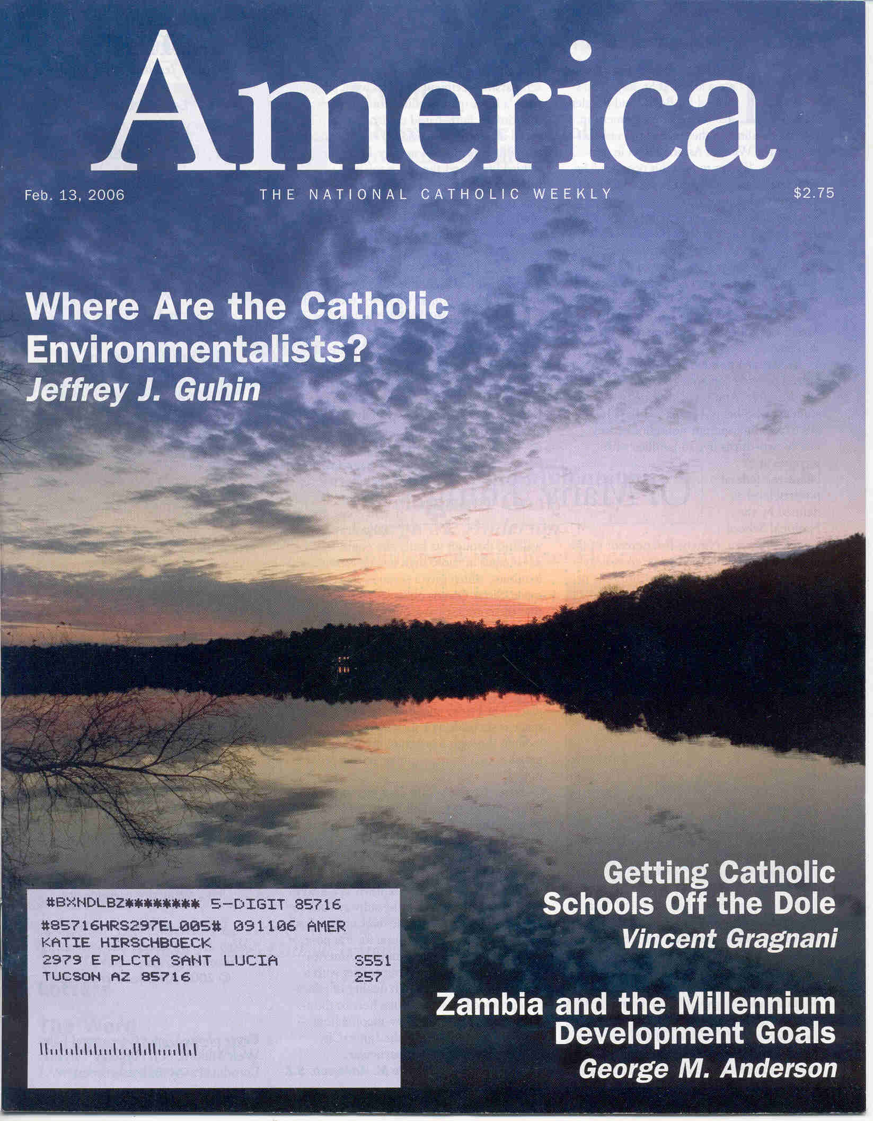
“The action . . . Is not national, and it often is not issue-driven. . . . [it] is going on locally, and the most pressing changes are occurring not in issues but in attitudes . . . . Catholics across the country are beginning to rethink how they relate to the Earth and to re-evaluate their role in the ecological balance.
After all, this is ecology, so the best way to go is organic, and the best way to start is from the ground up.”
Feb 13, 2006 issue

