Slide 1
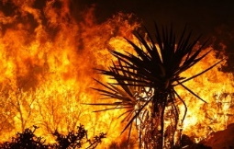
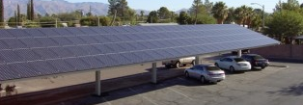
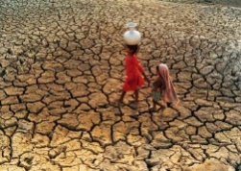
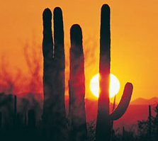


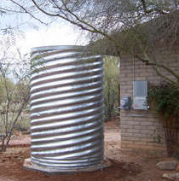
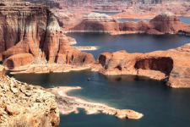
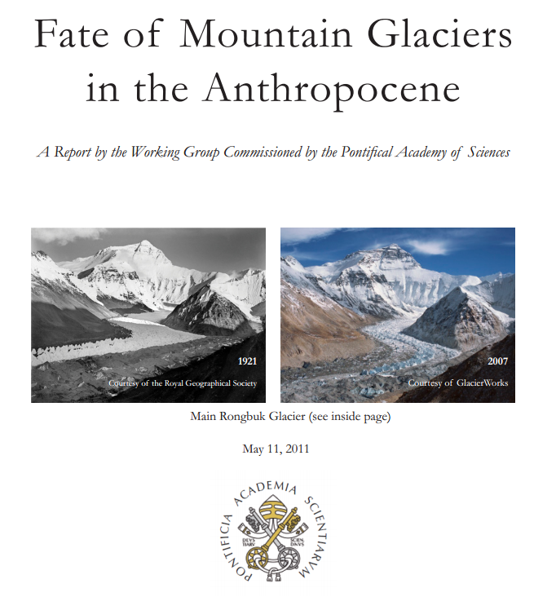


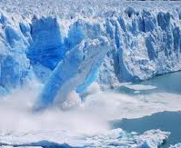
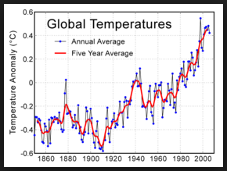










Corpus Christi Parish Presents:
MONDAY MARCH 3rd @ 6:30 – 8:00 pm
Climate Change and Care for Creation
WHY & HOW…
. . . Catholics are Called to Act
Katie Hirschboeck
UofA Climate Scientist
Laboratory of Tree-Ring Research
& Catholic Climate Ambassador
Hank Krzysik
Corpus Christi Parish 300 N Tanque Verde Loop Rd Tucson, AZ

