Slide 1
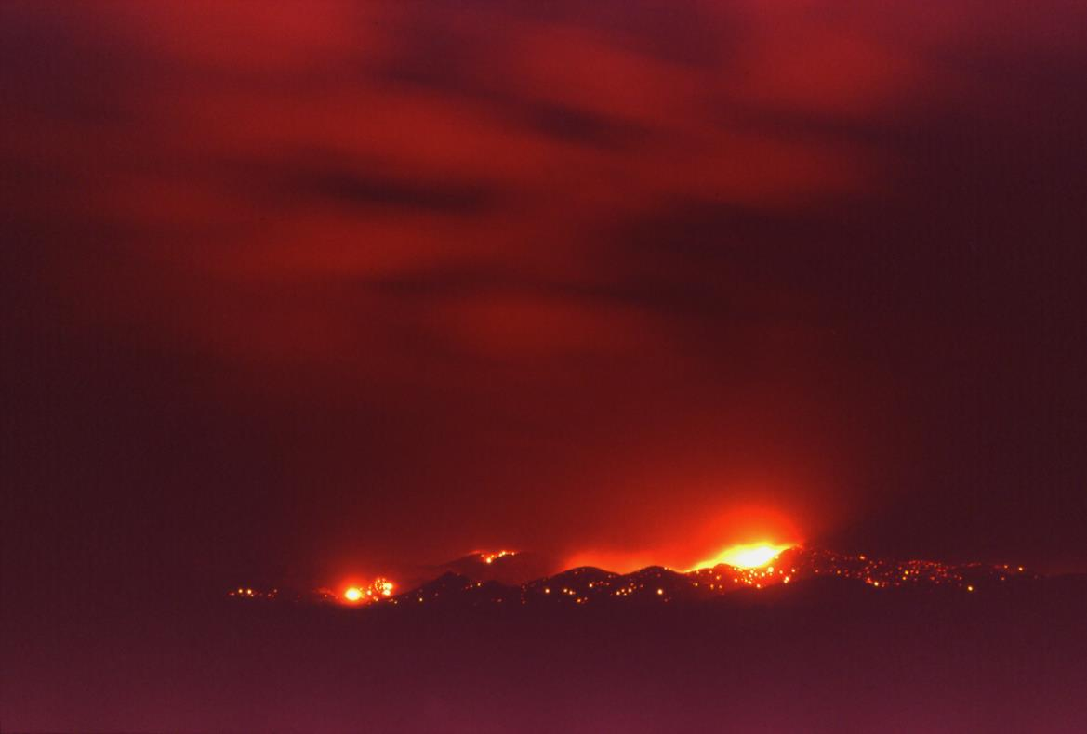
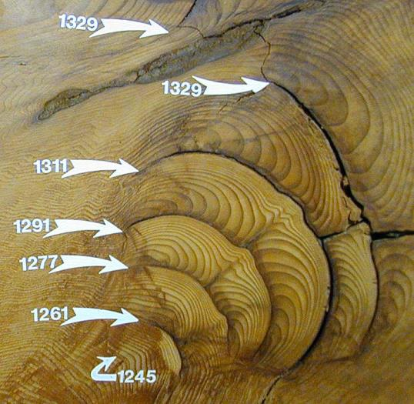
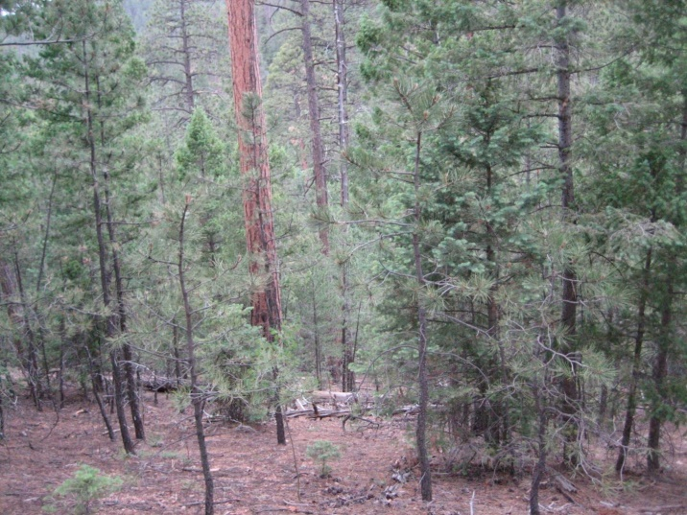
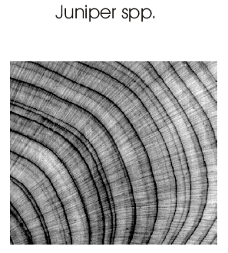
Tree-rings: introduction and applications for fire and forest restoration

Slide 2
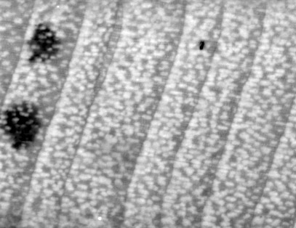
Quiz - whataya know?
Who’s ever seen tree rings?
What can tree rings tell us?

Slide 3
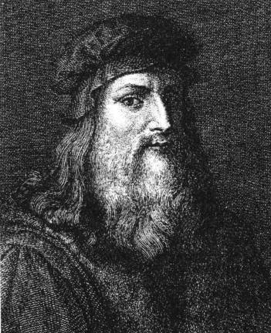

Leonardo da Vinci (1500 AD)
Aristotle (350 BC)
“Rings in the branches of sawed trees show the number of years and, according to their thickness, the years which were more or less dry. Thus, they reflect the individual worlds to which they belong, in the north [of Italy] they are much thicker than in the south.”

Slide 4
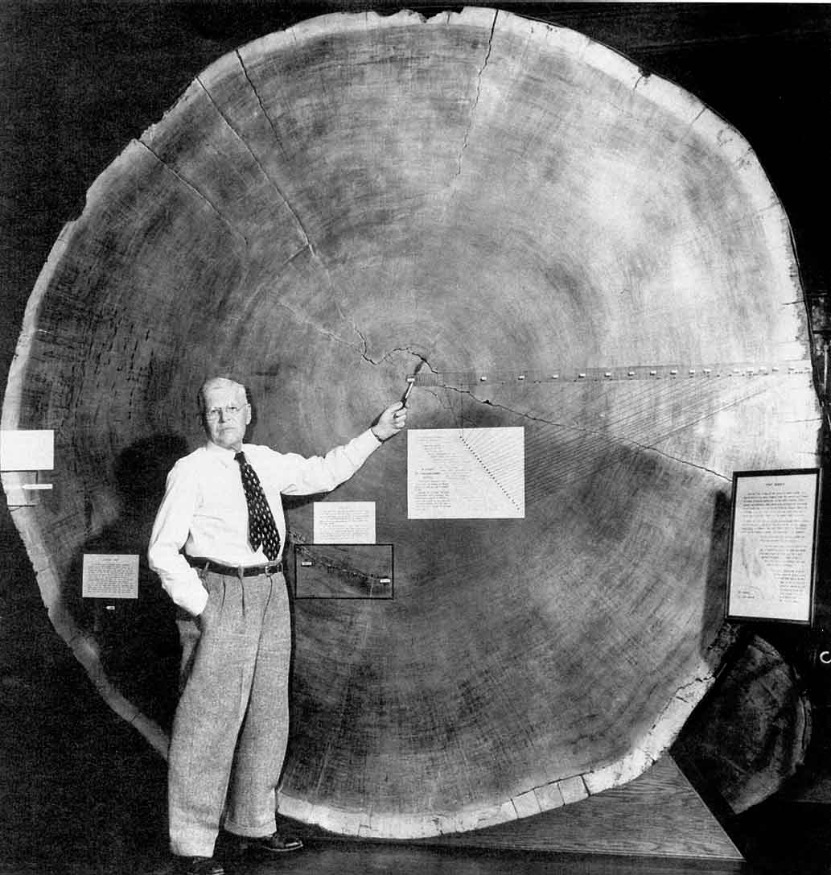
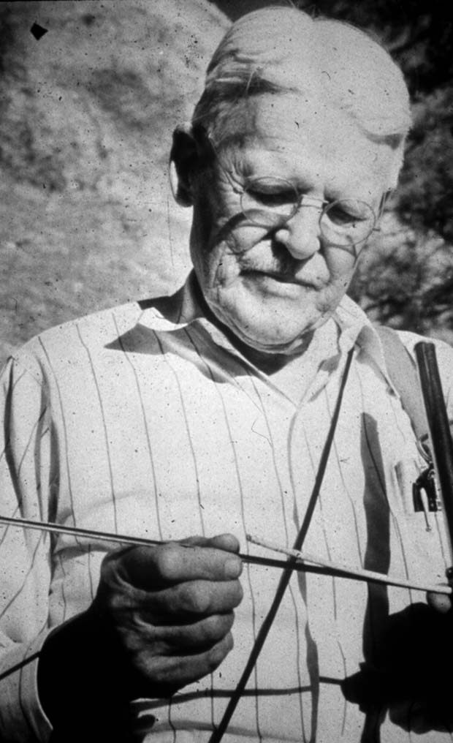
Andrew Ellicott Douglass 1867-1962
Founder of Modern Dendrochronology
&
Laboratory of Tree-Ring Research

Slide 5
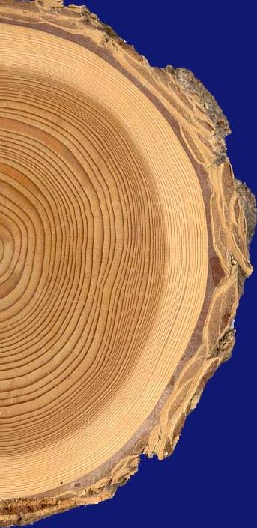
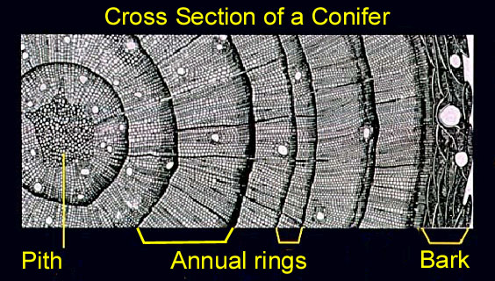
Environmentally beneficial years
Environmentally stressful year
Notes:
So what are tree-rings?

Slide 6
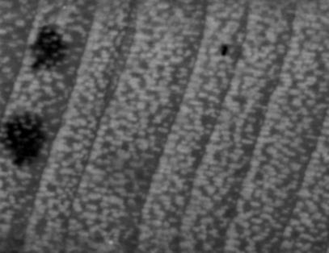
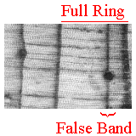
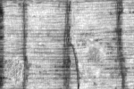
But it’s not just counting rings!
False rings
Missing Rings

Slide 7
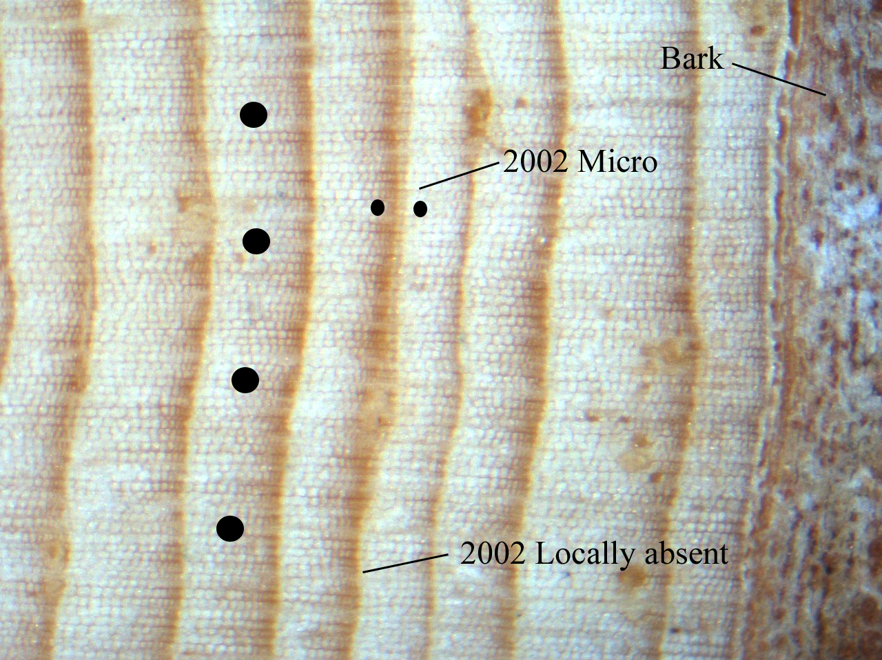

Slide 8
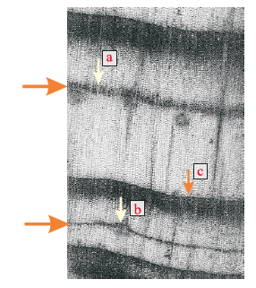
False rings are common in the SW because of the monsoon climate
Pinus spp.
Juniperus spp.

Slide 9
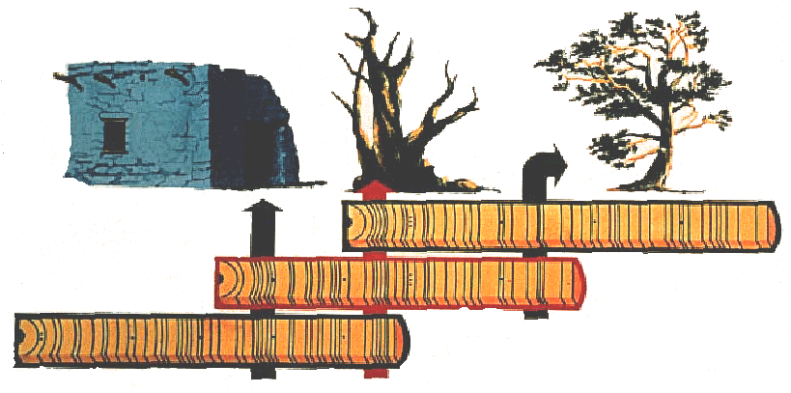
Crossdating: The Basic Principle of Dendrochronology
C
B
A
A
1920
1930
B
1900
1910
C
1850
1860
1870
1880
1890
<<<<<<<“Bridging” back in time<<<<<<<
Notes:
So because you can’t just ring count, Douglass figured out a system for pattern matching to correct for errors and ensure annual accuracy – Crossdating

Slide 10
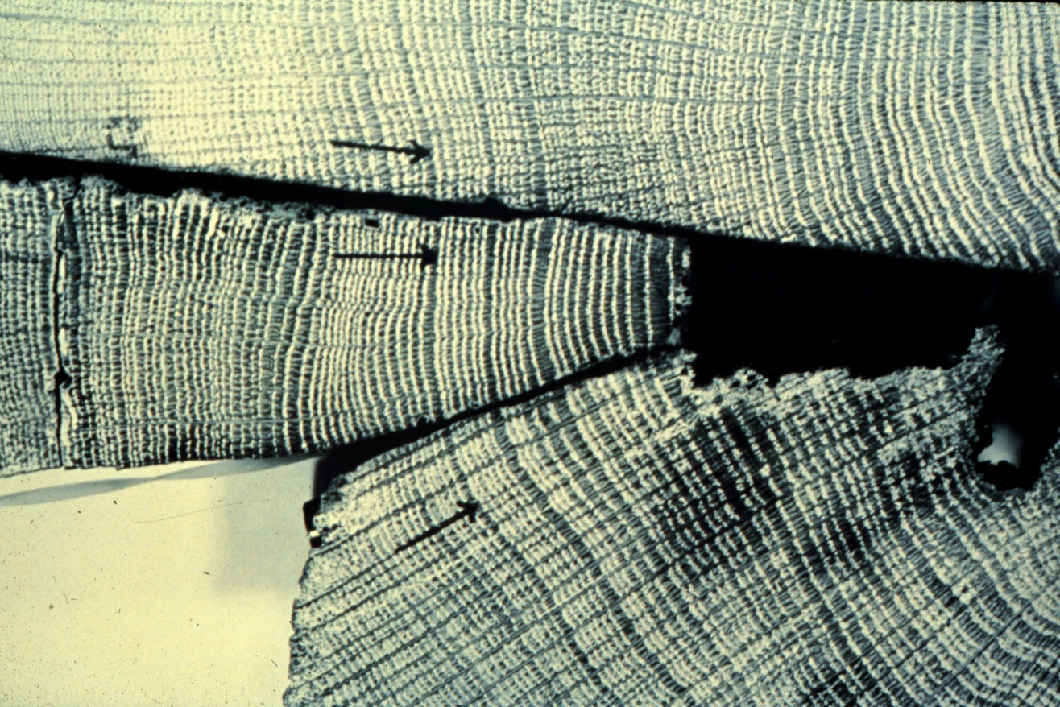
Shared pattern of ring growth
(makes crossdating possible)
Baillie, 1982
Quercus (oak) timbers from locations in Ireland up to 200 km apart. Note similarity of patterns - marked year is AD 1580
Notes:
Why is this pattern matching or “crossdating” possible?

Slide 11
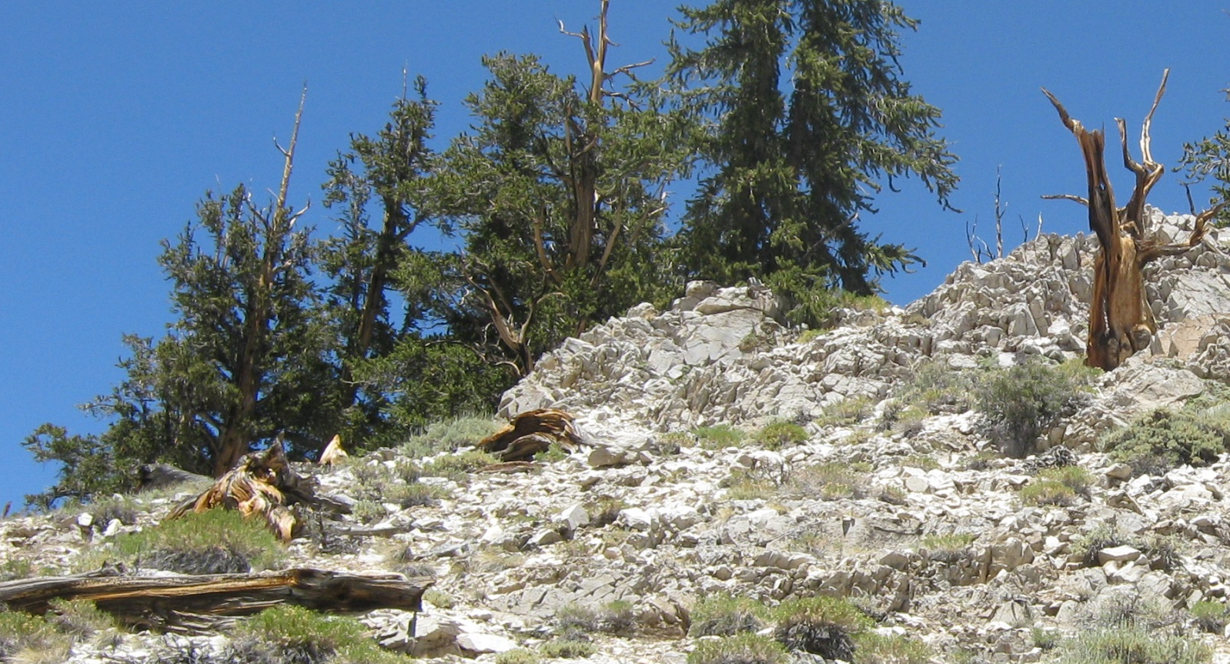
The Secret to Dendrochronology
How do we figure out the year of ring growth from dead or remnant trees that have been laying on the ground for an unknown number of years?
The tree-ring pattern!
Notes:
In this class I’m going to teach you the secret of dendrochronology

Slide 12
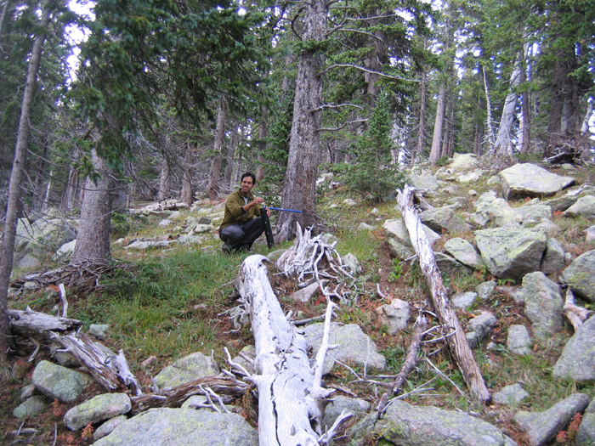
Tree-ring sampling

Slide 13
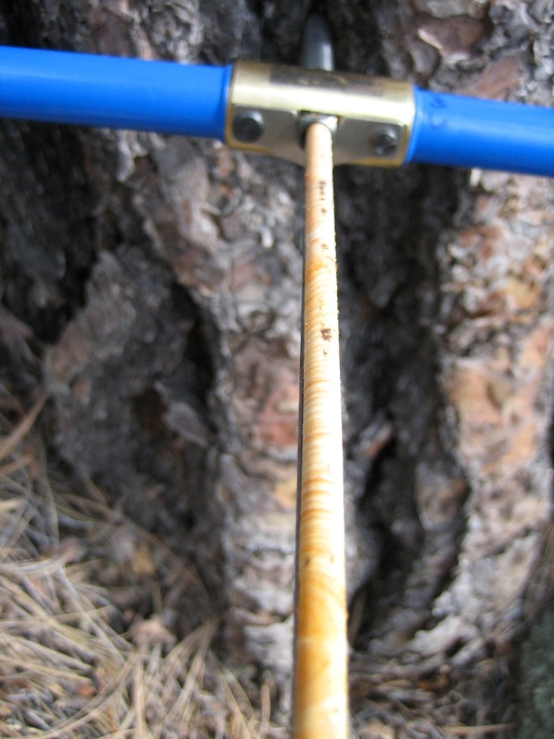
Increment cores:
1. tree age
2. climate reconstruction

Slide 14
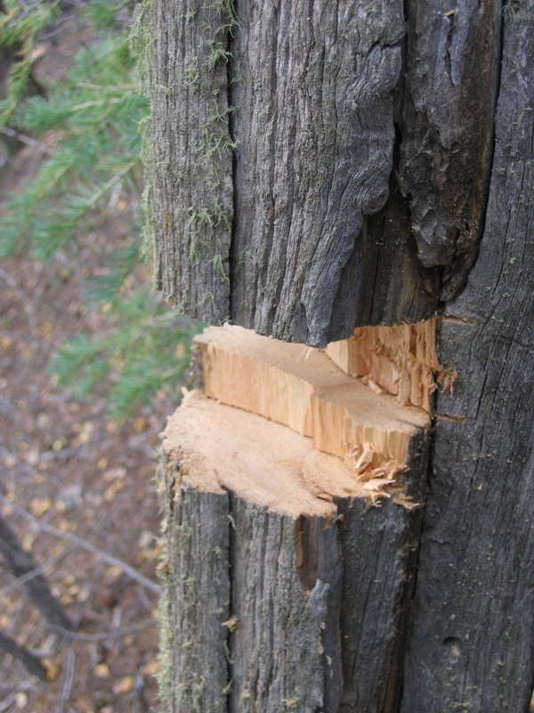
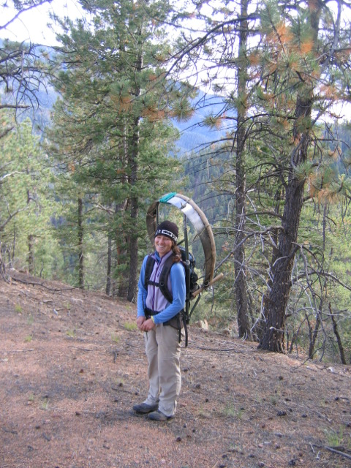
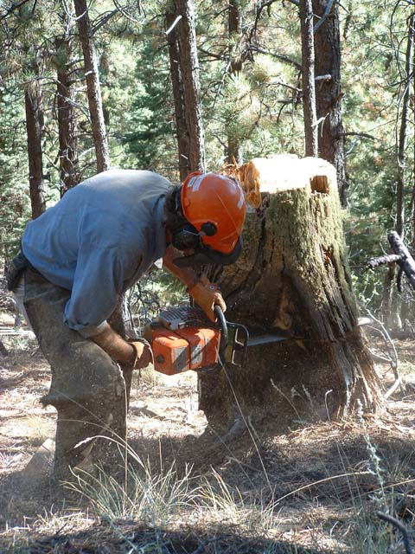
Fire scars

Slide 15
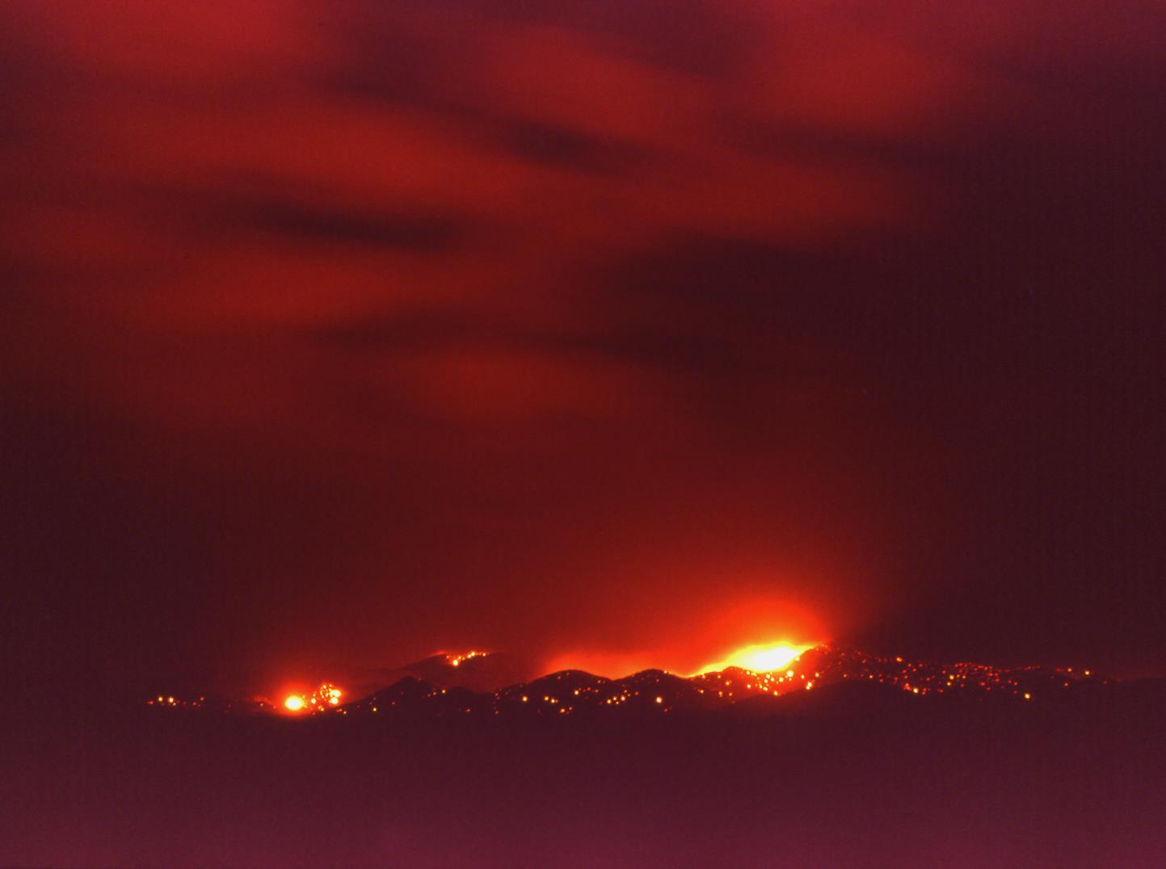
Fire and Forest Restoration

Slide 16
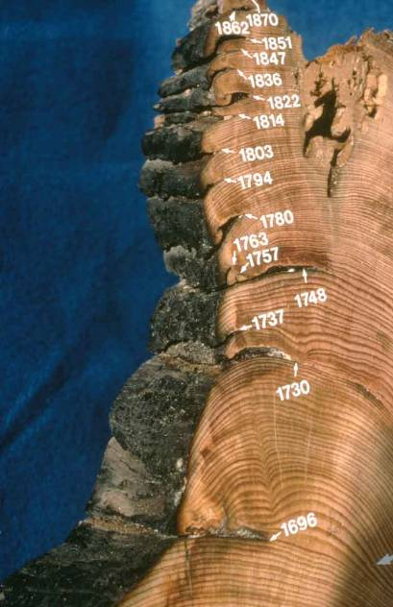
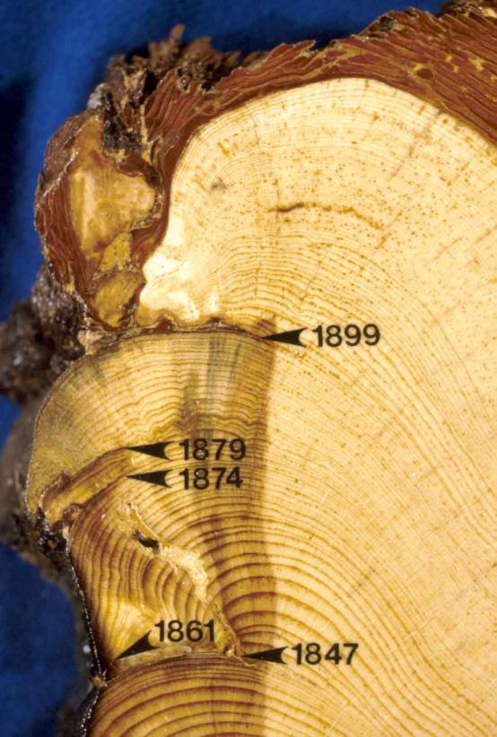
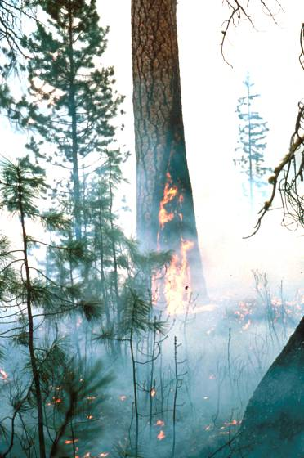
Tree rings provide a remarkable record of historical fires
Fire scars
Notes:
So how do we know about historical conditions? - historical photos, written accounts, and…..tree-rings - lots of tree-ring studies in N NM

Slide 17
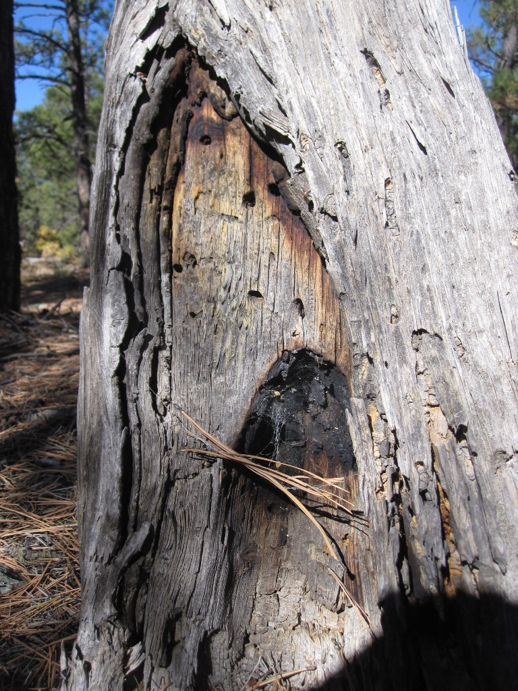
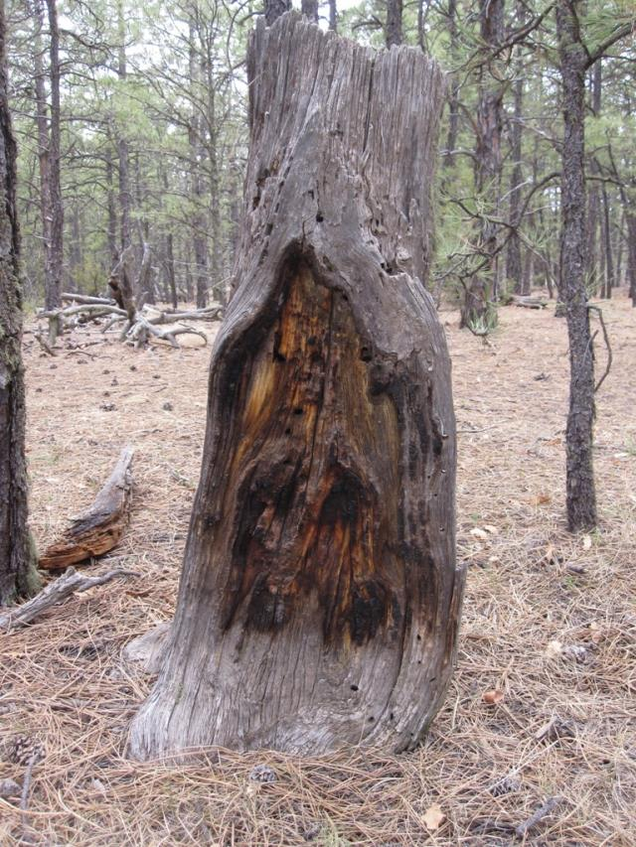
Fire scarred
ponderosa pine

Slide 18
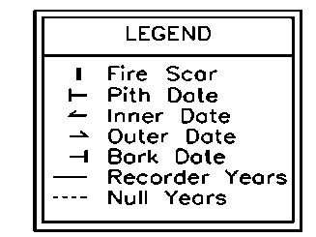
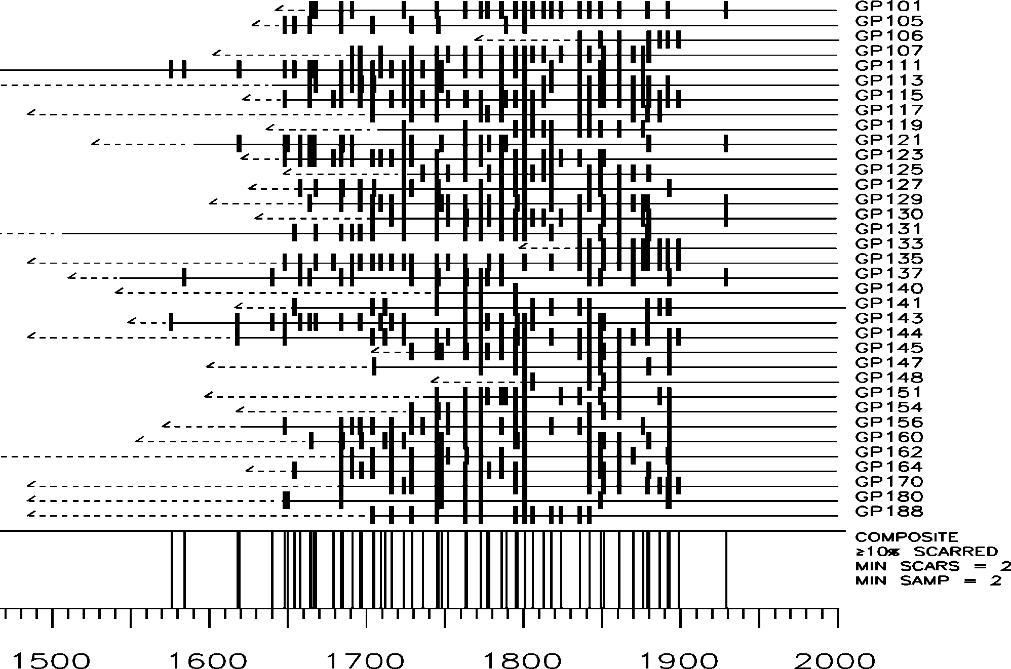
Monument Canyon Research Natural Area, Fire Scar Fire History (Don Falk)

Slide 19
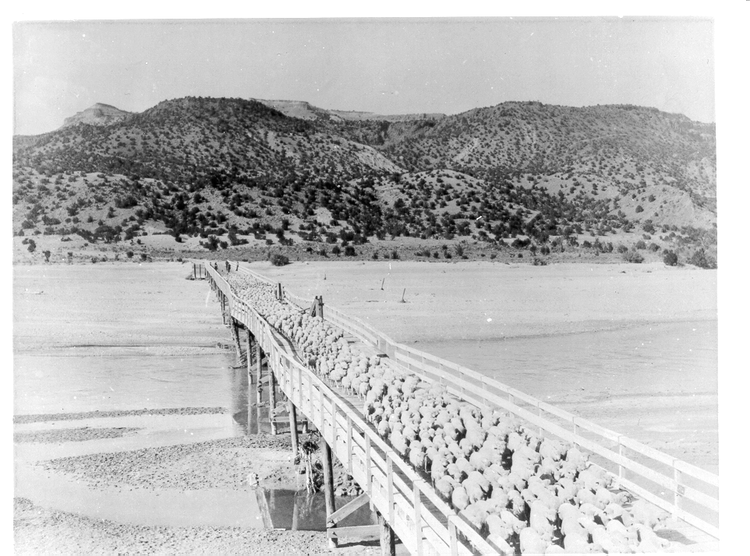
Very clearly, the first reason for reduction of widespread surface fires was the introduction very large numbers of sheep, cows and horses.
RAILROADS led to > 5 million sheep and 1.5 million cattle in New Mexico by 1890

Slide 20
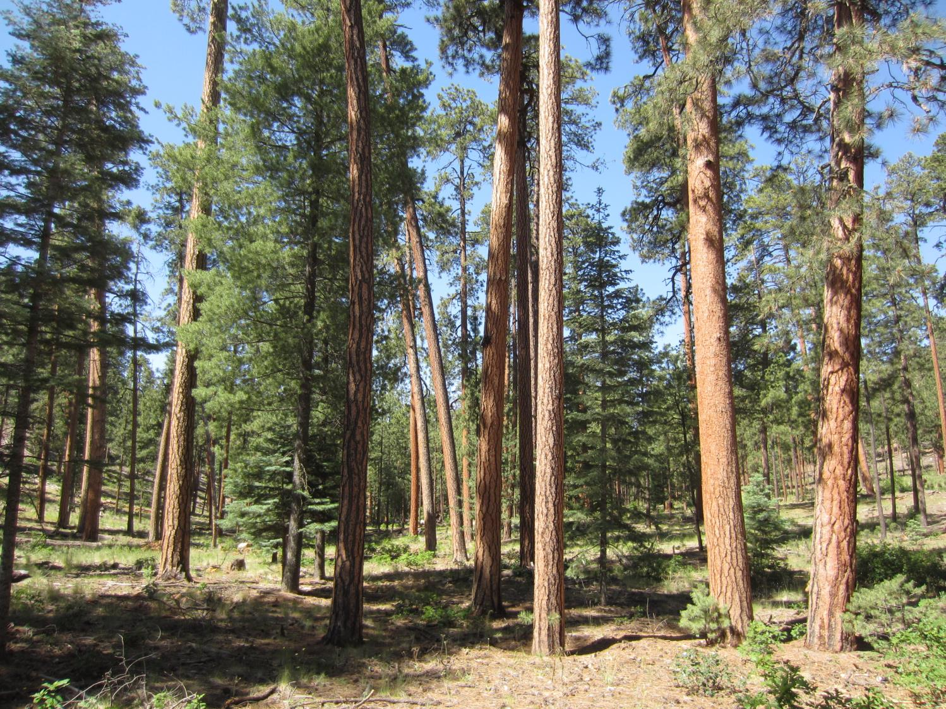
Ponderosa Pine
Fire Frequency: High
Fire Severity: Low
Notes:
PJ PIPO MC Spruce-fir veg types - all historically burned with unique fire regimes

Slide 21
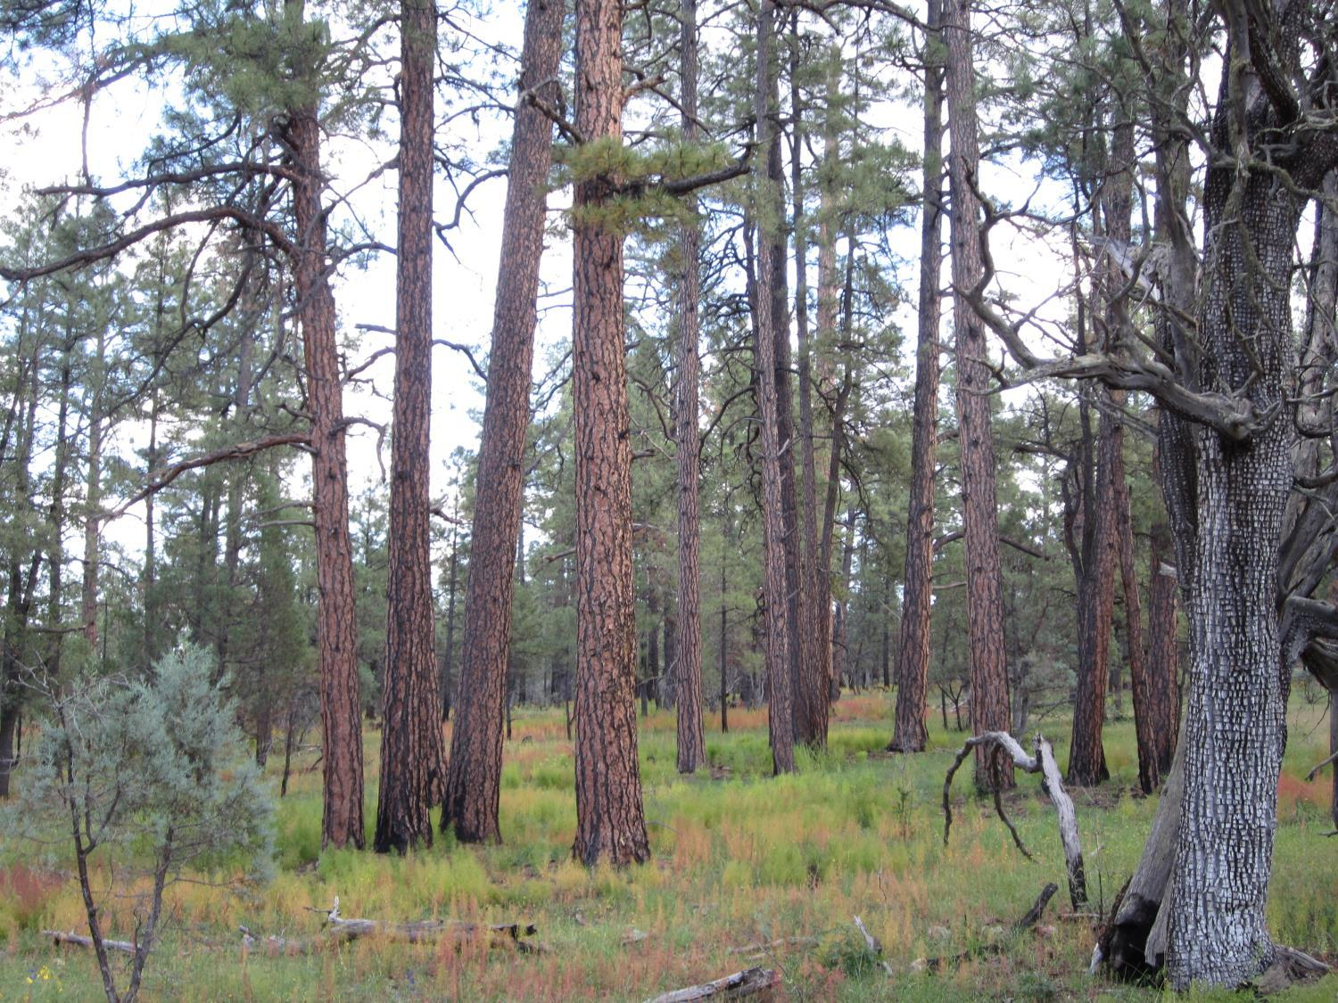
Fire “thinned” the small trees
and kept the forest open
Notes:
This site has burned multiple times in 20th century – Gila

Slide 22
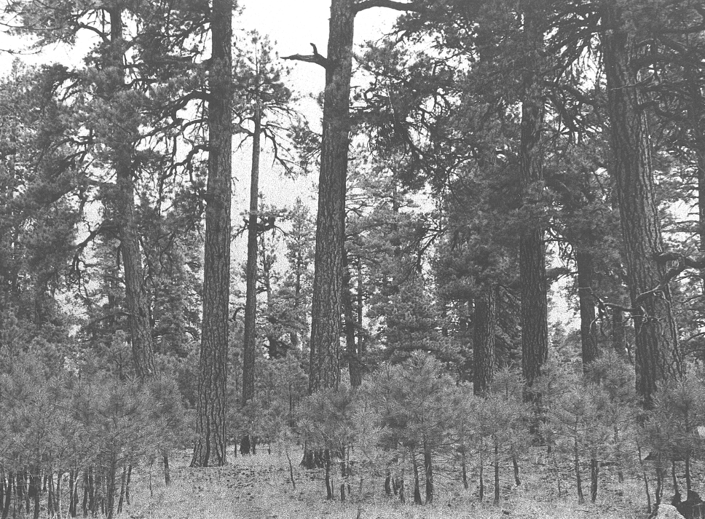
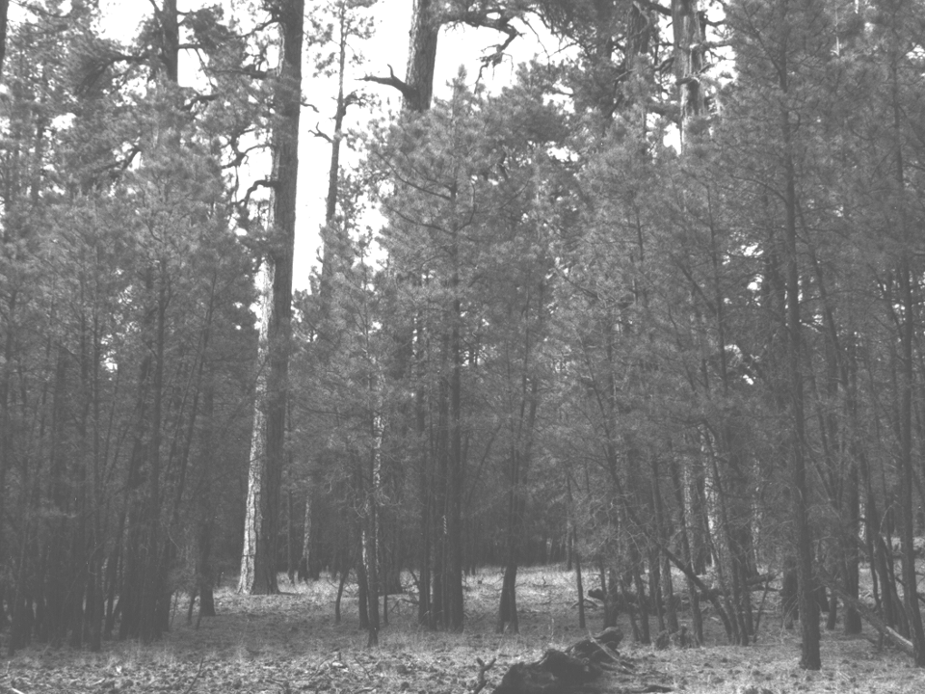
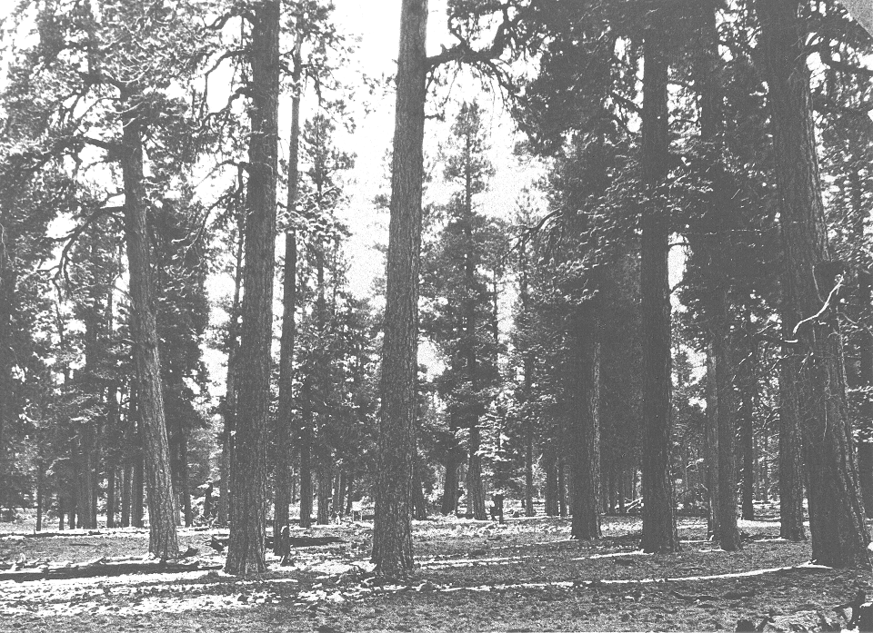
1990
1949
1909

Slide 23
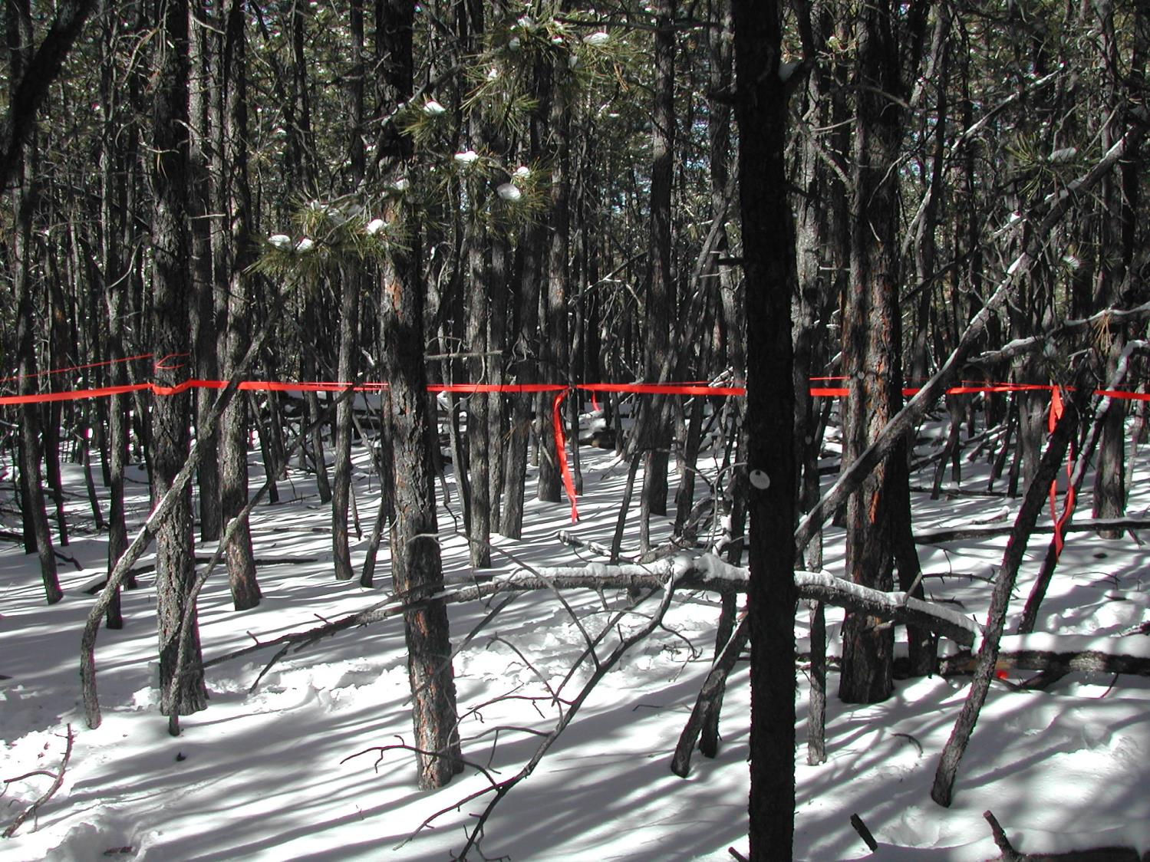
After we stopped fires the density of the dry conifer forests increased dramatically

Slide 24
Increased forest density and connectivity:
= greater risk of large high severity fires
1935
2005
Santa Fe Watershed, New Mexico

Slide 25
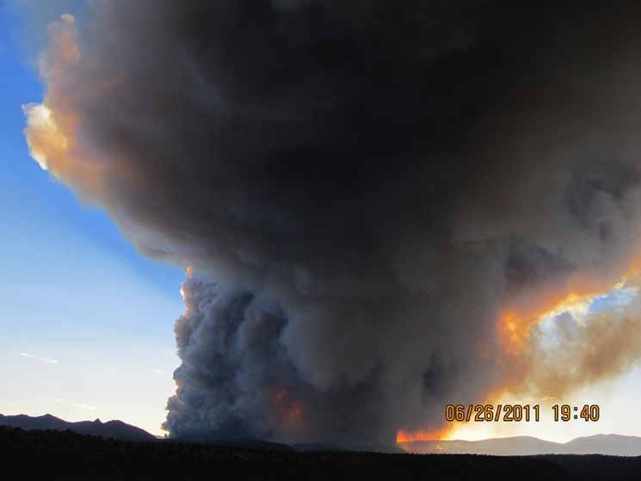
Las Conchas Fire near Los Alamos, NM (June 2011)
Burned 40,000 acres in first 12 hours, as a massive tornado-like “horizontal roll vortex”.
Photo by Craig Allen

Slide 26
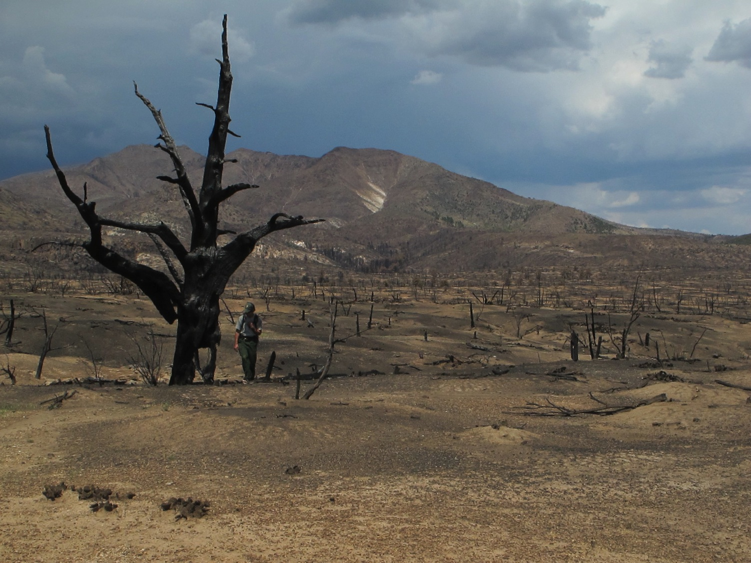
Sparse pinyon-juniper woodlands, near total incineration by Las Conchas Fire, June 2011
Photo courtesy Craig Allen

Slide 27
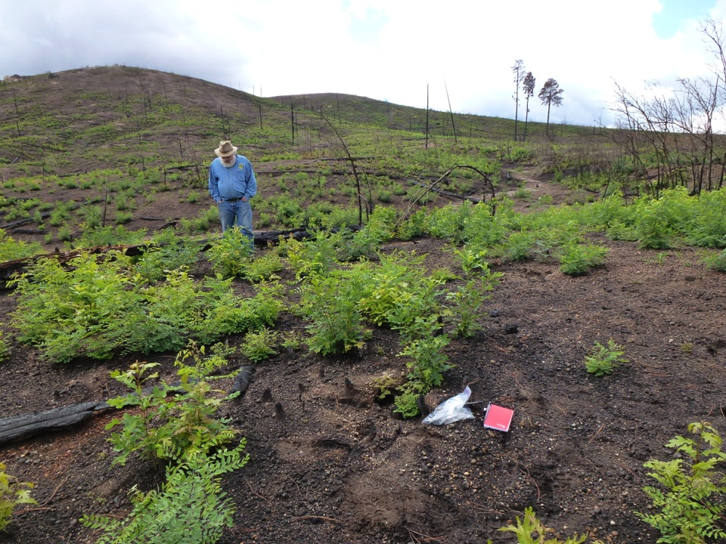

Slide 28
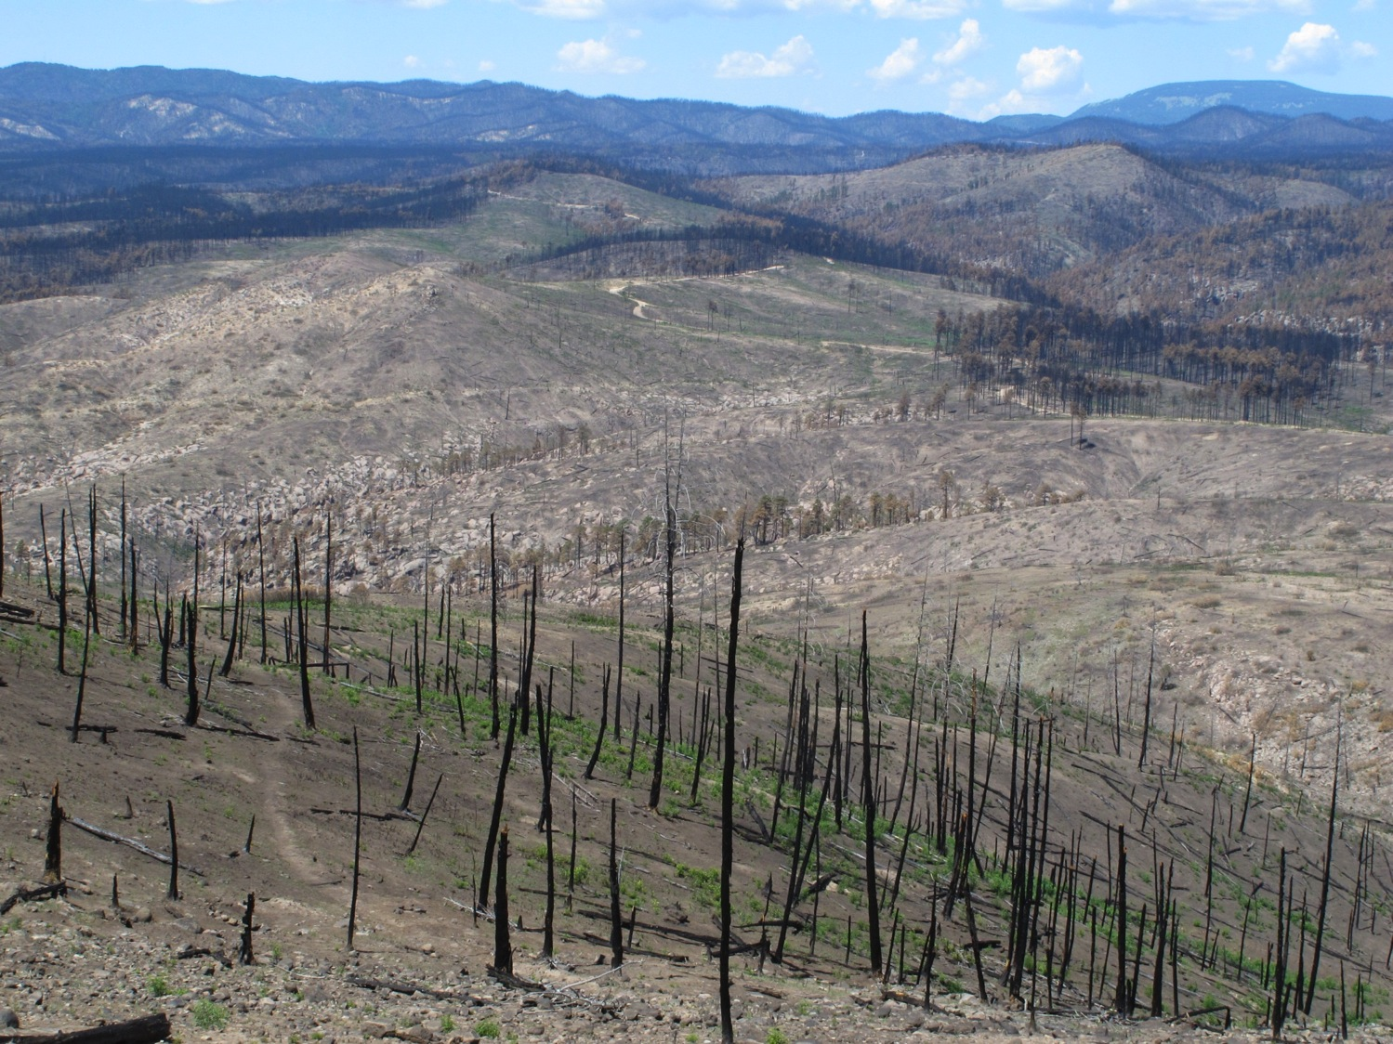
Now these dense conifer forests burn high severity
Tree-ring fire histories provide strong evidence in support of reducing forest density and restoring low severity fire regimes
Photo: C.D. Allen

Slide 29
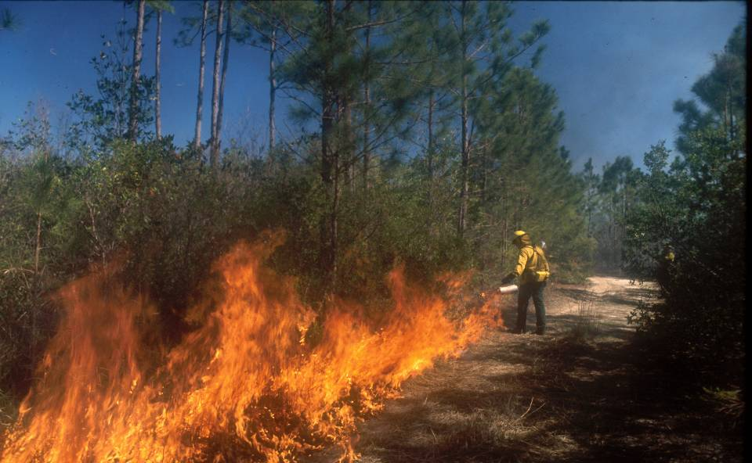
Low severity fire needs to be returned to these systems

Slide 30
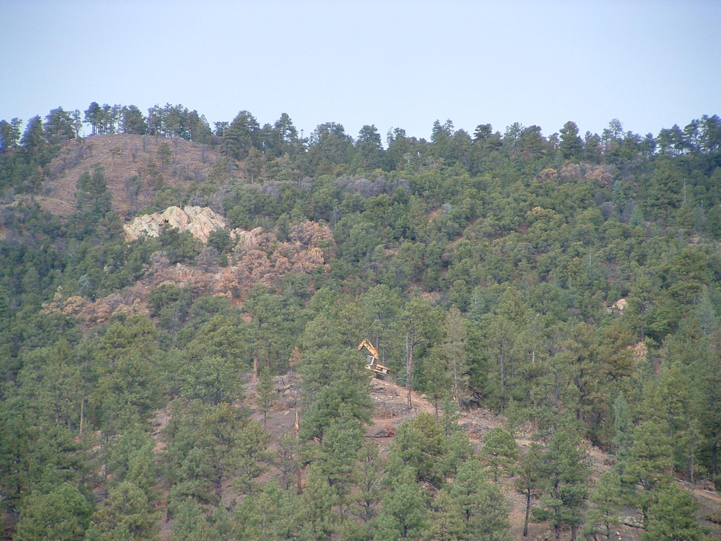
Mechanical treatment is necessary in some areas
Tree-eating machine
Santa Fe Watershed, NM Photo from Jeff Balmat
Notes:
Treatment in the Pipo – but they still don’t know about the mc and the sf where mechanical treatment is prohibited bc it’s in the wilderness

Slide 31
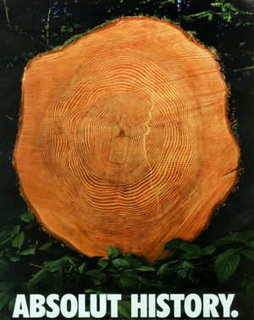
“History never repeats itself,
but it does tend to rhyme.” Mark Twain

Slide 32
1685 fire
Recorded by fire scars at 68% of fire scar plots
Largely stand-replacing in the spruce-dominated forest
Worst drought yr in over 1000 years; PDSI = – 6.92!
(Cook et al 2004)

Slide 33
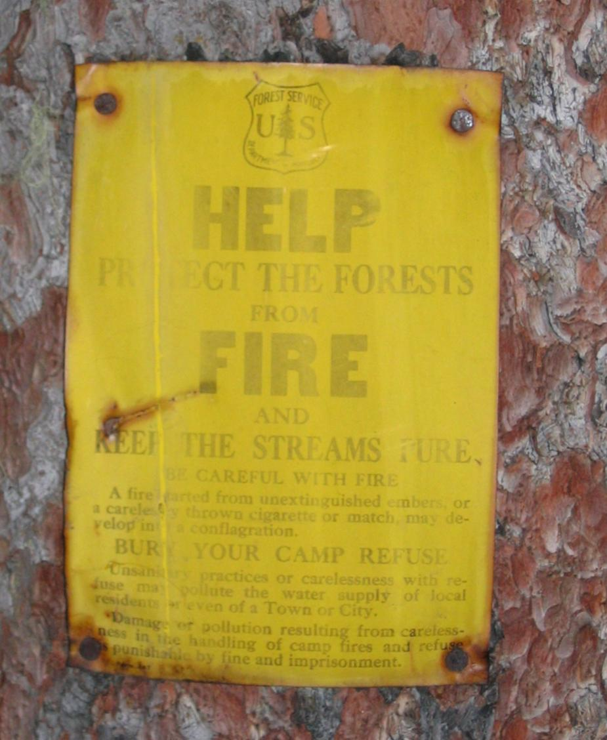
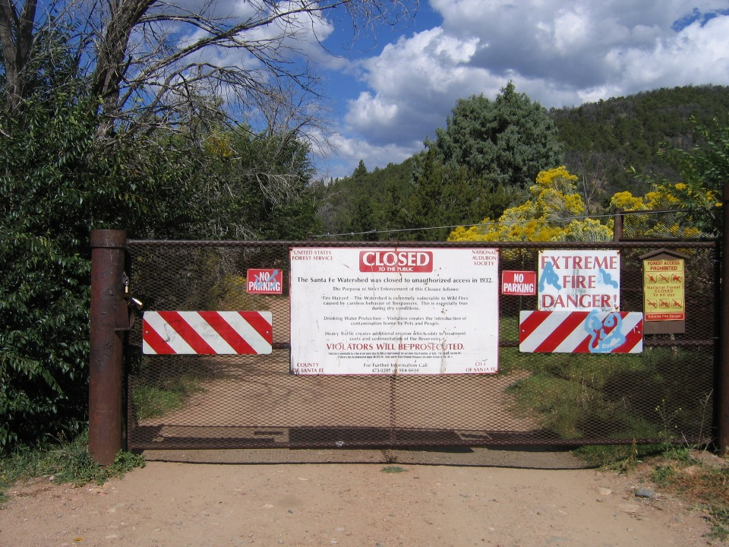
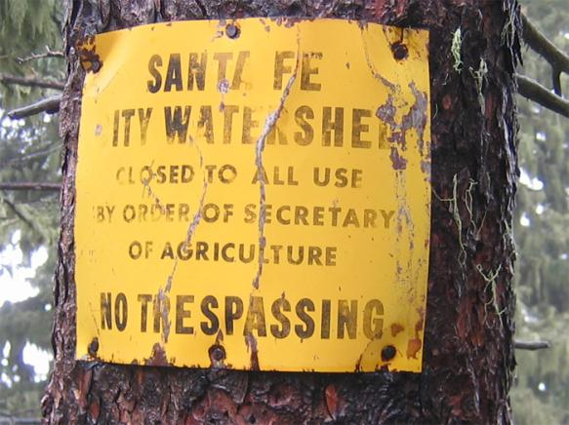
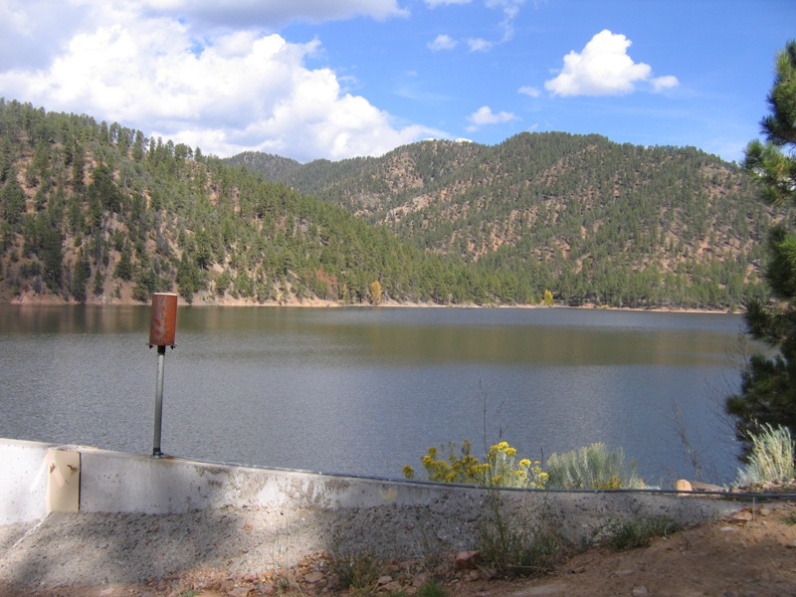

Notes:
Additionally, it’s a high priority location for forest restoration because of the high risk of stand-replacing fire that would jeopardize a major source of water for Santa Fe or potentially even flood historic downtown Santa Fe!

Slide 34
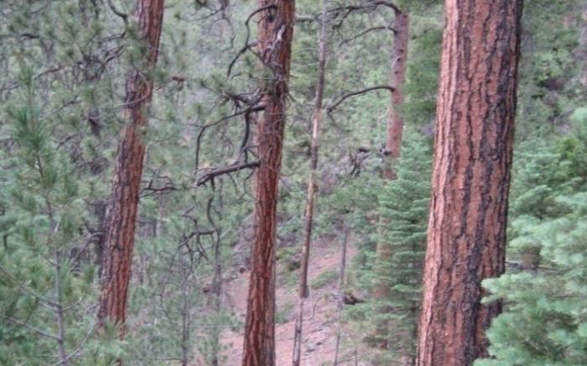

Tree-ring applications for
watershed management
Ellis Margolis
Laboratory of Tree-Ring Research, Univ of Arizona
Tucson, Arizona

Slide 35

What are the effects of fire suppression?

Slide 36

Are recent large crown fire patches natural occurrences in some forest types?
Cerro Grande Fire, Los Alamos, NM 2000

Slide 37

What’s the risk of post-fire flooding and debris flows?

Slide 38

How does climate affect fire regimes?
Notes:
Collected four lines of tree-ring evidence at each site -

Slide 39




Case study: Santa Fe Watershed
Margolis & Balmat 2009 Forest Ecology & Management
Notes:
The Santa Fe watershed is a great place to address some of these issues because of the continuous forest gradient from ponderosa pine to mixed conifer and spruce-fir
100km up the road - E of Santa Fe
W slope of the Sangre de Cristo Mtns
S end of the S. Rocky Mtns

Slide 40

Spruce
Mixed-conifer/ Aspen
PonderosaPine
7016 ha
Elev. 2240m – 3850m

Slide 41



Old fire-scarred wood!
1387 inner ring; 1444 fire scar
1337 inner ring; 1399 fire scar

Slide 42

Reconstructed fire area & severity

Slide 43








Sample From Plot #28 Showing 9 Scars Since 1925
Saguaro-Rincon Wilderness Area, southern Arizona
1993
1988
1972
1975
1993
1988
1972
1964
1956
1950
1956
1943
1950
1925
(before NPS
records)
1943
Plot 28
Fire Perimeters
N
Fire perimeters are from Saguaro National Park’s fire database.
0
2 km

Slide 44
Skeleton plots
Simple graphical representation of the ring width pattern in a sample (focusing on narrow rings)

Slide 45

Does this forest need to be restored?

