Slide 1
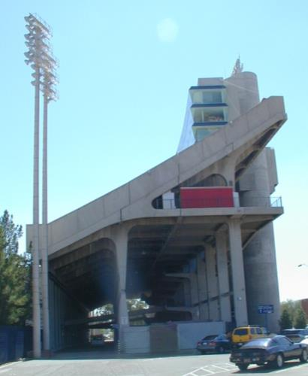
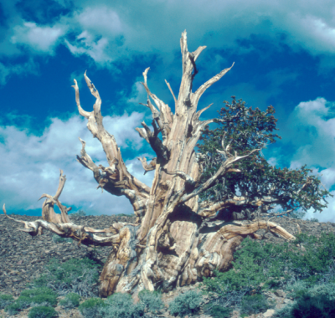
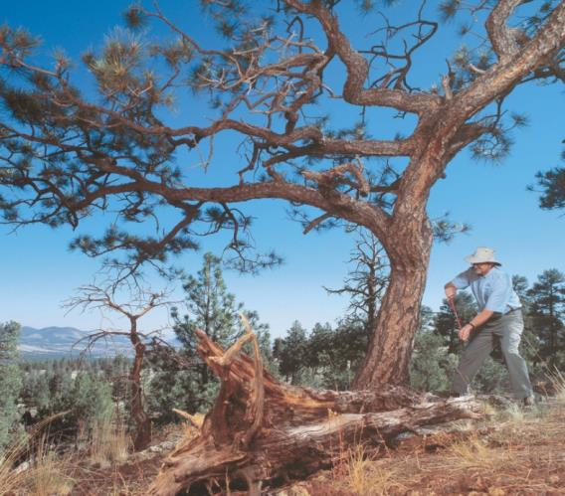
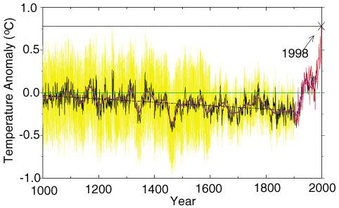
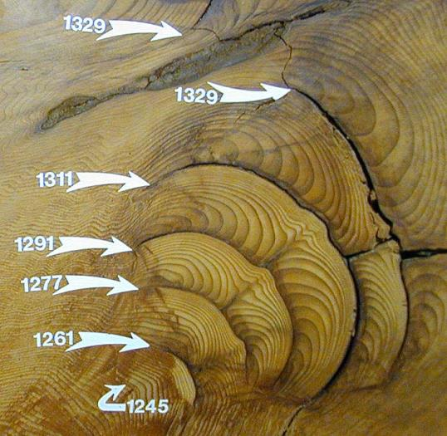
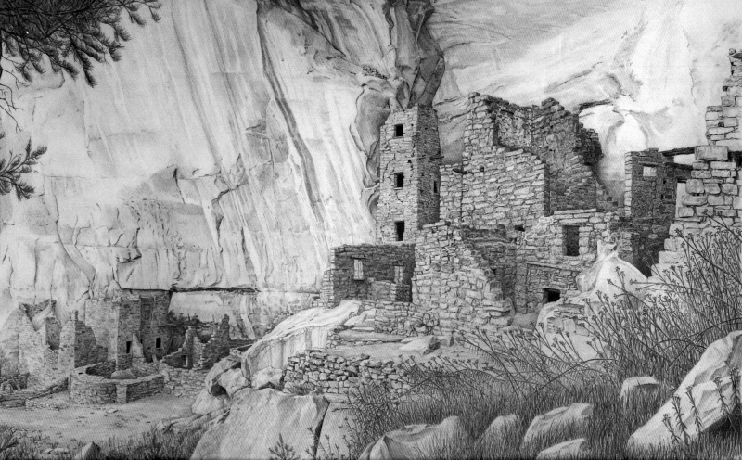
Tree-rings: records of the past, insights into the future
David Street

Slide 2
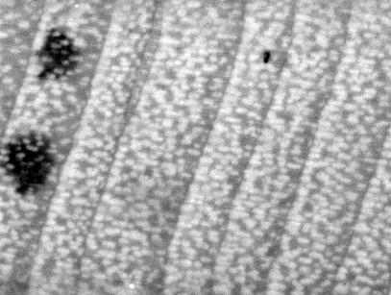
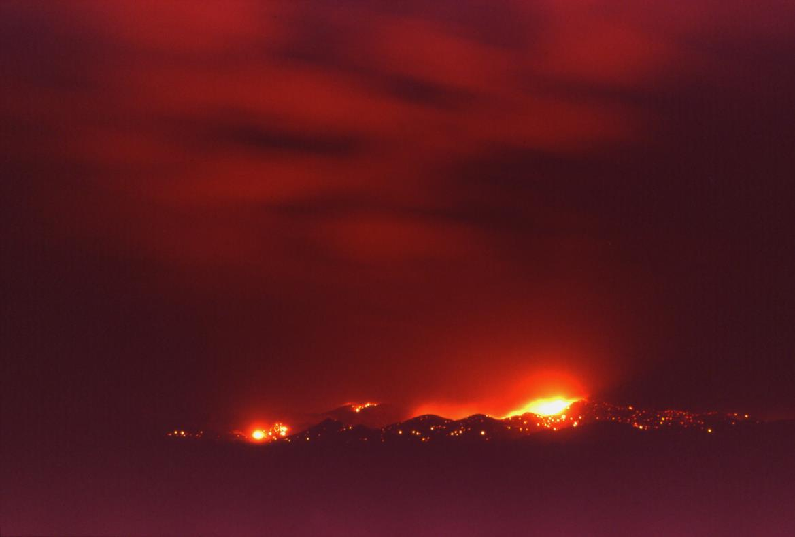
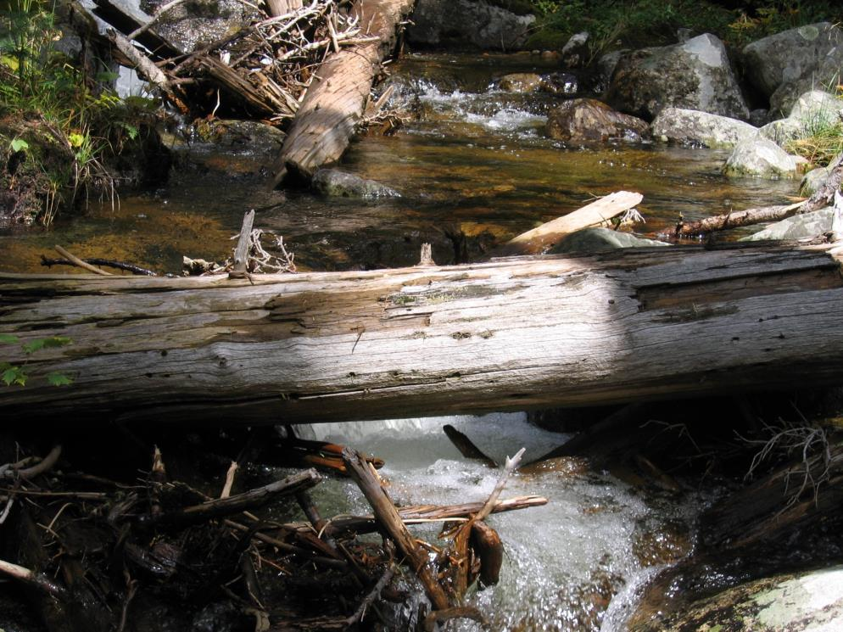
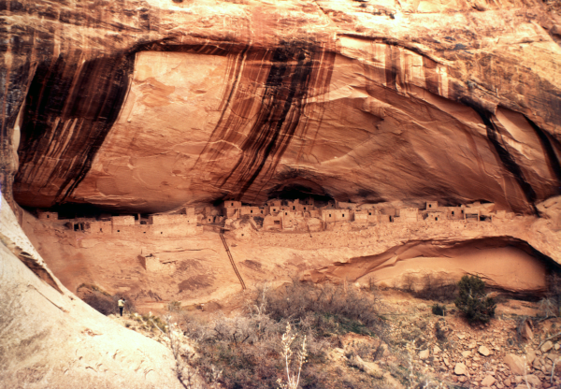
Tree rings and….
Societal change
Water
Fire

Slide 3
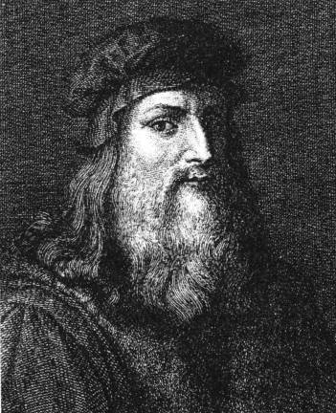

Leonardo da Vinci (1500 AD)
Aristotle (350 BC)
“Rings in the branches of sawed trees show the number of years and, according to their thickness, the years which were more or less dry. Thus, they reflect the individual worlds to which they belong, in the north [of Italy] they are much thicker than in the south.”

Slide 4
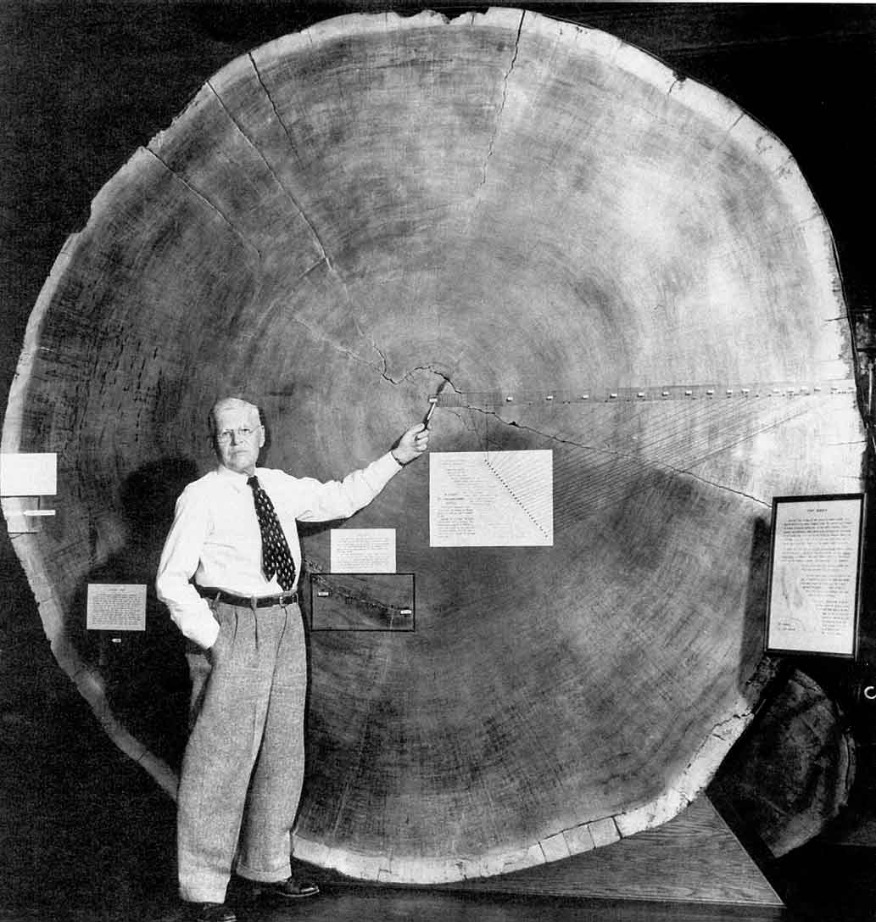
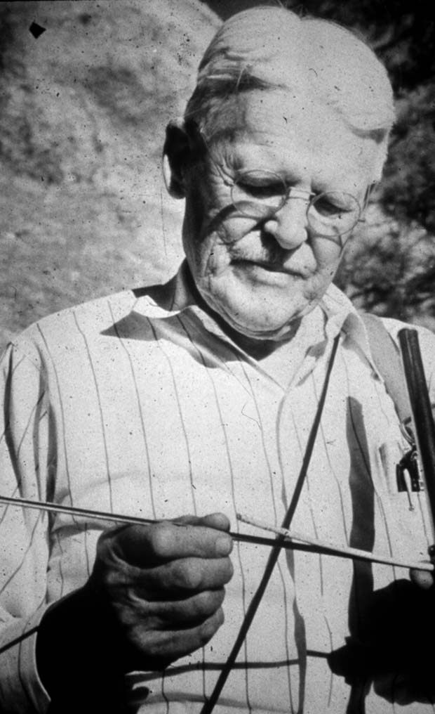
Andrew Ellicott Douglass 1867-1962
Founder of Modern Dendrochronology
&
Laboratory of Tree-Ring Research

Slide 5
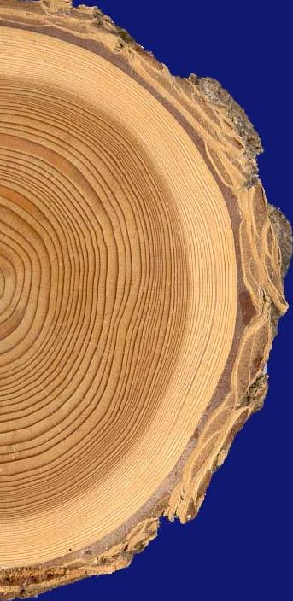
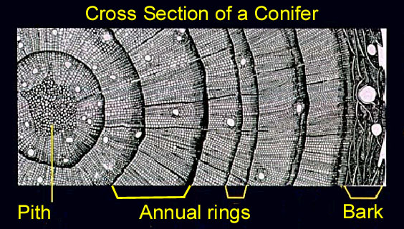
Environmentally beneficial years
Environmentally stressful year
Notes:
So what are tree-rings?

Slide 6
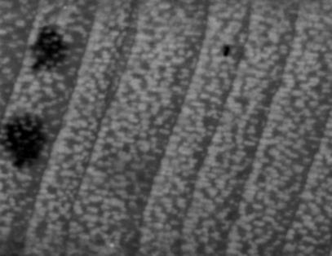
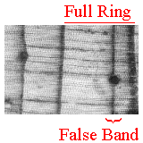
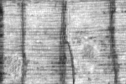
But it’s not just counting rings!
False rings
Missing Rings

Slide 7
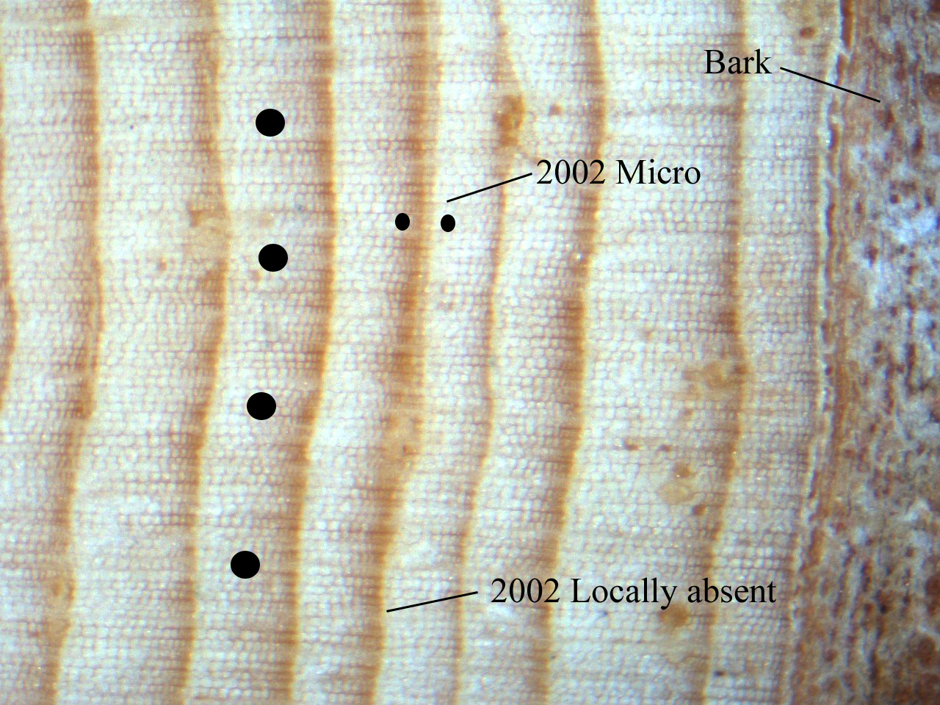

Slide 8
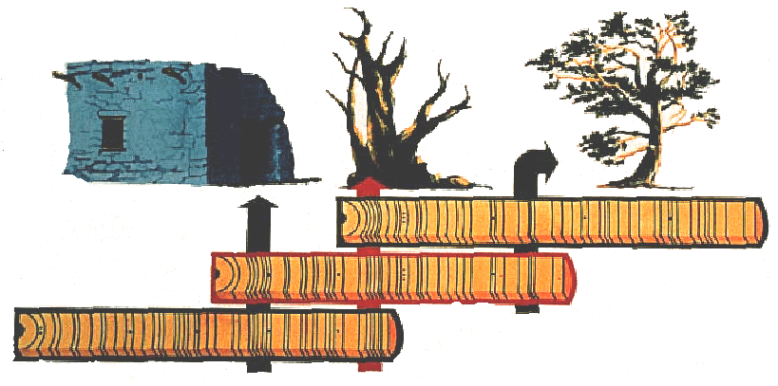
Crossdating: The Basic Principle of Dendrochronology
C
B
A
A
1920
1930
B
1900
1910
C
1850
1860
1870
1880
1890
<<<<<<<“Bridging” back in time<<<<<<<
Notes:
So because you can’t just ring count, Douglass figured out a system for pattern matching to correct for errors and ensure annual accuracy – Crossdating

Slide 9
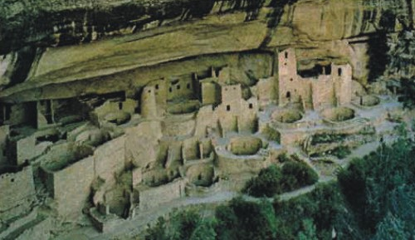
What happened to the Anasazi? Why did they leave and where did they go?
Notes:
What happened to the ancient great civilizations of the SW?

Slide 10
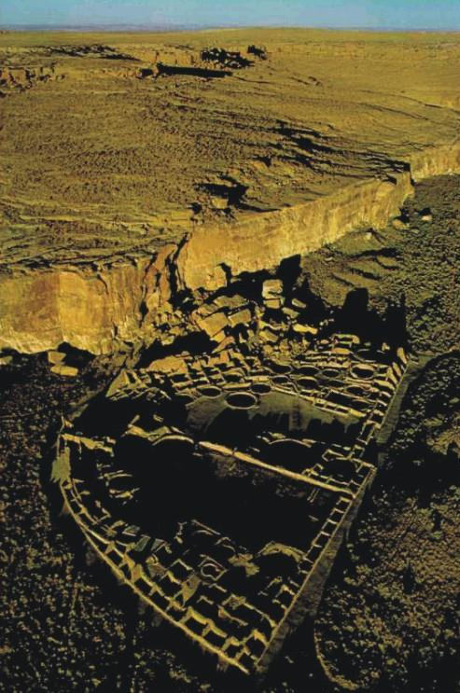
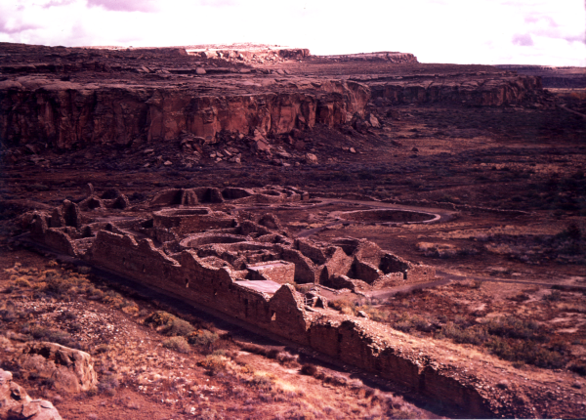

Slide 11
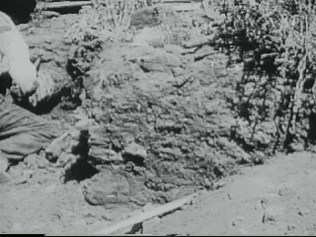
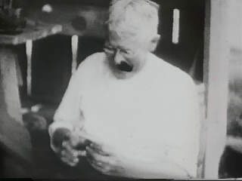
Excavating specimen HH-39, which “bridged the gap” – Show Low, Arizona, July 22, 1929
floating chronology
HH-39
living tree chronology
}
“gap”
700
1200
1300
present

Slide 12
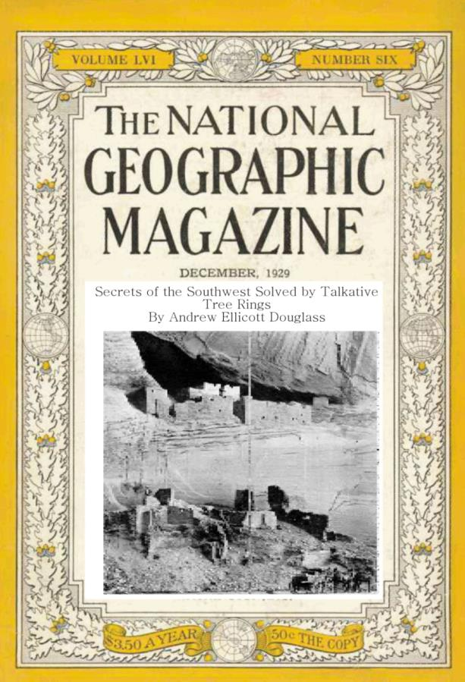
“Secrets of the Southwest Solved by Talkative Tree Rings”, by A. E. Douglass, National Geographic magazine, December 1929

Slide 13
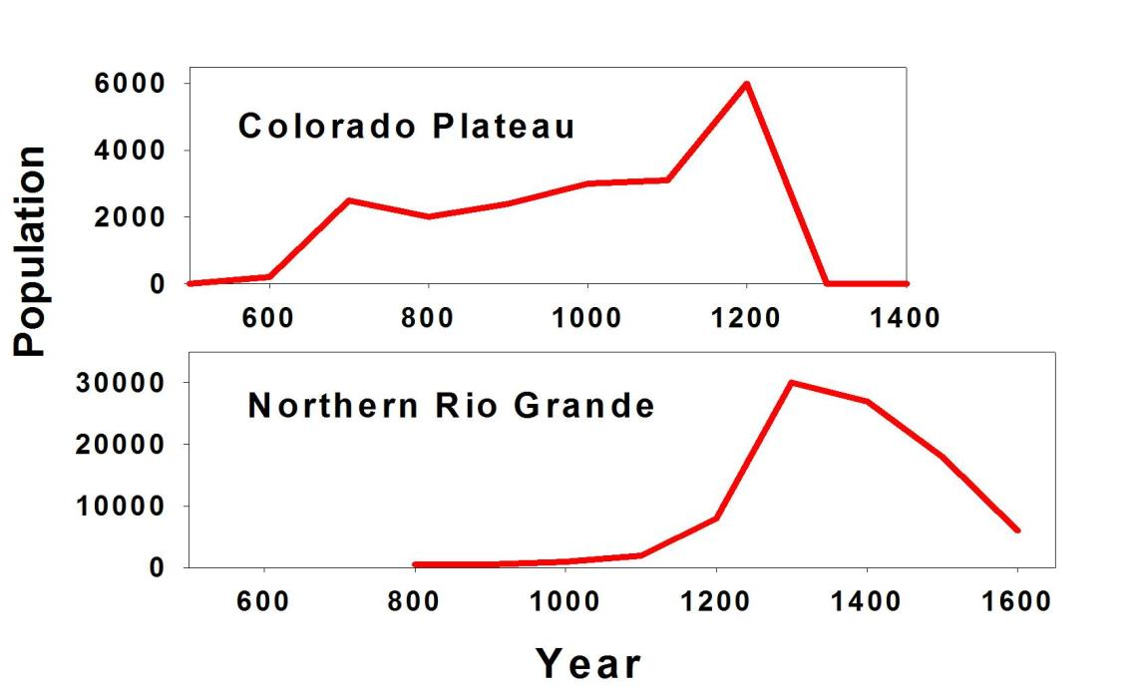
Population estimates from tree-ring dated dwellings indicate nearly total abandonment of the Colorado Plateau by AD 1300, while a major influx of people occurred in northern New Mexico at this time.
From Dean, Doelle, & Orcutt 1994
Notes:
Why did they abandon? Late 1200’s was a bad drought – likely played a role

Slide 14

Water: How variable are our water supplies?
Ex – Colorado River Compact

Slide 15
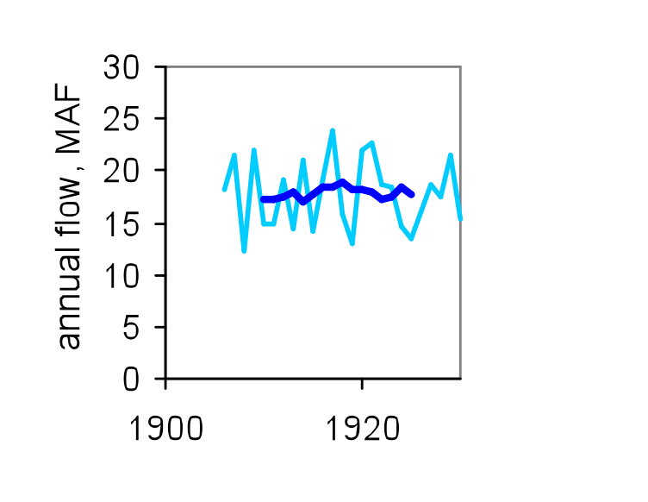
Tree-rings guide water management
Colorado River at Lees Ferry
Gaged (natural flow) record, 1906-1930
Colorado River Compact Signed in 1922
http://treeflow.info/
Notes:
Traditionally, planning and management of water systems have been based on an observed (gaged) record, beginning no earlier than the late 1800s. So water managers have had to, in effect, learn from experience. This “experiential record” was gained year by year, with occasional unexpected extreme flows, upon which “worst-case scenarios” were then based.
Shown here is the observed naturalized flow record for the Colorado River at Lees Ferry, AZ, with annual flows in light blue, and the 10-year running mean in dark blue. As of 1930, about 25 years of experience with the river indicated a mean flow of about 17.5 million acre-feet (MAF)—a figure which was used as the basis for the Colorado River Compact of 1922. Note also the lack of annual flows lower than 12 MAF.

Slide 16
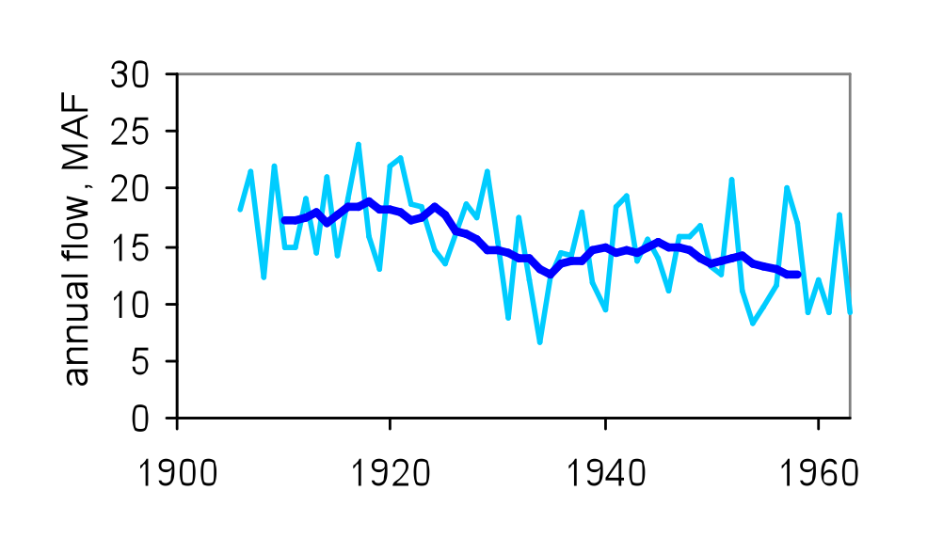
Tree-rings guide water management
Colorado River at Lees Ferry
Gaged (natural flow) record, 1906-1963
http://treeflow.info/
Notes:
The experience with the Colorado River from 1931 to 1963, however, gave a much different picture than did the previous three decades. Decadal mean flows dropped below 15 MAF, and several individual years, most prominently 1934, had flows under 10 MAF. Was this period a long excursion away from a higher long-term mean, or was it reflective of a lower long-term mean than assumed in the 1920s? Or, worse, would the declining trend in streamflow continue?

Slide 17
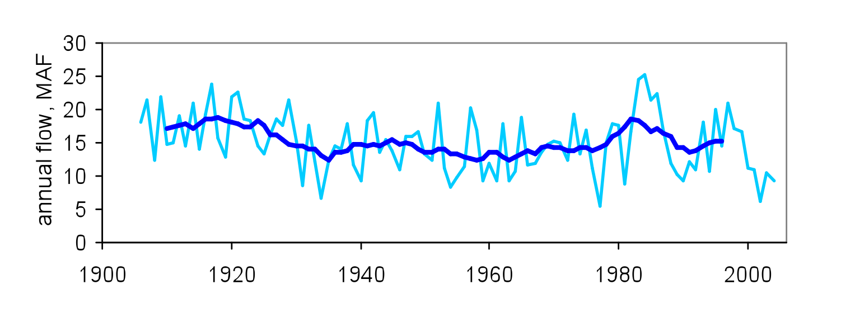
Tree-rings guide water management
Colorado River Compact Signed in 1922
Colorado River at Lees Ferry
Gaged (natural flow) record, 1906-2004
http://treeflow.info/
Notes:
As it turned out, the features of the next 40 years of experience could not have been predicted based on a repeat of the previous 60 years. The period from 1964-2004 included the two lowest annual flows (1977, 2002) and the two highest annual flows (1983, 1984) on record. The latter half of that period saw two multi-year wet periods sandwiching a 5-year drought, followed by the most severe multi-year drought in the entire record (2000-2004).
The 2000s drought clearly showed that almost 100 years of experience, as captured in the observed flow record, was still an insufficient basis for management. But the only way to get more experience, through only the observed record, is to keep managing the river into an increasingly uncertain future. How can we get more information about hydrologic variability than is contained in the observed record?

Slide 18

Tree-ring reconstructed flow
of the Colorado River
(1500 – 2000)

Slide 19
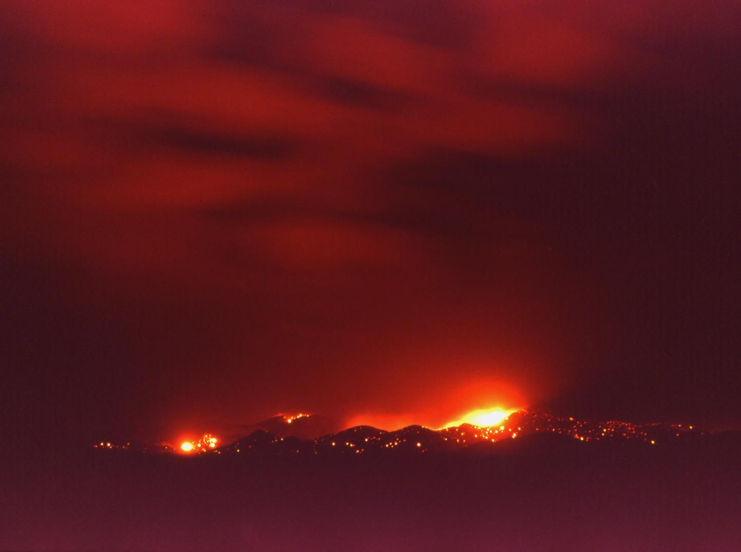
Fire

Slide 20
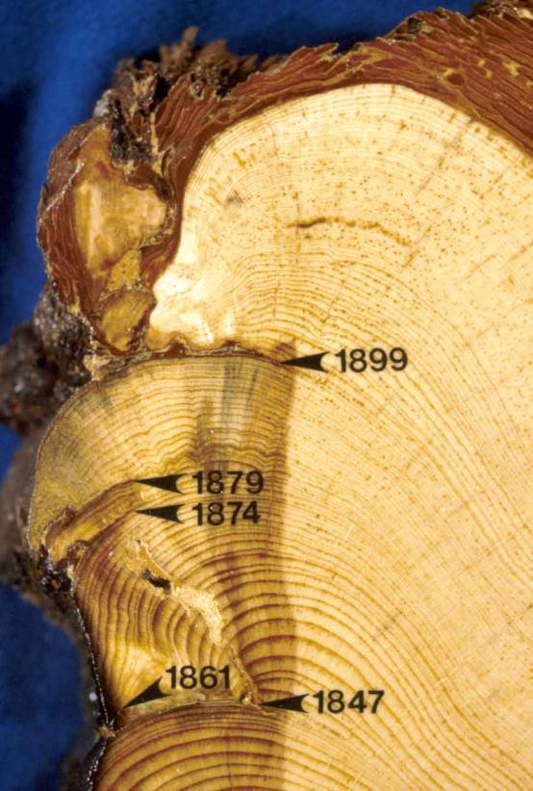
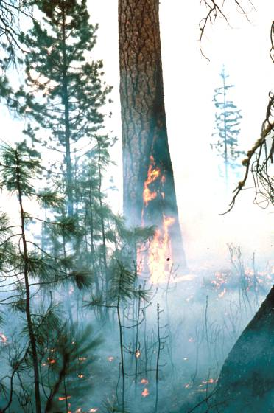
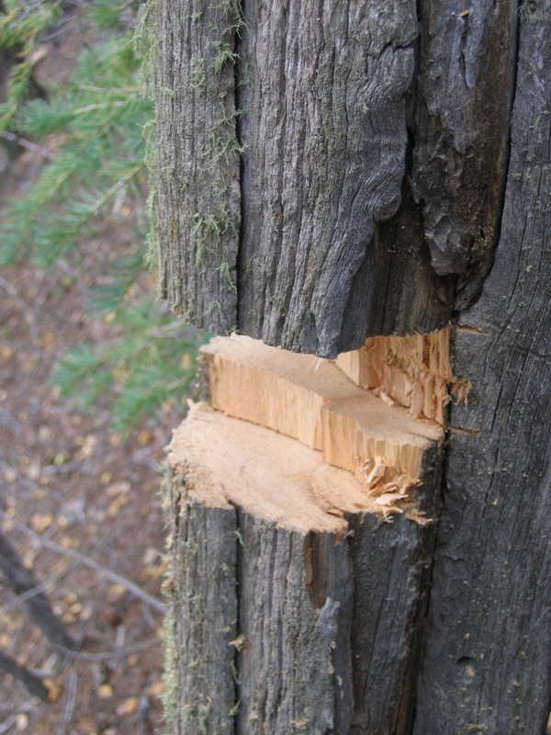
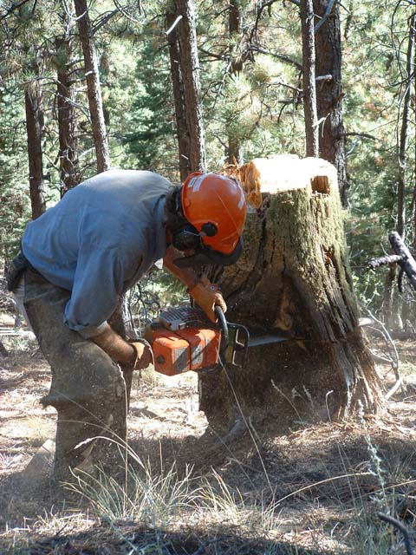
Tree rings provide a remarkable record of historical fires
Fire scars
Notes:
So how do we know about historical conditions? - historical photos, written accounts, and…..tree-rings - lots of tree-ring studies in N NM

Slide 21
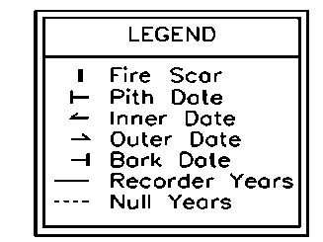
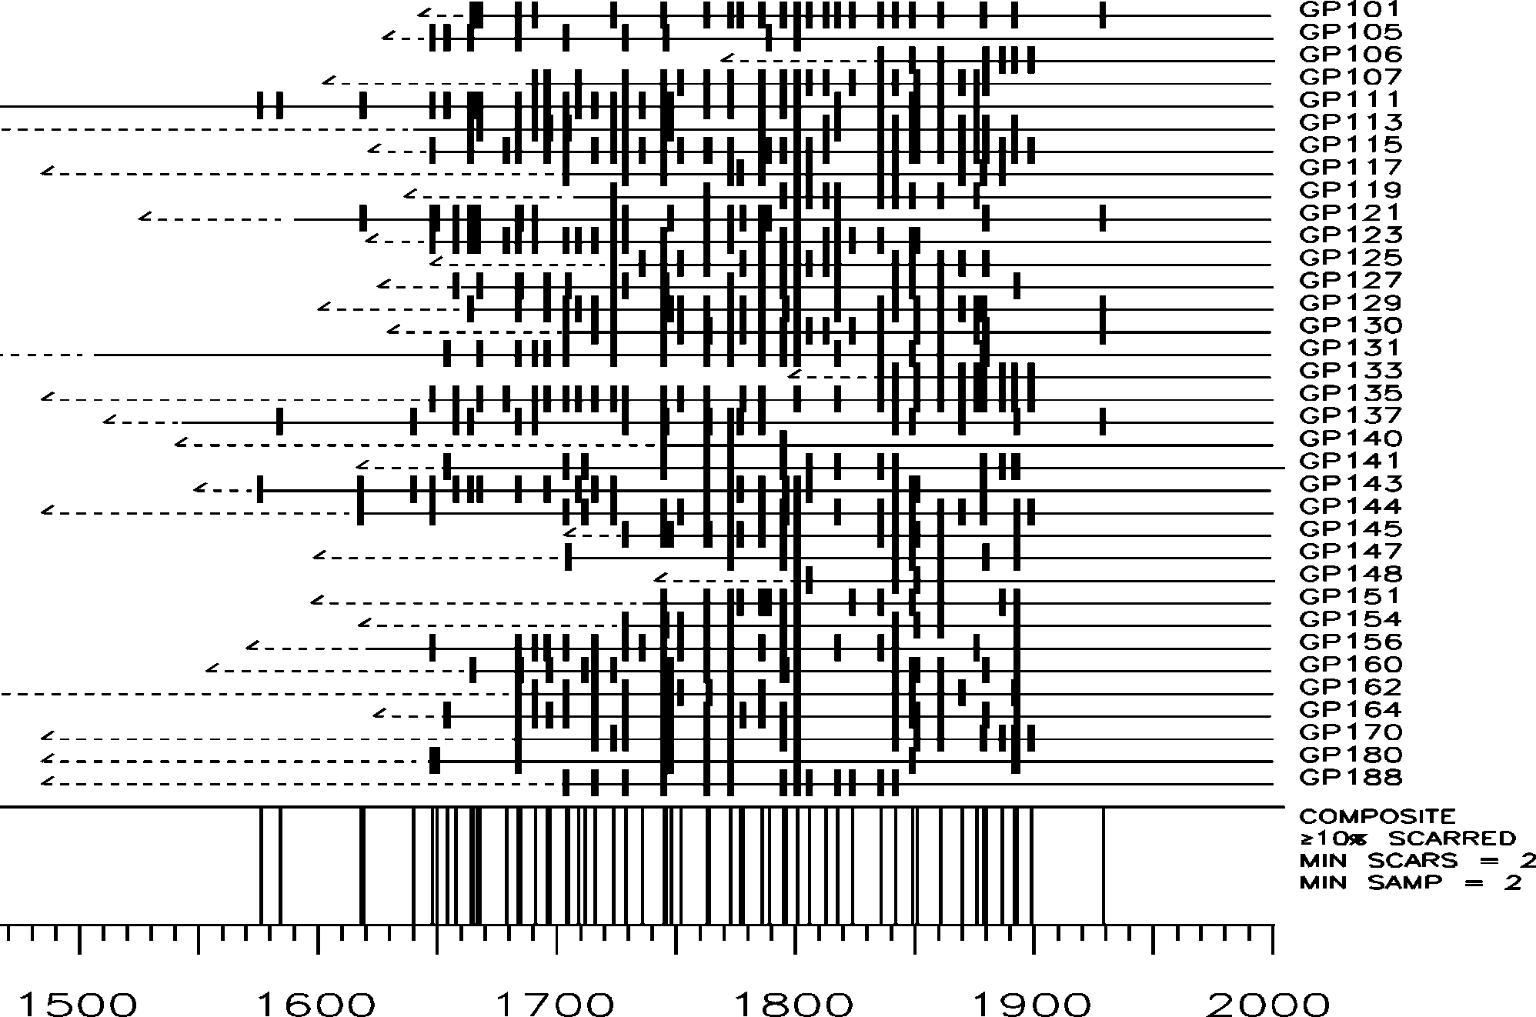
Monument Canyon Research Natural Area, Fire Scar Fire History (Don Falk)

Slide 22
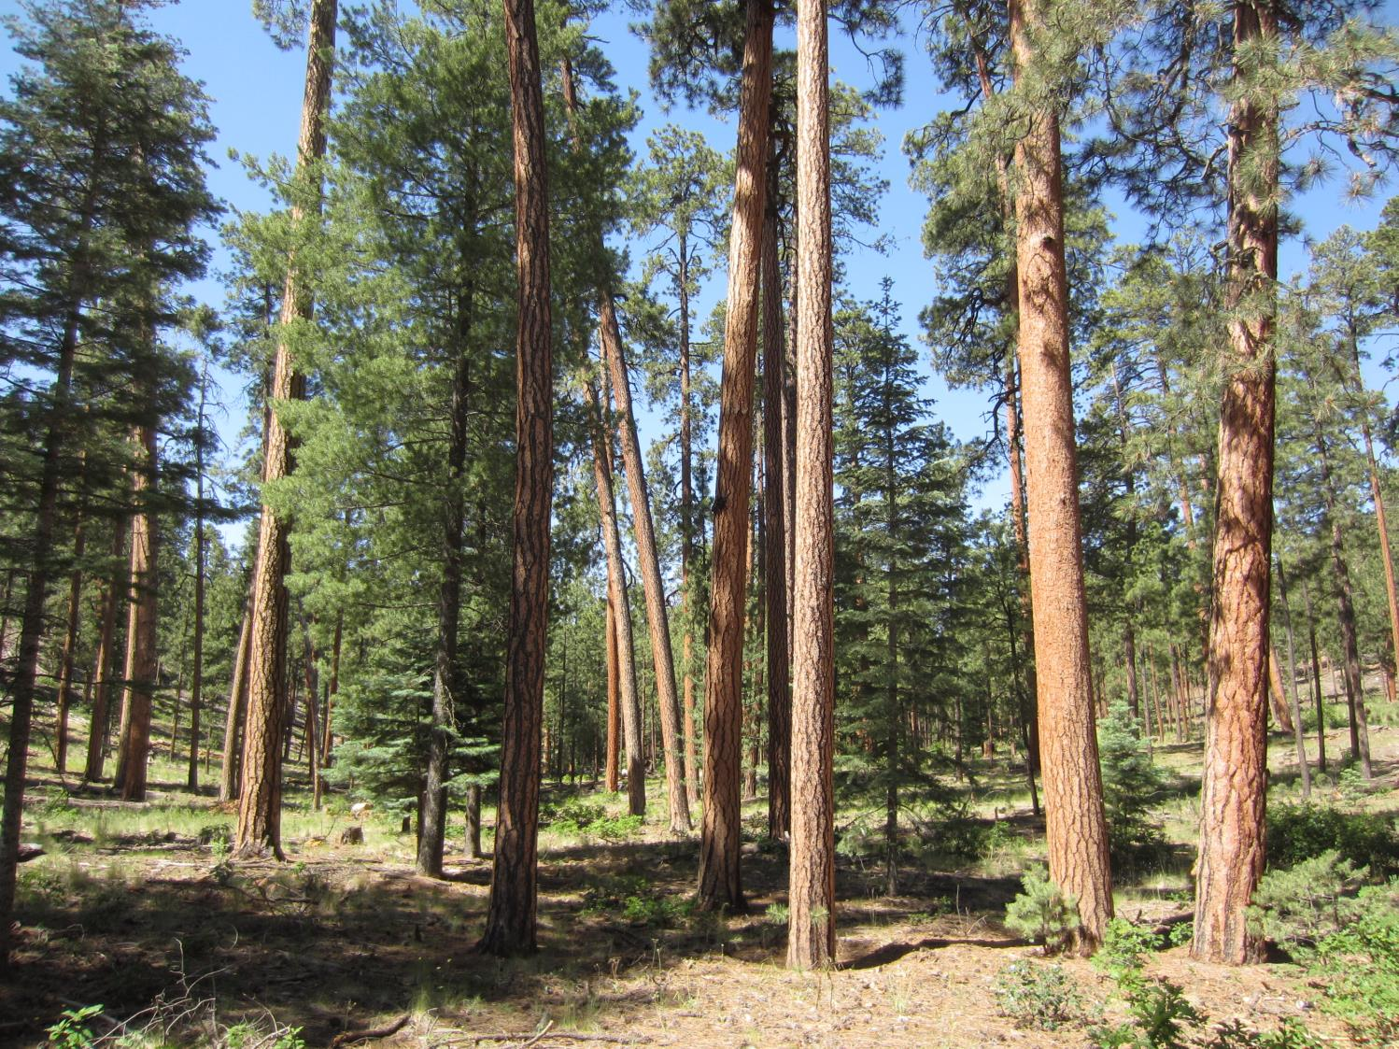
Ponderosa Pine
Fire Frequency: High
Fire Severity: Low
Notes:
PJ PIPO MC Spruce-fir veg types - all historically burned with unique fire regimes

Slide 23
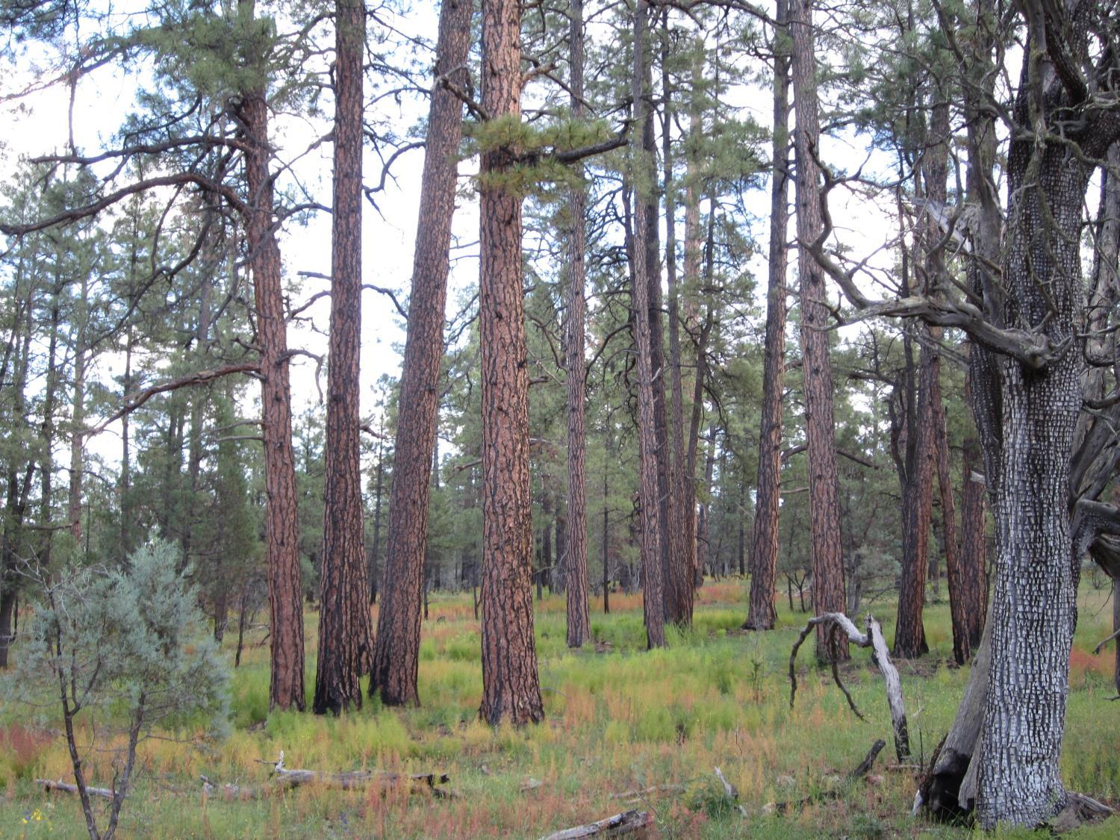
Fire “thinned” the small trees
and kept the forest open
Notes:
This site has burned multiple times in 20th century – Gila

Slide 24
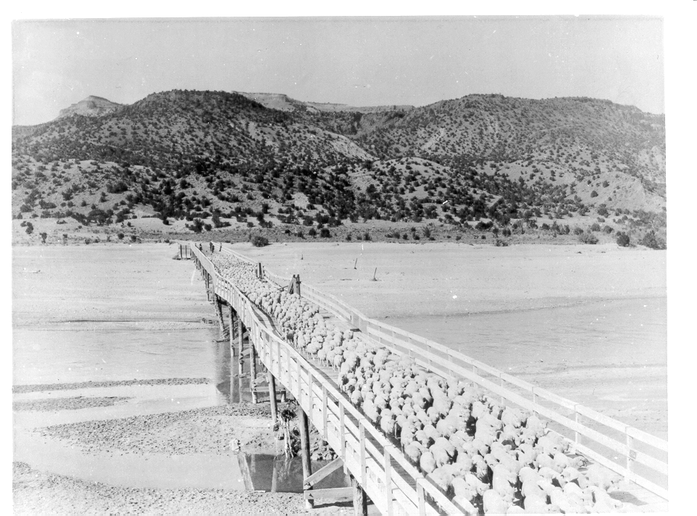
Very clearly, the first reason for reduction of widespread surface fires was the introduction very large numbers of sheep, cows and horses.
RAILROADS led to > 5 million sheep and 1.5 million cattle in New Mexico by 1890

Slide 25
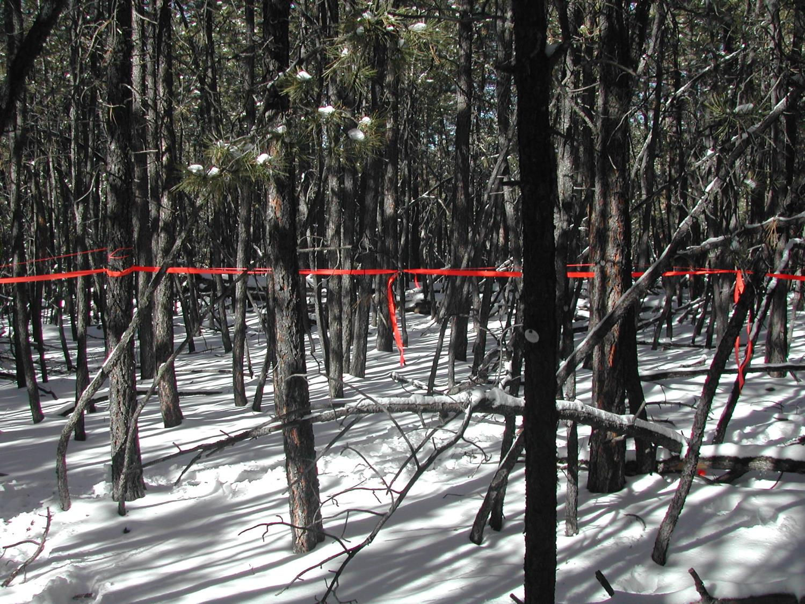
After fires stopped the density of the dry conifer forests increased dramatically

Slide 26
Increased forest density and connectivity:
= greater risk of large high severity fires
1935
2005
Santa Fe Watershed, New Mexico

Slide 27
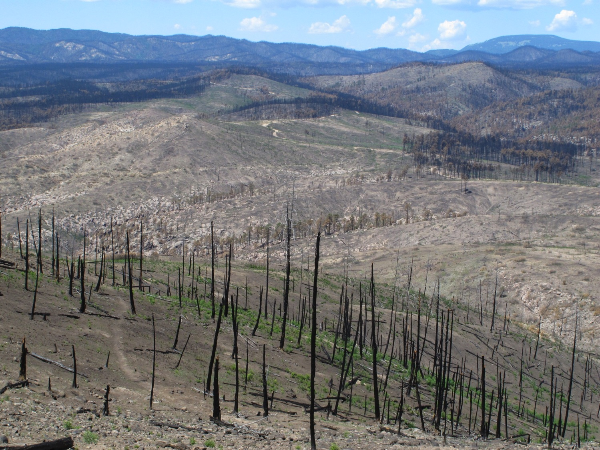
Now these dense conifer forests burn high severity
Tree-ring fire histories provide strong evidence in support of reducing forest density and restoring low severity fire regimes
Photo: C.D. Allen

Slide 28
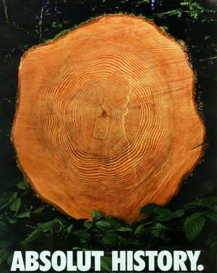
“History never repeats itself,
but it does tend to rhyme.” Mark Twain

Slide 29
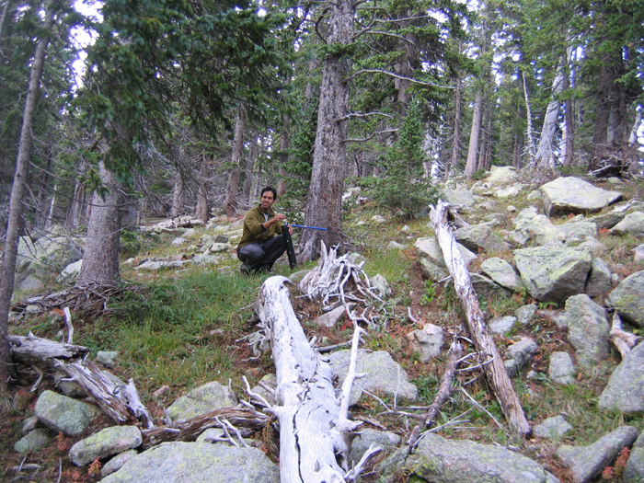
Tree-ring sampling

Slide 30
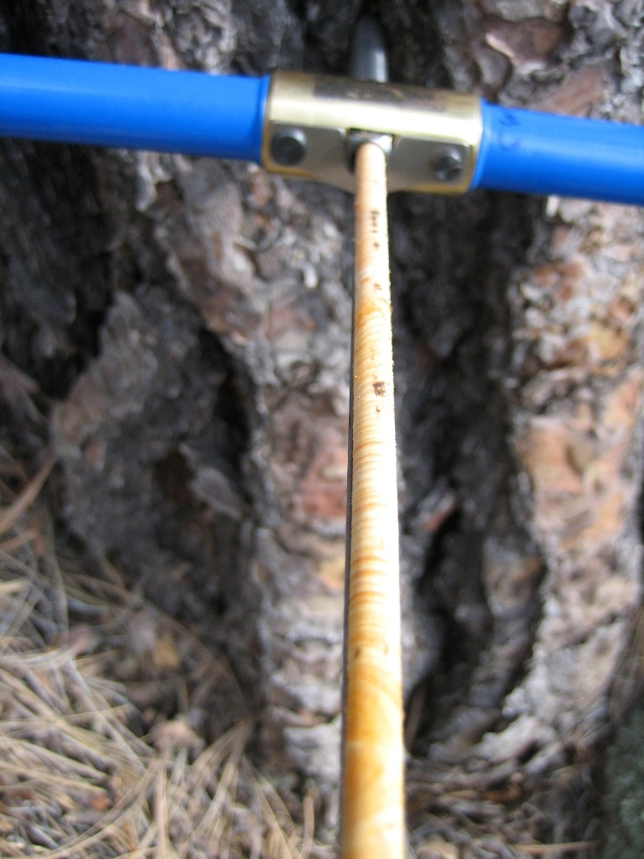
Increment cores:
1. tree age
2. climate reconstruction

Slide 31
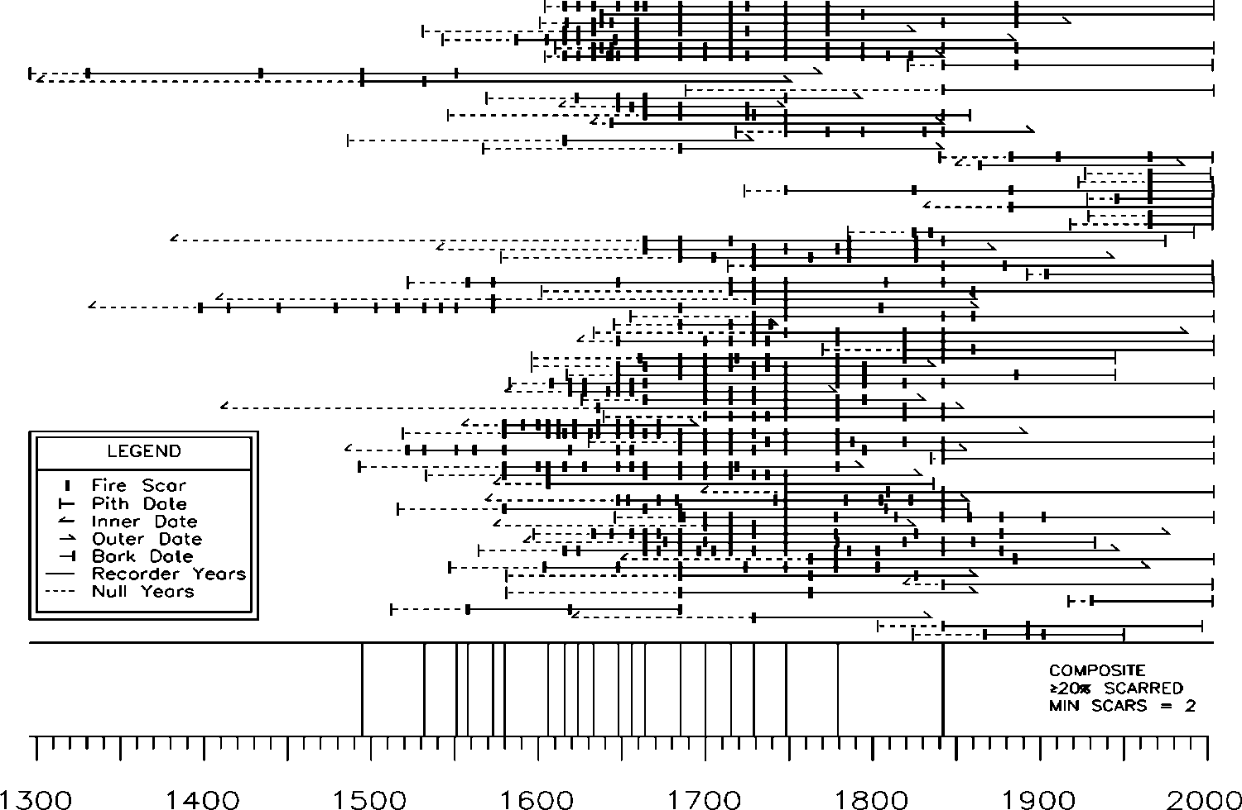
Ponderosa pine fire history (1296-2004)
1685
1842

Slide 32
Ponderosa Pine
Fire Frequency: High
Fire Severity: Low
Notes:
PJ PIPO MC Spruce-fir veg types - all historically burned with unique fire regimes

Slide 33
Conclusions
Fire historically burned across gradients of elevation, forest types and fire severity
MC/aspen – mixed severity fire regime with small (<100 ha) stand-replacing patches immediately adjacent to low severity patches
Spruce - last fire (1685) was largely stand-replacing (1200 ha, 93% of sampled area), recorded as fire scars throughout the MC and Pipo, and burned during a severe, regional drought (PDSI = - 6.92)
The drought-fire relationship suggests that if droughts become more frequent and severe, as predicted, the probability of large, severe fire occurrence will increase

Slide 34
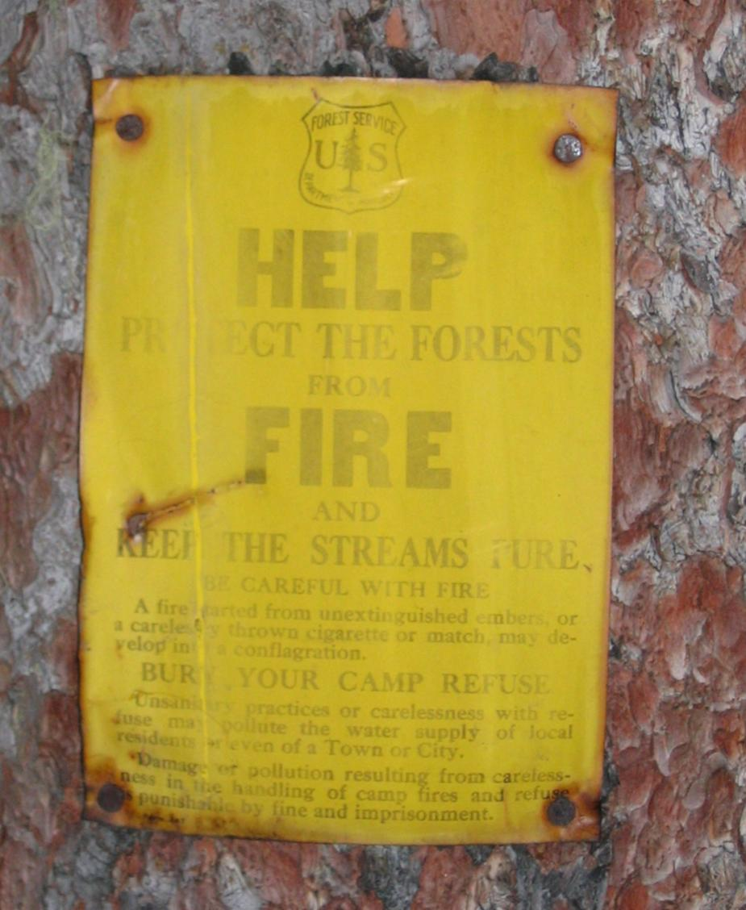
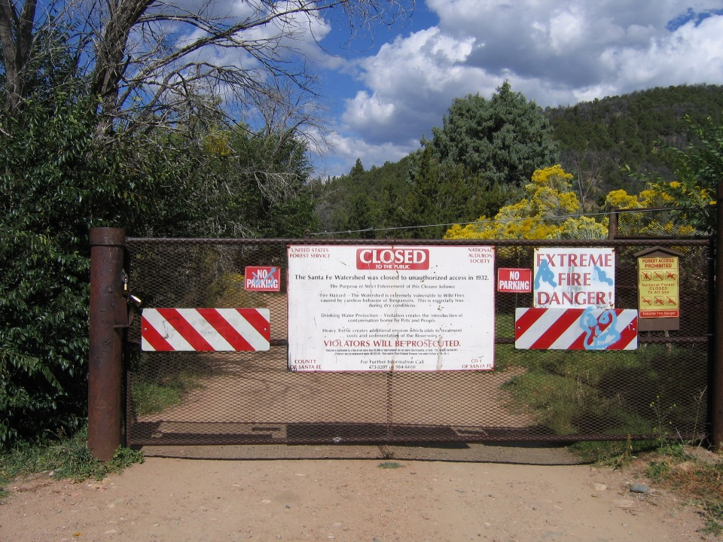
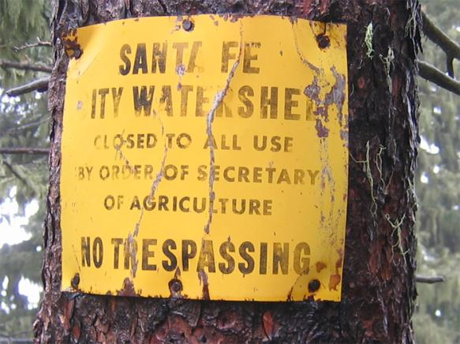
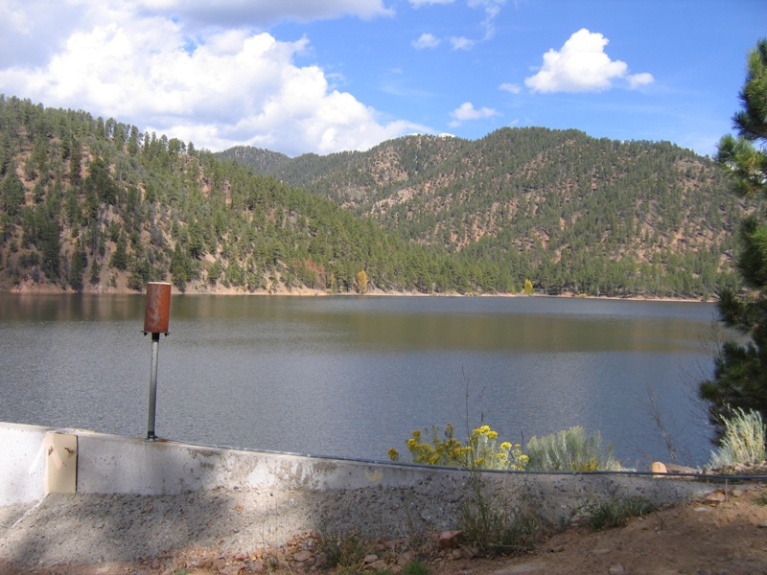

Notes:
Additionally, it’s a high priority location for forest restoration because of the high risk of stand-replacing fire that would jeopardize a major source of water for Santa Fe or potentially even flood historic downtown Santa Fe!

Slide 35

Is high severity fire a natural part of the Gila Wilderness?
Unknown fire, 8/23/2003
Ellis Margolis
Laboratory of Tree-Ring Research, University of Arizona
Tucson, Arizona
Notes:
High severity = fire that kills most of the trees, even the big and old ones

Slide 36


Northern Hemisphere Temperature
Professor Malcolm Hughes

Slide 37

Growth release following 1685 fire

Slide 38

Ponderosa pine tree-ring fire history
Notes:
Walk them through fire chart – each horizontal line is a tree, each vertical tick mark is a fire event recorded as a fire scar

Slide 39




Slide 40
SW US - precipitation sensitivity
Water is generally a limiting factor
Narrow ring = less precipitation
Wide ring = more precipitation

Slide 41


Pipo Fire Scars

Slide 42
1685 fire
Recorded by fire scars at 68% of fire scar plots
Largely stand-replacing in the spruce-dominated forest
Worst drought yr in over 1000 years; PDSI = – 6.92!
(Cook et al 2004)

