Slide 1
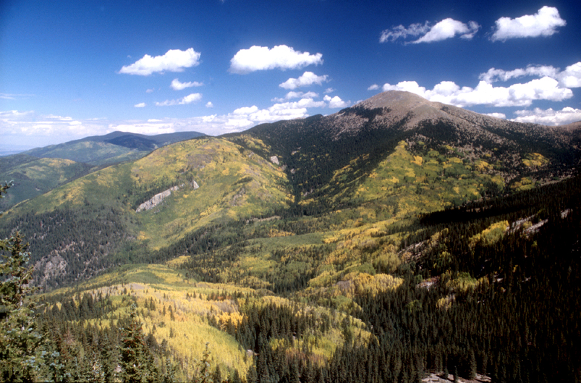
Fire and Ecosystem Dynamics
Ellis Margolis
Research Associate
Laboratory of Tree-Ring Research
University of Arizona
Slides courtesy of Andi Thode
Notes:
Fire is an ecosystem process that is part of the environment like precipitation, wind, flooding, soil development, erosion, predation, herbivory, carbon & nutrient cycling, and energy flow.

Slide 2
Objectives
Review fire regimes
Identify general species responses to fire and their role in predicting post-fire ecosystem changes.
Present a framework for thinking about fire effects on plant populations
Fire regimes and community effects

Slide 3
Outline
Fire regimes (review and additions)
Review fire effects on individual plants
Fire effects on plant populations and communities

Slide 4
Fire Regimes

Slide 5
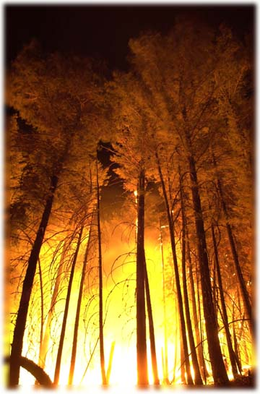
Fire as an Ecosystem Process
Fire is interdependent with other ecosystem components (e.g., vegetation structure, species composition, moisture)
Changes in one component results in significant changes to the ecosystem
Fire as a variable process maintains landscape diversity
Notes:
If there’s one take home, it’s to think about fire as a process, not just an event or something to put out or light
Analogous to stream flow

Slide 6
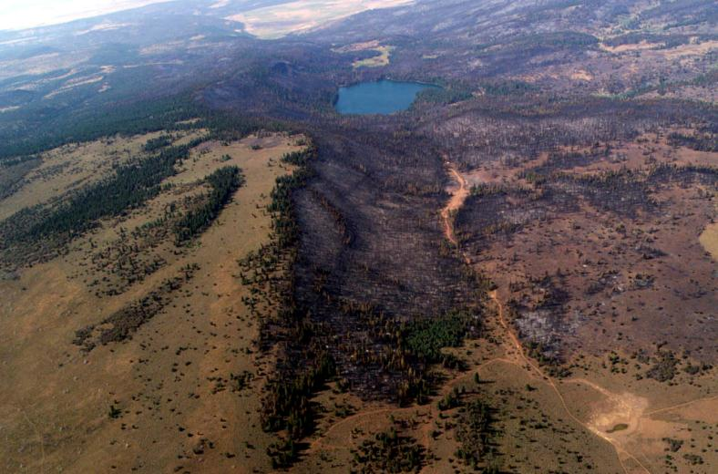
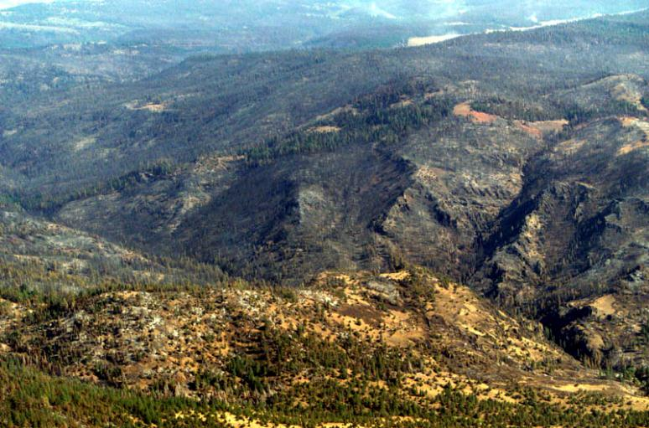
Fire Regimes
A summary of the “kind of fire history that characterized an ecosystem”
(Heinselman 1981)
The “generalized description of the role fire plays in an ecosystem”
(Agee 1993)
Notes:
Blue Fire – Modoc National Forest

Slide 7
Two Views of Fire
Individual fires
(single fires in isolation)
Vs
Repeated patterns of fire over time
(fire regimes)
(Agee 1993)
Notes:
Fire regimes encompass the range of variability of all individual fires

Slide 8
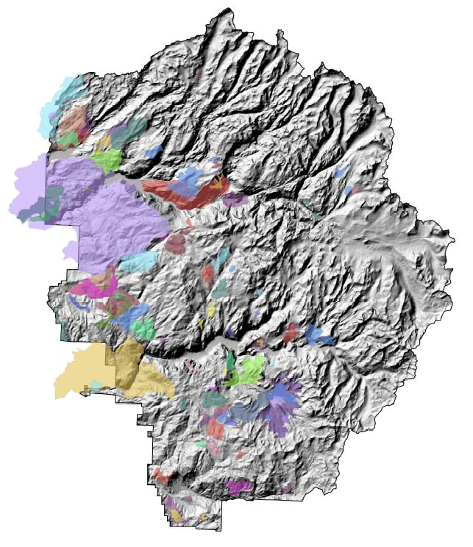
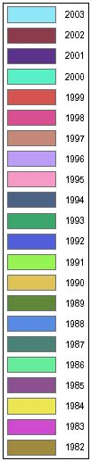
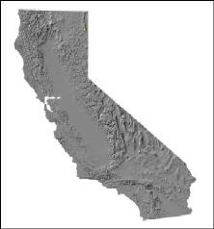

Yosemite N.P. Fire Atlas
Notes:
Now what happens if we group all the fire severity data by vegetation type or watershed? – the result is a fire regime
Participation – how many have had areas reburned where they work? – start to get pattern and range of fire regime components

Slide 9
5 National Fire Regime Categories
I | 0-35 year frequency and low (surface fires most common) to mixed severity (less than 75% of the dominant overstory vegetation replaced
II | 0-35 year frequency and high (stand replacement) severity (greater than 75% of the dominant overstory vegetation replaced)
III | 35-100+ year frequency and mixed severity (less than 75% of the dominant overstory vegetation replaced
IV | 35-100+ year frequency and high (stand replacement) severity
V | 200+ year frequency and high (stand replacement) severity.
Hardy et al 2001
Notes:
In this classification there are only 2 fire regime attributes – Participation - what are they?
Participation – who can name other fire regime attributes??

Slide 10
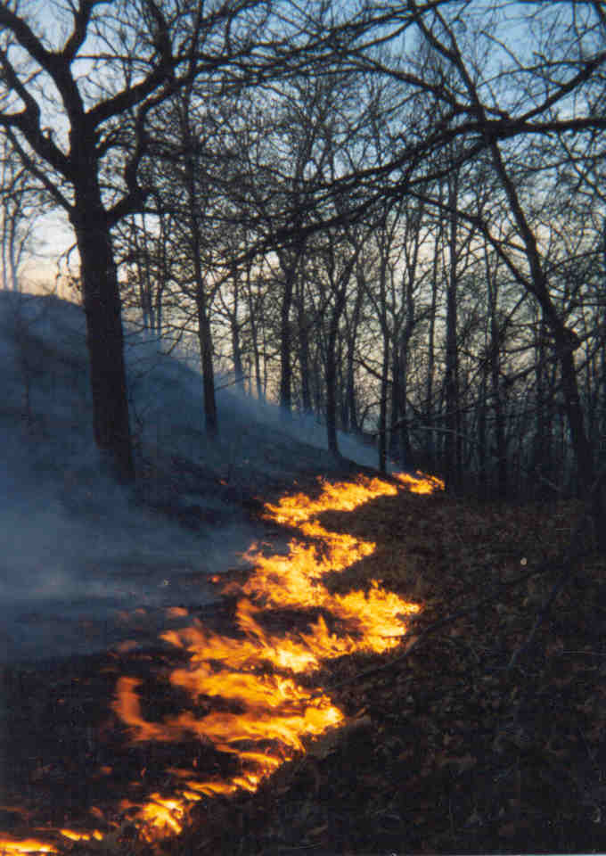
7 Fire Regime Attributes
Temporal
  Seasonality
  Fire Return Interval
Spatial
  Size/extent
  Spatial complexity
Magnitude
  Intensity
  Severity
  Fire type
Sugihara, N.G., J. W. van Wagtendonk, J. Fites-Kaufman. in press. Fire as an ecosystem process. in N. G. Sugihara, J. W. van Wagtendonk, J. Fites-Kaufman, K. E. Shaffer, and A. E. Thode, editors. Fire in California Ecosystems. University of California Press, Berkeley, CA.
Notes:
Sugihara et al define 7 attributes of a fire regime - we’ll look at the effects of these fire attributes on populations and communities

Slide 11
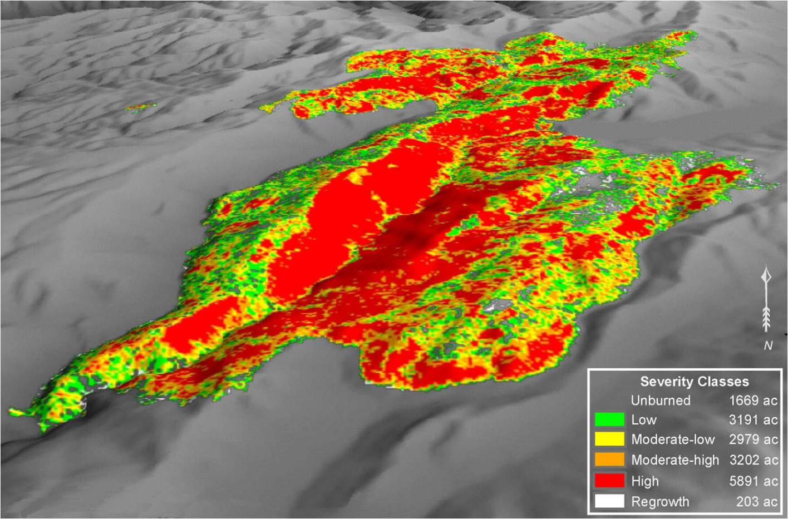
burn severity, size & complexity
Notes:
Of course, anything containing the word ecology is complex and fire as an ecosystem process is no different – much complexity in a single fire event, but with multiple fires patterns emerge

Slide 12
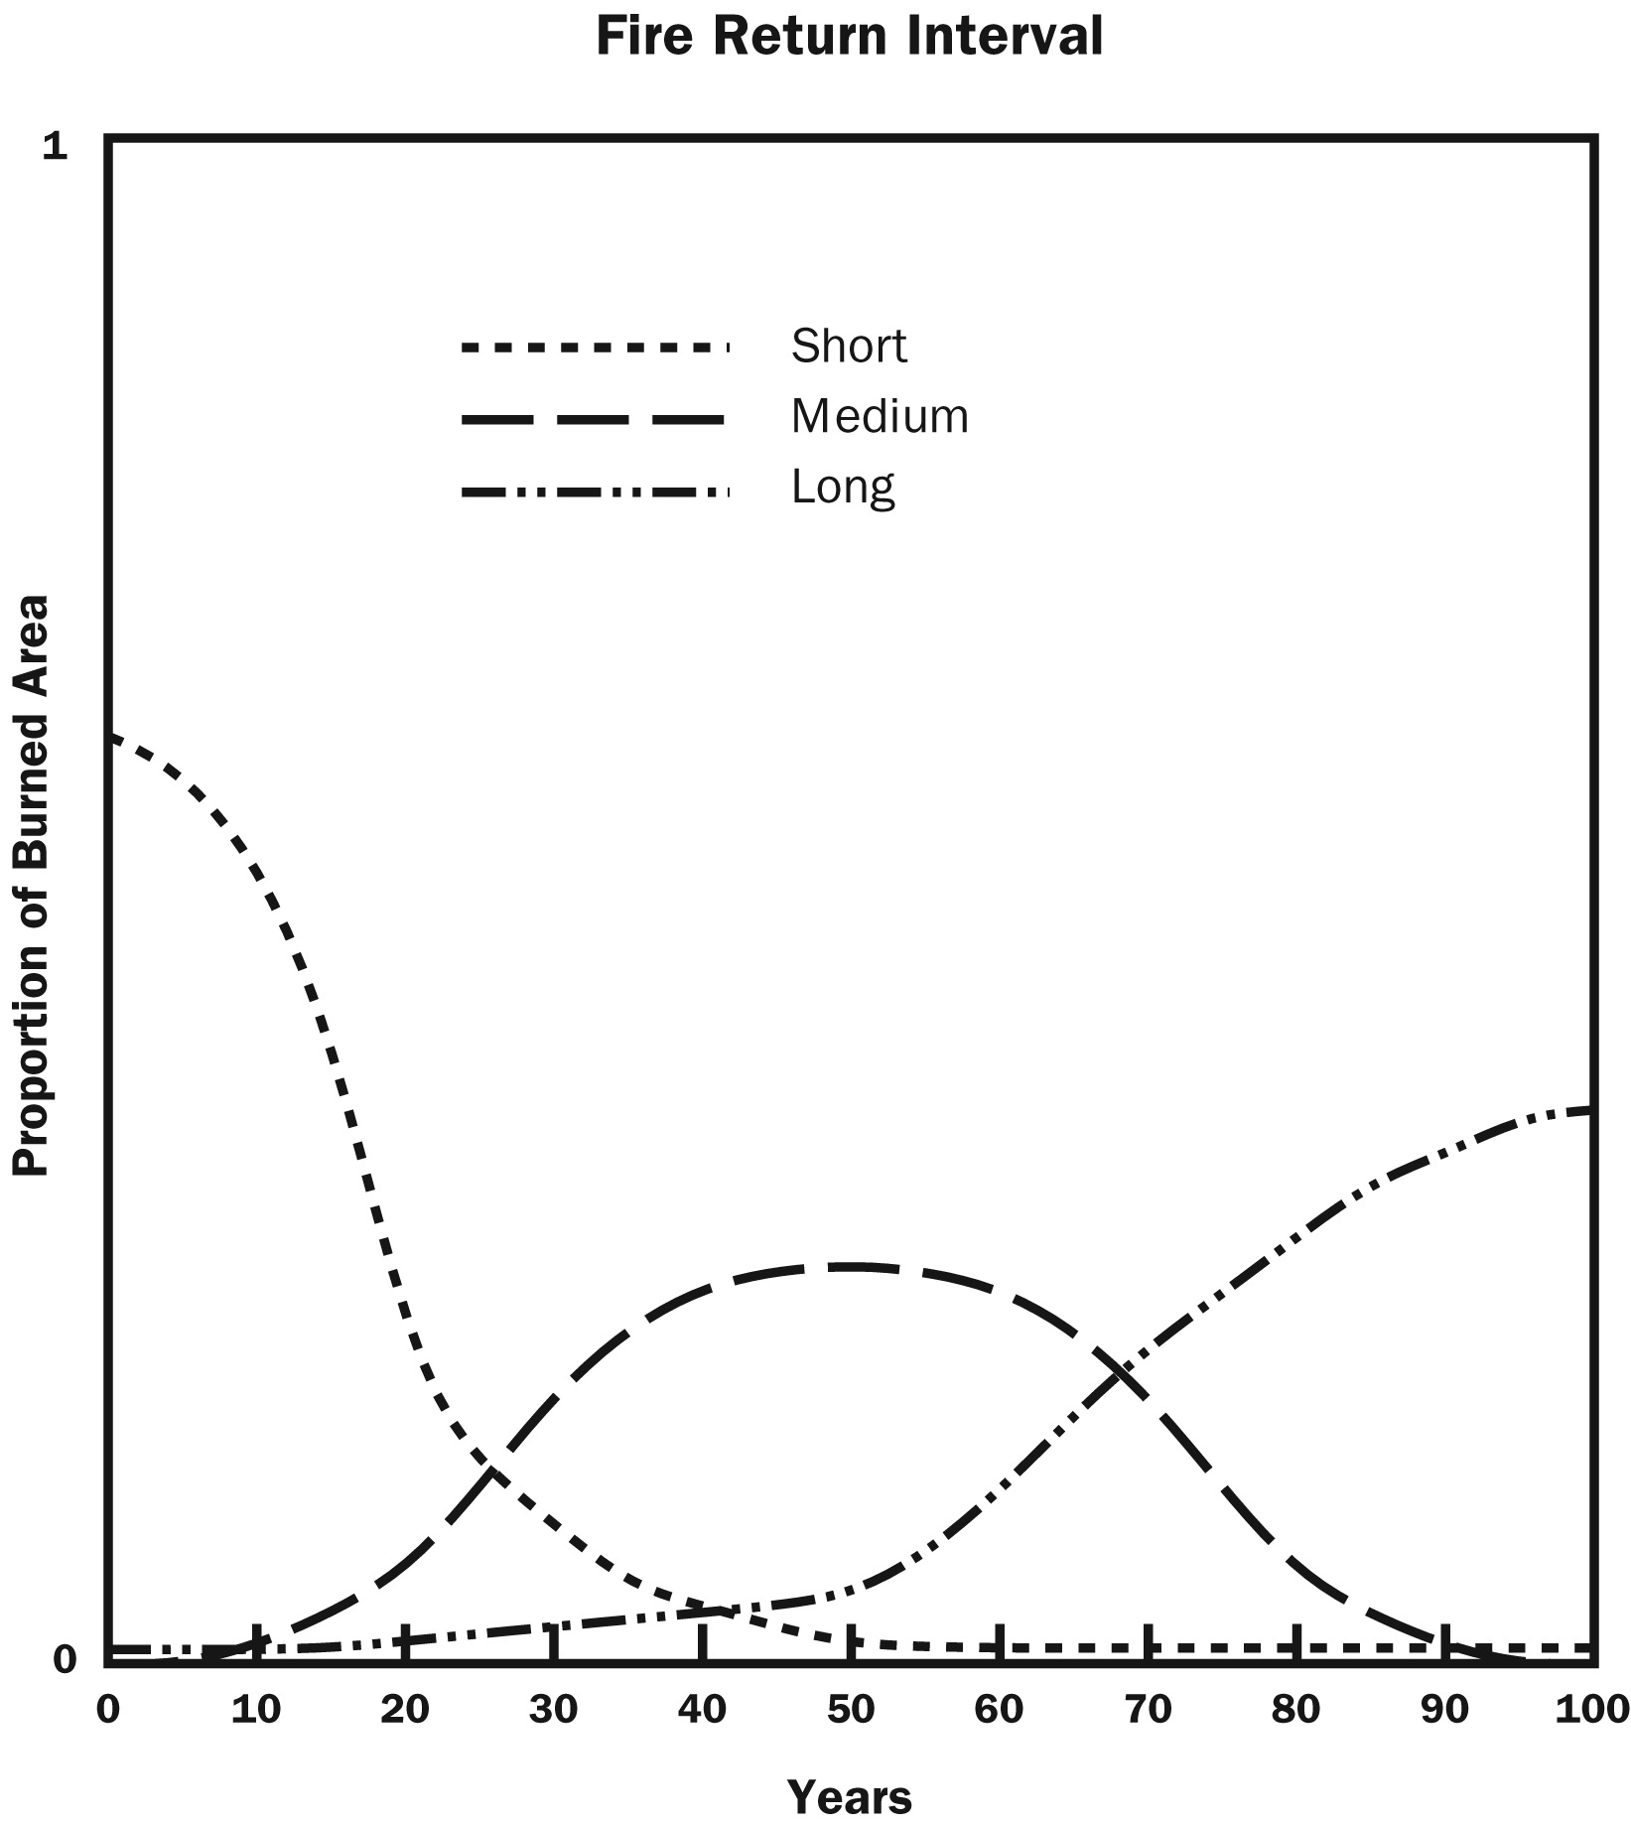
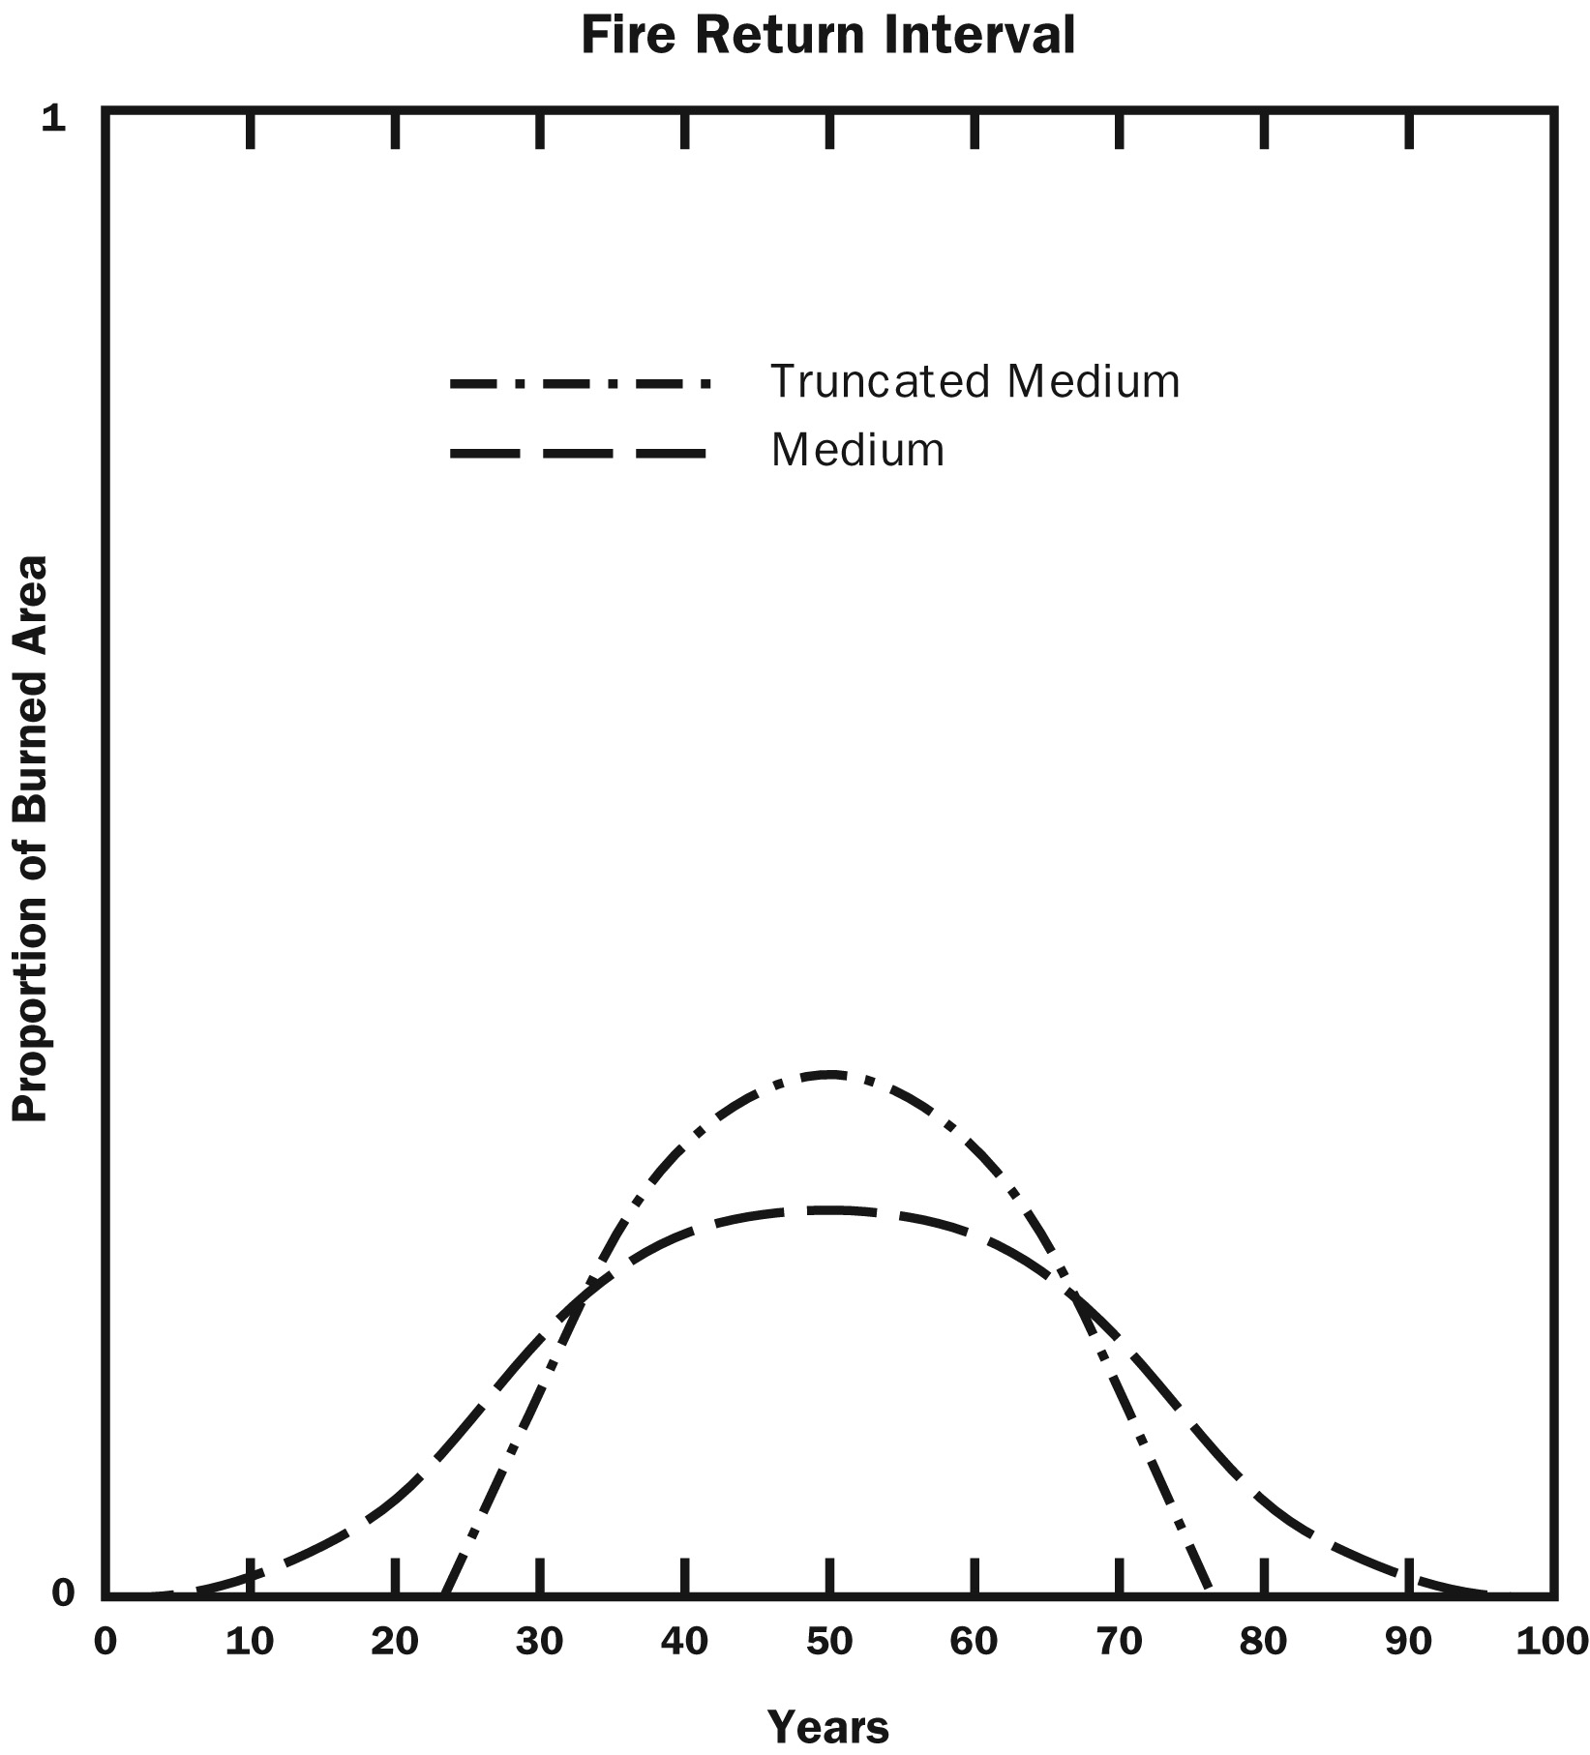
Fire Return Interval
Sugihara et al 2007.
Notes:
Thinking about the distribution of fire intervals (instead of just a mean) encompasses the wide range of possible intervals, which as we’ll see later, can greatly affect species populations and communities and promotes diversity. Three general types – short, medium, and long
Also flavors of any one of the types – EX – medium with tails, or truncated - Difference between the two can produce very different communities - E.g., - Truncated – never have fire return intervals < 25 yrs - effect –species that are dependent on fire with a lifespan < 25 yrs would be selected against

Slide 13
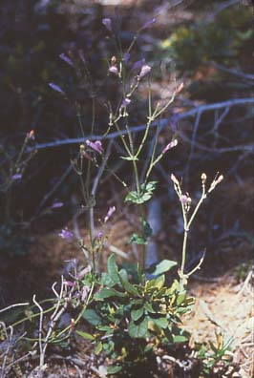
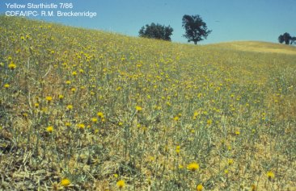
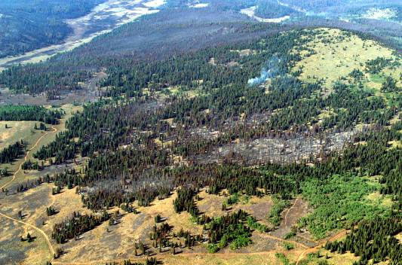
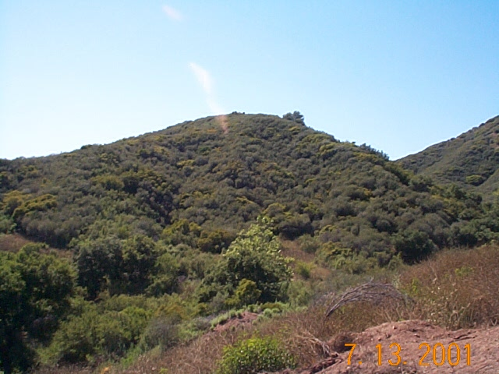
Biological levels of organization
Populations
- all individuals of
same kind in
area
Individual Plants
Plant community
- all plants together
in an area
Landscapes
- mosaic of plant
communities in an area

Slide 14
Fire effects – individual plants
Plant survival is related to: (1) surviving the fire by avoiding heat damage, and (2) being able to establish and spread in post-fire environments
Plants tend to have one of two fire adapted strategies
Resistance – plant tissues are protected from heat allowing the plant to survive fire
Persistence – plants are damaged by fire but are able to regenerate after fire
Notes:
This is a review, but it’s the basis of population and community responses to fire - Participation – ask if they’ve seen this before? – What are two strategies to survive in a fire environment (1) resistance (2) persistence

Slide 15
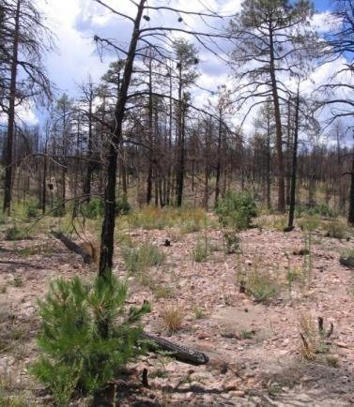
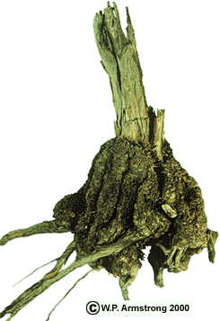
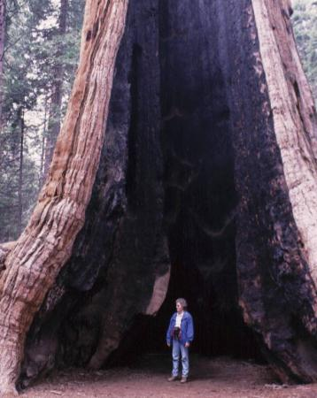
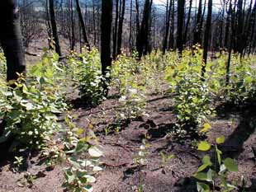
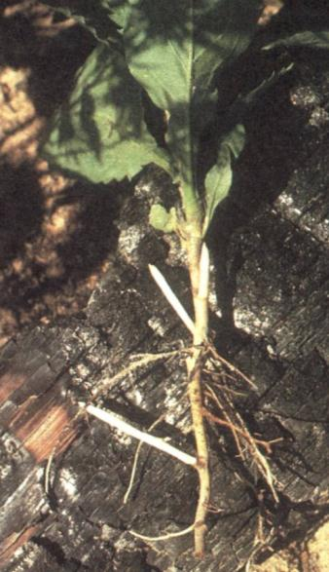
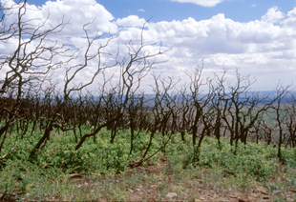
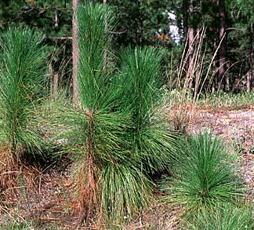
Avoiding heat damage
Thick bark on Giant Sequoia
Aspen resprouting (CO Cooperative extension)
Chihuahuan pine resprouting (Pete Fulé)
Gambel oak resprouting (CO Cooperative extension)
Longleaf pine grass stage (NCSU)
New rhizome growth
Notes:
Ex’s - Participation – resistance or persistence?

Slide 16
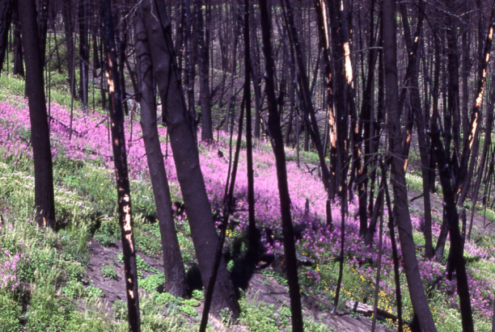
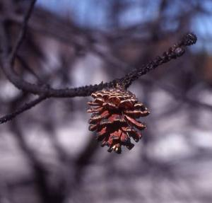
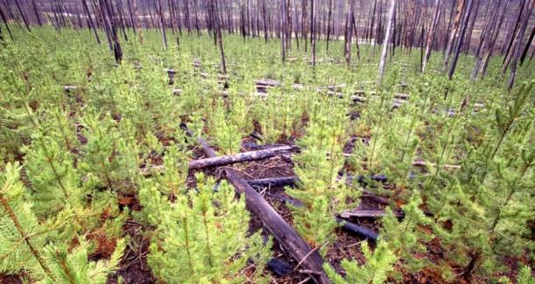
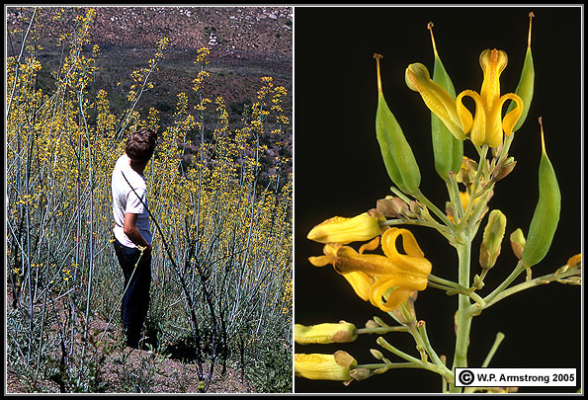
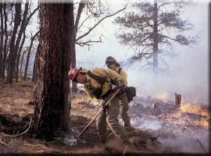
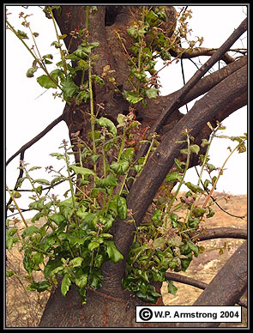
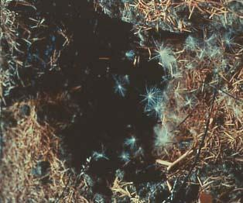
Armstrong, W.P. 2001. Wayne's Word: 9 May 2001. http://waynesword.palomar.edu/wayne.htm.

Slide 17

General Species Responses to Fire - Reproduction
Reproductive Strategy
Fire Response Type
Sprouters
Non-Sprouters
Not killed by fire
Killed by fire
Flowering only or almost entirely after fire
Fire Stimulated flowering, germination, seed release
Seed release from heat
Fire-dependent
Fire-stimulated
Species increase after fire, also establishment in fire-free interval
Seed release and seedling establishment enhance
Seed germination enhanced
Fire-enhanced
Sprouting recruitment same following fire as in fire-free interval; continuous sprouters
Seed germination same following fire than in fire-free interval; seed producers survive fire
Long-distance seed dispersal
Fire-neutral
Not fire-stimulated
Sprouting recruitment less following fire than in fire-free interval
Seed germination less following fire than in fire-free interval
Mature and seedling individuals killed by fire; post-fire recruitment low
Fire-inhibited
Notes:
Framework for classifying species fire response and reproductive strategy
Fire stimulated are responses that increase with fire such as sprouting or germination
Ceanothus megacarpus

Slide 18
Plant Populations, Communities and Fire
Notes:
1/3 over – stand up and stretch - should be no later than 3:30

Slide 19
Populations-key considerations for determining potential effects
Is the population dependent or enhanced by fire?
  Yes? – fire effects generally positive
Fire-neutral or Fire-inhibited?
  Depends on mosaic of burn and proportion of population affected
Keys to population persistence:
  Survival
  Reproduction
Notes:
Introduce the concept of a population to discuss other components of the fire regime – size, spatial complexity…

Slide 20
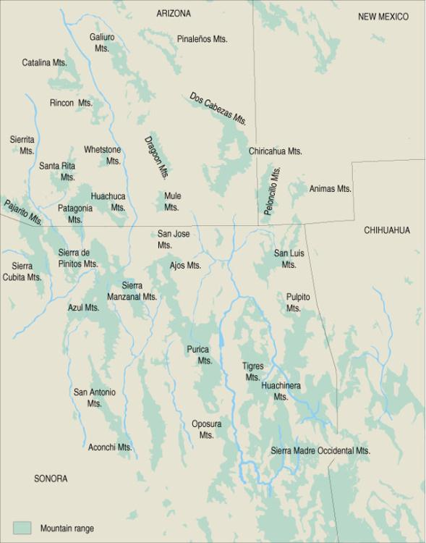
Fire Size
(relative to population size)
Small populations in Sky Islands
Size relative to the plant population determines effects
Population distribution patterns compared to fire size
  Endemic
  Patchy
  Continuous
USGS
Notes:
an organism being "endemic" means exclusively native to a place or biota –wikipedia
EQM – Endemic - only population left in the world!!

Slide 21
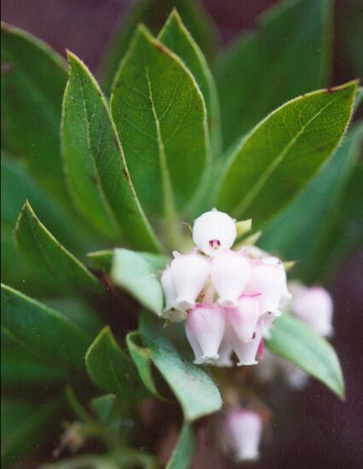
Marin Manzanita
(Arctostaphylos virgata)
Rare Plant
endemic to Marin County, CA
require heat from fire to break seedcoats and stimulate seed germination
Responded very well to 1995 Vision Fire in Point Reyes National Seashore
Copyright © 2004, Point Reyes National Seashore http://www.nps.gov/pore/fire_photos.htm

Slide 22
Fire and spatial distribution of a population
  Example:
  Fire inhibited species (killed by fire)
Continuous
  Ability to re-colonize depends on species’ spatial distribution (continuous vs. patchy)
Patchy

Slide 23

Potential Population Effects
Spatial Distribution Pattern
Fire Response Type
Fire-dependent
Fire-enhanced
Fire-neutral
Fire-inhibited
Maintains or increases distribution and abundance
Same as dependent
May greatly restrict pop
Decrease in distribution and abundance
Endemic
Maintains or increases distribution and abundance
Same as dependent
May negatively affect portion of distribution
Recolonization may be limited
Decrease in portion of distribution
Recolonization may be limited
Patchy
May negatively affect portion of distribution where fire occurs
Recolonization NOT limited
Decrease in portion of distribution
Recolonization NOT limited
Maintains or increases distribution and abundance
Same as dependent
Continuous
Note: depends on season, spatial complexity, severity, intensity!
Notes:
Framework to organize the effects of spatial distribution and fire response on a population following fire

Slide 24
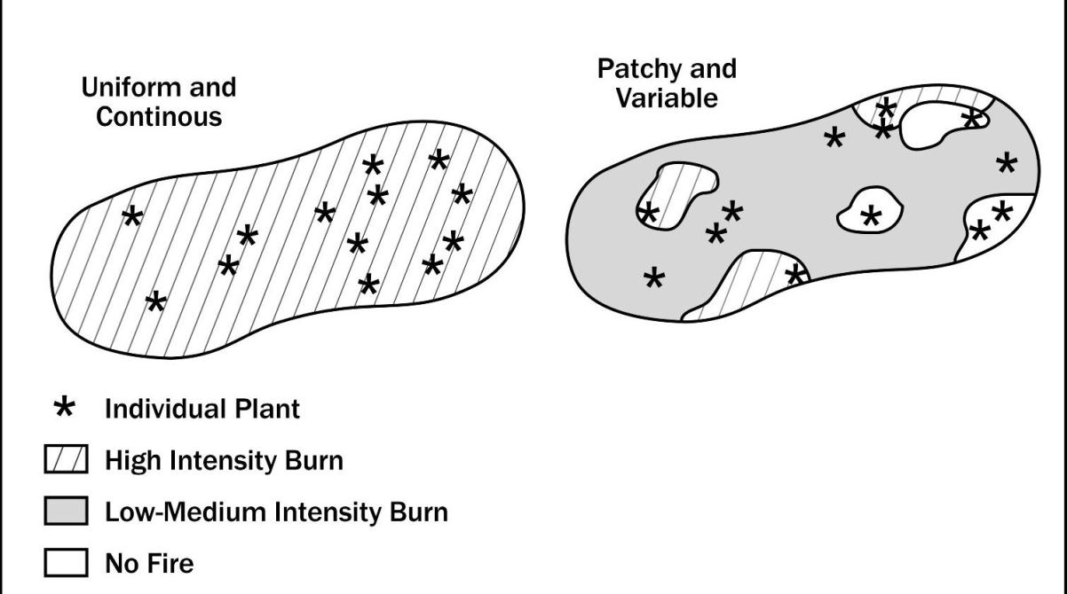
Fire Spatial Complexity and Plant Populations
Notes:
Fire spatial complexity – fire regime attribute
At one extreme, fire with uniform intensity will have uniform effects, either positive or negative
Complex fire will have varied effects on a plant population
As long as characteristics of fire are within the distributions of the suitable fire regime, fire-dependent and fire-enhanced species will have a greater positive population response to a uniform fire than one that is variable
Fire-inibited: greater spatial complexity would result in a higher prob of survival

Slide 25
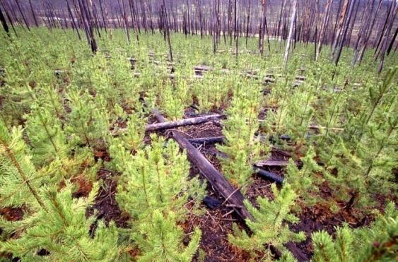
Fire spatial complexity and species adaptation to fire
  Fire persistent species can withstand large, uniform patches (resprout, seed survives fire)
  Fire resistant species may not be able to re-colonize large and intense fires, but may re-colonize patchy fires
164 ft
Ponderosa pine seedling establishment in high severity burn patches
Lodgepole pine – Yellowstone National Park

Slide 26
Fire Seasonality and Phenology
New growth
Carbohydrate Levels
flowering
dormant
fruiting
Plants go through different
Stages with the seasons
-dormant least sensitive to fire
Notes:
Ex of when Carbohydrate storage peaks in roots (dormant) – during growing season – less is in the roots and more in above-ground

Slide 27
Seasonality and Plant Populations
Can influence population size and age distribution which influences pop growth and reproductive viability
  short term – destruction of year’s seed or elimination of cohort
  long term – depressed reproduction, loss of competitive edge
What happens with:
  Fire during flowering or seed development
  Fire during season with wet soils
  Early growing season fires
Notes:
Fire during flowering or seed development stages result
in greater mortality due to loss of seed that year
following year reproduction can be low due to using reserves to respond to fire and not into developing seed
Annuals can be harder hit

Slide 28
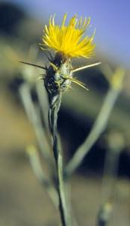
Seasonality and plant populations Ex: Yellow Starthistle (invasive)
  Fire during sensitive stages of development can increase mortality
  Fire can also impact flowering or seed development at different stages
Timing of burning is important in controlling invasive plant populations
3 years of spring/early summer burning can control yellow star thistle
Burns must be during flowering stage
Notes:
3 yrs of spring burns can control yellow star thistle

Slide 29
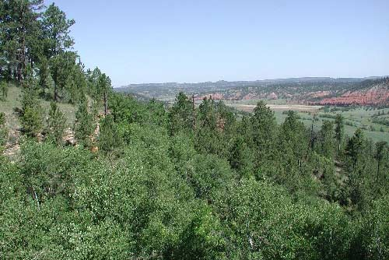
Fire effects on populations and communities
Different plant species will respond differently to seasonal patterns of fire
Gambel oak and ponderosa pine have different responses in different seasons
Notes:
Of course populations rarely exist in isolation, but are part of plant communities. Each component of the community likely has it’s own response to fire, which results in competition. So, in communities, fire regime characterists can favor some populations over others.

Slide 30
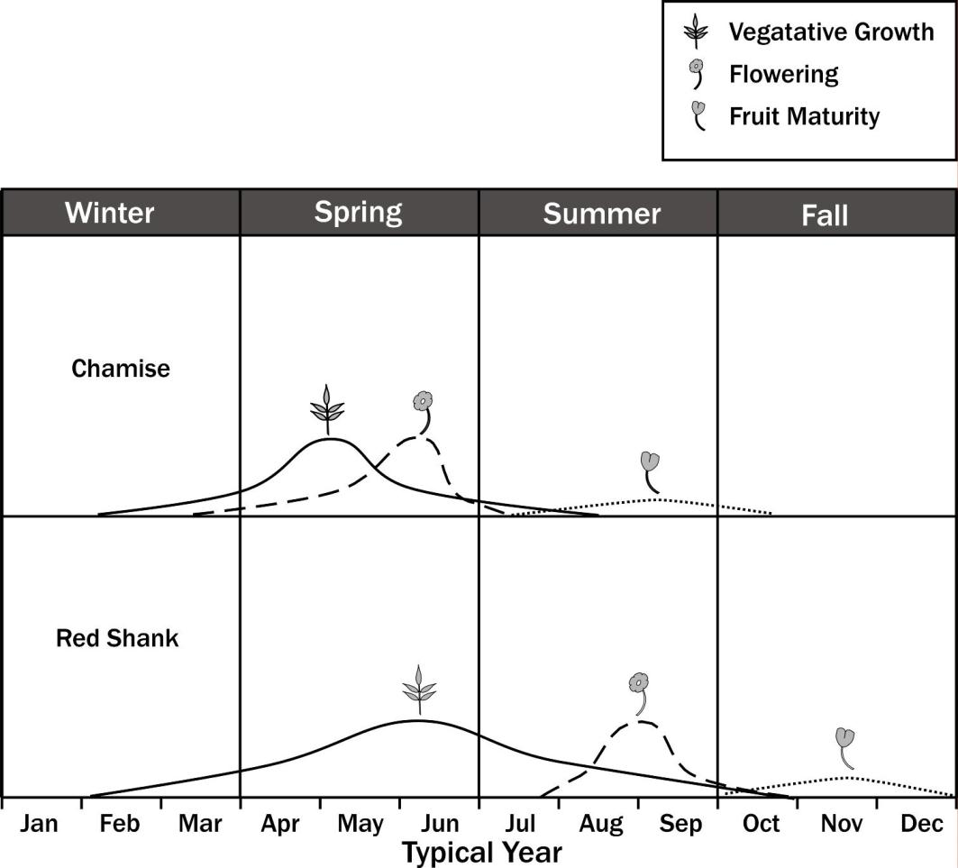
Plant Communities
Species Variation in Phenology
Notes:
30
Early spring fire more damaging to chamise due to energy being put into flowering.
Both southern CA plant species that co-occur
Red Shank Adenostoma sparsifolium – poor seeder and primarily relies on vegetative regeneration
Chamise - Reproduction by seed: Onset of seed production occurs early in chamise, often by 3 years of age [27].
Chamise reproduces sexually and vegetatively. Since chamise seed germinates at high rates only after fire, seedling recruitment and population expansion are fire dependent [68,69]. Canopy rejuvenation through the production of new basal sprouts occurs with or without the influence of fire [68,70].
Chamise produces a dimorphic seed population composed of dormant as well as readily germinable seeds

Slide 31
Fire Return Interval and Populations
Three effects of FRI on Fire-dependent or fire-enhanced plants
  Senescence risk – survival time (e.g., subalpine Quaking Aspen lifespan > MFI so it can resprout)
  Recruitment risk – maturity for seed production (Bishop Pine, Lodgepole pine…etc.)
  Immaturity risk – growth to resistant stage (ponderosa pine)
Notes:
Senescence - time intervals between fires exceeds survival time
produce seeds that last a long time (ceanothus)
have reproductive parts last a long time (bulbs)
live a long time (giant sequoia)
EQM – Ex – quaking aspen – will they survive long enough to resprout following the next fire
So if MFI is greater than the species lifespan, the population will be selected against.
Recruitment- recruitment by seed when the fire-return interval is shorter than the time required for individuals to mature and set seed
mature early ---- EQM – will the population be mature enough to produce seed before the next stand-r fire (e.g., lodgepole)?
Immaturity- fire-return interval is shorter than the time required for individuals to grow to a fire-resistant stage
Long leaf pine – sprouting stage after grass stage --- EQM – will the regeneration survive the next fire?

Slide 32
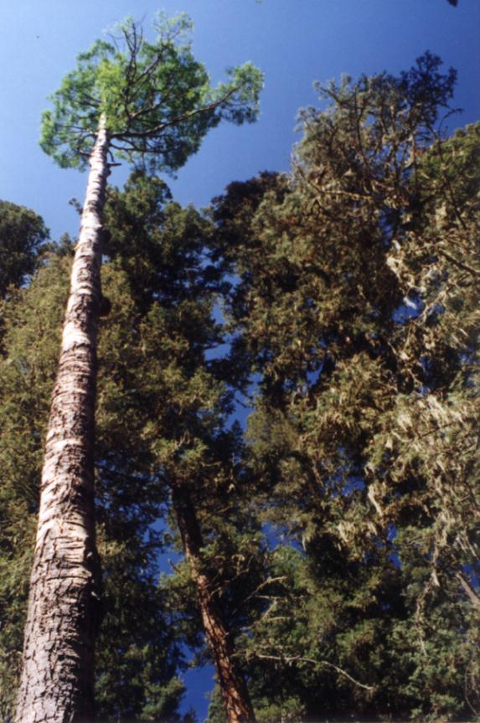
Senescence Risk – Quaking Aspen
Notes:
If seral quaking aspen growing in long return interval conifer system dies before the next fire then the population could die (lifespan < fire interval)

Slide 33
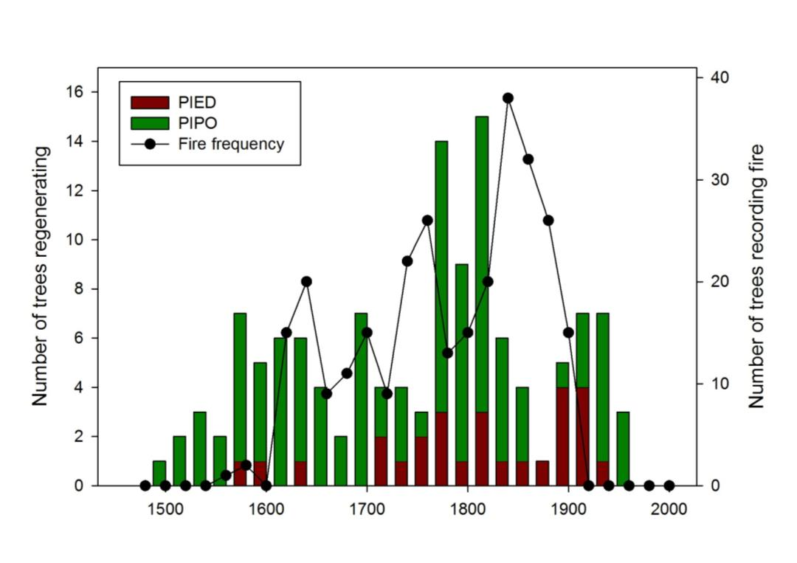
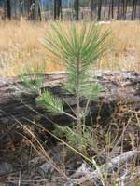
Immaturity Risk – Ponderosa Pine
Notes:
Pipo seedlings are susceptible to even low intensity fire - longer fire intervals can provide a window for PIPO to reach an age/size where it can resist fire - see legacy of this variability of fire intervals (the tails) in modern forests as age cohorts that recruited when there was less fire (and vice versa)

Slide 34
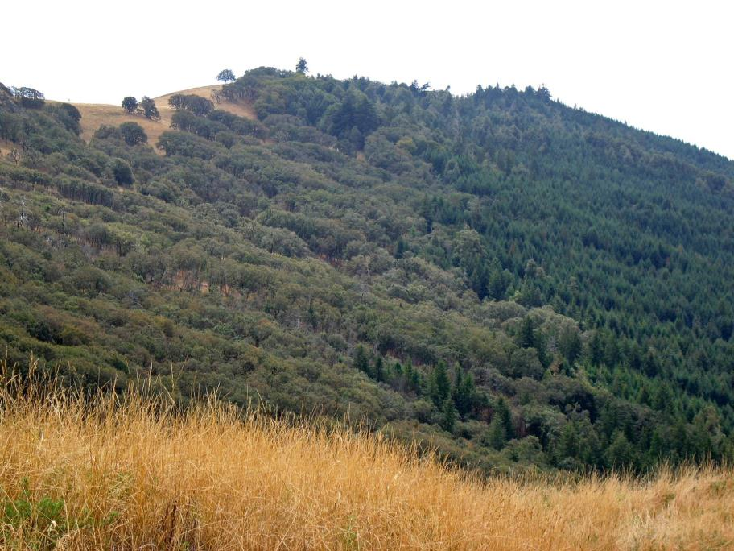
Oregon White Oak Woodlands/Doug Fir
Increased fire intervals favored Doug Fir
Fire Return Interval and Communities
Notes:
Oregon White Oak and Doug Fir – Redwood National Park
See CH4 inset
Fire regime changes (lengthening of fire interval and increased severity) resulted in shift from oak woodland to PSME forest
Ex of immaturity risk – short fire intervals used to keep PSME from establishing, but fire exclusion lengthened the fire intervals long enough to open a window to allow PSME to establish

Slide 35
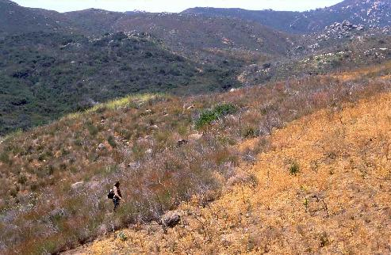
Fire Return Interval and Communities
  Fire return interval shorter than what plants are adapted to
    Species do not have a chance to grow into a fire resistant stage
    Species do not have a chance to recruit new individuals
1970 Laguna Fire
2001Viejas Fire
2003Cedar Fire
http://www.californiachaparral.com/pages/7/index.htm
Notes:
The far left shows 34 year old chaparral last burned during the 1970 Laguna fire.
The middle/left of the picture shows an area recovering from the Viejas fire of January 3, 2001. It is composed primarily of chamise, deerweed, and several other shrub species.
To the right is a portion of the Viejas fire scar reburned in the Cedar fire October, 2003.
Cedar fire scar is now filled with non-native grasses.
The majority of the resprouting shrubs have been killed and no obligate seeding species, such as Ceanothus, are present.
The interval between the two fires was too short, causing the elimination of the chaparral plant community.

Slide 36
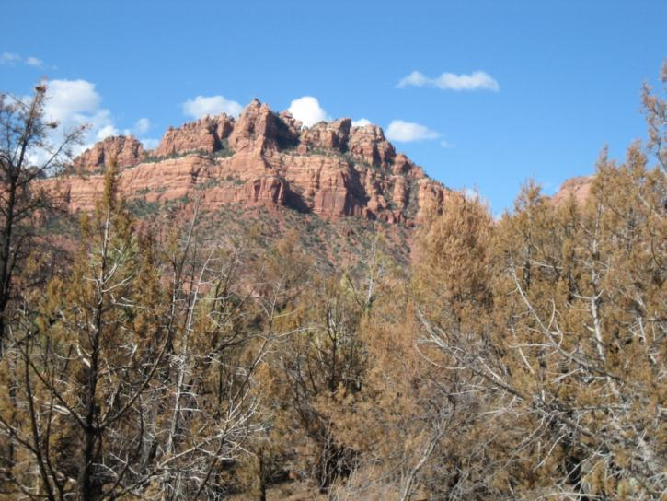
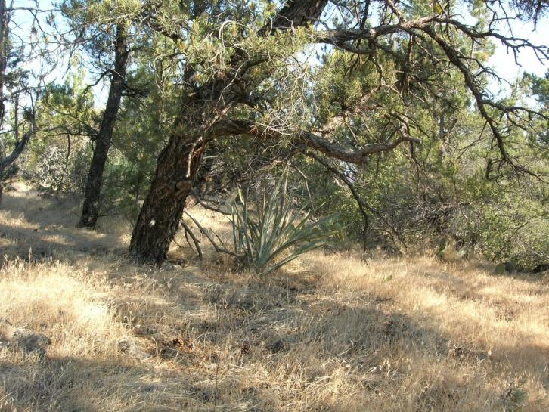
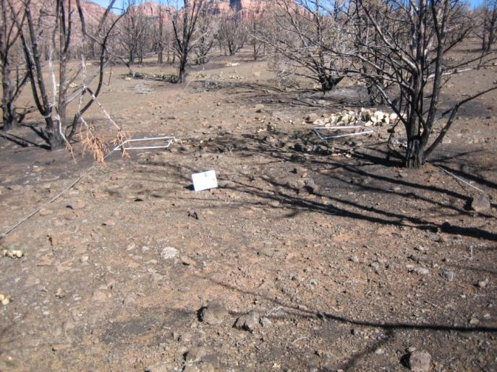
Zion National Park
Notes:
Change in fire regime (through introduced cheat grass leading to decreased fire intervals) can lead to community change

Slide 37
Populations and Fire Magnitude
(intensity, severity, and fire type)
Fire magnitude affects the size and extent of populations through:
  Direct mortality
  Indirect effects on:
    Survival
    Reproduction
    Recruitment
  *Mixed Severity (by species) Fire Type and Intensity interact with plant characteristics to produce a variety of fire severities

Slide 38
Intensity and Fire Type
Crown fires – high intensity
  Populations that persist regenerate via sprouting, seeds or colonization
Surface fires - low or moderate intensities
  Lower mortality - resistors
  More varied responses within the population

Slide 39
Intensity and Resisters
Resisters (often fire-neutral or fire-enhanced)
  do well with low or moderate intensity but generally have significant mortality with high severity (Ponderosa Pine and Douglas Fir)
  Age of cohorts will affect mortality even with low intensity fire
    Can affect overall tree population for centuries
Fire-inhibited
  Fire of any intensity can cause significant mortality

Slide 40
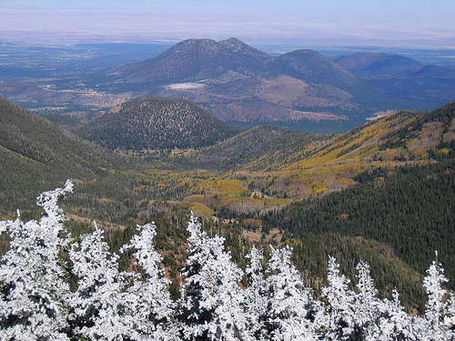
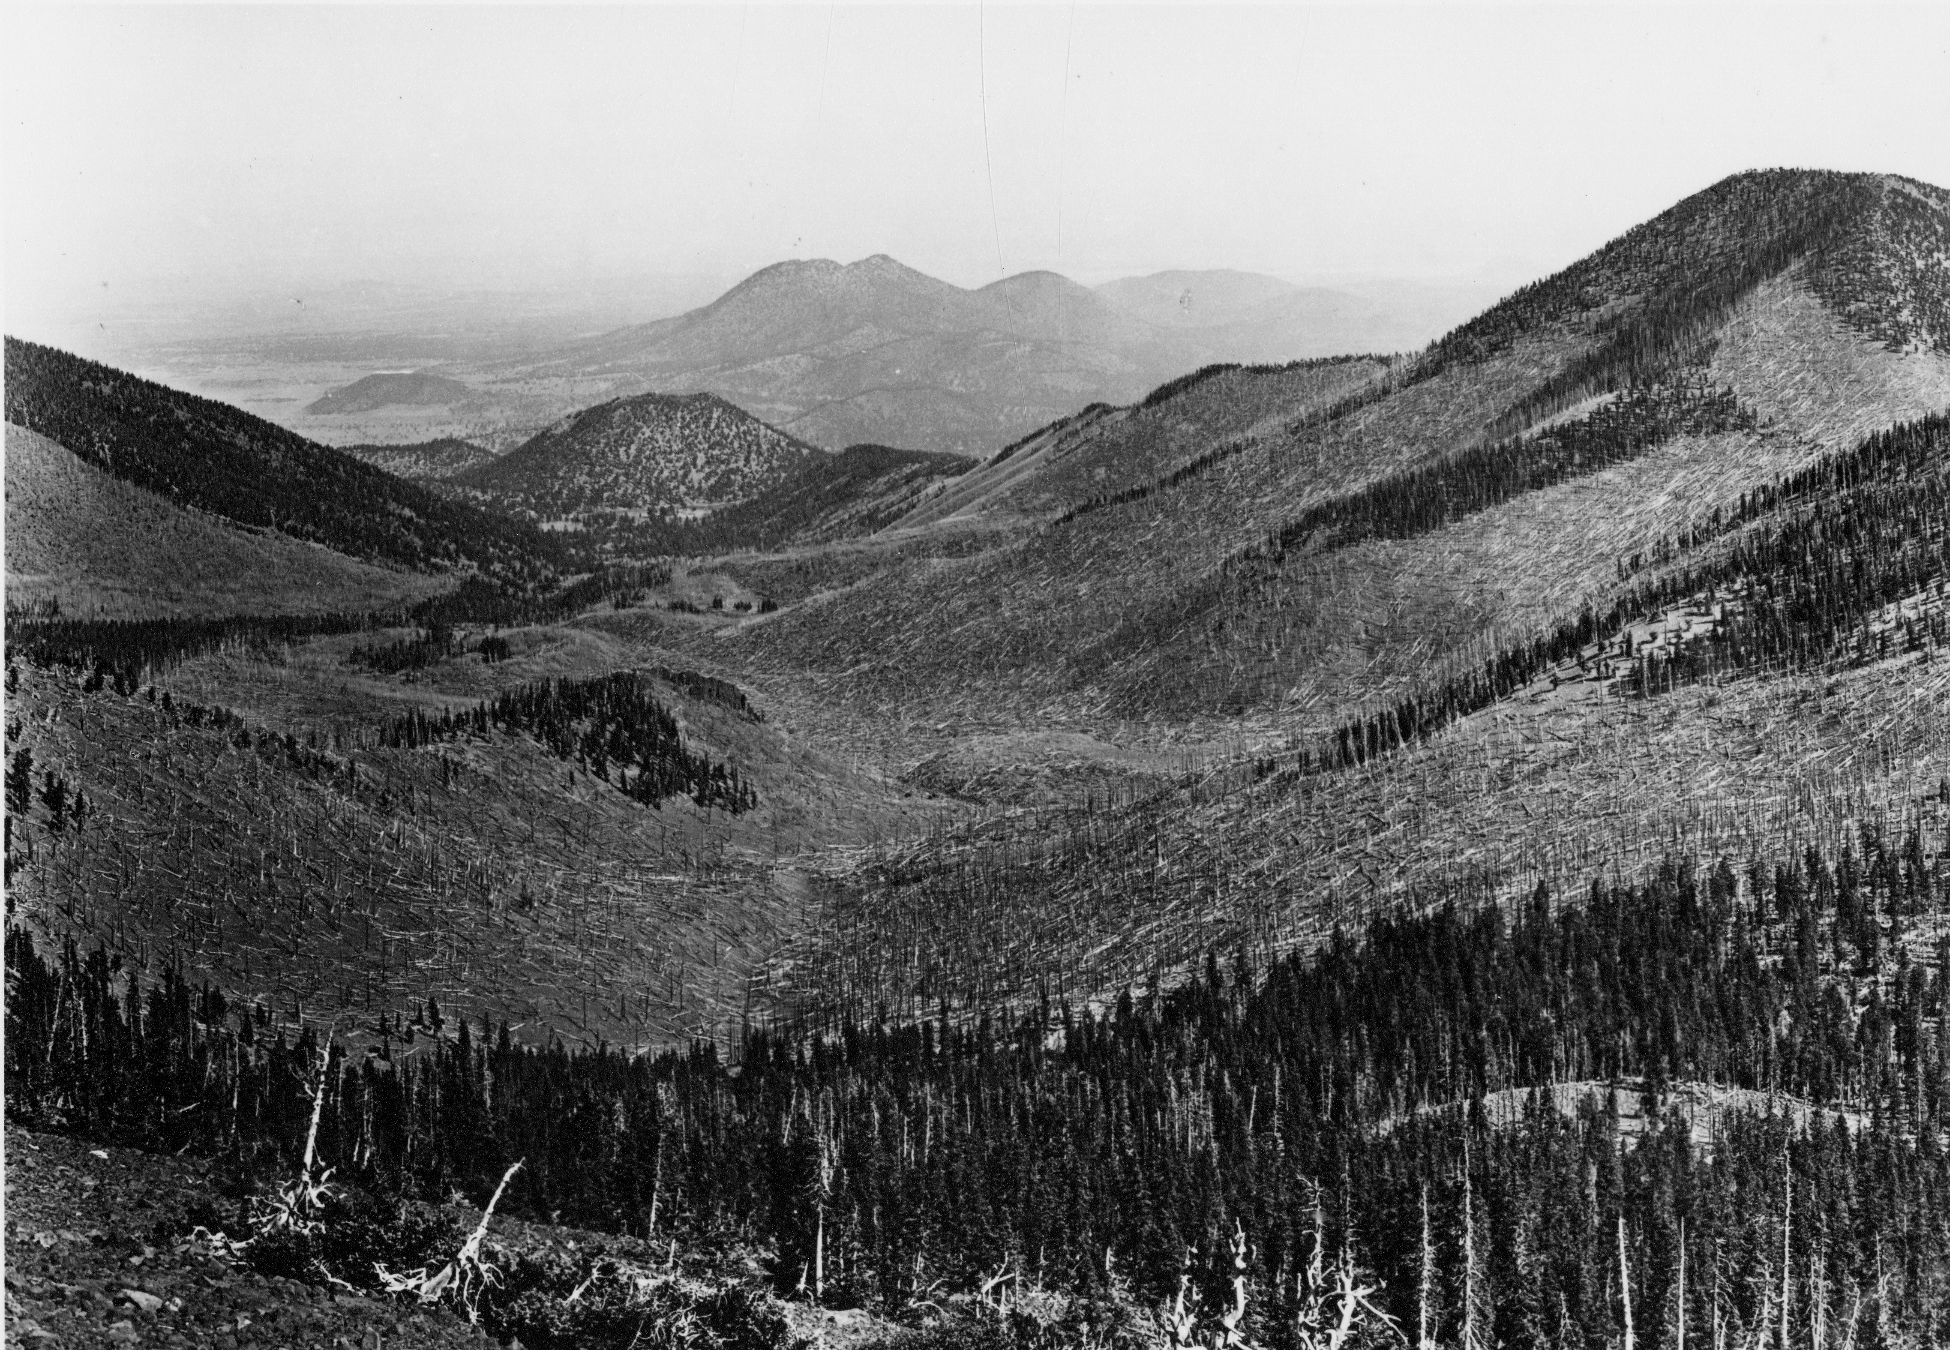
2 types of persistence - high intensity fire
San Francisco Peaks, AZ
2007 Photo
1910 Photo
Notes:
Ex of different persistence strategies following high severity fire (aspen – resprout; spruce-fir – seeding)

Slide 41
Summary
Seven components of a fire regimes
Thinking of fire regimes as distributions allows us to understand varying effects within fire regime types.

Slide 42
Summary (cont.)
Understanding individual plant responses to fire helps us to frame population and community responses to fire
Relating fire regime attributes to plant populations and communities can help us understand the possible implications of our management actions.

Slide 43
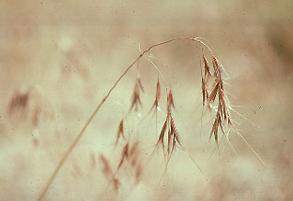
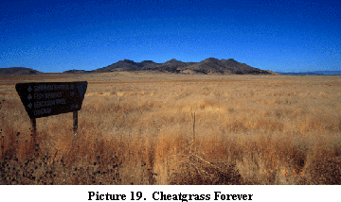
Plant Communities and Invasives
Cheatgrass
  Seasonality
  Frequency
  Intensity
  Severity
  Size
  Spatial Complexity
http://www.rangenet.org/projects/wplgalbum/page3/page3c.html

Slide 44
Zion National Park

Slide 45
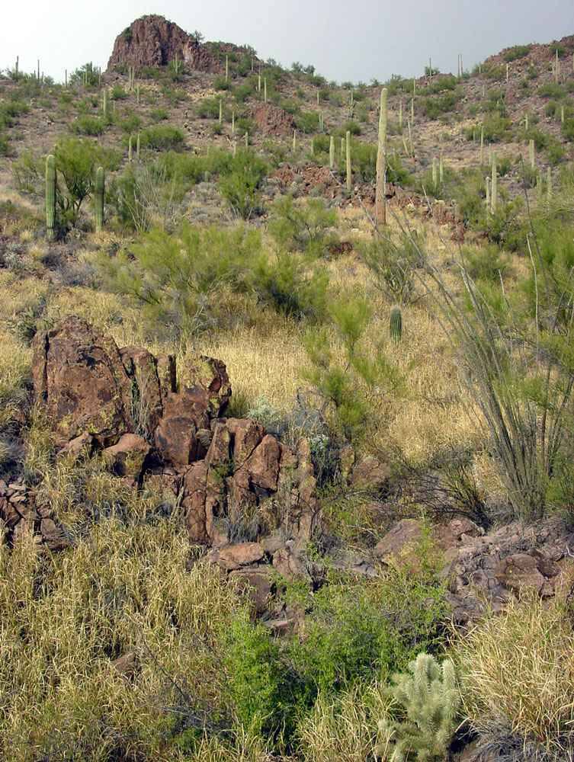
Plant Communities and Invasives
Bufflegrass
  Seasonality
  Frequency
  Intensity
  Severity
  Size
  Spatial Complexity
http://www.desertmuseum.org/invaders/invaders_buffelgrass.htm

Slide 46
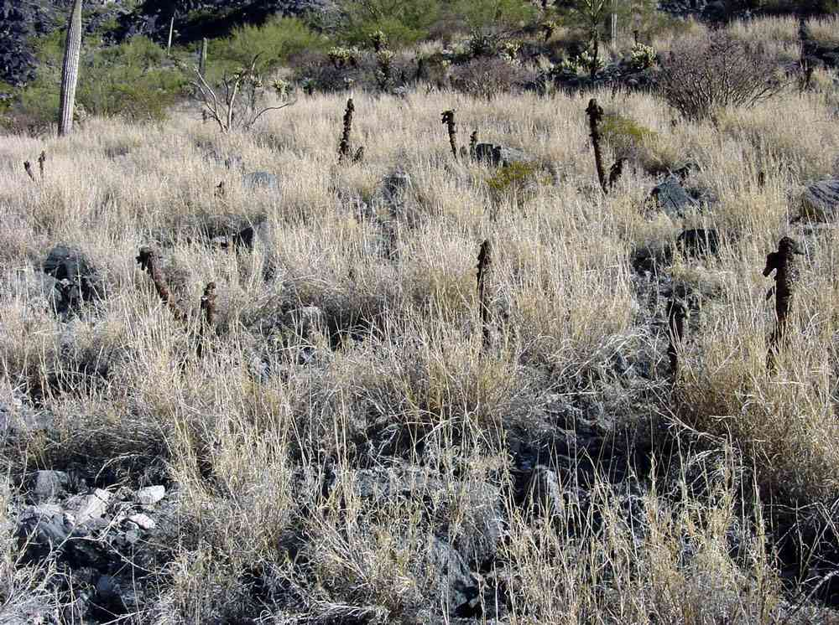
http://www.desertmuseum.org/invaders/invaders_buffelgrass.htm
Notes:
Bufflegrass

Slide 47



Questions?

