Slide 1
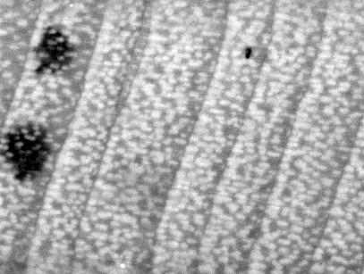
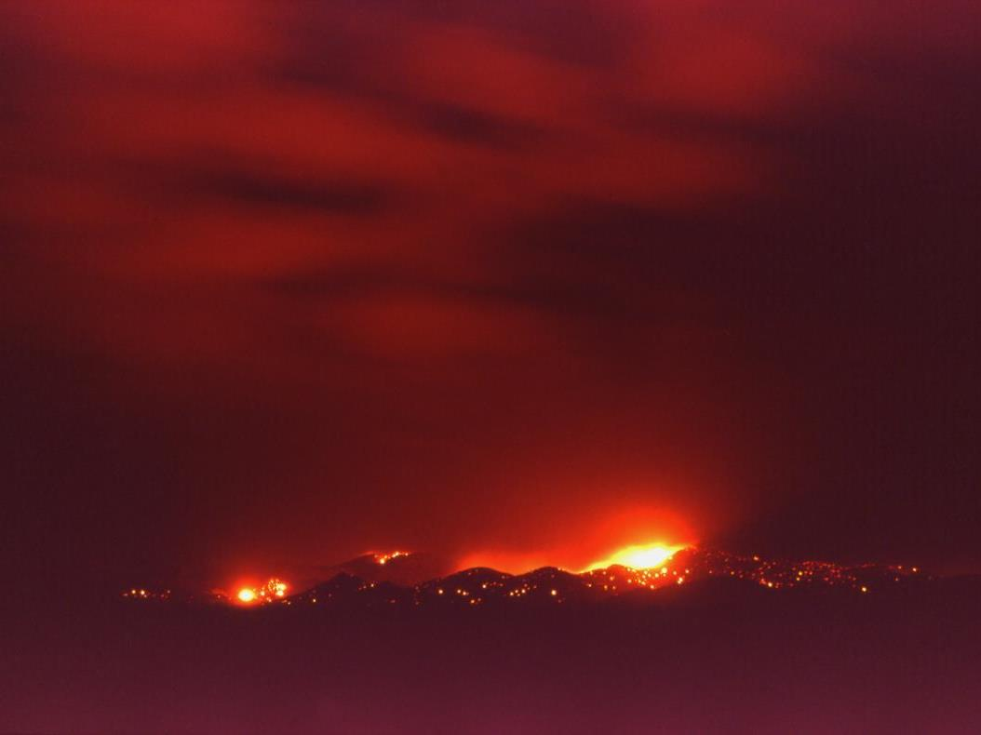
Tree rings, fire and the North American Monsoon
Ellis Margolis, Kyle Miller, Connie Woodhouse, Tom Swetnam, and Don Falk +

Slide 2
Dendroclimatology + Dendropyrology
Instrumental records show a positive relationship between prior year summer precipitation and current year fire occurrence.
However, the current fire regime has been highly altered by over a century of fire suppression and invasive species.
Until recently, there were no tree-ring reconstructions of summer precip to test for historical fire-monsoon relationships.

Slide 3
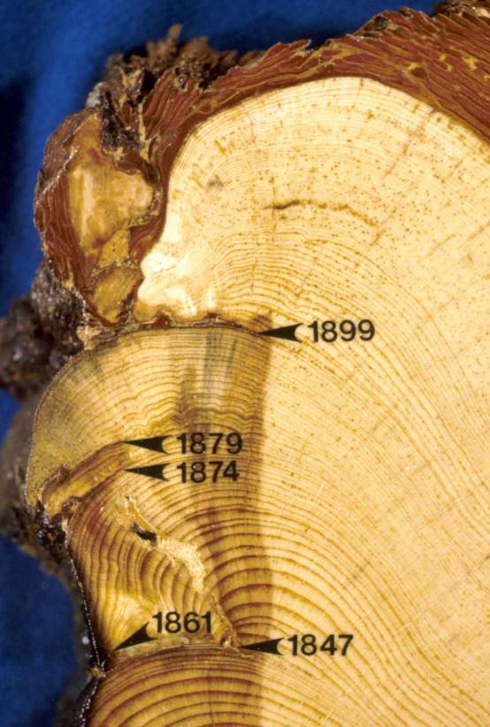
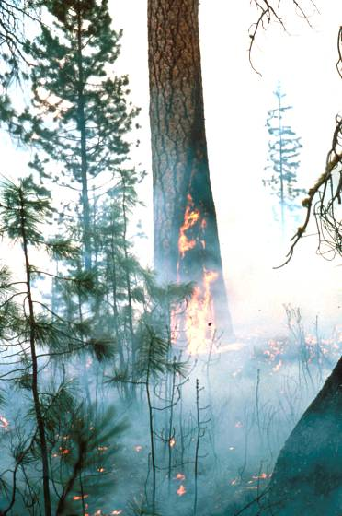
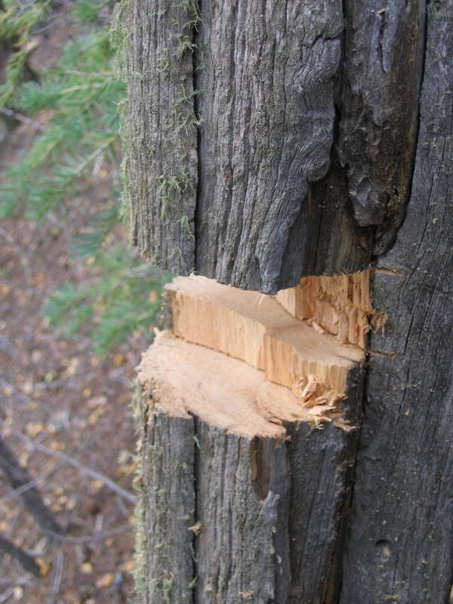
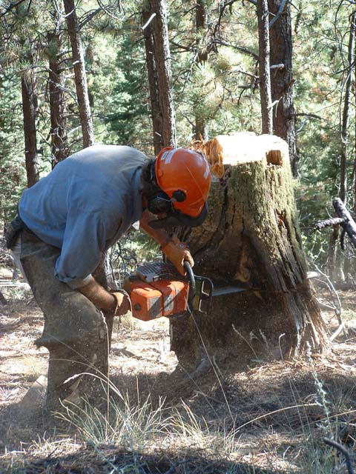
Tree ring fire scars: sub-annual precision of fire occurrence
Fire scars
Notes:
So how do we know about historical conditions? - historical photos, written accounts, and…..tree-rings - lots of tree-ring studies in N NM

Slide 4

L
LE
ME
EE
D
fire scar
Credit: Laboratory of Tree-Ring Research

Slide 5
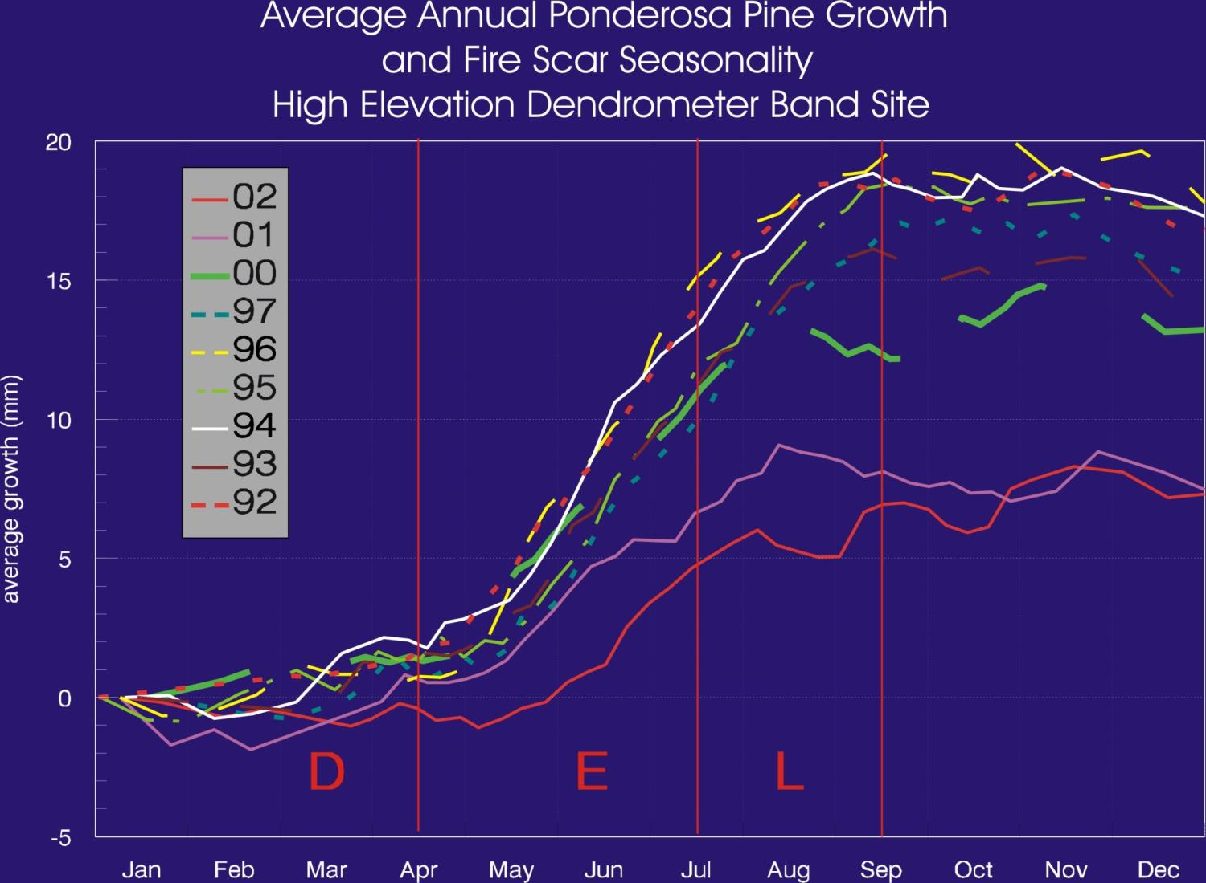
EE ME LE
C.D. Allen

Slide 6
Fire scar seasonality defined (Farris et al. 2010)
Rincon Mtns, AZ – 20th century fire scars vs fire atlas
  Dormant – before mid-May
  Early earlywood – mid-May to early June
  Middle earlywood – June
  Late earlywood – late June or July
  Latewood – August to mid-October

Slide 7
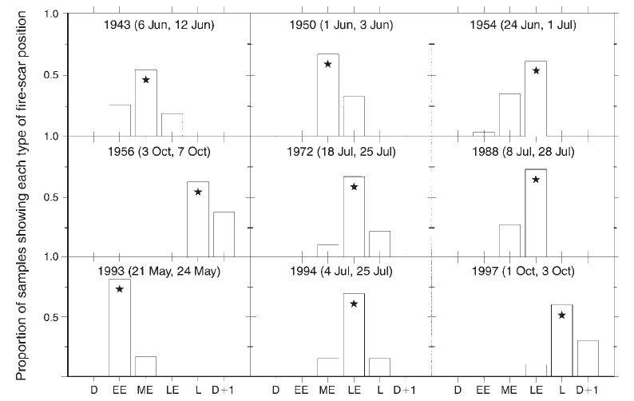
Fire scar seasonality corroboration (Farris et al. 2010)

Slide 8
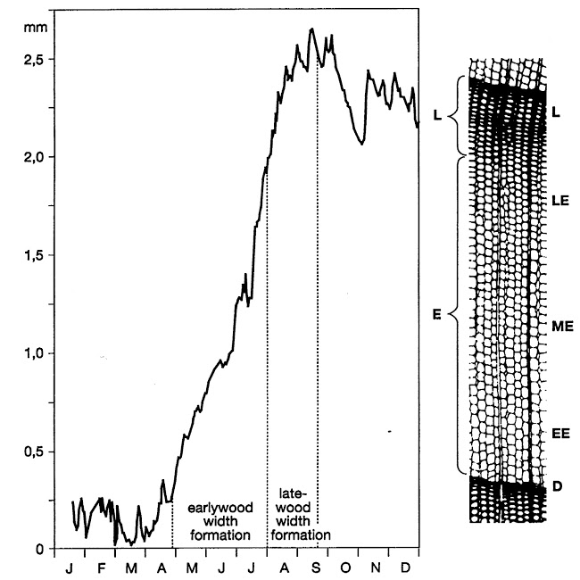
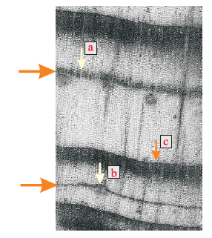
Latewood and false rings have a summer moisture signal

Slide 9

Research Questions
How did the North American Monsoon, in combination with other seasonal climate variables, affect historical wildfire seasonality?
How did the North American Monsoon, in combination with other seasonal climate variables, affect historical wildfire synchrony?

Slide 10
Fire seasonality hypotheses
Decreased summer NAM precipitation (weak, late monsoon) would extend the fire season into mid- and late-summer, producing more late earlywood and latewood fire scars.
Increased summer NAM precipitation (strong, early monsoon) would limit the fire season to the dry pre-monsoon period in late spring-early summer (i.e., dormant or early earlywood fire scars).

Slide 11
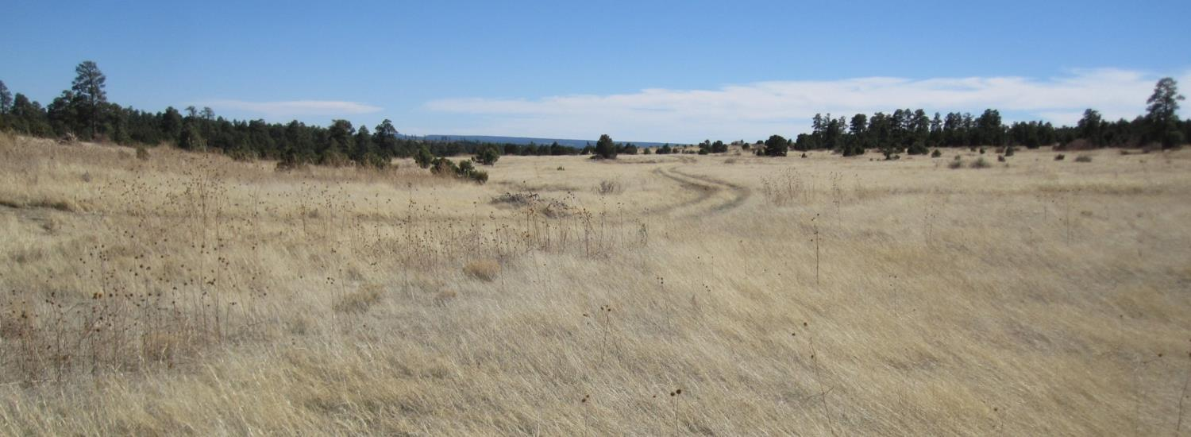
Effect of monsoon rain on fuels & fire
Late spring photograph from a PJ/Pipo savanna in north central New Mexico.
Fine fuels are cured and it’s windy.
This is ready to burn!!!!!!

Slide 12
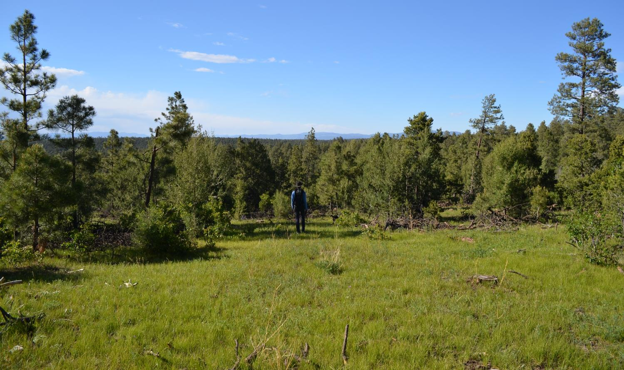
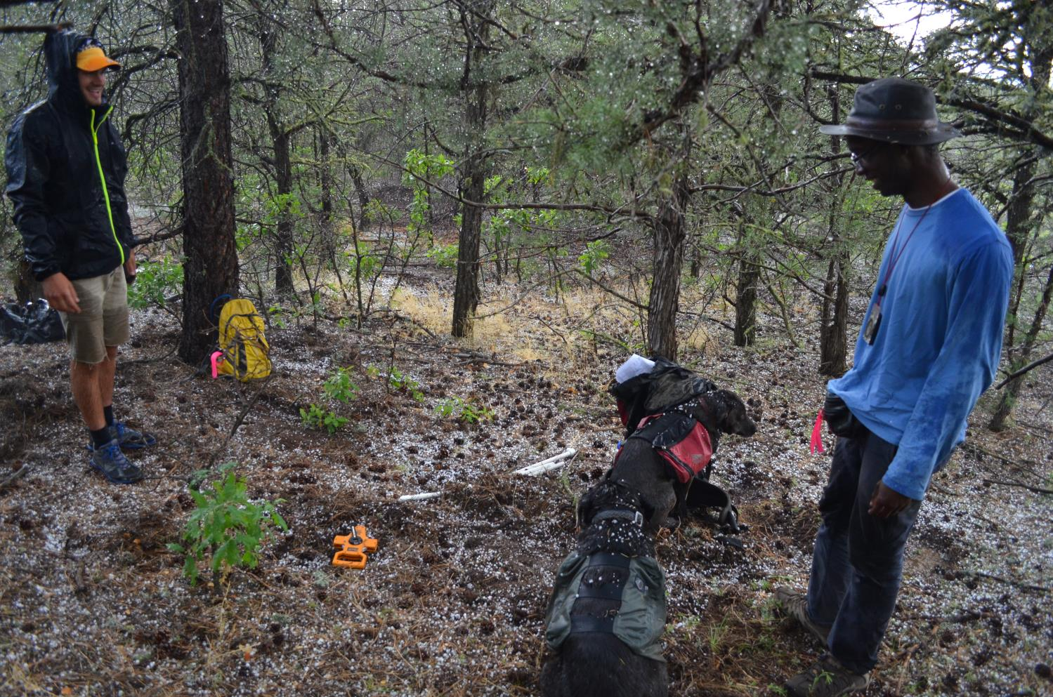
Pre-monsoon or Monsoon Rain = green up = no fire

Slide 13
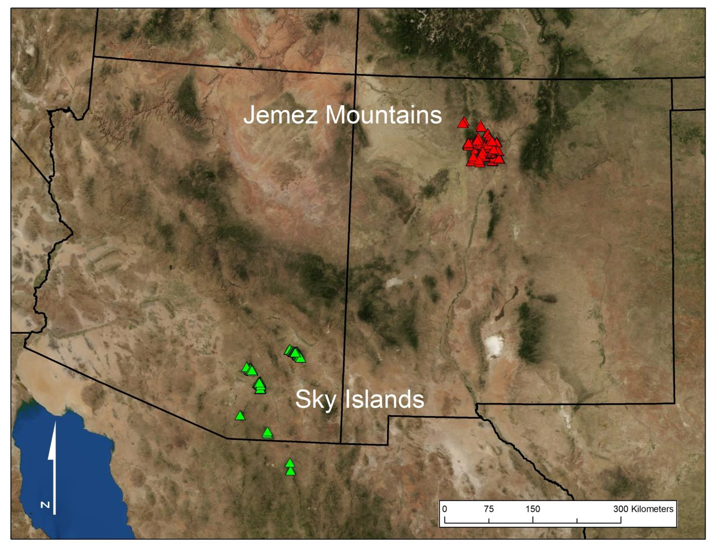

Slide 14
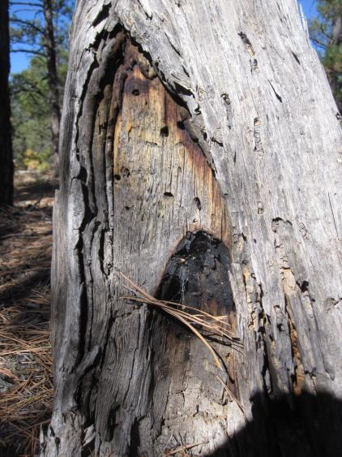
Data
Dendropyro reconstructions:
  Fire scar seasonality - intra-ring position of fire scars in a year
  Fire scar synchrony - number of trees recording fire in a year
Dendroclimatic SPEI reconstructions :
  Cool Season (prior Oct – current April)
  Pre-monsoon (May – June)
  Monsoon (July – August)

Slide 15
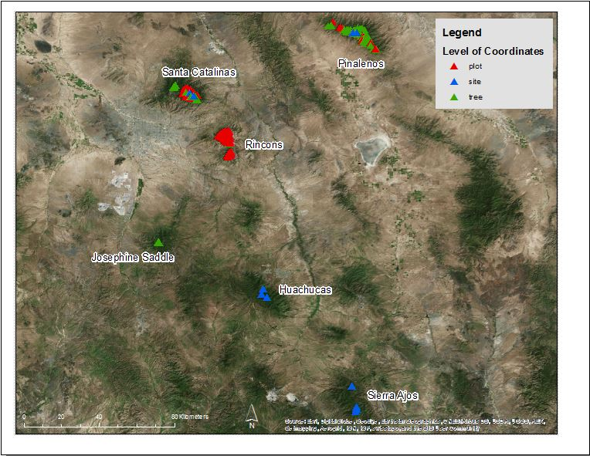

Slide 16
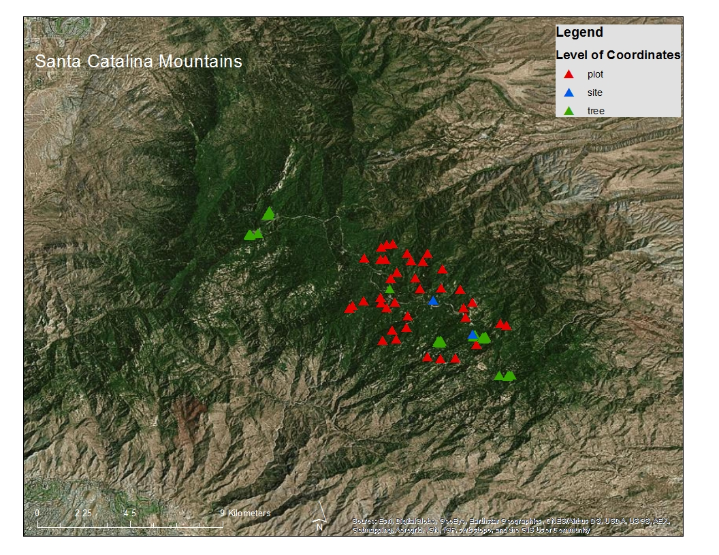

Slide 17
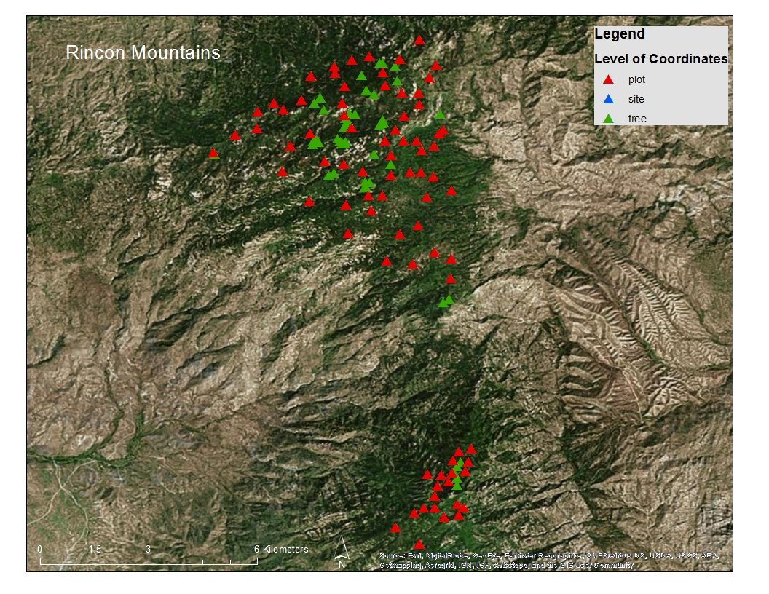

Slide 18
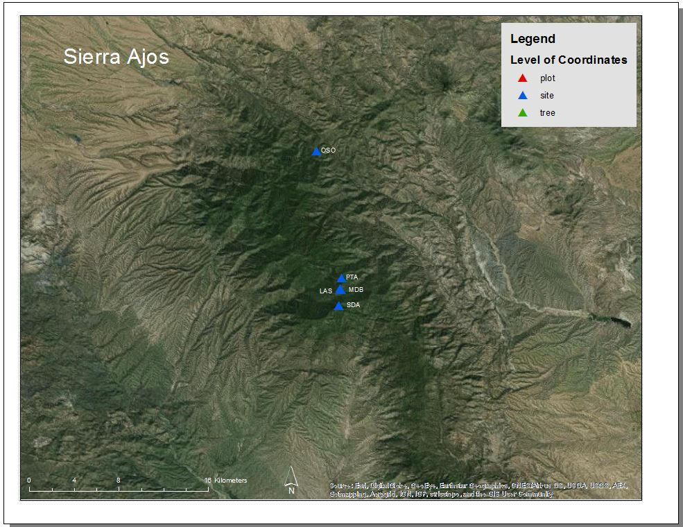

Slide 19
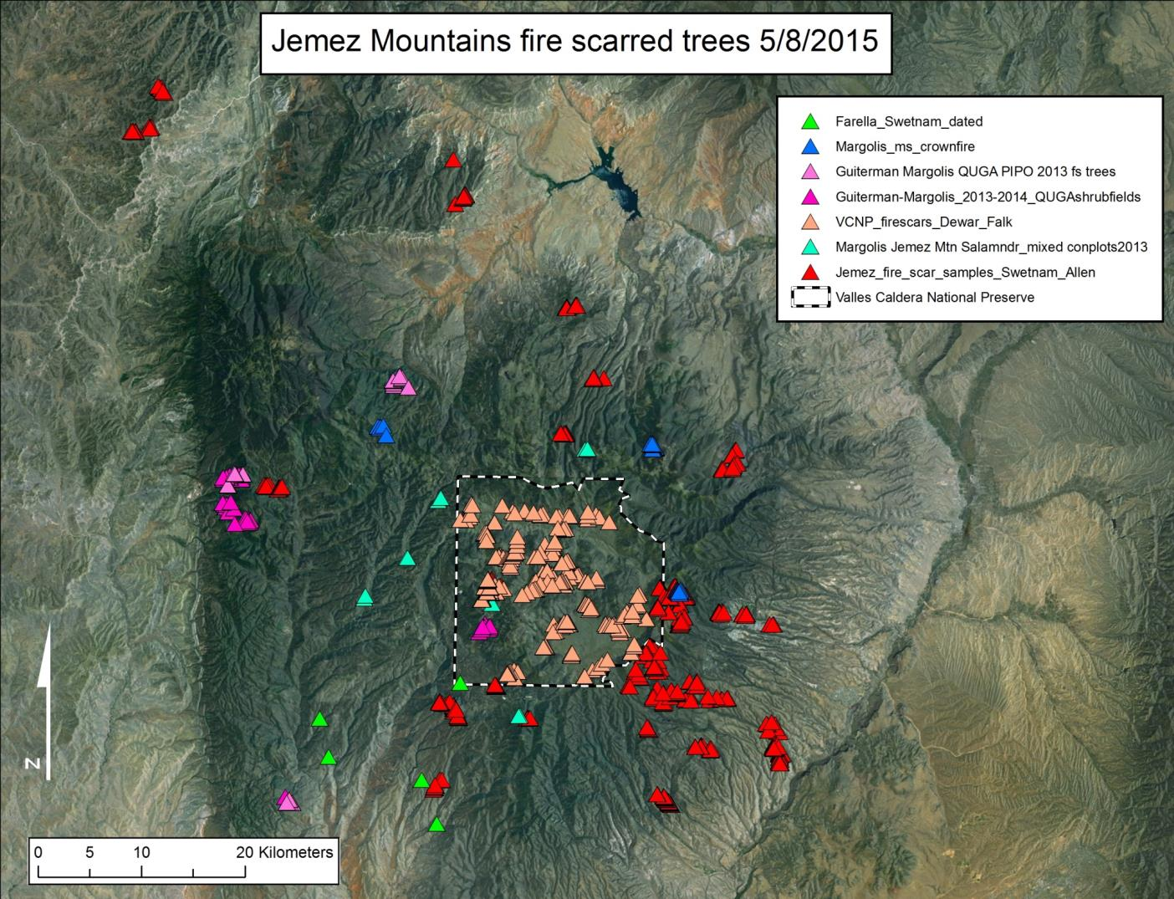

Slide 20
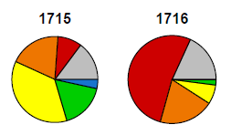
Data & Analysis
Fire seasonality:
Annual fire scar seasonality proportion visual “time series”
Annual time series of fire scar occurrence for each of six fire scar seasonalities
Analyses – SEA, correlation, & regression with climate time series

Slide 21
Preliminary Results
Fire scar seasonality time series
Fire scar seasonality maps
SPEI reconstructions
Very preliminary SEA results

Slide 22
Jemez – seasonal distribution of fire scars
n = 7918 fire scars
total trees = 1165
(1248 – 1993)

Slide 23
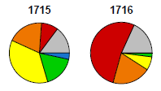
“Time series” of annual fire seasonality proportion
Pie radius scaled by padded log of number of trees recording fire
Notes:
1752 (ME – LE), 1737 (L), 1664-1668 (L-LE); Large fire yrs w/ diff seasonality (1847 – D, EE vs 1851 – D, EE, ME, LE, L); shift to D & EE in 1800’s

Slide 24
Traditional time series
Number of trees scarred annually for each fire scar season changing sample size issue
1550-1993, n=7844 fire scars

Slide 26
Proportion of recording trees scarred annually for each fire scar season

Slide 27
Notes:
Min 2 trees scarred

Slide 28
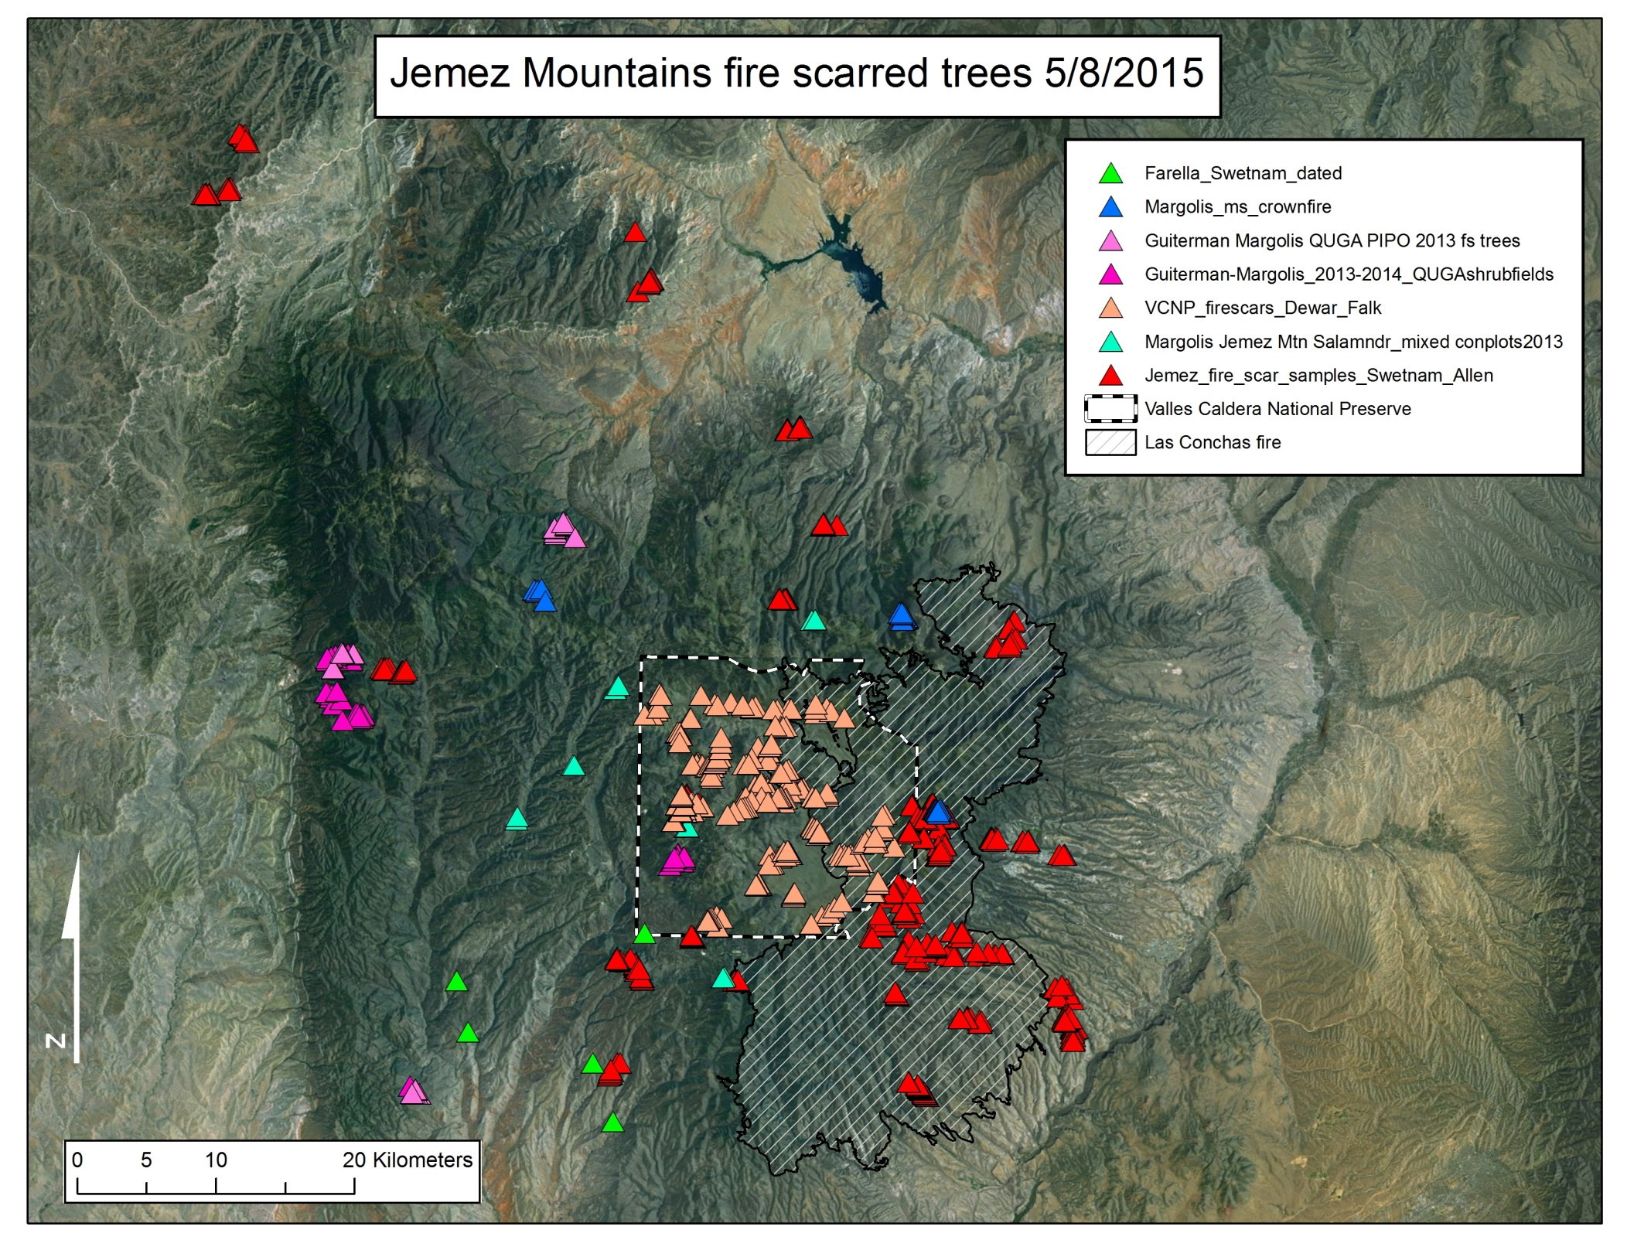

Slide 29
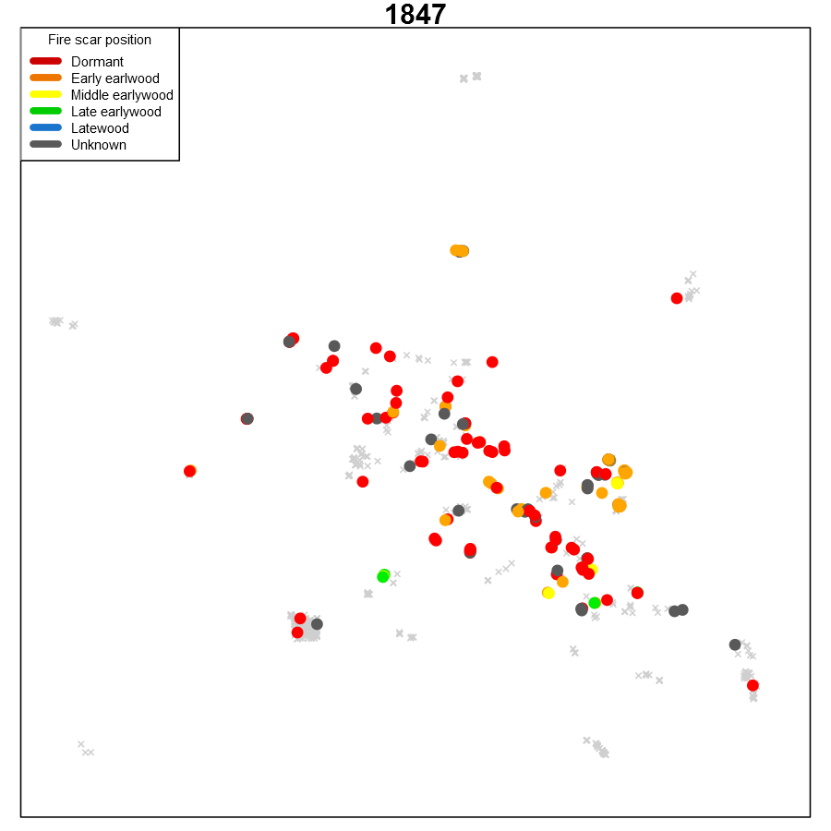

Slide 30
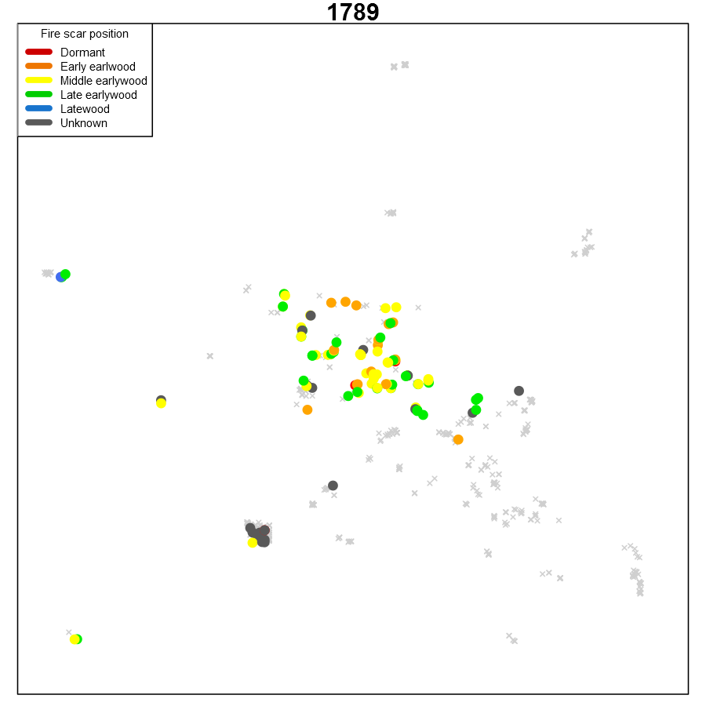

Slide 31
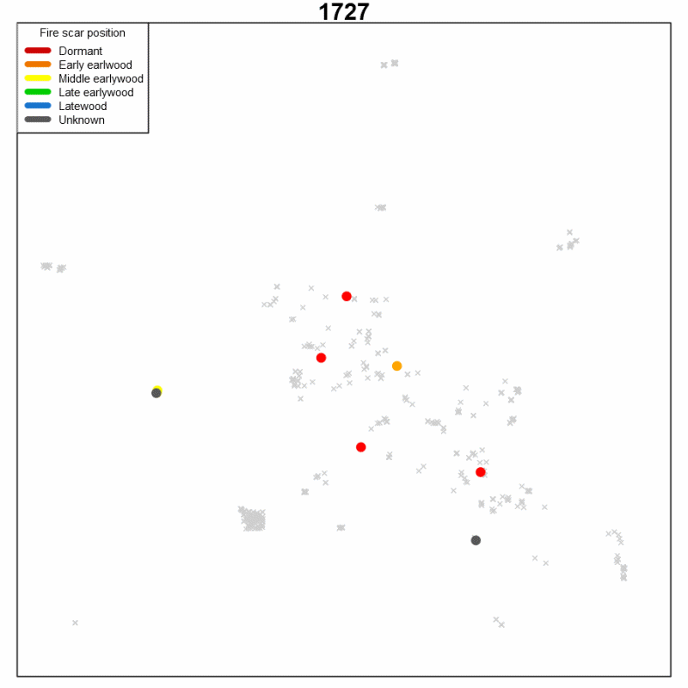

Slide 32
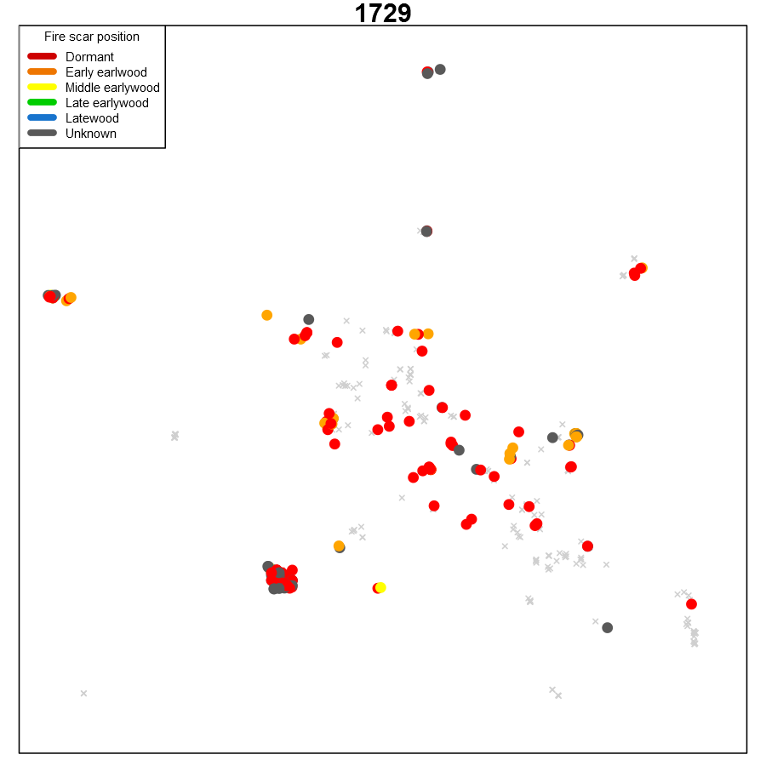
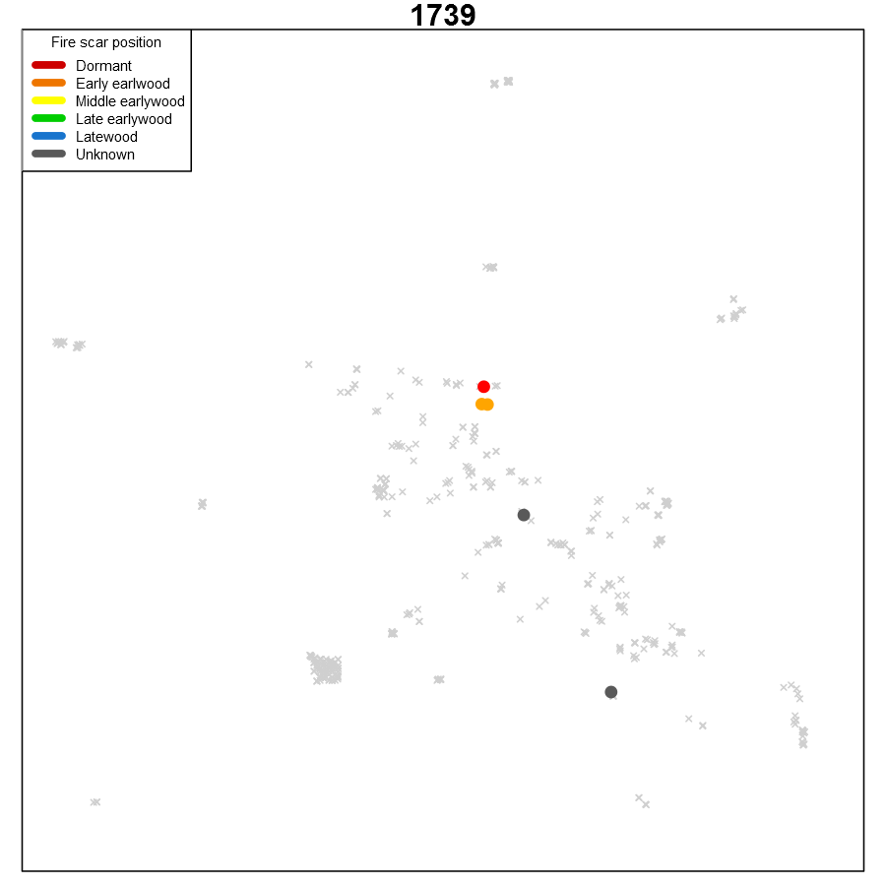

Slide 33
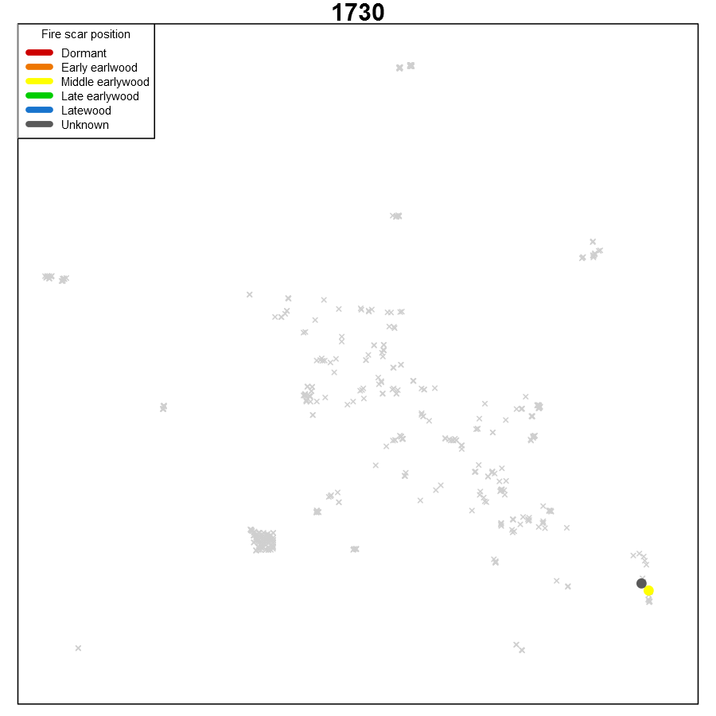

Slide 34
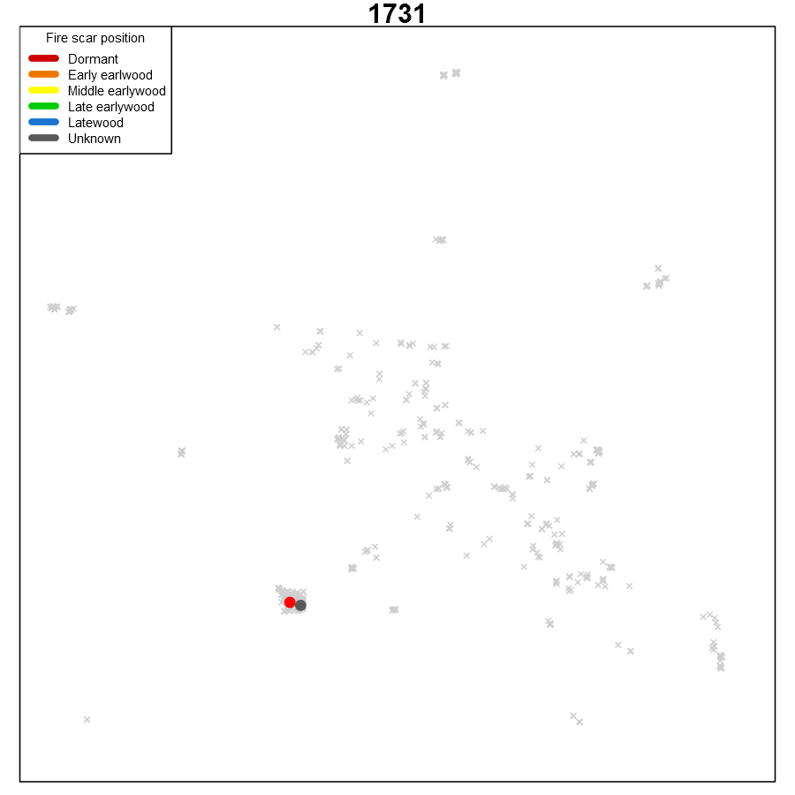

Slide 35
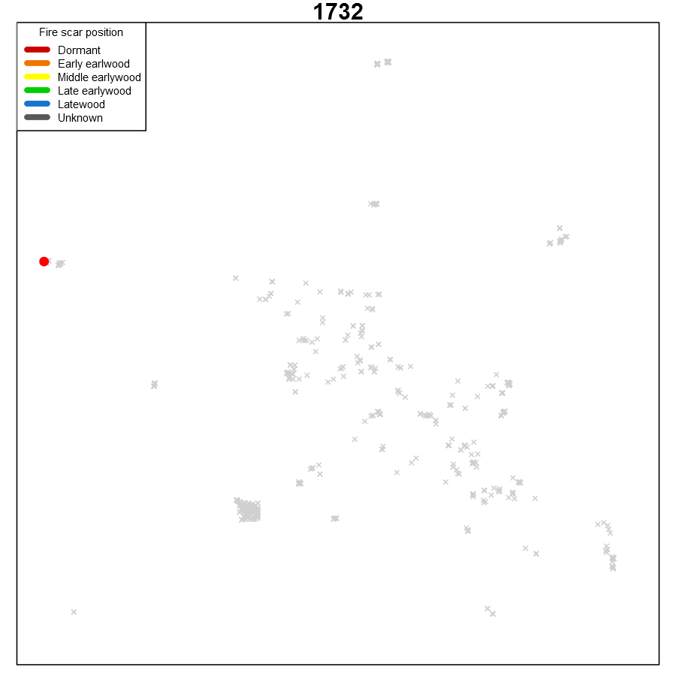

Slide 36
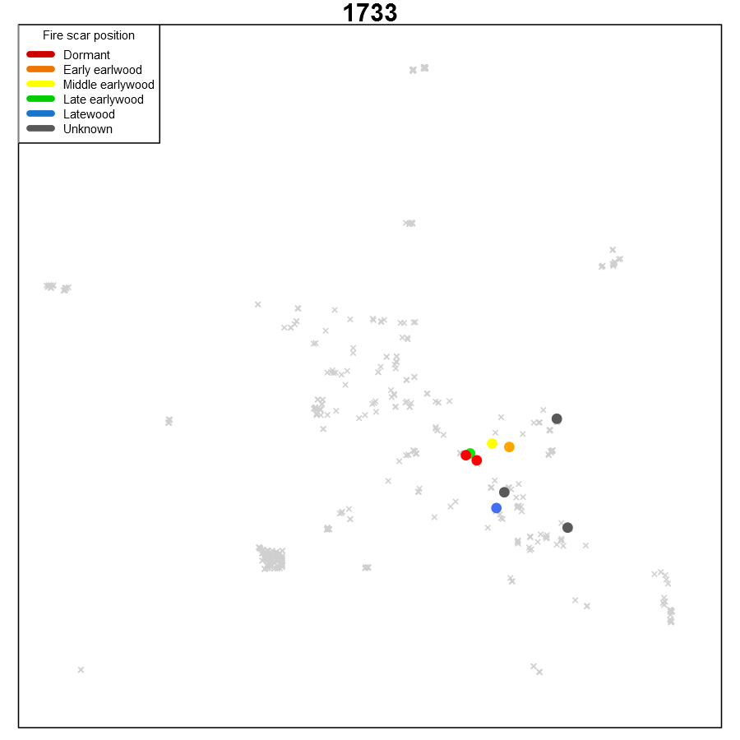

Slide 37
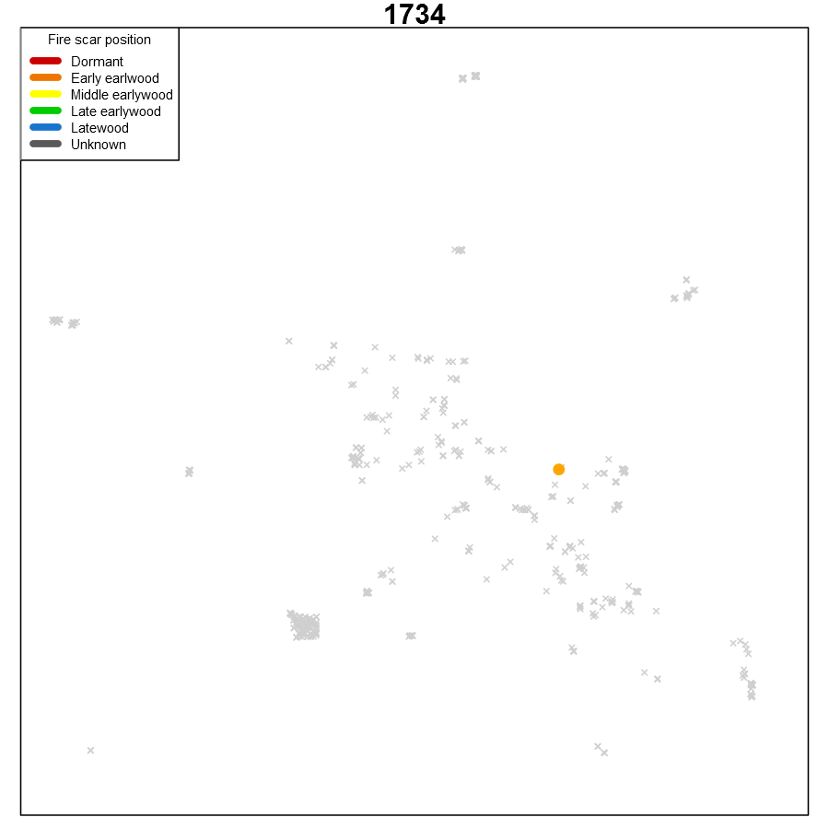

Slide 38
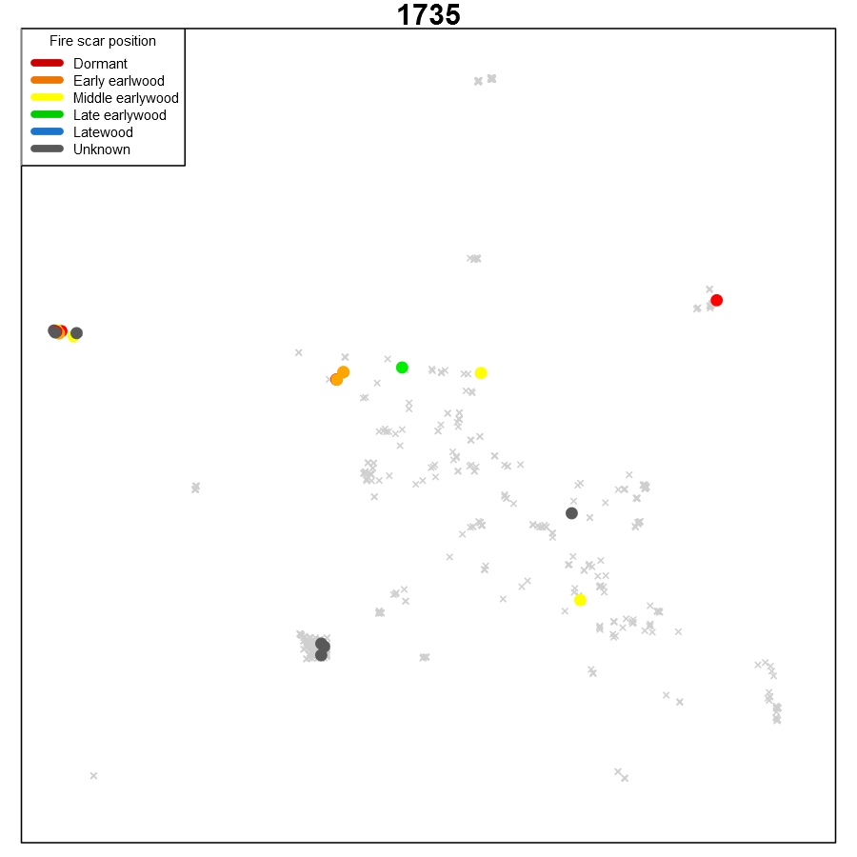

Slide 39
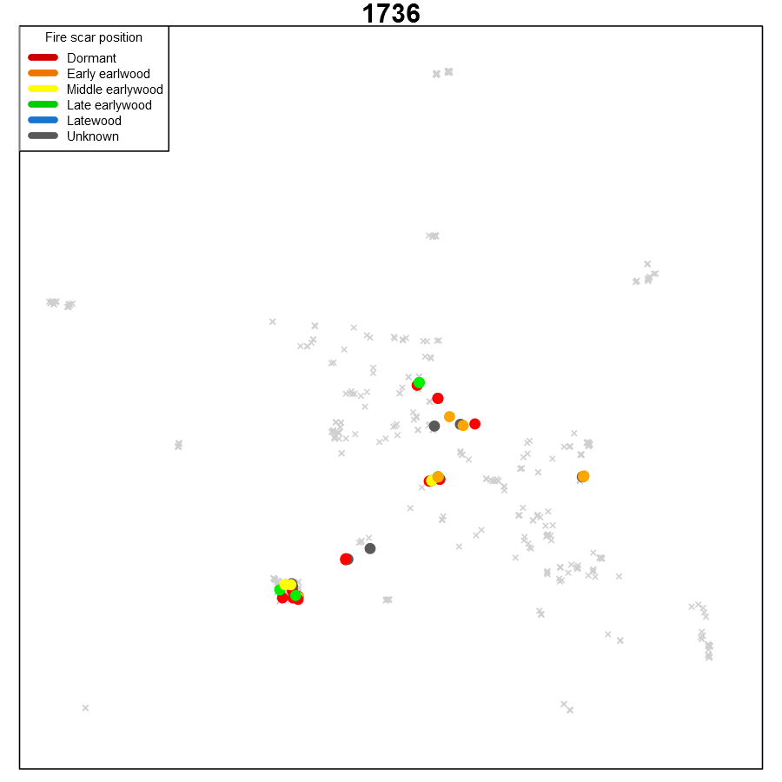

Slide 40
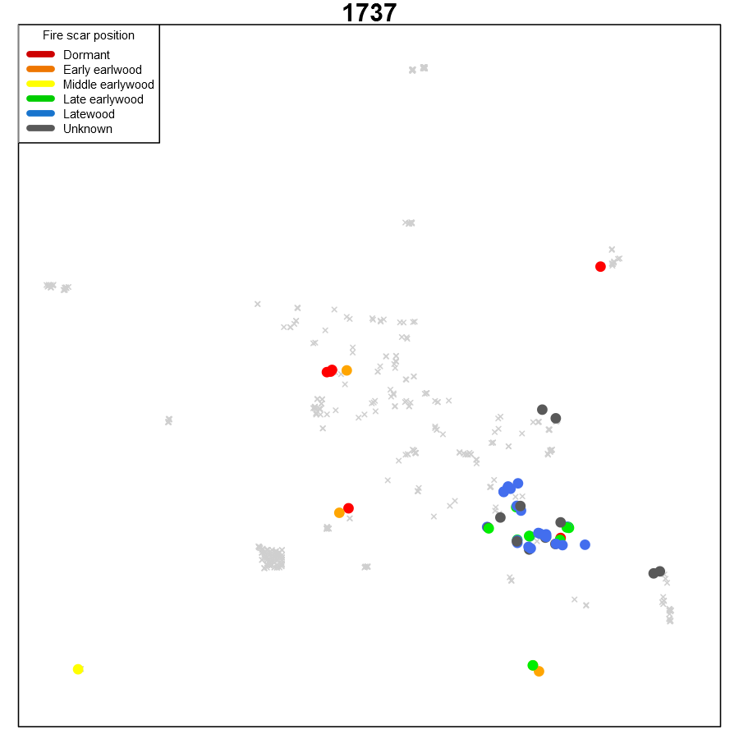

Slide 41
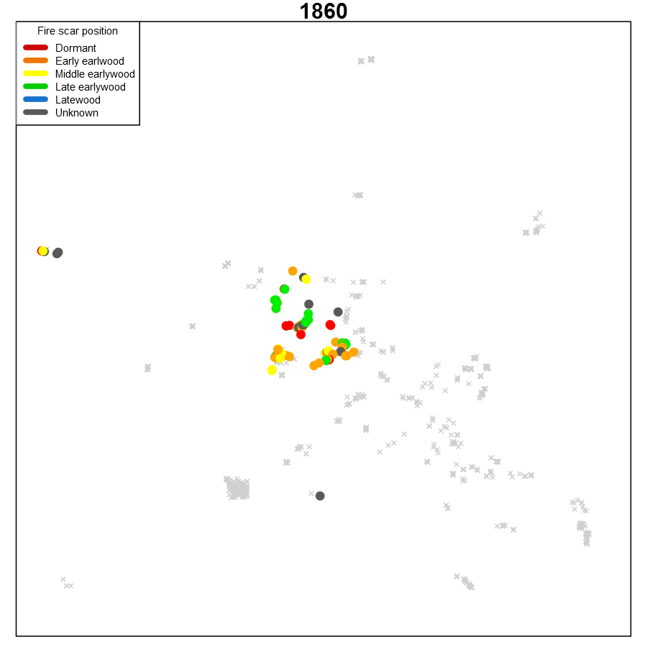
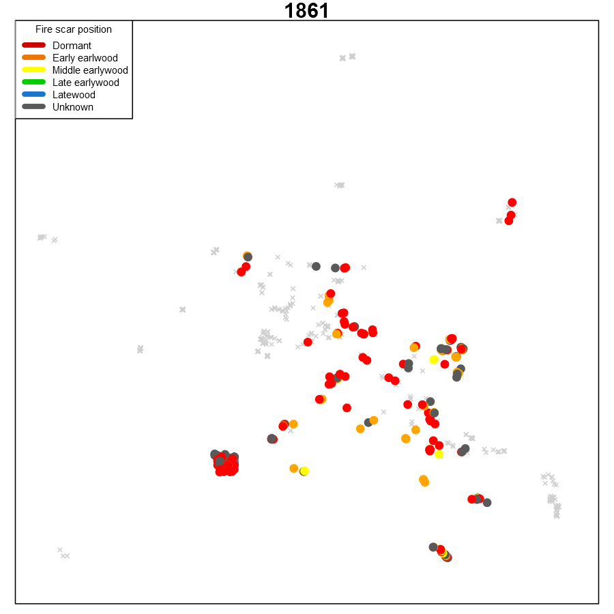
Self-limiting behavior

Slide 42
Jemez Region Reconstructions of Cool Season, Pre-monsoon, and Monsoon Standard Precipitation and Evapotranspiration Index (SPEI)
SPEI from The Global SPEI Database (SPEIbase)
SPEI is base is based on monthly precipitation and potential evapotranspiration from the Climatic Research Unit of the University of East Anglia. Currently the version 3.22 of the CRU TS dataset has been used.
The SPEIbase is based on the FAO-56 Penman-Monteith estimation of potential evapotranspiration. This is a major difference with respect to the SPEI Global Drought Monitor, that uses the Thornthwaite PET estimation. The Penman-Montheith method is considered a superior method, so the SPEIbase is recommended for most uses including long-term climatological analysis.
http://sac.csic.es/spei/index.html
http://www.wrcc.dri.edu/wwdt/about.html

Slide 43
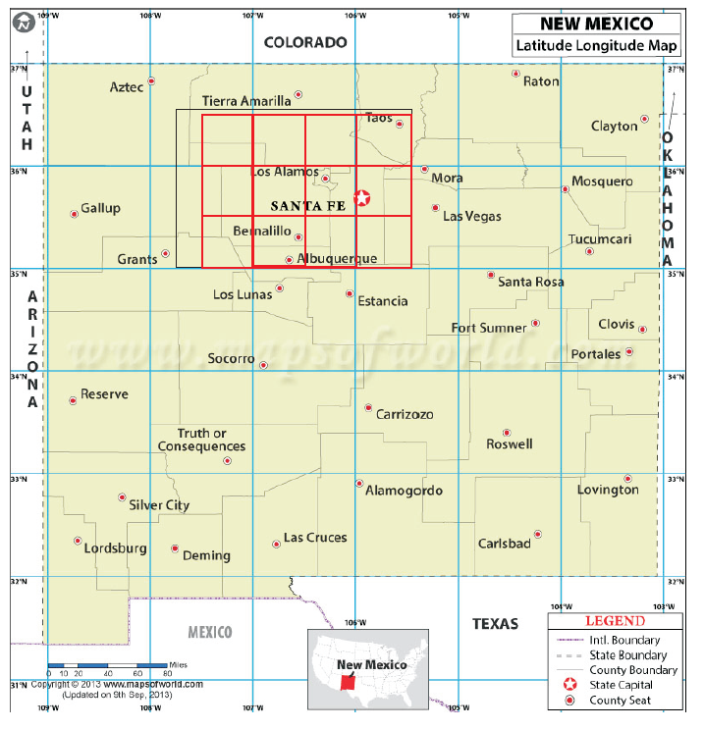

SPEI data average across 20 grid points for:
Oct-April,
May-June
July-Aug
Monthly SPEI, is averaged across these months

Slide 44
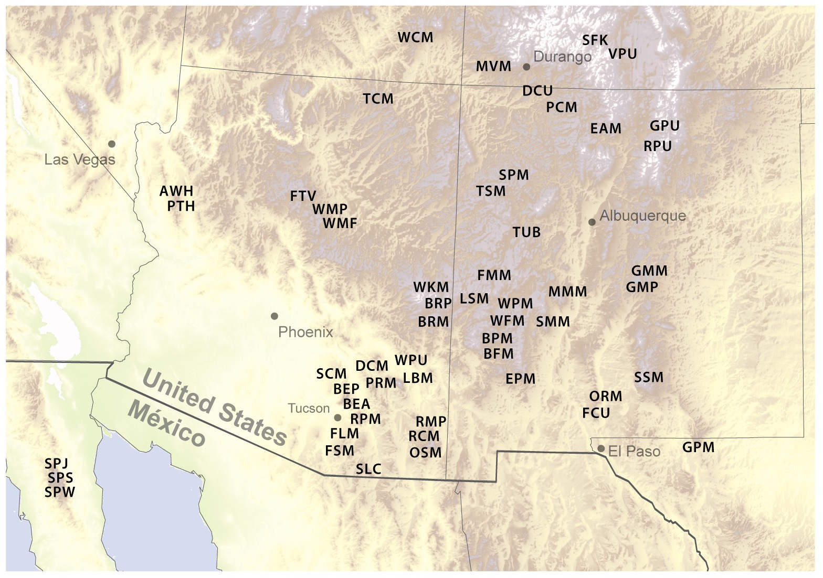
Chronologies used in screening process for climate reconstruction models (EW and LW)
CDP-new
SFW-new
= too short (1669 cut off) or ended before 2007, so not used
Notes:
SPEI pools
Oct-April – all EW passed split correlation
Jul-Aug – 10 LW;
May- Jun – all EW but TSM, LW chron DCU, FMM, MVM, PCM, RPU, SMM, SSM
CDP was added after, into May-Jun pool (EW)

Slide 45
Oct-April SPEI model
Pool of candidate predictors for stepwise regression is based on significant (p< 0.05) over full and half periods
Full reconstruction: 1612-2008

Slide 46
May-June SPEI model
*negative trend in residuals, r = -0.266
Full reconstruction: 1664-2007

Slide 47
July-Aug SPEI model
Full reconstruction: 1599-2008

Slide 48
Chronologies used in screening process for climate reconstruction models (EW and LW)
Oct-Apr
May-Jun
July-Aug
CDP
LW
SFW
LW
LW
LW
Notes:
SPEI pools
Oct-April – all EW passed split correlation
Jul-Aug – 10 LW;
May- Jun – all EW but TSM, LW chron DCU, FMM, MVM, PCM, RPU, SMM, SSM
CDP was added after, into May-Jun pool (EW)

Slide 49
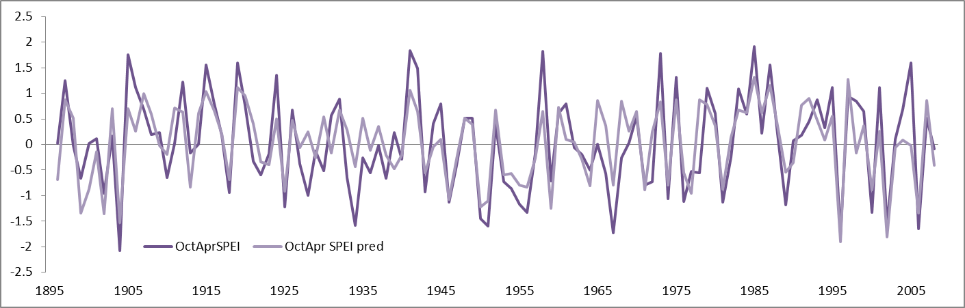
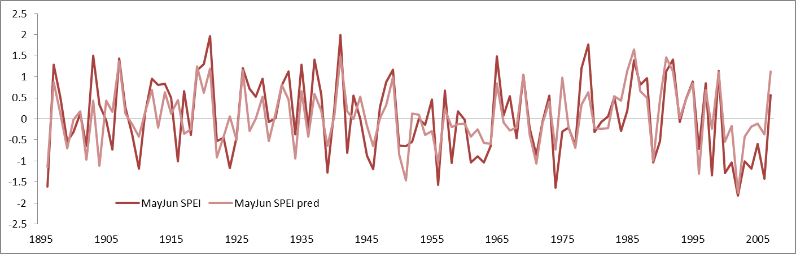
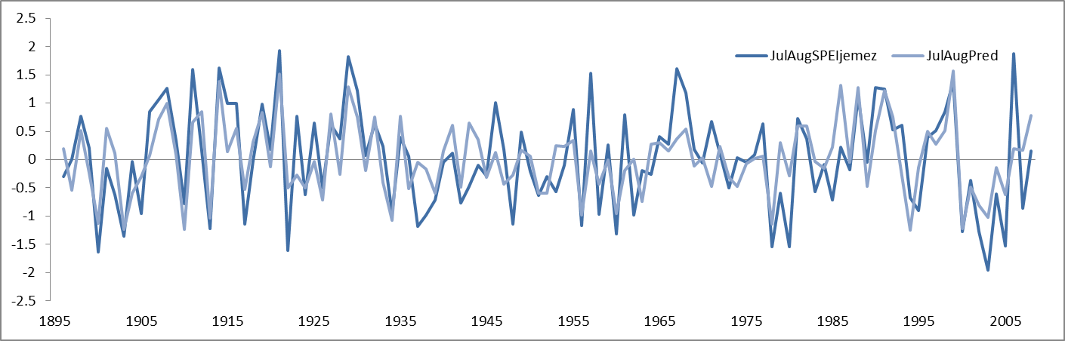
Observed vs reconstructed SPEI, 1896-2007/8

Slide 50
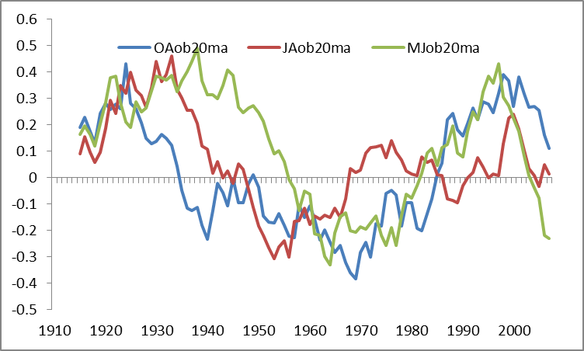
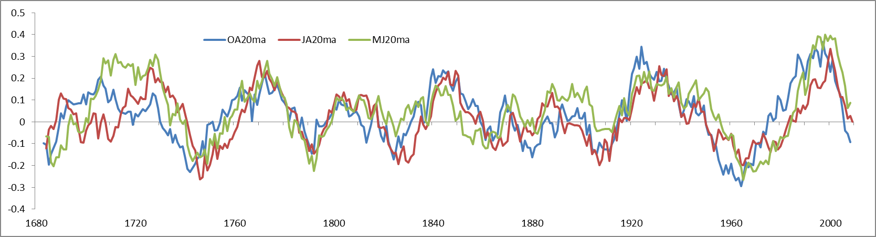
Observed and Reconstructed Jemez Climate, 20-year moving average

Slide 51
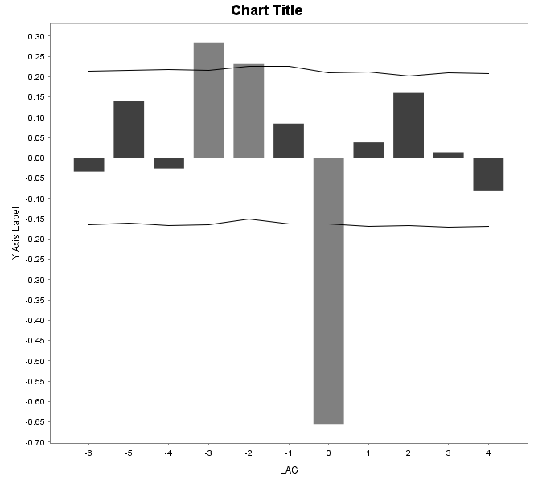
pOct-April SPEI: 10 pct scarred 2 min

Slide 52
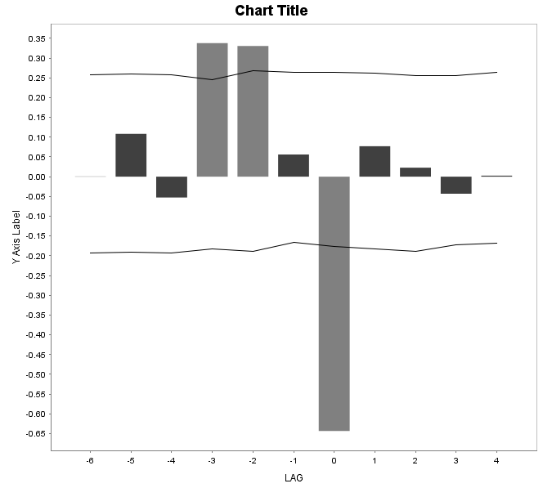
May-June SPEI: 10 pct scarred 2 min

Slide 53
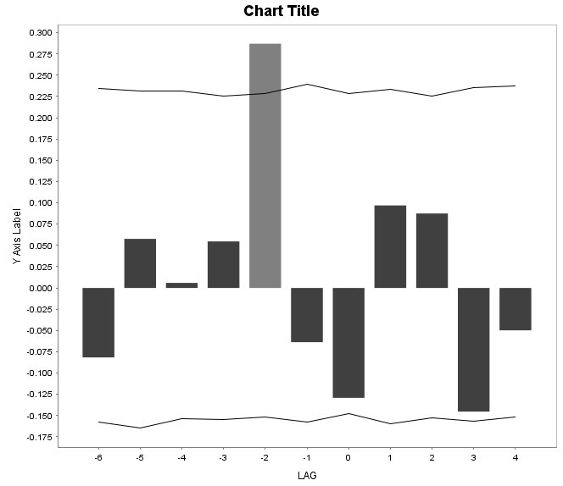
July-Aug SPEI: 10 pct scarred 2 min

Slide 54
What’s next?
Correlation analysis: correlations between reconstructed fire seasonality and reconstructed seasonal climate variables.
Superposed epoch analysis: testing for consistent patterns (including lagging relationships) of reconstructed seasonal climate variables with the time series of annual proportion of sites (or trees) scarred
Regression analysis: modeling variability in annual proportion of sites (or trees) recording fire as a function of reconstructed summer, winter, and pre-monsoon SPEI.
Clustering of fire year by seasonality

Slide 55
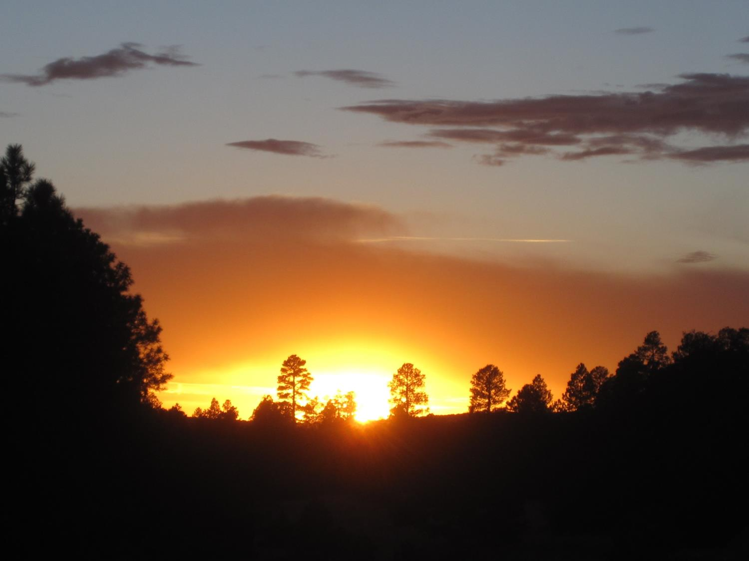
Thanks!
Funding from NSF Macrosystems program (P.I.’s - R. Monson, C. Woodhouse, T. Swetnam); Assistance with FhxR from B. Malevich and C. Guiterman; Additional support from the UofA Tree-Ring Lab.

Slide 56
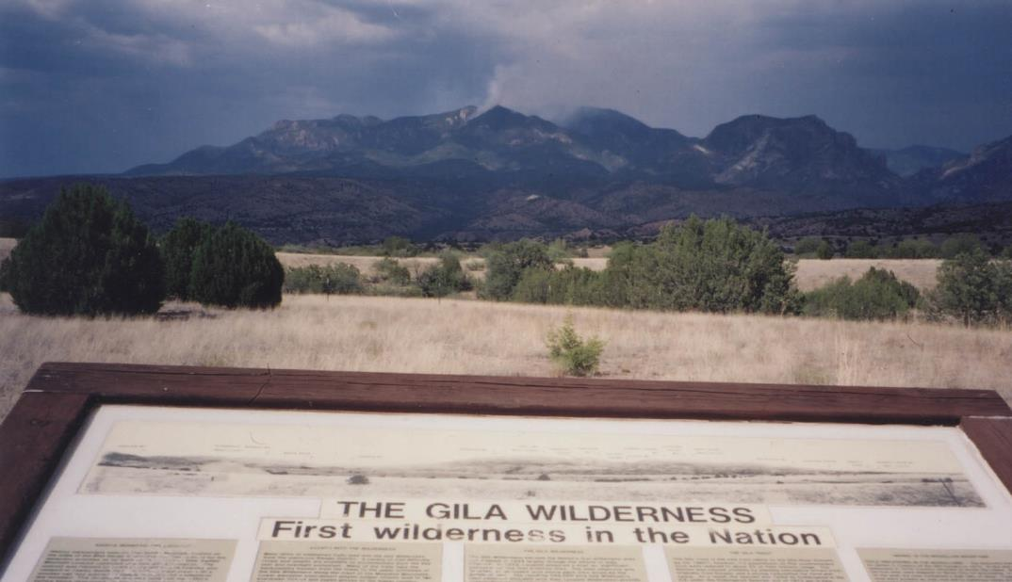
Is high severity fire a natural part of the Gila Wilderness?
Unknown fire, 8/23/2003
Ellis Margolis
Laboratory of Tree-Ring Research, University of Arizona
Tucson, Arizona
Notes:
High severity = fire that kills most of the trees, even the big and old ones

Slide 57

Low Site
1992-1996

Slide 58

Middle Site
1992-1996

Slide 59

Upper Site
1992-1996

Slide 61


Slide 64


Slide 66


Slide 67


Slide 68


