Slide 1
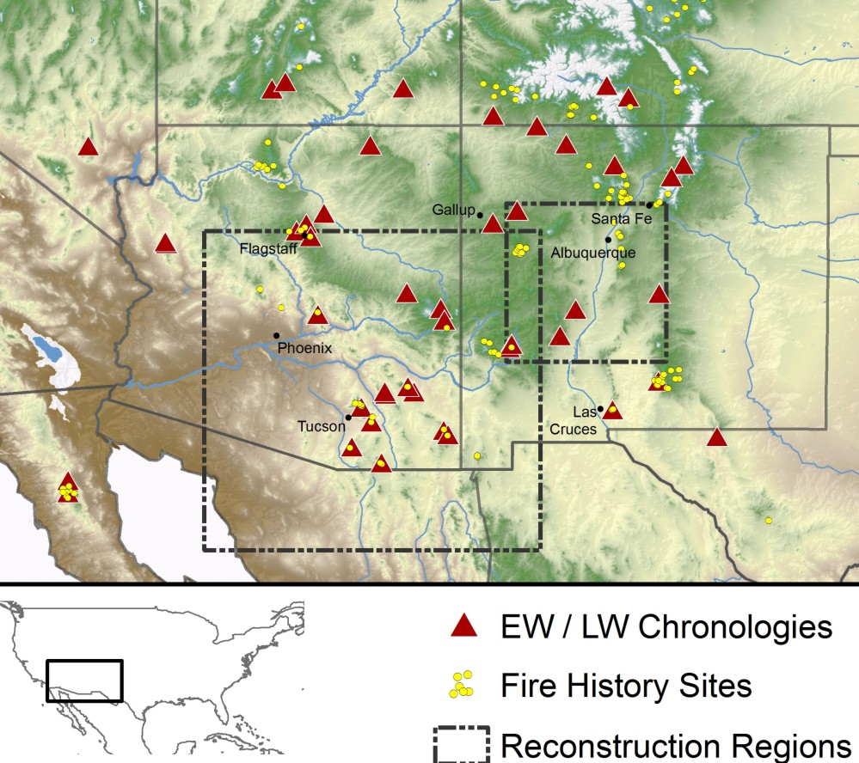
SE Arizona
Notes:
The map shows the locations of tree-ring chronologies recently developed that have bee used to reconstruct winter (from earlywood, EW, chronologies) and monsoon (from latewood, LW, chronologies) precipitation. We’ve reconstructed both Oct-April and June-Aug precip for both boxes, but focus here on the AZ box and the fire history data circled. Fire history data from Swetnam, Falk, and a host of others. The questions we’re asking is 1) does the monsoon play a role in wildfire occurrence and 2) can we use information about moisture in both seasons to define sequences that most commonly lead to big fire years? Of course, fire suppression has wrecked havoc with the natural fire regime, but understanding the underlying antecedent conditions that lead to fire could be useful….

Slide 2
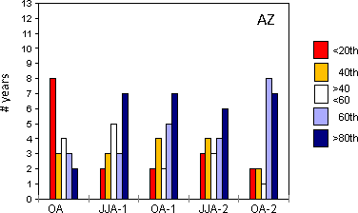
Most widespread fire years (top 20th percentile, 1600-1899, 50 total) and their associations with seasonal precipitation
OA = cool season precipitation
JJA = monsoon precipitation
OA is the winter preceding the fire season; OA-1 is the previous year, OA-2 is 2 years before the fire year.
A very dry cool winter immediately preceding the fire season is the strongest relationship, but these largest fire years also appear to be associated with wet conditions in the prior seasons as well.
Southeastern region
Percentiles of precipitation
Notes:
A preliminary result. These are the years with fire scars recorded at the greatest number of sites in the southeastern part of Arizona; so the most widespread fire years for this region.

Slide 4
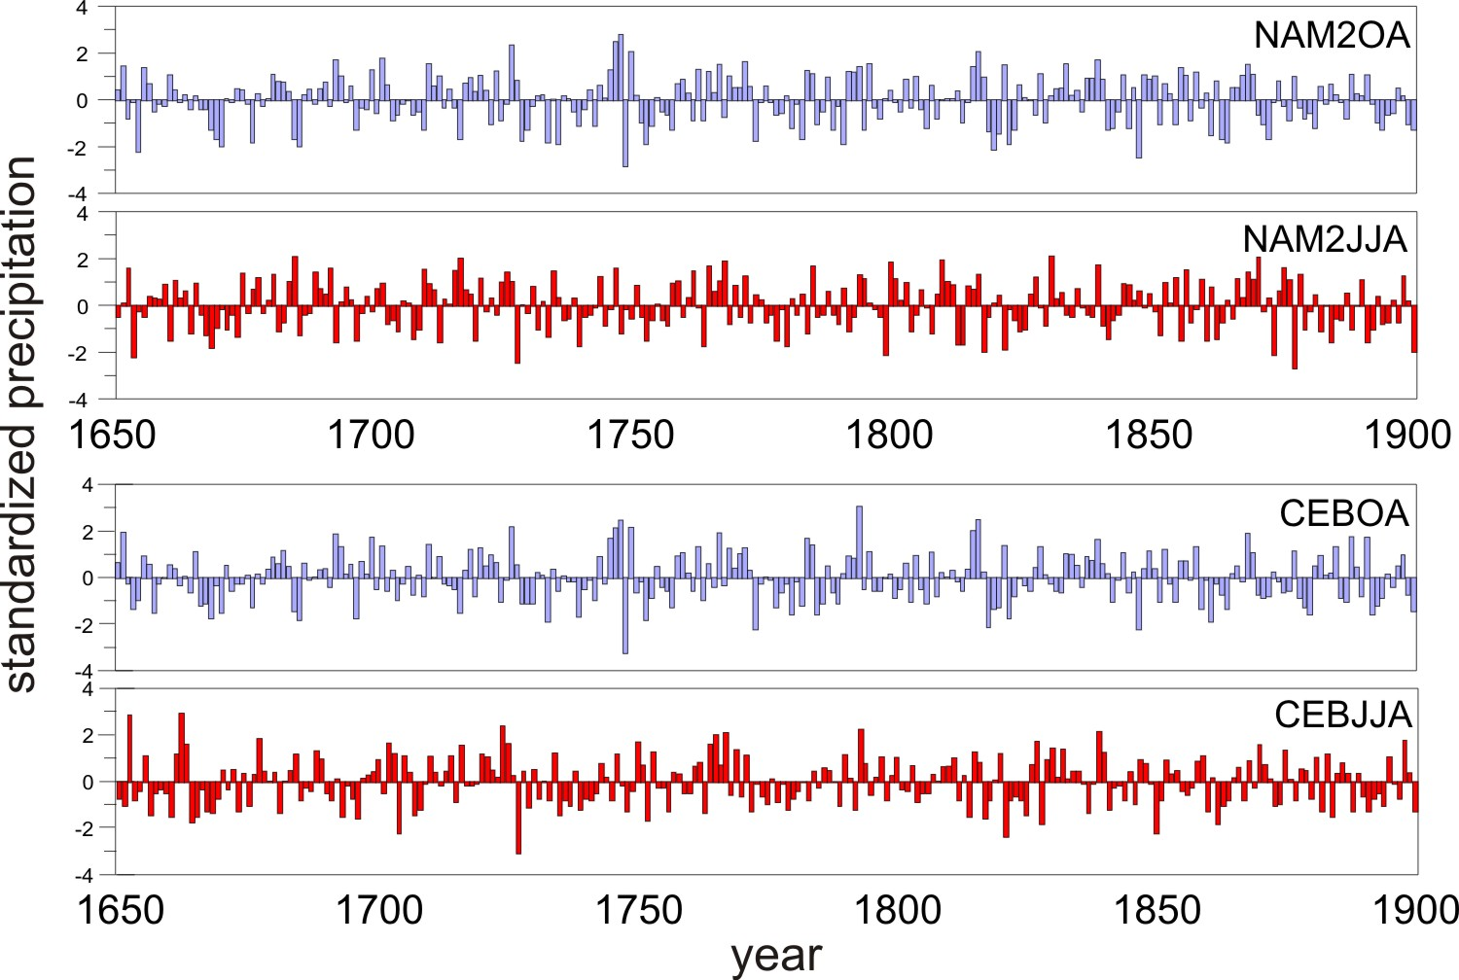
Reconstructed cool season (Oct-Apr) and monsoon (June-Aug) precipitation (standardized) for the NAM2 and CEB regions, 1650-1900

Slide 5
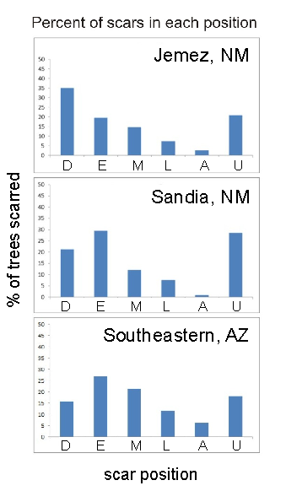
The timing of fire scarring can be determined by examining the position of the scar relative to the annual ring. Fires occur during the dormant season (D), the early and middle part of the earlywood (E, M), the later part of the earlywood (L) and in the latewood (A) (right). Most commonly, fire scars occur before monsoon onset in positions D,E, and/or M (far right). Here, we are not considering U (undetermined) scars.

Slide 6
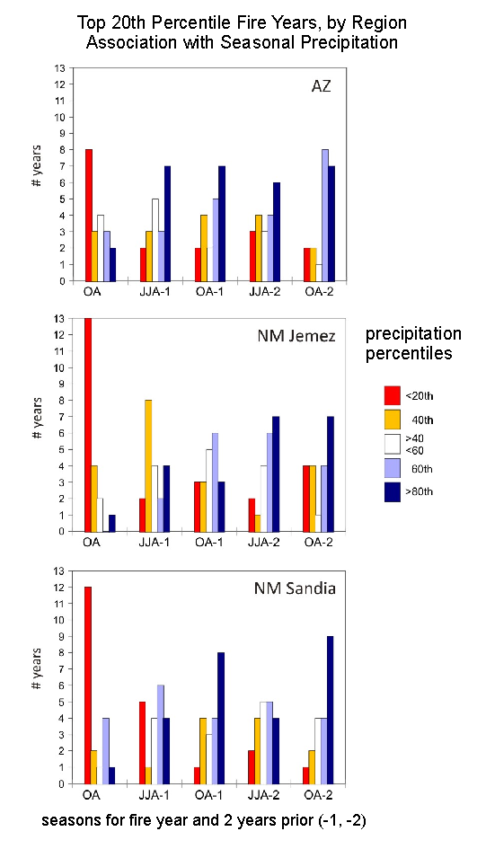
Moisture conditions (percentiles of precipitation) corresponding to the most widespread DEM fire years by region.
Take home: the fire/seasonal climate relationship may be different for these three areas.

Slide 7
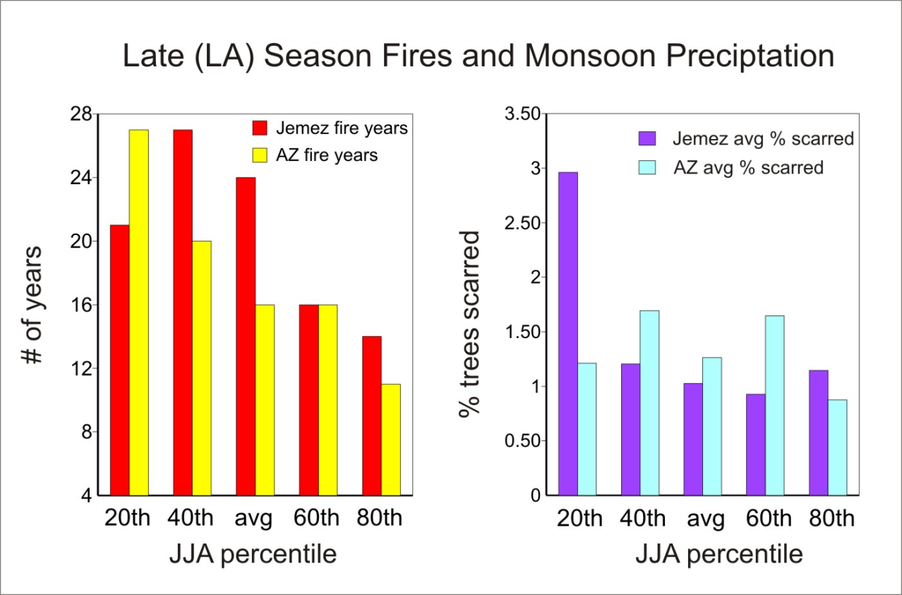
Late Season (L, A) fires and Monsoon Precipitation
These fires are much less widespread, and occur in 36%, 42%, and 15% of the years in the Arizona, Jemez, and Sandia regions, respectively. They are almost always preceded by pre-monsoon fires (e.g., 89% in AZ, 92% in Jemez).
Drier monsoons appear to be associated with a higher number of LA fires in both the AZ and Jemez regions . The % of trees scarred seems related to extreme dry monsoons in the Jemez region, but no relationship between monsoon precipitation and % of trees scarred in AZ is evident (lower right).

