Slide 1
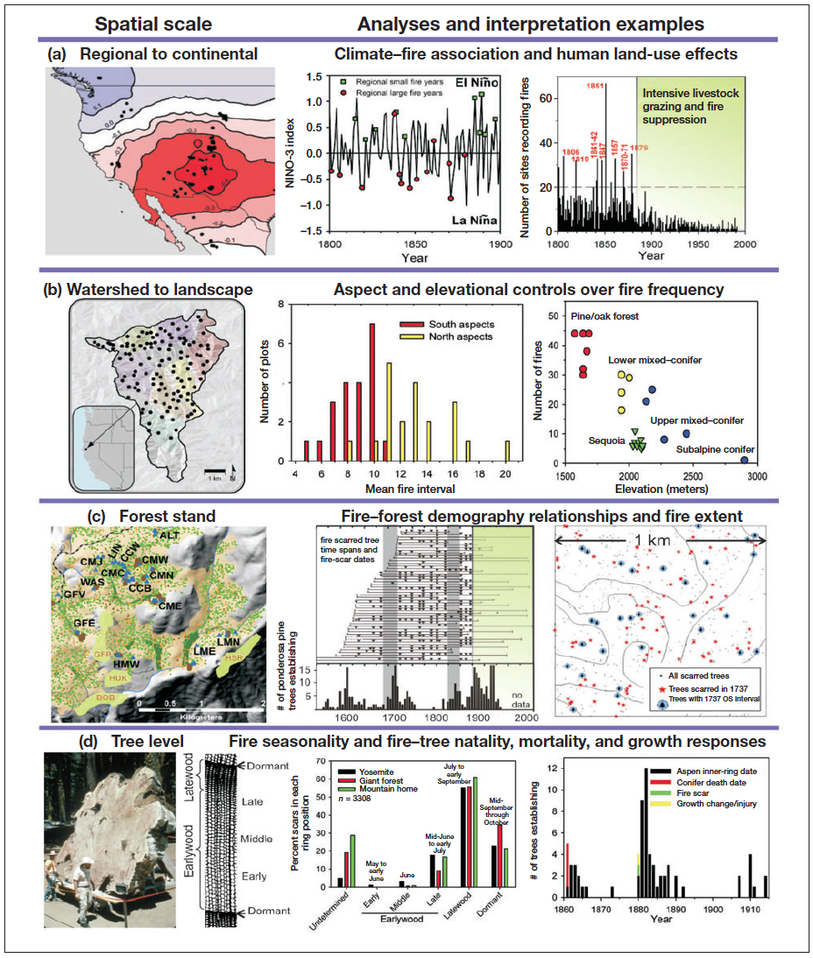
Falk et al.
2011
Frontiers Ecol & Environ.

Slide 2
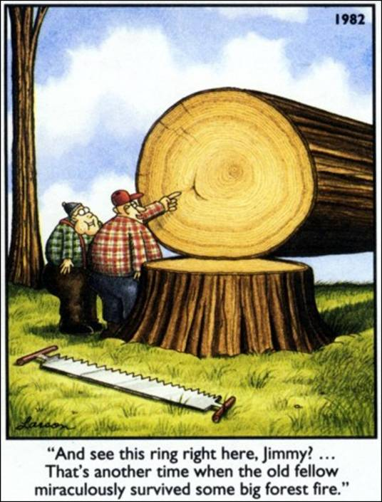
Fire Scar!

Slide 3
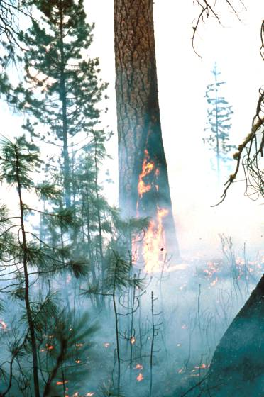
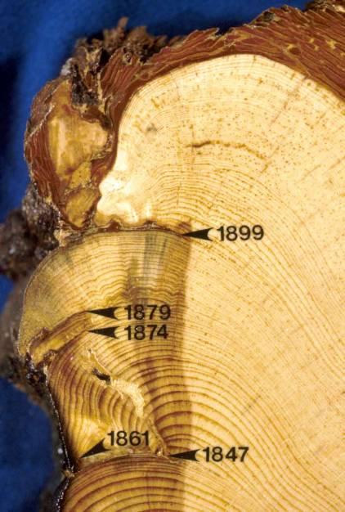
Fire-scarred trees can be reliable recorders of low to moderate intensity fires, and in some circumstances high intensity fires as well.

Slide 4
Dieterich & Swetnam 1982

Slide 5
Caprio & Swetnam 1995

Slide 6
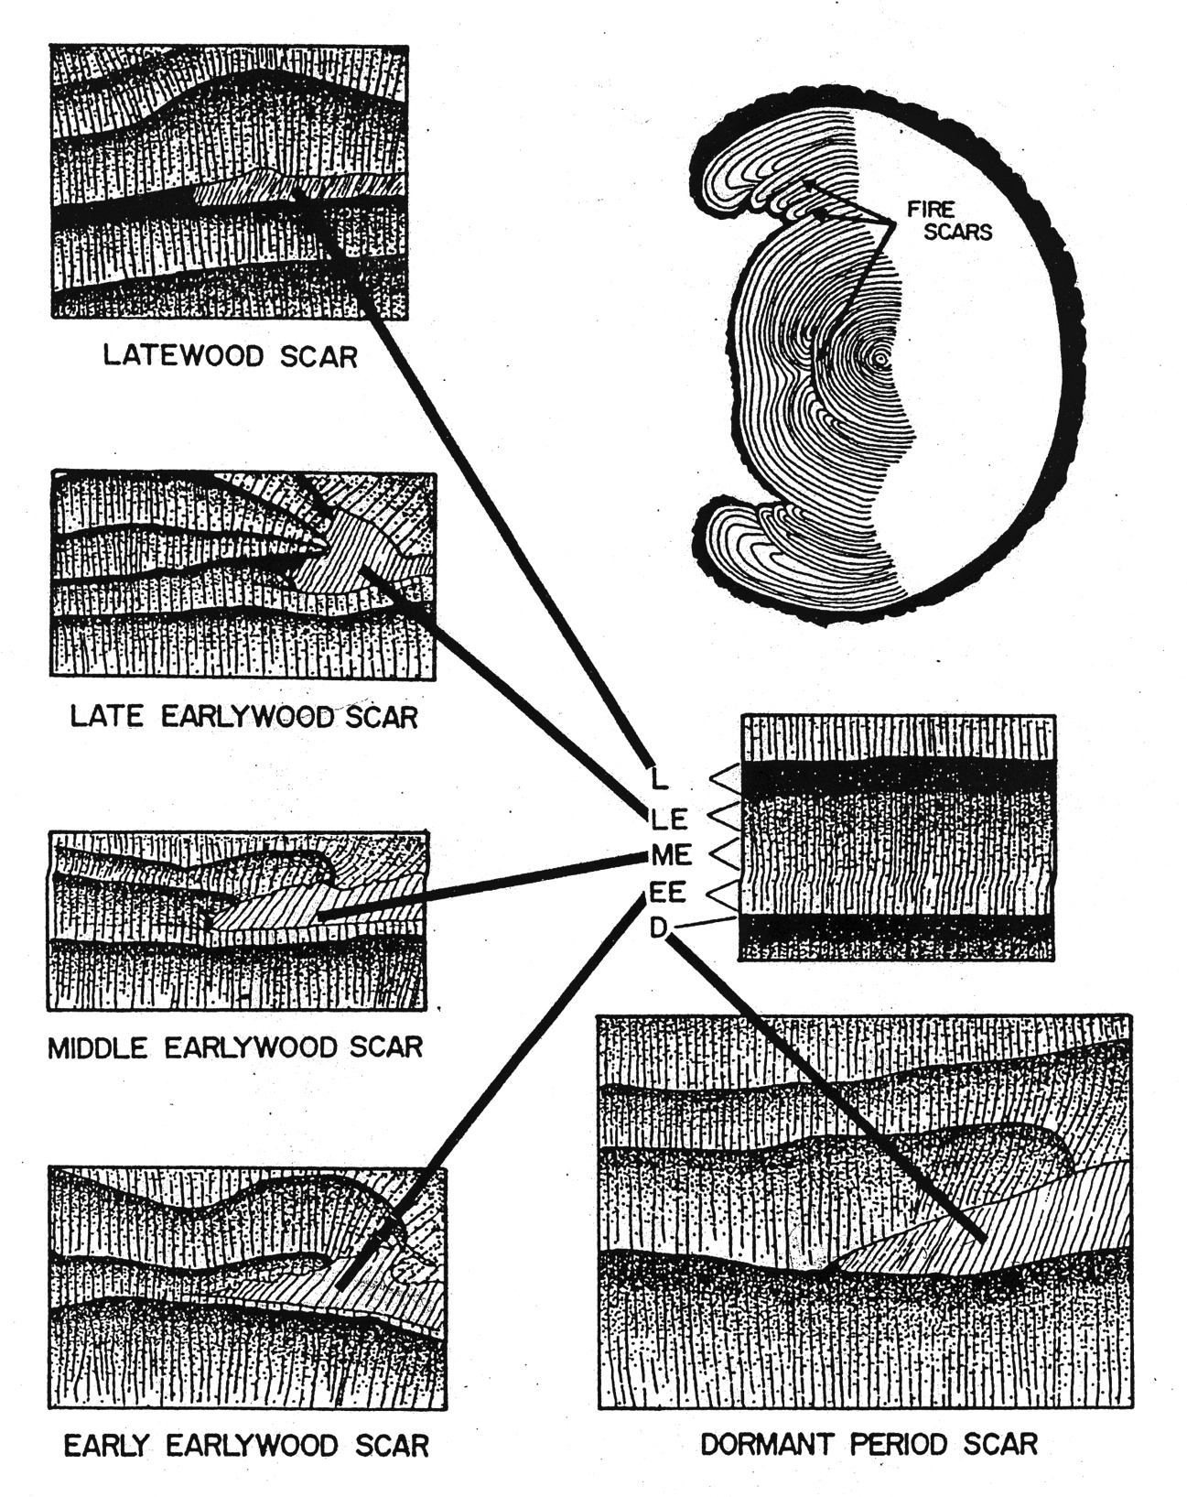

Slide 7
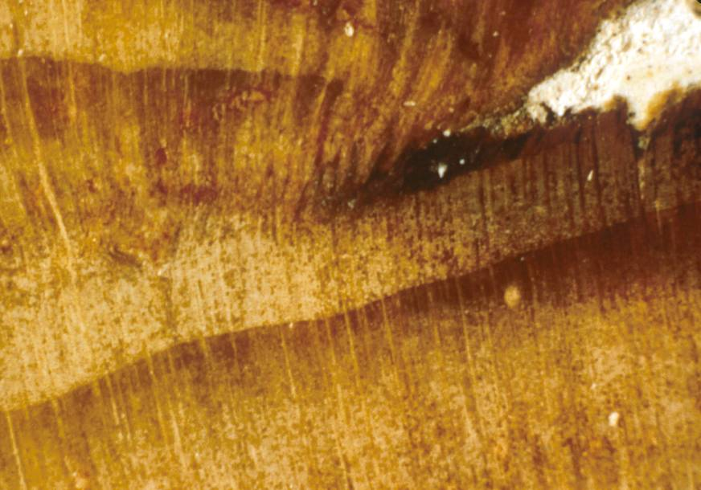
L
LE
ME
EE
D

Slide 8
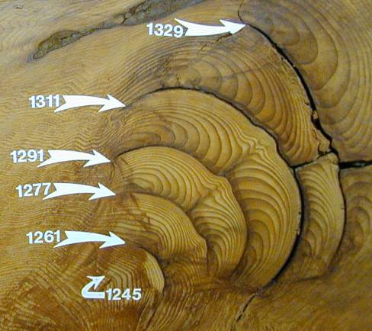

Slide 9
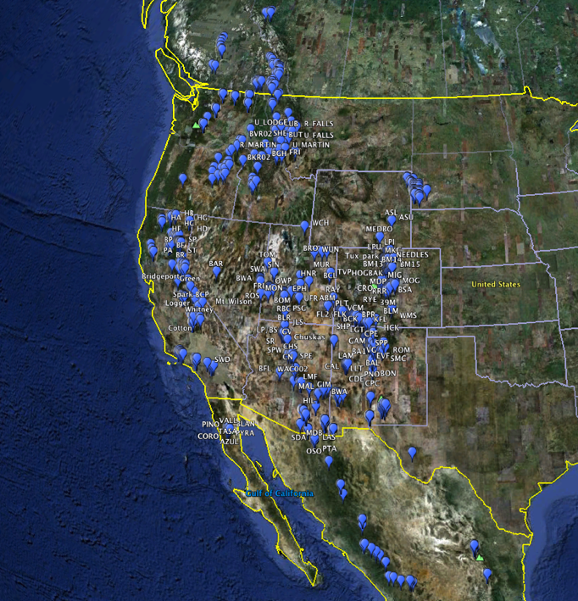

Slide 10
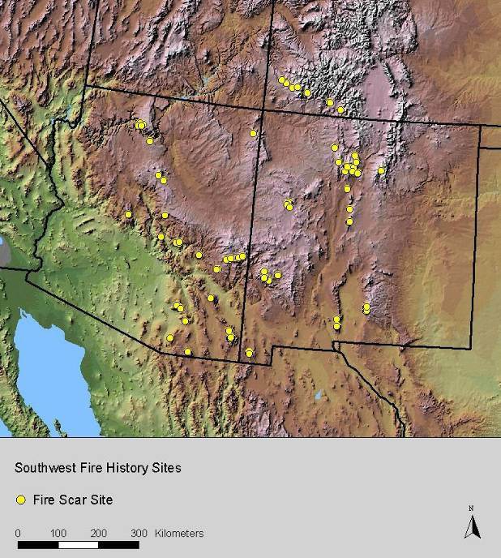
The fire-scar chronology network in southwestern North America currently includes about 120 sites.
Most sites 10-100 ha, some >1000 ha. Typical sample sizes ≈ 10-50 fire scarred trees, hundreds in a few cases.
The SW fire history network represents the collective effort of many people and institutions over more than 3 decades.
Notes:
Could draw ellipses around the sub-regions

