Slide 1
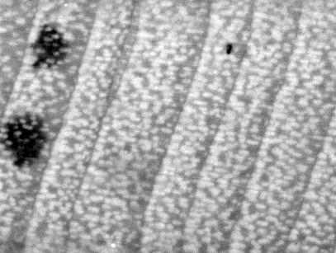
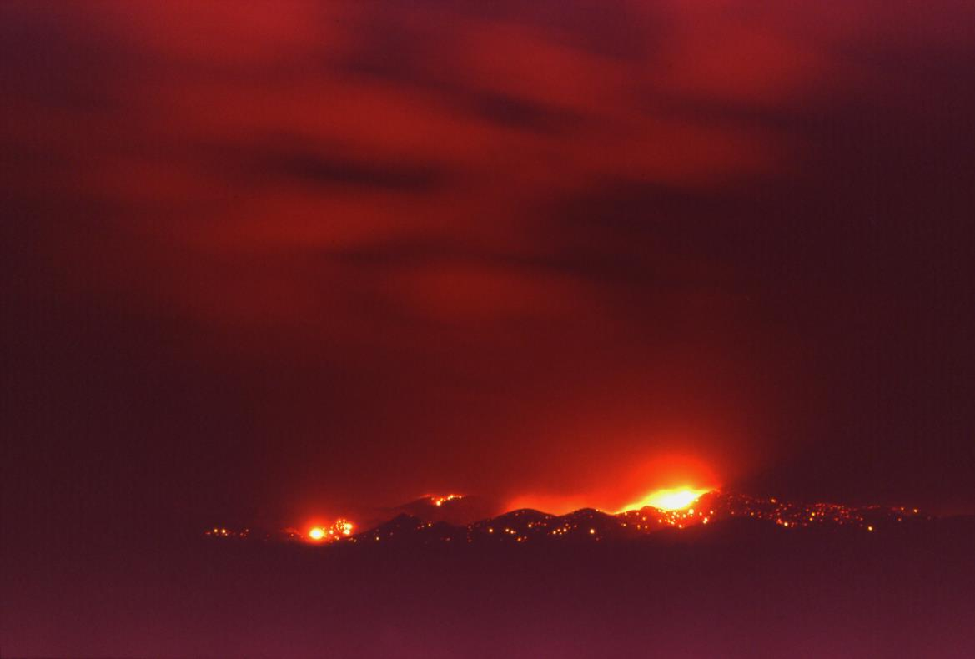
Tree rings, fire and the North American Monsoon
Ellis Margolis, Kyle Miller, Connie Woodhouse, Tom Swetnam, and Don Falk

Slide 2
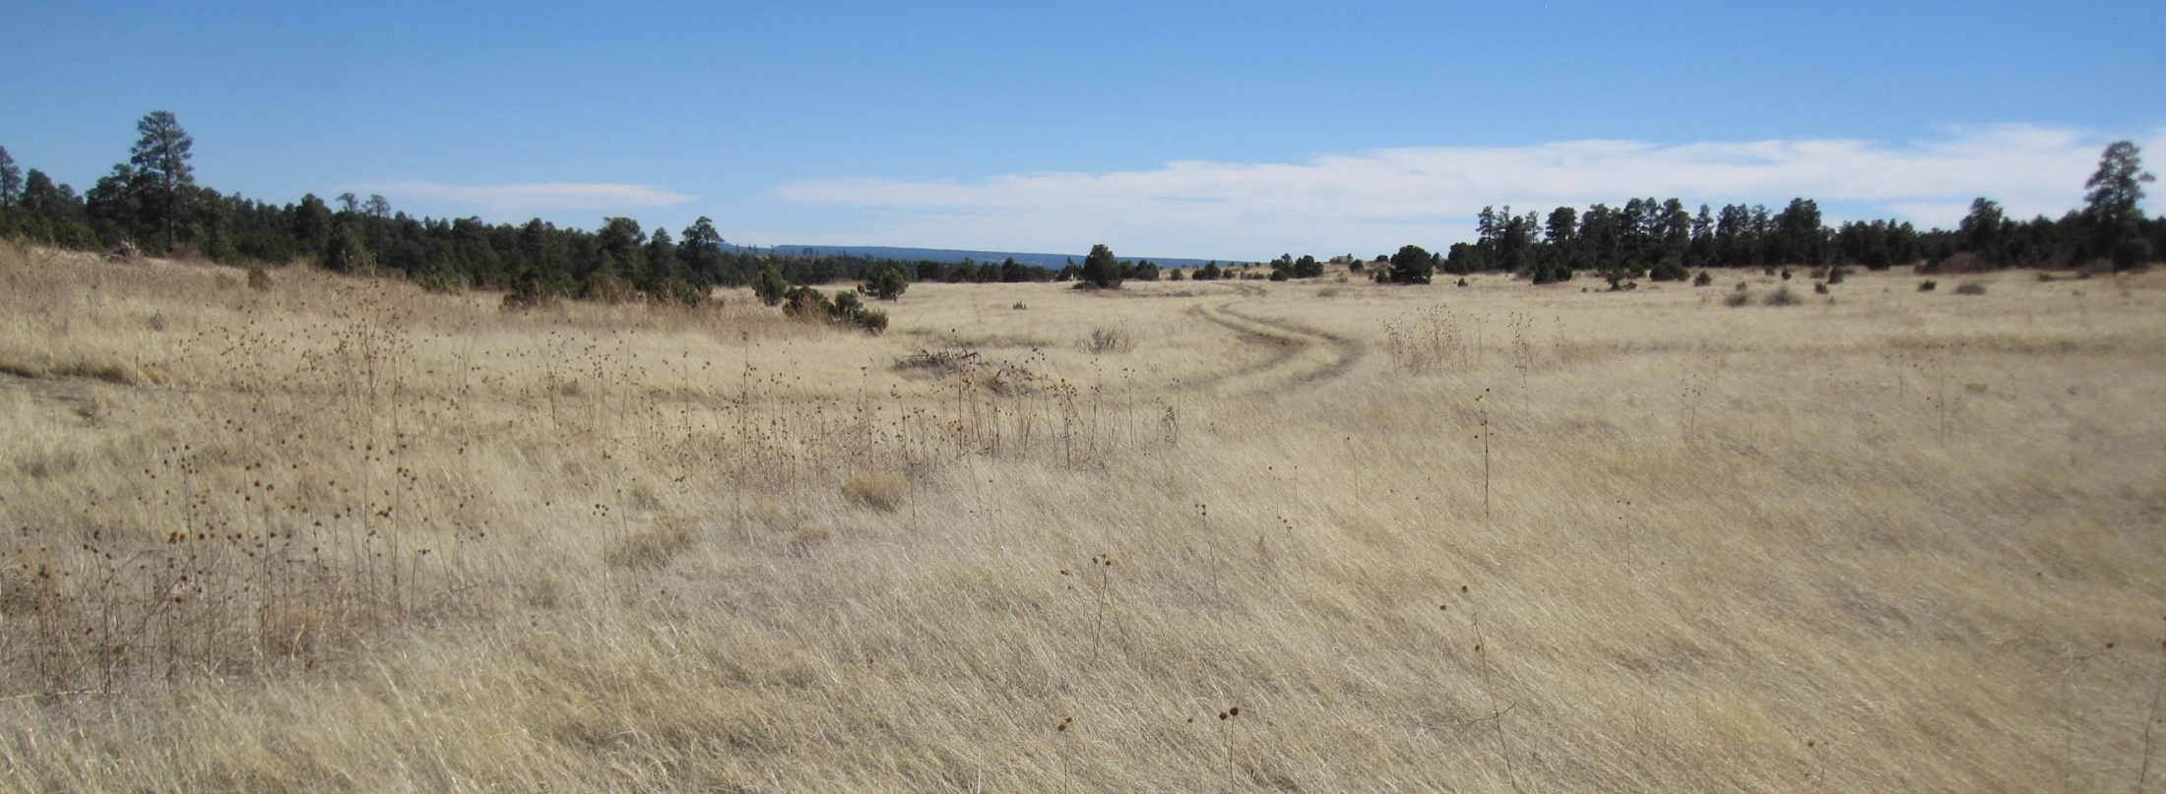
Effect of monsoon rain on fuels & fire
Late spring photograph from a PJ/Pipo savanna in north central New Mexico. This is ready to burn!!!!!!

Slide 3
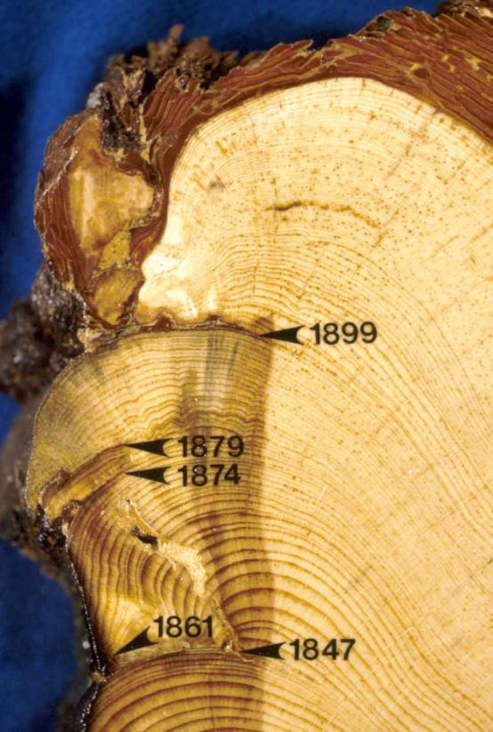
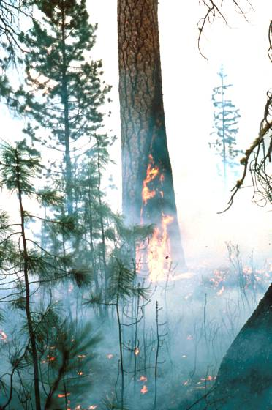
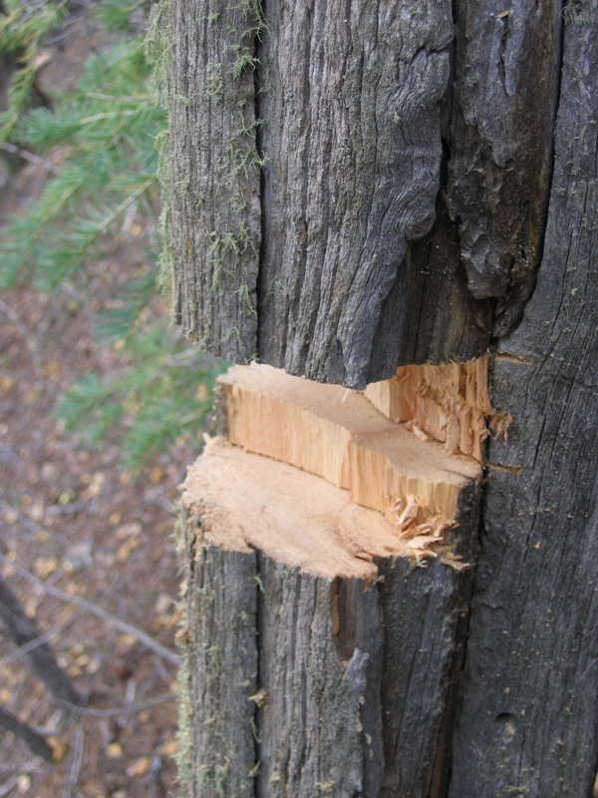
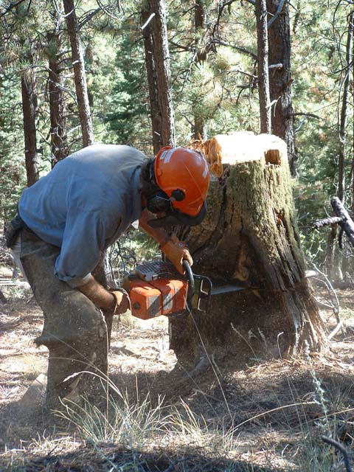
Tree ring fire scars: sub-annual resolution of fire occurence
Fire scars
Notes:
So how do we know about historical conditions? - historical photos, written accounts, and…..tree-rings - lots of tree-ring studies in N NM

Slide 4
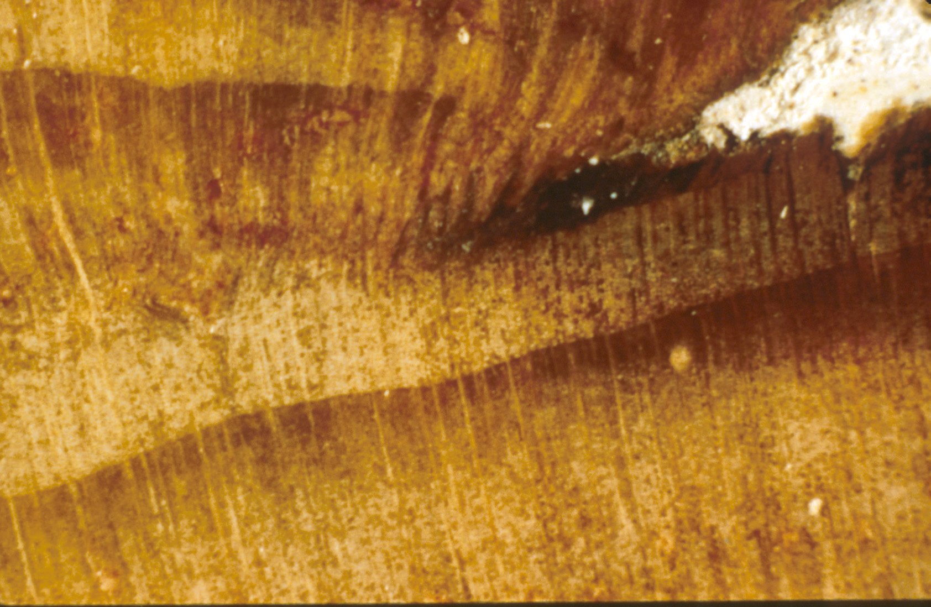
L
LE
ME
EE
D
fire scar
Credit: Laboratory of Tree-Ring Research

Slide 5
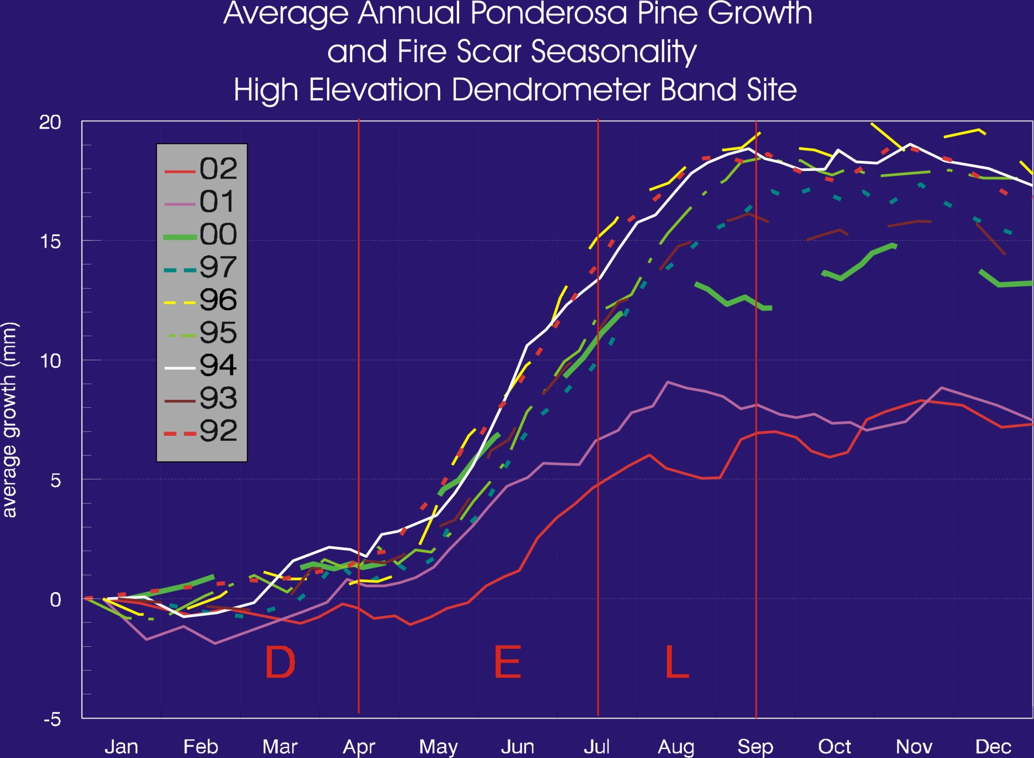

Slide 6
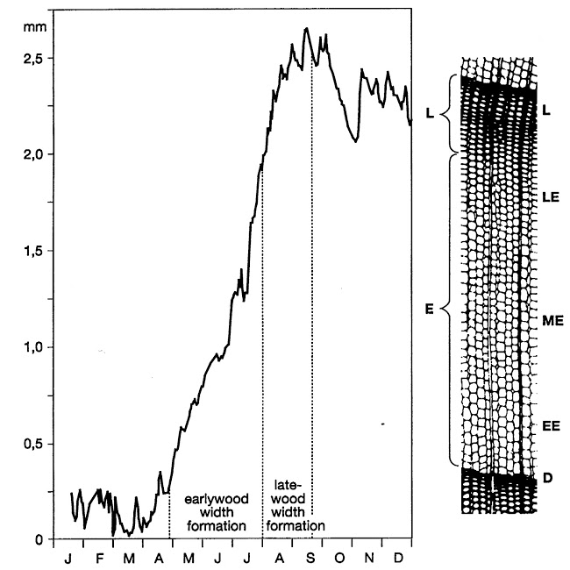

Slide 7

Research Questions
How did the North American Monsoon, in combination with other seasonal climate variables, affect historical wildfire seasonality?
How did the North American Monsoon, in combination with other seasonal climate variables, affect historical wildfire synchrony?

Slide 8
Fire seasonality hypotheses
Decreased summer NAM precipitation (weak, late monsoon) would extend the fire season into mid- and late-summer, producing more late earlywood and latewood fire scars.
Increased summer NAM precipitation (strong, early monsoon) would limit the fire season to the dry pre-monsoon period in late spring-early summer (i.e., dormant or early earlywood fire scars).

Slide 9
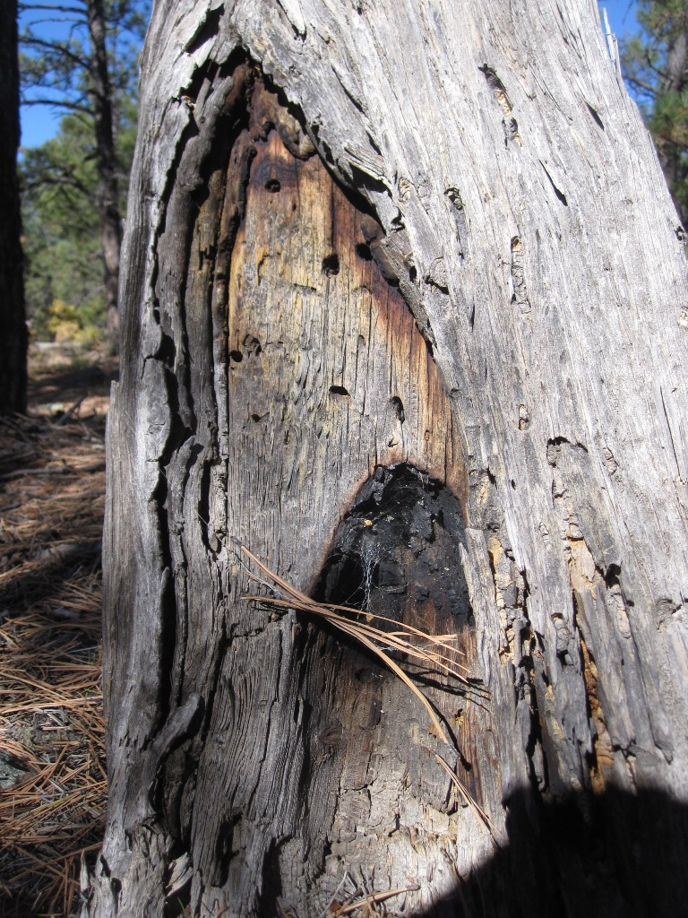
Data
Dendropyro reconstructions:
Fire scar synchrony (number of trees [or sites] recording fire in a year)
Fire scar seasonality (intra-ring position of fire scars)
Dendroclimatic reconstructions:
Cool Season (prior Oct – current April)
Pre-monsoon (May – June)
Monsoon (July – August, Sept?)

Slide 10
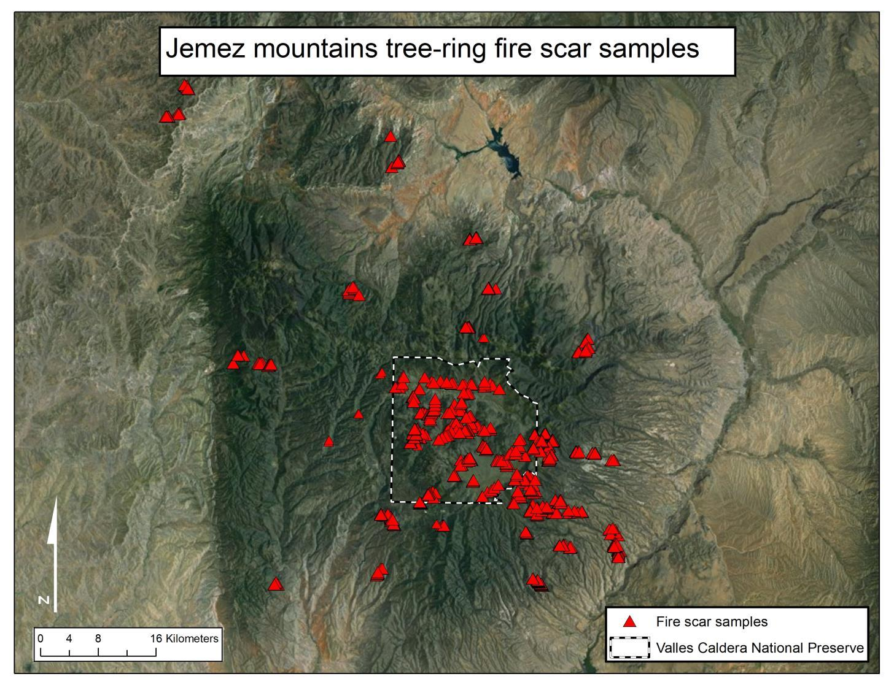
Notes:
We have lots of these fire history records - For example, in the Jemez Mountains many researchers have collected hundreds of tree-ring fire history samples all over the mountain range

Slide 11
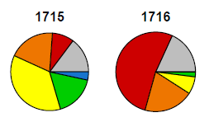
Data & Analysis
Fire seasonality:
Annual fire scar seasonality proportion
visual “time series”
Annual time series of fire scar occurrence for each of six fire scar seasonalities

Slide 12
Preliminary Results

Slide 13
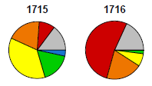
Time series of annual fire seasonality proportion
Pie radius scaled by padded log of number of trees recording fire

Slide 14
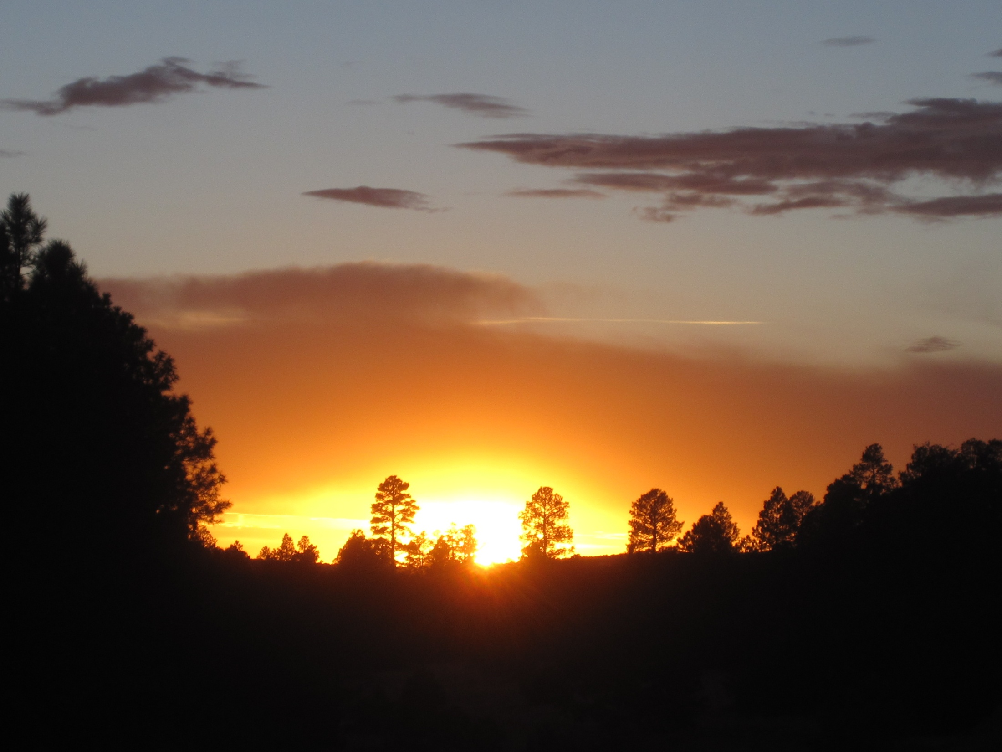
Thanks!
Funding from NSF Macrosystems program (P.I.’s - R. Monson, C. Woodhouse, T. Swetnam); Assistance with FhxR from B. Malevich and C. Guiterman; Additional support from the UofA Tree-Ring Lab.

Slide 15
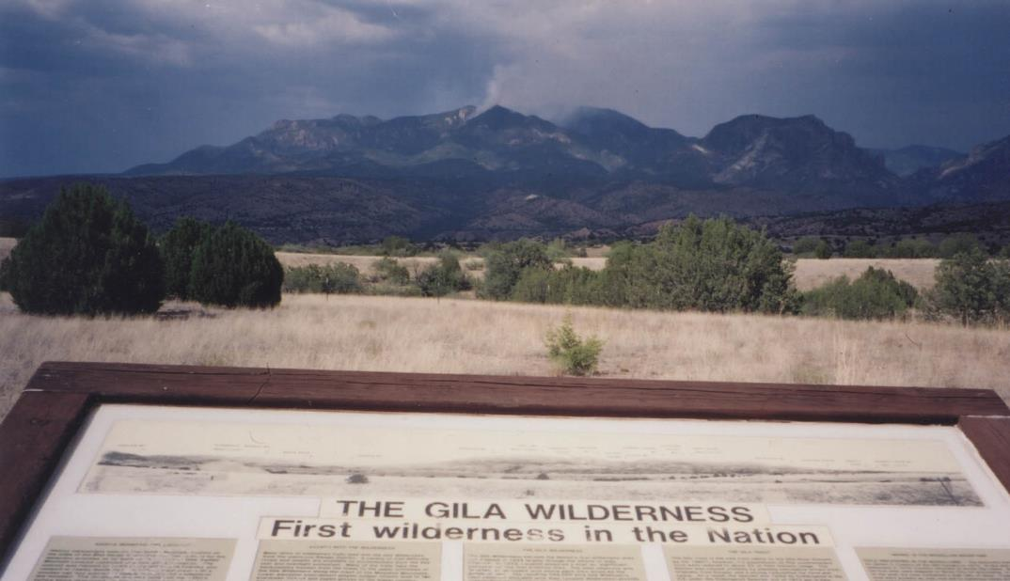
Is high severity fire a natural part of the Gila Wilderness?
Unknown fire, 8/23/2003
Ellis Margolis
Laboratory of Tree-Ring Research, University of Arizona
Tucson, Arizona
Notes:
High severity = fire that kills most of the trees, even the big and old ones

Slide 16
Research Questions
How did the North American Monsoon, in combination with other seasonal climate variables, affect historical wildfire seasonality?
How did the North American Monsoon, in combination with other seasonal climate variables, affect historical wildfire synchrony?

Slide 17
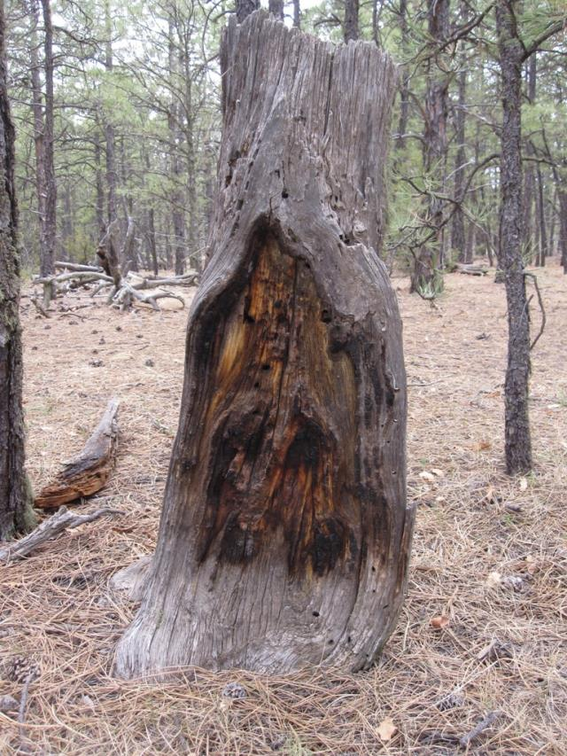
Fire Scars

Slide 18
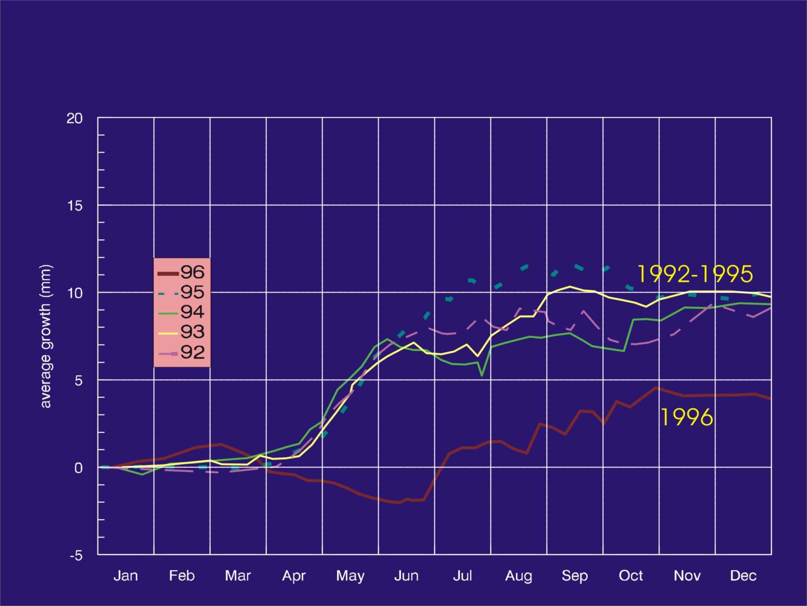
Low Site
1992-1996

Slide 19
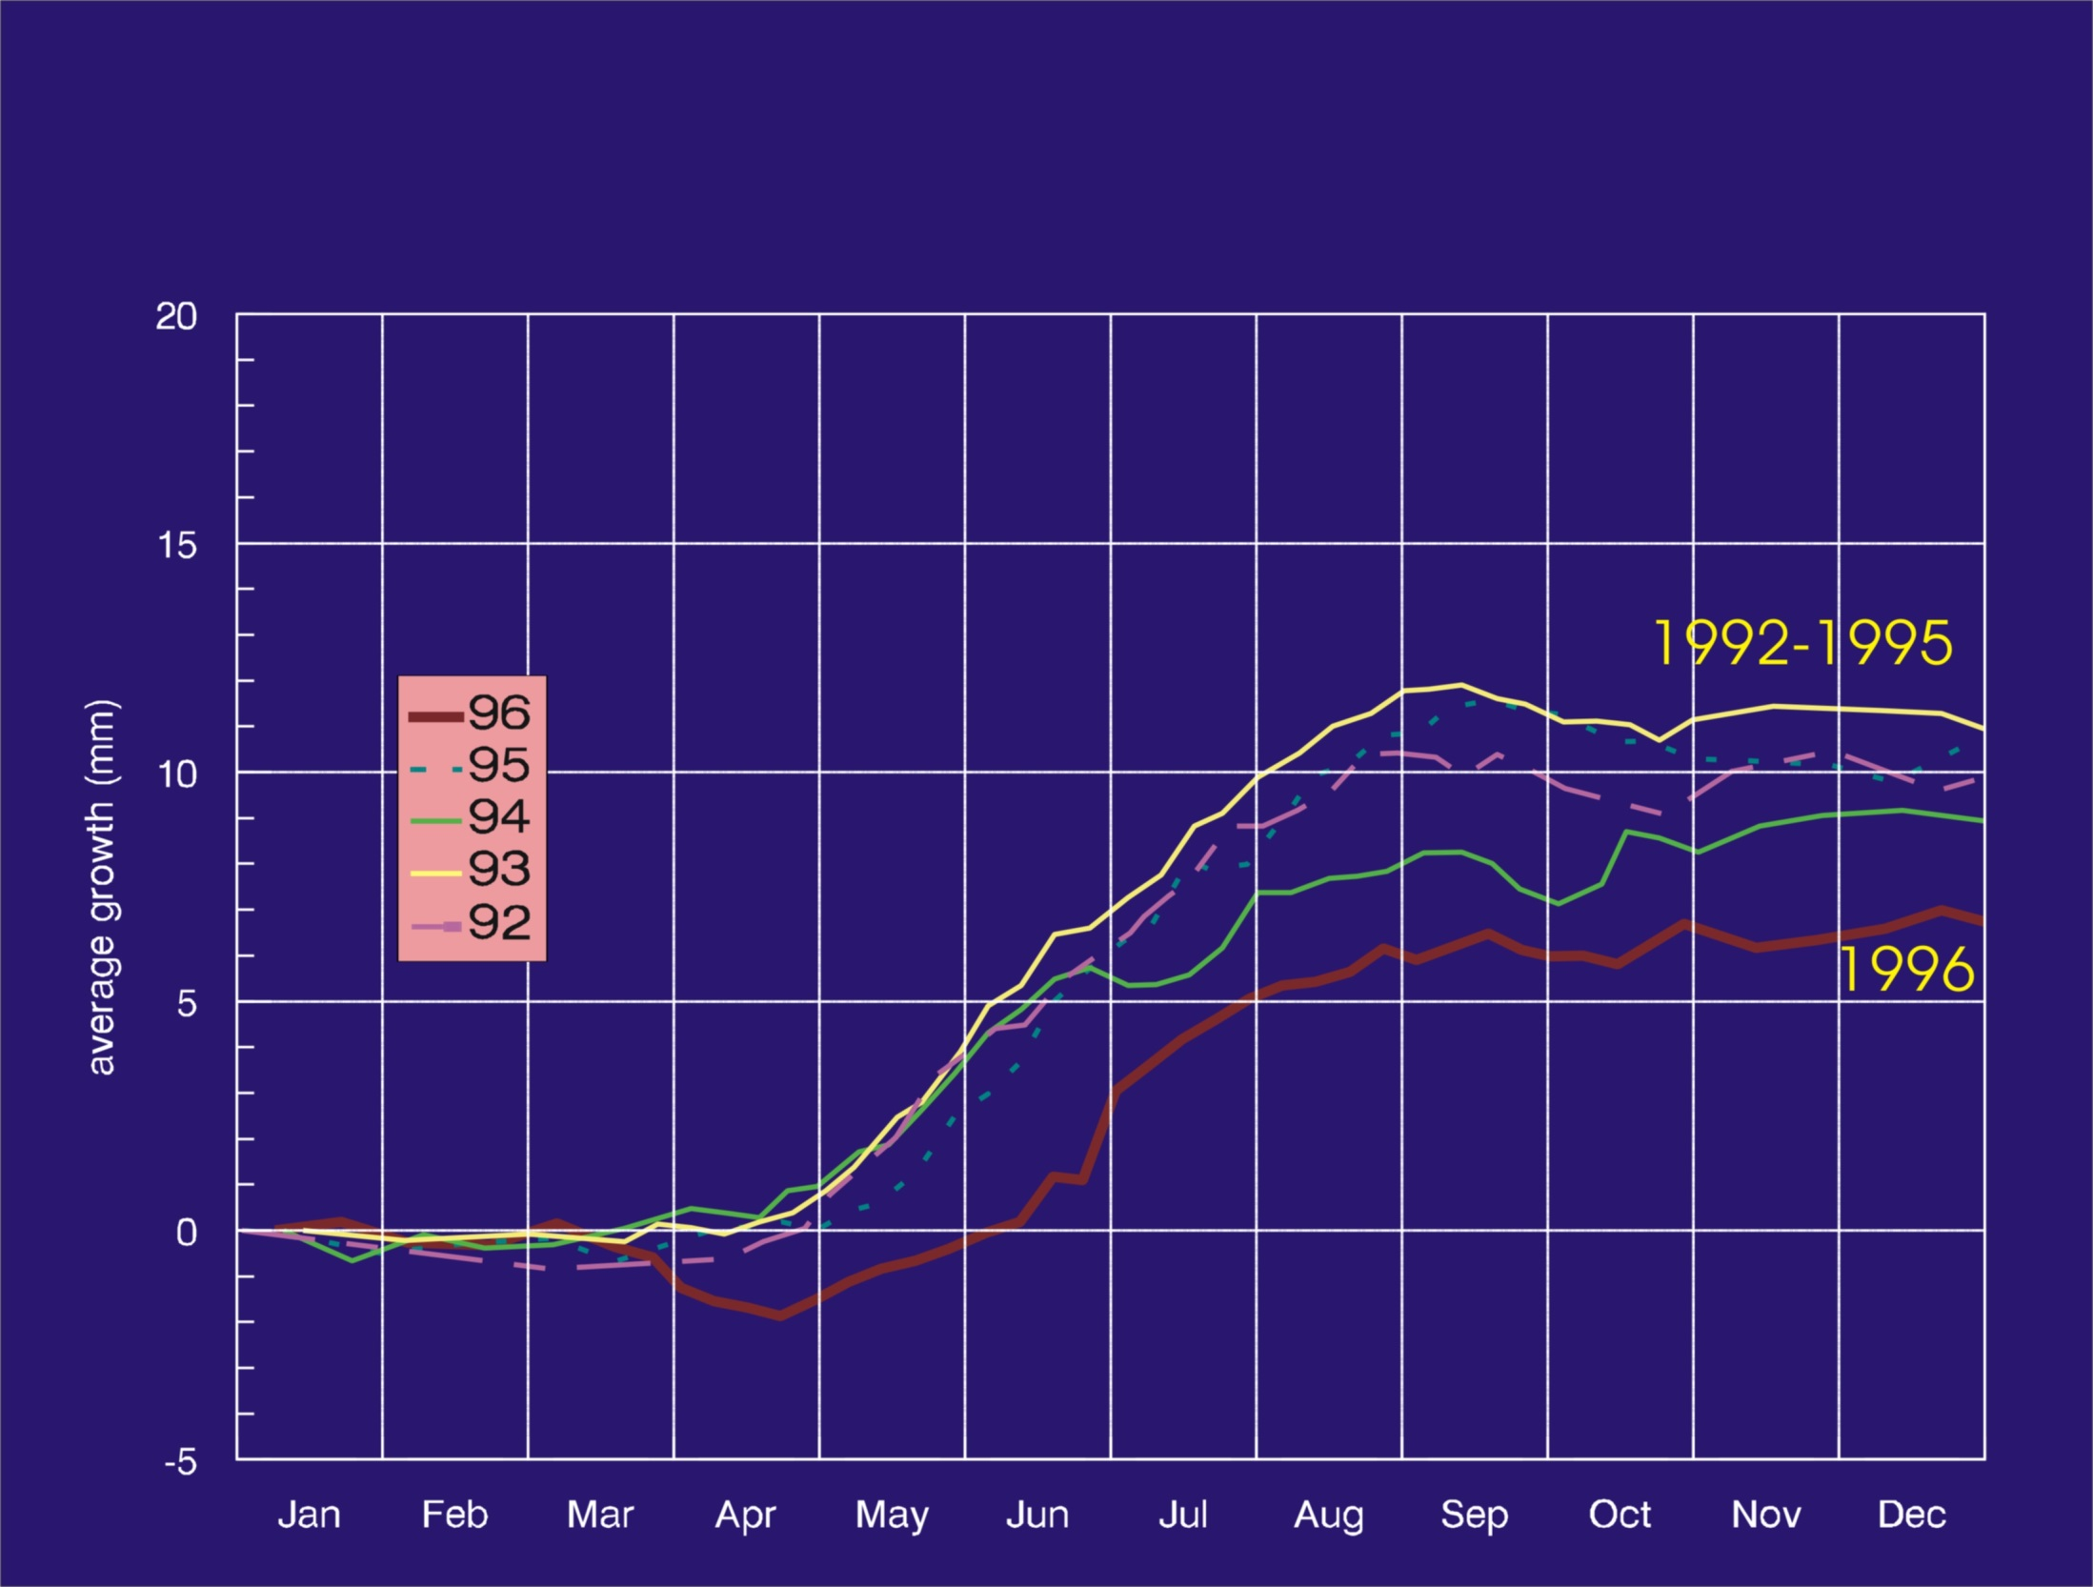
Middle Site
1992-1996

Slide 20
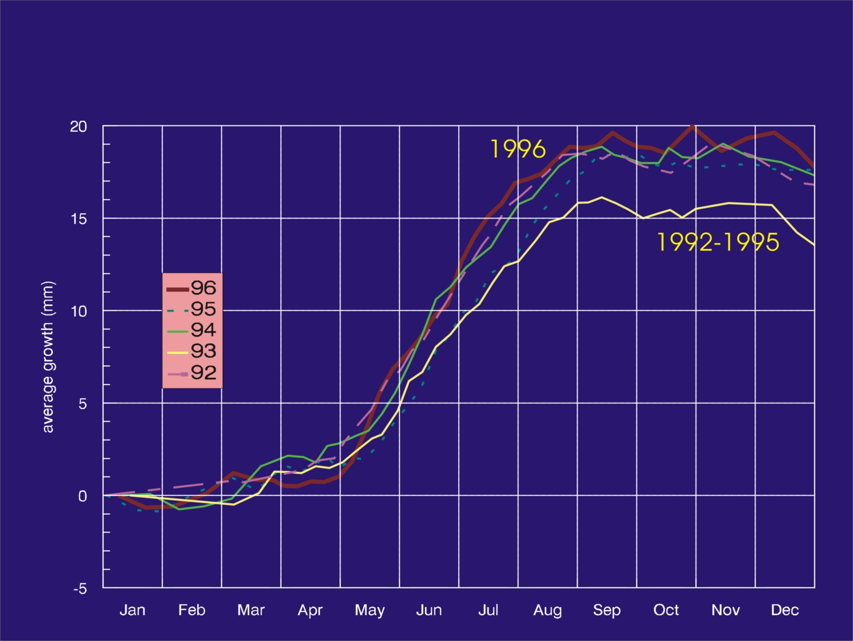
Upper Site
1992-1996

