Slide 1
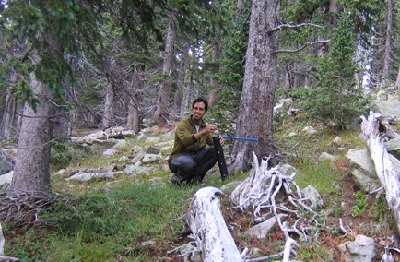
Site and tree selection, sample design, and sampling techniques
How do we decide which trees to sample?
How do we collect tree-ring samples?

Slide 2
There are endless sampling designs to choose from!
• Plots (fixed radius or n-tree)
• Targeted
• Systematic grids
• Stratified (random)
• Transects

Slide 3
Sampling is driven by the study design, which is always defined by the research question:
• Climate reconstruction
• Chronology building
• Tree growth along an environment gradient
• Climate change effects on tree growth
• Age structure
• Effects of topographic position on tree growth
• Fire or insect outbreak history
• Others?

Slide 4
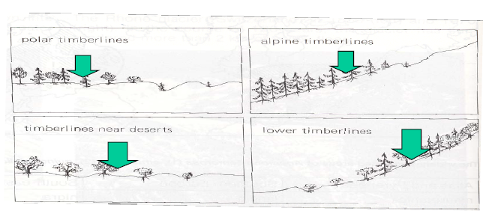
Site selection for climate reconstruction
If building a dating chronology, or seeking climate signal, one would go near, but probably not to, a distributional limit:
From Schweingruber

Slide 5
Why these locations?
Near the limit because these are usually where a single environmental factor – for example available soil moisture – controls growth, so tree rings will tend to show stronger patterns of common variation.
Not exactly at limit, because conditions are often so stressed there that circuit uniformity is poor, and missing rings so frequent that dating is more difficult.
Open-grown stand – reduce between-tree interactions (thus, this depends on question).

Slide 6
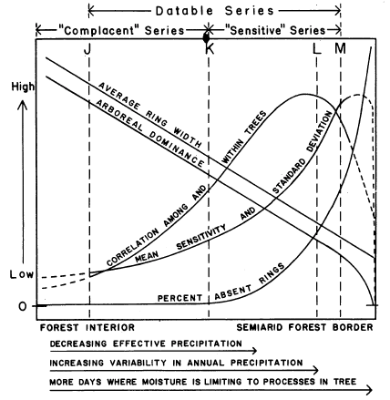
Site selection at the semiarid margin of a species' local distribution reveals moisture as limiting factor
Fritts 1965, Ecology

Slide 7
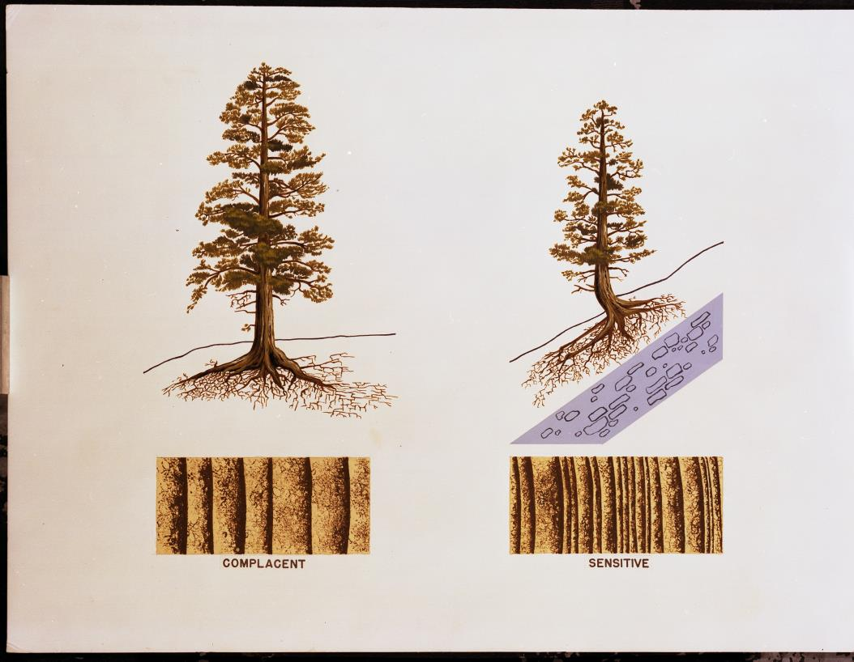
Sensitive vs Complacent Trees
Notes:
Moisture is limited growth of the sensitive tree

Slide 8
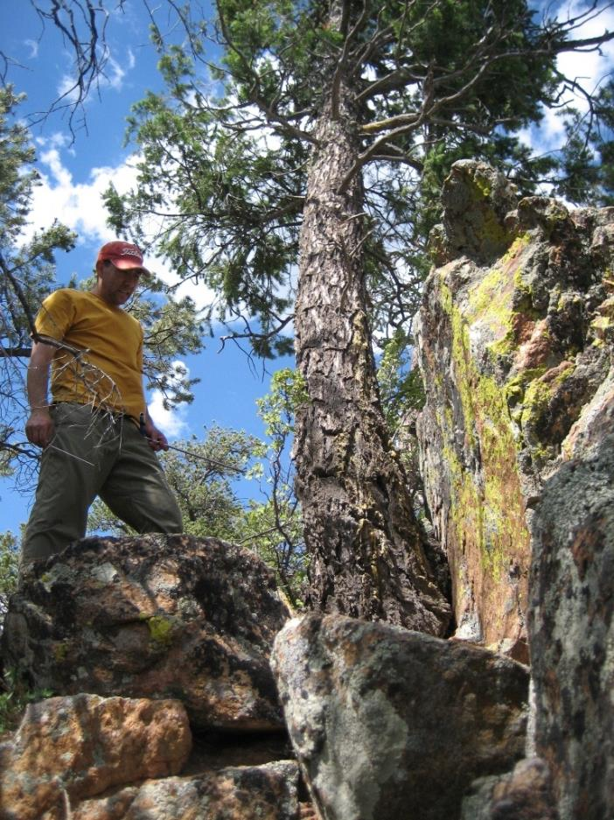
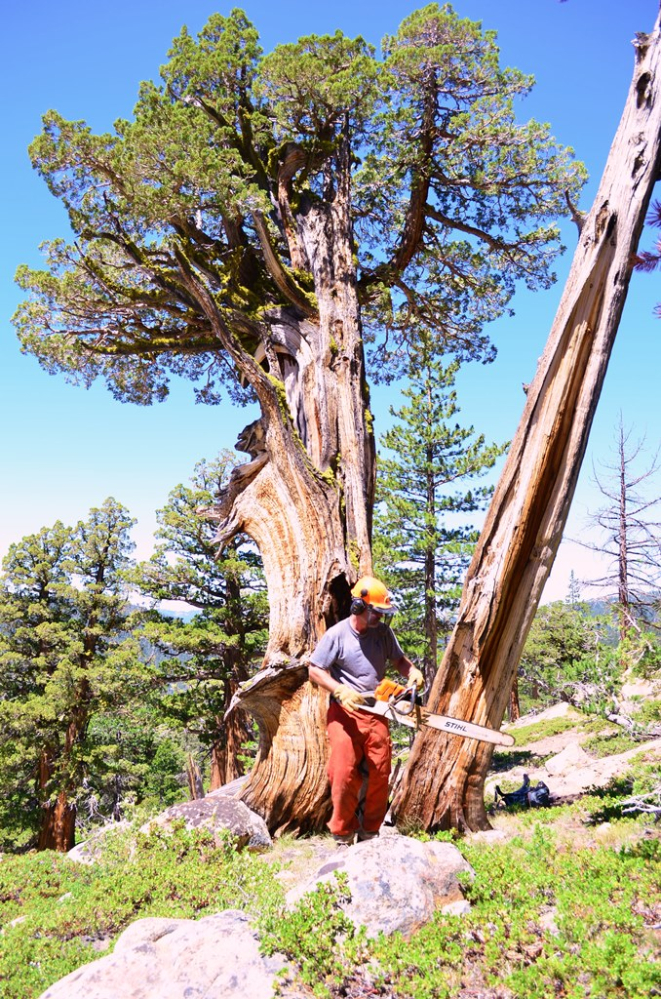
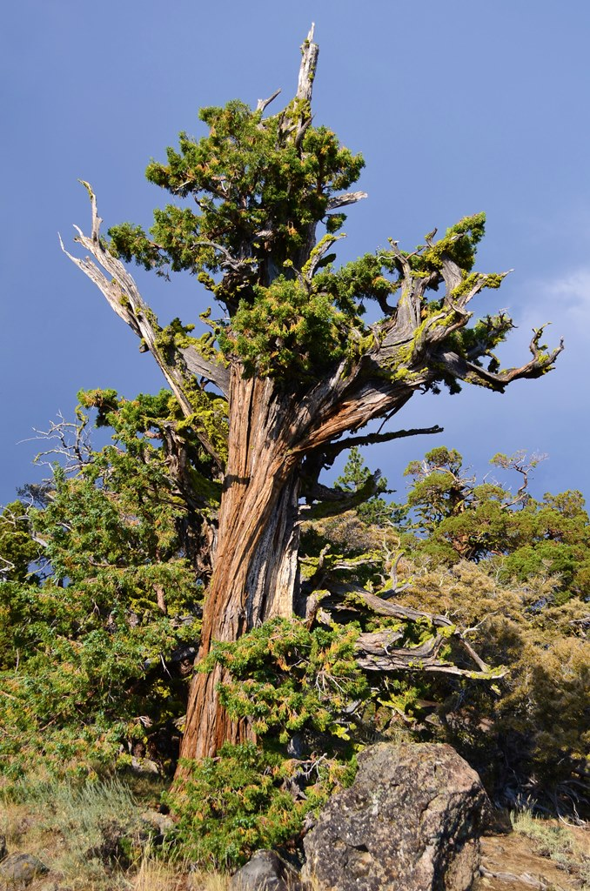
Climate sensitive trees

Slide 9
Salzer MW, Kipfmueller KF. 2005. Reconstructed temperature and precipitation on a millennial timescale from tree-rings in the Southern Colorado Plateau, USA. CLIMATIC CHANGE 70 (3): 465-487

Slide 10
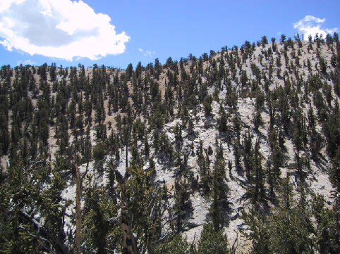
Other considerations in tree and site selection
Open-grown stand, minimal tree interaction maximizes climate signal.Pinus longaeva, White Mts, California, about 3000 yrs old.
Photo V.C. LaMarche

Slide 11
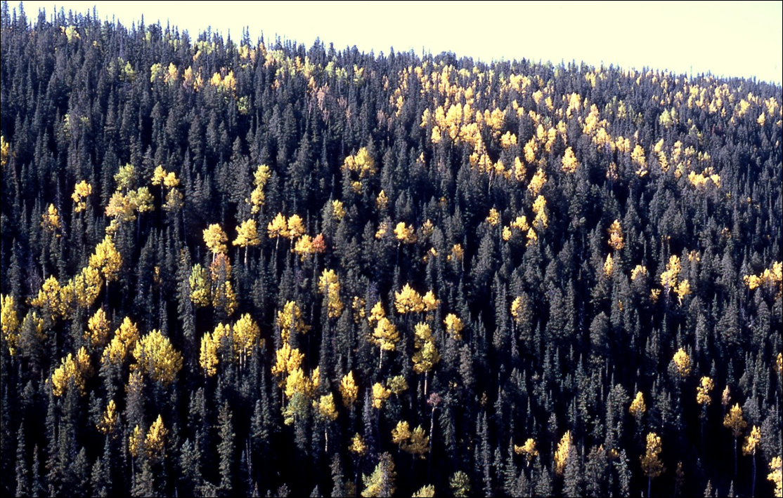
Closed-canopy stand with evidence of past disturbance, substantial tree interactions, and thus more of an ecological signal in the tree-ring record.
Picea engelmannii, Abies concolor and Populus tremuloides, White Mts, Arizona

Slide 12
Sampling design for dendroecology may follow different logic:
Often in dendroecology we look for growth differences among trees:
Growth increases in trees released from competition
Host/non-host differences in stands affected by a host-specific insect (e.g. defoliator)
Growth changes from foliar damage during fire
Clusters of recruitment dates reflecting climate and disturbance

Slide 13
Sampling considerations in fire history
Example Research Questions:
How does fire occurrence and extent vary with climate?
To what extent is fire area burned governed by topography?
What is the influence of sample area on metrics of the fire regime?
Each of these would suggest different sampling strategies

Slide 14
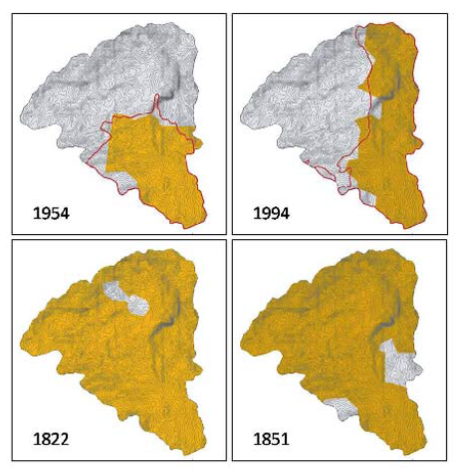
Farris et al. 2010: Objective was to compare landscape patterns of area burned reconstructed from fire scars with perimeters in fire atlases (Rincon Mts, AZ)
This objective required a spatially distributed, gridded sample design

Slide 15
“Occupied” Jemez Mountain Salamander sites
Notes:
Spatially distributed sample in remaining JMS habitat that had not burned in last 15 years

Slide 16
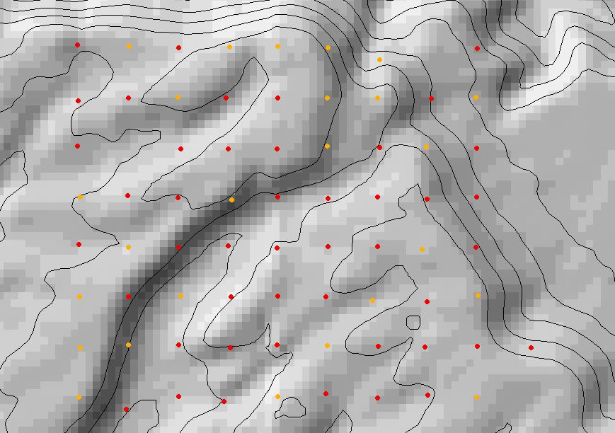
Gridded fire history at Monument Canyon RNA, NM Question: Are metrics of the fire regime scale dependent?

Slide 17
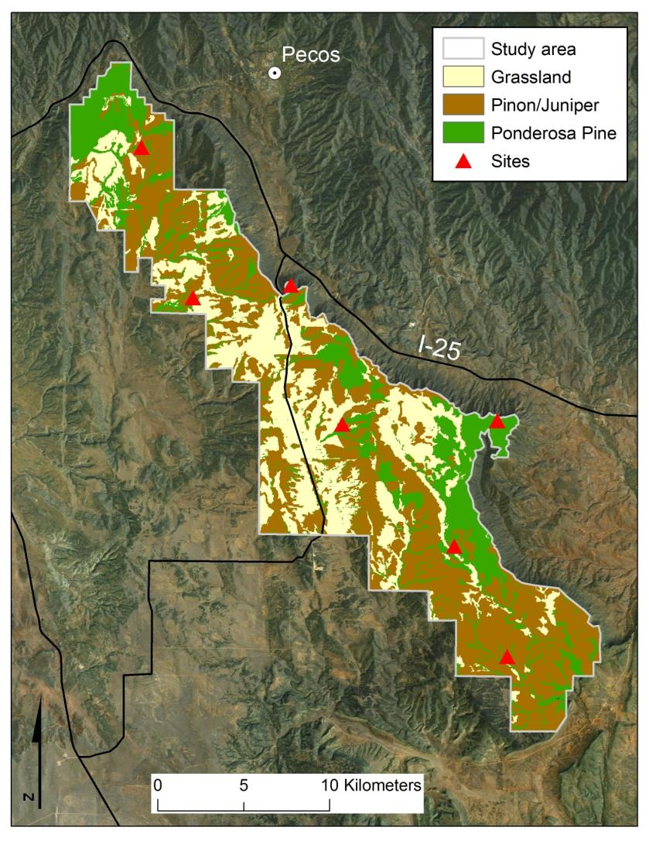
Vegetation
(ground corrected Landfire EVT):
47% - Piñon-juniper (savanna) - Pinus edulis, Juniperus scopulorum, J. monosperma
29% - Grassland (short grass) - Bouteloua gracilis
24% - Ponderosa pine - Pinus ponderosa, Quercus undulata
Margolis 2013 IJWF
Notes:
PJ landscape - ~ 50% PJ

Slide 18
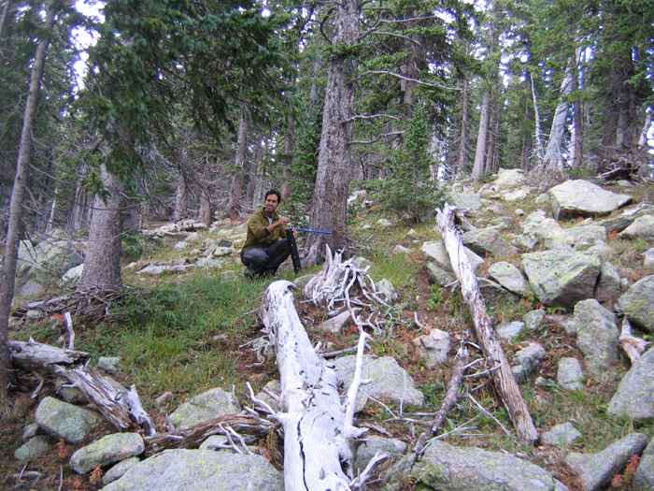
Tree-ring sample collection

Slide 19
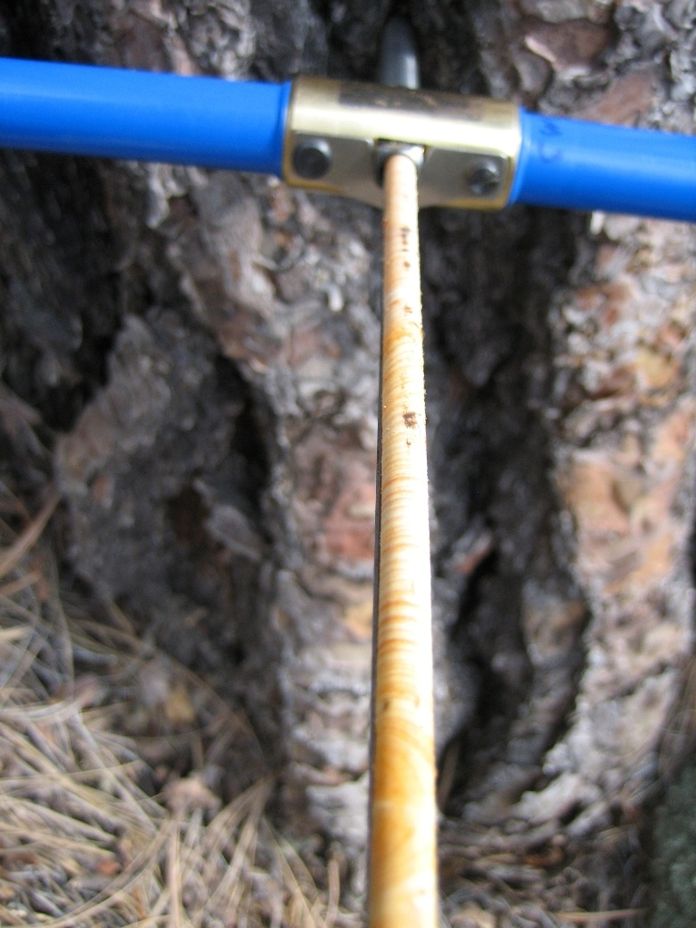
Increment cores: 1. tree age 2. climate reconstruction

Slide 20
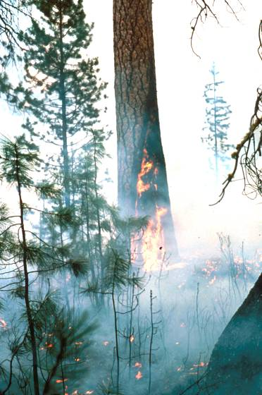
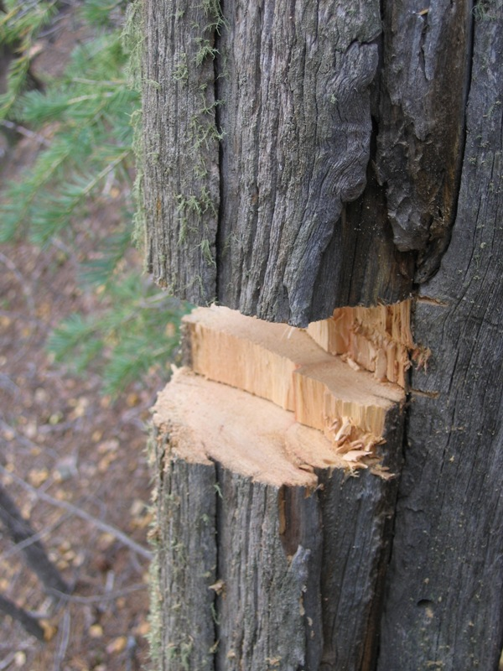
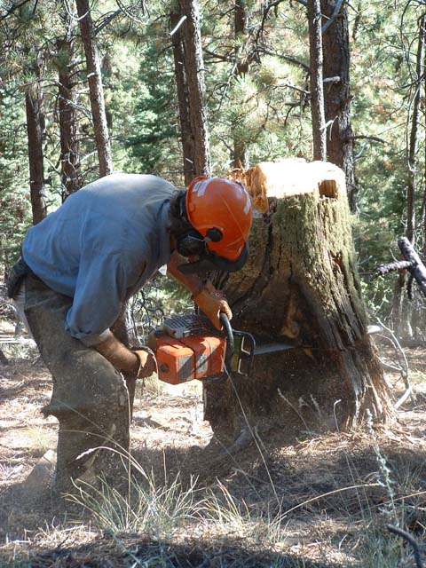
Surface fire history
Fire scars
Notes:
So how do we know about historical conditions? - historical photos, written accounts, and…..tree-rings - lots of tree-ring studies in N NM

Slide 21
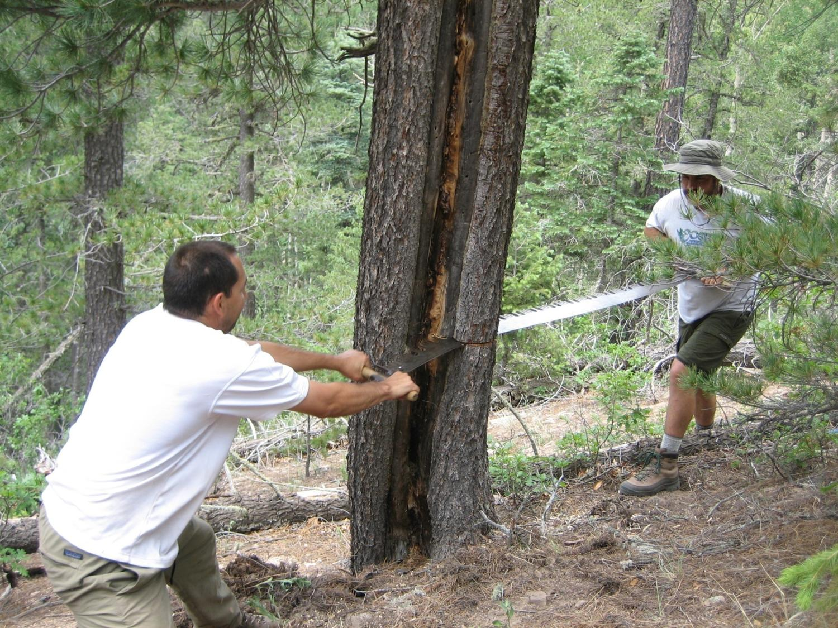
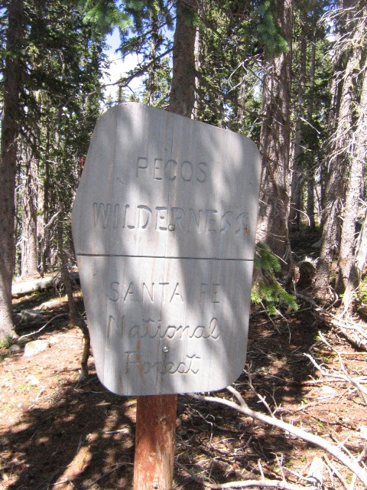
Pecos Wilderness

Slide 22
Notes:
Twin Cabins plot (

Slide 23
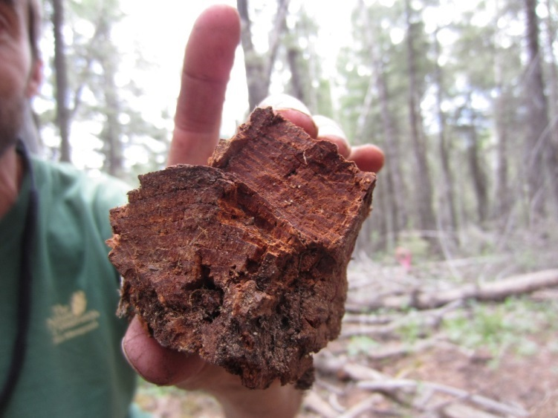
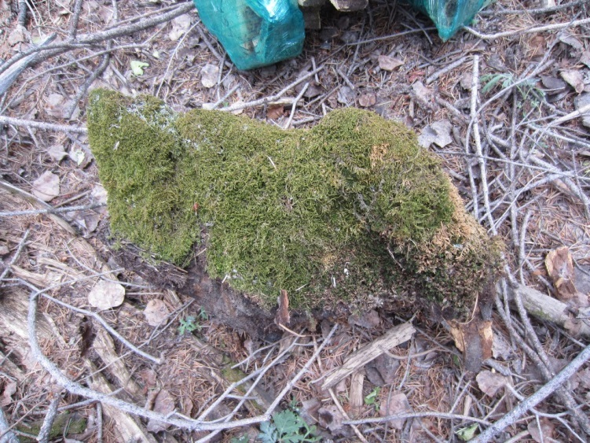
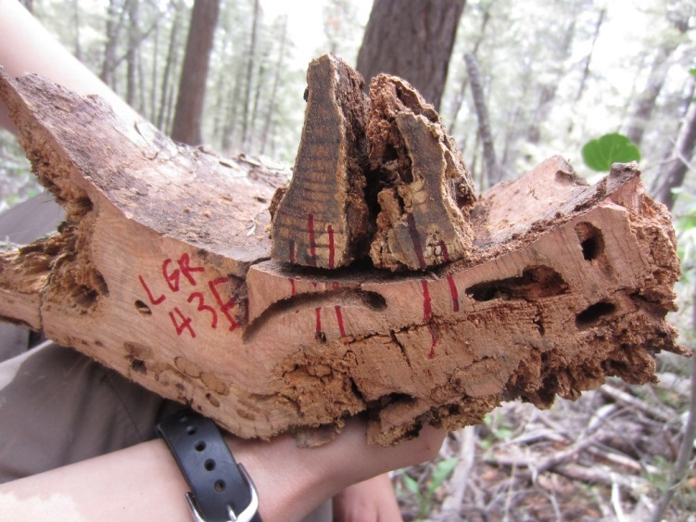
Sometimes you take anything you can find
Sampling all live and dead trees to reconstruct composition, age structure, and fire history in mixed conifer forests
Notes:
This mainly comes from persistent PJ woodlands – (e.g., Mesa Verde; Floyd et al 2000, 2004) - Long interval, high severity fire - it all burns to the ground and regenerates

Slide 24
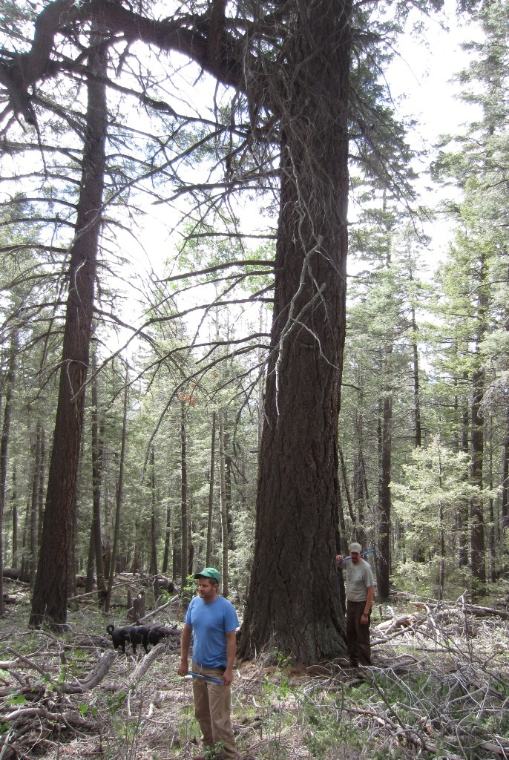
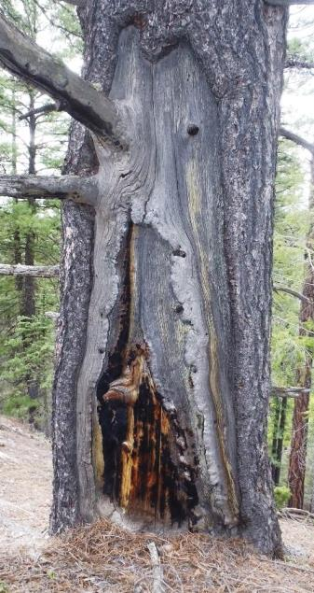
We often “target” certain trees that have the information we seek

Slide 25
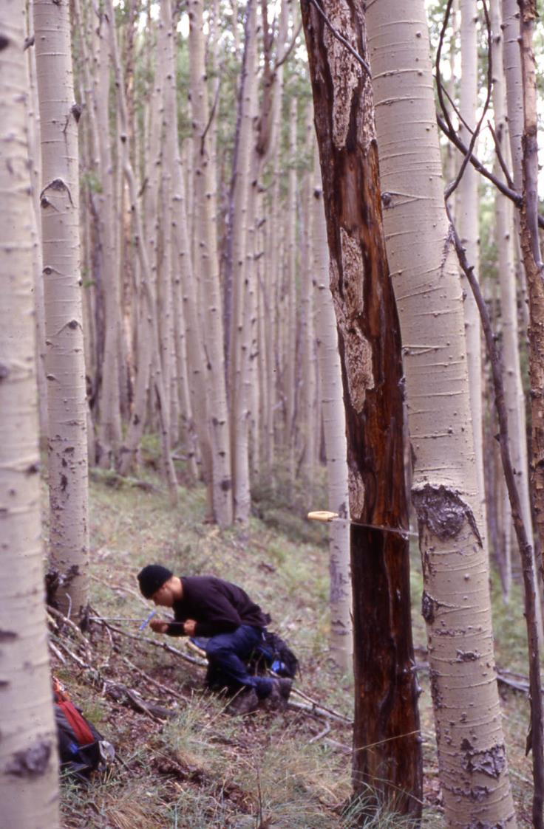
Fire-killed tree death dates

Slide 26
Class Field Trip

Slide 27
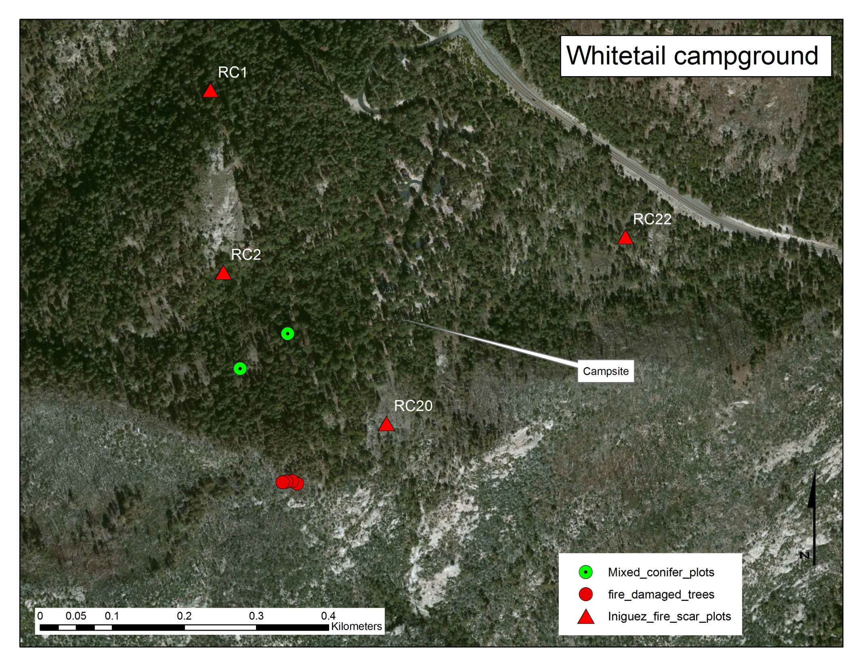

Slide 28
Research questions
Has fire exclusion affected tree species composition and density?
Is there a tree-ring response to crown damage from fire?

Slide 29
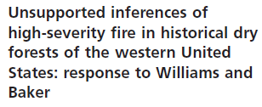
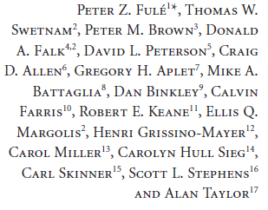
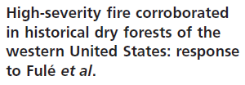
Species composition and density change?
“current attempts to ‘‘restore’’ forests to open, low-severity fire conditions may not align with historical reference conditions in most ponderosa pine and mixed-conifer forests of western North America.”

Slide 30
Last widespread fire in 1899

Slide 31
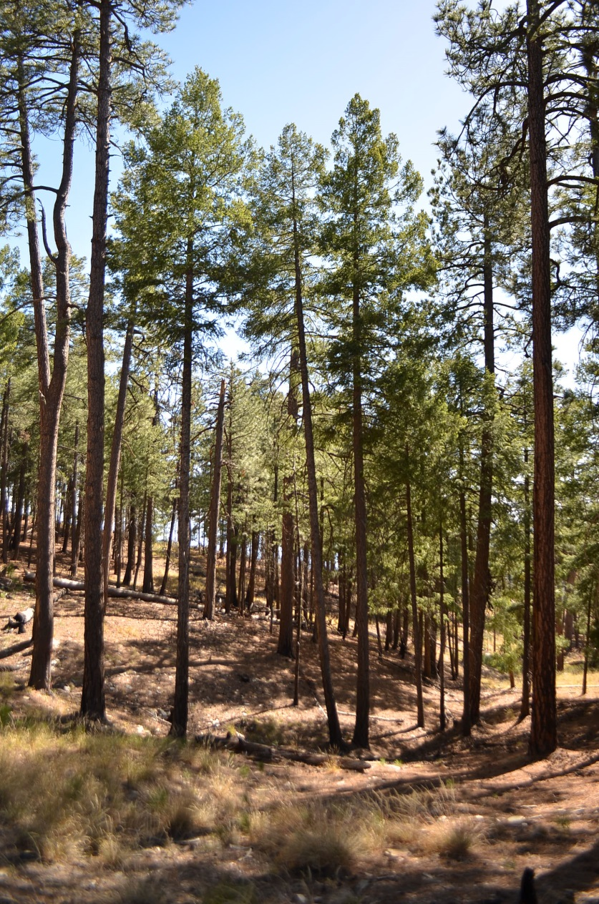
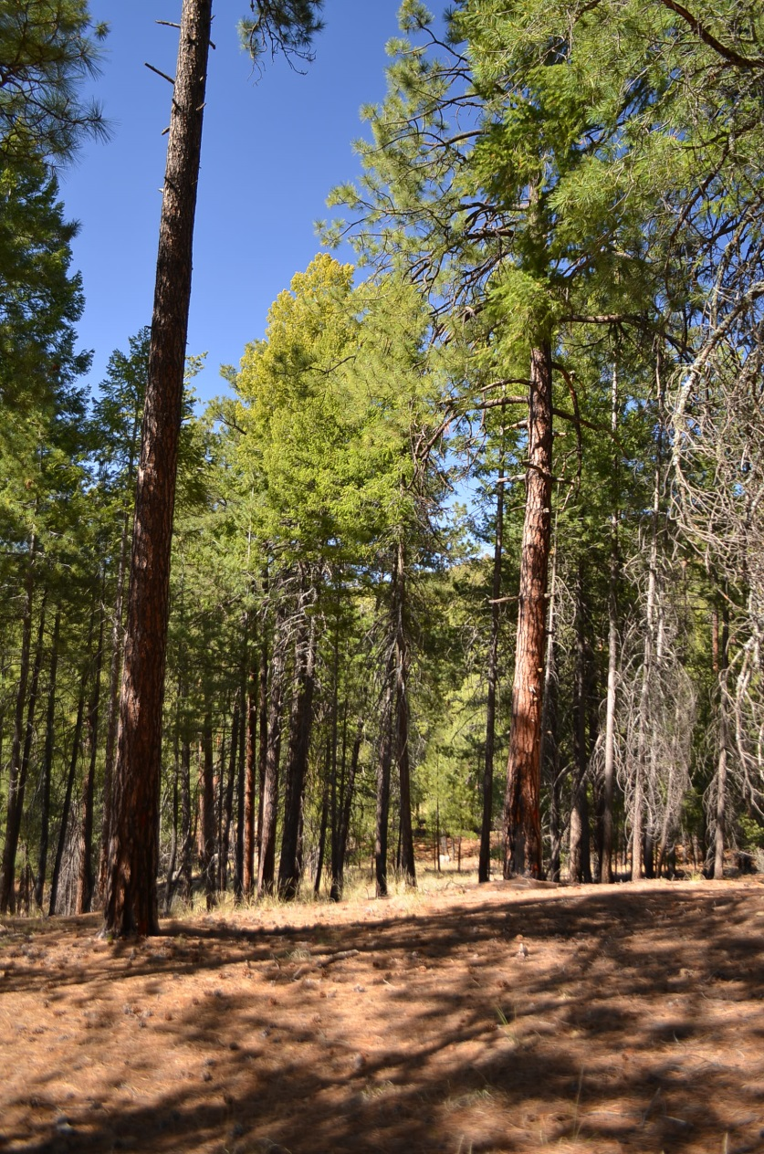
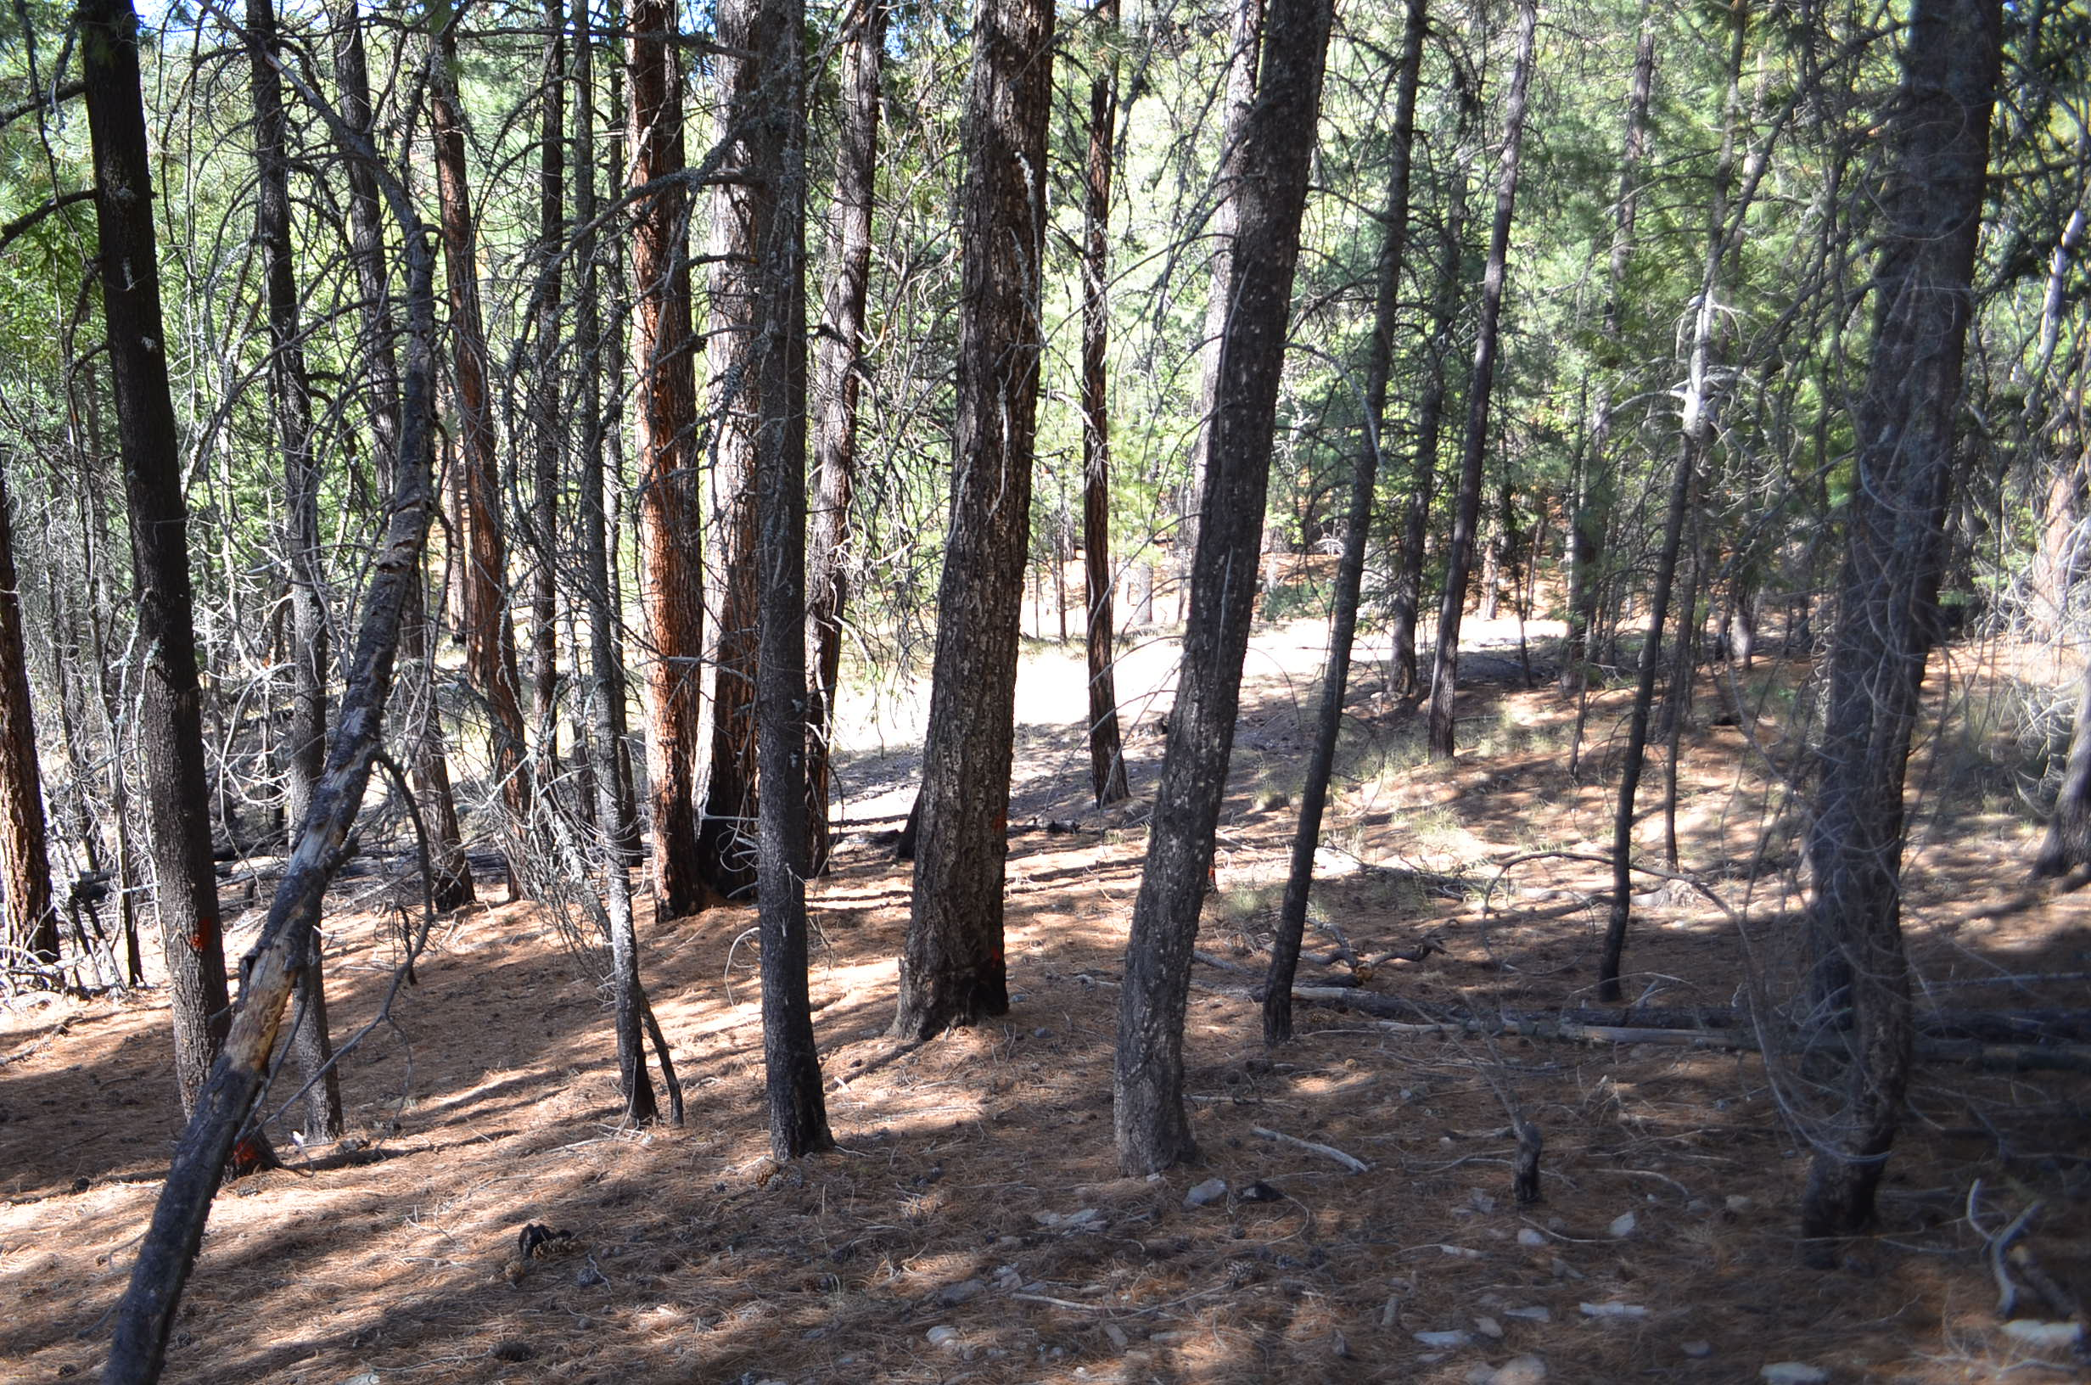
Were these sites mixed conifer when there was frequent fire?

Slide 32
Sample design
2 n-tree plots in mixed conifer forest
Core 30 trees in each plot to determine whether they pre- or post-date the last widespread fire (1899)?

Slide 33
Research questions
Has fire exclusion affected tree species composition and density?
Is there a tree-ring response to crown damage from fire?

Slide 34
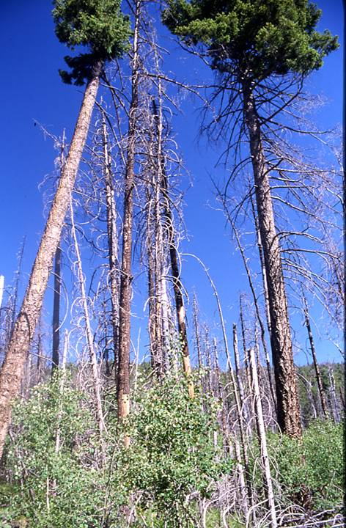
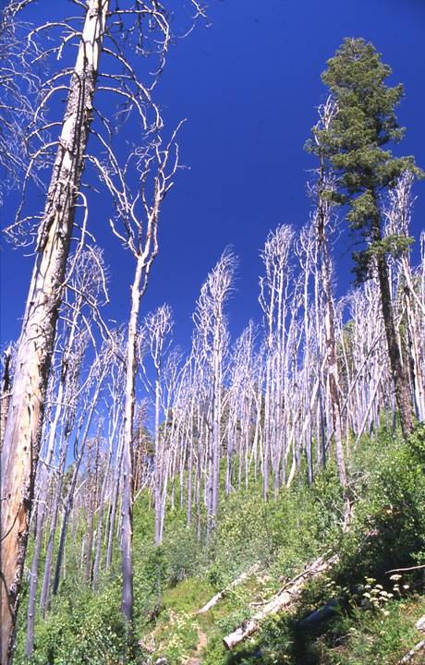
Injured fire-survivors
(growth changes/resin ducts)

Slide 35
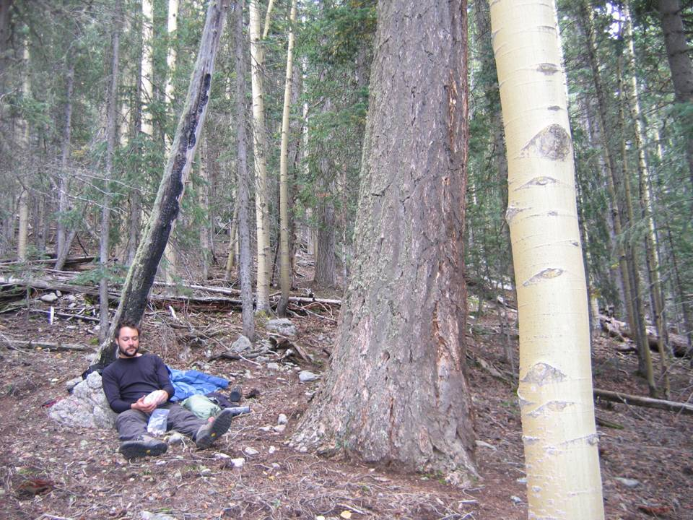
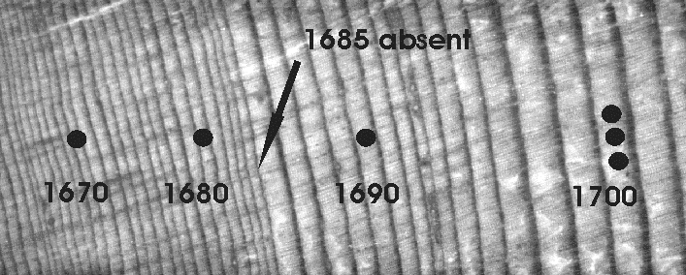
Fire-survivors
Missing ring, then release after fire
Margolis & Balmat 2009

Slide 36
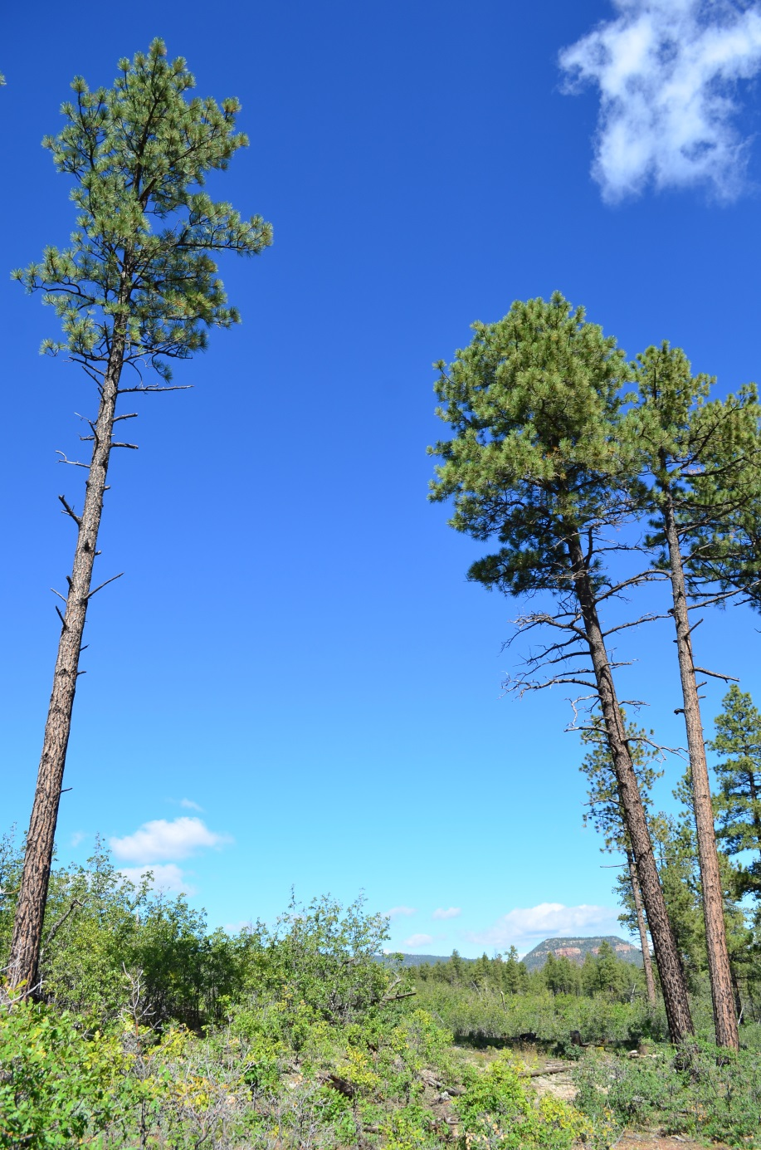
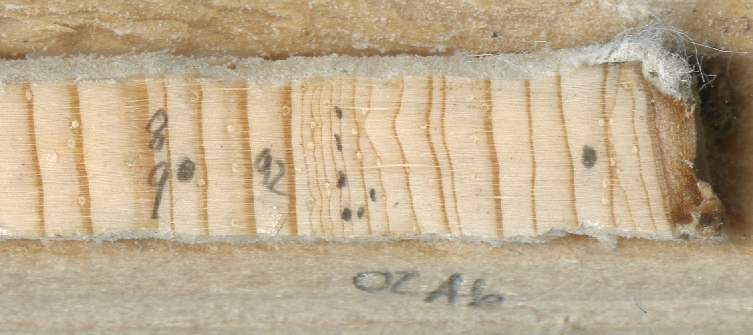
Growth suppression following crown damage from fire

Slide 38
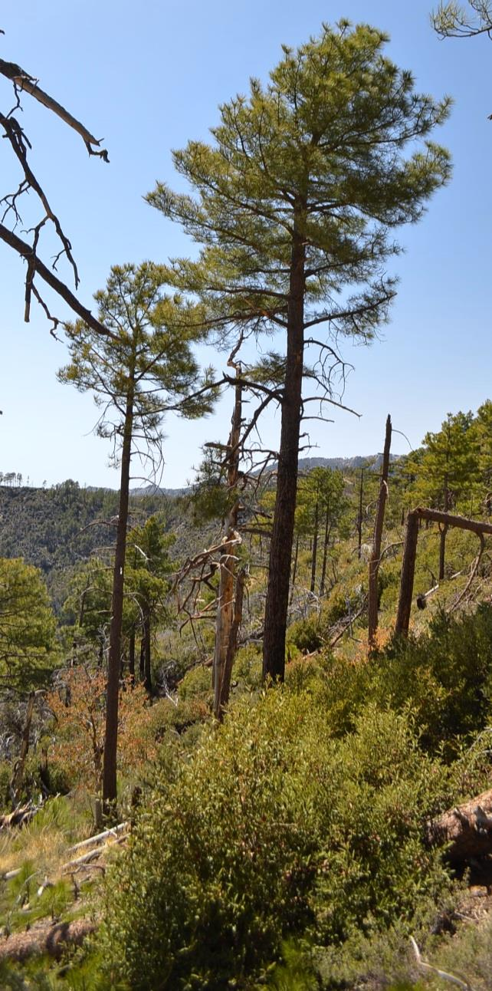
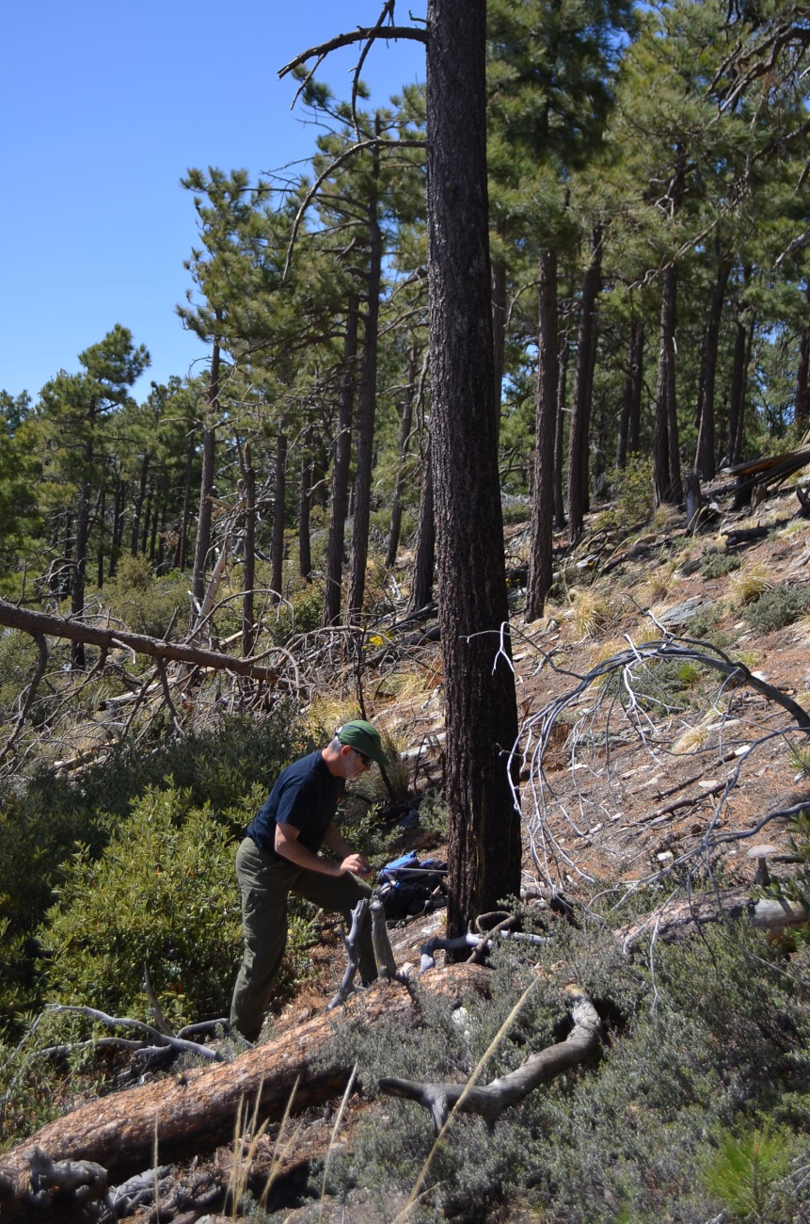
Tree-ring response to crown damage from fire

