Slide 1
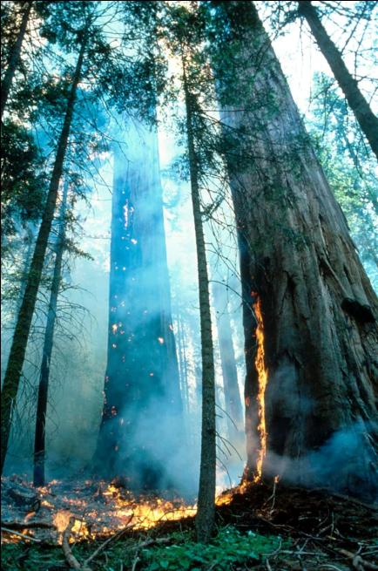
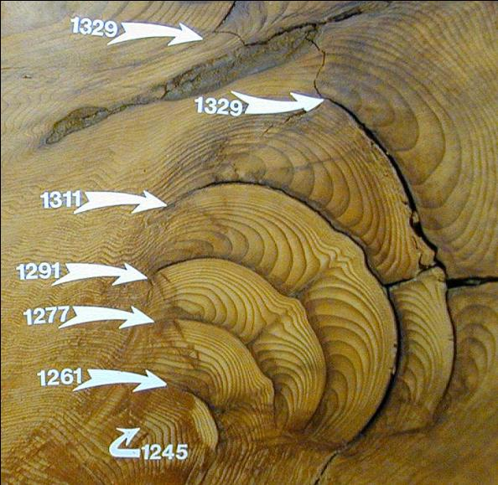
Fire History From Tree Rings

Slide 2
OUTLINE
Define terms: e.g., fire regime, fire severity
Relevance – societal implications and scientific research questions
How? Tree-ring fire history methods
Fire history networks
Fire + climate

Slide 3
Terms
Fire Regime: combination of fire frequency, intensity, seasonality, and extent characteristic of fire in an ecosystem (Agee 1993; p. 417)
Fire intensity: units of energy released by flaming front
vs.
Fire severity: the effects of fire on an ecosystem
Low Severity Fire Regime: the typical fire results in low mortality of overstory trees.
High Severity Fire Regime: the typical fire results in stand-mortality or stand-replacement, often characterized by, but not limited to high intensity, high severity crown fire.
Mixed Severity Fire Regime: a complex combination of low and high severity fire in space and time.

Slide 4
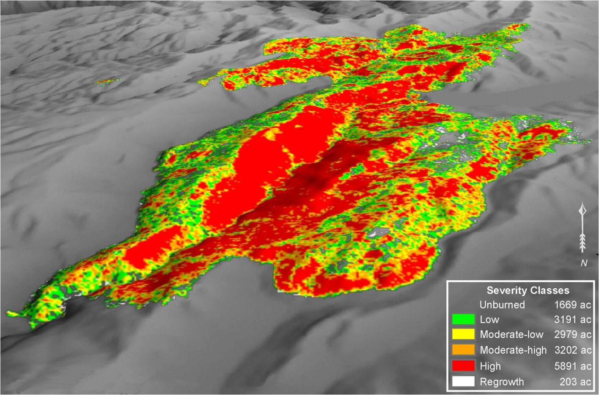
Burn severity map of a single fire
Notes:
Of course, anything containing the word ecology is complex and fire as an ecosystem process is no different – much complexity in a single fire event, but with multiple fires patterns emerge

Slide 5
Why reconstruct fire history?
Contemporary fires have severe, direct impacts on society.
  Life and property loss
  Ecosystem service loss (e.g., surface water)
Contemporary fires in a historical context
Many important fire-related applied and theoretical ecological research questions.

Slide 6
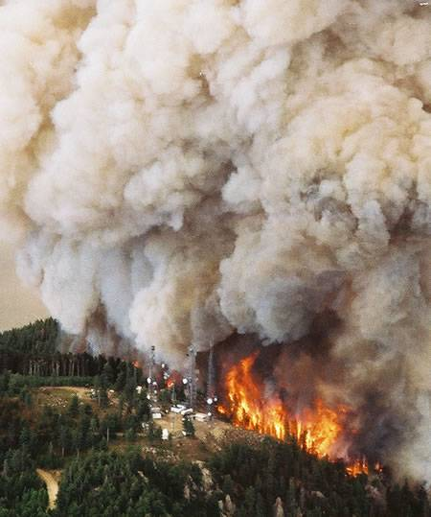
Stand-replacing fire in spruce-fir
Pinaleño Mtns - Southern Arizona
Photo credit: Dan Eckstein
Notes:
People like to build expensive things in places that burn

Slide 7
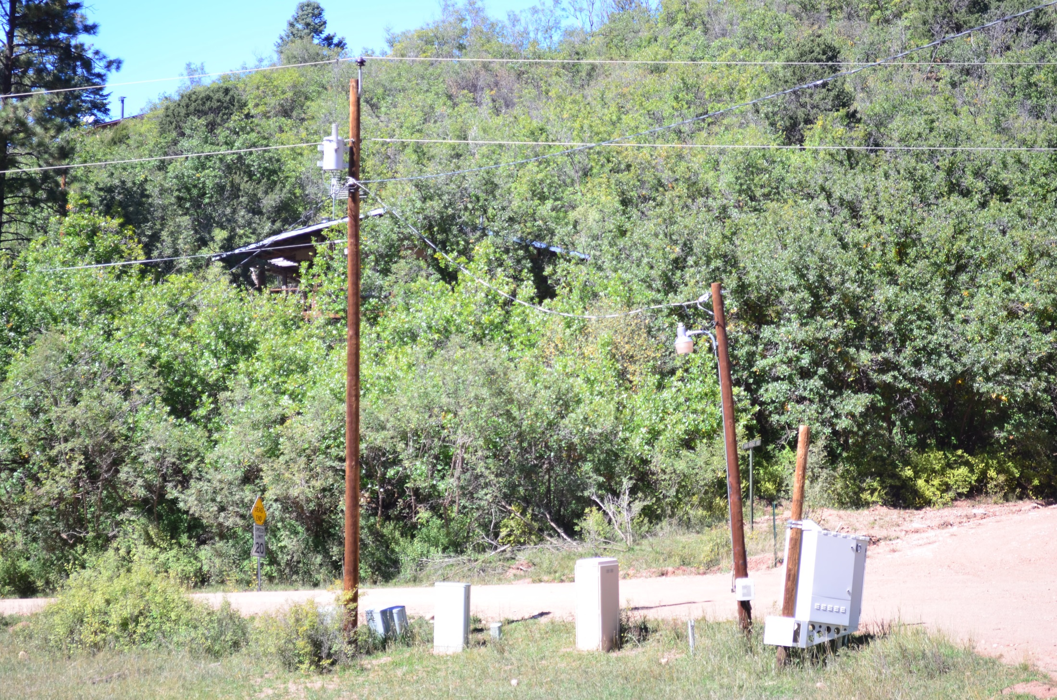
Increased Wildland Urban Interface
Notes:
More people living in the woods (literally). We also like to live where it burns.

Slide 8
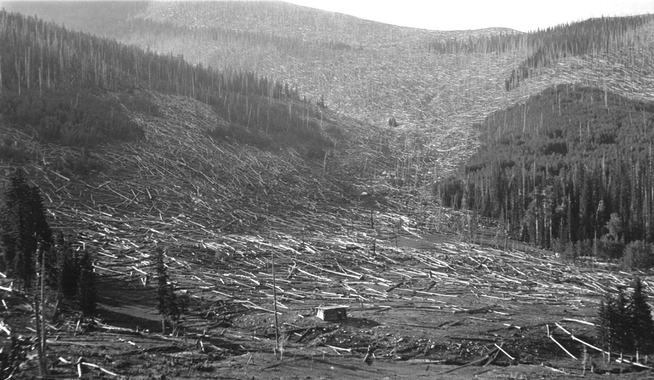
Denuded watershed after crown fire: Santa Fe Ski Basin
Photo courtesy of Craig Allen

Slide 9
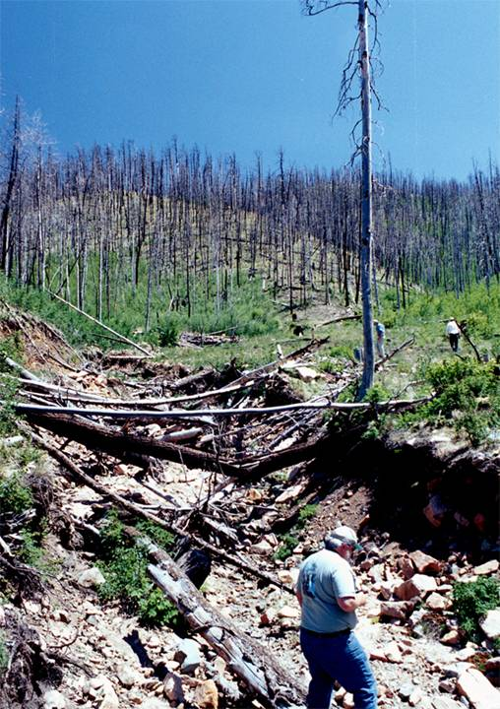
Post-fire hydrology
Flooding and debris flows: Missionary Ridge & Viveash Fires
2 orders of magnitude increase in peak runoff: Cerro Grande & Las Conchas Fires

Slide 10
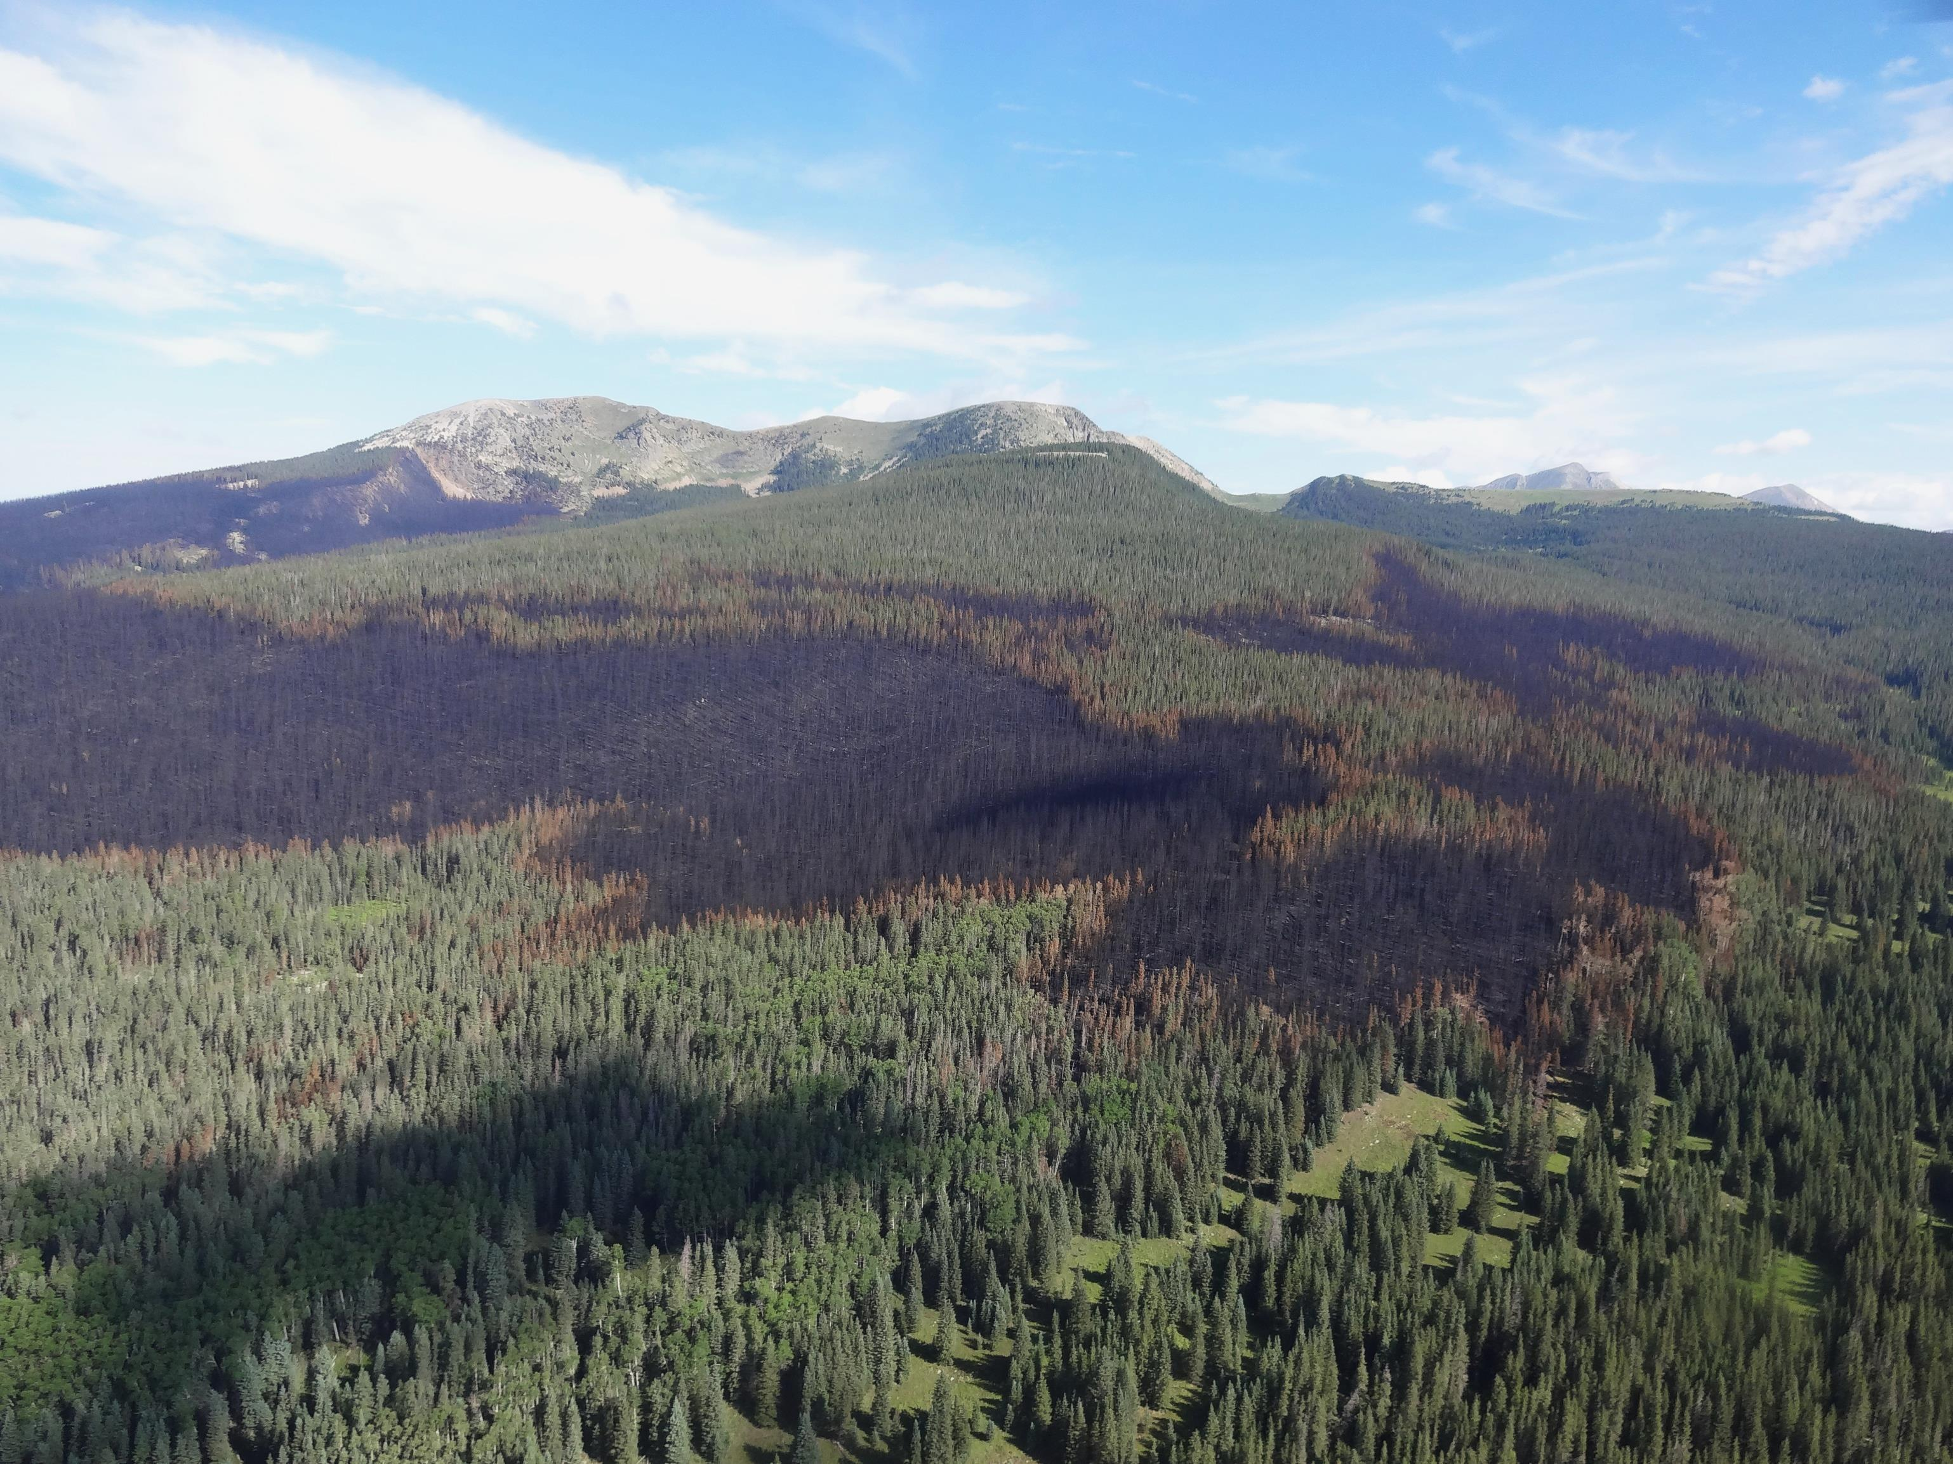
Recent fires in a historical context
Notes:
Has this happened in the past – can we expect it to happen in the future?
Tree-ring evidence suggest that this high severity fire is likely within the natural range of variability. Sangre de Cristo Mtns, NM 2012? fire

Slide 11
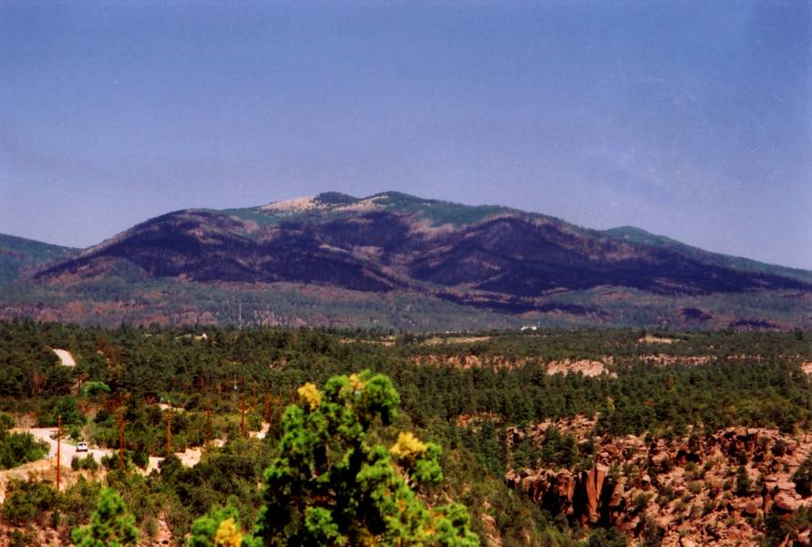
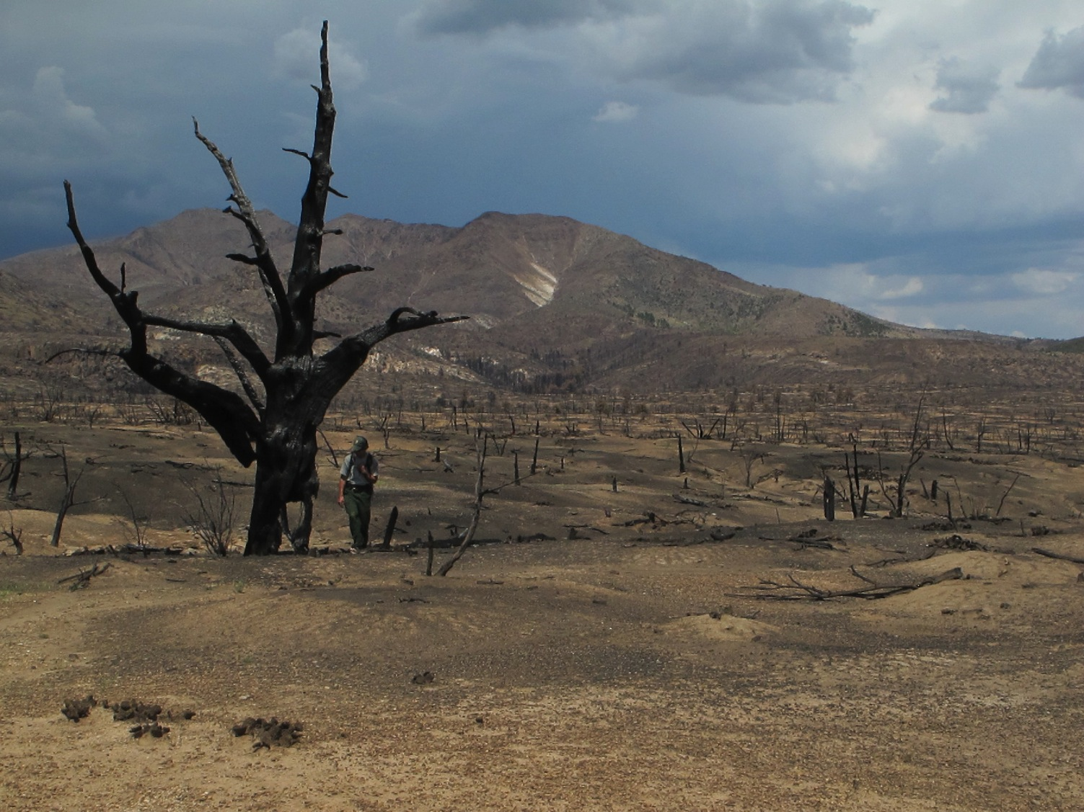
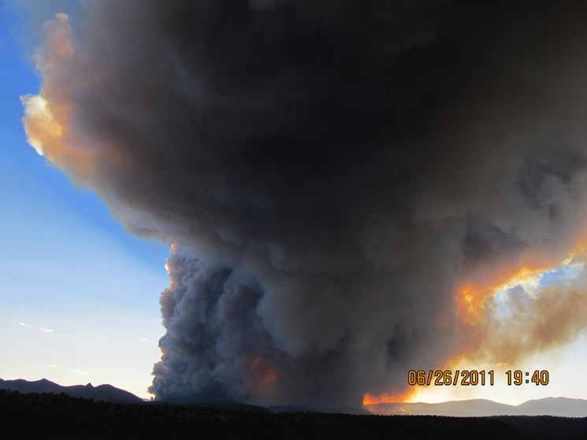
Are recent large crown fire patches within the historic range of variability?
Cerro Grande Fire, Los Alamos, NM 2000
Photo courtesy Craig Allen
Notes:
Did recent events occur regularly in the past, or were they outliers, or no-analog cases?

Slide 12
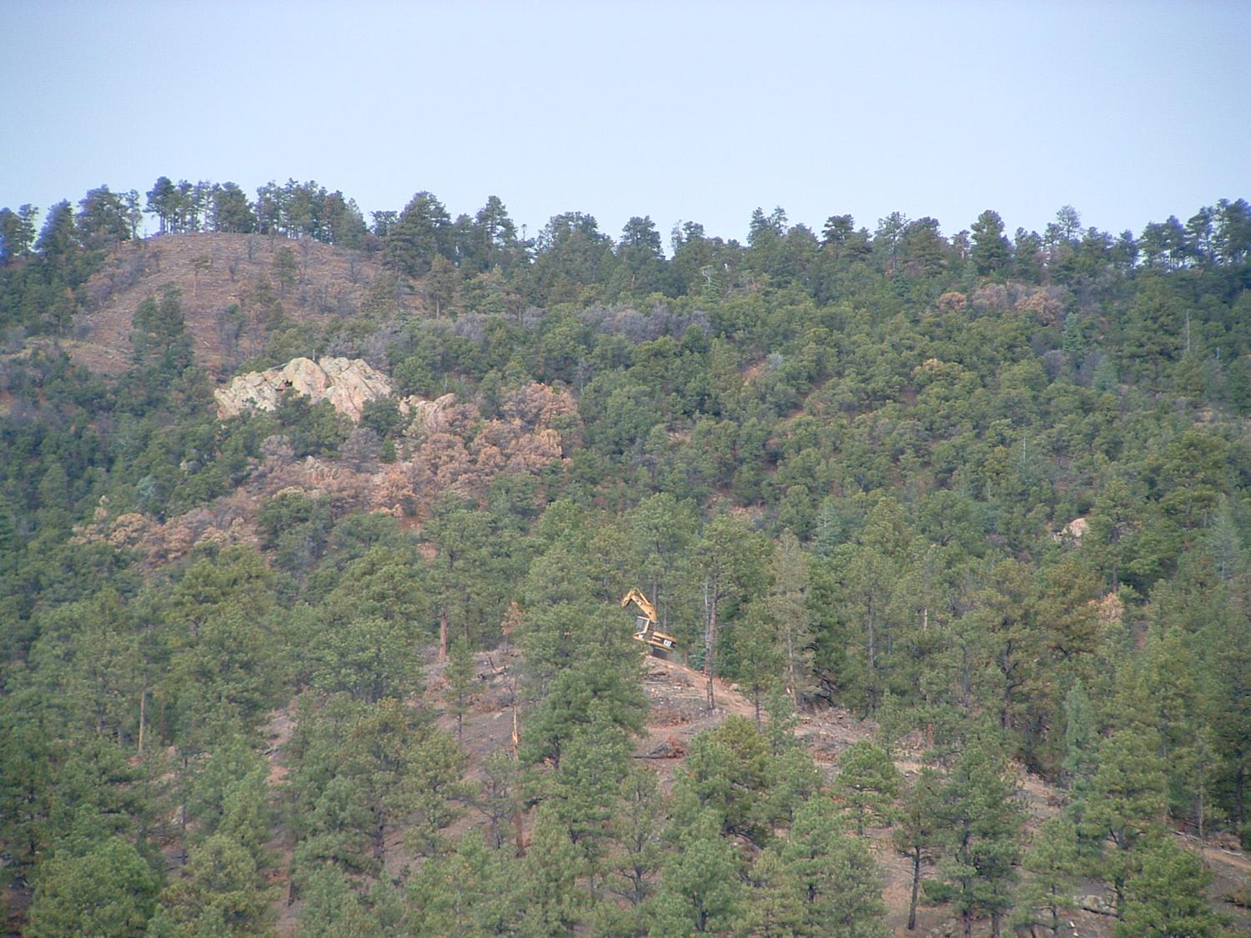
Is forest restoration (e.g., thinning and burning) ecologically justified, and if so, where, how often, and at what scales?

Slide 13
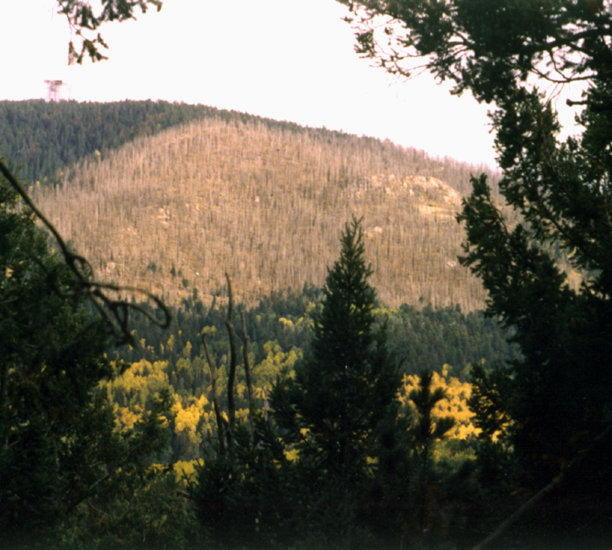
Will disturbance catalyze the shift (and loss) of upper elevation forests with climate change?

Slide 14
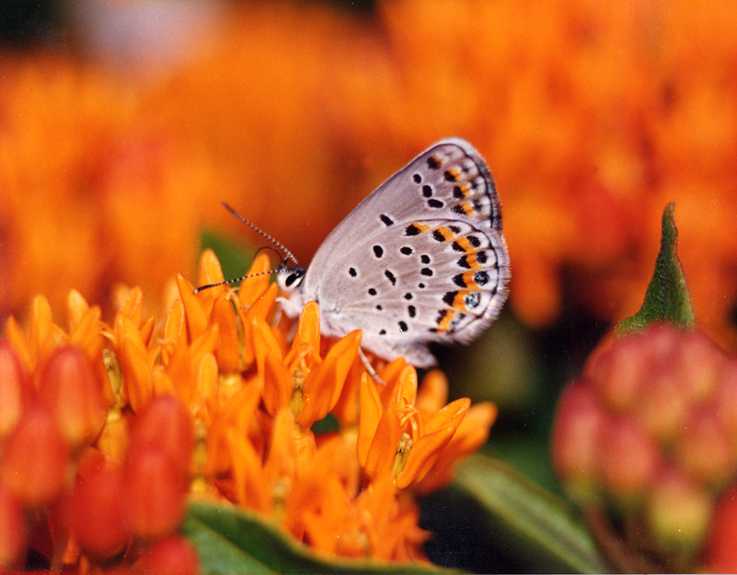
What type of fire regime did endangered species evolve with?

Slide 15
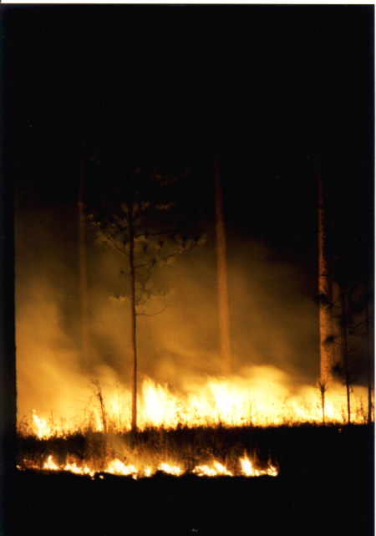
Do fire-climate relationships exist and can they be used to forecast future fire regimes?
Notes:
Collected four lines of tree-ring evidence at each site -

Slide 16
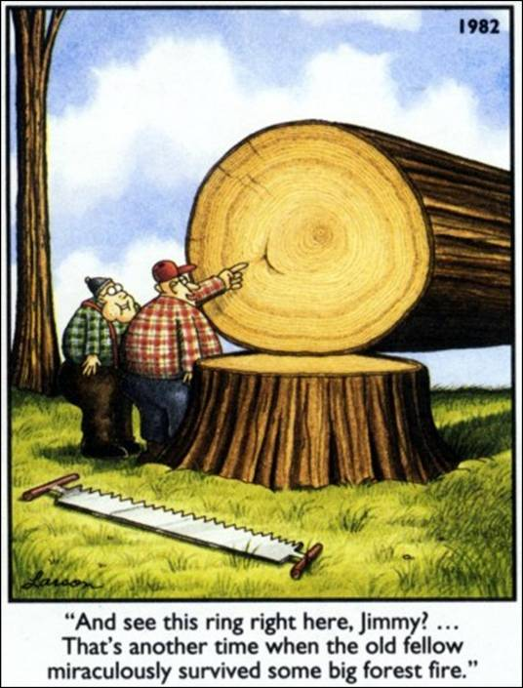
Fire Scar!

Slide 17
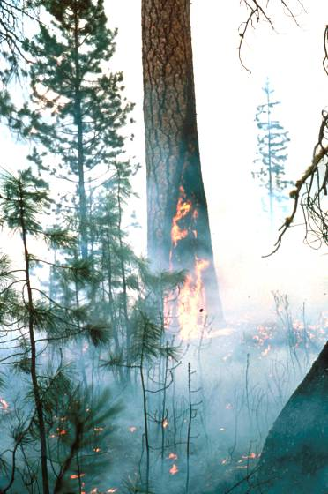
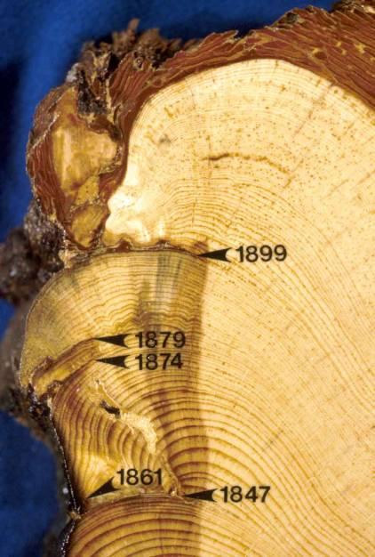
Fire-scarred trees can be reliable recorders of low to moderate intensity fires, and in some circumstances high intensity fires as well.

Slide 18
Caprio & Swetnam 1995

Slide 19
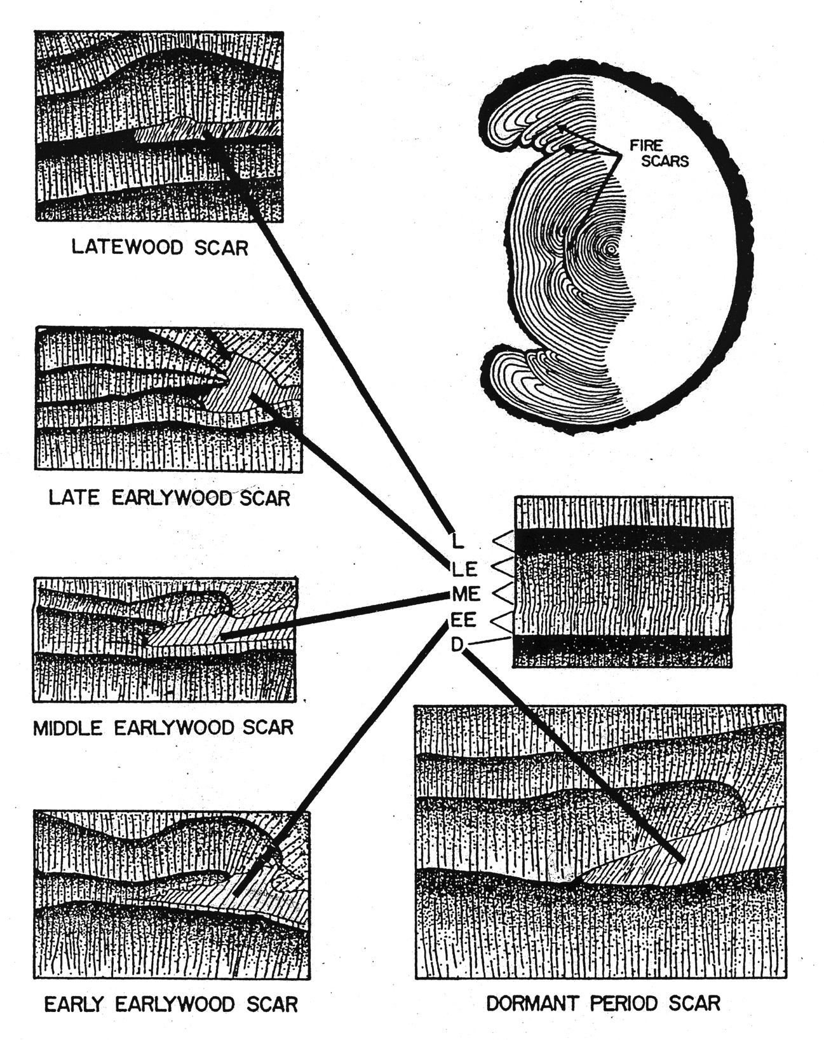

Slide 20
Dieterich & Swetnam 1982

Slide 21
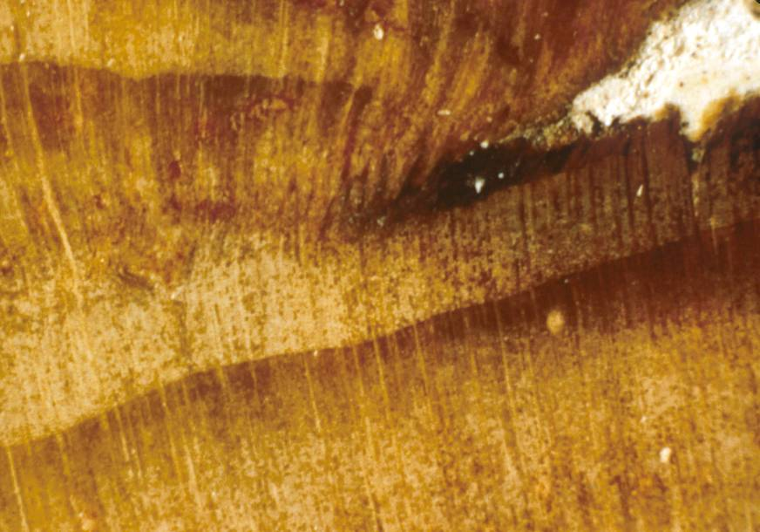
L
LE
ME
EE
D
Notes:
Find that most scars occurred in D, EE, ME – prior to monsoon (before July). Modern area burned by lightning fires peaks in June – similar to fire scar record. Interestingly, most ignitions actually occur in July. Why?

Slide 22
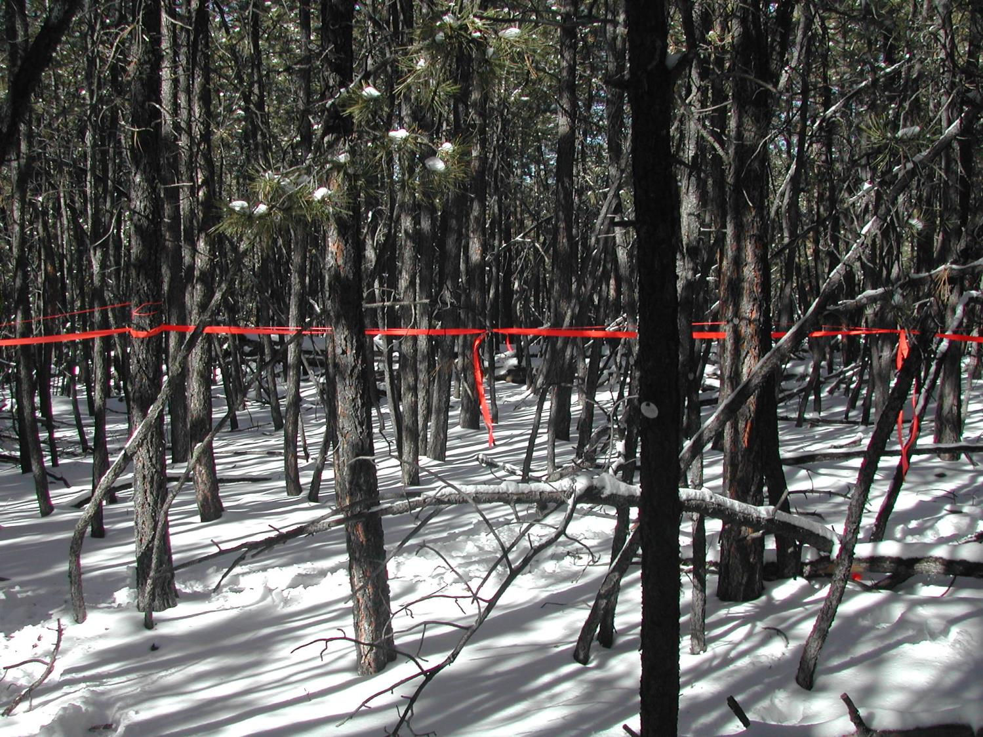
Was this forest always this dense?
Ponderosa Pine

Slide 23
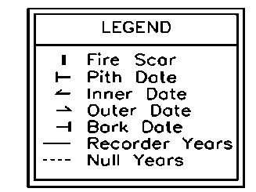
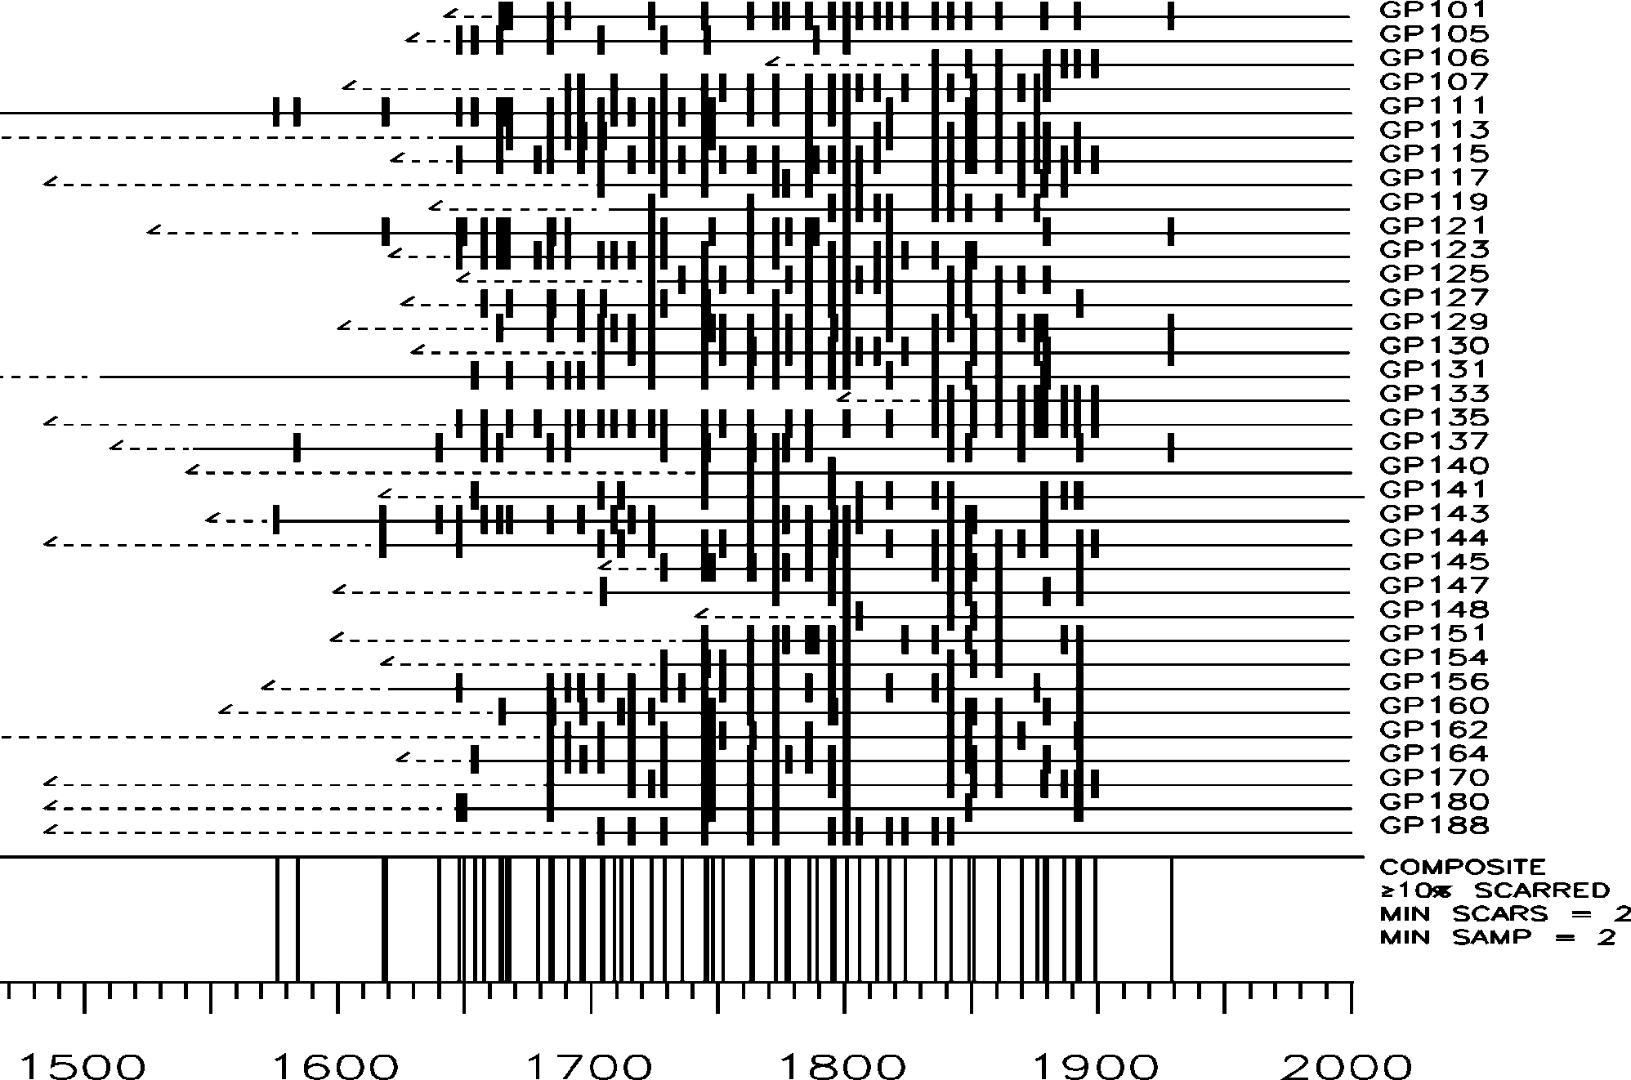
Monument Canyon Research Natural Area, Fire Scar Fire History (Don Falk)

Slide 24
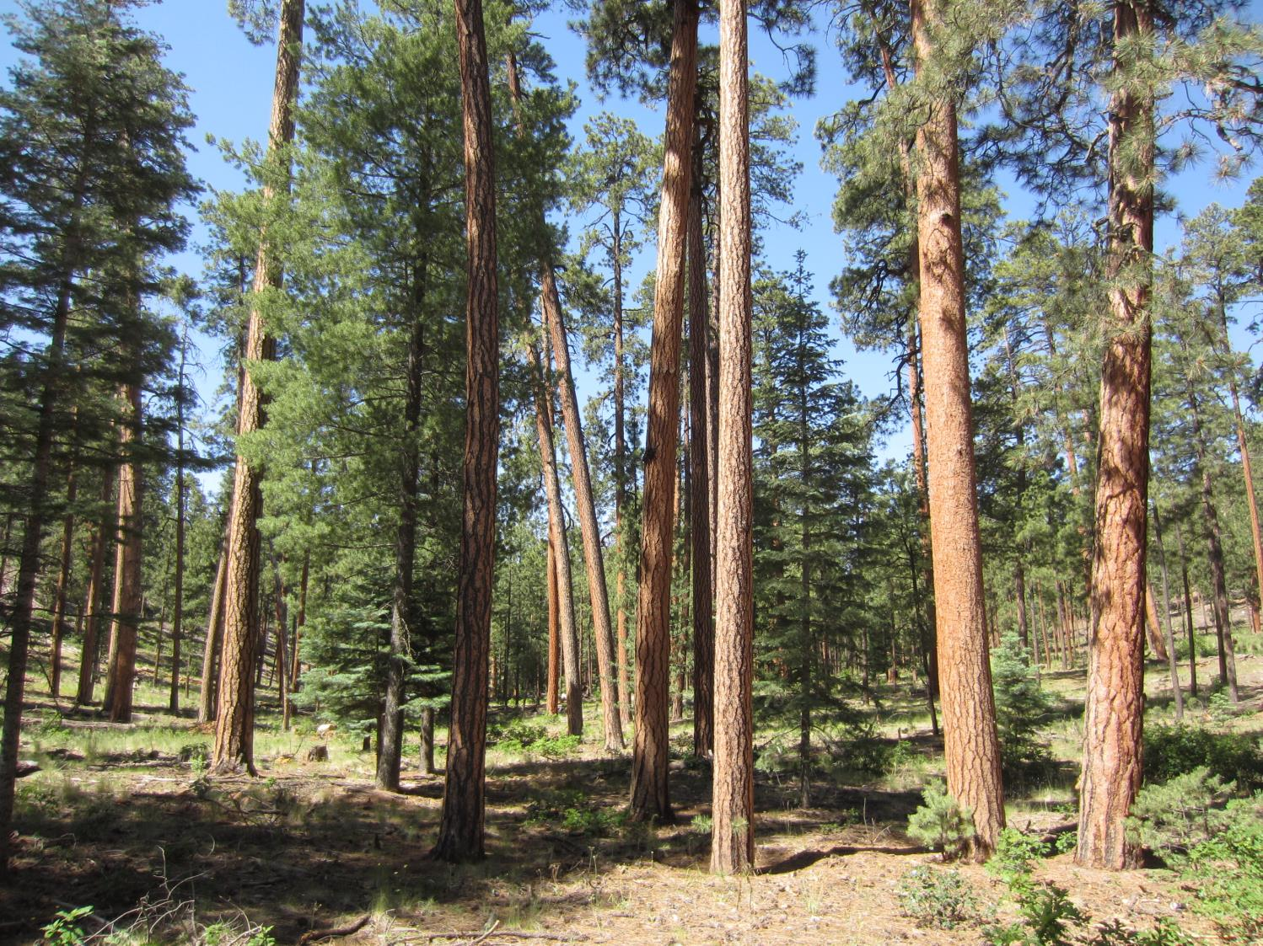
Ponderosa Pine
Fire Severity: Low
Fire Frequency: High

Slide 25
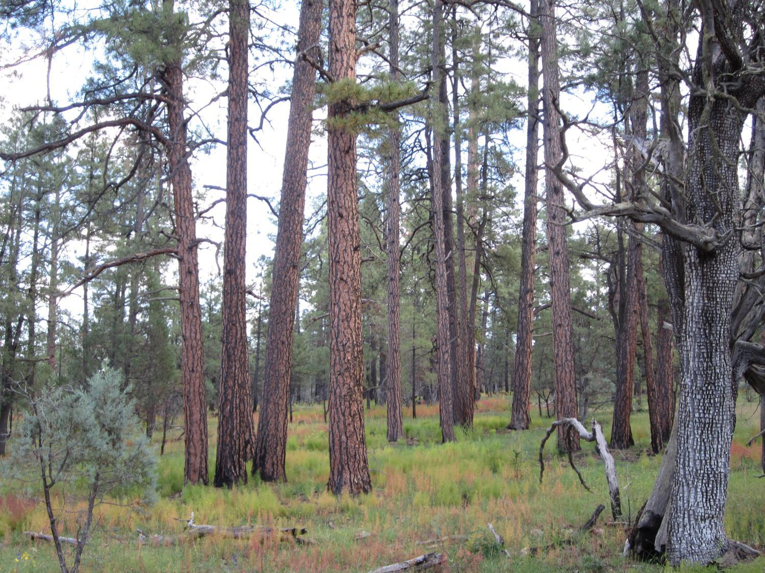
Fire “thinned” the small trees
and kept the forest open
Notes:
This site has burned multiple times in 20th century – Gila

Slide 26
After fires stopped the density of dry conifer forests increased dramatically across the West

Slide 27
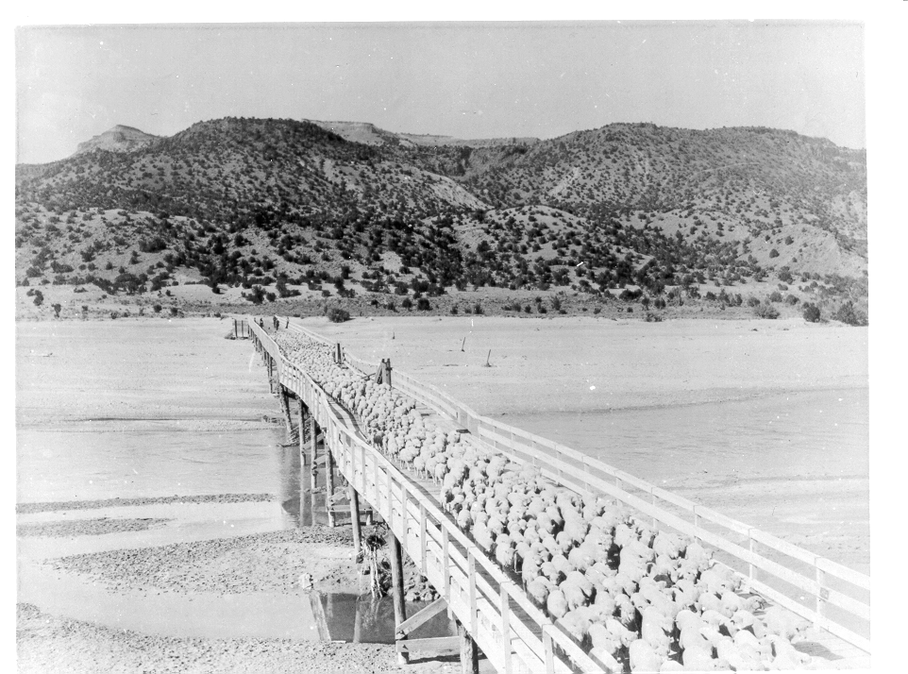
Very clearly, the first reason for reduction of widespread surface fires was the introduction very large numbers of sheep, cows and horses.
RAILROADS led to > 5 million sheep and 1.5 million cattle in New Mexico by 1890
Notes:
Why did fires stop?

Slide 28
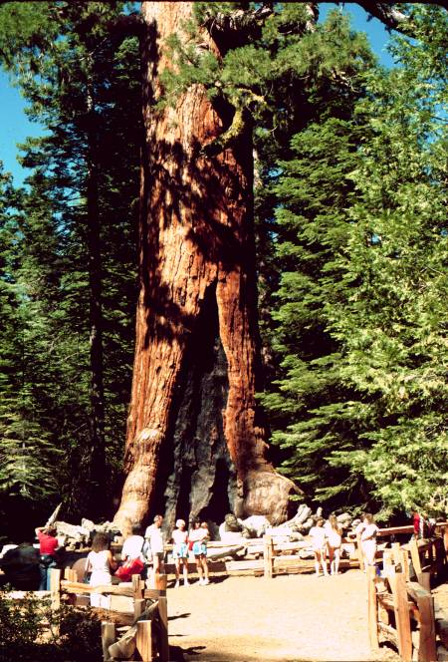
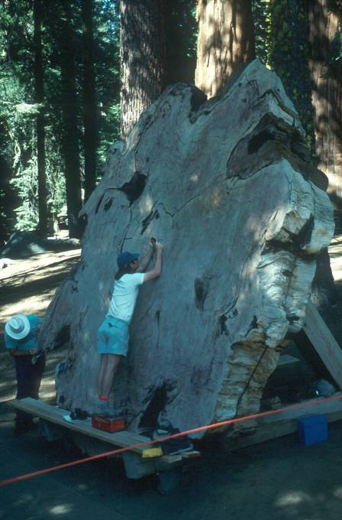
Fire-scar samples from five giant sequoia groves provide fire history evidence extending back 1500 to 3000 years.

Slide 29
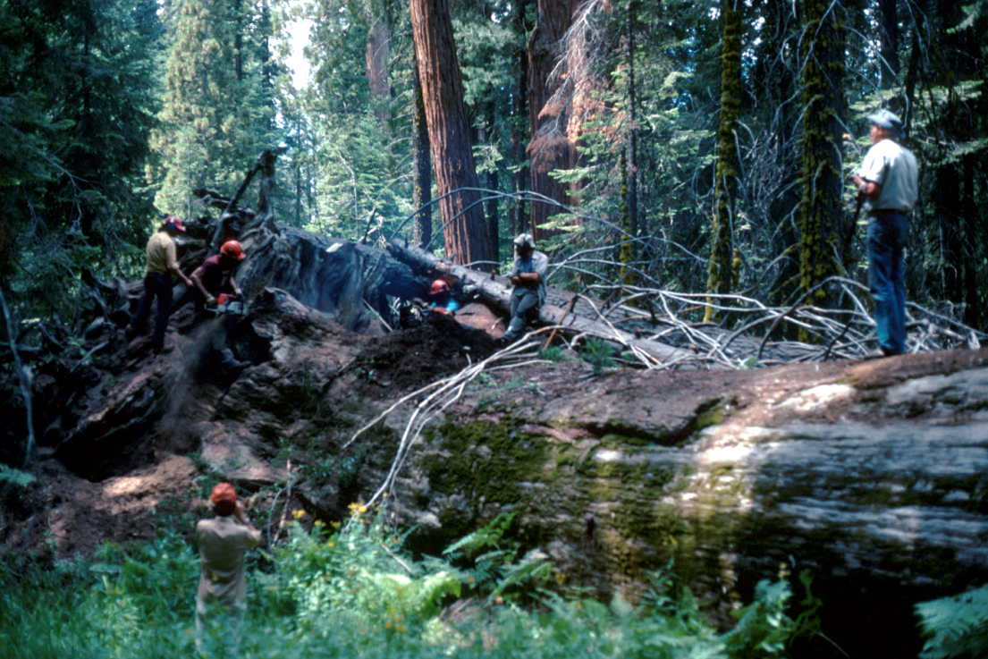
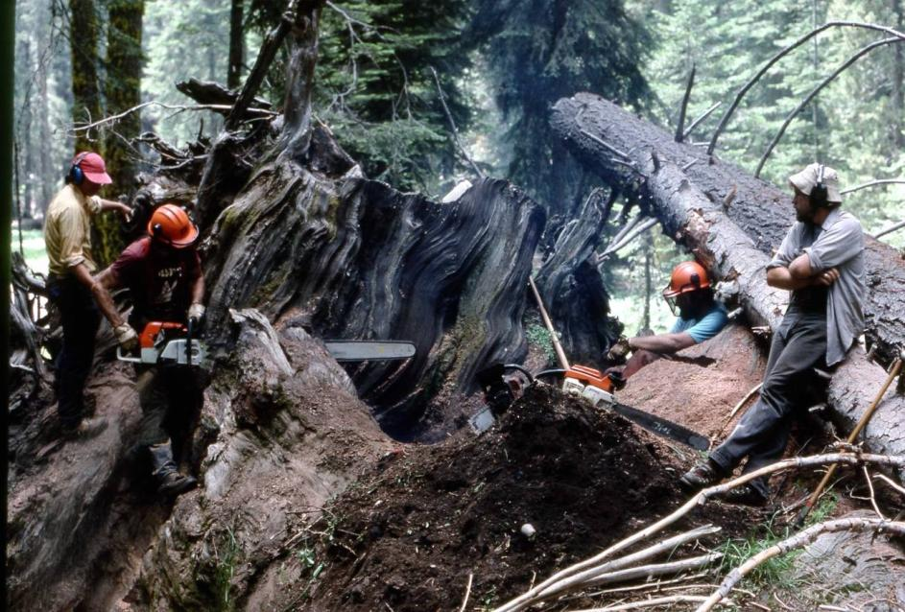
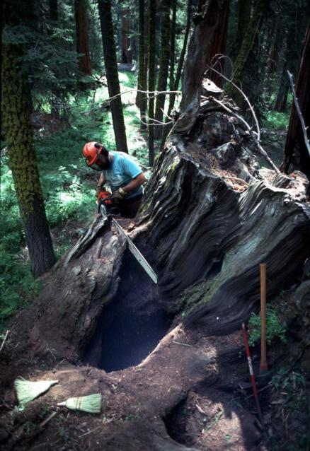
Photo by J. Dieterich
Photo by T. Caprio

Slide 30
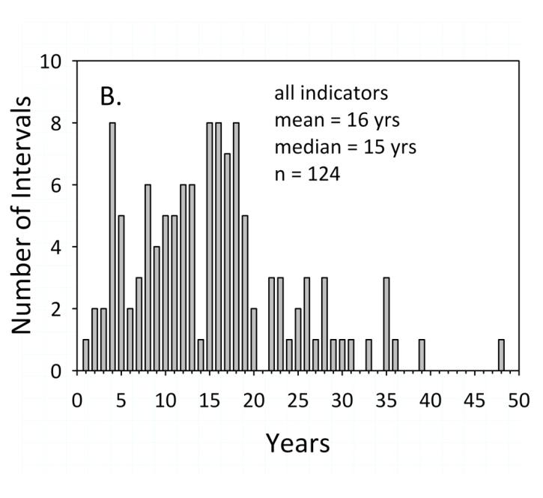
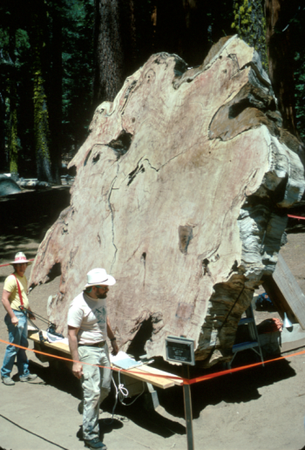
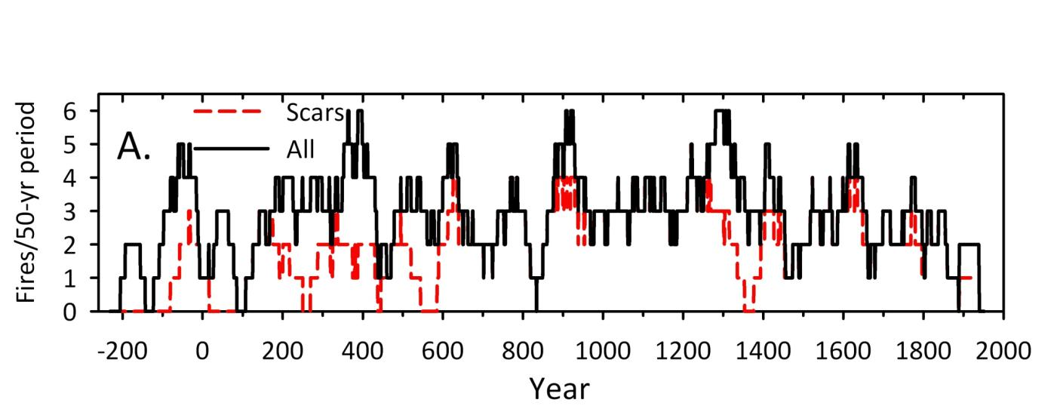
The most complete fire history from a single tree (GVF1), resulted in 125 fire dates over the period 259 BCE to 1951 CE.
Swetnam, T.W., C. H. Baisan, A. C. Caprio, P. M. Brown, R. S. Anderson, and D. W. Hallett. 2009. Multi-millennia fire history of the Giant Forest, Sequoia National Park, USA. Fire Ecology 5(3):117-147.

Slide 31
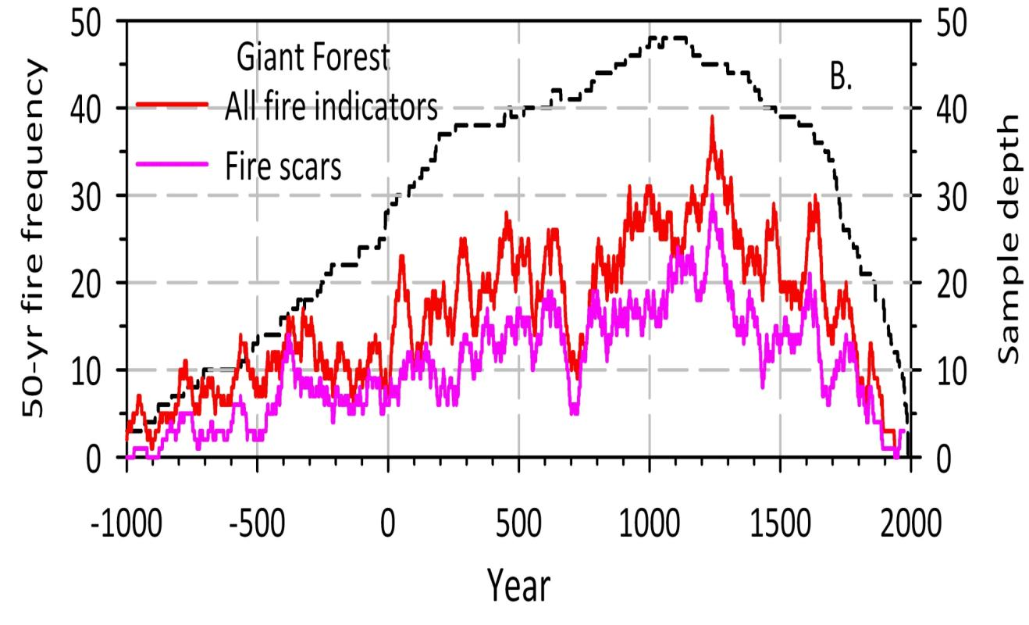
Fire frequencies were generally quite high throughout the past 3,000 years, with a maximum of about 3 to 5 fires per decade during the period circa 900 to 1300 CE.
Swetnam et al. 2009, Fire Ecology

Slide 32
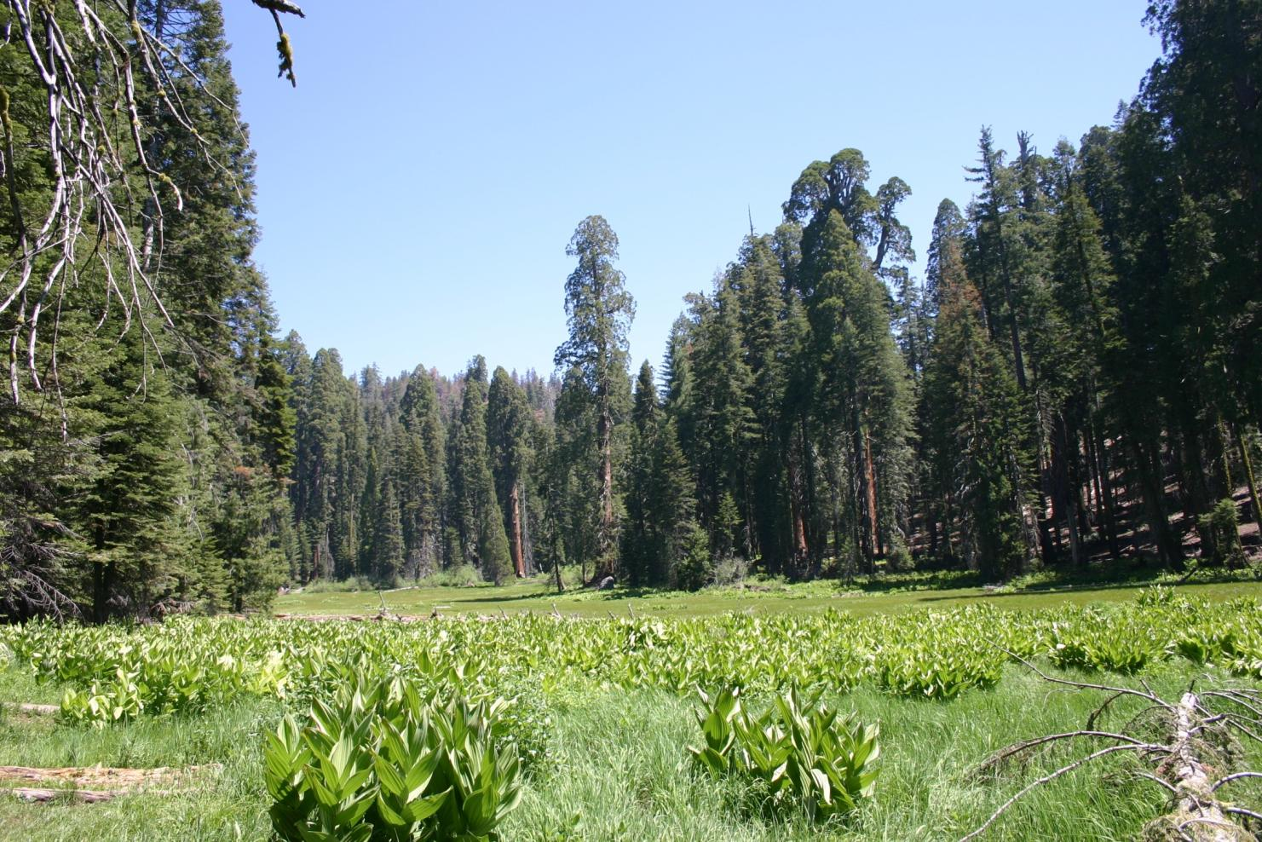

Slide 33
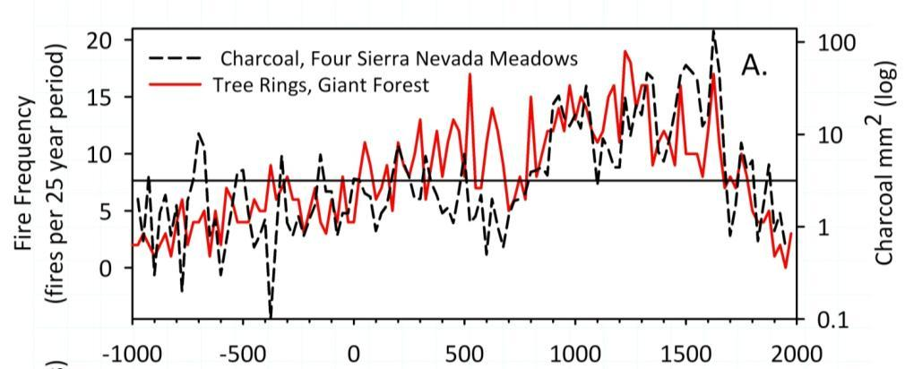
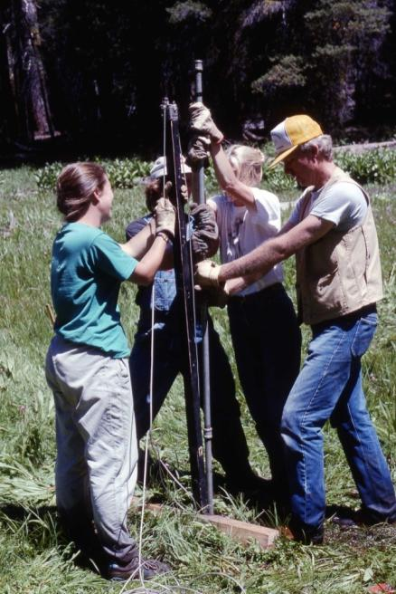
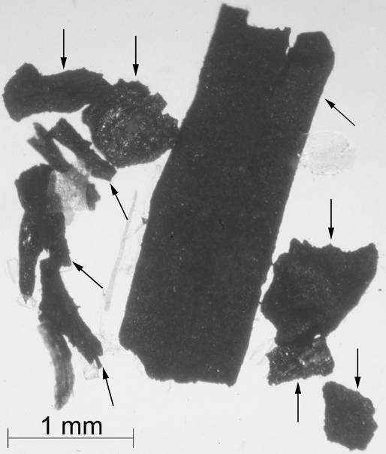
Comparison of giant sequoia fire scar history with regional sedimentary charcoal history from the same groves shows considerable correspondence.
charcoal
fire scars
r = 0.55, p <0.001
Scott Anderson & assistants.
Year
Swetnam et al. 2009, Fire Ecology

Slide 34
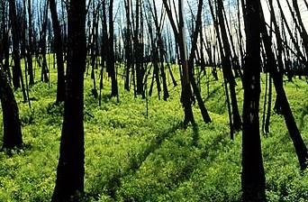
Five years after 1988 Yellowstone Fires
Clements 1910
Courtesy of Kurt Kipfmueller

Slide 35
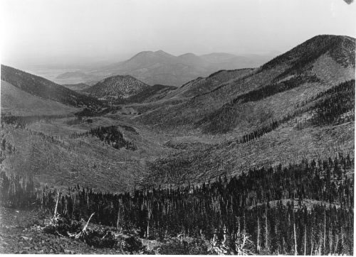
San Francisco Peaks, AZ 1900. Courtesy of USFS

Slide 36
How can we reconstruct high-severity fire?
Multiple lines of tree-ring evidence
    Tree age
    Death dates
    Fire survivor growth changes/traumatic resin ducts
    Fire scars (rare in these ecosystems)
Margolis et al. 2007, CJFR

Slide 37
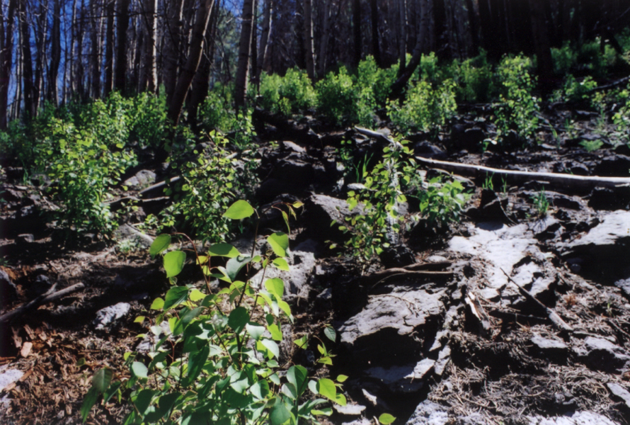
Quaking aspen - Post-fire
sprouts (suckers)
Notes:
Grow > 1 m tall in first year post-fire (reduce age-to-core height issue) and most suckers come in within 1 – 3 years post-fire

Slide 38
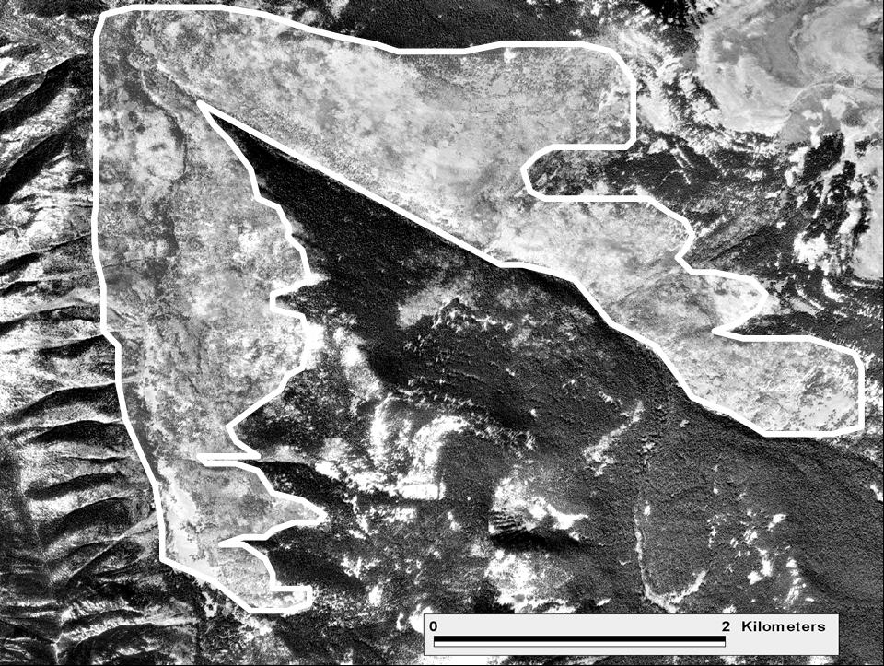
(Aspen) crown fire patch

Slide 39
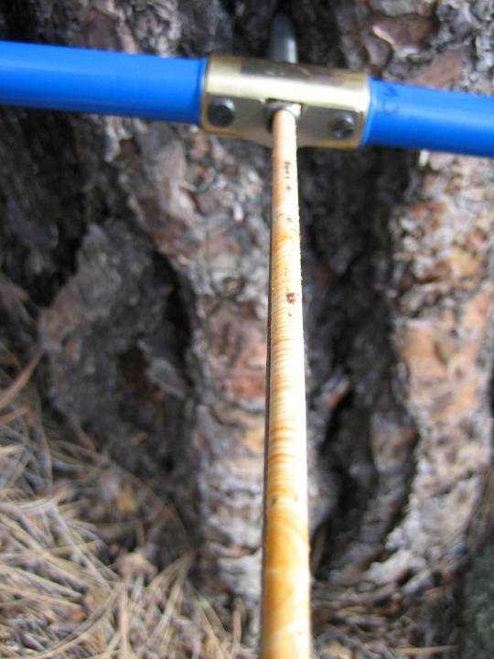
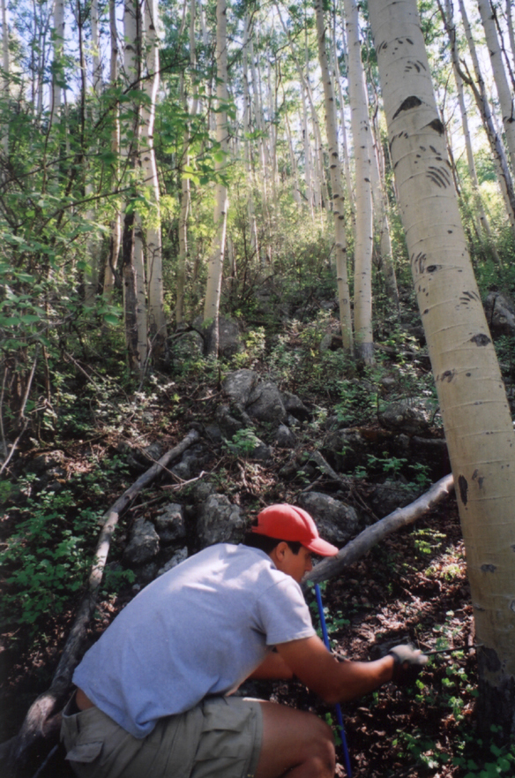
Increment cores from aspen to determine tree age
Tree age
Notes:
Because aspen resprouts post-fire, pulses of aspen dates likely indicate fire dates

Slide 40
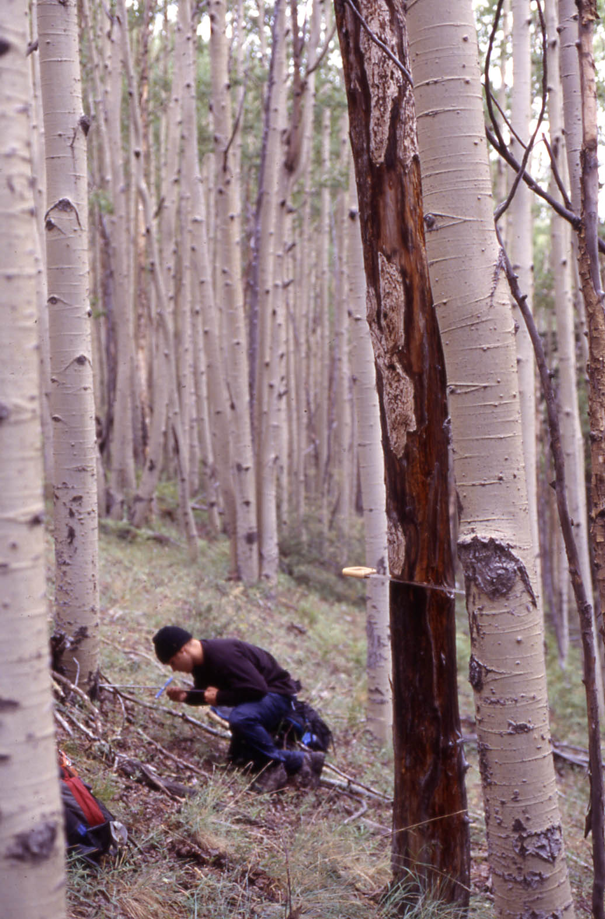
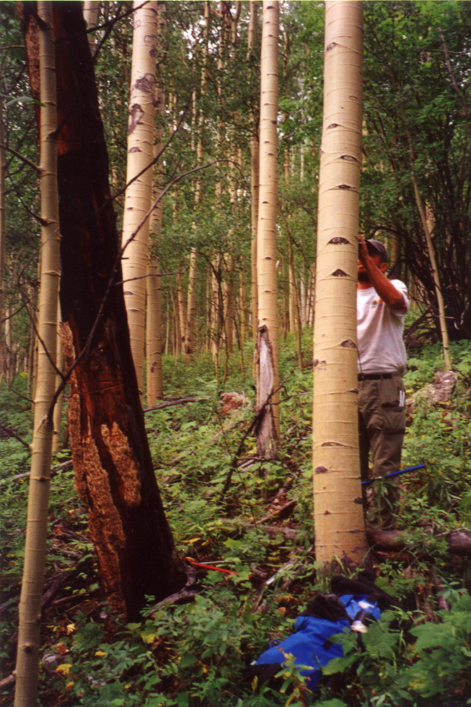
Fire-killed tree death dates

Slide 41
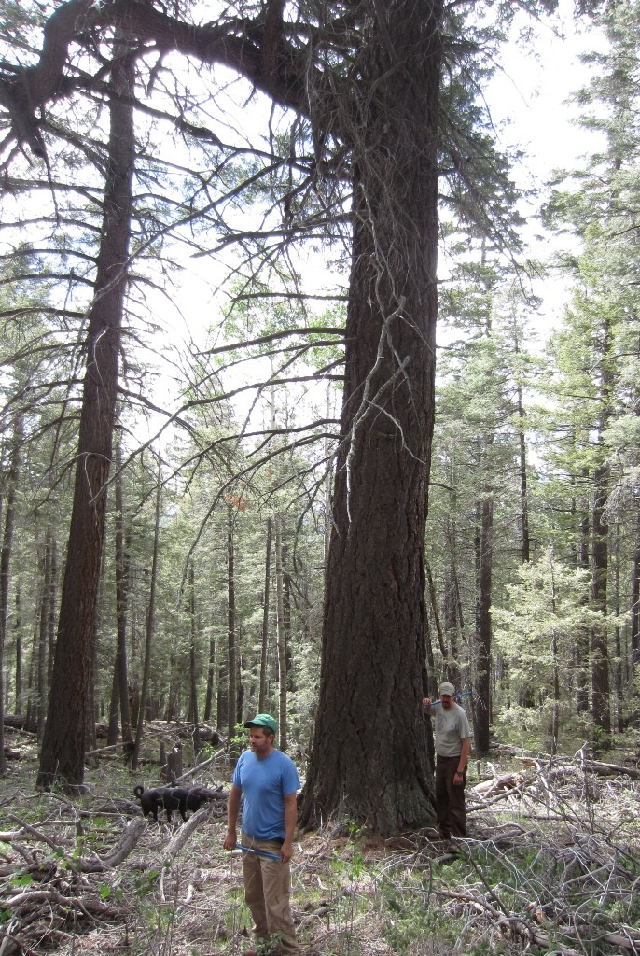
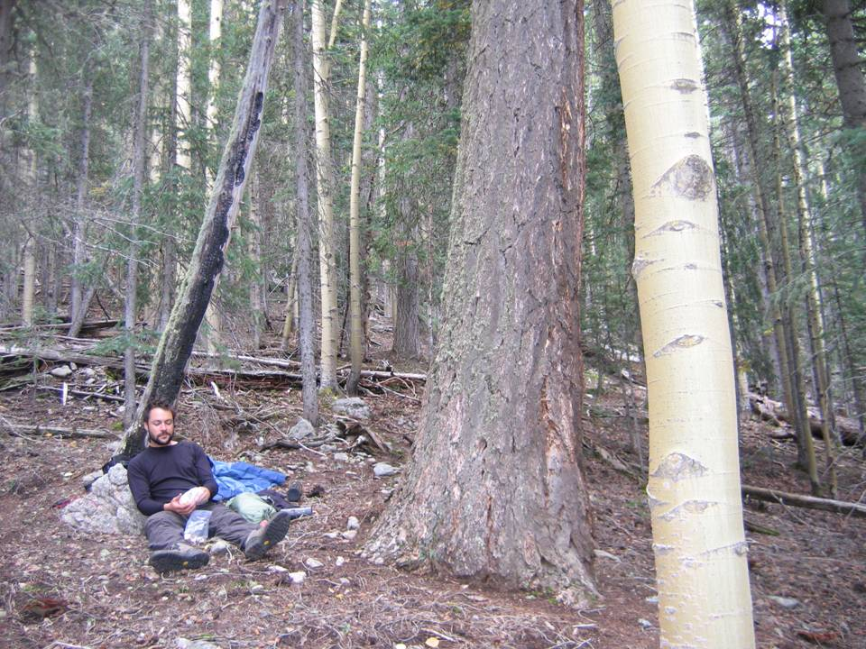
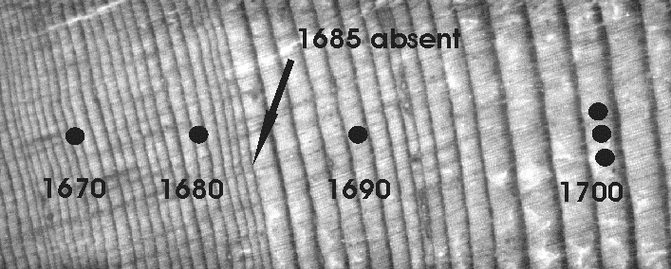
Injured fire-survivors

Slide 42


Fire scars
(rare in high elevation forests – maybe present at burn edges)
Fire scars

Slide 43


San Francisco Peaks, Arizona

Slide 44

Heyerdahl et al. 2012 CJFR

Slide 45
Notes:
Tree-ring evidence suggest that this high severity fire is likely within the natural range of variability. Sangre de Cristo Mtns, NM 2012? fire

Slide 46


Slide 47
Fire History Networks
Following strategies of dendroclimatology, fire-scar based fire history networks are now being compiled at regional to continental scales
Fire scar networks enable us to evaluate broadscale, long-term fire-climate patterns and trends
A general strategy is to use independent dendroclimatic reconstructions (e.g., precipitation, PDSI, ENSO, etc.) to compare/test against the fire history time series

Slide 48
Scales of disturbance history analysis and types of factors involved in synchrony/asynchrony
Climate, broad-scale human land uses
Topographic and elevation effects on fire spread
Fine-scale vegetation, fuels, wind, micro-climate
Very fine-scale, localized patterns determining first and subsequent scarring
Regional
Watershed/Landscape
Stand
Tree
Swetnam, T. W. and C. H. Baisan. 1996. USDA Forest Service General Technical Report RM-GTR-286.

Slide 49



INTERNATIONAL MULTIPROXY
PALEOFIRE DATABASE (IMPD)
http://www.ncdc.noaa.gov/paleo/impd/paleofire.html; map from Heyerdahl, Falk et al. in prep.
Notes:
Plug the IMPD as the main way we know a lot of these things – contribute your data

Slide 50

Western North America Fire History Network

Slide 51

The fire-scar chronology network in southwestern North America currently includes about 120 sites.
Most sites 10-100 ha, some >1000 ha. Typical sample sizes ≈ 10-50 fire scarred trees, hundreds in a few cases.
The SW fire history network represents the collective effort of many people and institutions over more than 3 decades.
Notes:
Could draw ellipses around the sub-regions

Slide 52

Regional composite fire scar chronology from 31 sites in the Madrean Archipelago. The vertical tick marks are fire events recorded by 25% or more of sampled trees within each site.

Slide 53
Synchrony is evident both in timing of fire events, and lack of events in multiple sites.
Swetnam, T.W. and P. M. Brown. 2011. Climatic inferences from dendroecological reconstructions. Chapter 9, In: Hughes, M.K., T.W. Swetnam, and H.F. Diaz, editors, Dendroclimatology: Progress and Prospects, Springer, New York.

Slide 54


Drought sensitive tree-ring width chronologies are calibrated with instrumental-based records of Summer Palmer Drought Severity Index, and interpolated to an evenly spaced grid network.
Cook, E.R., C.A. Woodhouse, C.M. Eakin, D.M. Meko, D.W. Stahle. Science 306:1015-1018. Nov. 5 2004

Slide 55
Regional large and small fire years in the Southwest are strongly linked to wet and dry conditions.
Swetnam, T.W., and J. L. Betancourt. 1998. Mesoscale disturbance and ecological response to decadal climatic variability in the American Southwest. Journal of Climate 11:3128-3147.

Slide 56

Prior years wet conditions appears to be largely a factor in lower elevation pine-dominant forests where grass fuels are limiting to fire ignition and spread.
Large Fire Events, SW US, 1700-1900)
Swetnam and Betancourt. 1998. J. Climate.

Slide 57

Inter-annual to decadally persistent and repetitive features of the ocean-atmosphere explain substantial spatial and temporal variation in climate AND fire.

Slide 58




Ocean-Atmosphere Oscillations
Atlantic Multidecadal Oscillation
El Niño
La Niña
Pacific Decadal Oscillation
PDO +
PDO -

Slide 59


Correlations of the PC amplitude series with the gridded Cook et al. PDSI network in western North America shows a strong NW-SW dipole pattern. This is consistent with a known dipole pattern of precipitation and ENSO teleconnections across these regions (e.g., Dettinger et al. 1998, J. Climate).
PC1 - PDSI
Kitzberger, T., P. M. Brown, E. K. Heyerdahl, T.W. Swetnam, and T. T. Veblen. 2007. Contingent Pacific-Atlantic ocean influence on multi-century wildfire synchrony over western North America. Proceedings of the National Academy of Sciences 104(2):543-548.
PC2 - PDSI

Slide 60

It appears that the first PC is moderately associated with ENSO, and the 2nd PC is weakly associated with PDO.
ENSO/Fire: r = -0.48, P < 0.0001
PDO/Fire: r = 0.17, P < 0.05
Kitzberger et al. 2007, PNAS

Slide 61

Fire‐climate interactions in the American West since 1400 CE.
Valerie Trouet, Alan H. Taylor, Eugene R. Wahl, Carl N. Skinner, and Scott L. Stephens
GEOPHYSICAL RESEARCH LETTERS, VOL. 37, L04702, doi:10.1029/2009GL041695, 2010

Slide 62

Trouet et al. GRL, 2010

Slide 63


