Slide 3
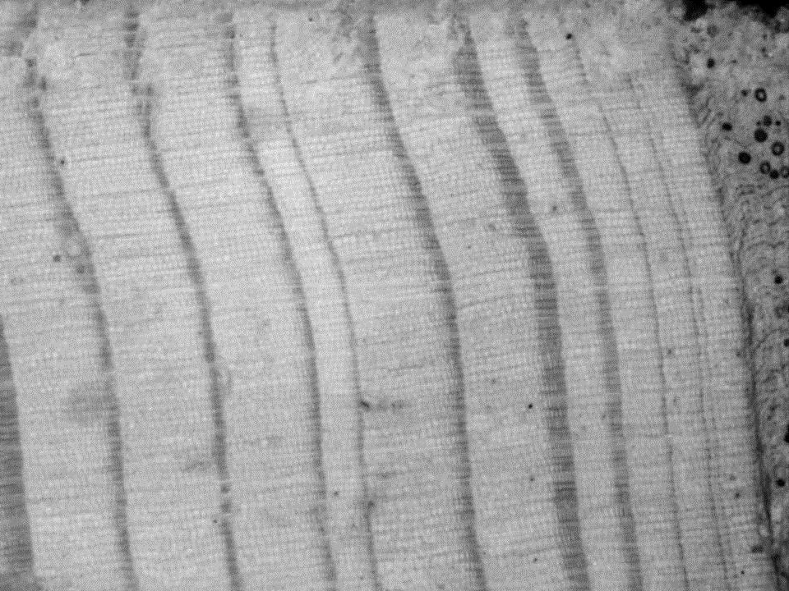
Mounting cores
9/30/14

Slide 4
It’s easy. But it’s also easy to screw up!

Slide 5
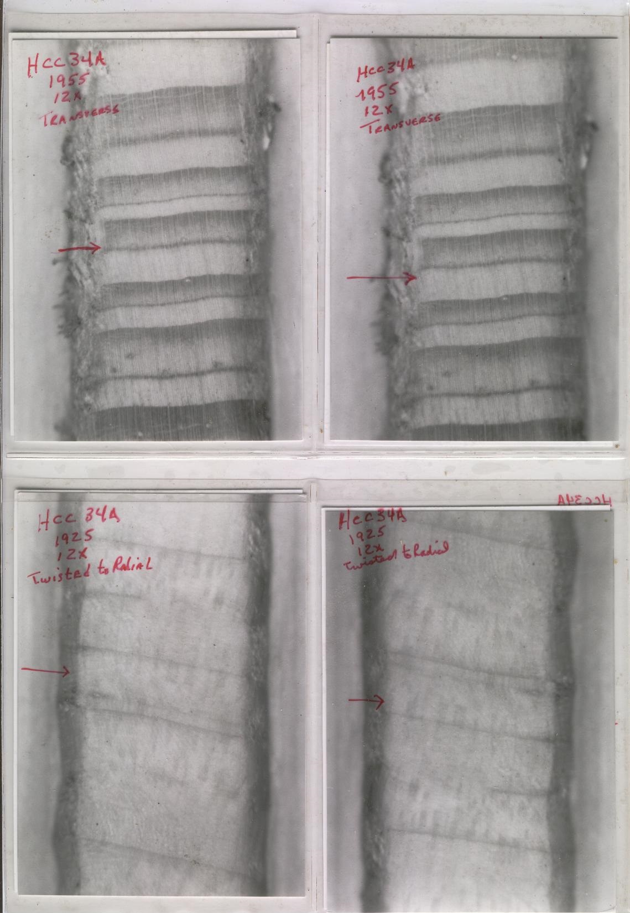
Right
Wrong

Slide 6
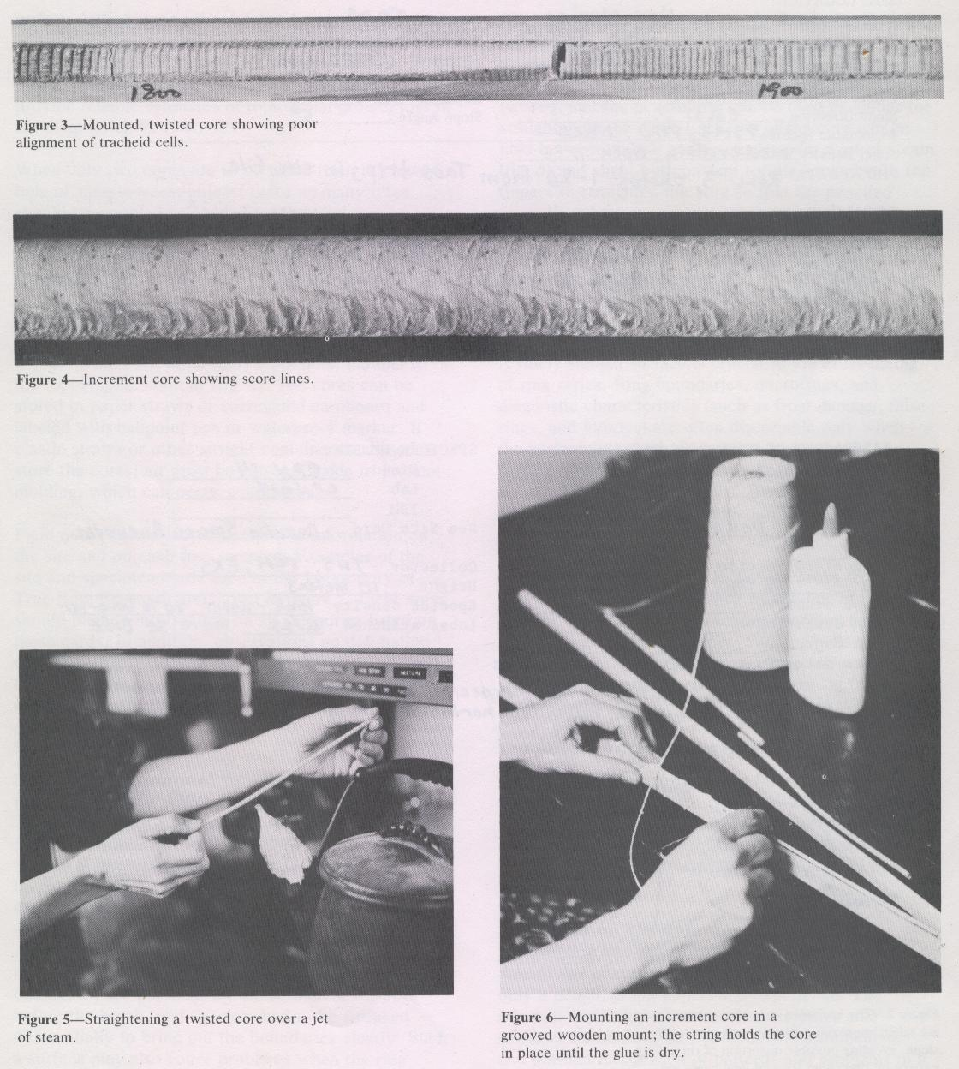

Slide 7
DO NOT
1) mount the core at the incorrect angle!
2) mount the core if it is twisted!
3) forget to label the core mount

