Slide 1
The missing ring!

Slide 2
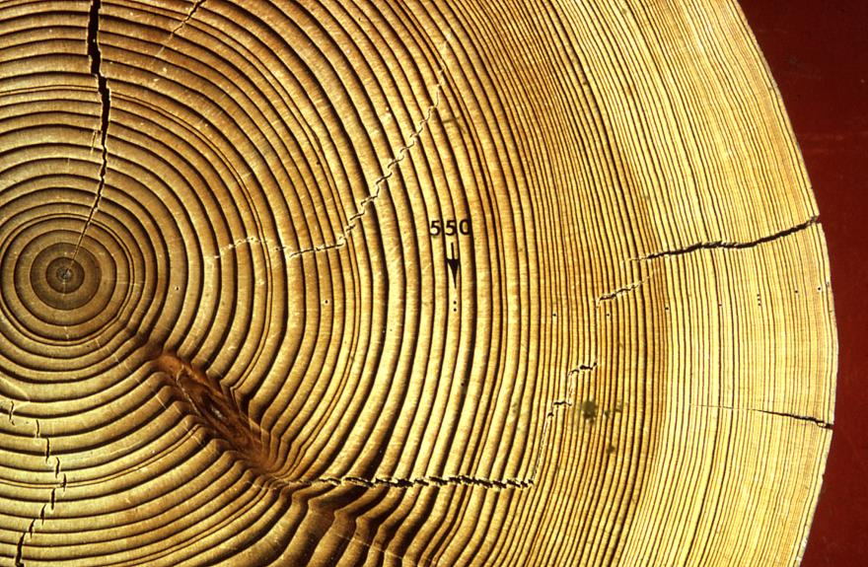
Notes:
Who’s in the class – their link to dendro
Slides on

Slide 3
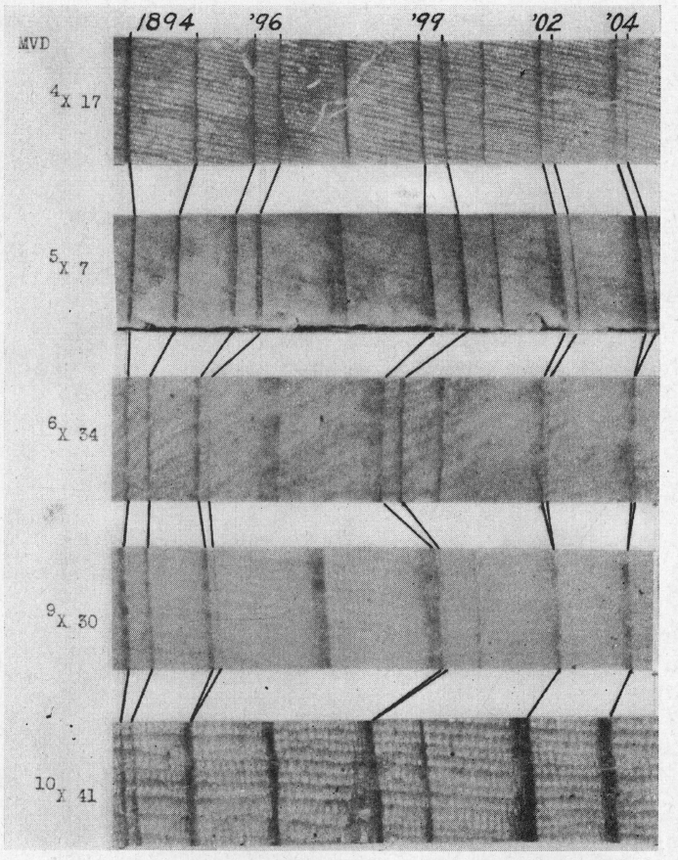
Not just ring counting anymore
Locally absent rings
Four missing rings from 1893 – 1905!

