Slide 1
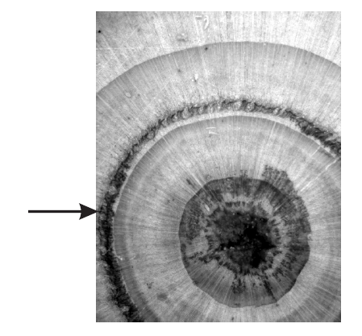
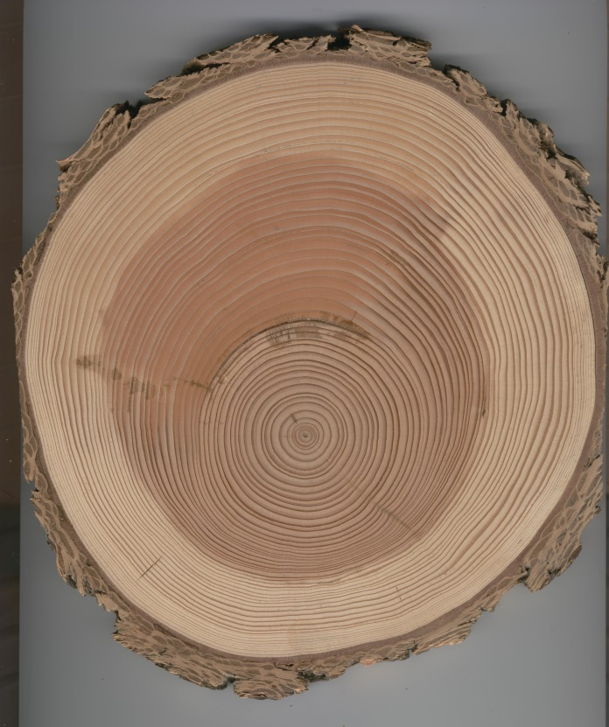
Frost rings, compositing and reaction wood
9/2/2014

Slide 2
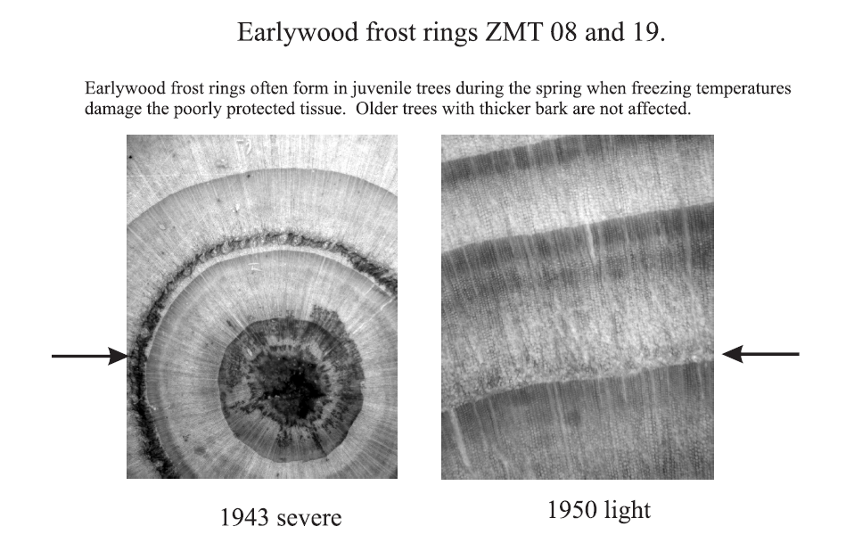

Slide 3
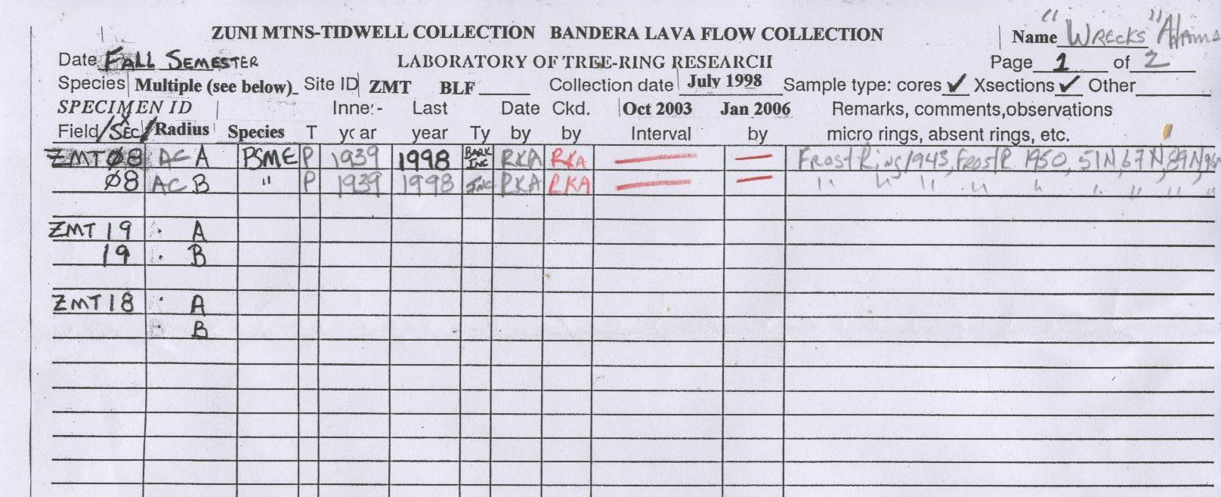
Data sheets

Slide 4
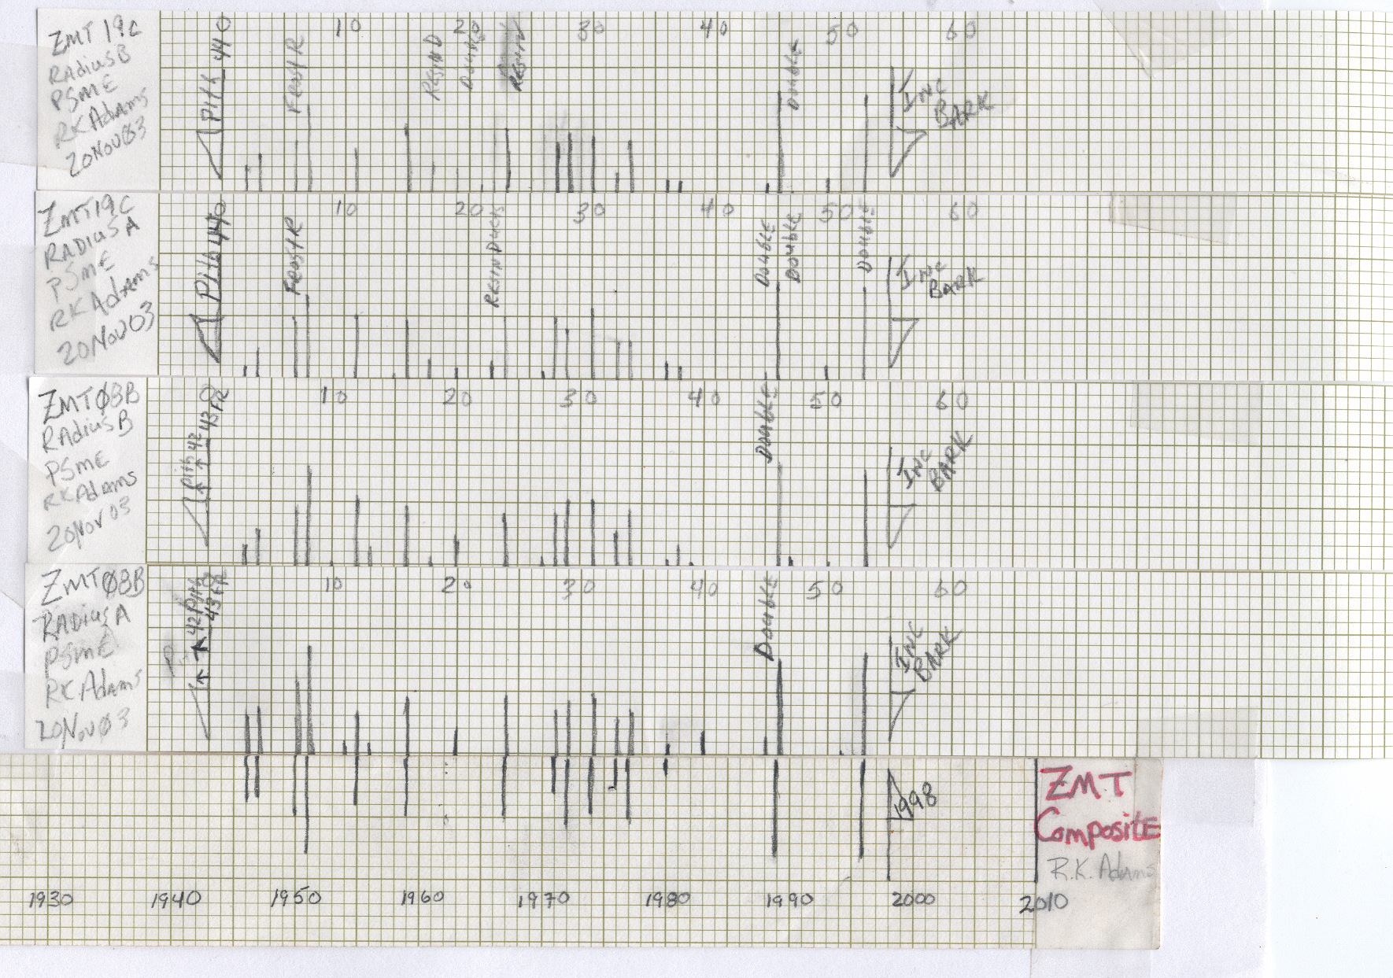
Building a composite master chronology
1. Mirror image of skeleton plot
2. Info goes on the RIGHT
3. Glue the strips together

Slide 5
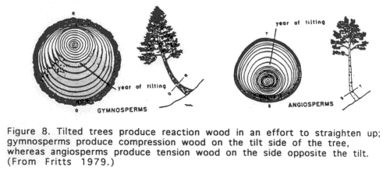
Push or Pull? (Reaction wood)
Gymnosperms push up hill (compression wood)
Angiosperms pull up hill (tension wood)

Slide 6
You can leave early if you finish and have me check ZMT18

