Slide 1
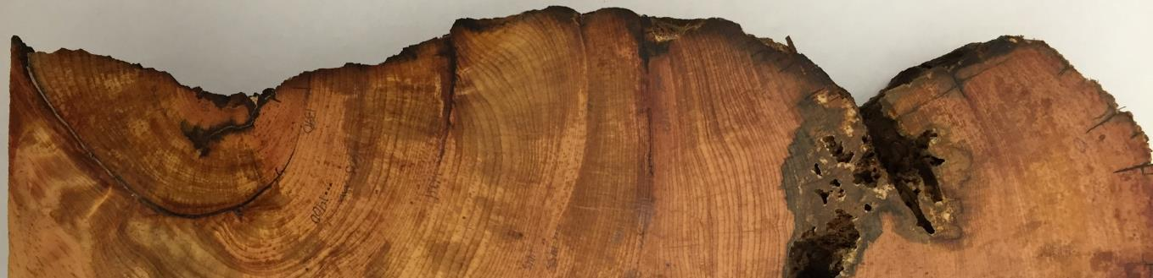



Using tree rings to inform watershed restoration
Ellis Q. Margolis
Research Ecologist
USGS Fort Collins Science Center
New Mexico Landscapes Field Station, Santa Fe, NM
Affiliated with the University of Arizona Laboratory of Tree-Ring Research, Tucson, AZ
and the University of New Mexico, Albuquerque, NM

Slide 2
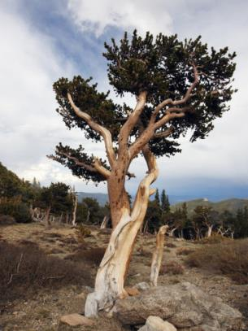
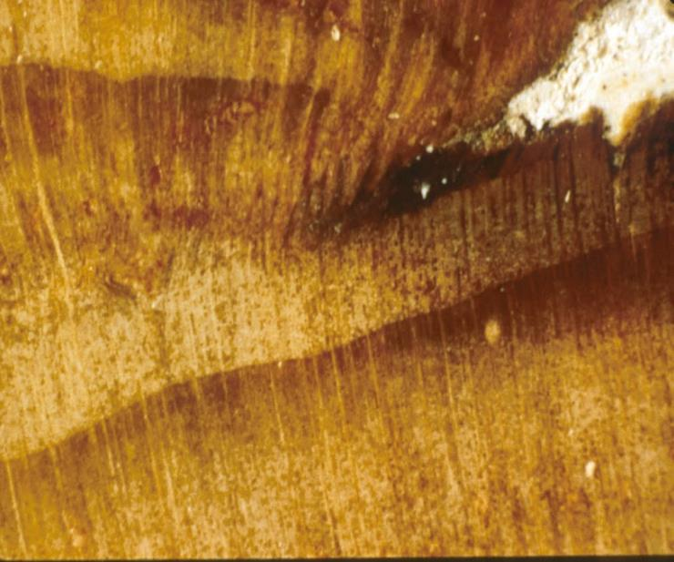
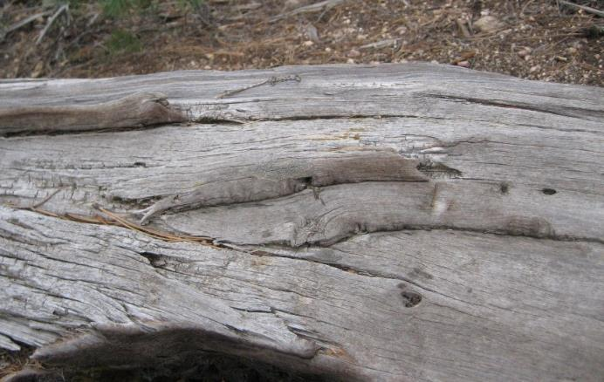
Dendrochronology (study of tree-ring dating)
Trees record the environment in their rings.
Crossdating enables annual accuracy and sub-annual precision (e.g., historical fire seasonality).
In the arid SW we find wood > 1000 years old!
Old wood - Santa Fe Watershed
1387 inner ring; 1444 fire scar
Annual ring
Mid-summer fire scar
Notes:
Trees record their environment like weather stations, and the records are stored in their tree rings. Climate, events (fire, erosion), air pollution,
In the SW we can find wood > 1000 years old. BCP – Round mtn 1200’s fire scars - Santa Fe fire scar Ex – Add Western Juniper piece – almost 2000 yrs old!!!

Slide 3
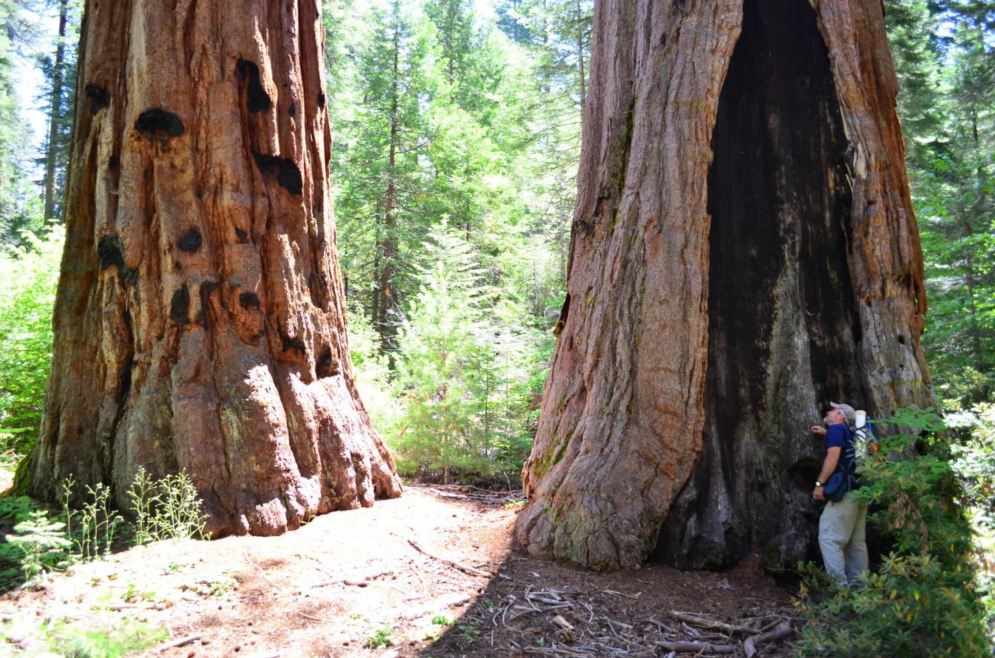
Tree-ring fire scars are a remarkable record of fires

Slide 4
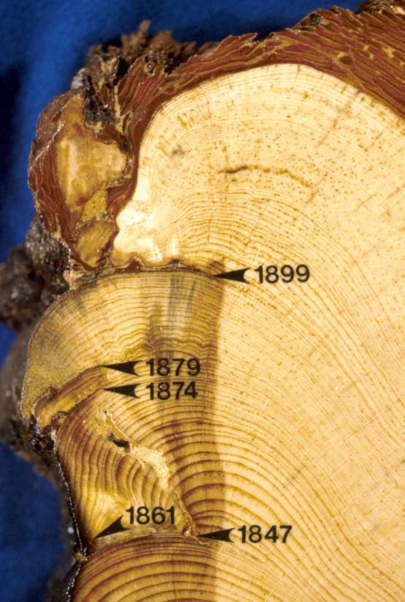
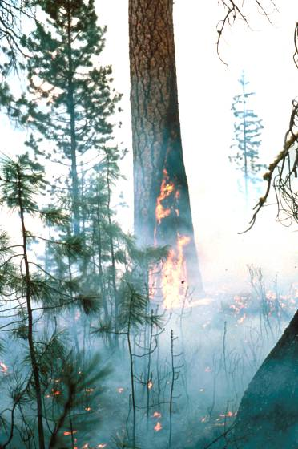
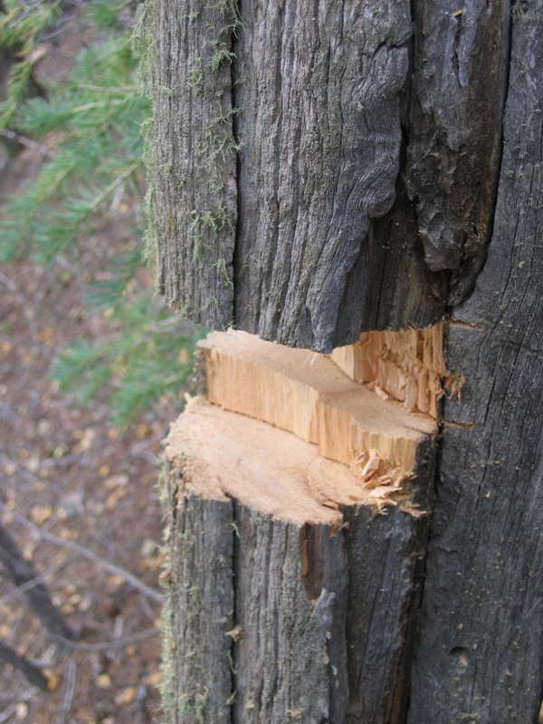
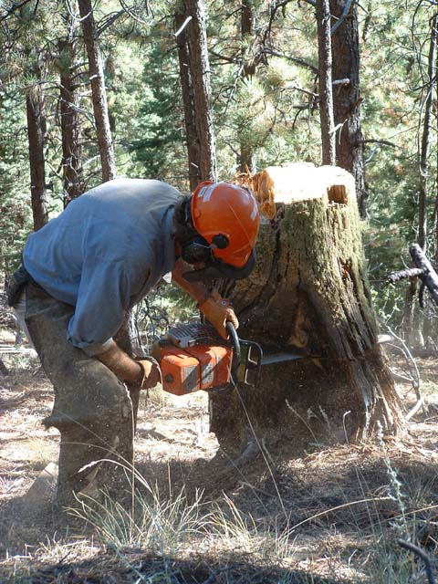
Tree-ring fire scars are a remarkable record of fires
Fire scars
Notes:
So how do we know about historical conditions? - historical photos, written accounts, and…..tree-rings - lots of tree-ring studies in N NM

Slide 5
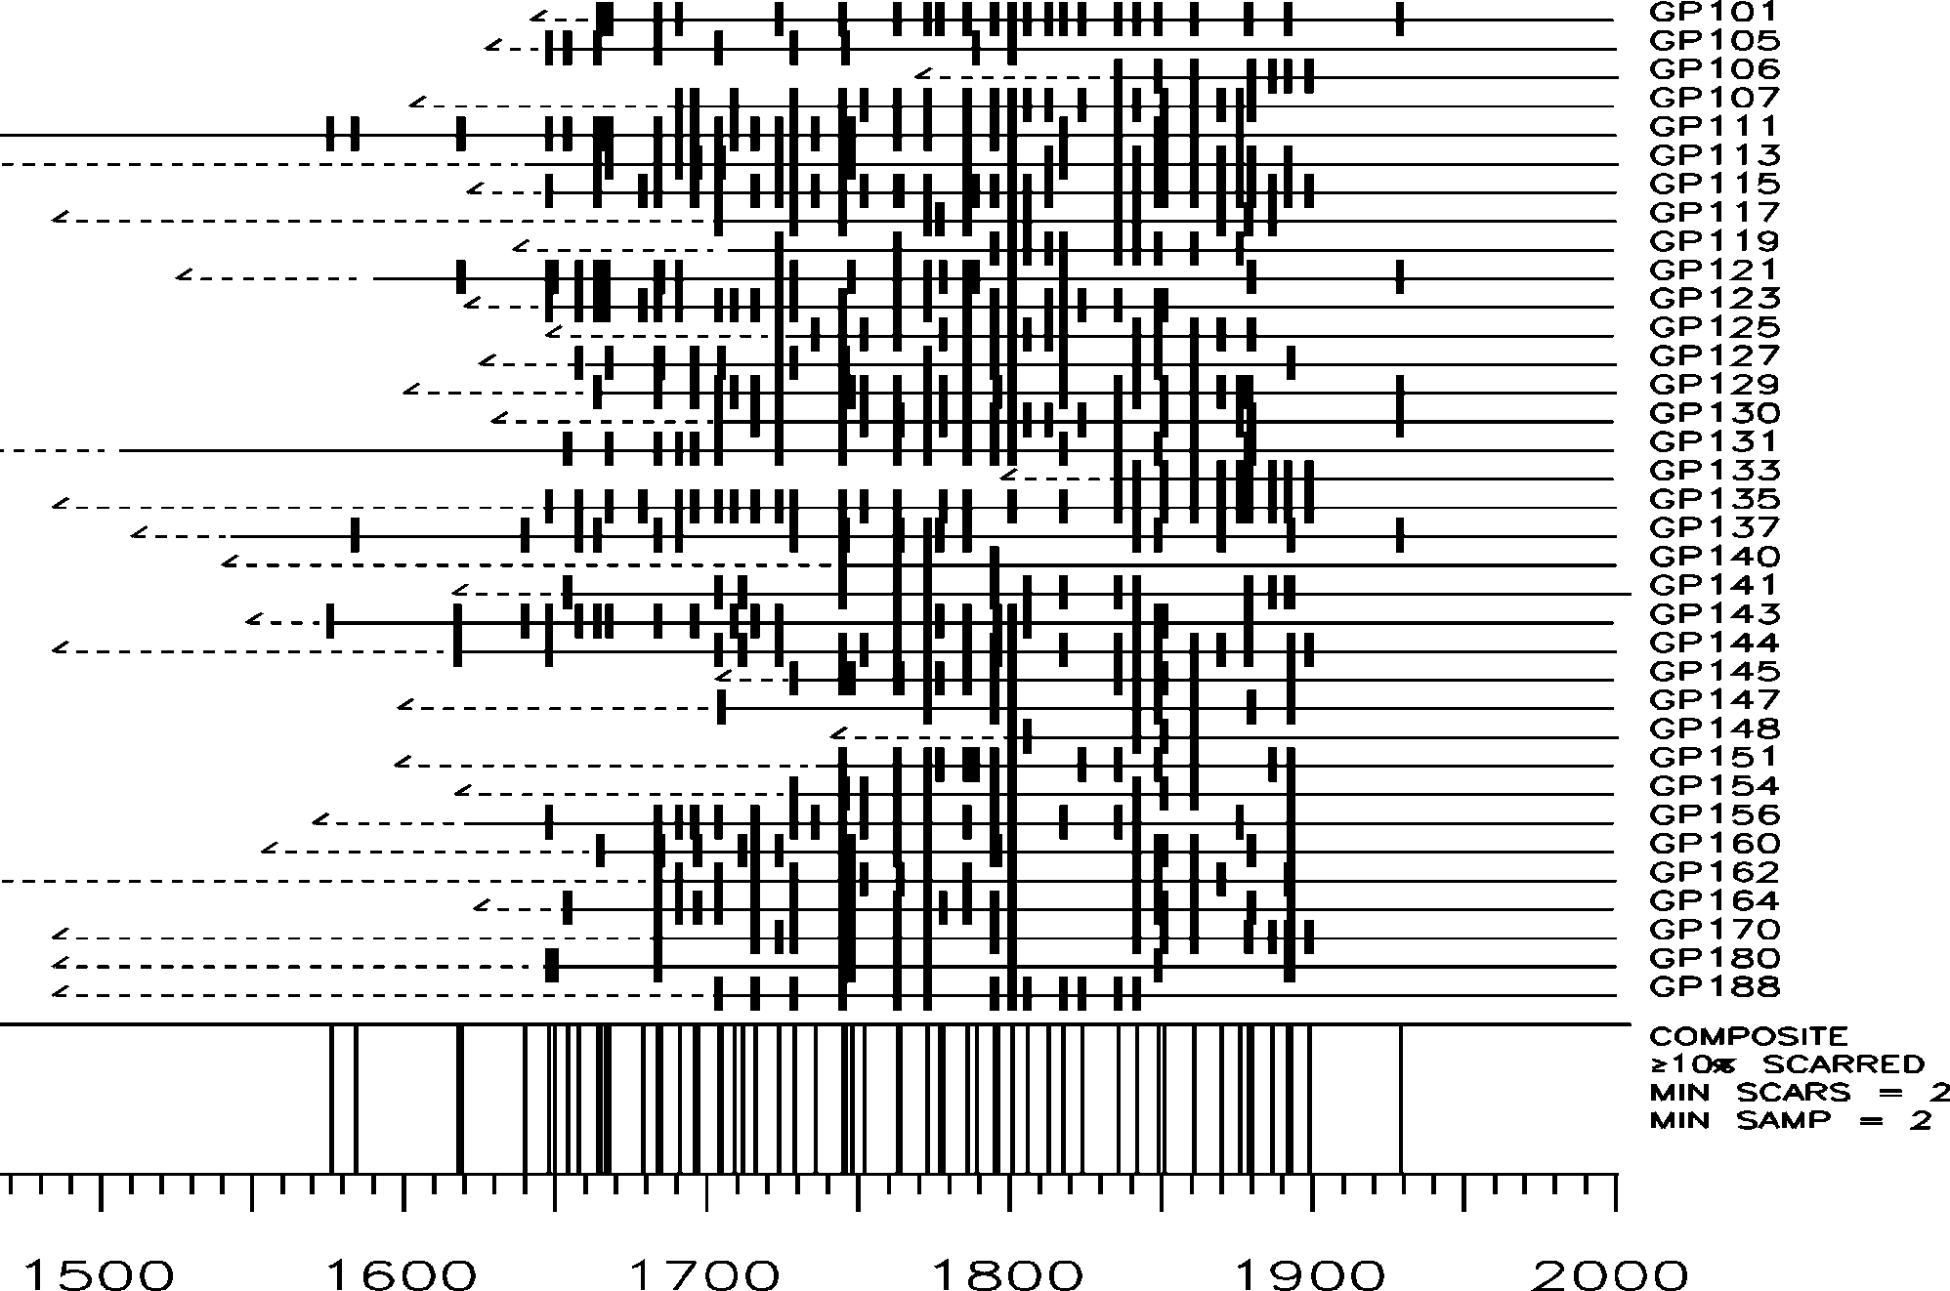
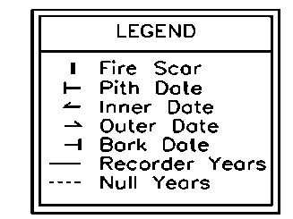
Most dry conifer forests of the Southwest burned frequently, with low severity

Slide 6
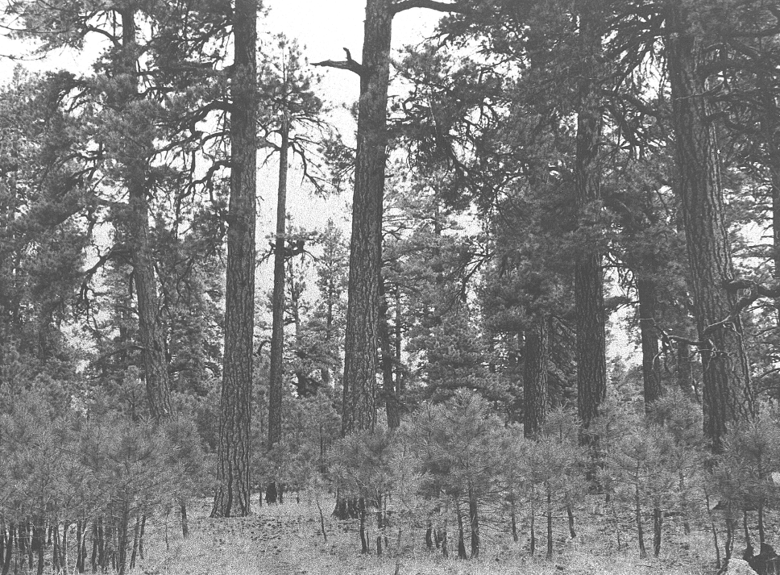
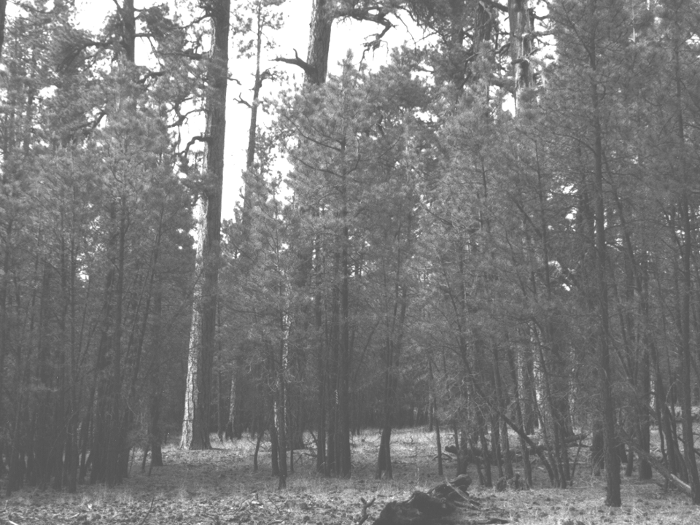
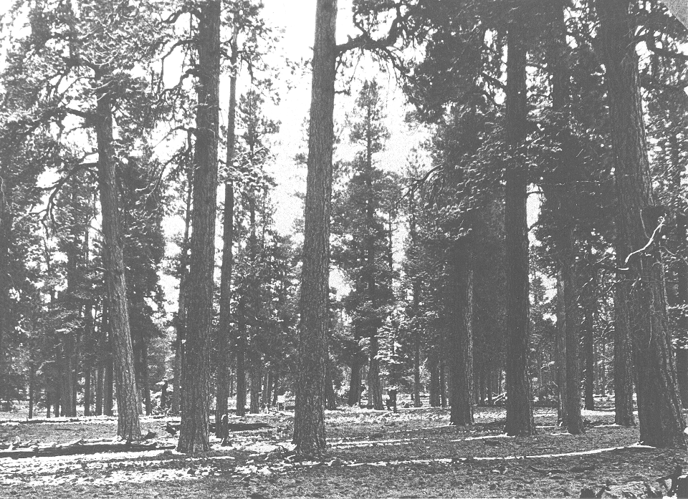
1990
1949
1909
Biondi et al 1999

Slide 7
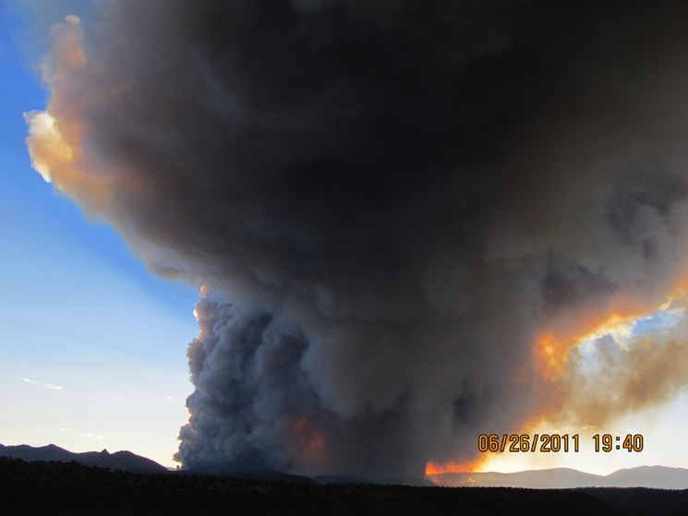
Megafires – Las Conchas Fire, Jemez Mountains

Slide 8
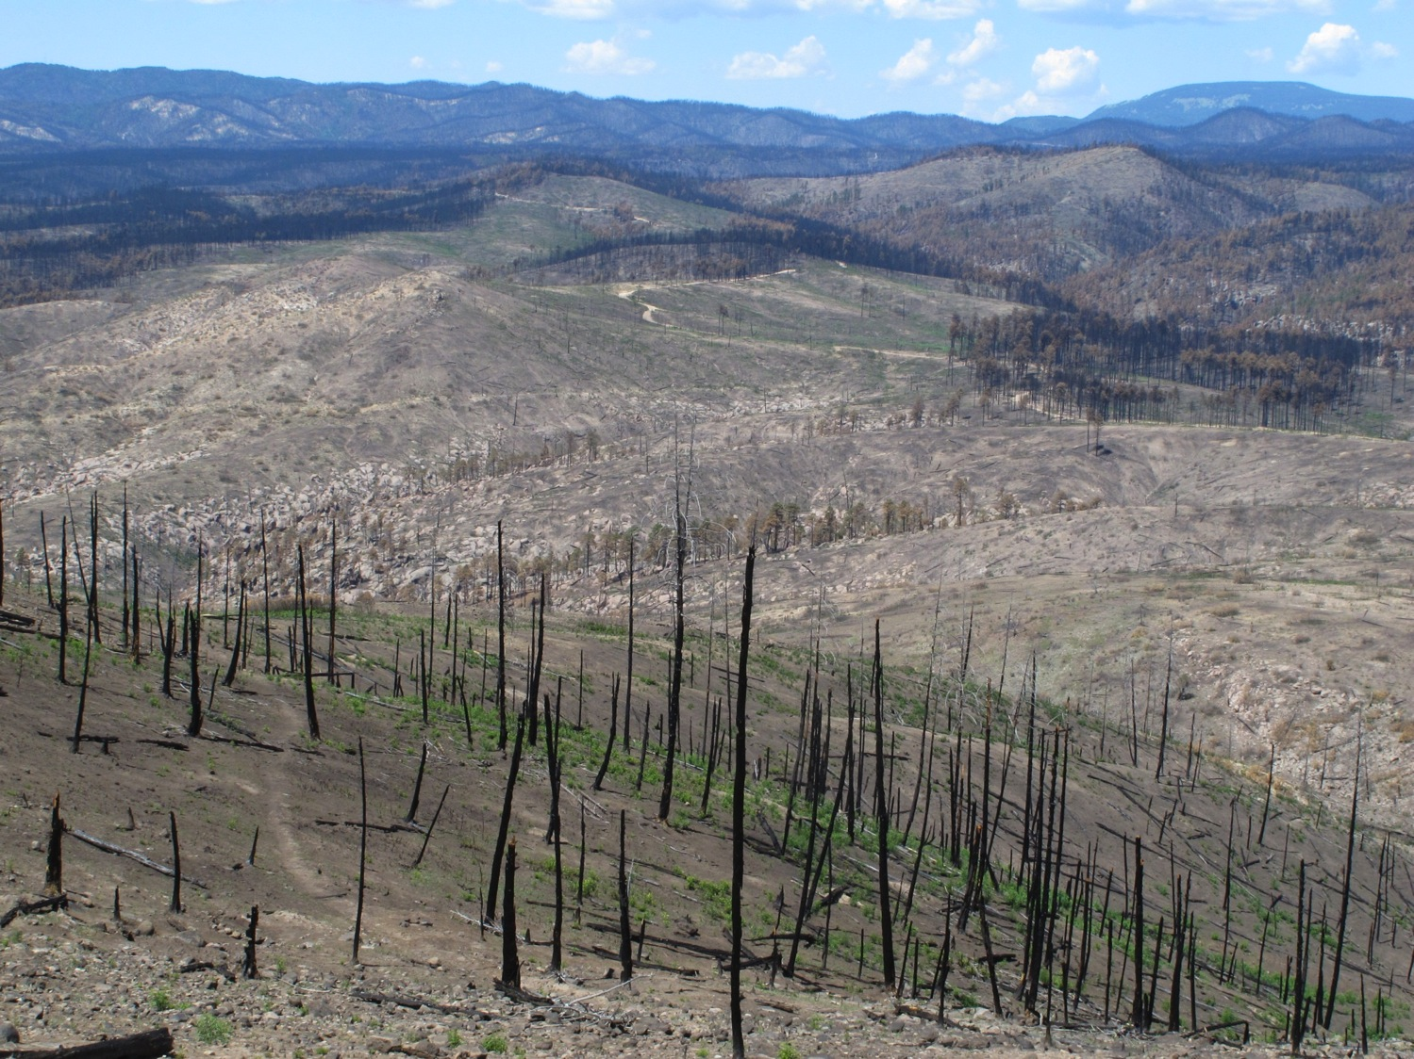
Dry conifer forests are converting to grass and shrubs
Jemez Mountains, NM
Photo: C.D. Allen

Slide 9
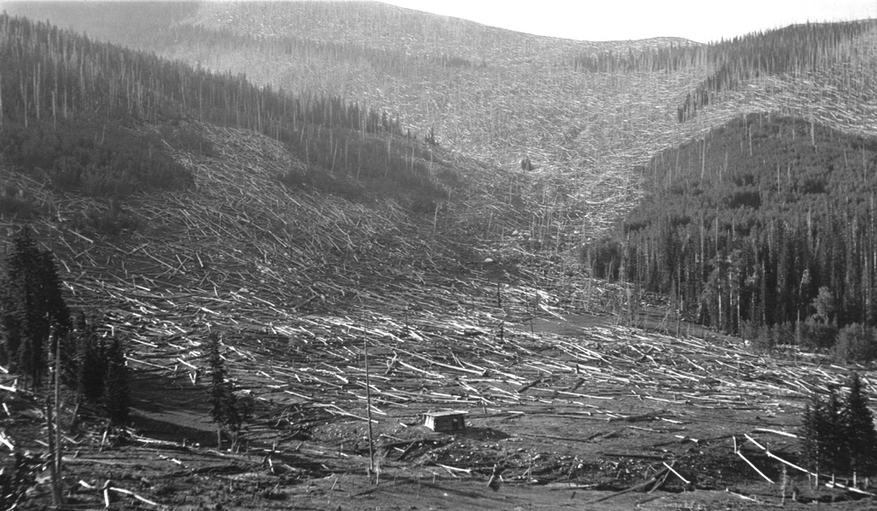
Wet forests (spruce-fir/aspen) – crown fire is natural
Large patches of tree-killing fire and post-fire flooding and erosion
Many trees die (and regrow, like aspen) and few trees survive
Santa Fe Ski Basin (early 1900’s) - Photo courtesy of Craig Allen

Slide 10
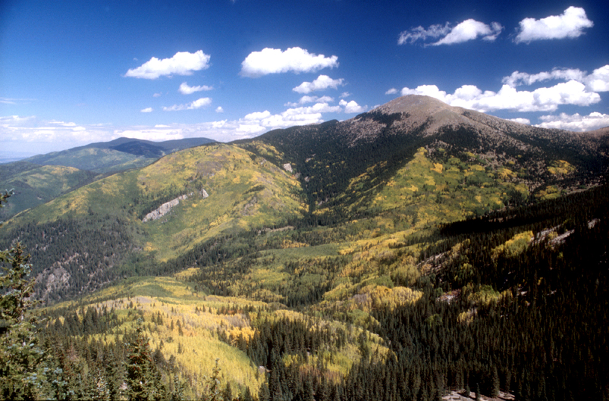
Nambe drainage and Santa Fe Baldy
Notes:
However, there is evidence of historical high severity fire (in large patches) in the highest elevation forests (spruce-fir and aspen). Photo circa 1910 of inner basin, San Francisco Peaks and Santa Fe Baldy

Slide 11
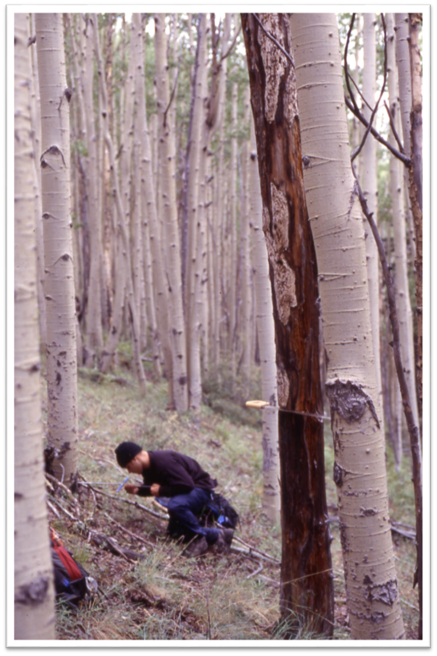
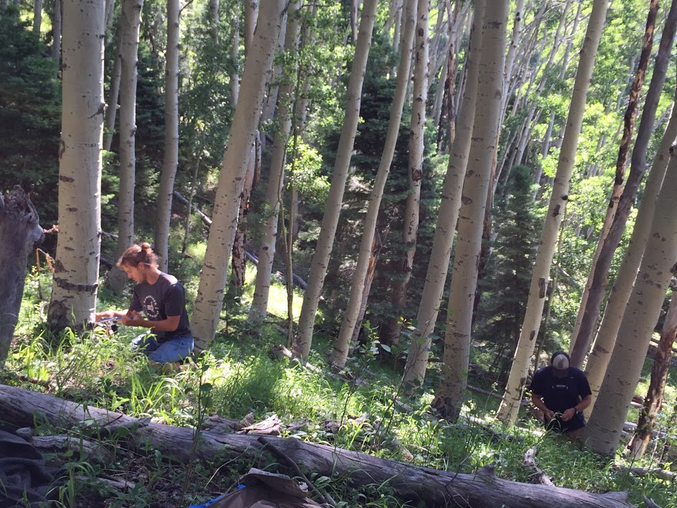
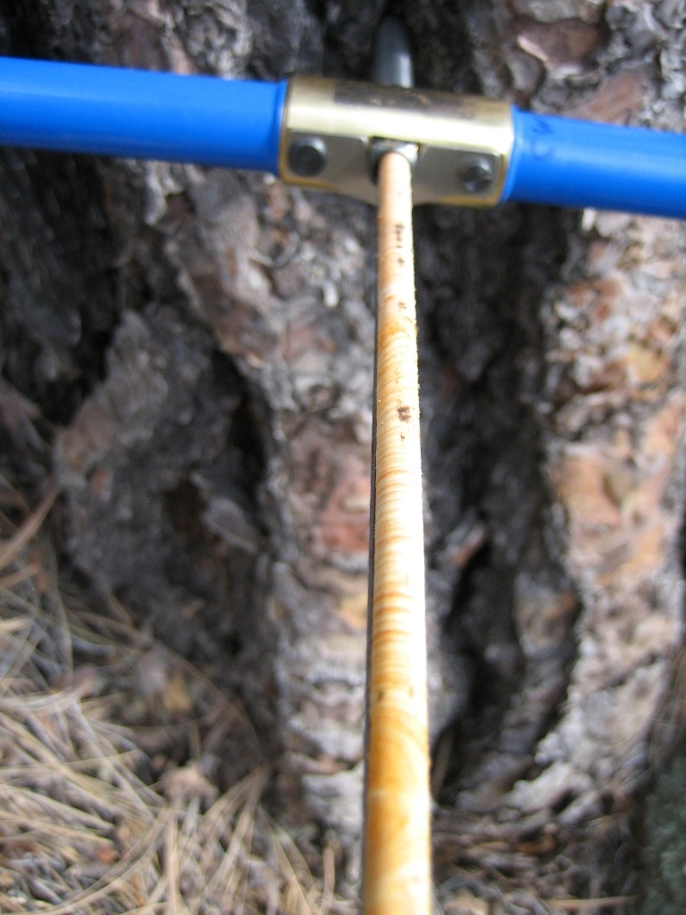
Aspen ages can tell us the time since the last fire

Slide 12
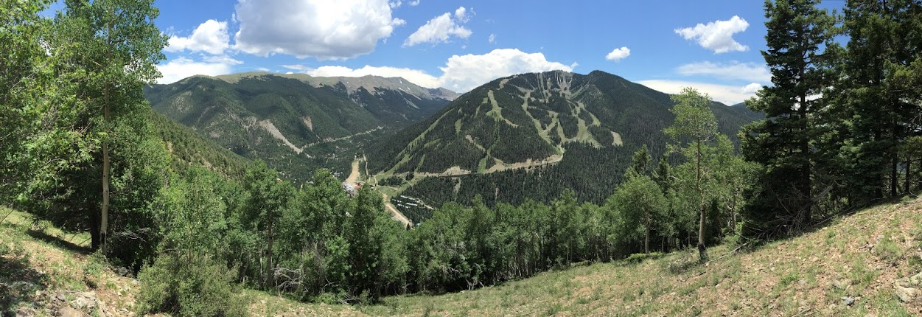
So, what can the trees tell us about fire in the Taos Valley watersheds?

Slide 13
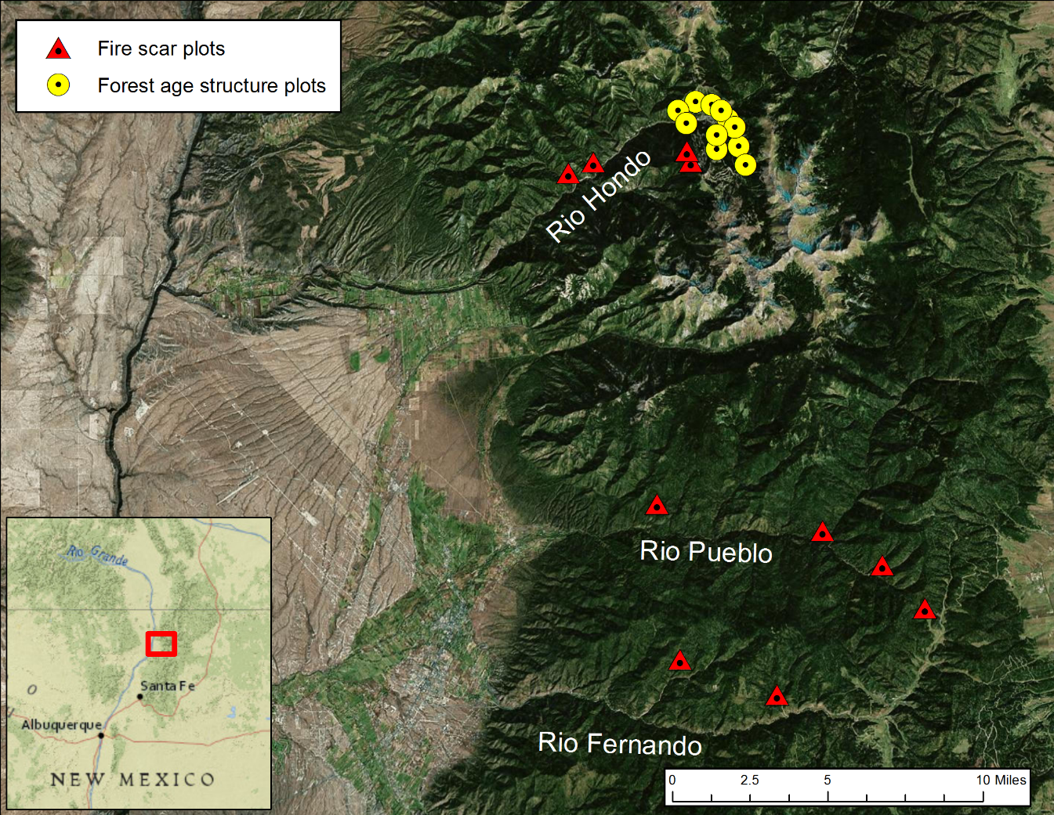

Slide 14
Gradient from dry conifer to mesic conifer forests
Likely a fire regime gradient:
  - Low-severity (dry sites) to high-severity (wet sites)
  - There is a lot of wet forest up there

Slide 15
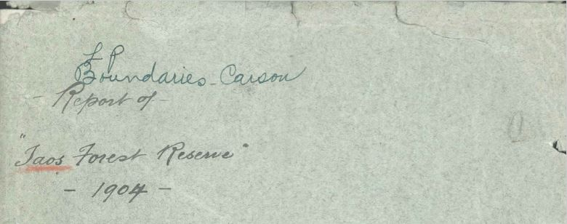
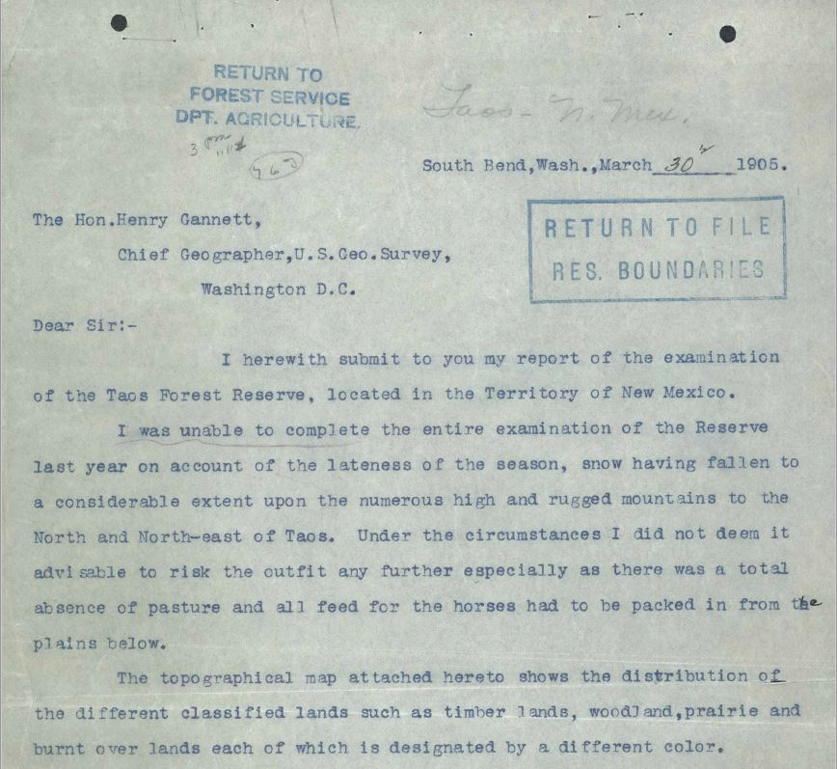
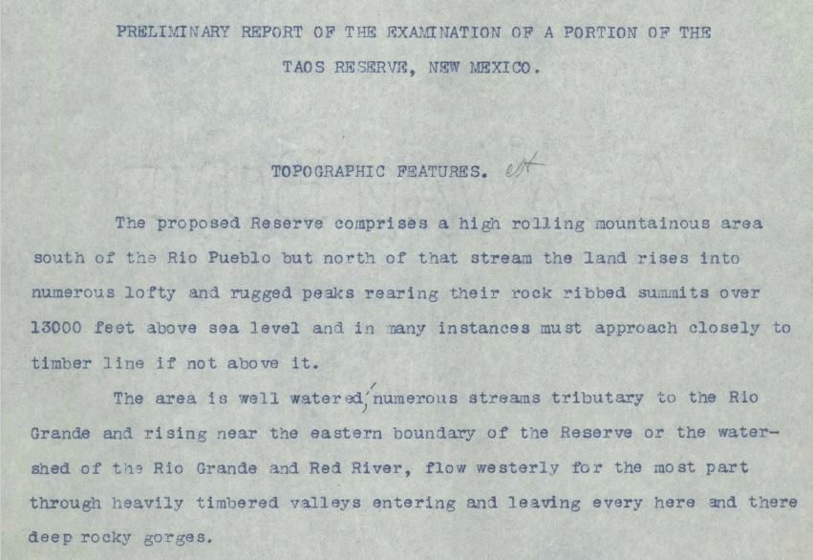
Historical surveys
Notes:
For me, one of the great things about these research questions, is that you can often get some context from historical documents and photos.

Slide 16
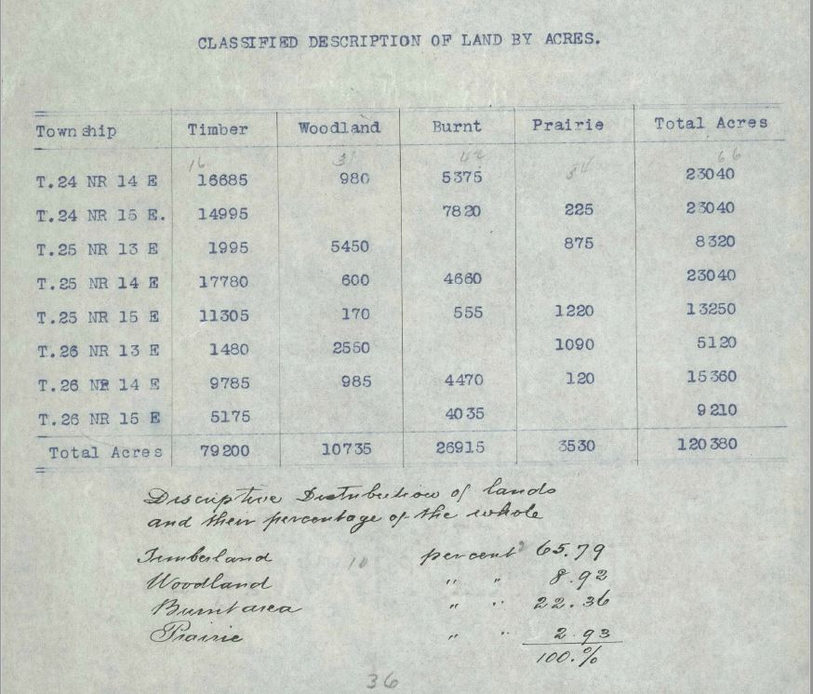
Historical surveys
Notes:
Surveyed lands within townsips divided into timber, woodland, burnt, and prairie

Slide 17
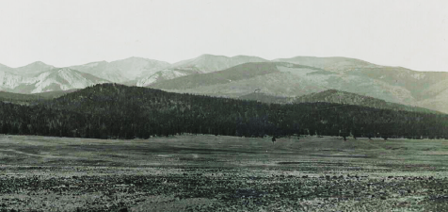
Historical crown fire patches
1903 photo from the Moreno Valley
– looking NNW toward Taos Pueblo
Notes:
Trees record their environment like weather stations, and the records are stored in their tree rings. Climate, events (fire, erosion), air pollution,
In the SW we can find wood > 1000 years old. BCP – Round mtn 1200’s fire scars - Santa Fe fire scar Ex – Add Western Juniper piece – almost 2000 yrs old!!!

Slide 18
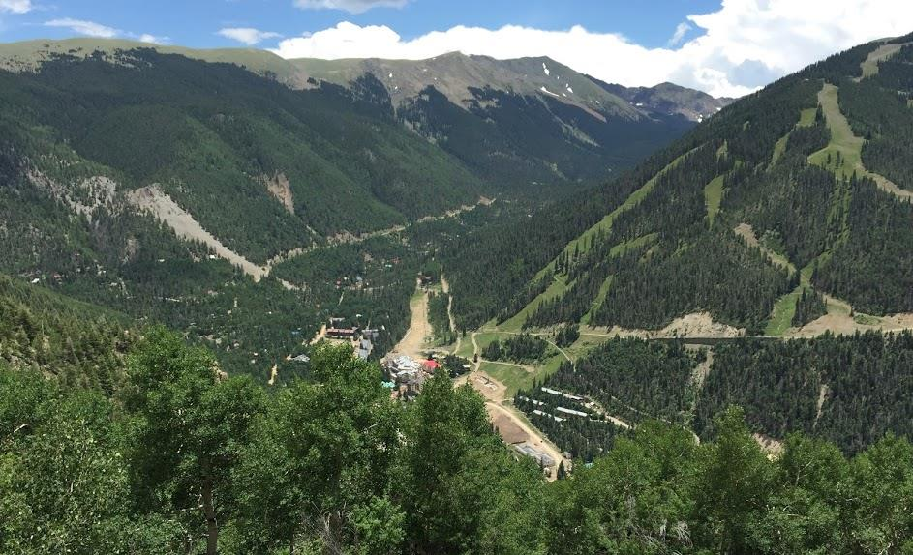
Taos Ski Valley and upper Rio Hondo - 2016
Notes:
June 2016, note the aspen on the east side of the basin and in the foreground. Also, the infill of the forest on the north slope of the ski hill

Slide 19
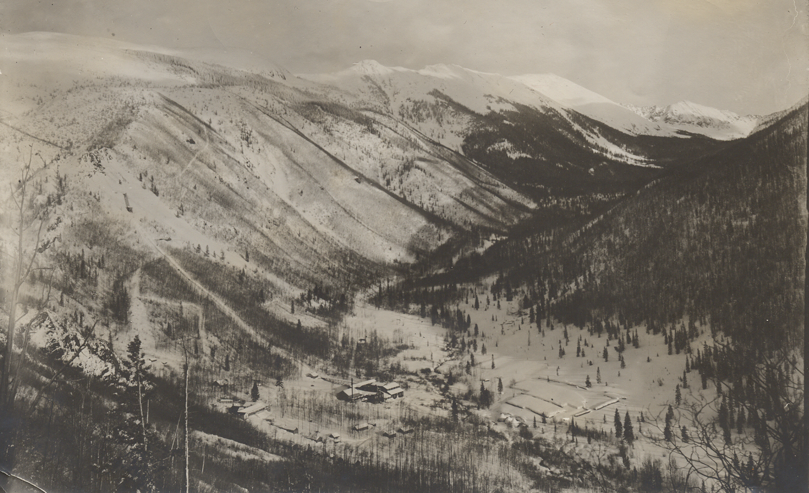
Taos Ski Valley and upper Rio Hondo - 1902
The open, snowy slopes on the east side of the valley, as well as the young aspen on the slopes where the photo was taken, likely indicate high-severity fire, combined with logging, in the 1800s.
Notes:
The Rio Hondo was not reported on in the Taos Forest Reserve Report but images are super helpful.
Taos Ski Valley image ca. 1900 looking south from the north side of the basin

Slide 20
2016 Tree-ring sampling
Notes:
145 trees sampled in 3 watersheds

Slide 21
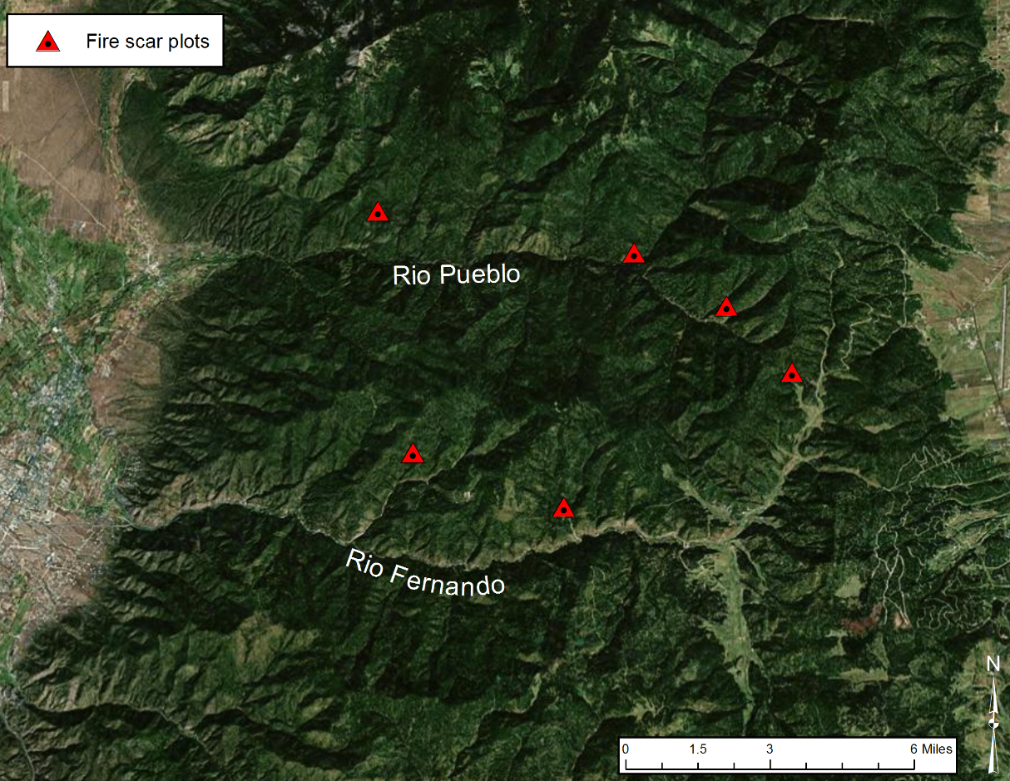
2016 Tree-ring sampling
Rio Pueblo (Taos Pueblo) & Rio Fernando
6 fire scar plots – dry forest

Slide 22
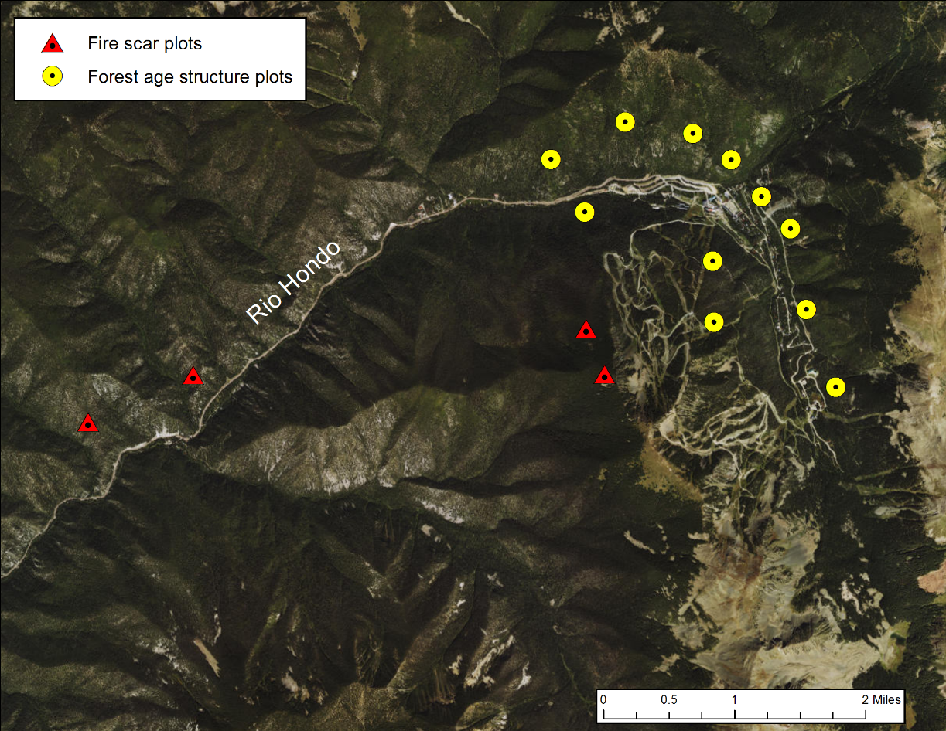
2016 Tree-ring sampling
Rio Hondo – Taos Ski Valley:
11 forest age plots – wet forest
3 fire scar plots – dry forest

Slide 23
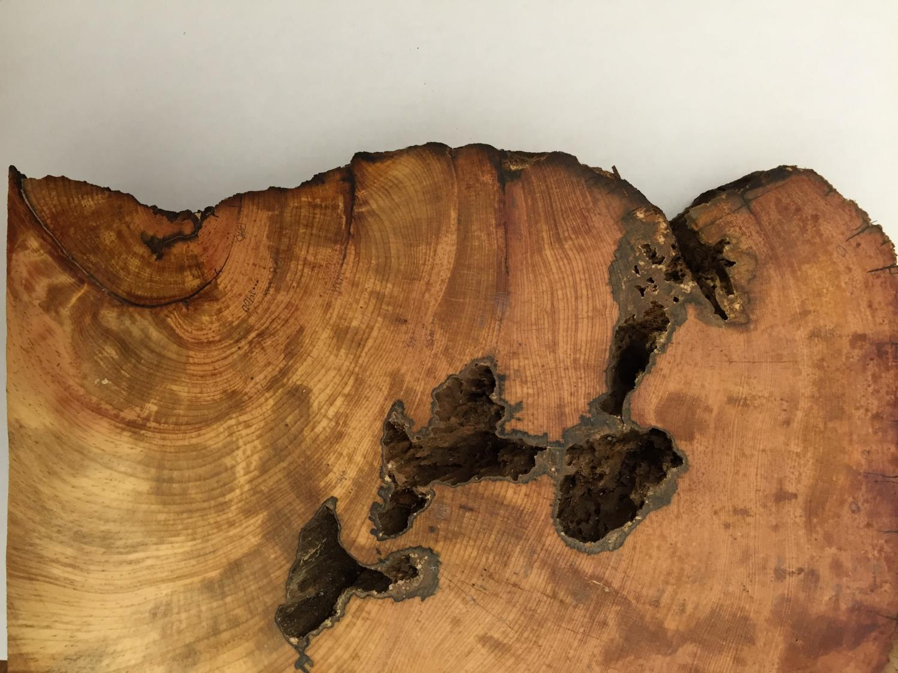
Old limber pine with six fire scars Manzanita Canyon, Rio Hondo
1480
1424
1455
Inner
Ring: 1354
1405
1628
1390
Outer
Ring: 1766
Notes:
400 year record of fire from a single limber pine tree in Manzanita Canyon

Slide 24
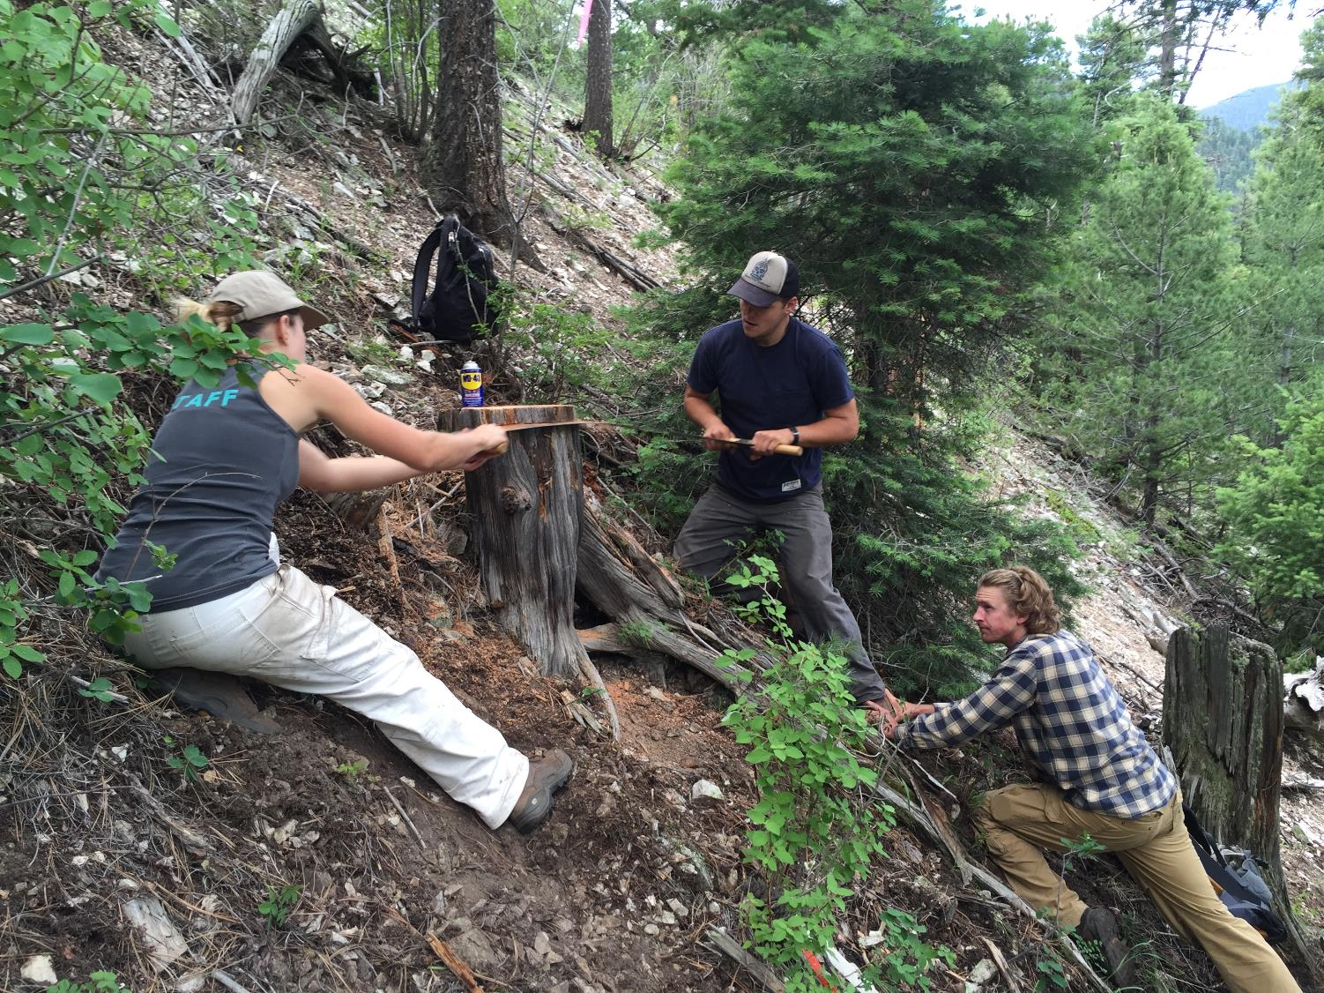

Slide 25
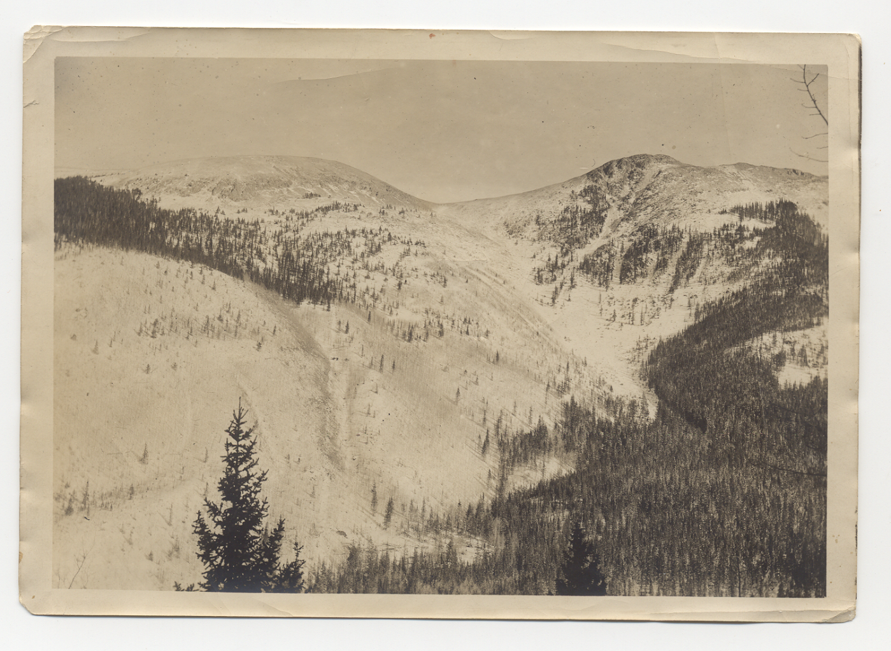
Last burned – mid 1800’s
Did not burn in 1800’s fire
Last burned – 1600’s
Notes:
We decided to to rely on some of the historic imagery from the Taos Ski Valley to target specific parts of the basin for patch aging.

Slide 26
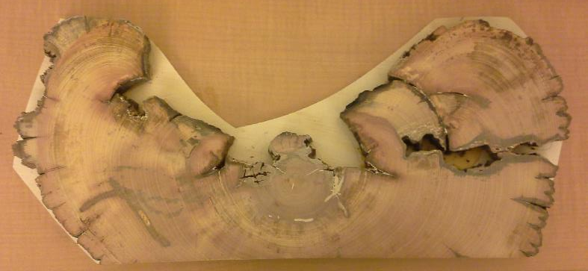
So, what do the trees tell us (so far) about management in the Taos Valley watersheds?
Dry conifer forests:
Restore low-severity fire regimes
Reduce tree density and canopy continuity in dry conifer forests
Mesic conifer/aspen forests:
Be prepared for the big one, and the aftermath
Possibly break up the fuels (mechanical or fire)

Slide 27
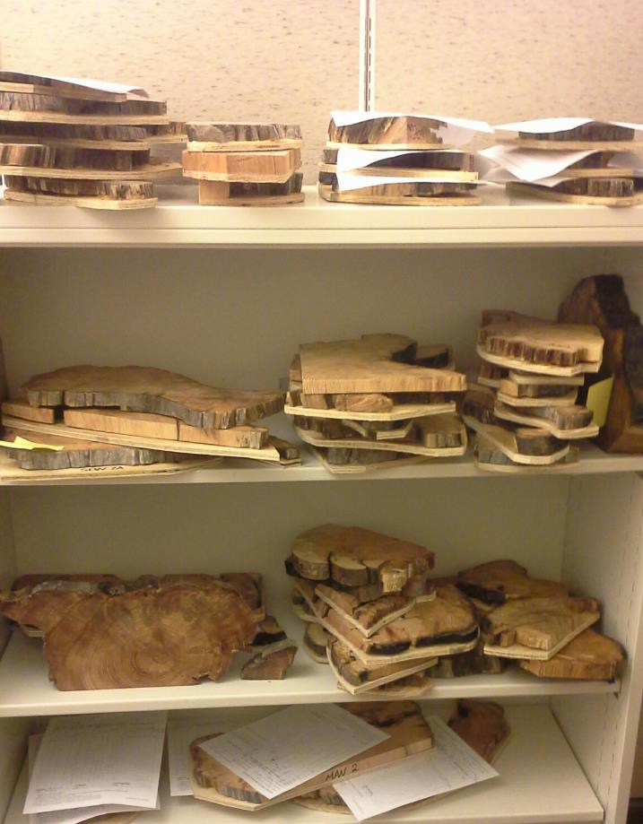

Next steps:
Continue dating the wood
Present preliminary results at the Association for Fire Ecology Conference in Tucson, AZ (December 2016)
Progress report to TNC, USFS, TSV December 2016
Final report and presentation - Spring 2017

Slide 28
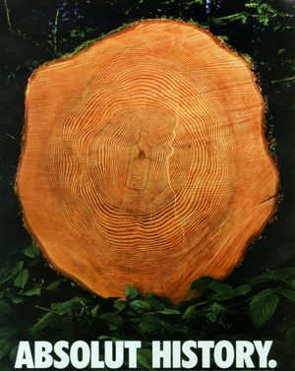
“History never repeats itself,
but it does tend to rhyme.” Mark Twain
We are grateful for support from TNC, USFS, TSV, and the Rio Grande Water Fund
The Research Group:
Ellis Margolis, emargolis@usgs.gov
Lane Johnson, NPS Research Technician
Collin Haffey, USGS Ecologist
Craig Allen, USGS Research Ecologist
Thomas Swetnam, Regents’ Professor UofA
Rachel Bean, Patrick Brewer, Charles Mogen, and Ben French - 2016 Interns

Slide 29
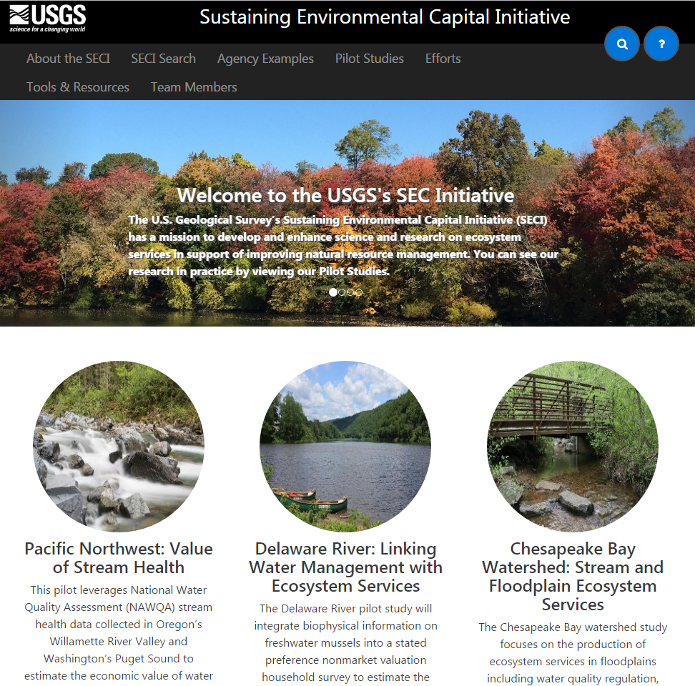
Sustaining Environmental Capital Initiative (SECi)
New pilot study: land management in Northern New Mexico
  Ecosystem service values and benefits to inform adaptation
  Economic benefits of wilderness
  Specific interests:
    Water resources
    Fire risk/forest restoration
    Cultural values
For more info, contact
Collin Haffey (USGS) chaffey@usgs.gov

Slide 30
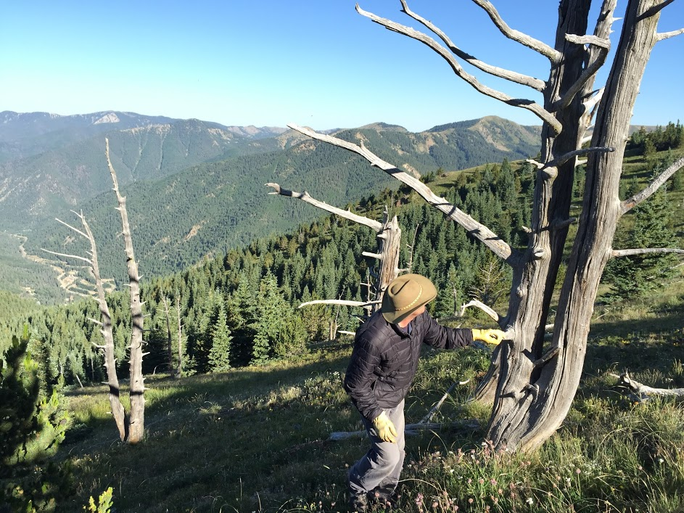
Notes:
Roger Pattison with bristlecone ghost forest above the Taos Ski Basin. 1601 pith date; outer ring date ca. 1829. The XS includes a marker year of 1817 - a frost ring - that coincides with the 1815 Tambora eruption in Indonesia.

Slide 31

Fire-monsoon project
Fire seasonality vs precipitation seasonality in the Jemez
Fire seasonality vs precipitation seasonality in the Jemez
Annual ring
Margolis, Woodhouse, Swetnam. In review – Climatic Change
Notes:
NSF Macrosystems grant - Working w Connie woodhouse and T. Swetnam

Slide 32
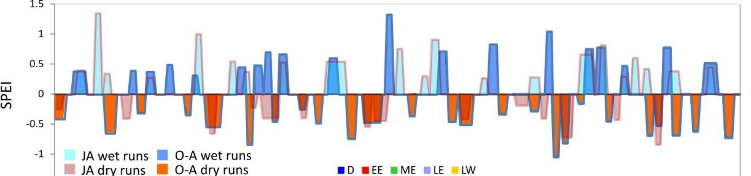
Fire-monsoon project
Fire seasonality vs precipitation seasonality in the Jemez
Multi-season moisture reconstructions

Slide 33
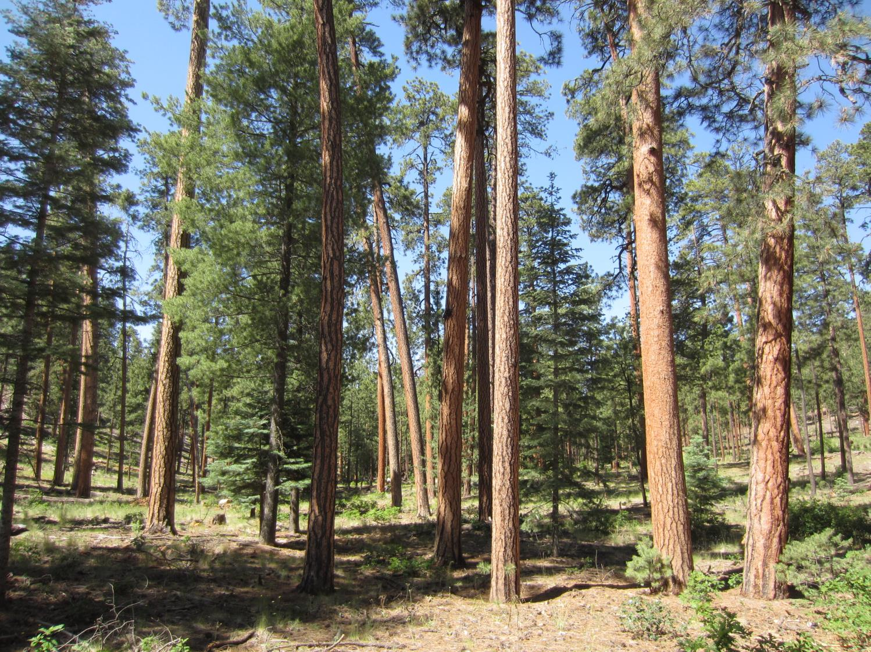
Ponderosa Pine
Fire Frequency: High
Fire Severity: Low
Notes:
PJ PIPO MC Spruce-fir veg types - all historically burned with unique fire regimes

