Slide 1
Introduction to Dendrochronology Lab
Instructor: Ellis Margolis
ellisqm@ltrr.arizona.edu
BBTRB room 321

Slide 2
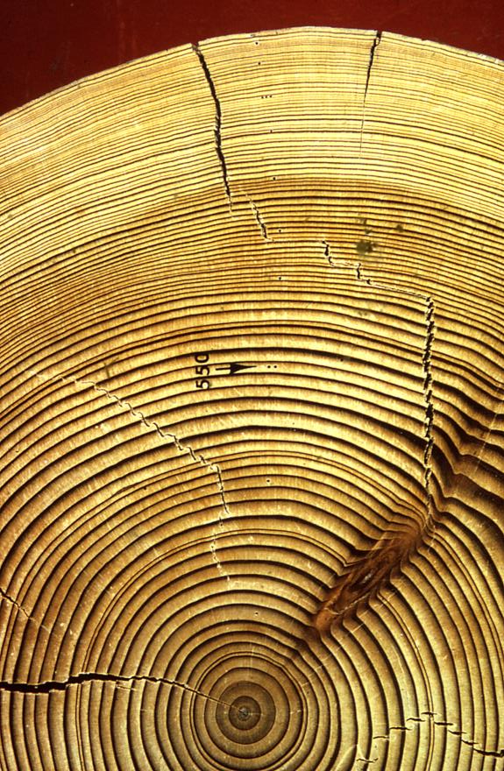
What we’re doing today
Introductions (photo)
Syllabus and schedule
Tree-ring dating background
Lab notes
Tree-ring exercises
Paper bristlecone pine
Paper archeological site
Notes:
Who’s in the class – their link to dendro
Slides on

Slide 3
Goal of the class
To learn the skeleton plotting method to accurately determine the year of annual tree-ring formation (i.e., crossdating). This is the foundation of dendrochronology.
Details of many of these procedures can be found in (Stokes & Smiley 1968) and your lab notes.

Slide 4
What is a tree-ring?
Earlywood - Large thin-walled cells (light)
Latewood - Small thick walled cells (dark)
Notes:
Ask class

Slide 5
The Secret to Dendrochronology
How do we figure out the year of ring growth from dead or remnant trees that have been laying on the ground for an unknown number of years?
The tree-ring pattern!
Notes:
In this class I’m going to teach you the secret of dendrochronology

Slide 6
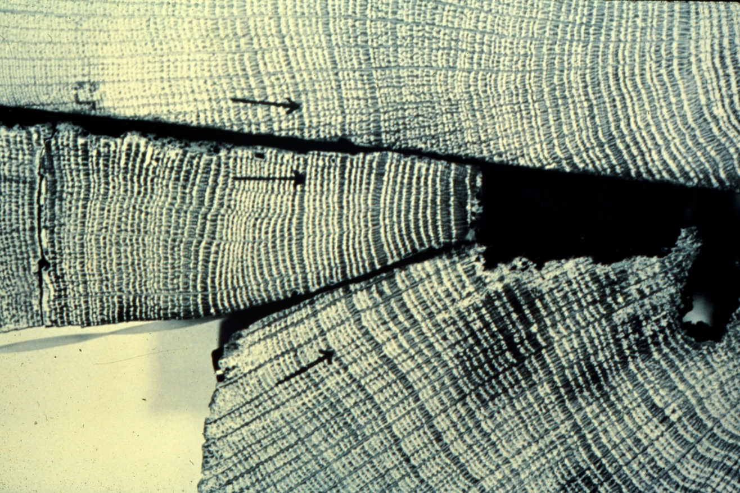
Shared pattern of ring growth (makes crossdating possible)
Baillie, 1982
Quercus (oak) timbers from locations in Ireland up to 200 km apart. Note similarity of patterns - marked year is AD 1580
Notes:
Why is this pattern matching or “crossdating” possible?

Slide 7
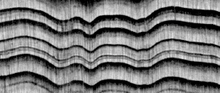
Definition: “Crossdating is the recognition of the same ring pattern in different trees, so that the actual growth date of any one ring of the pattern is the same in the different trees and one may carry a chronology across from tree to tree.”
A.E. Douglass (1941) – Journal of Forestry
Revolves around pattern recognition
Three basic techniques:
Graphical techniques (skeleton plot)
Statistical techniques
Memorization techniques

Slide 8
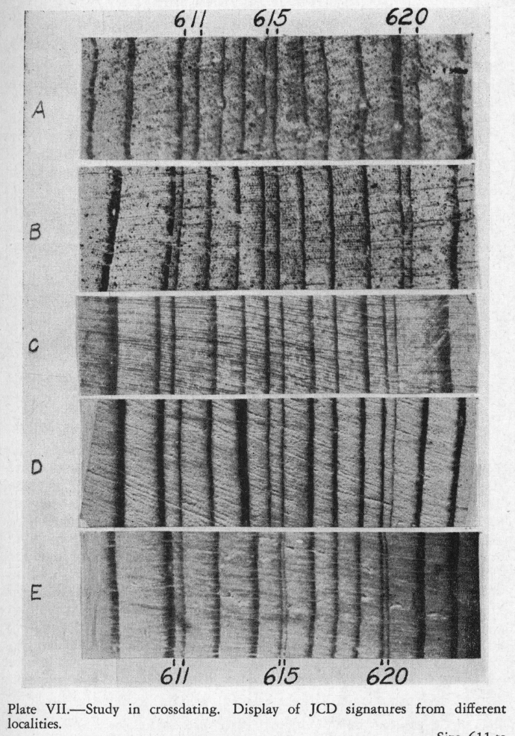
Example of matching ring-width patterns

Slide 9
How is cross-dating between different trees (and even between species) possible?
Tree (ring) growth cannot proceed faster than is allowed by the most limiting factor to the physiological processes of ring formation.
If trees have the same limiting factor, the pattern of year to year variation in ring properties will reflect the variation in the limiting factor. Hence they will show similar growth patterns.
For example: tree rings from dry regions often reflect variations in moisture availability, and those from cold regions reflect growth season temperature

Slide 10
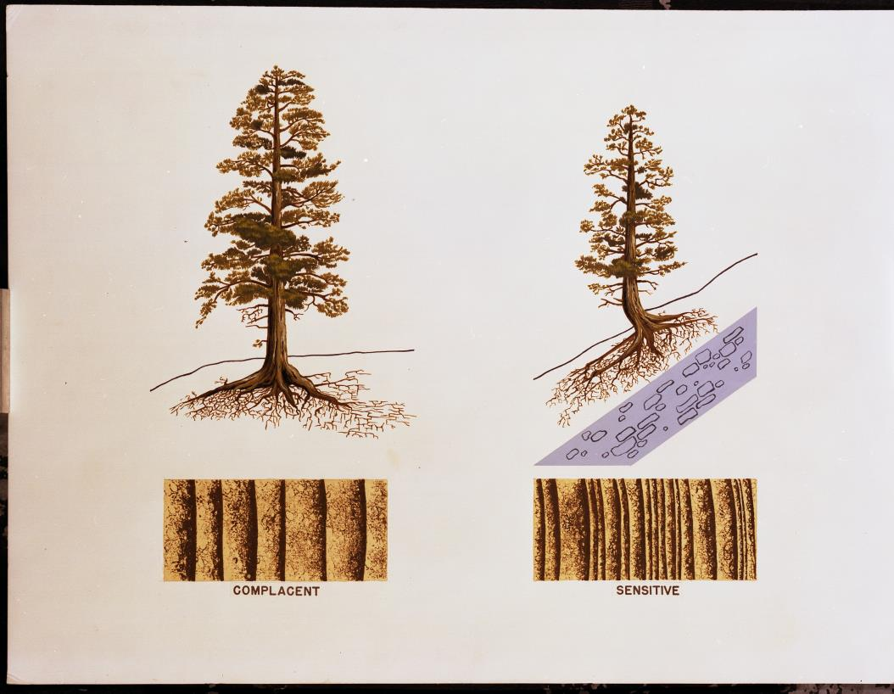
Sensitive vs Complacent Trees
Notes:
Moisture is limited growth of the sensitive tree

Slide 11
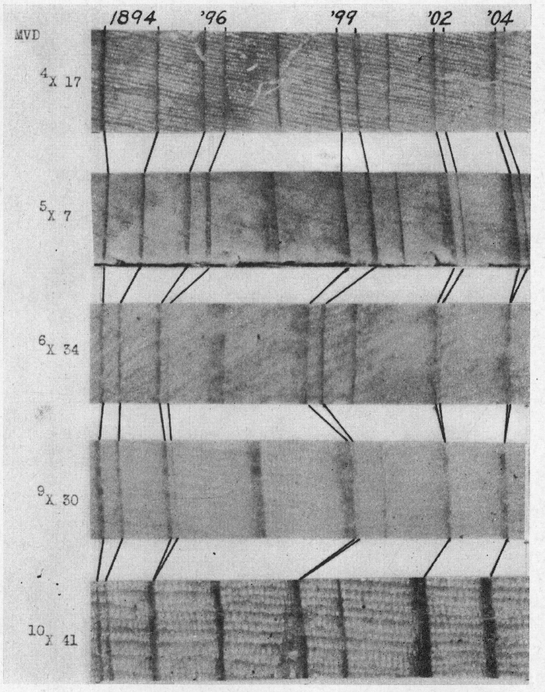
So you just count the rings, right?
Missing Rings
Four missing rings from 1893 – 1905!

Slide 12
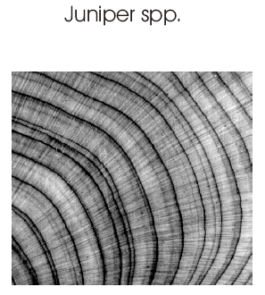
Other challenges for crossdating
False rings

Slide 13
Skeleton plots
Simple graphical representation of the ring width pattern in a sample (focusing on narrow rings)

Slide 14
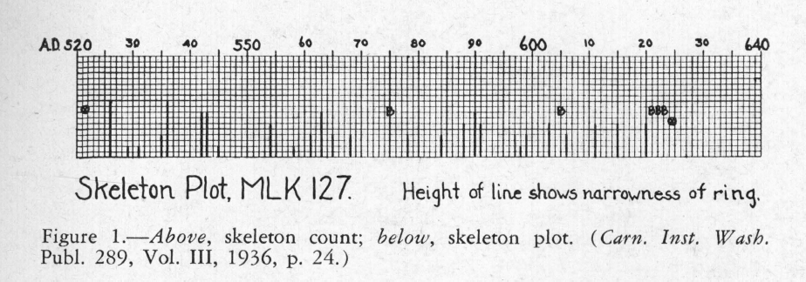
Skeleton plots
“This count of small rings then is turned into a skeleton plot….these deficient rings expressed in vertical lines from the base of a long paper strip, the length of line being greater for more deficiency and specially long or dotted for absences. These can easily be compared together for the satisfactory relative place of each specimen and a composite made that can be compared with a master chart if one has been made.”
A.E. Douglass. 1946. PRECISION OF RING DATING IN TREE-RING CHRONOLOGIES. University of Arizona Laboratory of Tree-Ring Research Bulletin No. 3.

Slide 15
Skeleton plotting – uses
Quick way to find dates of wood at a site with an existing chronology
To develop a master chronology at a new site

Slide 16
Skeleton plot required elements
On the far Left side: name (“E.Q. Margolis”), date, sampleID, and radius (e.g., “A”)
5 spaces in: Inner ring “Flag” and inner ring descriptor (“pith” or “Inc.”). Flag filled if pith, open if Inc.
“0”, “10”, “20”,…… every 10 squares on top of plot
Final ring “Flag,” filled if complete, unfilled if incomplete.
Final ring descriptor: (Inc., or Complete, Bark).
Descriptors on special rings (e.g., Big [“B”],False [“Fls”], Frost[“Frst”], Injury [“Inj”], or Locally Absent [“LAb”])

Slide 17
Skeleton plotting online tool developed by Dr. Paul Sheppard:
http://www.ltrr.arizona.edu/skeletonplot/introcrossdate.htm

Slide 18
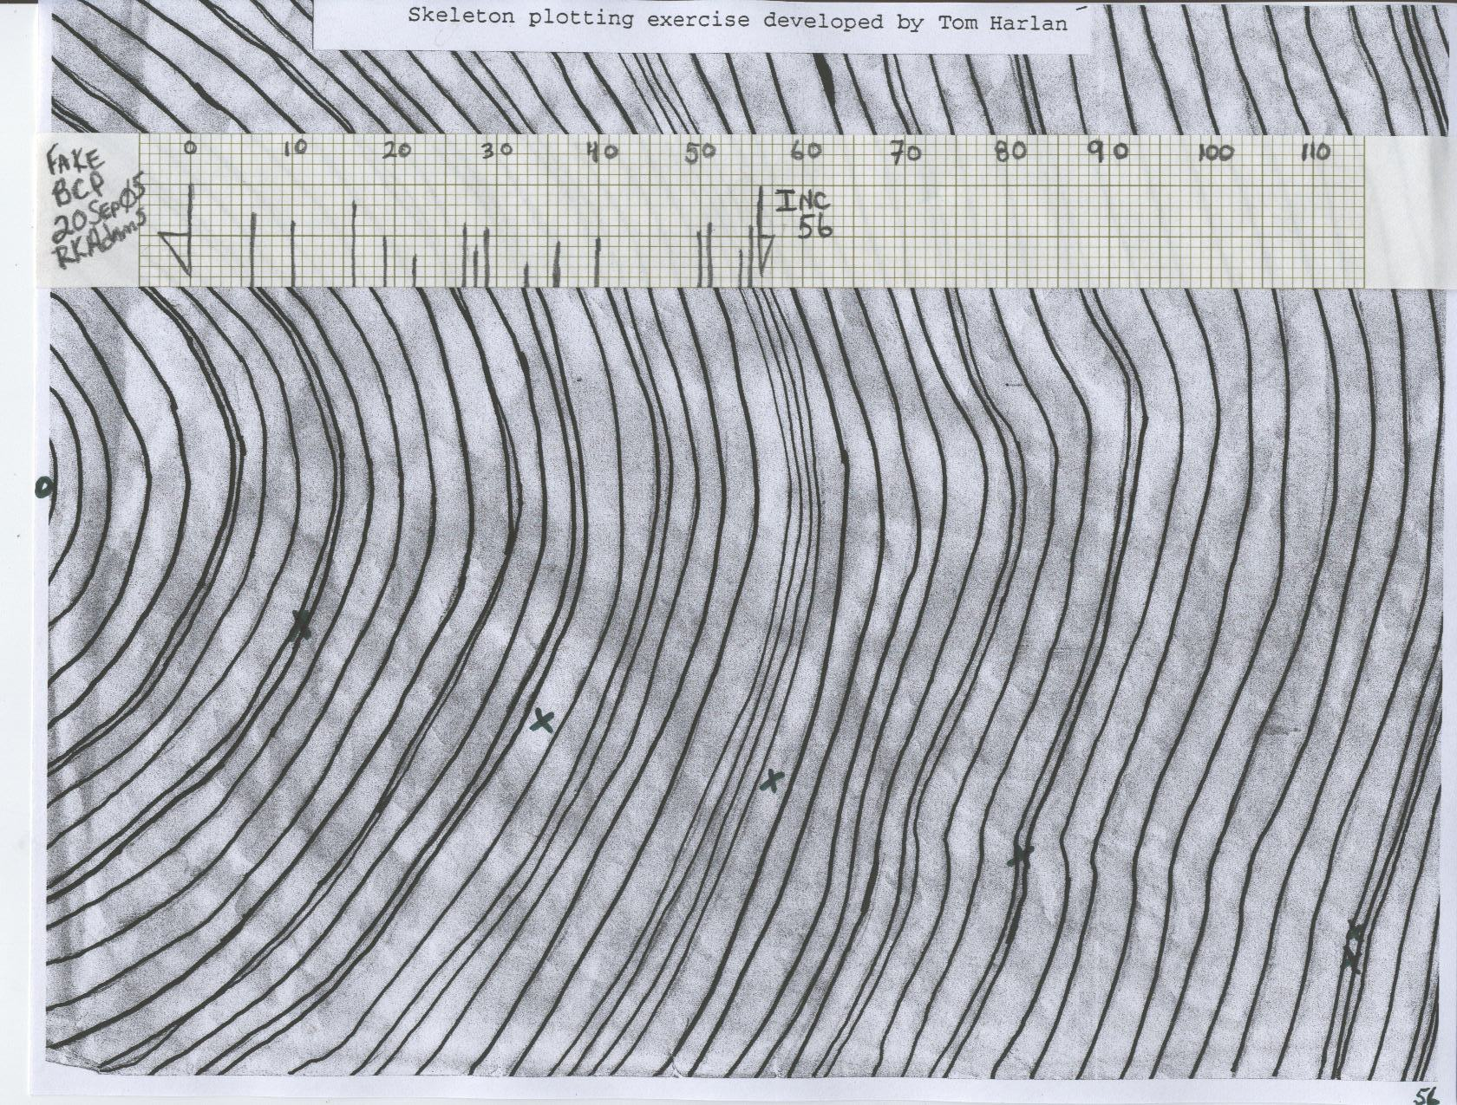
Now everyone gets to make their own skeleton plots

Slide 19
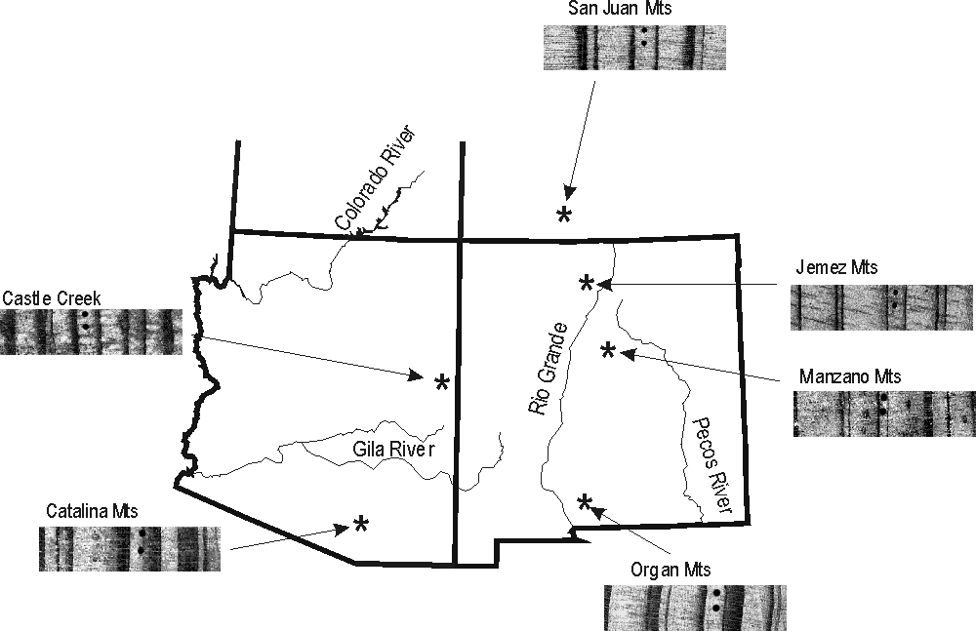
1750AD ring-width “signature”
Kipfmueller and Swetnam, 2001
1747 wide - 1748, 1750, 1752 small

Slide 20
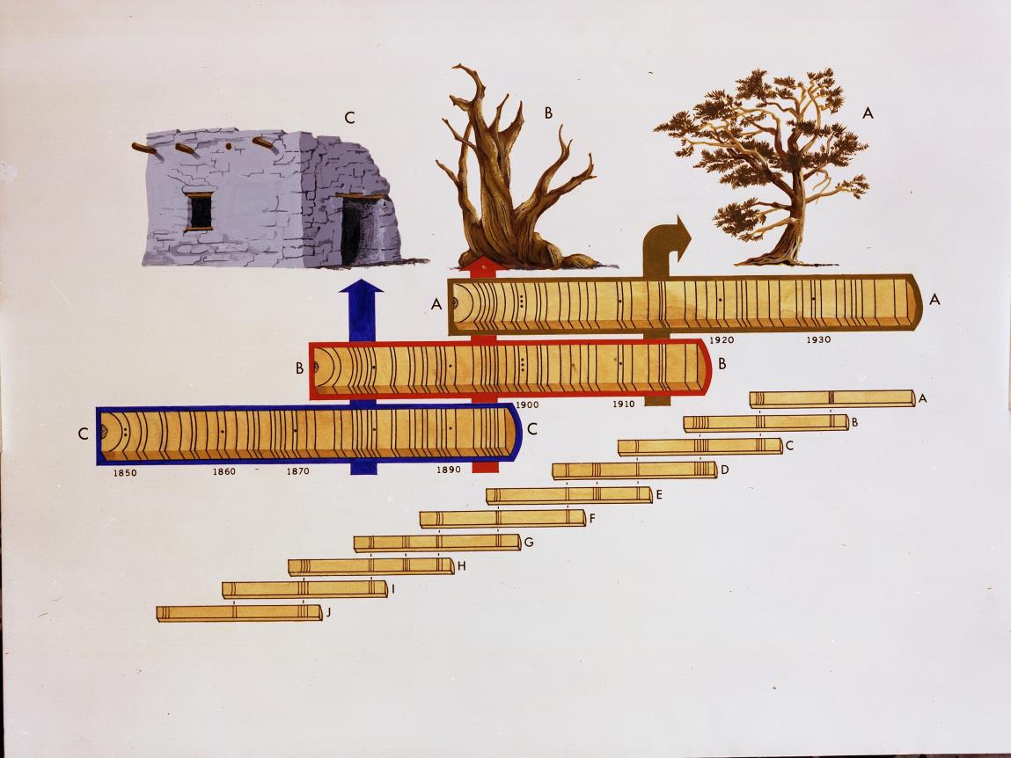
Chronology building

