Slide 1
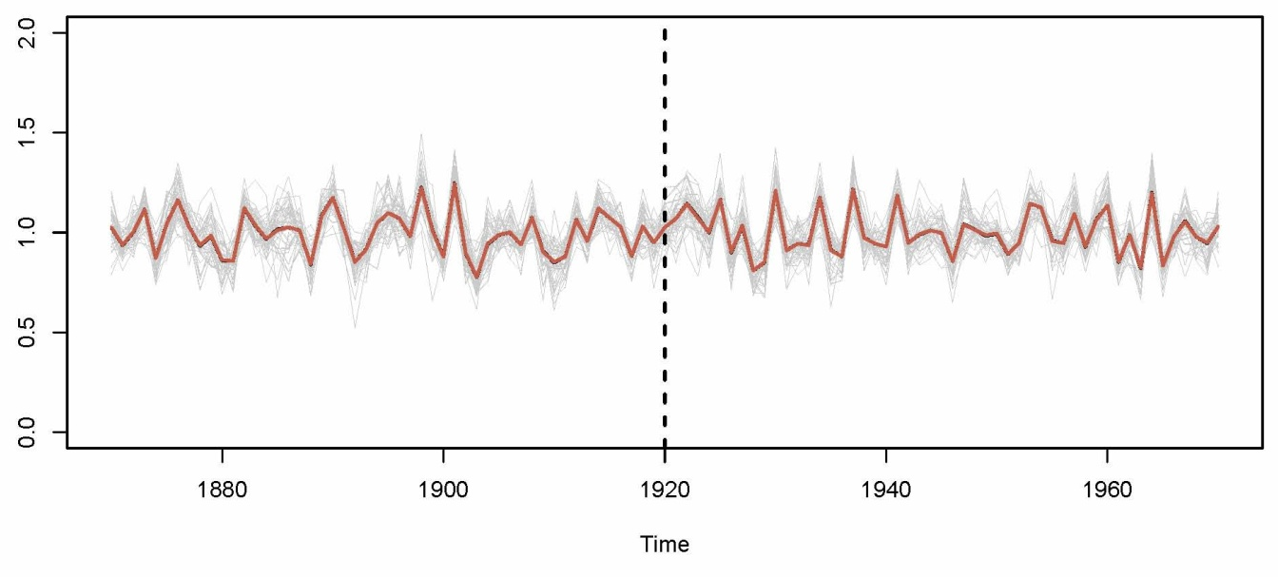
The spatial extend of past climate anomalies
From the site to the continent
Flurin Babst
LTRR, University of Arizona

Slide 2
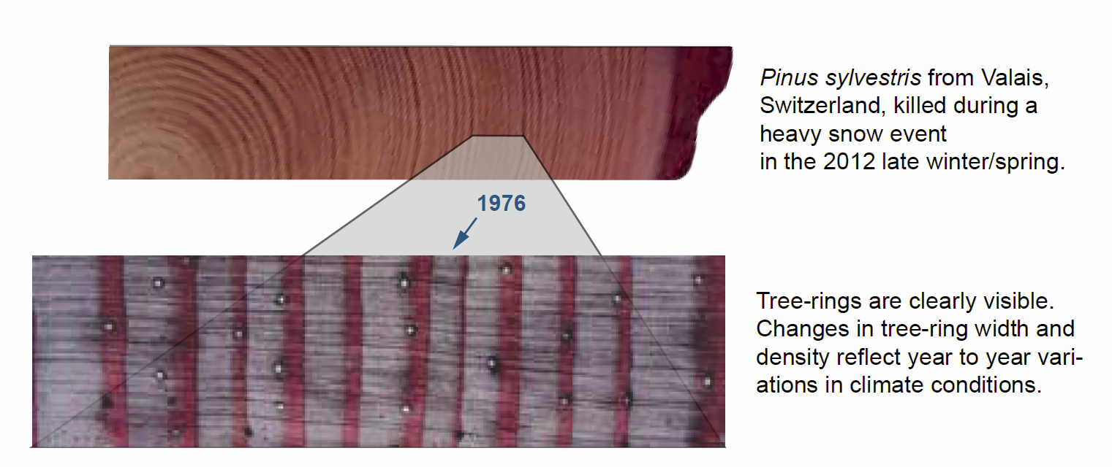
Long-term perspective

Slide 3
Large-scale perspective

Slide 4
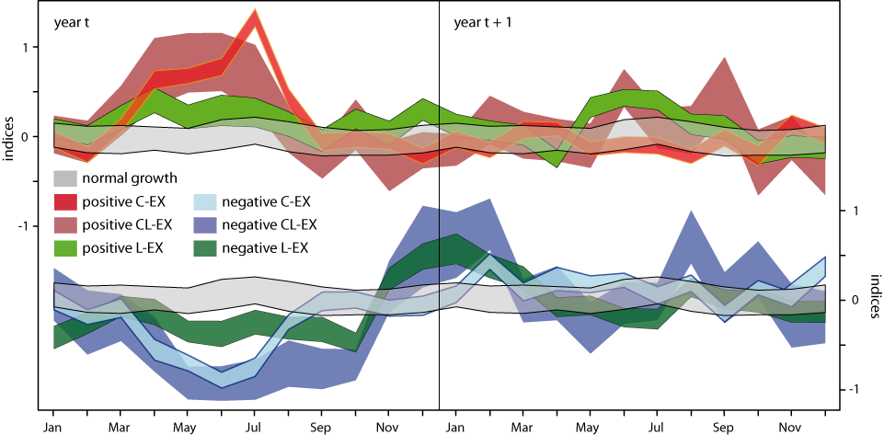
Carry-over effects
→ Unfavorable growth conditions in autumn and high winter temperatures lead to reduced growth in the following year.

Slide 5
Thank you!

