Slide 1
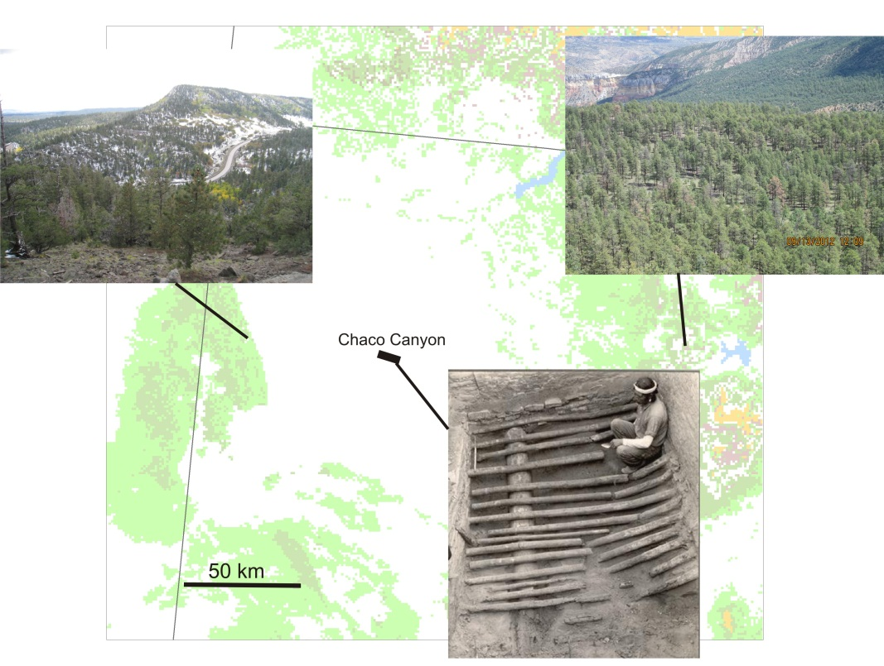
A Test of Dendroprovenancing in the Southwest
Christopher Guiterman, Thomas Swetnam, Jeffrey Dean, Christopher Baisan, & Pearce Paul Creasman
Laboratory of Tree-Ring Research
Earthweek 2013 - Tree-Ring Day, April 9, 2013

Slide 2
Chaco Woodshed Chronology Network

Slide 3
Chuska Mountains

Slide 4
Mesa Alta

Slide 5
Chaco Canyon

Slide 6
Experimental Dendroprovenance

