Slide 1
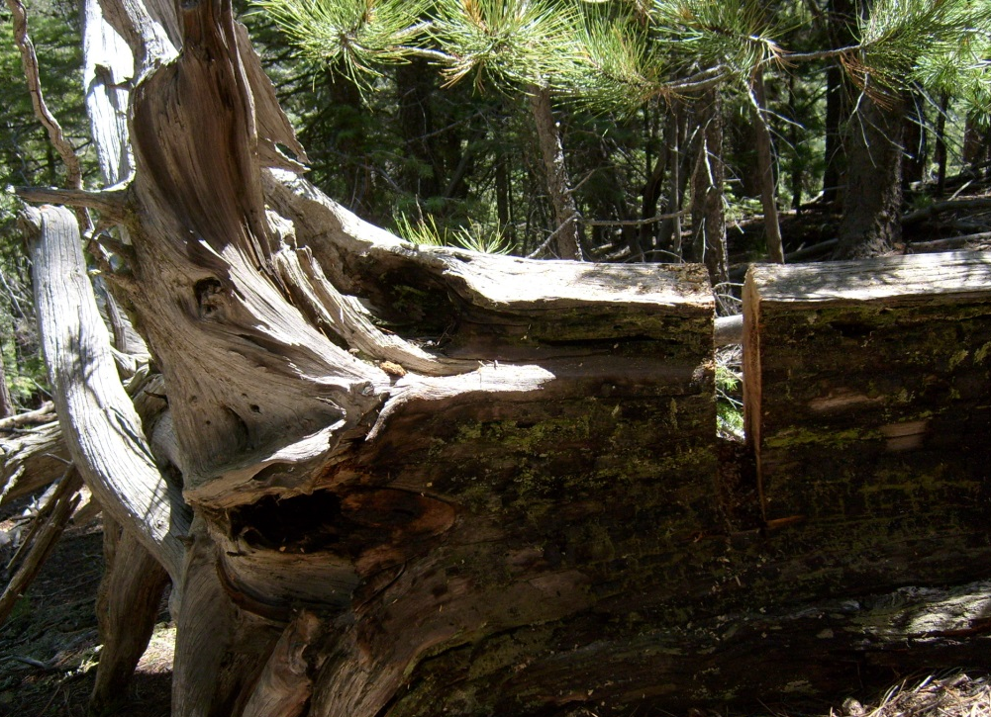
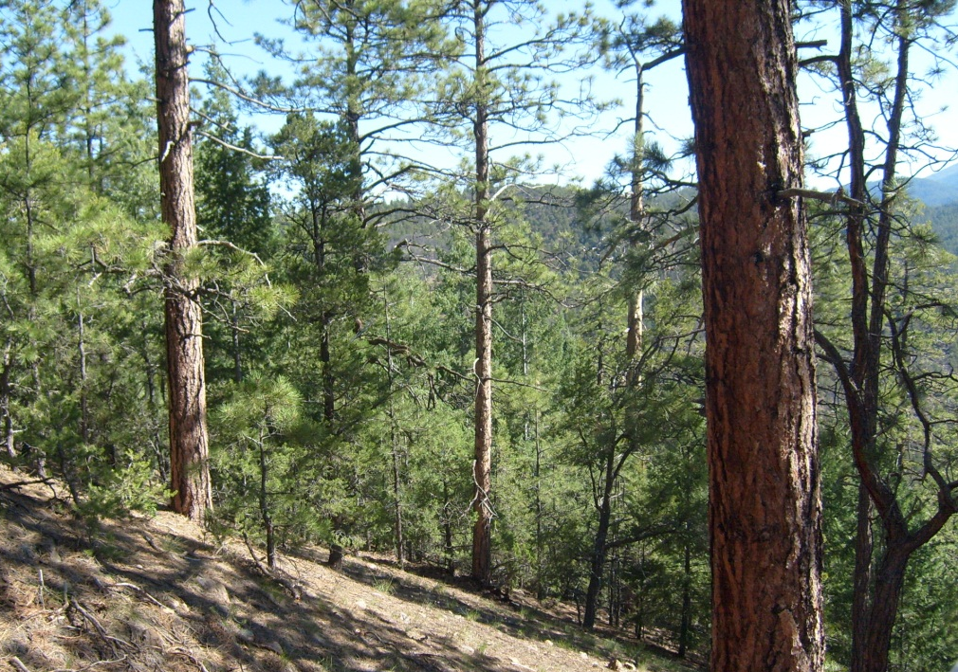
A cross-watershed fire history comparison in the Sangre de Cristo Mountains, New Mexico
Laura Marshall 4/9/13

Slide 2
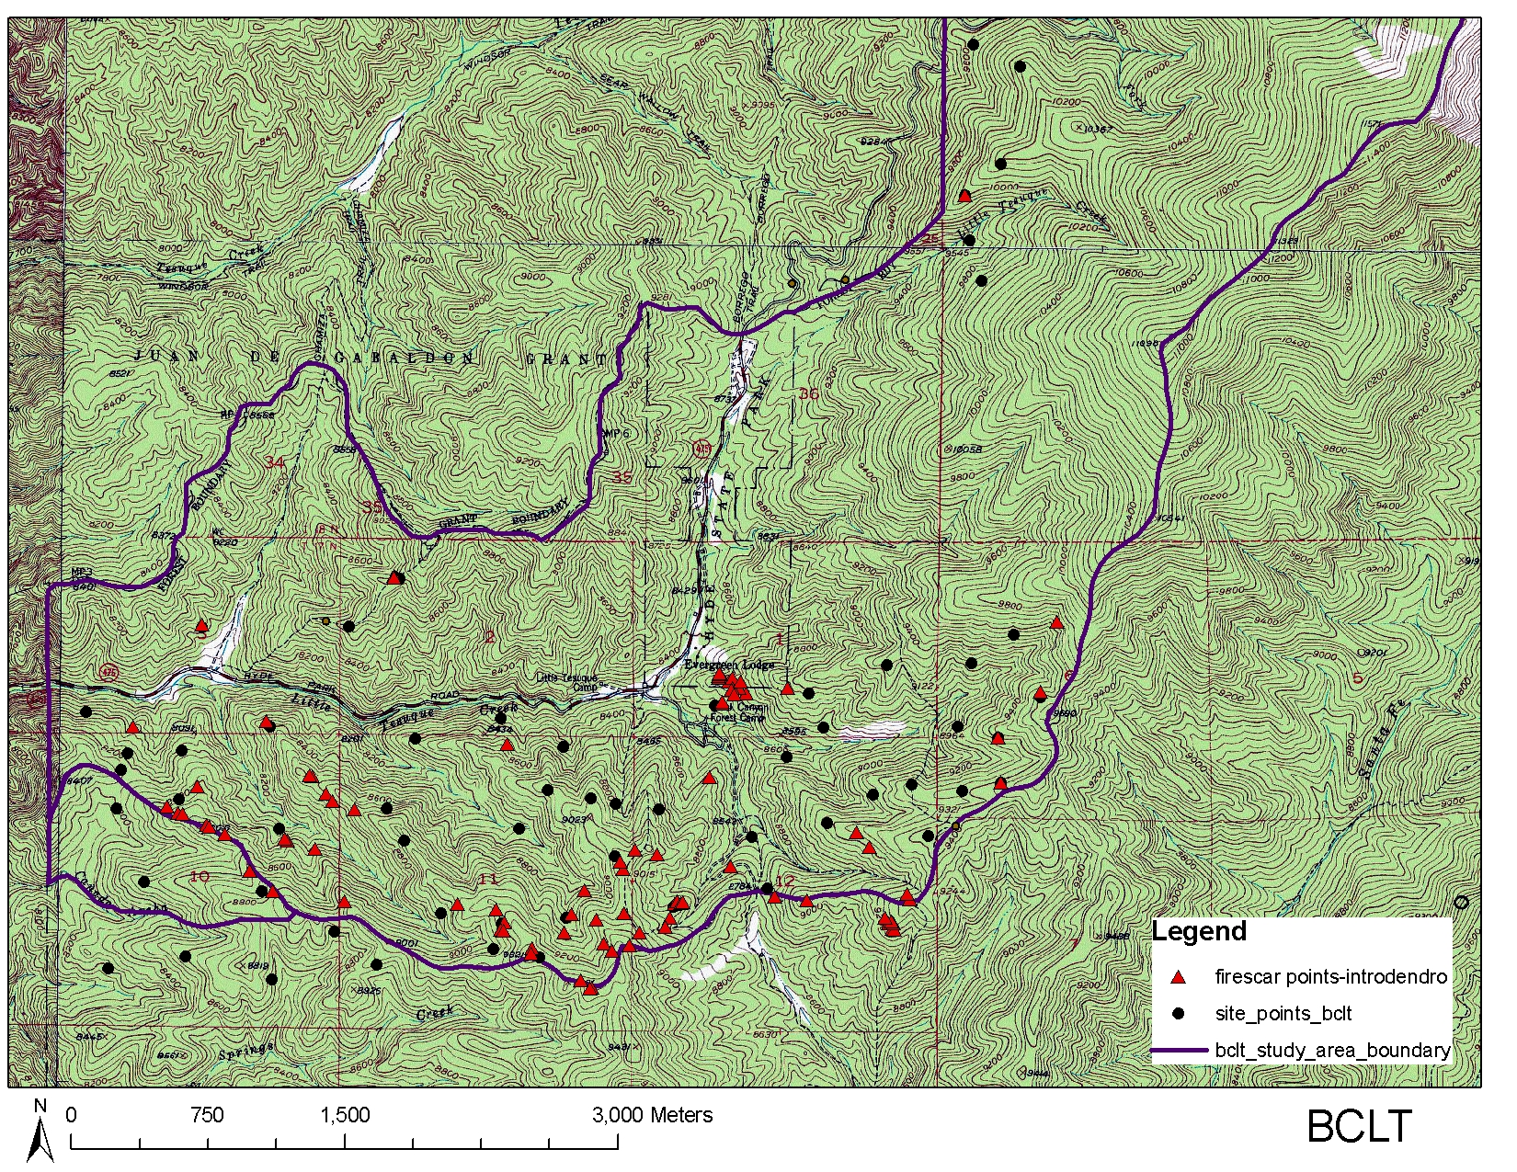
Black Canyon/Little Tesuque Watershed (BCLT), north of Santa Fe Watershed (SFW)
Introduction
Fire reconstruction: comparison between two watersheds
What size area should manage for fire to replicate past conditions?
Watershed versus “fireshed” as a management unit
On-the-ground factors that contribute to major modern fires
2011: Las Conchas versus Pacheco
Fire spread and connectivity across a landscape
Where do they connect?
Topographic factors influencing cross-watershed connectivity
Notes:
Las Conchas vs Pacheco

Slide 3
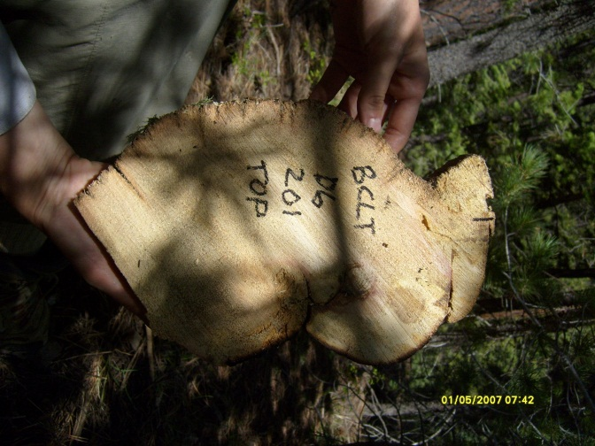
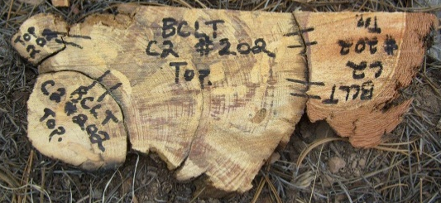
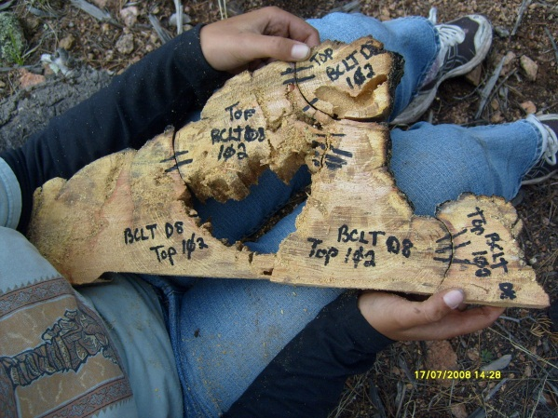
Methods
Field collection 2009-2010
111 fire scarred trees total
Compare to reconstruction in SFW
Fire spread across elevations
(Margolis and Balmat 2009)
Fire spread across watersheds
Subset of trees:
11 dated so far
along watershed boundary

Slide 4
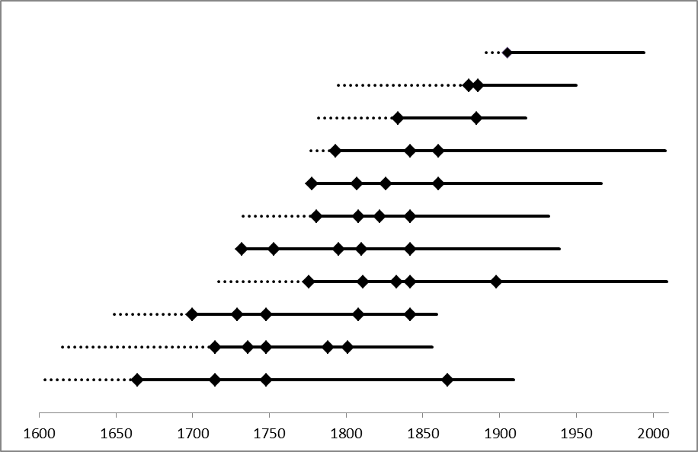
Results
Samples recording fire
1604-2010
Year

Slide 5
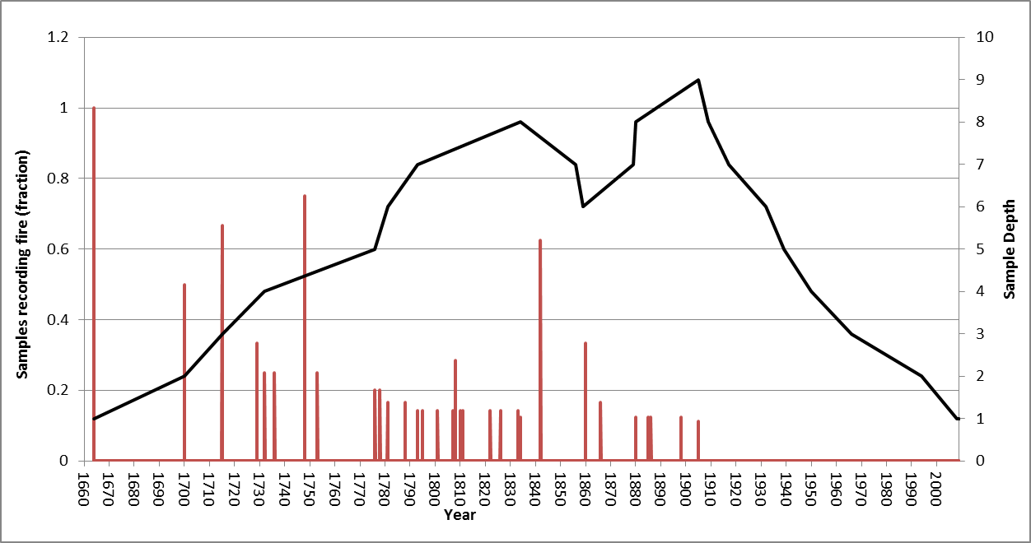
Results
Samples Recording Fire
Sample Depth
Year
Widespread fire (>20% scarred)
BCLT: 1700, 1715, 1729, 1748, 1842, 1860
SFW: 1700, 1715, 1729, 1748, 1773, 1842

Slide 6
Results
SFW
Ponderosa Pine
BCLT
Search area (ha) 500 1600
 | >20% scarred | All | >20% scarred | All
Mean fire interval (years) | 16 | 8.0 | 17.1 | 4.3
Median fire interval | 16.5 | 6.0 | 15.0 | 4.0
Interval range | 2-34 | 1-36 | 7-63 | 1-16

Slide 7
Conclusions
Fire interval is characteristic of SW ponderosa pine forest
Similar fire intervals between SFW and BCLT
Widespread fire years mostly the same across watersheds
Probably need to thin BCLT to reduce risk to SFW
Absence of fire after 1900
Further Work
Statistical analysis
Similarity between watersheds; SEA, etc. for climatic influences
Spatial analysis: fire year maps across watersheds
Compare to modeled fire spread

Slide 8
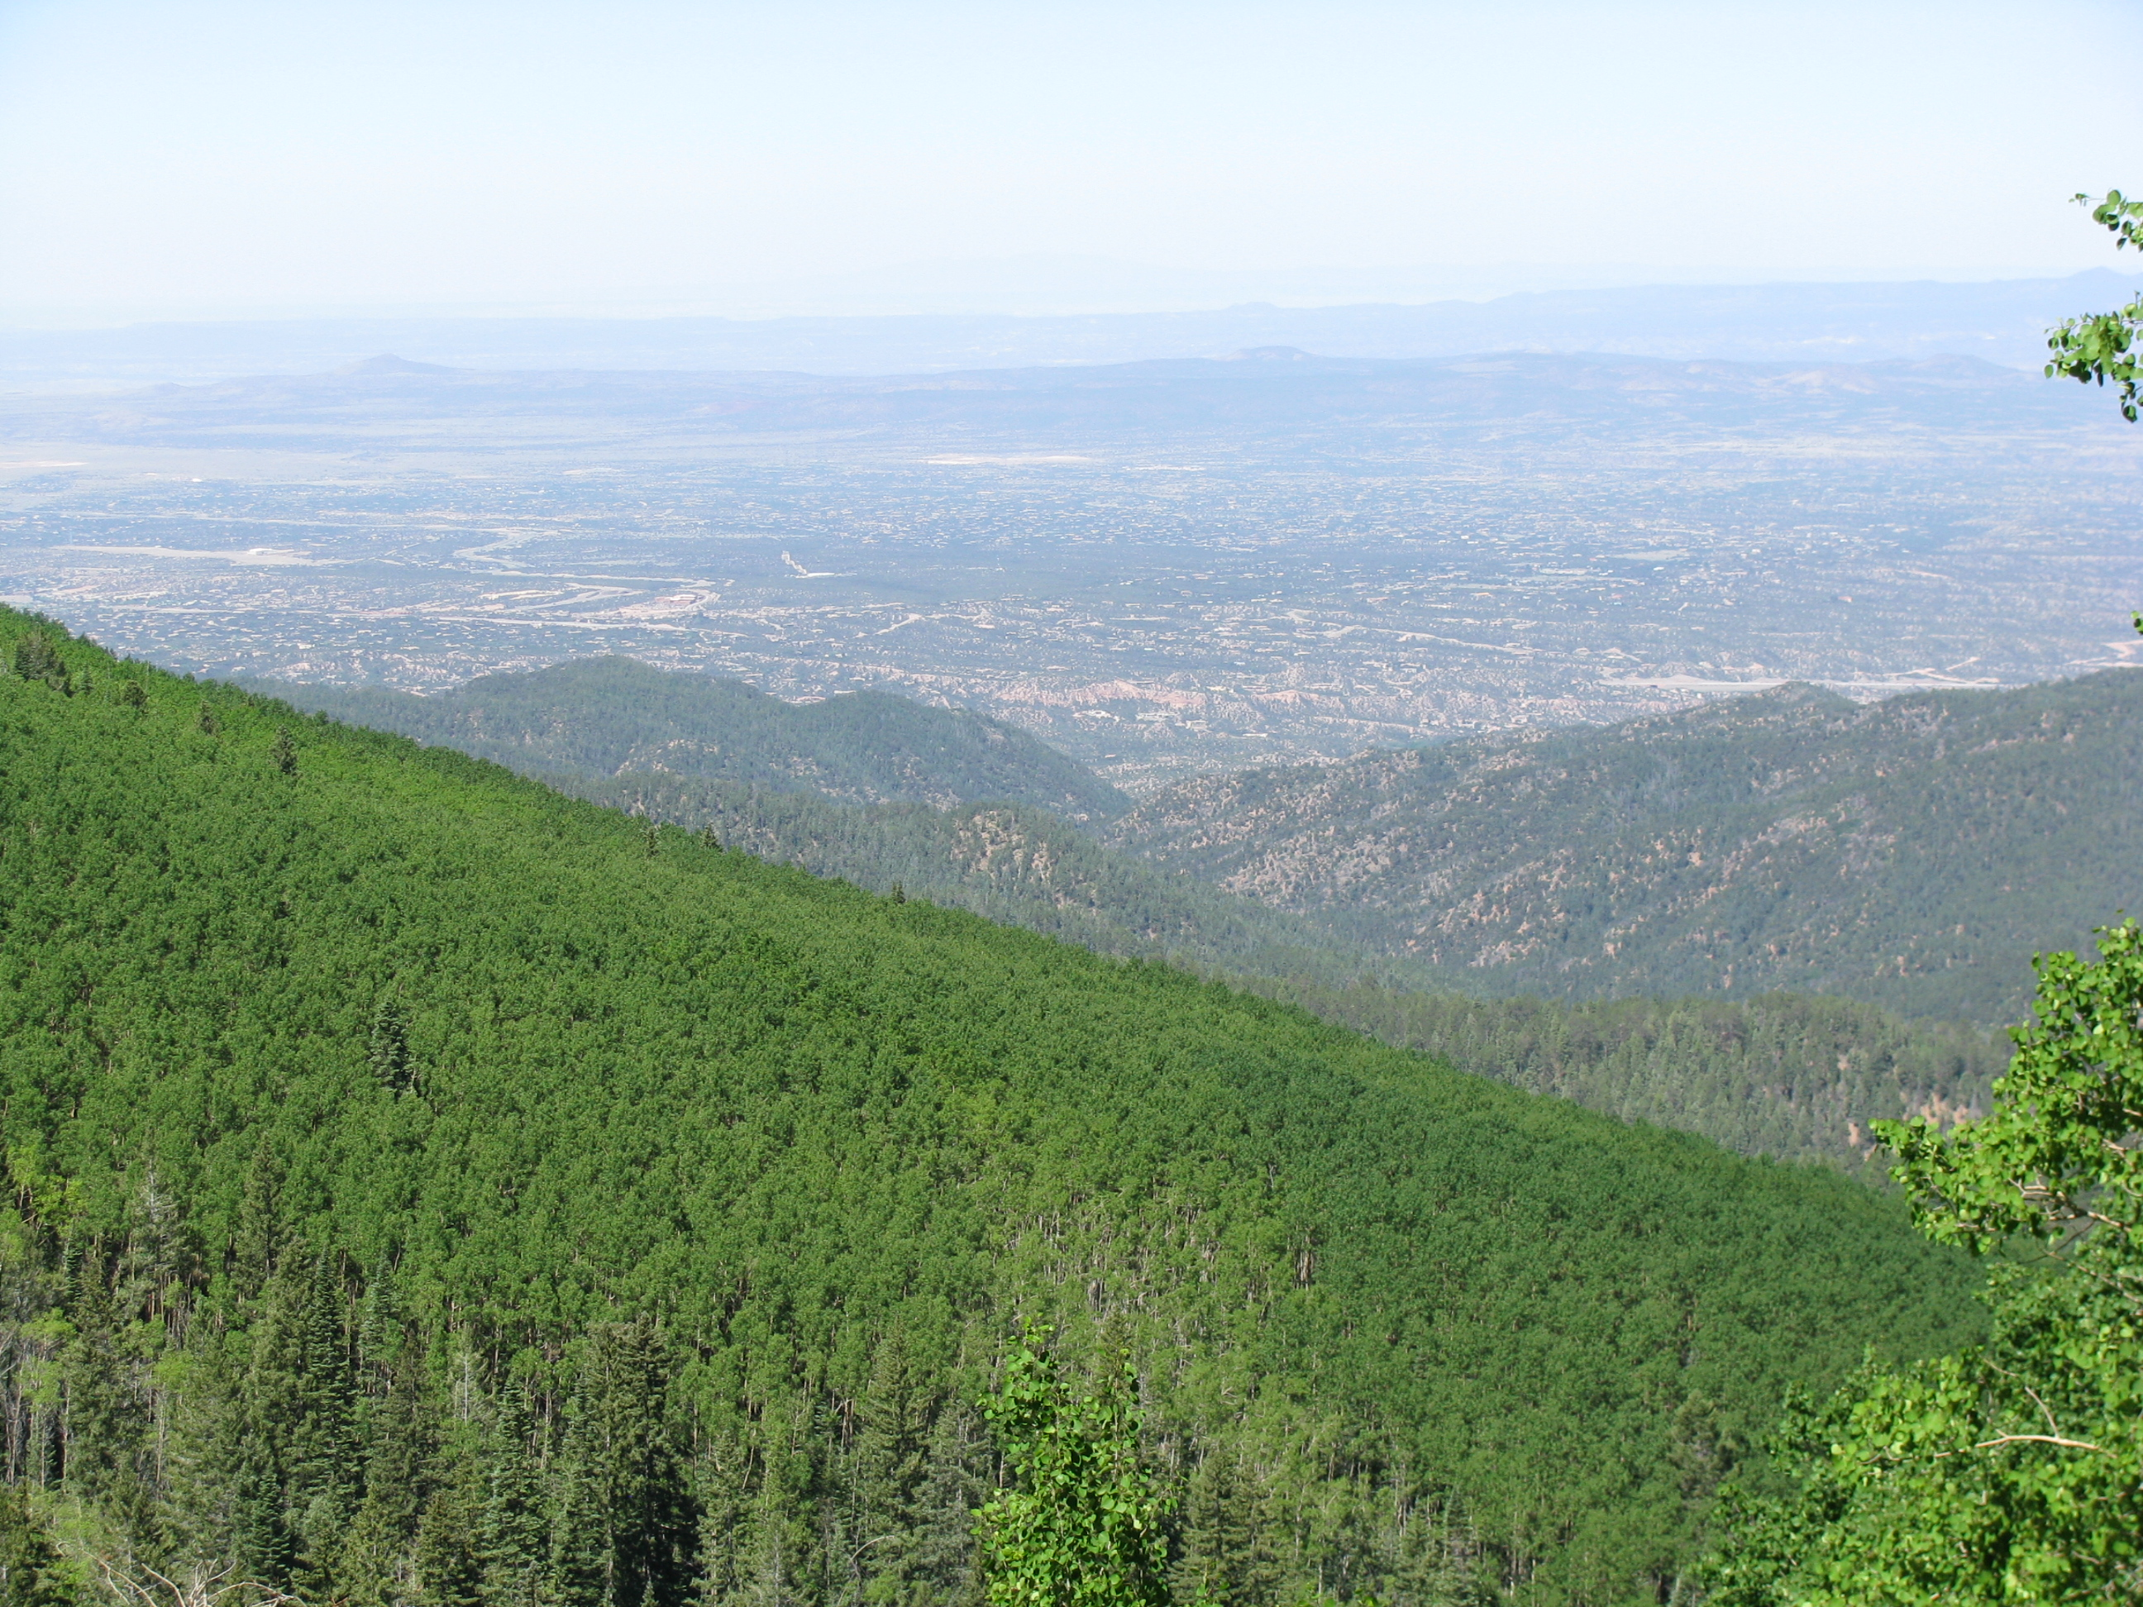
Thank you!

