Slide 1
Tales Tree Rings Tell
Mrs. Pamela Pelletier
Community Planner
University of Arizona

Slide 2
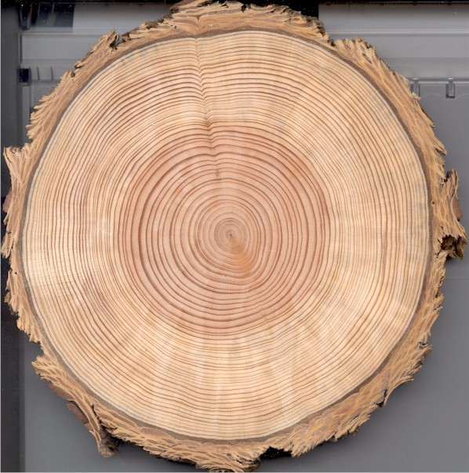
What do you see?
Image from: www.goscienceseven.com

Slide 3
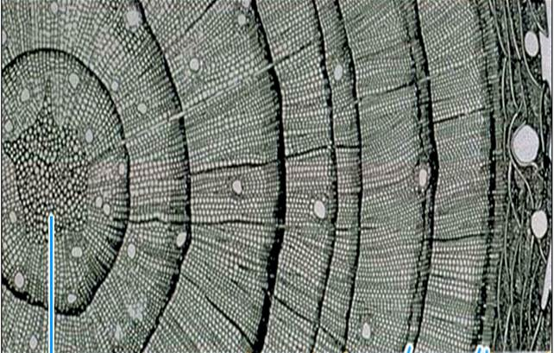
Cross Section
Pith
Early Wood
Late Wood
Annual Ring
Bark

Slide 4
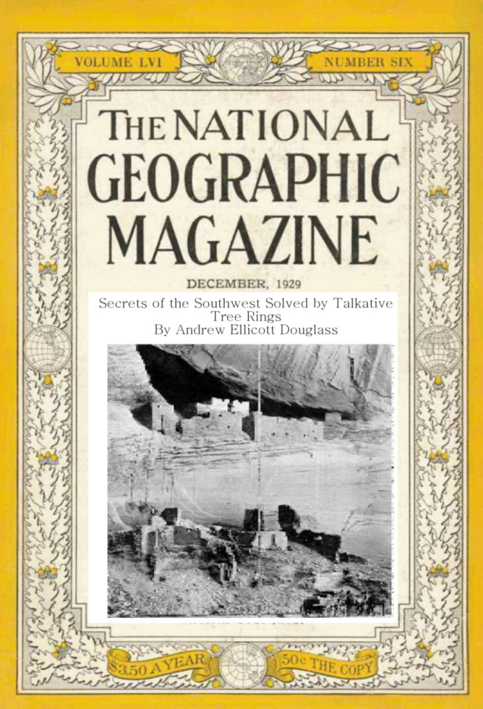
Birth of Dendroarchaeology
“Secrets of the Southwest Solved by Talkative Tree Rings”
by A. E. Douglass
National Geographic magazine, December 1929
Pueblo Chronology
HH-39
living tree chronology
1200
}
700
1300
present
“the gap”

Slide 6
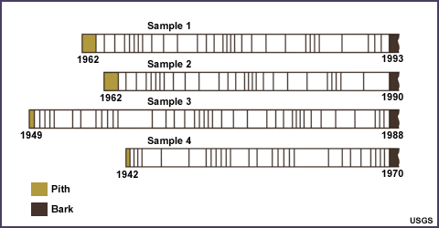
Cross Matching

Slide 7
1942
1970
1949
1962
1962

Slide 8
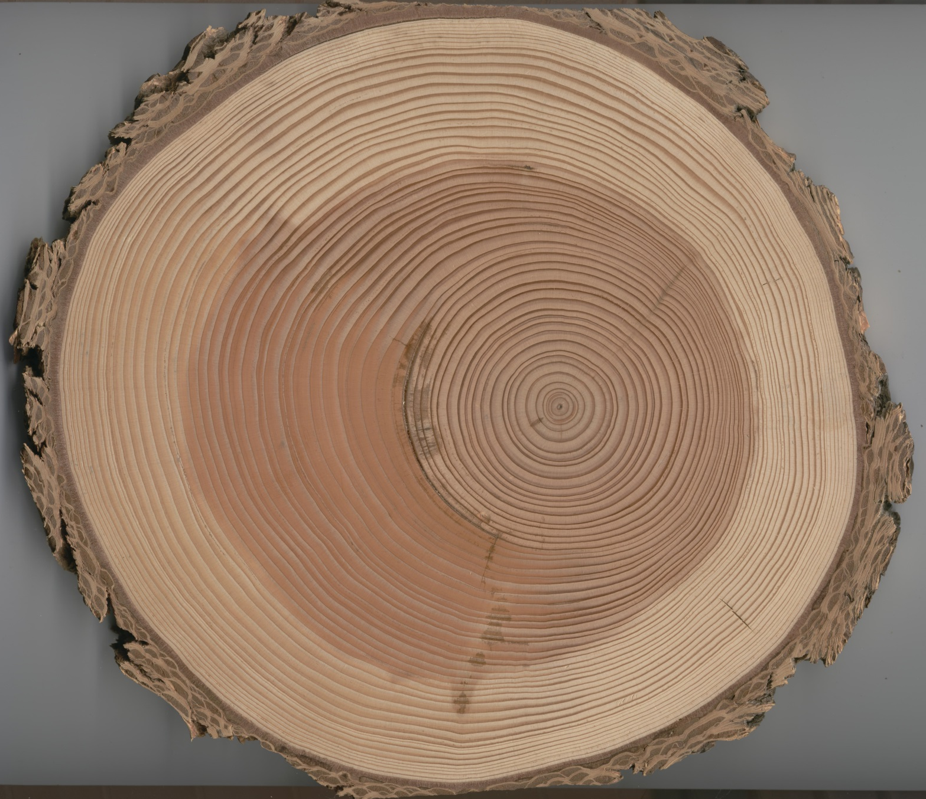
Geomorphic Processes

Slide 9
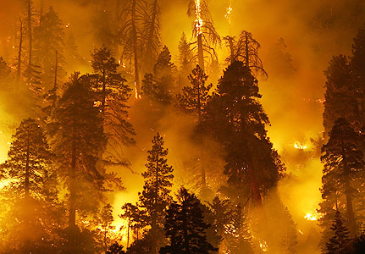
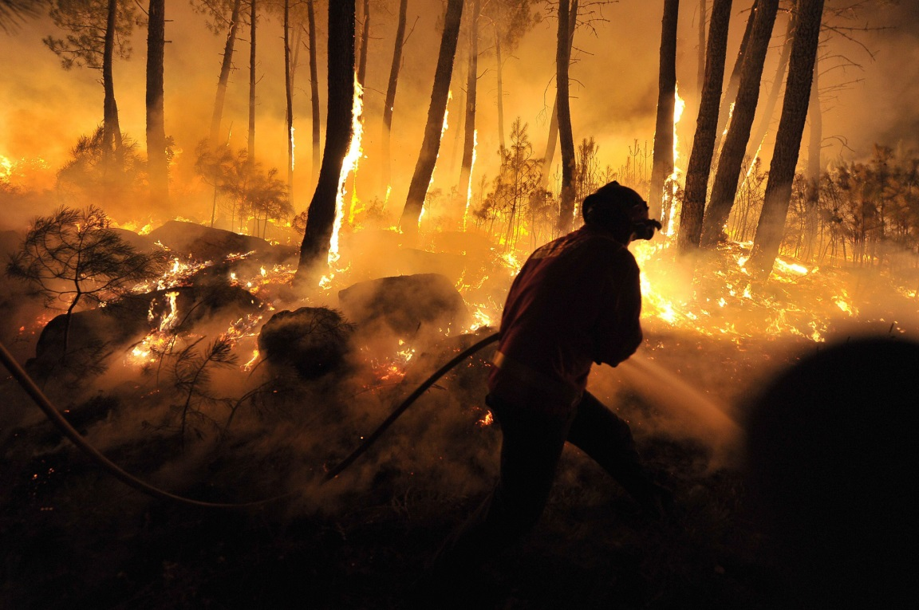
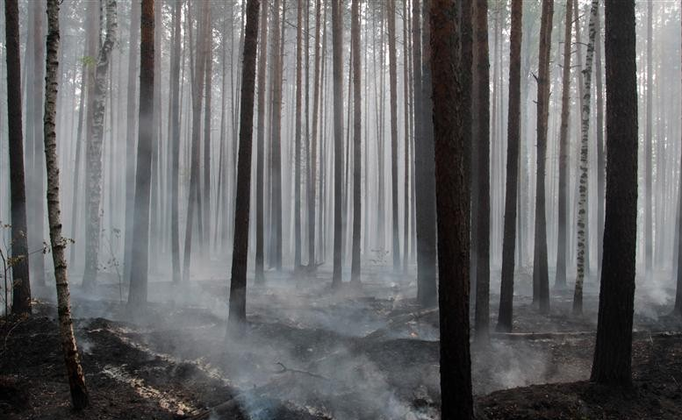
Images from: weadapt.org; www.projectshum.com; & blogs.ft.com

Slide 10
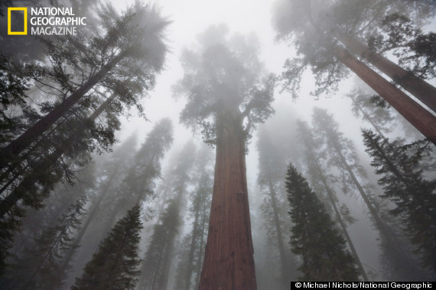
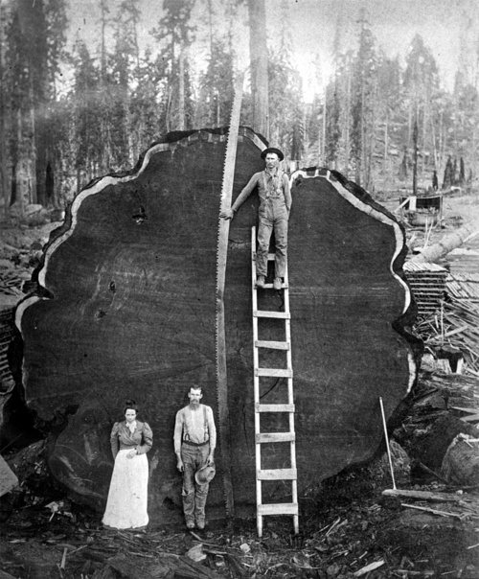
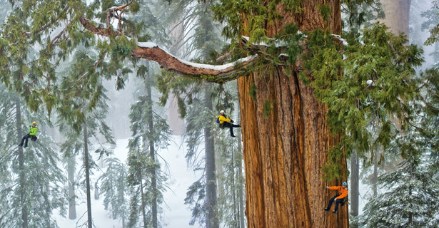
Images from: ngm.nationalgeographic.com; scanzen.tumblr.com; www.huffingtonpost.com

Slide 11
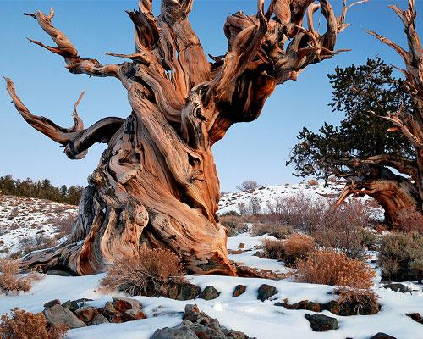
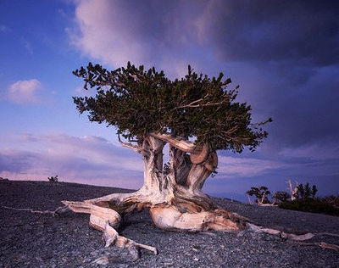
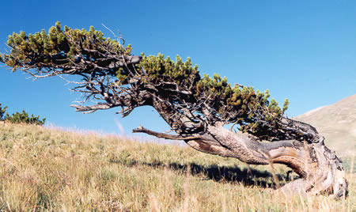
Images from: www.mn.com; www.dingtwist.com; & www.woodmagazine.com

Slide 12
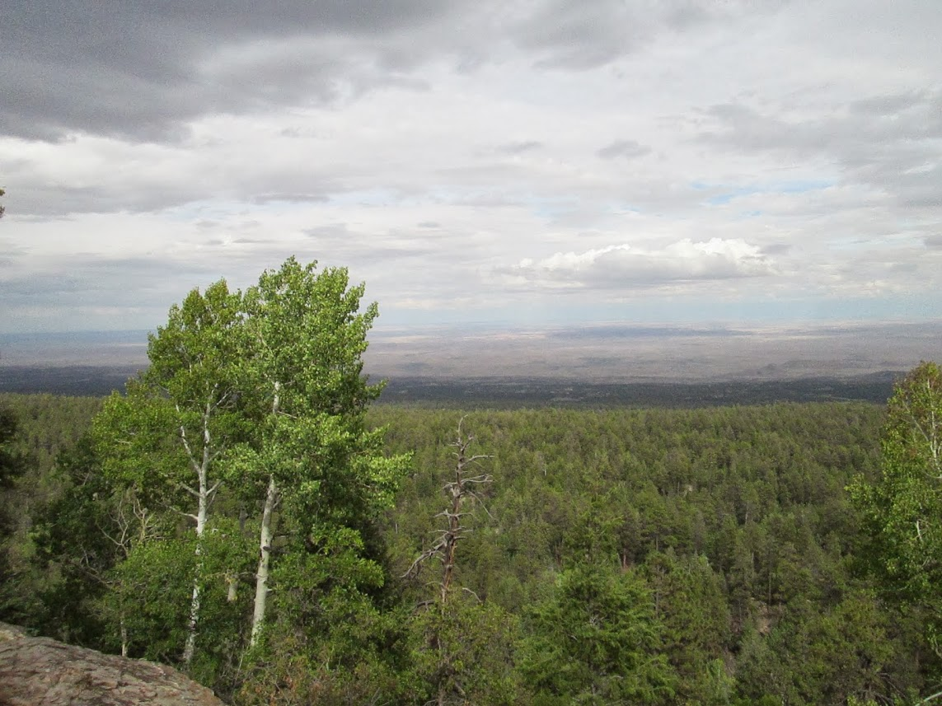
Questions?
Thank you!
Visit www.ltrr.arizona.edu

