Slide 1
Tales Tree Rings Tell
Mrs. Pamela Pelletier
Community Planner
University of Arizona

Slide 2
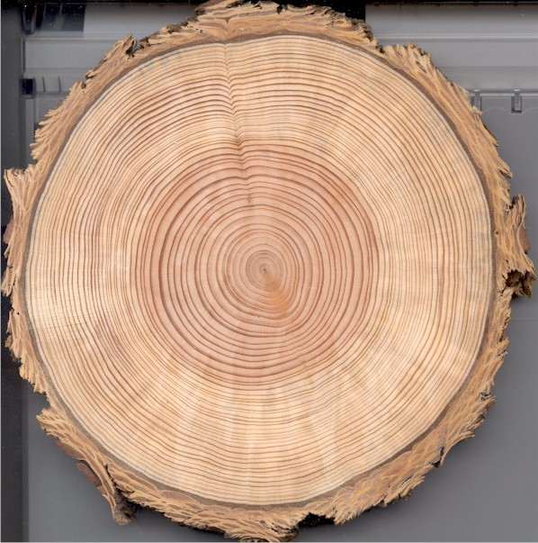
What do you see?
Image from: www.goscienceseven.com

Slide 3
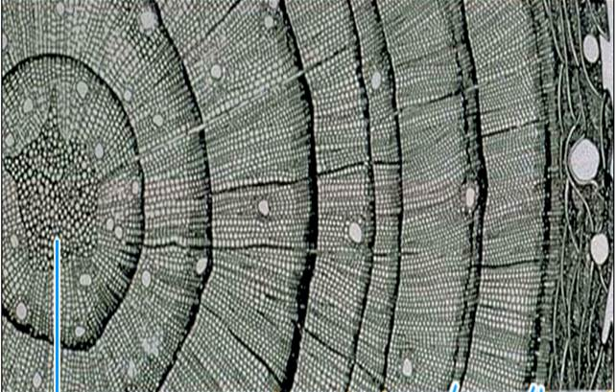
Cross Section
Pith
Early Wood
Late Wood
Annual Ring
Bark

Slide 4
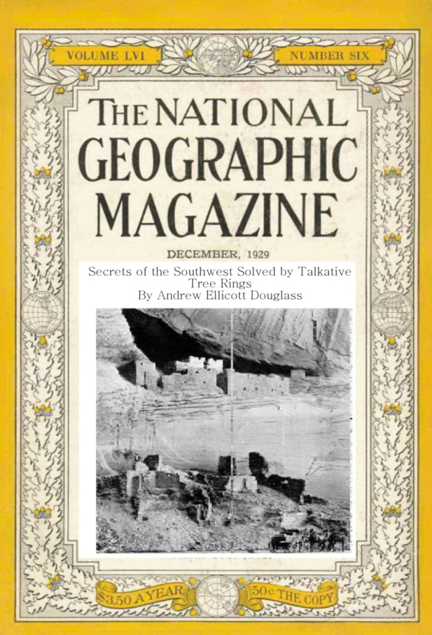
Birth of Dendroarchaeology
“Secrets of the Southwest Solved by Talkative Tree Rings”
by A. E. Douglass
National Geographic magazine, December 1929
Pueblo Chronology
HH-39
living tree chronology
1200
}
700
1300
present
“the gap”

Slide 5
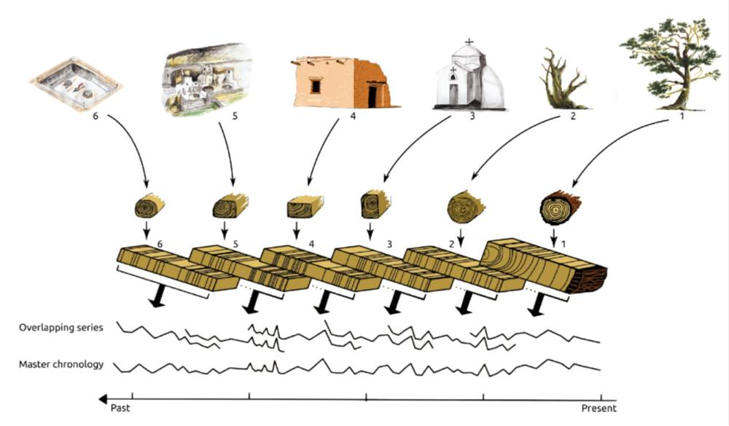

Slide 7
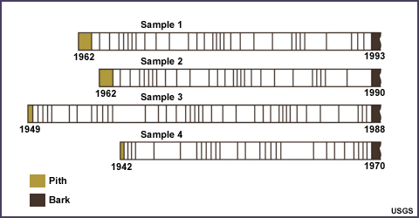
Cross Matching

Slide 8
1942
1970
1949
1962
1962

Slide 9
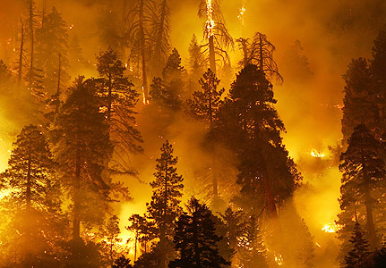
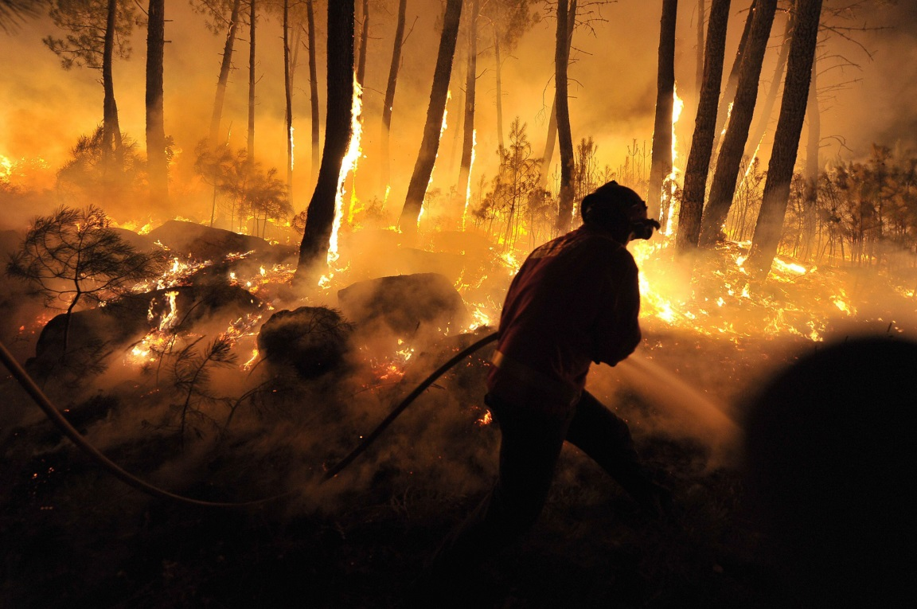
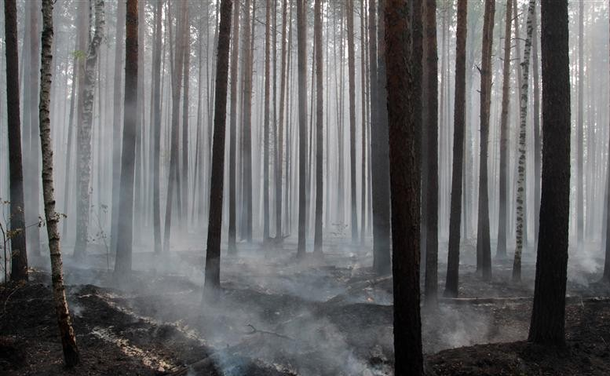
Images from: weadapt.org; www.projectshum.com; & blogs.ft.com

Slide 10
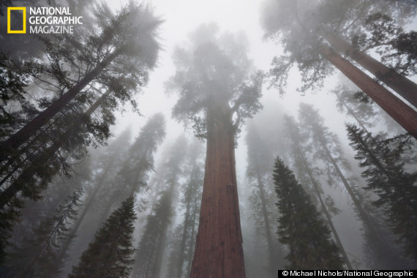
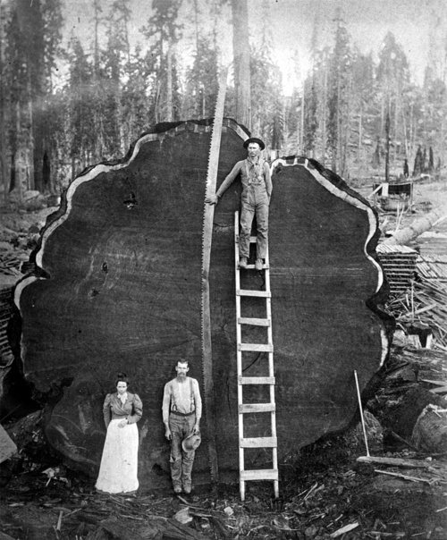
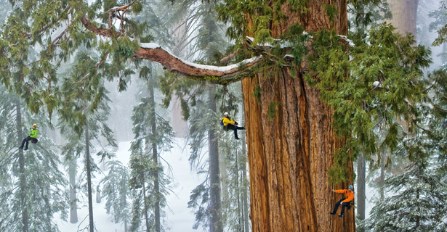
Images from: ngm.nationalgeographic.com; scanzen.tumblr.com; www.huffingtonpost.com

Slide 11
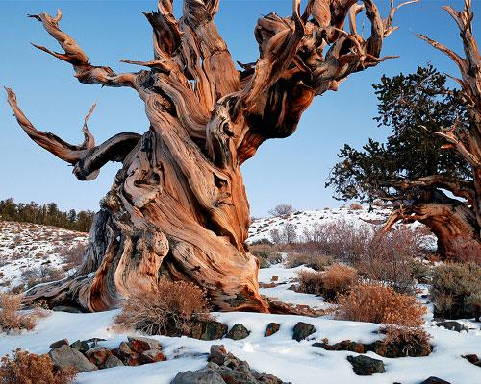
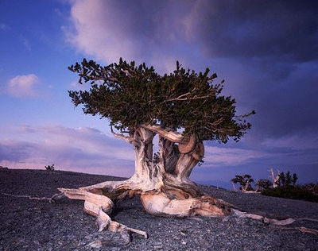
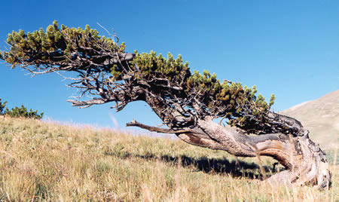
Images from: www.mn.com; www.dingtwist.com; & www.woodmagazine.com

Slide 12
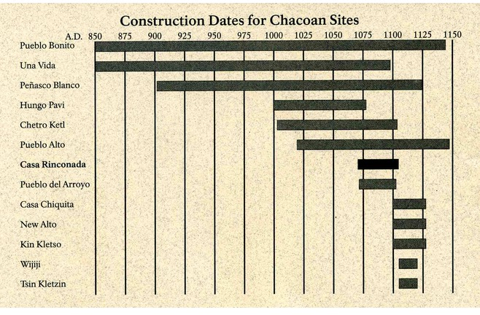
Chaco Culture Timeline

Slide 13
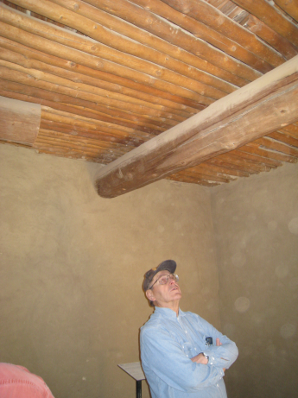
Beams of chaco culture
Photo: O.C. Havens, 1925

Slide 14
The Chaco Halo
Cameron & Toll, 2001

Slide 15
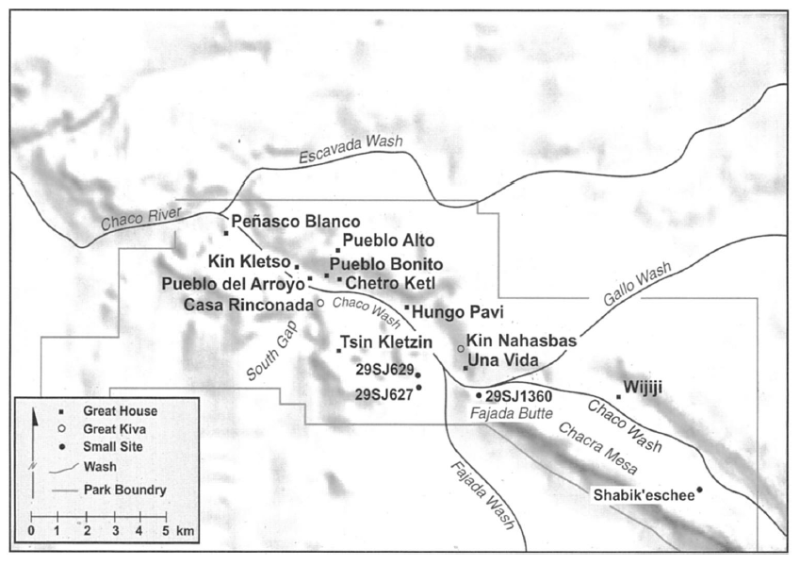
Downtown Chaco
Cameron & Toll, 2001

Slide 16
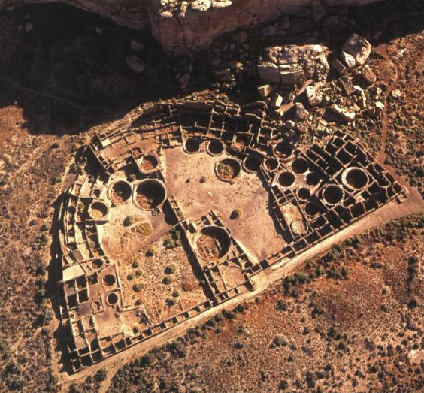
Chaco is an Environmental Enigma
Chaco Canyon
Pueblo Bonito
Notes:
Massive structures in a place that’s pretty desolate

Slide 17
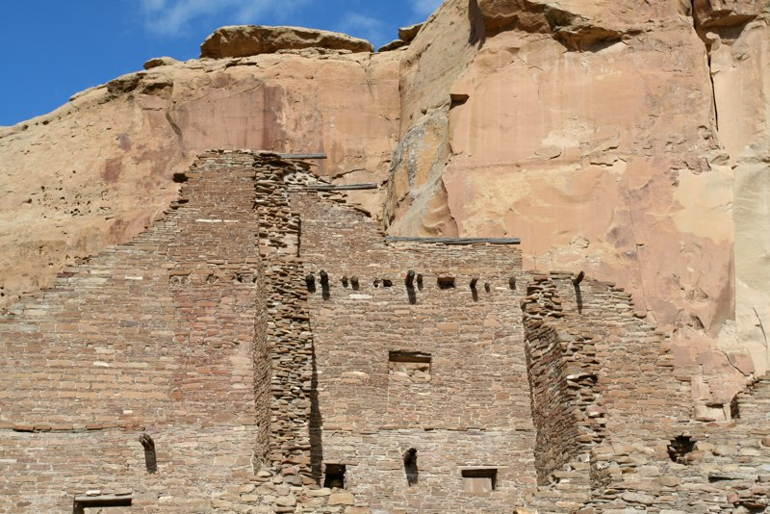
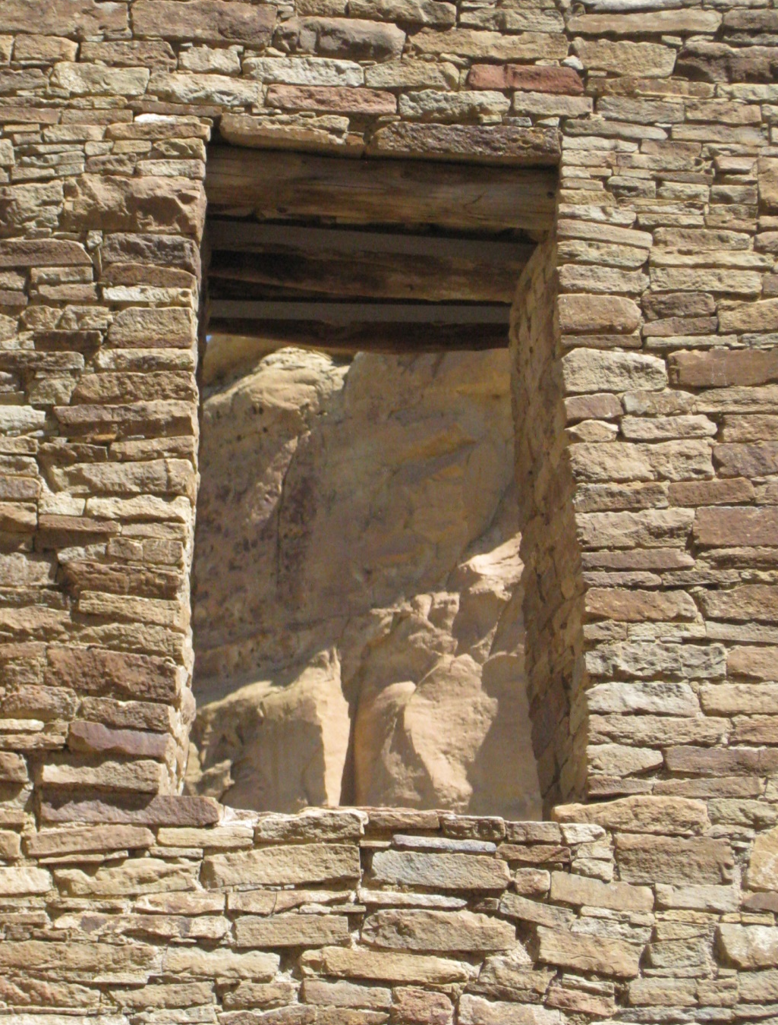
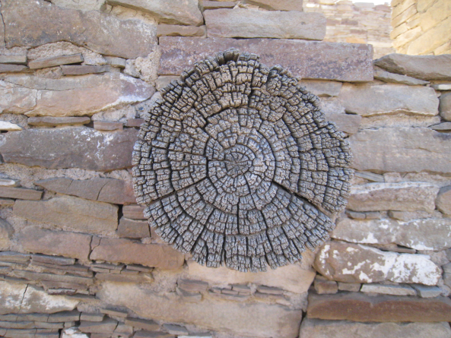

Slide 18
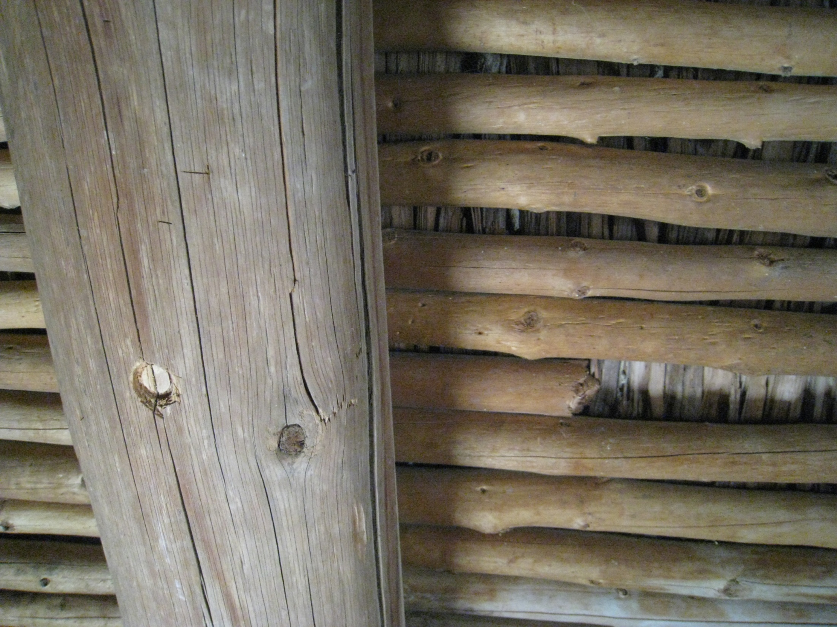
240,000 trees
Notes:
Ask yourself: Where did all that wood come from?

Slide 19
Where did all that wood come from?

Slide 20
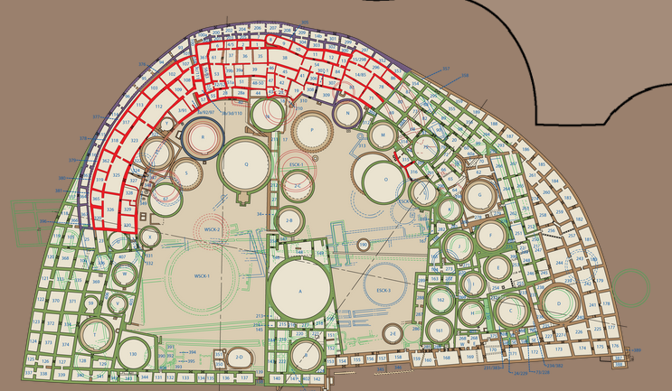
1924 Discovery of the “rooted tree” in the west plaza of Pueblo Bonito
JPB-99: A.D. 731 - 981
Photo: O.C. Havens, 1924

Slide 21
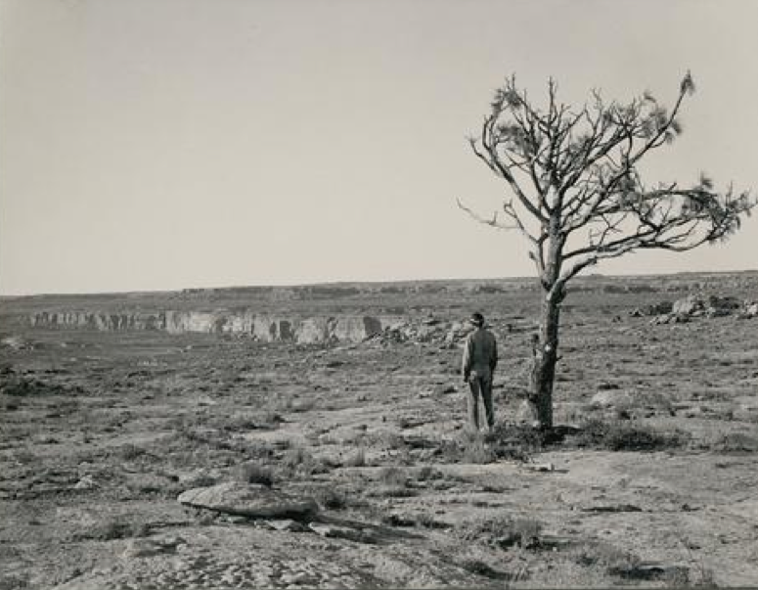
Remnant Pines of Chaco Canyon: Evidence of a prehistoric forest?
Photos: Neil M. Judd, 1926

Slide 22
The Plaza Tree probably didn’t grow where it was found
Plaza Stratigraphy
Depth at discovery
Chaco Culture National Historical Park Brochure
Probable rooting depth
Wills 2012

Slide 23
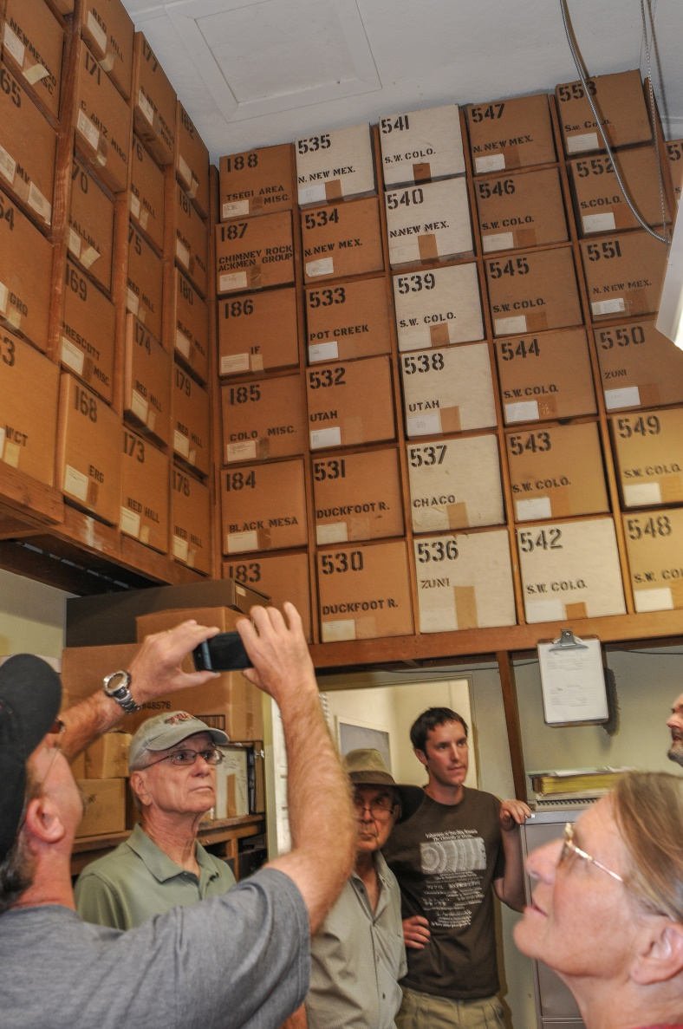
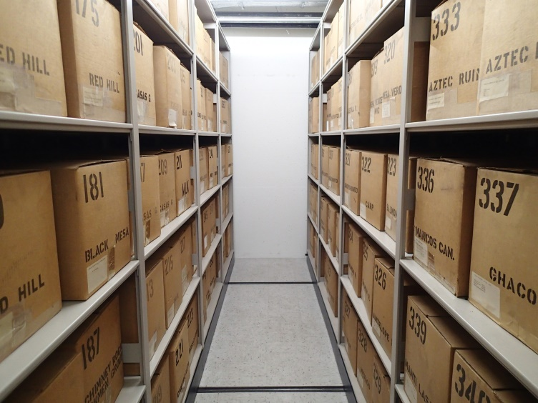
New Research using old collections: The Tree-Ring Archives
New LTRR archive shelving funded by Save America’s Treasures and the National Science Foundation grants.
Photo: P.K. Weiss
Notes:
Source of new knowledge from old collections

Slide 24
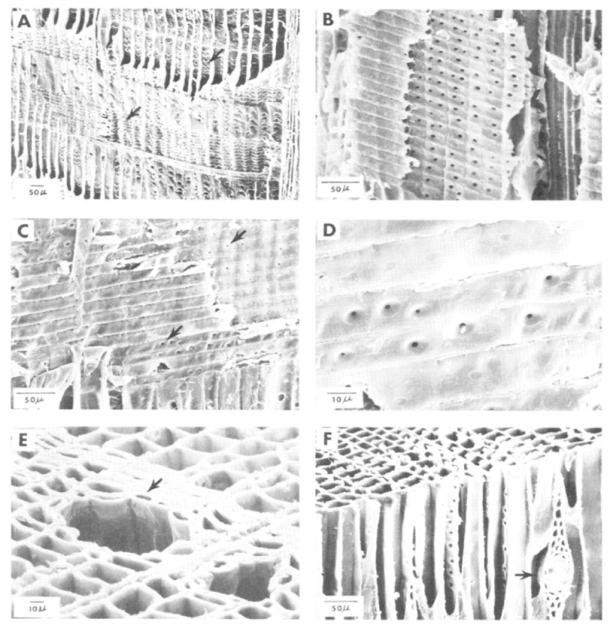
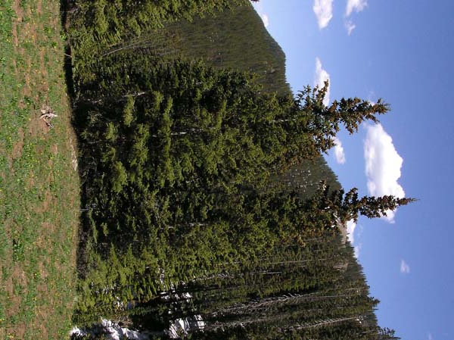
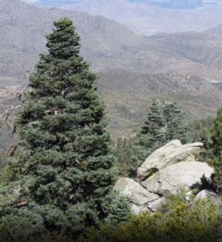
Identification of spruce and fir trees in the archaeological record. These species only grow at high elevations

Slide 25
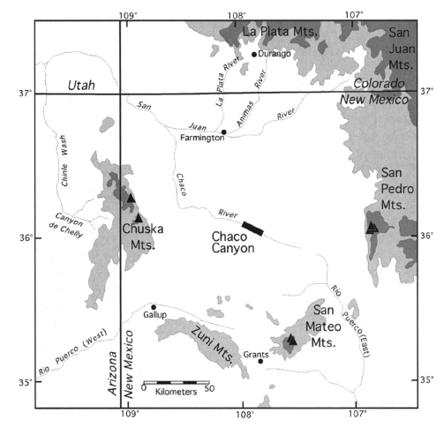
The “Chaco Woodshed”
English et al. 2001

Slide 26
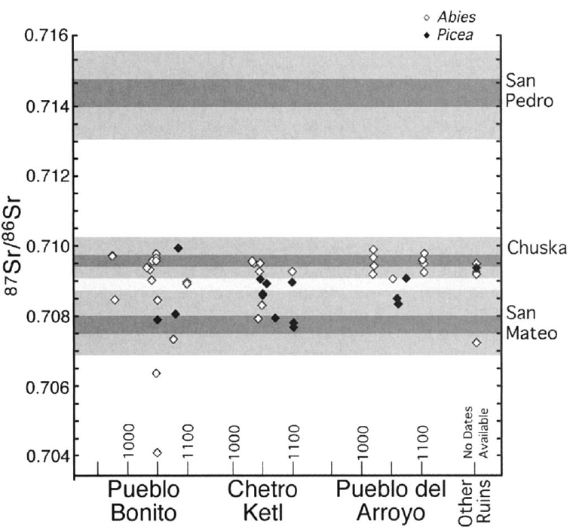
Main sources for spruce and fir are Chuska Mountains and Mt Taylor
Definitive evidence for long-distance transport of wood for > 30 mi to get to Chaco

Slide 27
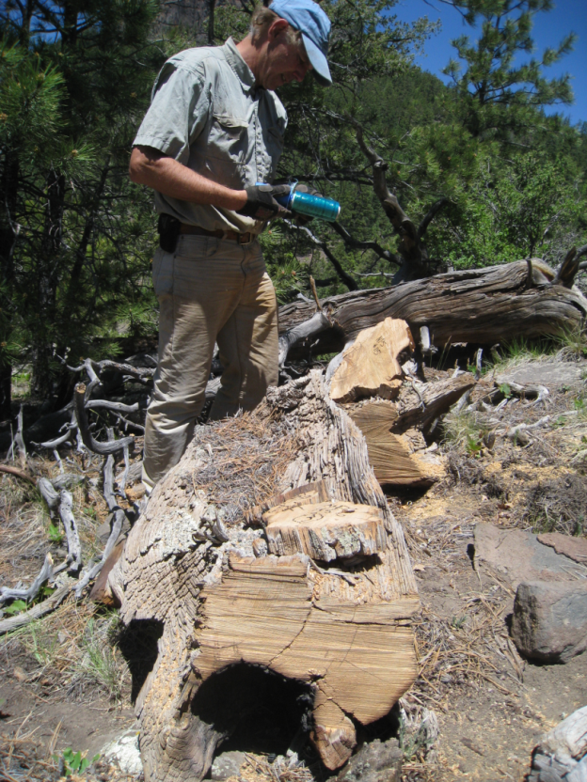
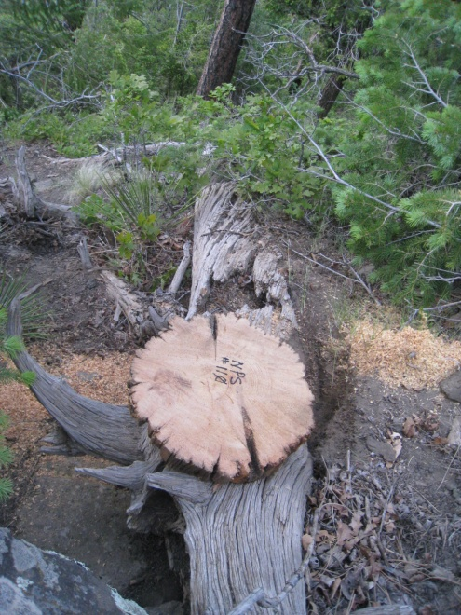
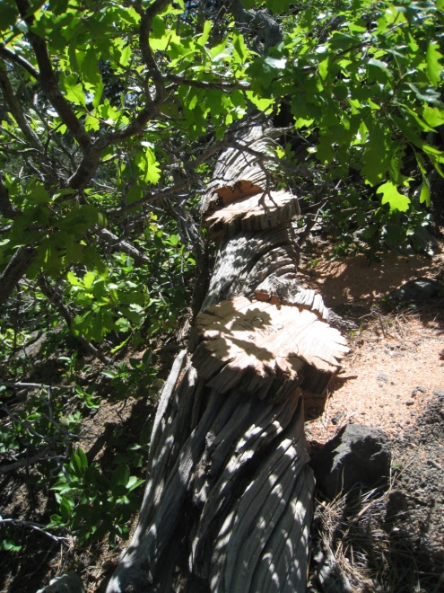
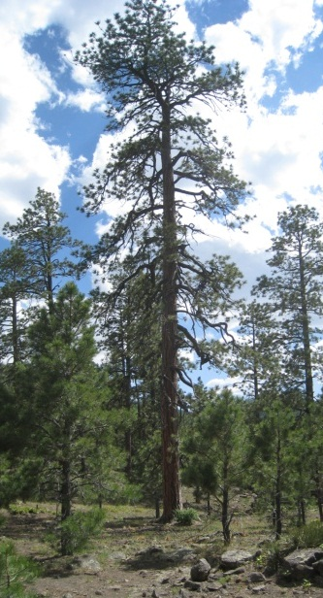
Chuska Mountain Chronology
1173 - 1441
1313 - 1584
A.D. 870 - 1090
1571 - present
Sampling on Narbona Pass since 2011 yielded a millennium-length ponderosa pine tree-ring chronology.

Slide 28
Chuskas had strong Cultural and Land-use Ties
Narbona Pass Chert in the Chuska Mountains
Chuskas
Chuska Mountains Provided:
Timber
Stone tools
Utilitarian pottery
Maize
Game and Turkeys

Slide 29
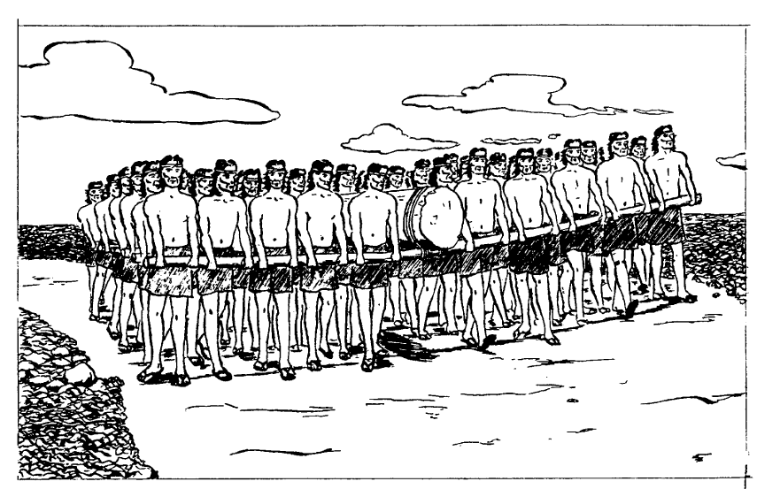
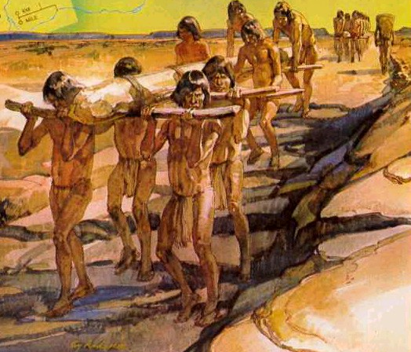
How did they carry all of that wood?
Conventional notion:
Snygg and Windes 1998
National Geographic Society

Slide 30
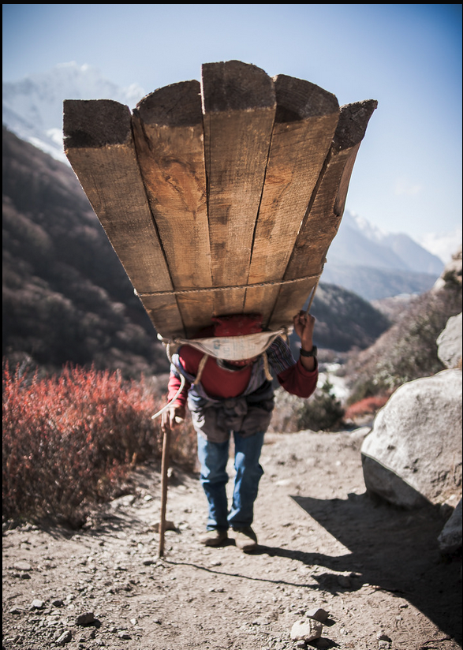
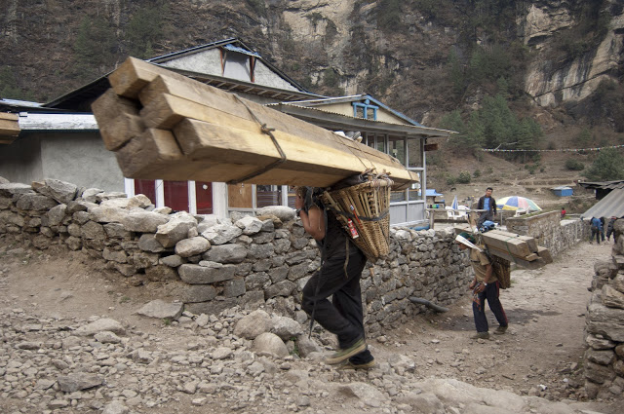
How did they carry all of that wood?
Likely alternative, based on Nepali porters
Photo: Rob Hart
Photo: Arsenii Gerasymenko

Slide 31
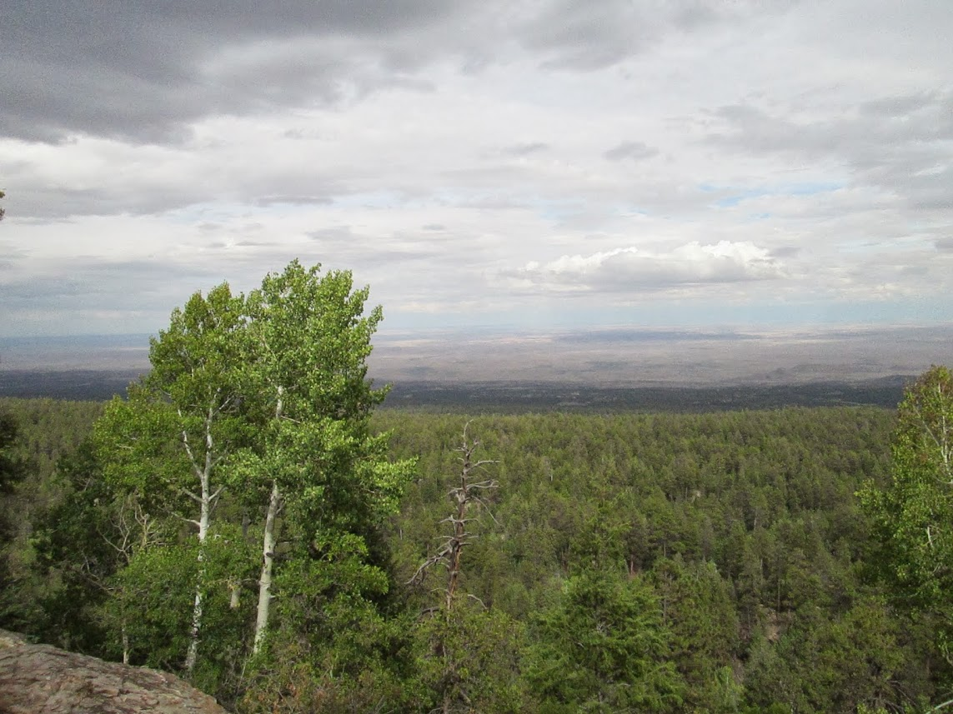
Questions?
Thank you!
Visit www.ltrr.arizona.edu

