Slide 1
Crossmatching and Crossdating Activity: Match the ring patterns to identify where these 4 tree-ring cores overlap.

Slide 2
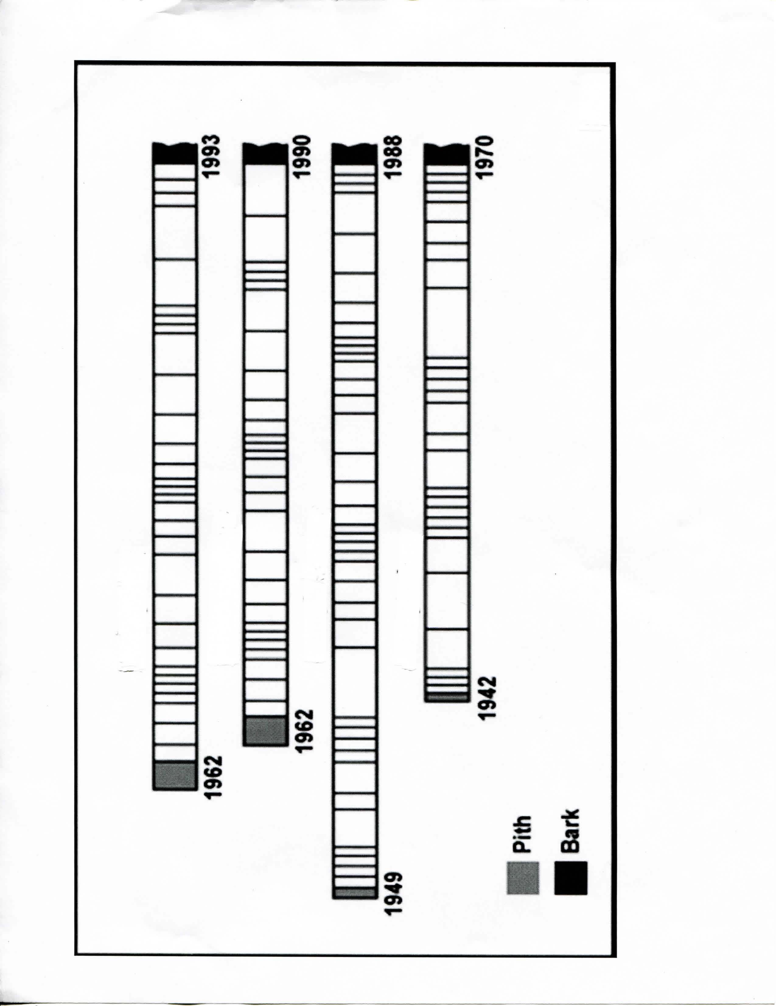
1984
2015
1984
2012
1971
2010
1964
1992

